Slide 1
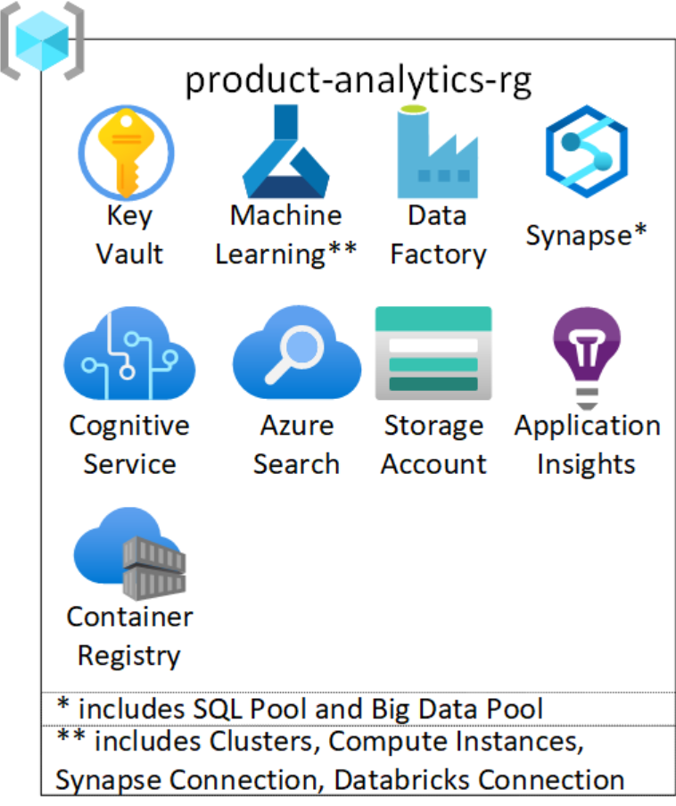

Intelligent Recommendations

Slide 2









































Foundations for retail cross-cloud solutions
Supply chain teams
Loss prevention
Store
manager
Customer experience
Marketing
team
Employees
Developers, Analysts
PromoteIQ
Custom Apps
Dynamics 365 Supply Chain Management
Dynamics 365 Intelligent Order Management
Dynamics 365 Fraud Protection
Dynamics 365 Commerce
Customer
Service
Dynamics 365 Marketing
Power Virtual Agents
Microsoft for
Frontline Workers
Viva
Learning
Viva
Insights
Analytics
Microsoft Advertising
Low code, no code
DevOps
Dataverse – Retail data model
Clarity
AAD
Power
Apps
Power
Automate
Power BI
Web
Applications
Monitor
3P & in-house applications
LEGEND
AKS
VMs
Azure ML
Microsoft Cloud
for Retail
Log Analytics
Azure Synapse
Data
Factory
Serverless
Synapse Industry Models
Intelligent Recommendations
Cognitive
Search
Data
Lake
Policy
Power
Platform
Azure Networking
Azure
Bricks & Mortar stores
On-premises systems
3P platforms
3P Payment Gateway
Third-party (3P)

Slide 3




model.json
Modeling Resource 1
Service Endpoint 1
Repo
Application Pods
Container A
Storage Account
Container B
Application Pods
model.json
Modeling Resource 2
Service Endpoint 2

Slide 4

Stable version
model.json
Modeling Resource 1
Service Endpoint 1
Application Pods
Storage
Account
Container A
Incoming Traffic
Container B
Application Pods
New model.json
Modeling Resource 2
Service Endpoint 2
New Release
Canary Deployment with IR

Slide 5

C
D
model.json
Modeling Resource 1
Service Endpoint 1
Application Pods
A
F
Storage
Account
Container A
Incoming Traffic
Container B
H
Application Pods
New model.json
Modeling Resource 2
Service Endpoint 2
G
B
E
Azure DevOps – Repos and Pipelines

Slide 6

Intelligent Recommendations Account
C
B
A
D
E
External Applications
Endpoint Authentication
Service Endpoints
Modeling Resources
App 1
App 2
.
.
.
.
App N
AAD App ID 1
AAD App ID 2
.
.
.
.
AAD App ID N
Service Endpoint 1
Service Endpoint 2
.
.
.
.
Service Endpoint N
Modeling Resource 1
Modeling Resource 2
.
.
.
.
Modeling Resource N
AAD-backed App ID

Slide 7
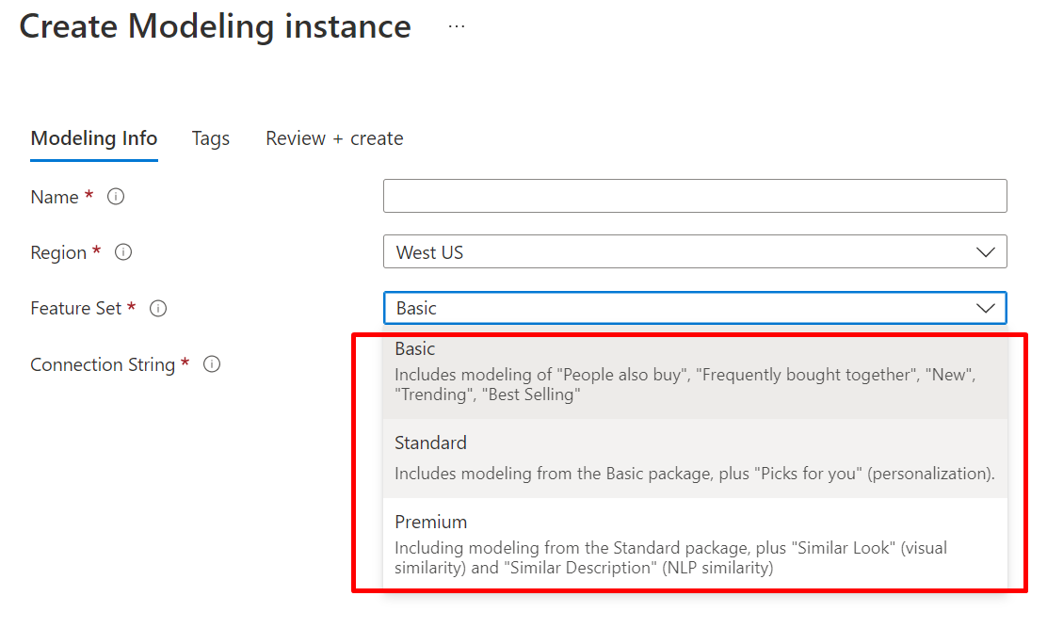

Slide 8

Single region HA deployment
IR Account 1
Input datasets
Batch run of Cooking Process
Modeling Resource
Service Endpoint
Apps consuming data from IR service endpoint
ADF
Storage
Account1
Source System
Input datasets
Batch run of Cooking Process
Modeling Resource
Service Endpoint
Apps consuming data from IR service endpoint
ADF
Storage
Account2
IR Account 2

Slide 9
Cross region deployment for DR
Region 1
IR Account 1
Input datasets
Batch run of Cooking Process
Modeling Resource
Service Endpoint
Apps consuming data from IR service endpoint
Source System
ADF
Storage
Account1
Async copy of data using Azure Storage GRS
Source System
Batch run of Cooking Process
Modeling Resource
Service Endpoint
Apps consuming data from IR service endpoint
ADF
Storage
Account2
IR Account 2
Region 2

Slide 10



LEGEND
Network access path between IR and other Azure services
A
Storage Account with private endpoints enabled
E
IR Account
D
Network access path between web application and end-users
snet4
Modeling Resource
Storage
Account1 with public endpoint and container(s) with data
Service Endpoint
snet3
F
GET/POST HTTPS request
App GW provides L7 load-balancing and web firewall
Consumer apps hosted on AKS
G
B
End-users accessing data from application
snet1
C
snet2
Public IP
VNET
AZURE REGION

Slide 11
Primary Region
Secondary Region
0s
A. Enable RA-GRS and background processes copy data to secondary account async.
SA primary
Async (managed by MSFT)
SA RA-GRS
B. MS declares a DR and fails over to secondary region. Secondary now becomes new Primary and operates in LRS mode.
SA primary
SA primary with LRS
C. MS restores Storage Account in the original primary region; however, it has stale data and behind the new primary in secondary region.
SA primary
SA primary with LRS
SA primary with LRS
D. Re-enable RA-GRS on the original primary Storage Account and this will create a new account in secondary region.
Elapsed time
SA primary
SA RA-GRS
async
Copy delta to original primary
SA primary with LRS
E. Copy data from acting primary in secondary region and copy it across to the original primary. At this stage. MS platform async copies data to secondary storage account paired with primary.
SA primary
SA RA-GRS
Async (managed by MSFT)
Sync
complete
SA primary with LRS
F. Once data has been copied to the first region, delete the old Storage Account in secondary region.
x’
SA primary
SA RA-GRS
Async (managed by MSFT)

Slide 12
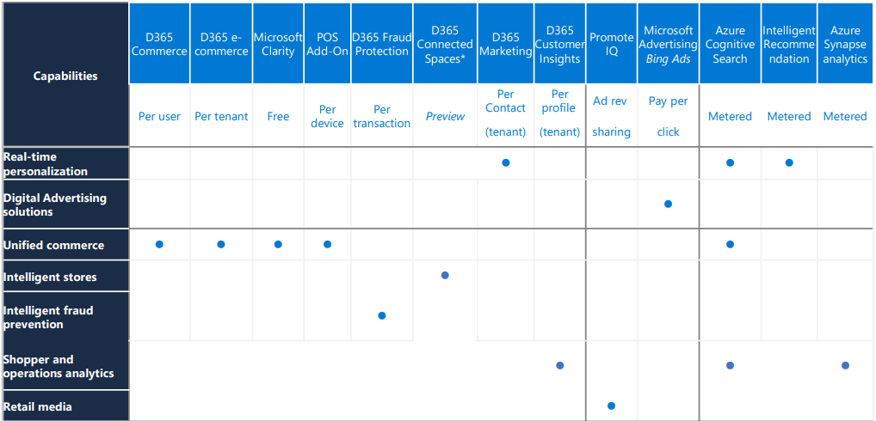

Slide 13
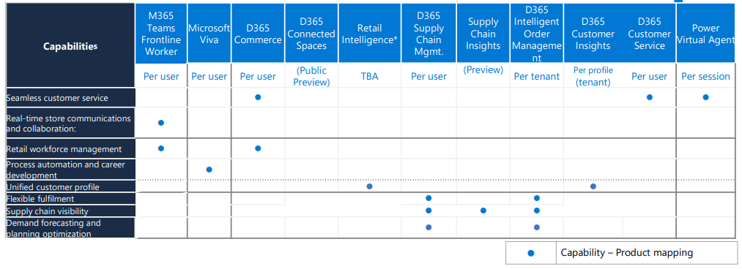

Slide 14
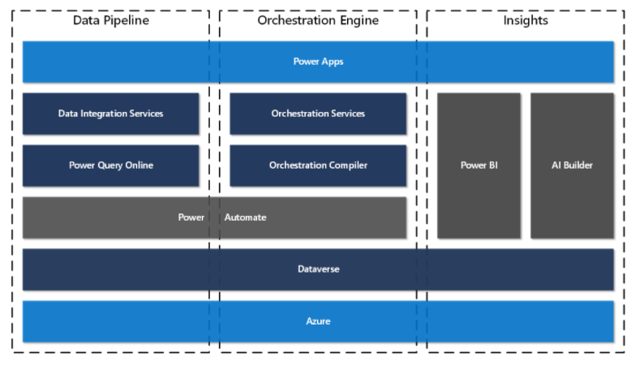
Key Components of IOM

