Slide 1
Brain
(user program)
Web
Browser
Clients
MCU
Services
USB/Jacdac bridge
Network
Packet-based protocol
Bus
Services
Module 1
Module 2
MCU
MCU
Servers
sensor/actuator(s)
sensor/actuator(s)

Slide 2
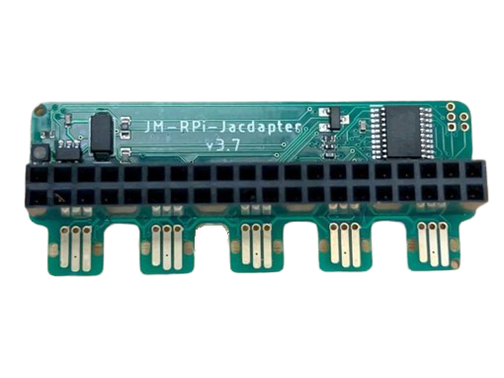
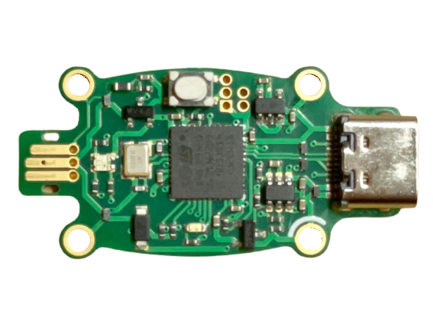
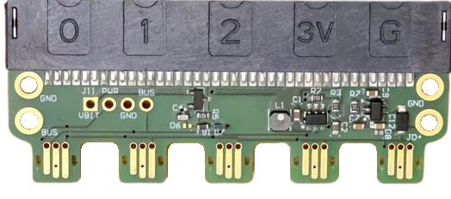
Plays Well With Others
USB
RPi
micro:bit

