Slide 1
mcf
ADVANCED FEATURES

Slide 2
Pattern based random data generation
Generate records with random values based on regular expression patterns
Seed based == reproducible
<!-- generate 1 to 5 letters from the set: a,b,c,d -->
<rec key="A" regex="true">[abcd]{1,5}</rec>
<!-- generate either ‘cat’ or ‘dog’ -->
<rec key="A" regex="true">(cat)|(dog)</rec>
<!-- generate more ‘dog’ than ‘cat’ (%75 vs %25) -->
<rec key="A" regex="true">(cat)|(dog)|(dog)|(dog)</rec>
<!-- generate a phone number -->
<rec key="A" regex="true">\d{3}-\d{4}</rec>

Slide 3
Pattern based random data generation
Use from xml or from test code
public void Run(IContext ctx)
{
string arg1 = ctx.Framework.NextString("[ABC]{3,10}");
// returns string from 3 to 10 characters containing 'A's or 'B's or 'C's
string filename = ctx.Framework.NextString(@"[CD]:\\file\.txt");
// s == "D:\file.txt" or "C:\file.txt“
string filesystem = ctx.Framework.NextString(@"(FAT)|(NTFS)|(CDFS)|(FAT32)");
// s == "FAT" or "NTFS" and so on.
}

Slide 4
Pattern based random data generation
Smart fuzzing, pattern/anti-pattern(invalid switch)
Invalid strings are generated by marking sections of the pattern, or the entire pattern, with \i
Deep code penetration, token based, “almost” correct data
Call(string phone) {
if(phone[0] != ‘(’) BAIL…
if(phone[4] != ‘)’) BAIL…
if(phone[8] != ‘-’) BAIL…
Dial(…)… <<<<< dumb fuzzing - hard to reach
}
<var>
<!--(555)123-4567 -->
<rec key="ValidPhoneNumber" regex="true">(\d\d\d)\d\d\d-\d\d\d\d</rec>
<rec key="InvalidPhoneNumber" regex="true">\i((\d\d\d)\d\d\d-\d\d\d\d)</rec>
<rec key="InvalidAreaCode" regex="true">\i((\d\d\d))\d\d\d-\d\d\d\d</rec>
.
.
</var>

Slide 5
Pattern based random data generation
More Examples
Expression | Sample Output
\iabc | Mbc (text node abc is invalidated)
a\ibc | ab$ (text node bc is invalidated)
\i[a-cY-Z] | L (Set node “[a-cY-Z]” is invalidated
\ia{3,5} | 888 (text node “a” is invalidated)
a\i{3,5} | aaaaaa (repeating node is invalidated)

Slide 6
Constraints
True C# expressions that specify the conditions under which a variation, block, group can be run
Can be applied to variations, blocks (allows for conditional execution), sections, groups, permutations etc.
Multiple constraints can be specified
Test cases, permutations that do not satisfy any of the constraints are excluded (not run)

Slide 7
CONSTRAINtS
A test case that is only applicable for a particular set of configurations (i.e. a particular version of IE)
<var dsc=“Verify IE search providers for the site”>
<constraint>IE == “7.0”</constraint>
<fnc>InstallSearchProvider</fnc>
<fnc>SearchSiteWithIESearchProvider</fnc>
.
.
.
</var>

Slide 8
Constraints
An example with permutations -- a full permutation with invalid / unimportant pairs of values (e.g. Win7 with IE 6.0 or IE 7.0, Vista with IE 6.0)
<var permutation=“FULL">
<recm key="OS">
<val>XP</val>
<val>Vista</val>
<val>Win7</val>
</recm>
<recm key="IE">
<val>6.0</val>
<val>7.0</val>
<val>8.0</val>
</recm>
</var>

Slide 9
Constraints
With constraints (invalid / unimportant pairs of values excluded)
<var permutation=“FULL">
<recm key="OS">
<val>XP</val>
<val>Vista</val>
<val>Win7</val>
</recm>
<recm key="IE">
<val>6.0</val>
<val>7.0</val>
<val>8.0</val>
</recm>
<constraint><![CDATA[OS == "Win7" && IE == "8.0"]]></constraint>
<constraint><![CDATA[OS == “Vista" && IE.In(“7.0”, "8.0“)]]></constraint>
<constraint><![CDATA[OS == "XP” && IE.In("6.0","7.0")]]></constraint>
</var>

Slide 10
Constraints
Supported functions and expressions for constraints
String Comparison | OS == “XP”
String Pattern Matching | OS.Like (“Win.*”)
String Sets | OS.In (“XP”, “Vista”)
Number Comparison | RAM > 128
Parameter Value Comparison | Height > Width

Slide 11
Fnc call enhancements
public void foo(int arg1, string arg2, bool arg3)
{
Console.WriteLine(arg1.ToString() + arg2.ToString() + arg3.ToString());
}
foo is independent of types.dll/mcf, arbitrary code can be called - within type limits etc.
Notes:
Foo is independent of types.dll/mcf, arbitrary code can be called - within type limits etc.

Slide 12
Fnc call enhancements
public void foo(int arg1, string arg2, bool arg3)
{
Console.WriteLine(arg1.ToString() + arg2.ToString() + arg3.ToString());
}
foo is independent of types.dll/mcf, arbitrary code can be called - within type limits etc.
Short vs. long format:
<var>
<!-- Long format -->
<fnc name="foo">
<rec key="arg1">5</rec>
<rec key="arg2">a string</rec>
<rec key="arg3">true</rec>
</fnc>
<!-- Short format -->
<fnc>foo;arg1=5;arg2=a string;arg3=true</fnc>
</var>

Slide 13
Record replacement
Record replacement allows assigning record values in terms of the values of other records
<var>
<fnc>OpenIE;url=%baseurl%/default.aspx</fnc>
</var>
<grp>
<rec key=baseurl">http://codeboxtest</rec>
</grp>

Slide 14
Record replacement
Examples
<var>
<fnc>OpenIE;url=%baseurl%/default.aspx</fnc>
</var>
mcf.exe /m:varmap.xml /baseurl:http://www.microsoft.com
<var>
<rec key="port">8090</rec>
<rec key="url">http://%baseurl%:%port%</rec>
<fnc>OpenIE;url=%url%</fnc>
.
.
</var>
<grp>
<rec key=baseurl">http://codeboxtest</rec>
</grp>

Slide 15
Record replacement
Examples
<var permutation="full">
<recm key="homepage">
<val>http://www.microsoft.com</val>
<val>http://www.google.com</val>
<val>http://www.yahoo.com</val>
</recm>
<fnc>OpenIE;url=%homepage%</fnc>
</var>

Slide 16
Record Replacement: Scoping
Records can be referenced by any children node in xml node hierarchy:
Cmdline →Groups →Sections →Variations→Blocks → Fncs
<var>
<rec key="port">8090</rec>
<rec key="url">http://%baseurl%:%port%</rec> <!– OK -->
<fnc>OpenIE;url=%url%</fnc>
.
</var>
<var>
<rec key="url">http://www.microsoft.com:%port%</rec> <!-- Not OK! -->
<fnc>OpenIE;url=%url%</fnc>
.
</var>
<grp>
<rec key=baseurl">http://codeboxtest</rec>
<rec key=grpkey“>%port%</rec> <!-- Not OK! -->
</grp>

Slide 17
Using function return values
It is possible to update the values of existing records or create new records with the return values of functions
<var>
<fnc ret="currentDate">GetDate;format=MM/dd/yyyy</fnc>
<fnc>Echo;str=%currentDate%</fnc>
</var>
public string GetDate(string format)

Slide 18
Optional Parameters
Define the domain of a parameter using Action.Parameter function calls inside a method
If no value is supplied, framework picks a random value
void Foo(int a)
{
Action.Parameter(0, () => NextInt(1, 100)); //NextInt is a user defined function
}
<!-- Parameter omitted. Framework will call NextInt and retrieve a random value -->
<fnc>Foo</fnc>
<!-- Parameter specified. Framework will use the user supplied value -->
<fnc>Foo;a=200</fnc>

Slide 19
Setup, Cleanup Nodes
Allow test case specific setup / cleanup steps
Setup nodes are called after ISetup runs
Cleanup nodes are called before ICleanup runs
<var>
<setup>ImpersonateUser;user=testuser</setup>
<setup>OpenIE;url=http://www.microsoft.com</setup>
<fnc>LoginUser</fnc>
.
.
.
<cleanup>CloseIE</cleanup>
<cleanup>StopImpersonation</cleanup>
</var>
Notes:
Discuss differences in err handling

Slide 20
Section Node
Contains variation nodes and other section nodes to logically group test cases (both authoring helper and run-time!)
Stores common data/recs for the contained test cases
Has setup, cleanup steps for the contained test cases
Can be collapsed/expanded in xml editor
Like inline groups – only Tree, no DAGs as w/ groups

Slide 21
Section Node
<section cls=“MyClass” dsc=“API test cases">
<rec key="url">http://msw</rec>
<setup>Launch;view=%url%</setup>
<var set="2" lvl="1" vid="4"/>
<var set="2" lvl="2" vid="5"/>
.
.
<cleanup>CloseView</cleanup>
</section>
<section dsc=“Nested sections">
<section>
<var set="1" lvl="1" vid="1"/>
.
.
</section>
<section>
.
.
</section>
</section>

Slide 22
Using XPath for variation filtering
Add records to vars as tags
<var>
<rec key="smoke"/>
<rec key="globalization"/>
.
Then reference tagged vars in varref node
<grp>
<varref>[rec[@key=“smoke”]]</varref>
</grp>
<grp>
<varref set="1">[rec[@key=“globalization”]]</varref>
</grp>
Or in xpath switch passed to mcf.exe
mcf /m:x.xml /xpath:[rec[@key=“smoke”]]
mcf /m:x.xml /xpath:[rec[@key=“globalization”]] /s:1
Notes:
Arbitrary Taxonomies, Overlapping Sets, etc can be used on anything recs – nodes, parent/child, attributes etc including recs

Slide 23
Using XPath for variation filtering
Examples
<!-- all variations in set 1, level 2, with custom record owner=joe -->
<varref set="1">[@lvl=“2”][rec[@key=“owner”]=“joe”</varref>
mcf /m:x.xml /xpath:[@lvl=“2”][rec[@key=“owner”]=“joe” /s:1
<!-- all variations directly under the section with sid=’2’ -->
<varref>[..\section[@sid=“2”]]</varref>
mcf /m:x.xml /xpath:[..\section[@sid=“2”]]
Notes:
Arbitrary Taxonomies, Overlapping Sets, etc can be used on anything recs – nodes, parent/child, attributes etc including recs

Slide 24
Snippets
Macros that can be used by variations
<snippet id="Create Item">
<fnc>OpenApp</fnc>
<fnc>Click;id=create</fnc>
<fnc>InputText;box=title;text=%TITLE%</fnc>
<fnc>Click;id=OK</fnc>
<snipref id="Publish Item" />
</snippet>
<snippet id="Publish Item">
.
.
</snippet>
<var>
<rec key="TITLE">Item one</rec>
<snipref id="Create Item" />
</var>

Slide 25
Special Execution Nodes ( AKA easy modeling)
Containers for <fnc> nodes that allow specifying/changing their execution characteristics
Shuffle
Optional
Choice
Sequence
Block

Slide 26
Shuffle Node
Domain | ______________________
Alias | ______________________
Password | ______________________
 | submit

Slide 27
Shuffle Node
Domain | ______________________
Alias | ______________________
Password | ______________________
 | submit
Notes:
A shuffle node is used to designate a group of steps that can be run in any order. An example of this is a login screen; the domain, username, and password can be entered in any order and the result should be the same.

Slide 28
Shuffle Node
Domain | ______________________
Alias | ______________________
Password | ______________________
 | submit
<var>
<fnc>GotoLogin</fnc>
<shuffle>
<!-- These steps can be run in any order -->
<fnc>EnterDomain;domain=Redmond</fnc>
<fnc>EnterUser;user=user1</fnc>
<fnc>EnterPassword;pass=secret</fnc>
</shuffle>
<fnc>ConfirmLogin</fnc>
</var>

Slide 29
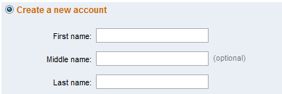
Optional Node
<var>
.
.
<fnc>EnterFirstName</fnc>
<optional>
<fnc>EnterMiddleName</fnc>
</optional>
<fnc>EnterLastName</fnc>
.
.
</var>

Slide 30
Choice Node
<var>
.
.
<choice>
<!-- Create a new item... it doesn’t matter how -->
<fnc>CreateItemThroughWebUI;title=new item</fnc>
<fnc>CreateItemThroughWebServices;title=new item</fnc>
</choice>
<choice>
<!-- Verification is slow, so only verify once. -->
<fnc>VerifyItemThroughWebUI;title=new item</fnc>
<fnc>VerifyItemThroughWebServices;title=new item</fnc>
</choice>
.
.
</var>
Notes:
Add UI example

Slide 31
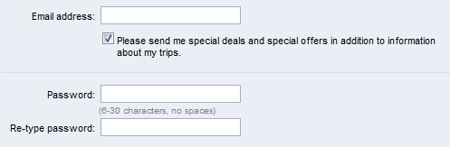
Sequence Node
<var>
<shuffle>
<fnc>EnterName</fnc>
<fnc>EnterEmailAddress</fnc>
<sequence>
<fnc>EnterPassword</fnc>
<fnc>EnterPasswordConfirmation</fnc>
</sequence>
</shuffle>
</var>

Slide 32
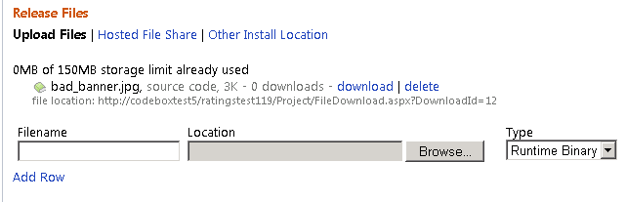
Block node
<var>
.
.
<block dsc="AddFilesToRelease" iter="20">
<rec key="filename" regex="true">file\d\d\d.txt</rec>
<fnc>AddFileToRelease;filename=%filename%</fnc>
</block>
.
.
</var>

Slide 33
Modeling
XML based (Petri Nets) or
Code based (FSM)
See ‘Modeling in MCF’ in http://codebox/mcf

Slide 34
Expected Exceptions
Test negative scenarios without having to write new verification functions
Match ANY info in exception (stack, message, class…)
If no exceptions → VAR_FAIL
<fnc name=“DeleteFile">
<rec key=“file"></rec>
<expect>System.ArgumentException.*Invalid File Name</expect>
</fnc>

Slide 35
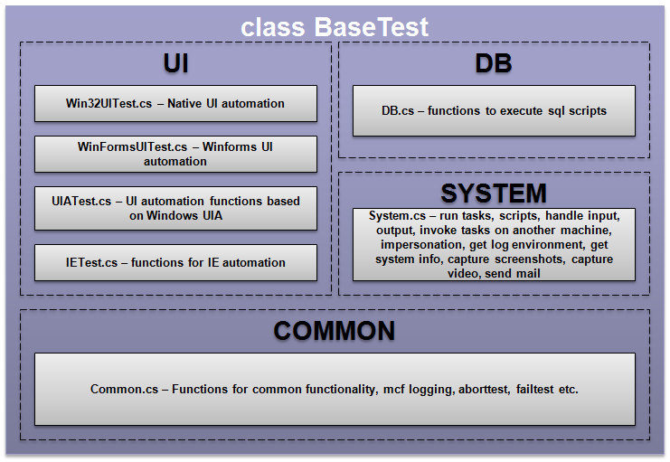
MCFTestLib
DB, RemoteExec, Silverlight, WPF, Win32GUI, WinForms, IE, video cap…
Notes:
DB, RemoteExec, Silverlight, WPF, Win32GUI, WinForms, IE

Slide 36
MCFTestLib: UI.cs
public void HandleMessageBox(string title_rx, string caption_rx, string action_rx)
public void HandleWin32BrowseForFolder(string browseto)
public void ClickHtmlLink(string innertext)
public void VerifyHtmlContains(string html)
public void InputUIATextBox(string id, string text)
public void ClickUIAControl(string id)

Slide 37
MCFTestLib: System.cs
public void ExecuteAppRemoteAsUser(string machine, string command, string arguments, string directory, int timeout, string user, string passwd, bool expectedresult)
public void ImpersonateUser(string user, string password)
public void WaitForEvent(string computer, string message_rx, DateTime after, int timeout)
public void CaptureScreenToFile(string fileName, bool appendDateTime)
public void CaptureScreenToAVI()
public void SendMail(string to, string subject, string body)
public void SetIPAddressForHost(string hostName, string ipAddress)

Slide 38
More Info
http://codebox/mcf - All MCF docs/slides, modeling info
http://codebox/regexgen - Pattern based random data generation library
http://codebox/pict - Combinatorial Generation library
http://codebox/remoteexec - Remote execution library

