Slide 1
MCF
Improving Coverage
Minimizing Effort

Slide 2
Example: Login page
Domain | ______________________
Alias | ______________________
Password | ______________________
 | submit
Assumption that following functions exist, or corresponding inputs can be made:
EnterDomain(string)
EnterAlias(string)
EnterPassword(string)
Submit()
Each path connecting 2 adjacent states (FSM model) or 2 adjacent places (HLPN model) results in a call to a function from the above set (input to the system/component)

Slide 3
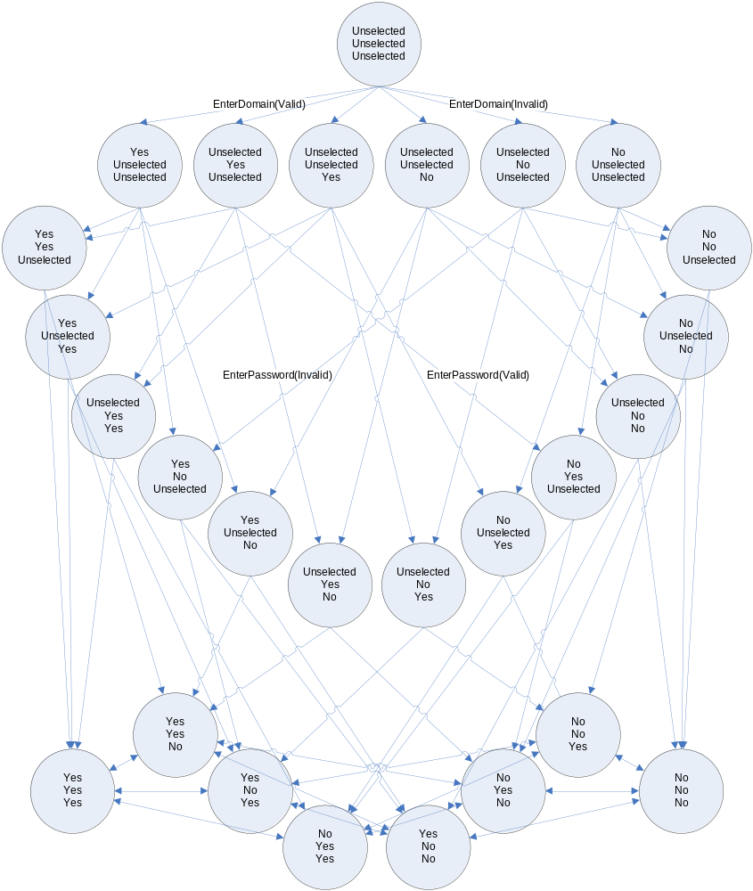
Ideal Coverage
Legend:
Yes – positive input
No – erroneous input
Unselected – no input yet

Slide 4
Static
<snippet id="enter login fields">
<fnc>InputDomain;domain=%domain%</fnc>
<fnc>InputAlias;alias=%alias%</fnc>
<fnc>InputPassword;pass=%pass%</fnc>
</snippet>
<var ... dsc="Verify valid login">
<recs domain="REDMOND" alias="test1“ pass="pass1"/>
<snipref id="enter login fields"/>
<snipref id="Verify Logged In"/>
</var>
<var ... dsc=“Verify invalid password“>
<recs domain="REDMOND" alias="test1“ pass="fail1"/>
<snipref id="enter login fields"/>
<snipref id=“Verify Login Failure“/>
</var>
<var ... dsc=“Verify invalid alias“>
<recs domain="REDMOND" alias=“invalid1“ pass=“pass1"/>
<snipref id="enter login fields"/>
<snipref id=“Verify Login Failure“/>
</var>
Notes:
fnc- - more dynamic than code
Snippets, for commonly repeated steps. Can be paramaterized with records
Record replacement

Slide 5
Static
(continued)
<snippet id="Verify Logged In">
<fnc>OnErrorContinue</fnc>
<fnc>VerifyPageText;text=%domain%\%alias%</fnc>
<fnc name="VerifyPageText">
<rec key="text">Invalid username or password</rec>
<expect>VarFail.*‘Invalid username or password’ not found</expect>
</fnc>
<fnc name="entries">GetUserEntries</fnc>
<fnc>VerifyAccess;entryList=%entries%</fnc>
</snippet>
<snippet id="Verify Login Failure">
<fnc>OnErrorContinue</fnc>
<fnc name="VerifyPageText">
<rec key="text">%domain%\%alias%</rec>
<expect>VarFail.*not found</expect>
</fnc>
<fnc>VerifyPageText;text=Invalid username or password</fnc>
</snippet>
Notes:
OnErrorContinue
Expected exceptions
Return values from fnc call (always returns as a string)

Slide 6
Data Generation
<snippet id="enter login fields">
<fnc>InputDomain;domain=%account%domain%</fnc>
<fnc>InputAlias;alias=%account%alias%</fnc>
<fnc>InputPassword;pass=%account%pass%</fnc>
</snippet>
<var ... dsc=“Verify valid login“ permutation=“rows“>
<recm key=“account“>
<val>domain=REDMOND;alias=test1;pass=pass1</val>
<val>domain=NTDEV;alias=test2;pass=pass2</val>
</recm>
<snipref id=“enter login fields“/>
<snipref id="Verify Logged In"/>
</var>
<var ... dsc="Verify invalid login" permutation="rows" iter="5">
<recm key="account" regex="true">
<val>domain=NTDEV;alias=test1;pass=(pass1|pass2)</val>
<val>domain=REDMOND;alias=test1;pass=(.{0,4}|.{6,20})</val>
</recm>
<snipref id="enter login fields"/>
<snipref id=“Verify Login Failure“/>
</var>
Notes:
SubRecord replacement
Permutations, iter (also loop)
regex

Slide 7
Special Execution Nodes
<var ... dsc="Verify valid login" permutation="rows">
<recm key="account">
<val>domain=REDMOND;alias=test1;pass=pass1</val>
<val>domain=NTDEV;alias=test2;pass=pass2</val>
</recm>
<block iter=“5“>
<rec key=“random“ regex=“true“>.{3,10}</rec>
<shuffle>
<optional>
<fnc>InputDomain;domain=%random%</fnc>
</optional>
<optional>
<fnc>InputAlias;alias=%random%</fnc>
</optional>
<optional>
<fnc>InputPassword;pass=%random%</fnc>
</optional>
</shuffle>
</block>
<shuffle>
<fnc>InputDomain;domain=%account%domain%</fnc>
<fnc>InputAlias;alias=%account%alias%</fnc>
<fnc>InputPassword;pass=%account%pass%</fnc>
</shuffle>
<snipref id="Verify Logged In"/>
</var>
Notes:
Shuffle – execute all child nodes in random order
Optional – 50% chance to execute all child nodes
Sequence – Execute all child nodes in order (use for linear steps within shuffle/choice)
Choice – Execute one of the child nodes
Block – Additional scope within a var. Has its own cleanup, records, records, permutation, iteration

Slide 8
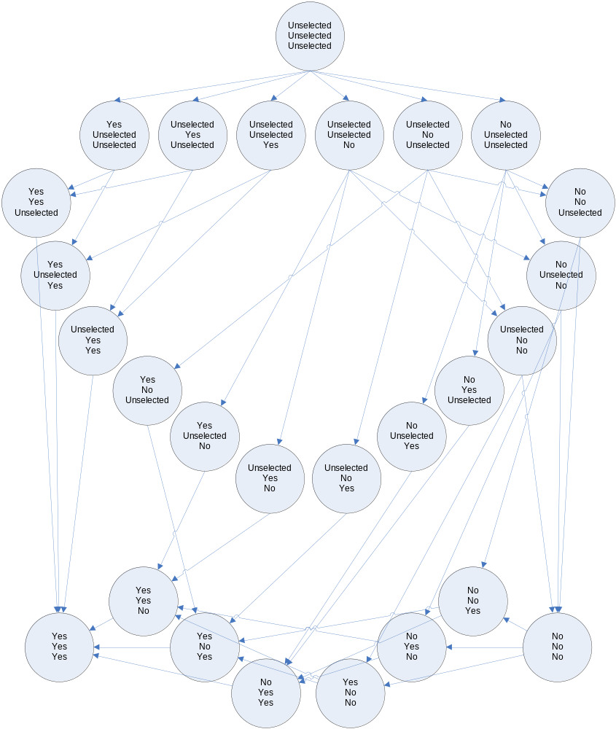
Pseudo-modeling Coverage

Slide 9
Petrinet
Alias Entered
EnterAlias
Domain Entered
Submit
EnterDomain
Password Entered
EnterPassword
Notes:
Petrinets are initially more complex than models, but they don’t suffer nearly as much from state explosion because they support multiple tokens

Slide 10
Petrinet
Alias Entered
EnterAlias
Domain Entered
Submit
EnterDomain
Password Entered
EnterPassword
Notes:
Only one transition is executed during each step. Which transition is run is a random choice among all enabled transitions.

Slide 11
Petrinet
Alias Entered
EnterAlias
Domain Entered
Submit
EnterDomain
Password Entered
EnterPassword
Notes:
Since the password is incorrect, the submit button cannot be clicked yet. First the correct password must be entered.

Slide 12
Petrinet
Alias Entered
EnterAlias
Domain Entered
Submit
EnterDomain
Password Entered
EnterPassword
Notes:
Now the user can log in since the username, domain, and password match.

Slide 13
Modeling – XML Based
<transition id="Post discussion">
<in id="discussion header" place="Discussions">
<select>
<place id="Discussions"/>
</select>
</in>
<in id="discussion project" place="Projects">
<join>
<read id="discussion header"/>
<place id="Projects"/>
</join>
</in>
<tokens id="new post">
<join>
<new type="discussion post">
<field id="title">discussion title</field>
<field id="content">discussion content</field>
</new>
<read id="discussion header"/>
</join>
</tokens>
<block permutation="rows">
<tokens id="discussion project"/>
<tokens id="discussion header"/>
<tokens id="new post"/>
<rec key="title" regex="true">[a-z]{5,20}</rec>
<rec key="content" regex="true">[a-z]{10,200}</rec>
<fnc>SetValues;new post%discussionpost.title=%title%;new post%discussion post.content=%content%</fnc>
<fnc name="PostDiscussion">
<rec key="project">%discussion project%project.url%</rec>
<rec key="header">%discussion header%discussion.title%</rec>
<rec key="title">%new post%discussion post.title%</rec>
<rec key="content">%new post%discussion post.content%</rec>
</fnc>
</block>
<out id="discussion project" place="Projects"/>
<out id="discussion header" place="Discussions"/>
<out id="new post" place="Discussion posts"/>
</transition>
Read tokens from petrinet places for the project and discussion
Create new token for the discussion post
Execute the action using data from the tokens
Send to tokens back to petrinet places

Slide 14
Modeling – Code Based
public void CreatePost(string projectUrl, string discussionName, string body)
{
Action.Parameter(0, () => RandomElement(Projects));
Action.Parameter(1, () => RandomElement(Projects[projectUrl].Discussions.Keys));
Action.Parameter(2, () => NextString(“abc|def|ghi"));
Action.Requires(() => Projects[projectUrl].Discussions[discussionName].Posts.Count == 0);
Navigate2(projectUrl + "/Thread/List.aspx");
FindDiscussionInDiscussionListPage(discussionName).Click();
ClickHtmlButton(ctrlPf + "NewPostLink");
InputHtmlTextArea(ctrlPf + "NewPostTextBox_EditTextBox", body);
ClickHtmlButton("ctl00$ctl00$ctl00$Content$ProjectBaseMain$ProjectMain$NewPostButton");
Post post = new Post();
post.Body = body;
Discussion discussion = Projects[projectUrl].Discussions[discussionName];
discussion.Posts.Add(post);
Action.Verify(() => VerifyDiscussionPage(projectUrl, discussionName));
}
1
2
3
4
1 – ‘Parameter’ statements are called by MCF to retrieve one of the available values for an action parameter. ‘Requires’ statements are called by MCF to check if it is possible to execute the action.
2 – The action is performed on the system under test using automation
3 – The model is updated with the expectation
4 – The state of the system under test is compared to the expected state in the model.

Slide 15
Modeling – Code Based
<rec key="discussionName" regex="true">[:alpha:]{1,20}</rec>
<fnc>LoginSite</fnc>
<model_iFSM maxSteps="10">
<action>CreatePost</action>
<action>DeletePost</action>
<action>CreateDiscussion;name=%discussionName%</action>
<action>DeleteDiscussion</action>
</model_iFSM>
<fnc>LogOffSite</fnc>

