Slide 1
2000-2009
MCF

Slide 2
What is MCF?
MCF is a scenario/data-driven test harness.
MCF makes it possible to organize, automate and simplify many scenario execution tasks.
It provides a unified logging and error reporting mechanism, an infrastructure for rapid scenario development, integrated pattern based/random data generation, etc.
Custom scenario logic can be written in multiple languages.
It is shared source project. Anybody can contribute. (http://codebox/mcf)
Notes:
MCF received its name from the CCF which is common code framework.

Slide 3
History
MCF is based on CCF (Common Code Framework) - initiated inside the NT team
Multiple branches of CCF were created in MS
40+ devs contributed to CCF (not counting other branches)
CCF - first record: 11-Sep-90 by DavidSt
MCF derived its name from CCF
MCF preserves CCF’s success, concepts and know-how
Notes:
CCF stands for common code framework. MCF is a logical continuation of CCF which is a project
that was originated in NT team and is an example of amazingly long living application. It accumulated a lot of crud over the years but nevertheless it proved to be rock-solid over years. Multiple branches where created.
More then 39 developers was working on it during more than 10 years.
Actually first record was in 1989 I believe.

Slide 4
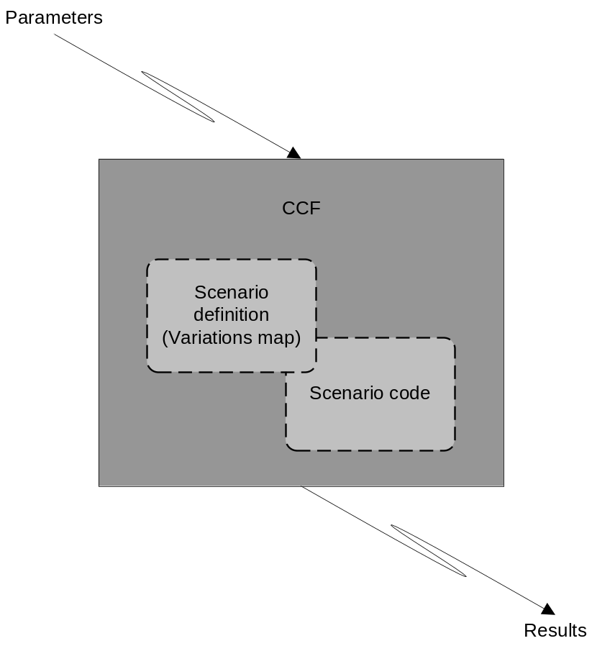
History (cont.)
Source Code reuse model. Custom code and scenario description statically links with CCF
Result – single monolithic executable containing CCF engine, custom logic and scenario itself
Disadvantages: Single lang. supported, need to recompile if scenario or custom logic changes, hard to maintain and modify, hard to tweak when investigating, etc…
Notes:
Under this model one used to link all test code, product code, the framework itself in one monolithic executable. Any change in var map or scenario code required recompilation. This model also implies one language only – C/C++.

Slide 5
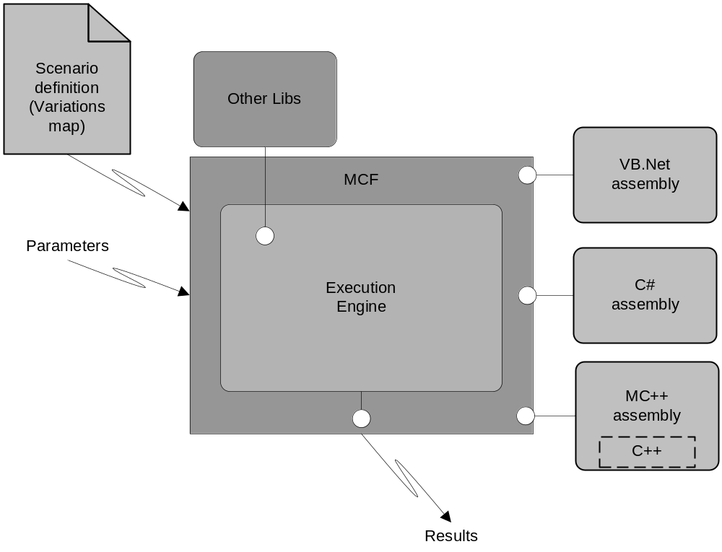
Architecture from 10,000 feet
Notes:
Here you can see resemblance to the old CCF and also certain differences on this slide it even retained an original name which was CCF Managed at the begging in of development cycle.
The variation map resides in separate file which gives you a lot of flexibility so that you do not need to recompile you scenario over and over again.
The scenario code is now put in different binary which introduces a higher level of software reuse which is binary reuse as opposed to code reuse employed by MCF.
And it is managed code which is much easier to master, develop and maintain without compromising performance or so.

Slide 6
Scenario - variations map (varmap)
<varmap assembly='unit.dll'… >
<section>
<var set='1' lvl='1' vid='1' cls='Namespace.Foo' />
...
</section>
<var set='10' lvl='5' vid='7' cls='Namespace.Bar' />
<grp>
<grp>
<varref/>
</grp>
</grp>
</varmap>
<varmap> – Root of the varmap
<grp> – Group node, can have optional identity, group id (gid)
<section> – Section node, can have optional identity, section id (sid)
<var> – Variation node, always has identity (set, level, var id)
<varref> – Variation reference node
1,1,1 – Unique ID (Set, Level, Var ID)
assembly – Path and filename of the user’s library
cls – Namespace and class of the user’s methods

Slide 7
Varmap (cont)
Variation (AKA Test Case) – the most granular unit of execution representing one test case. During execution a variation passes (succeeds) or fails as one whole entity.
Variations map – scenario definition. Defines a set of variations to be executed and organizes them according to a specific order and hierarchy.
Groups – elements of the variation map graph. Organize variations into logical groups and hierarchies.
Notes:
We used to have a bunch of different frameworks targeting different specific technologies. I observed a couple of times somebody’s test code having a memory leak being debugged.
Productivity is inheritably higher. Flexibility is much better – you do not need to recompile framework in order to disable particular variation or rearrange the order of their execution of couple of variations. I’d really like to see anybody trying to do that on the test brick.

Slide 8
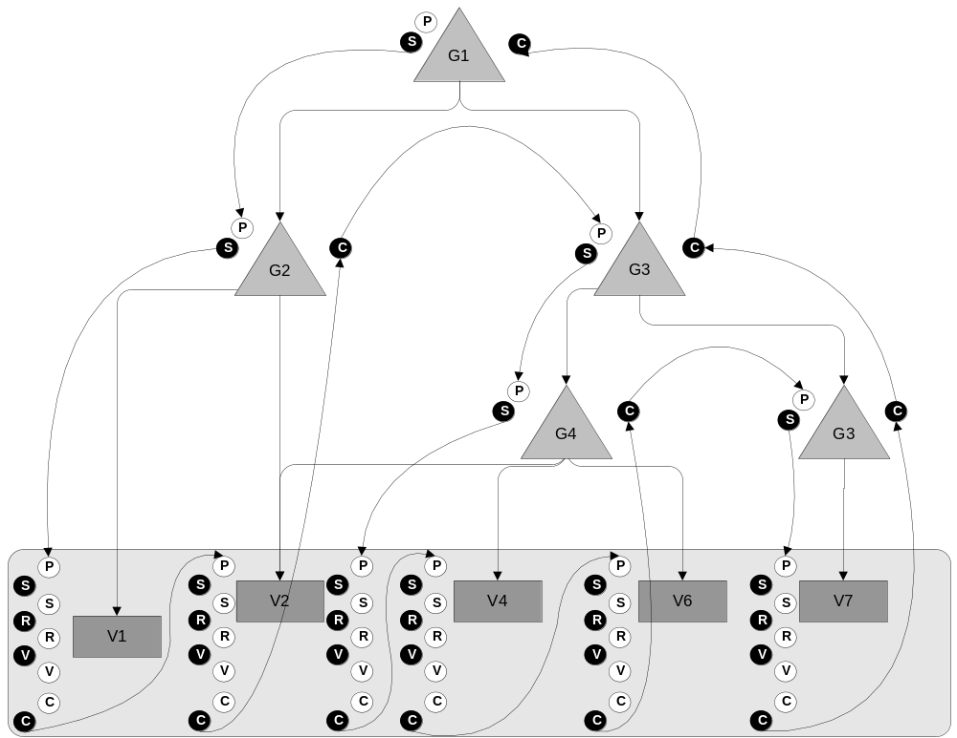
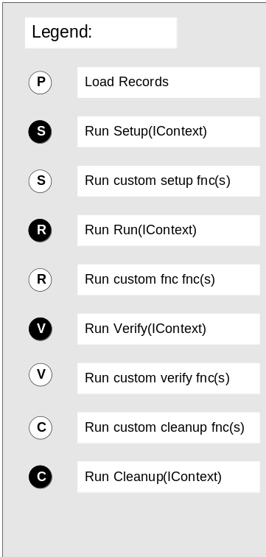
Varmap execution flow
Notes:
Meanwhile there are 4 methods that framework expects user classes to implement but they don’t have to (Run, Setup, Verify, Cleanup). All this for historical reasons.
Note1: there are also custom functions analogous to each of these 4 methods
Note2: The var map can form directed graph

Slide 9
Variation map node - ‘varmap’
Root node. Specifies global settings.
‘assembly’ – Scenario code to be loaded, mandatory
‘dsc’ – description, mandatory
‘owner’ – mandatory
‘contact’ – mandatory

Slide 10
Section node - ‘grp’
Can contain other ‘section’ nodes and/or ‘var’ nodes
‘dsc’ – description, optional
‘cls’ – class, optional
‘sid’ – section id, optional
‘act’ – active (true/false), optional
‘bugid’ – optional
Notes:
gid (group id) is used to identify variations contained in groups (via identifying groups) in cases set, level, var is not enough (e.g. cross reference, diamond shape formation – same var referenced by 2 groups)
Act can have 2 values true or false which allows/disables execution of particular group

Slide 11
Group node - ‘grp’
Can contain other ‘grp’ nodes or ‘varref’ nodes but not both
Can contain multiple ‘grp’ or ‘varref’ nodes
‘dsc’ – description, optional
‘cls’ – class, optional
‘gid’ – group id, optional
‘act’ – active (true/false), optional
‘bugid’ – optional
Notes:
gid is used to identify variation in cases set, level, var is not enough (e.g. cross reference)
Act can have 2 values true or false which allows/disables execution of particular group

Slide 12
Variation node – ‘var’
‘set’ – mandatory
‘lvl’ – level, mandatory
‘vid’ – var id, mandatory
‘cls’ – class, mandatory
‘act’ – active (true/false), optional
‘bugid’ – optional
‘timeout’ – optional
‘cid’ – custom id, optional
‘permutation’ – algorithm for combinatorial generation (full, pict, rows), optional
Variation reference node – ‘varref’
References from 1 to all variations.
‘set’ – optional
‘lvl’ – optional
‘vid’ – optional
innertext (xpath) – optional
Notes:
Act can have 2 values true or false which allows/disables execution of particular group
Timeout allows to specify time in ms if exceeded the varfail is reported, NO async handling if thread is stuck will be stuck forever no attempt to terminate the thread or other funky stuff.

Slide 13
Snippet node – ‘snippet’
Snippets == macros
Contains any nodes that can be used in a variation node
‘id’ – unique identifier, mandatory
Snippet reference node – ‘snipref’
References a single snippet
‘id’ – mandatory

Slide 14
Variation map
<varmap assembly='my_assembly.dll' dsc='my assembly' owner=‘joesmith' contact=‘joesmith;johndoe'>
<snippet id=‘Baz’>...</snippet>
<section cls=‘Qux’>
<var set='1' lvl=‘2' vid='1' cls='Bar'>
<rec key=‘basic’ />
<snipref id=‘Baz’ />
</var>
...
</section>
<var set='10' lvl='5' vid='7' cls='Bar'>...</var>
<grp> <!– execution starts here -->
<grp cls='Foo' >
<varref set='1' />
</grp>
<grp gid="...">
<varref/>
<varref set='1' lvl='2' />
<varref set='1'>[@cls=‘Bar’][rec[@key=‘basic’]]</varref>
</grp>
</grp>
</varmap>
Notes:
Groups can be embedded.
You can reference all variation in you variation map, you can reference specific subset based on the any combination of set, level, vids and a you can have multiple variation references within one group with any combination of filtering attributes.
They might lead you to the question if you can reference the same variation from the different groups. Yes you can. It leads us from the strictly hierarchical structure to acyclic graph.

Slide 15
Group & Variation identity
Each variation has unique identity. Triplet – Set, Level and Variation#. (Optional Custom ID supported for integration w/ other s/w)
Set – Allows to group logically related variations
Level – 0 or Unit Test, BVT, Functional, Smoke, etc…
Variation# - Makes up unique identity among variation with the same level and set
There is also optional custom ID and a dynamically generated permutation ID
Groups can have optional group IDs.
Notes:
Each variation has an unique identity which is a compound unique key consisting of all three values – set. Level , var id
Variation id which is different from UID - allows to make up UID for a set of variation sharing the same set and level

Slide 16
Group & Var Classes
Implemented by user
Specified using ‘cls’ attributes in groups and variatons
The ‘cls’ attribute is mandatory on variation nodes and optional on group nodes.
Can implement Setup, Run, Verify, Cleanup
Only Setup and Cleanup are invoke for group class instances
Can implement unlimited custom methods to be referenced by the varmap
Notes:
A couple of clarifications
Methods are not mandatory – dropped
We used to support arbitrary custom methods but dropped support from RTM because of the bug in RTM of CLR.
Do not use constructor and finalizer/destructor

Slide 17
Group & Var Classes (cont)
--- SomeComponent.cs ---
namespace Org.Test.SomeComponent {
public class SimpleVar {
public void Foo(string data, int num, bool decide) { …}
}
}
--- Varmap.xml ---
<var set='1' lvl='1' vid=‘2' cls='Org.Test.SomeComponent.SimpleVar'>
<fnc>Foo;data=message;num=2;decide=false</fnc>
<verify name=‘Foo'>
<recs data=“other” num=“47” decide=“true” />
</verify>
</var>
Notes:
All interfaces are optional. IRun and IVerify can be implemented on group classes but never called. This effectively means that you can associate the same class with both variations and groups.
Custom methods can be defined with IContext as the only parameter, or they can contain string, float, int, and boolean parameters that will be automatically parsed from the function records if the key matches the parameter name.

Slide 18
Group & Var Classes (cont)
--- SomeComponent.cs ---
namespace Org.Test.SomeComponent {
public class ContextVar : ISetup, IRun, IVerify, ICleanup {
public void Setup(IContext ctx) { …}
public void Run(IContext ctx) { …}
public void Verify(IContext ctx) { …}
public void Cleanup(IContext ctx) { …}
...
public void Foo(IContext ctx) { …}
}
}
--- Varmap.xml ---
<var set='1' lvl='1' vid='1' cls='Org.Test.SomeComponent.ContextVar'>
<fnc name='Foo'>
<rec key='data'>message</rec>
</fnc>
<verify>Foo;a=27;data=other</verify>
</var>
Notes:
All interfaces are optional. IRun and IVerify can be implemented on group classes but never called. This effectively means that you can associate the same class with both variations and groups.
Custom methods can be defined with IContext as the only parameter, or they can contain string, float, int, and boolean parameters that will be automatically parsed from the function records if the key matches the parameter name.

Slide 19
Group & Var Classes (cont)
--- SomeComponent.cs ---
namespace Org.Test.SomeComponent {
public class MyGroup : ISetup {
public void Setup(IContext ctx) { …}
...
}
}
--- Varmap.xml ---
<grp cls=‘Org.Test.SomeComponent.MyGroup'>
<varref/>
</grp>
Notes:
All interfaces are optional. IRun and IVerify can be implemented on group classes but never called. This effectively means that you can associate the same class with both variations and groups.
Custom methods can be defined with IContext as the only parameter, or they can contain string, float, int, and boolean parameters that will be automatically parsed from the function records if the key matches the parameter name.

Slide 20
Error reporting
Exception based
Success – no reporting is needed, user method just returns
Failure – exception occurred in custom method
Distinguishes between well known (Framework defined, e.g. VarFail) and the rest e.g. NullReferense
User Action | Reported Result
No exception | VAR_PASS
throw new VarFail(…); | VAR_FAIL, STEP_FAIL
throw new VarAbort(…); User assembly error | VAR_ABORT
throw new GrpAbort(…); | GRP_ABORT
throw new Abort(…); | ABORT
throw new VarUnsupported(); | VAR_UNSUPPORTED
Notes:
Just return from you method w/o exception VAR_PASS will be logged
Framework will catch so called well-known exceptions defined by the framework, frmwrk doesn’t make any attempt to intercept others they will bubble up into debugger and execution will stop. This is by design.
This lead to somewhat different error handling paradigm since there is no gap between it used to be in ccf between functional error return value and general exception as AV where test code tended to report functional invocation report and skip on exceptions. Managed code implies intimate knowledge of the api you are testing and intercepting both functional return values and some of the exceptions too.(The example of the exceptions you shouldn’t catch is a set of unrecoverable exceptions – StackOverflow, CLR internal exceptions etc.
VarFail may be interpreted as a STEP_FAIL if MCF is executing with OnErrorContinue=True. This is automatic, there is no way to throw a StepFail. To avoid continuing when an error is serious, use VarAbort.
Throw abort, varabort, groupabort when continuation doesn’t have sense on the corresponding level. Abort means test code has a problem, fail means product has a problem.
VarAbort can not be thrown from group scope.

Slide 21
Logging
--- SomeComponent.cs ---
public void Run(IContext ctx)
{
ctx.Alw("..."); // 'Always'
ctx.Err("..."); // 'Error'
ctx.Wrn("..."); // 'Warning'
ctx.Trc("..."); // 'Trace‘
ctx.Cst(0x80000000, "..."); // ‘Custom‘
...
}
--- Log ---
[15:42:27] <59C> <6C4> ERR my_assembly - Result 0x80004005
Time
Stamp
Proc
ID
Thr.
ID
Cat.
user assembly
name
your message
Notes:
Remember Always and Error categories are always on no matter what you do with /dbglvl
In custom you have 16 bit (categories for you own use) It is high 16 bits.

Slide 22
Local parameters
Groups, variations and functions can be parameterized using records – ‘recs’ and 'rec' nodes
Key is not unique (allows named arrays)
Readable from XML and IContext
--- varmap.xml ---
<var …>
<rec key='A'>Val1</rec>
<rec key='A'>Val2</rec>
<recs B=“Val3” C=“Val4” />
<fnc>foo;val=Something</fnc> <!-- val=“Something” -->
<fnc>foo;val=%A%</fnc> <!-- val=“Val1” -->
<fnc>foo;val=%B%</fnc> <!-- val=“Val3” -->
<fnc>bar;array=%A%</fnc> <!-- array=[“Val1”, “Val2”] -->
</var>
--- SomeComponent.cs ---
public void foo(string val) { ... }
public void bar(string[] array) { ... }
public void Run(IContext ctx) {
string s = ctx.Records.GetValue (“A" ); // s == "Val1“
string [] ar = ctx.Records.GetValues("A" ); // ar == { "Val1", "Val2" }
...
}
Notes:
Keys are not unique. You can have multiple values associated with one key.
First method will return empty array if there is no key and second method will return NULL under same circumstances.
Copying data in XML using %A% works as FindValues(“A”);
Default key for ‘rec’ nodes is empty string, in this case you do not need to specify any attribute on the ‘rec’ node.

Slide 23
Global parameters
--- command line ---
D:\>frmwrk.exe /m:varmap.xml /MyKey1:MyValue1
--- SomeComponent.cs ---
public void Run(IContext ctx)
{
string s = ctx.Framework.GetValue("MyKey1" ); // s == "MyValue1"
...
}
--- varmap.xml ---
...
<fnc>echo;str=%MyKey1%</fnc> <!-- “MyValue1” -->
...
Notes:
Can specify custom parameters in run-time and retrieve them later in scenario code via context parameter or from XML
Keys are not unique. You can have multiple values associated with one key.

Slide 24
Non well formed data in recs
Via CDATA sections
Via commented sections
Via external references (e.g. file)
Via encoding (e.g. base64 and hex)
<var set="1" lvl="1" vid="4" cls=“Org.Test.SomeComponent.MyVar3" >
<rec key="Complex">
<!--
xmlns:ts="http://tempuri.org/ts.xsd"
<ts:iml catalog="Master" computer="#COMPUTER#" exception="0 3701">
DROP IML #CATALOG#
</ts:iml>
<ts:iml catalog="Master" computer="#COMPUTER#">
CREATE IML #CATALOG#
</ts:iml>
-->
</rec>
</var>
Notes:
This allows storing not only arbitrary xml but any non well formed data as a value of record. The only limitation is embedded xml comment markup.
Context any – only well formed?
This syntax will allow inclusion of complex and/or non-escaped data. You can do the same trick with CDATA section but it can cause some problem with SQRTS system. That is exactly why we abandoned first model based on CDATA. CDATA has another unpleasant property that you can not have a sequence of characters having CDATA. Comments have the same problem too but since comments are not essential there’s workaround stripping all comments from the XML fragment you are including.
Comment markers or CDATA markers will be automatically stripped

Slide 25
Sub Records
Can embed name/value collections inside records
--- varmap.xml ---
<var set="1" lvl="1" vid="4" cls="…" >
<rec key="File">name=c:\\file.txt;attributes=readonly,archive</rec>
<fnc>Foo;filename=%File%name%</fnc> <!-- c:\file.txt -->
<fnc>Bar;file=%File%</fnc> <!-- name=c:\file.txt;attributes=readonly -->
...
</var>
--- SomeComponent.cs ---
public void Run(IContext ctx) {
ctx.Records.GetSubRecord("File").GetValue(“name”);
ctx.Records.GetSubRecord("File").GetValues(“attributes”);
IRecords subrecord = ctx.Records.GetSubRecord(“File”);
subrecord.GetKeys();
}
public void Foo(string filename) { ... }

Slide 26
Custom methods
Two calling formats
--- varmap.xml ---
<var …>
<fnc name=‘foo’>
<rec key=‘arg’>1</rec>
</fnc>
<fnc>foo;arg=1</fnc>
</var>
--- SomeComponent.cs ---
public void foo(IContext ctx){
int arg = Int32.Parse( ctx.FncRecords.GetValue(“arg”) );
ctx.Alw( arg.ToString() );
}
Notes:
The two styles for calling from XML are equivalent. Choose based on the complexity of the arguments given.
foo(IContext ctx) offers more control since you have access to IContext, foo(int arg) is convenient since the same function has a familiar signature that can be easily called from other code.

Slide 27
Custom methods (cont)
Two calling formats
--- varmap.xml ---
<var …>
<fnc name=‘foo’>
<rec key=‘arg’>1</rec>
</fnc>
<fnc>foo;arg=1</fnc>
</var>
--- SomeComponent.cs ---
public void foo(int arg){
WriteLine( arg.ToString() );
}
Notes:
The two styles for calling from XML are equivalent. Choose based on the complexity of the arguments given.
foo(IContext ctx) offers more control since you have access to IContext, foo(int arg) is convenient since the same function has a familiar signature that can be easily called from other code.

Slide 28
Predefined functions
OnErrorContinue – throwing VarFail in a later function will log an error and continue
OnErrorFail – throwing VarFail in a later function will log an error and stop the variation
<var ...>
<fnc>StartApplication</fnc>
<fnc>OnErrorContinue</fnc>
<fnc>VerifyControl</fnc>...
<fnc>OnErrorFail</fnc>
</var>
SetValues – add/modify records
Write – write all function records to the log
WriteRecords – write all variation records to the log
WriteAllRecords – write all available records to the log
WriteMetaData – write all function records to the log as metadata
Notes:
SetValues – acts as an assignment operator to add or modify “variables” (records)

Slide 29
Random data generation
Seed based == reproducible
Strings, integers, byte array, etc. can be generated
Template/regex based generation for strings
Available via context
public void Run(IContext ctx) {
string s = ctx.Framework.NextString("[CD]:\\file\.txt")
// s == "D:\file.txt" or "C:\file.txt"
string s = ctx.Framework.NextString("(FAT)|(NTFS)|(CDFS)|(FAT32)");
// s == "FAT" or "NTFS" and so on.
ctx.Framework.NextString("[ABC]{3,10}");
// returns string from 3 to 10 characters containing 'A's or 'B's or 'C's
}
Notes:
Many of you can find a resemblance to regex syntax and indeed it is regex syntax. String from 3 to 10 characters will be generated containing random permutation of A, B, and C characters
Doug had a staticly linked library for the extended types beyond char sequences and numbers.

Slide 30
Even better (declarative)
Can embed random regex templates directly into records.
Use regex="true"
--- varmap.xml ---
<var set="1" lvl="1" vid="4" cls="…" >
<rec key="FileName" regex="true" >[CD]:\\file\.txt </rec>
<rec key="FileSystem" regex="true" >(FAT)|(NTFS)|(CDFS)|(FAT32)</rec>
<rec key="CharSequence" regex= "true">[ABC]{3,10}</rec>
<fnc>echo;str=%FileName%</fnc>
...
</var>
--- SomeComponent.cs ---
public void Run(IContext ctx) {
ctx.Records.GetValue("FileName”);
ctx.Records.GetValue("FileSystem”);
...
}
public void echo(string str) { ... } //str = C:\file.txt or D:\file.txt
Notes:
What will be returned on GetValue
The same line of code but the pattern is not hardcoded!
If framework sees regex=true it will interpret rec as a template and substitute its template with the generated value in the run time.

Slide 31
Combinatorial generation
F(P); P => 2^32
Too many values…
P
0
2^32
F(P); P => N; N cases
Reduce to well known values…
Notes:
We need to test F(P), there are 2^32 cases. Can’t test all values.
Select well known corner cases (e.g. Zero string, null string, Min, Max, 0, median, domain specific Min, domain specific Max, other domain specific, type specific, etc, etc.).
Can be manageable.

Slide 32
Combinatorial generation
F(P1, P2); P1 => 2^32, P2 => 2^32
Too many values…
P2
2^32
P1
0
2^32
F(P1, P2); P1 => N, P2 => M; (N+M) cases
Reduce to well known values…
Notes:
The same principle applies here we can reduce it to manageable amount of cases.

Slide 33
Combinatorial generation
F(P1, P2); P1 => 2^32, P2 => 2^32
Too many values…
P2
2^32
P1
0
2^32
F(P1, P2); P1 => N, P2 => M; (NxM) cases
Reduce to well known values…but
Notes:
The same principle applies here we can reduce it to manageable amount of cases for each parameter BUT...
There is a problem here 1st it is much more likely situation that previous one when parameters correlate (found by research) and problem here it is multiplication of all values for one parameter and other parameter.

Slide 34
Combinatorial generation
F(P1, …, Pn); P1 => 2^32, …, Pn => 2^32
Multidimensional function, unmanageable growth of cases…
P2
2^32
P1
0
2^32
F(P1, …, Pn); P1 => N1, …, Pn => Nn; (N1xN2…x…Nn) cases
Still exponential growth, good news – unlikely…
How many is too many? Factor in time also…
Notes:
The same principle applies here we can reduce it to manageable amount of cases.
There are 2 problems here 1st it is much more likely situation that previous one when parameters correlate (proven by research) and problem here it is multiplication of all values for one parameter and other parameter.
Sometimes thousands of combination can be Ok you need to factor in time to execute each combination of parameters.
Previous slide – most attention…

Slide 35
Combinatorial generation
Function( Platform, OS, FileSystem )
------------------------------------------------------
x86 W2K FAT32
IA64 XP NTFS
AMD64 XP Server CDFS
Longhorn
Notes:
Concrete example. Deliberatly excluded CDFS since matrix is to big

Slide 36
Combinatorial generation
Matrix : permutation = full
Platform OS FileSystem
-----------------------------------------------------------------------------
x86 W2K FAT32
x86 XP FAT32
x86 XP Server FAT32
x86 Longhorn FAT32
x86 W2K NTFS
x86 XP NTFS
x86 XP Server NTFS
x86 Longhorn NTFS
IA64 W2K FAT32
IA64 XP FAT32
IA64 XP Server FAT32
IA64 Longhorn FAT32
...
(Platforms x OSs x FileSystems) = 36 cases
Notes:
Combinatorial parameter data generation
Note similar to random gen in a sense but random gen selects one random values (simple or comples) per run where combinatorial all or at least all giving good coverage.
Note that I said pseudo exhaustive since we do not cover all possible values for each parameter but rather well known representative values were selected

Slide 37
Combinatorial generation
Solution – pair-wise coupling (order=2)
Matrix: permutation = pict
Platform OS FileSystem
-----------------------------------------------------------------------------
x86 W2K ###
x86 XP ###
x86 XP Server ###
x86 Longhorn ###
...
### W2K FAT32
### XP FAT32
...
IA64 ### FAT32
IA64 ### NTFS
...
= 12 cases (PICT)
Full permutations – order n combinations
PICT permutations – order 2 combinations
ROWS permutations – order 1 combinations
Notes:
Combinatorial parameter data generation
Note similar to random gen in a sense but random gen selects one random values (simple or comples) per run where combinatorial all or at least all giving good coverage.
Note that I said pseudo exhaustive since we do not cover all possible values for each parameter but rather well known representative values were selected

Slide 38
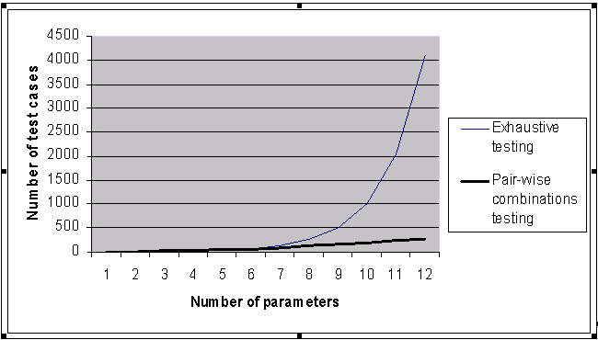
Combinatorial generation
Notes:
You might say – not a big deal but look at this.

Slide 39
Combinatorial generation
Research on pair-wise and higher order combinations:
Cohen et al. [1997]
Burr and Young [1998]
Dunietz et al. [1999]
Smith, Feather and Muscettola [2000]
Wallace and Kuhn [2001]
Kuhn and Reilly [2001]
Kuhn and Reilly: Investigated bugs in Mozzila browser and Apache web server.
Bugs found:
1 parameter – 29%, 42% (Mozilla, Apache respectively)
2 parameters – 76%, 70%
3 parameters – 95%, 89%
Only one order=6 in Mozilla.
Notes:
Does SQRTS support PICT?

Slide 40
Combinatorial generation
<var set="1" lvl="1" vid="4" cls=“MyClass" permutation="Full | PICT | rows">
<recm key="Platform">
<val>x86</val>
<val>AMD64</val>
<val>IA64</val>
</recm>
<recm key="OS">
<val>W2K</val>
<val>XP</val>
<val>XP Server</val>
<val>Longhorn</val>
</recm>
<recm key="FileSystem">
<val>FAT32</val>
<val>NTFS</val>
<val>CDFS</val>
</recm>
</var>
Dynamic, run-time generation.
Can be used for higher volumes than could be managed manually.
Full (order n), PICT (order 2), and rows (order 1)
Notes:
Combinatorial parameter data generation
Note similar to random gen in a sense but random gen selects one random values (simple or comples) per run where combinatorial all or at least all giving good coverage
Current limitation parameters that are not in the pair are selected randomly – we will have “default” attribute on the val node.
Only order 2 is supported. Future higher order.
Multiple VAR will be executed!!! == to amount of permutations per particular algorithm

Slide 41
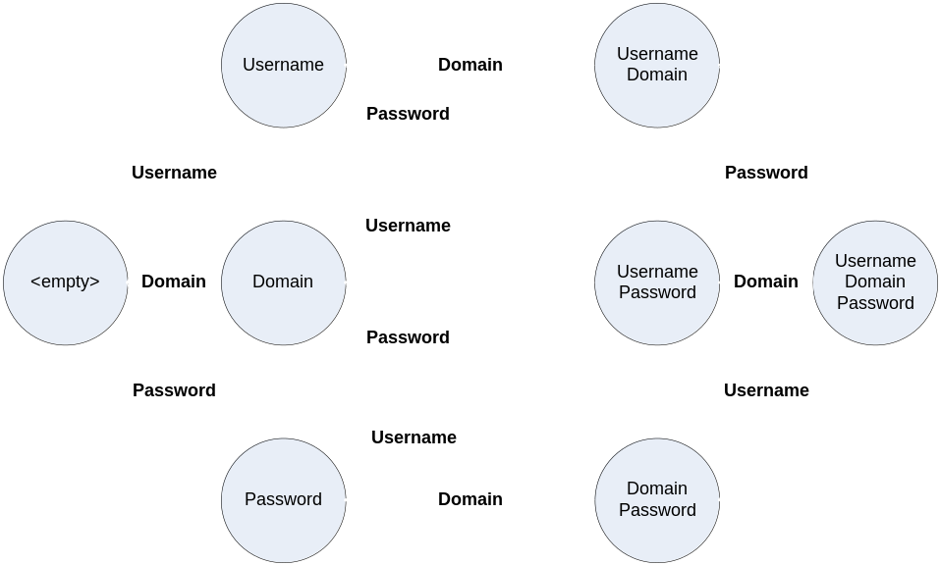
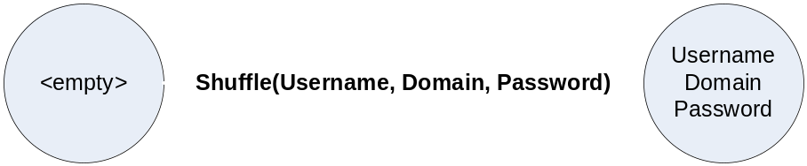
Special Execution Nodes
Before
Shuffle
Optional
Choice
Sequence
Block
<shuffle>
<fnc>EnterUsername</fnc>
<fnc>EnterDomain</fnc>
<fnc>EnterPassword</fnc>
</shuffle>
After

Slide 42
MCFTestLib
class BaseTest
UI
DB
Win32UITest.cs – Native UI automation
DB.cs – functions to execute sql scripts
WinFormsUITest.cs – Winforms UI automation
SYSTEM
UIATest.cs – UI automation functions based on Windows UIA
System.cs – run tasks, scripts, handle input, output, invoke tasks on another machine, impersonation, get log environment, get system info, capture screenshots, capture video, send mail
IETest.cs – functions for IE automation
COMMON
Common.cs – Functions for common functionality, mcf logging, aborttest, failtest etc.

Slide 43
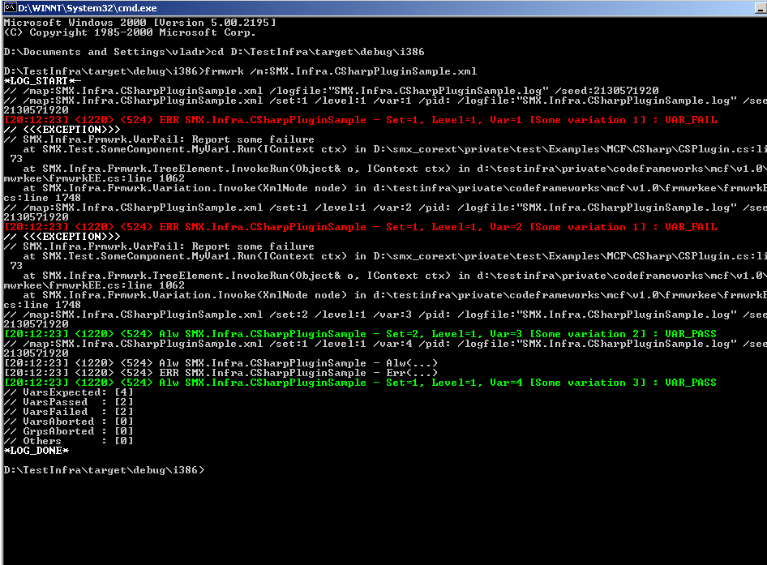
Usability
Notes:
Zilion of cmd parameters (loop, iter – mini-stress) Switches shortcuts, Different levels of output, different location of output
Time stamps
Full exception trace
Statistics
ReproLines
Colored schema

Slide 44
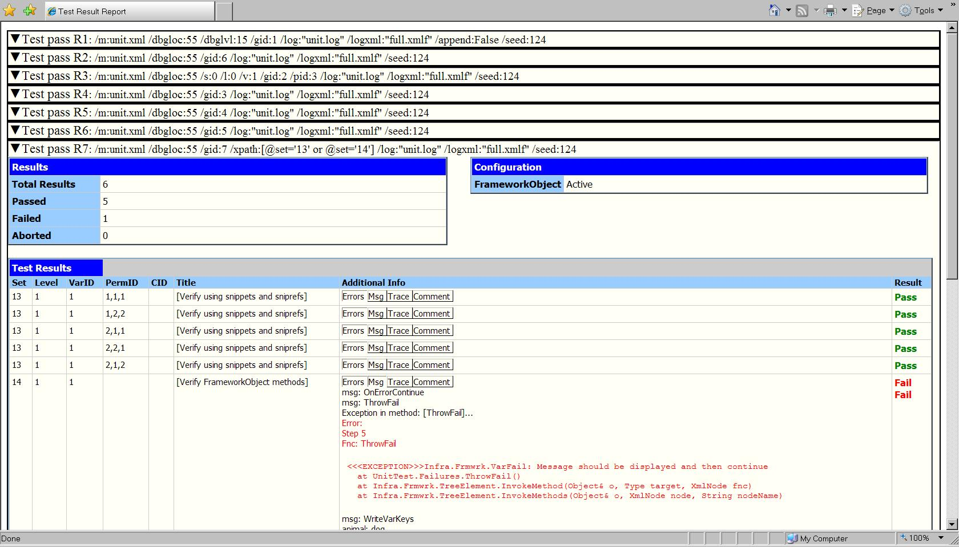
Usability (cont)
(xslt file included with release)
Notes:
An included XSLT makes the structured XML log readable through Internet Explorer. Additional tools can also send the report as an email.

Slide 45
Additional Tools
MCF2WTT - Converts MCF style log files to a WTT format
Monitor - Remotely monitor MCF execution by watching the text log. Supports coloring of text based on PASS FAIL etc.
SendMail - Sends an HTML file as an email to a specified email address
XmlTransform - Process an XML file using an XSL stylesheet and write the output to a file
TimestampFile.bat - Makes copies of a given file with the current date and time in the filename
Mcfreport.xslt - A transform for the xml log from MCF
Compact.xslt - A transform that takes an xhtml file and removes javascript information, hidden tags, and tags marked as "extra".
Escape - A tool to generated strings that are escaped for different parsers

Slide 46
Questions?

Slide 47
References
http://codebox/mcf
http://codebox/pict
http://pairwise
http://codebox/regexgen
(see http://codebox/codebox)

Slide 48
Appendix

Slide 49
Levels*
0 – Smoke
1 – Unit
2 - Build Verification (BVT)
4 - Functional
5 - InterOp/Integration
6 – Stress
7 - Performance/Scalability
8 – Acceptance
9 – Static Code Analysis
-N – negative, e.g. "-2" – Negative BVT
*Suggested meanings

Slide 50
Exceptions usage
Good.
catch(SomeException e) {
throw new VarFail("Message body", e); // Chaining/wrapping original
// exception
}
// Not wrapping use only when result is not based on other exception;
throw new VarFail("Message body");
catch(SomeException) { // Note there is no variable parameter defined!
throw; // Use with caution
}
Bad.
catch(SomeException e) { // Don’t do, it will loose original exception
// info in ‘e’
throw new VarFail("Message body");
}
catch { // Don’t do, it will loose original exception info in ‘e’.
throw new VarFail("Message body");
}
Don’t loose important information about exception…

Slide 51
Result types
Result | Src. | Cause
VAR_PASS | Test, MCF | Product success
VAR_FAIL STEP_FAIL | Test, MCF | Product failure or time out
VAR_ABORT | Test | Test failure or non-mcf exception (*)
GRP_ABORT | Test | Test failure
ABORT | Test, MCF | Test failure or internal frmwrk err.
VAR_ UNSUPPORTED | Test | Test opted not to run (**)
(*) - In “catch and continue“ mode.
(**) – Unlike failure and abort should not trigger investigation.

Slide 52
Switches (partial)
/?, /help
/a[ppend]
/cleanup
/cid – custom id
/dbgloc
/dbglvl
/g[id] – group id
/i[nternal]
/iter – iterations #
/l[evel]
/log[file]
/loop – loops #
/m[ap]
/pause
/pid – perm. id
/remark
/repro
/run
/seed
/s[et]
/setup
/sharedwrite
/stats
/v[ar]
/xpath – var filter
*See /? or /help for the full list
Notes:
Many commands have a short form to make you less typing… subset is here only see docs
0 0 - NONE
1 0 - DBGOUT (OutputDebugString) default (might remove it from default)
2 1 - STDOUT (Console) default
4 2 - LOG (Log file) will make default
3 - VERBOSE LOG (Log file)
/dbglvl – somewhat incorrect name since it is not a level but category (but we retained it for compatibility reasons)
Allows custom levels, Always and Error categories are always on.
1 0 - ALWAYS messages
2 1 - ERROR messages
4 2 - WARNING messages
8 3 - TRACE messages
- 6-15 - RESERVED
16-31 – CUSTOM

Slide 53
More
State-full action list (Modeling support!)
Stateless action lists (extended Run(…) )
Failure control – catch/nocatch/continue/wait/fail, etc.
Etc. – your feedback is welcome

