Slide 1

LangChain v1 Explained: Agents, Tools, and Beyond

Slide 2


Who are we?
Marlene Mhangami
Senior Developer Advocate​
@ Python Team
Yohan Lasorsa​
Principal Developer Advocate​
@ JavaScript Team

Slide 3
LangChain? 🤔
Open-source framework for building LLM-powered apps
Provides high level abstractions (models, agents, memory…)
Bridges data + reasoning
Active community and momentum

Slide 4
Core overview
Component | Usage
Models | LLM and embeddings abstraction
Messages | Input/output content abstraction
Tools | Functions that can be called by agents
Agents | Loop models and tools towards a goal
Middleware | Hook into agents execution steps
Memory | Store interactions and checkpoints
Streaming | Surface real-time updates

Slide 5
Core overview
Component | Usage
Models | LLM and embeddings abstraction
Messages | Input/output content abstraction
Tools | Functions that can be called by agents
Agents | Loop models and tools towards a goal
Middleware | Hook into agents execution steps
Memory | Store interactions and checkpoints
Streaming | Surface real-time updates

Slide 6
Core overview
Component | Usage
Models | LLM and embeddings abstraction
Messages | Input/output content abstraction
Tools | Functions that can be called by agents
Agents | Loop models and tools towards a goal
Middleware | Hook into agents execution steps
Memory | Store interactions and checkpoints
Streaming | Surface real-time updates

Slide 7
Agents are the focus
LangChain
Standard agent loop with create_agent
Common conversational agents
Simple and high-level
LangGraph
Graph-based execution for fine-grained orchestration
Custom workflow and automation
Full control, more low-level

Slide 8
Middlewares
Customizable hooks in the agent loop for dynamic control
Built-in Middlewares
Human-in-the-Loop: User approval before sensitive actions
Summarization: Condense chat history to fit token limits
PII Redaction: Detect and redact sensitive data

Slide 9
Deep Agents
Agents with extended autonomy and persistence.
Extra Capabilities
Persistent Memory: Stores knowledge across sessions
Filesystem Access: Read/write/edit files locally
Planning: Break tasks into steps, built-in todos
Subagents: Delegate to specialized subagents
Long-Running Workflows: Resume after interruptions

Slide 10

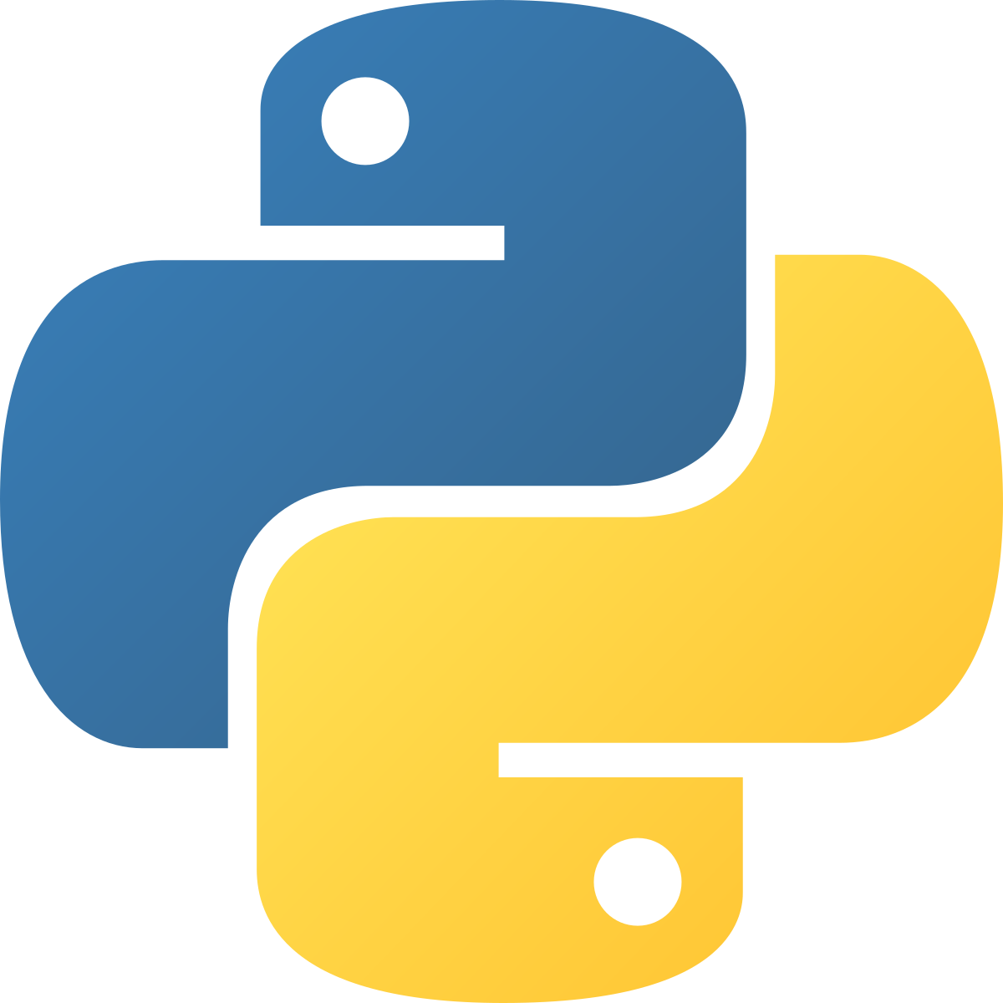
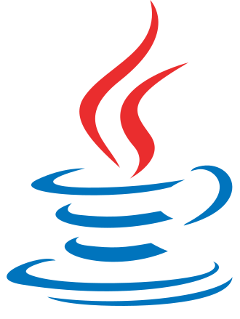
Free course
LangChain for Beginners

Slide 11

Thank you!
Any question? Join us on
Microsoft Foundry Discord
aka.ms/oss-ai-summit

