Slide 1
Programming assignment solutions
Mariia Mykhailova
Principal Software Engineer
Microsoft Quantum
(c) 2020 Microsoft. All rights reserved.

Slide 2
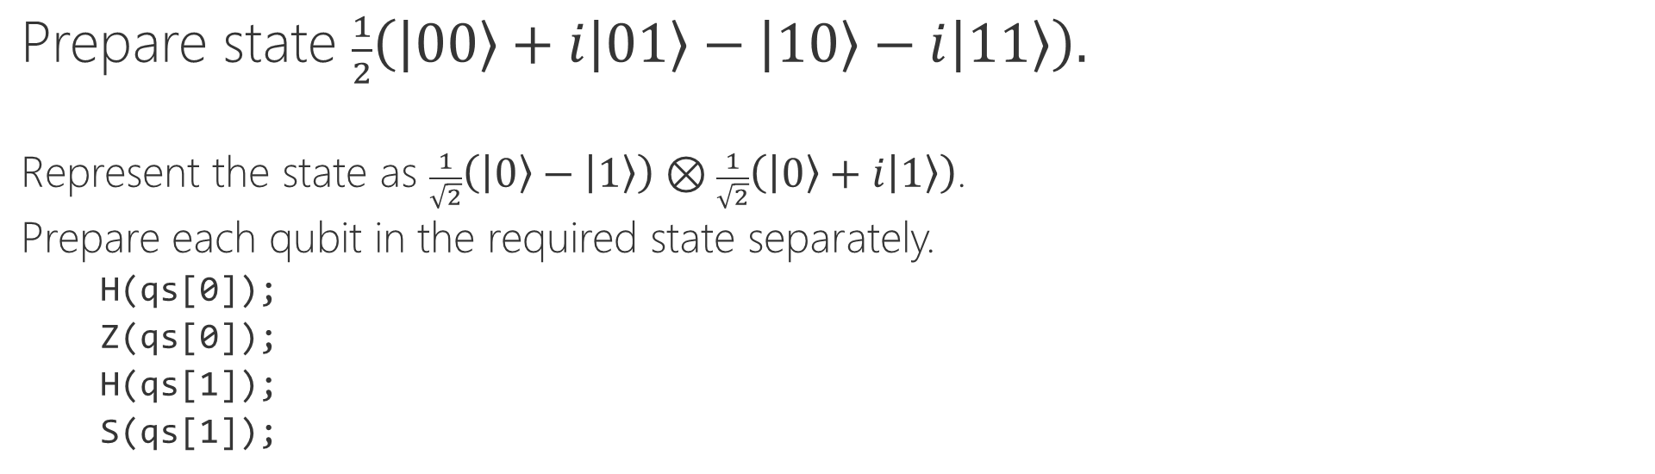
Task 1: Quantum state preparation
Prepare state $\frac{1}{2}\left(\left|00\right\rangle +i\left|01\right\rangle −\left|10\right\rangle −i\left|11\right\rangle \right).$
Represent the state as $\frac{1}{\sqrt{2}}\left(\left|0\right\rangle −\left|1\right\rangle \right)⊗\frac{1}{\sqrt{2}}\left(\left|0\right\rangle +i\left|1\right\rangle \right)$.
Prepare each qubit in the required state separately.
H(qs[0]);
Z(qs[0]);
H(qs[1]);
S(qs[1]);
(c) 2020 Microsoft. All rights reserved.

Slide 3
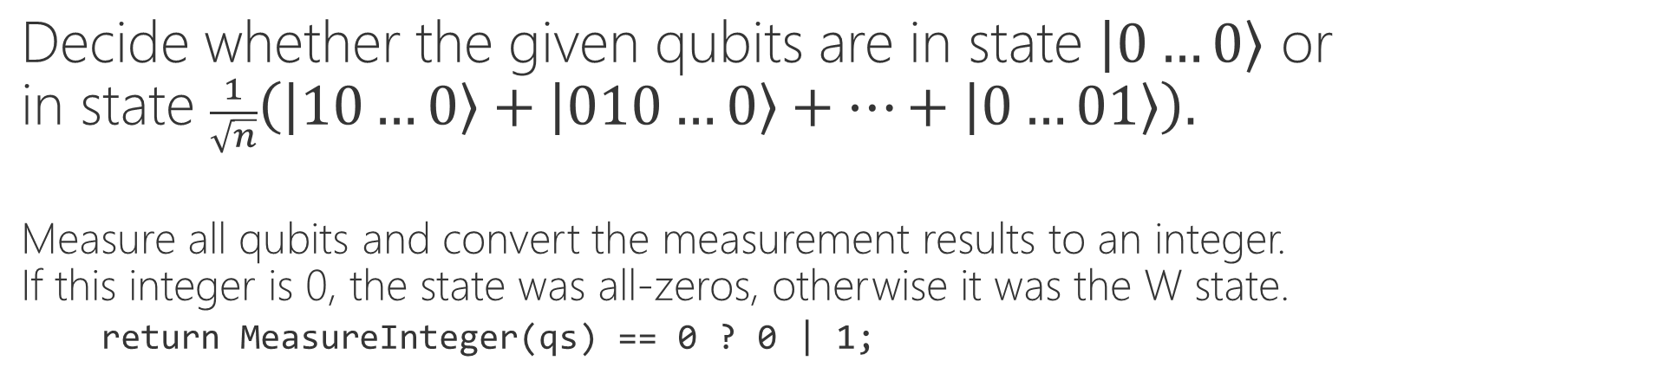
Task 2: Distinguishing quantum states
Decide whether the given qubits are in state $\left|0…0\right\rangle$ or in state $\frac{1}{\sqrt{n}}\left(\left|10…0\right\rangle +\left|010…0\right\rangle +…+\left|0…01\right\rangle \right).$
Measure all qubits and convert the measurement results to an integer. If this integer is 0, the state was all-zeros, otherwise it was the W state.
return MeasureInteger(qs) == 0 ? 0 | 1;
(c) 2020 Microsoft. All rights reserved.

Slide 4

Task 3: Implementing quantum gates
Apply a controlled Rz gate with $π/4$ angle argument.
Use Controlled functor to apply the controlled variant of the library Rz gate.
Controlled Rz([qs[0]], (PI() / 4.0, qs[1]));
(c) 2020 Microsoft. All rights reserved.

Slide 5
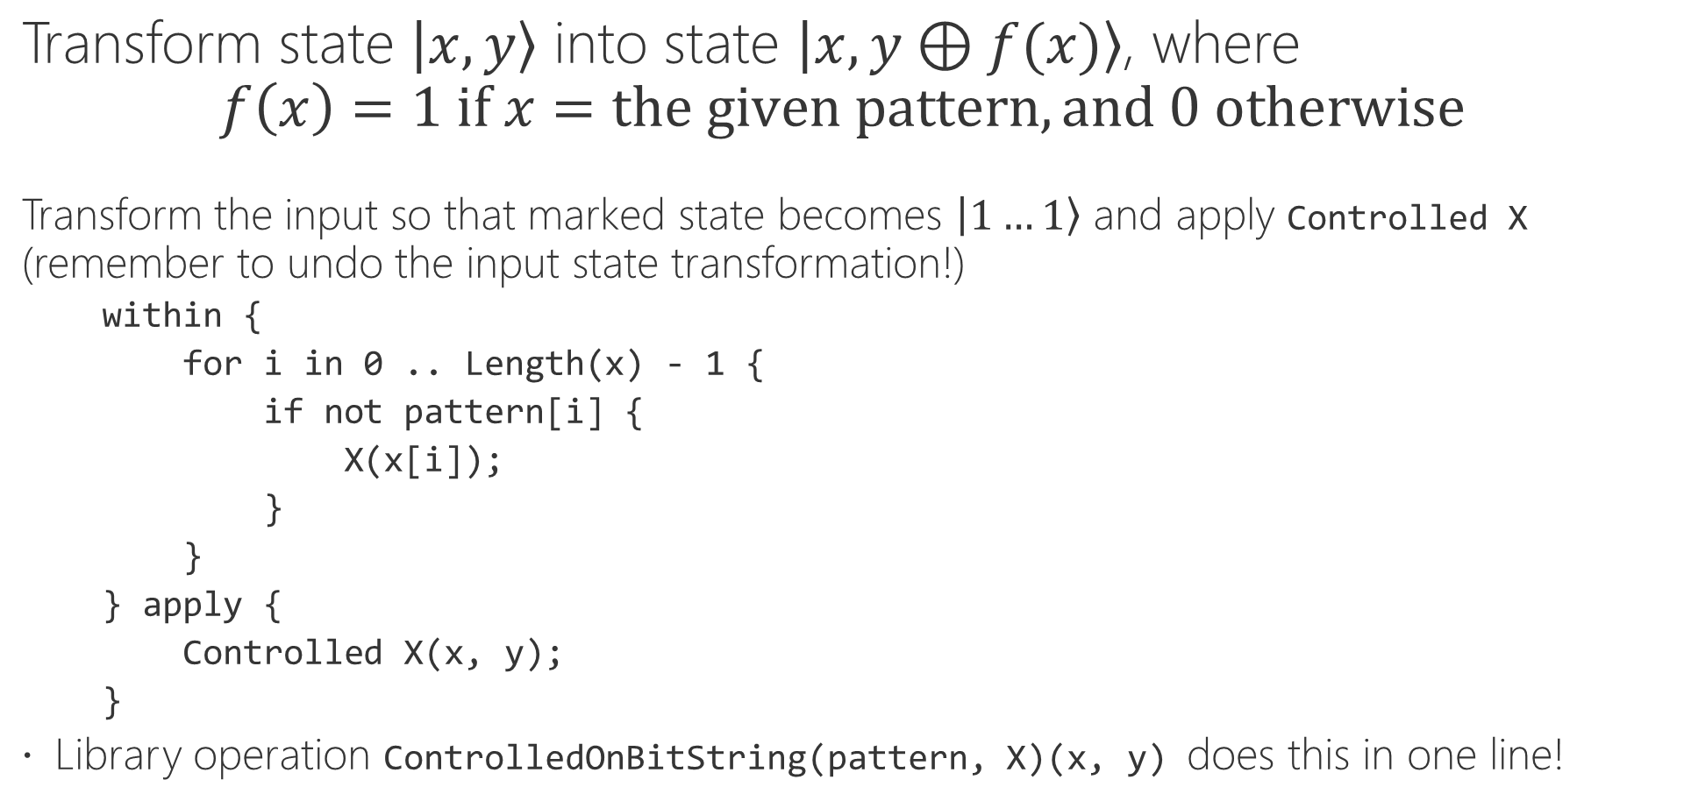
Task 4: Marking oracle for the given bit pattern
Transform state $\left|x, y\right\rangle$ into state $\left|x, y⊕f(x)\right\rangle$, where $$f\left(x\right)=1 if x=the given pattern, and 0 otherwise$$
Transform the input so that marked state becomes $\left|1…1\right\rangle$ and apply Controlled X (remember to undo the input state transformation!)
within {
for i in 0 .. Length(x) - 1 {
if not pattern[i] {
X(x[i]);
}
}
} apply {
Controlled X(x, y);
}
Library operation ControlledOnBitString(pattern, X)(x, y) does this in one line!
(c) 2020 Microsoft. All rights reserved.

