Slide 1

Lab 04: Model Context Protocol (MCP)
Notes:
MANDATORY SLIDE

Slide 2





What is MCP?
MCP is a standard protocol that lets language models interact with tools, data, and apps.
It’s like a translator between your model and everything else.

Slide 3

















MCP architecture
MCP Host
MCP Client
MCP Server
MCP Tools

Slide 4
MCP Server Types
STDIO
STREAMABLE HTTP
Use process stdin/stdout for communication.
Run as child processes of the client.
Local only (no network exposure).
Typically, single-client per process.
Very lightweight setup (no networking stack).
Use HTTP connections for communication.
Run as standalone services (URL/port accessible).
Can be remote or local, network-accessible.
Support multi-client connections simultaneously.
Enable event/data streaming over HTTP.

Slide 5


MCP Servers vs. Connectors
vs.
Notes:
Daniel - Lots of people have asked us in the last couple of months… What should I use? MCP servers or connectors? It’s actually the wrong question!

Slide 6
MCP Servers vs. Connectors
vs.
Notes:
It’s not a question of using a connector or an MCP Server…

Slide 7
MCP Servers & Connectors
&
Notes:
Instead, you are using both! To use a MCP Server in Copilot Studio, you need to create a connector. There are a couple of reasons why!

Slide 8
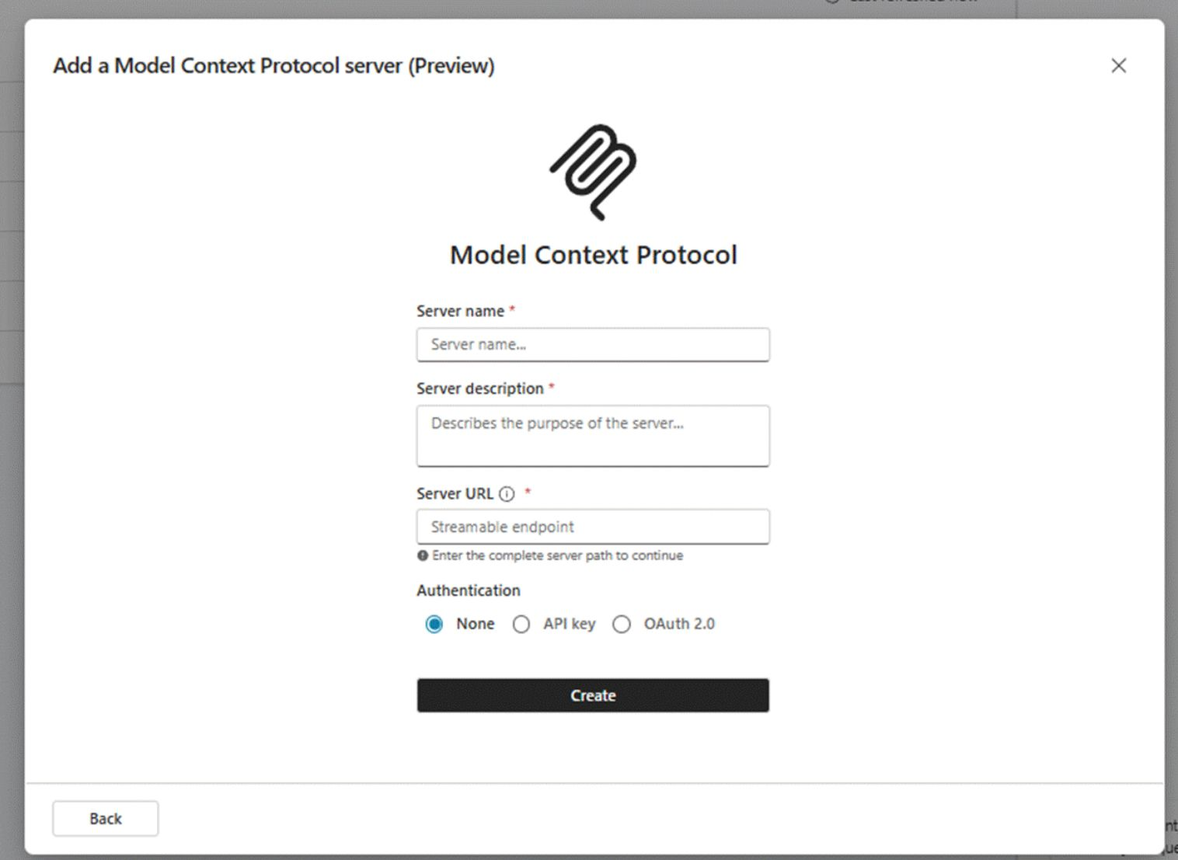
MCP Servers & Connectors
MCP Servers can be added as a connector action
Both as a new connector as well as an existing connector
Benefit from:
Data loss prevention
Multiple authentication methods
Virtual Network support
Certification for ISVs
Easy creation of MCP Servers in Copilot Studio via the new wizard (preview)

Slide 9
MCP Servers & Connectors
MCP Servers
Connectors
Only works in Copilot Studio
Multiple tools can be added at once
Agentic capabilities without configuration
No update needed after adding or removing a tool in the MCP Server
Data loss prevention on server level
Works in Copilot Studio, Power Apps, Power Automate & Logic Apps
Connector actions (tools) must be added one by one in Copilot Studio
Connector needs to be updated when adding or removing a connector action
Data loss prevention on action level

Slide 10
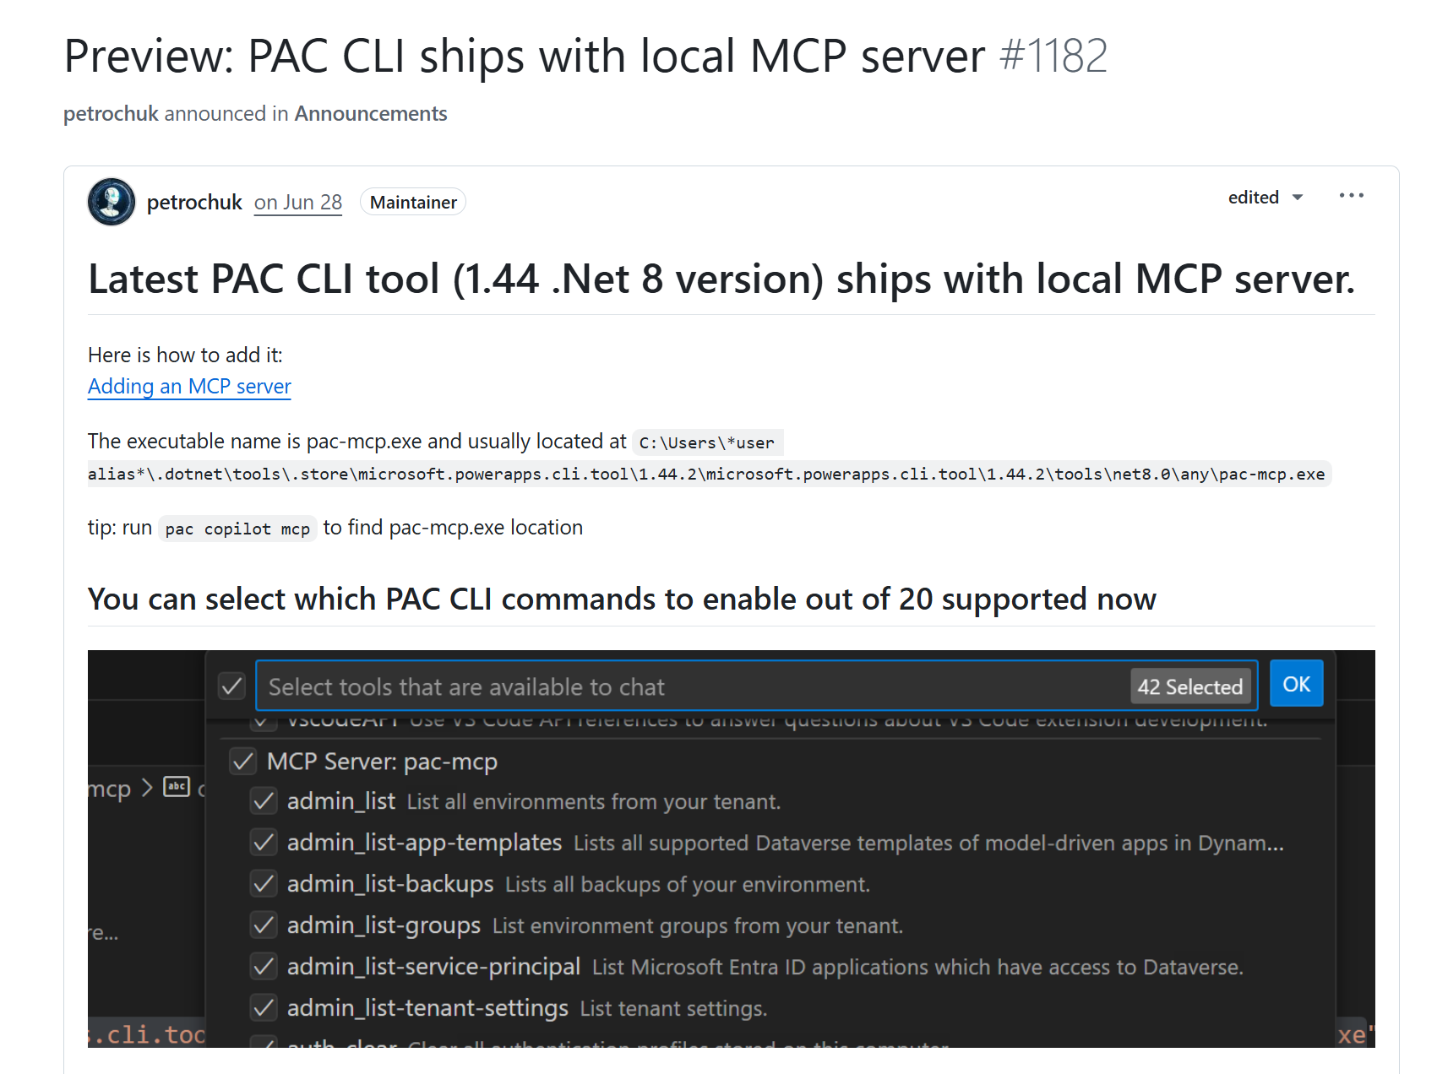
Local MCP Servers

Slide 11
Microsoft Copilot Studio & MCP
&
Notes:
Daniel

Slide 12
MCP Servers
Resources
Expose data and content from your servers to LLMs.
Prompts
Create reusable prompt templates and workflows.
Tools
Enable LLMs to perform actions through your server.
Sampling
Let your servers request completions from LLMs.
Notes:
Daniel

Slide 13
MCP Servers
Resources
Expose data and content from your servers to LLMs.
Prompts
Create reusable prompt templates and workflows.
Tools
Enable LLMs to perform actions through your server.
Sampling
Let your servers request completions from LLMs.

Slide 14
Lab 04
Model Context Protocol (MCP)
https://aka.ms/scs25-copilot-studio

Slide 15

THANK YOU TO OUR SPONSORS

Slide 16








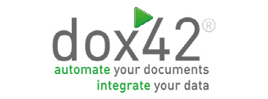














THANK YOU TO OUR SPONSORS
16

Slide 17




Thank you
Please provide feedback
Notes:
MANDATORY SLIDE – “Please use the QR code to provide session feedback.”

