Slide 1
Campus Recycling Program Review
Episode 08 PowerPoint MCP deck based on the approved Campus Recycling source paper.
Simulated educational data (2023-2024) used for training and demonstration.

Slide 2
Data Snapshot (Simulated)
Year | Landfill | Recycling | Compost | Total | Diversion
2023 | 930.0 tons | 602.7 tons | 296.6 tons | 1829.3 tons | 49.2%
2024 | 807.5 tons | 703.5 tons | 361.7 tons | 1872.7 tons | 56.9%
Source: campus-waste-data-2023-2024-simulated.csv

Slide 3
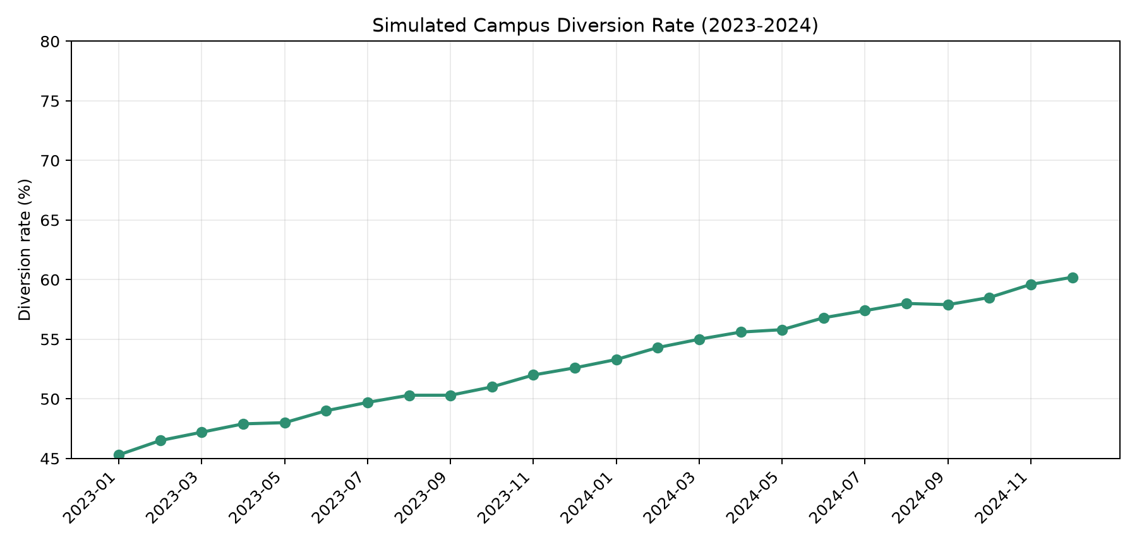
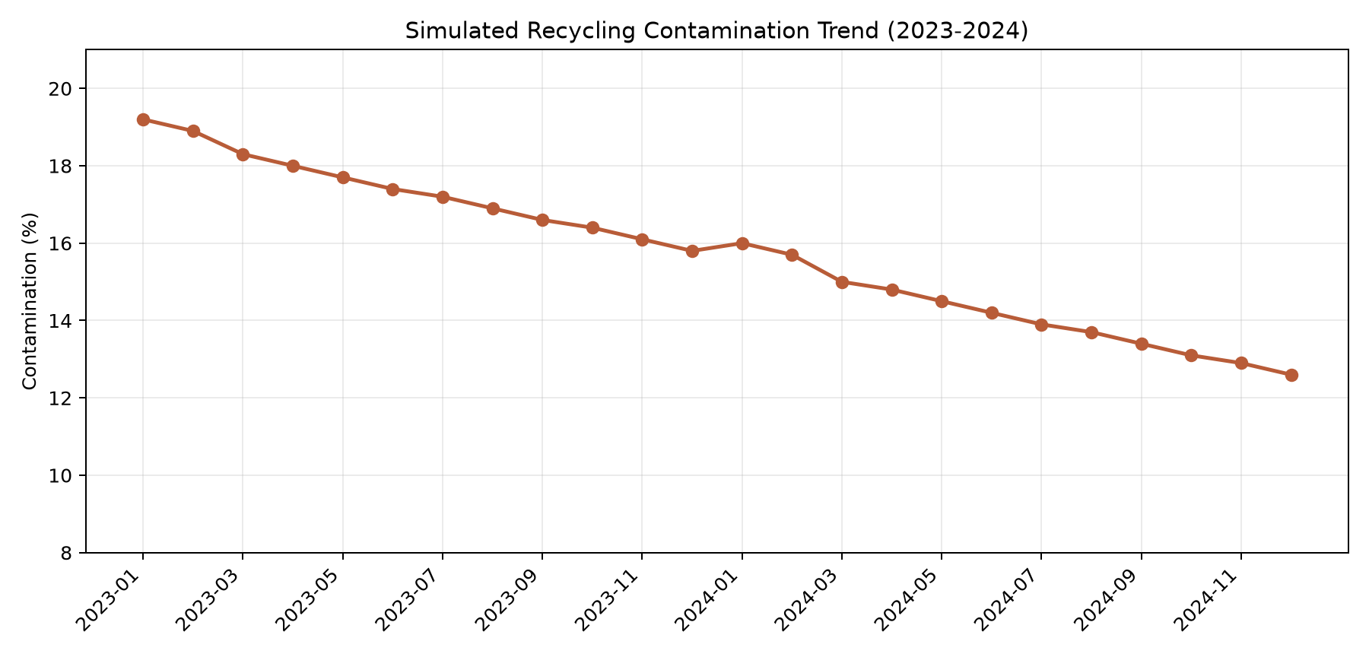
Key Findings
• Diversion improved from 49.2% to 56.9%.
• Landfill decreased by 122.5 tons year-over-year.
• Average contamination dropped from 17.4% to 14.2%.

Slide 4
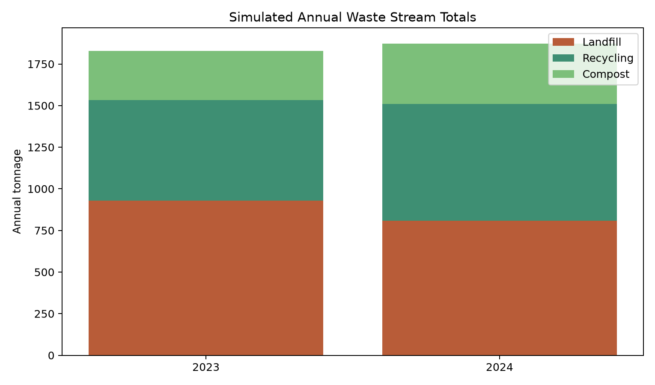
Evidence-Based Recommendations
1) Standardize tri-bin stations with icon-first signage in high-traffic zones.
2) Run monthly contamination-focused messaging with common error examples.
3) Publish building-level waste snapshots to sustain behavior feedback loops.

Slide 5
Limitations and Source Notes
Limitations:
• Dataset is simulated for educational use, not institutional reporting.
• Monthly values simplify operational variability and day-level events.
• Recommendations should be validated with real audits before policy use.
Source notes:
• CSV: campus-waste-data-2023-2024-simulated.csv
• Paper: Campus-Recycling-Source-Paper.docx/.pdf
• Charts generated directly from the simulated dataset.

Slide 6
Next Steps and Artifact Links
• Pilot two signage variants in parallel and compare contamination outcomes.
• Publish monthly building-level dashboard snapshots.
• Keep source pack and deck linked from the Campus Recycling project page.
Repository artifacts:
common/campus-recycling/Campus-Recycling-Source-Paper.pdf
common/campus-recycling/Campus-Recycling-Deck.pptx
Student AI Learning Series · Episode 08 MCP workflow

