Slide 1
Integrating Custom Vision with Power Apps for Diabetic Retinopathy Detection
Jingyi Zhu
Classify images with the Custom Vision service - Learn | Microsoft Docs
Customize a canvas app in Power Apps - Learn | Microsoft Docs
MS Ambassador
Sanya Sinha
MS Ambassador
Notes:
Link to published module on Learn: https://docs.microsoft.com/en-us/learn/modules/learn-pr/wwl-data-ai/classify-images-custom-vision/

Slide 2
Prerequisites
An Azure Account. You may get free credits from Azure for Students, or Azure Free Trial.
Sign up for free at PowerApps.com with a work or school account. Once you’ve signed up, you’ll be able to sign in to PowerApps on the web.

Slide 3
Learning objectives
Draw automatic & accurate detection insights from datasets
Use the Custom Vision service to create an image classification solution
Customize a Power app by adding controls, images, and logic.

Slide 4
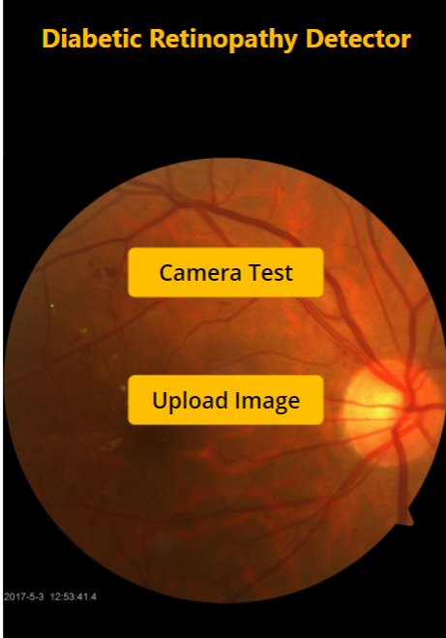
Learning objectives
What is Diabetic Retinopathy?
No symptoms or only mild vision problems at first.
Can lead to blindness.
Yearly eye exam
Notes:
A diabetes complication that affects eyes, which might cause no symptoms or only mild vision problems at first. But it can lead to blindness. Careful management of diabetes is the best way to prevent vision loss. Patient should see an eye doctor for a yearly eye exam with dilation — even if the vision seems fine.

Slide 5
Agenda
Presenter & objectives Introduction
How Azure image classification works?
Exercise - Create an image classification solution
Milestone 1 - Custom Vision project build up
Milestone 2 - Test the model & Generate Custom Vision link
Why Power Apps?
Exercise - Create your first app in Power Apps
Milestone 3 - Layout of Power App
Milestone 4 - Link Custom Vision model and Power App
Milestone 5 - App accuracy test with new inputs
Summary
Next steps
Q&A
Notes:
https://forms.office.com/r/nucza8taj4

Slide 6
How Azure image classification works?

Slide 7
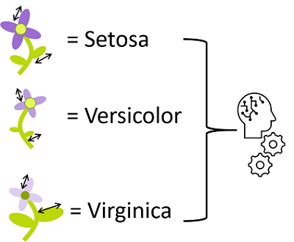
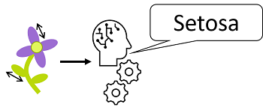
Understand classification
You can use a machine learning classification technique to predict which category, or class, something belongs to.
Notes:
You can use a machine learning classification technique to predict which category, or class, something belongs to. Classification machine learning models use a set of inputs, which we call features, to calculate a probability score for each possible class and predict a label that indicates the most likely class that an object belongs to.
For example, the features of a flower might include the measurements of its petals, stem, sepals, and other quantifiable characteristics. A machine learning model could be trained by applying an algorithm to these measurements that calculates the most likely species of the flower - its class.

Slide 8
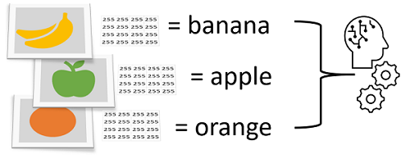
Understand image classification
Image classification is a machine learning technique in which the object being classified is an image, such as a photograph.
Notes:
Image classification is a machine learning technique in which the object being classified is an image, such as a photograph.
To create an image classification model, you need data that consists of features and their labels. The existing data is a set of categorized images. Digital images are made up of an array of pixel values, and these are used as features to train the model based on the known image classes.
The model is trained to match the patterns in the pixel values to a set of class labels. After the model has been trained, you can use it with new sets of features to predict unknown label values.

Slide 9
Uses of image classification
Some potential uses for image classification might include:
Product identification - performing visual searches for specific products in online searches or even, in-store using a mobile device.
Disaster investigation - evaluating key infrastructure for major disaster preparation efforts. For example, aerial surveillance images may show bridges and classify them as such. Anything classified as a bridge could then be marked for emergency preparation and investigation.
Medical diagnosis - evaluating images from X-ray or MRI devices could quickly classify specific issues found as cancerous tumors, or many other medical conditions related to medical imaging diagnosis.
Notes:
Some potential uses for image classification might include:
Product identification - performing visual searches for specific products in online searches or even, in-store using a mobile device.
Disaster investigation - evaluating key infrastructure for major disaster preparation efforts. For example, aerial surveillance images may show bridges and classify them as such. Anything classified as a bridge could then be marked for emergency preparation and investigation.
Medical diagnosis - evaluating images from X-ray or MRI devices could quickly classify specific issues found as cancerous tumors, or many other medical conditions related to medical imaging diagnosis.

Slide 10
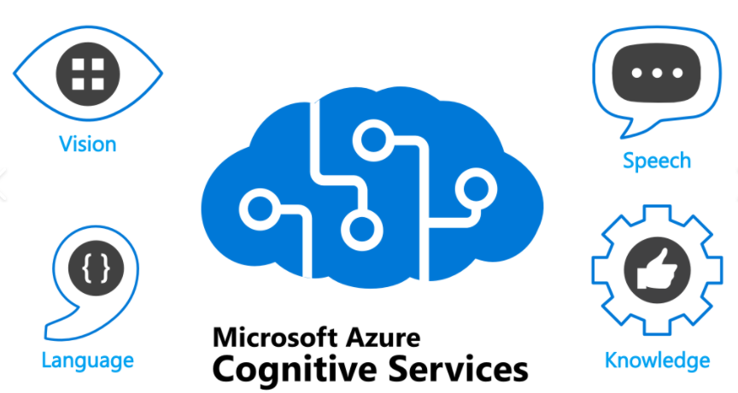
Get started with image classification on Azure
Notes:
You can perform image classification using the Custom Vision service, available as part of the Azure Cognitive Services offerings.
Cognitive Services comprises various AI services that enable you to build cognitive solutions that can see, hear, speak, understand, and even make decisions.

Slide 11
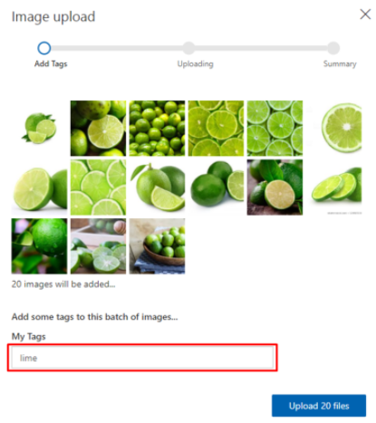
Model training
To train a classification model, you must upload images to your training resource and label them with the appropriate class labels.
Notes:
To train a classification model, you must upload images to your training resource and label them with the appropriate class labels. Then, you must train the model and evaluate the training results.
You can perform these tasks in the Custom Vision portal, One of the key considerations when using images for classification, is to ensure that you have sufficient images of the objects in question and those images should be of the object from many different angles.

Slide 12
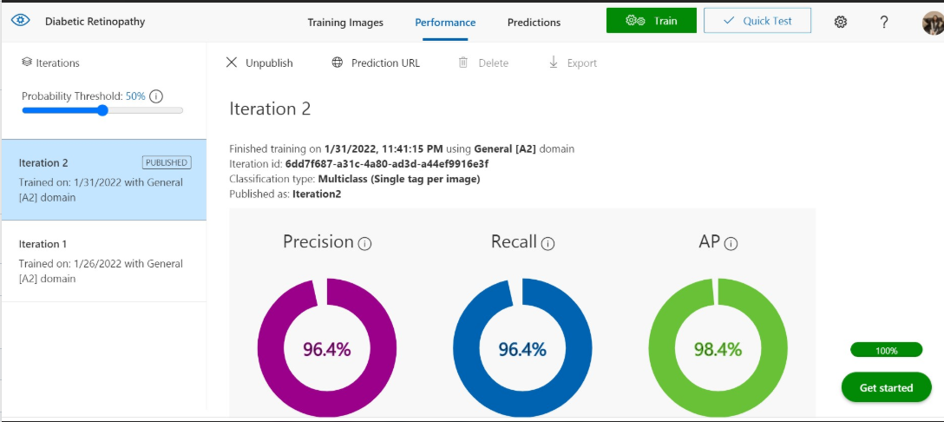
Model evaluation
Model training process is an iterative process in which the Custom Vision service repeatedly trains the model using some of the data, but holds some back to evaluate the model.
Notes:
Model training process is an iterative process in which the Custom Vision service repeatedly trains the model using some of the data, but holds some back to evaluate the model. At the end of the training process, the performance for the trained model is indicated by the following evaluation metrics:
Precision: What percentage of the class predictions made by the model were correct? For example, if the model predicted that 10 images are oranges, of which eight were actually oranges, then the precision is 0.8 (80%).
Recall: What percentage of class predictions did the model correctly identify? For example, if there are 10 images of apples, and the model found 7 of them, then the recall is 0.7 (70%).
Average Precision (AP): An overall metric that takes into account both precision and recall).

Slide 13
Using the model for prediction
After you've trained the model, and you're satisfied with its evaluated performance, you can publish the model to your prediction resource.
Project ID: The unique ID of the Custom Vision project you created to train the model.
Model name: The name you assigned to the model during publishing.
Prediction endpoint: The HTTP address of the endpoints for the prediction resource to which you published the model (not the training resource).
Prediction key: The authentication key for the prediction resource to which you published the model (not the training resource).
Notes:
After you've trained the model, and you're satisfied with its evaluated performance, you can publish the model to your prediction resource. When you publish the model, you can assign it a name
To use your model, client application developers need the following information:
Project ID: The unique ID of the Custom Vision project you created to train the model.
Model name: The name you assigned to the model during publishing.
Prediction endpoint: The HTTP address of the endpoints for the prediction resource to which you published the model (not the training resource).
Prediction key: The authentication key for the prediction resource to which you published the model (not the training resource).

Slide 14
Exercise
Create an image classification solution
Milestone 1 - Custom Vision project build up
Milestone 2 - Test the model & Generate Custom Vision link
Notes:
Link to published module on Learn: https://docs.microsoft.com/en-us/learn/modules/learn-pr/wwl-data-ai/classify-images-custom-vision/3-create-image-classifier

Slide 15
Exercise
Here is the link to demo video if you need
Notes:
Link to published module on Learn: https://docs.microsoft.com/en-us/learn/modules/learn-pr/wwl-data-ai/classify-images-custom-vision/3-create-image-classifier

Slide 16
Introduction to Power Apps

Slide 17
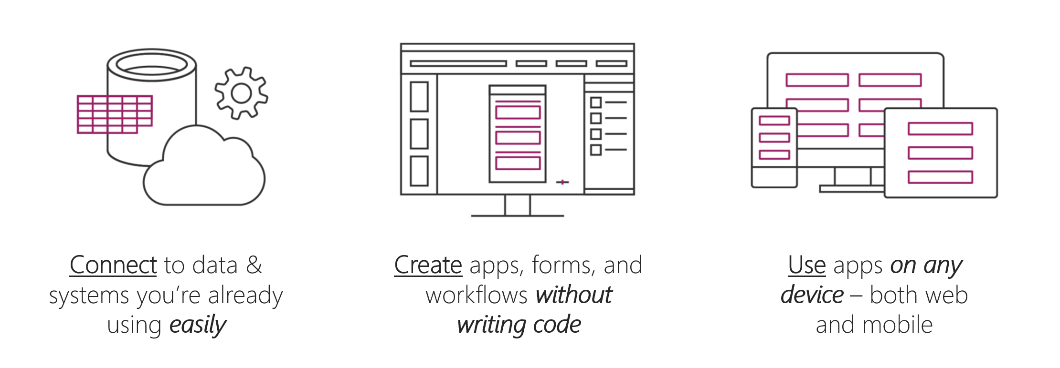
Introduction to Power Apps
Power Apps is a suite of apps, services, connectors, and a data platform that provides you with an opportunity to build custom apps for your business needs.
Build an app quickly by using the skills that you already have.
Connect to the cloud services and data sources that you're already using.
Share your apps instantly so that coworkers can use them on their phones and tablets.
Notes:
Power Apps is a suite of apps, services, connectors, and a data platform that provides you with an opportunity to build custom apps for your business needs. You can quickly build custom apps that connect to your data that is stored either in the underlying data platform (Microsoft Dataverse) or in various online and on-premises data sources (SharePoint, Excel, Office 365, Dynamics 365, SQL Server, and so on).
With Power Apps, you can:
Build an app quickly by using the skills that you already have.
Connect to the cloud services and data sources that you're already using.
Share your apps instantly so that coworkers can use them on their phones and tablets.

Slide 18
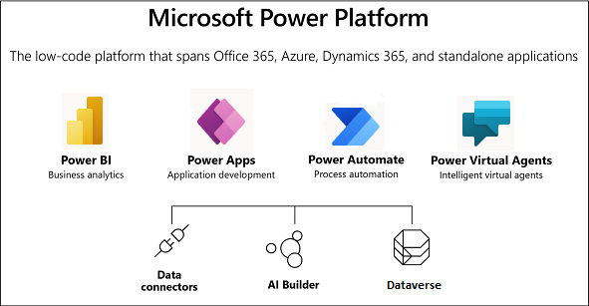
Microsoft Dataverse
An important data source option to explore further is the Dataverse.
Notes:
Dataverse lets you store and manage data that's used by business applications. Data within Dataverse is stored within a set of tables. Dataverse includes a base set of standard tables that cover typical scenarios, but you can also create custom tables that are specific to your organization and then populate them with data by using Power Query.

Slide 19
Power Apps building blocks
Power Apps is a collection of services, apps, and connectors that work together to let you do much more than just view your data.
Power Apps Home Page - Apps start here, whether you build them from data, a sample app, or a blank screen.
Power Apps Studio - Develop your apps further by connecting to data, adding and arranging user interface (UI) elements (known as controls), and building formulas.
Power Apps Mobile - Run your apps on Microsoft Windows, Apple iOS, and Google Android devices.
Power Apps Admin Center - Manage Power Apps environments and other components.
Note: To use these sites, you'll need to sign in by using your organizational account.
Notes:
This unit explores each part of the following Power Apps components:
Power Apps Home Page - Apps start here, whether you build them from data, a sample app, or a blank screen.
Power Apps Studio - Develop your apps further by connecting to data, adding and arranging user interface (UI) elements (known as controls), and building formulas.
Power Apps Mobile - Run your apps on Microsoft Windows, Apple iOS, and Google Android devices.
Power Apps Admin Center - Manage Power Apps environments and other components.
[!NOTE] To use these sites, you'll need to sign in by using your organizational account.

Slide 20
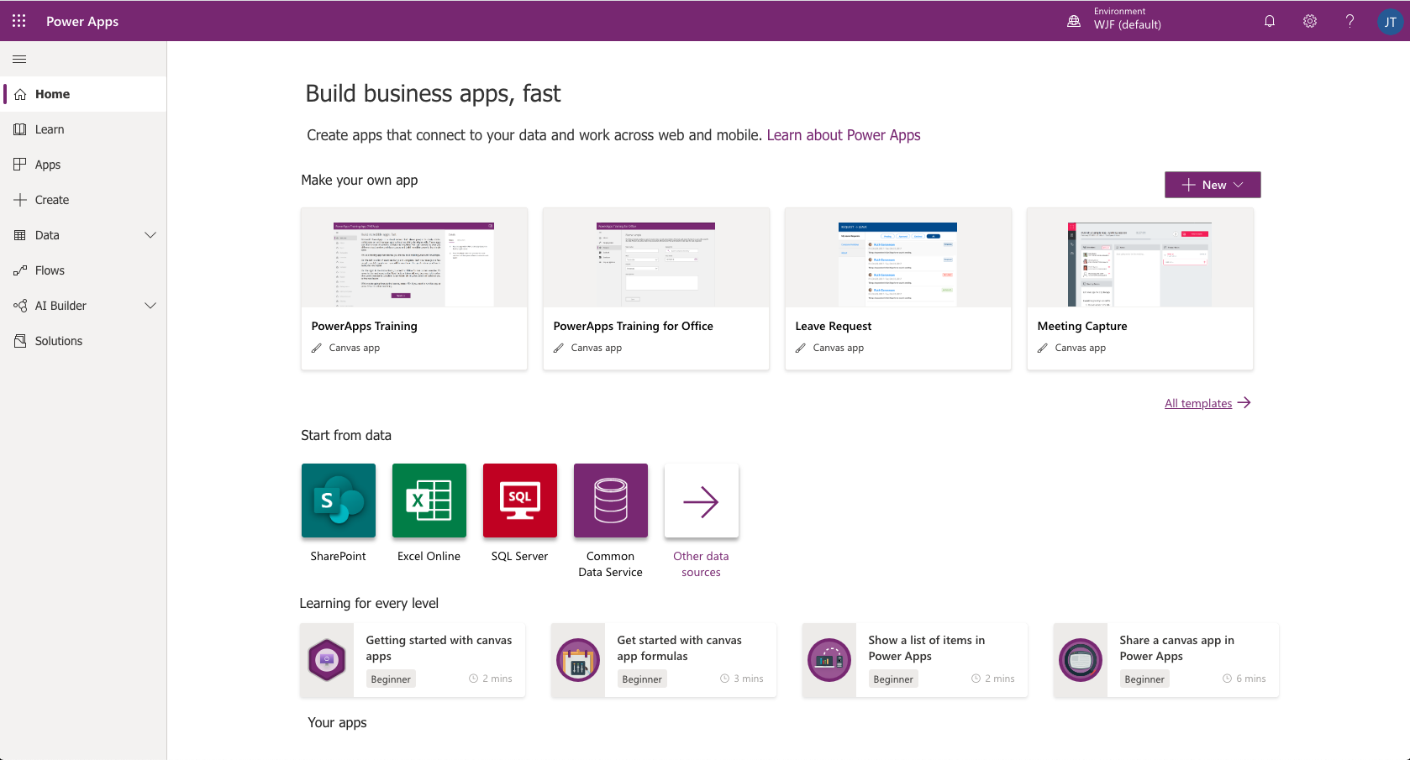
Power Apps Home Page
If you are building an app, you'll start with the Power Apps Home Page.
Notes:
If you are building an app, you'll start with the Power Apps Home Page. You can build apps from sample apps, templates, or a blank screen. All the apps that you've built appear here, along with any apps that others have created and shared with you.

Slide 21
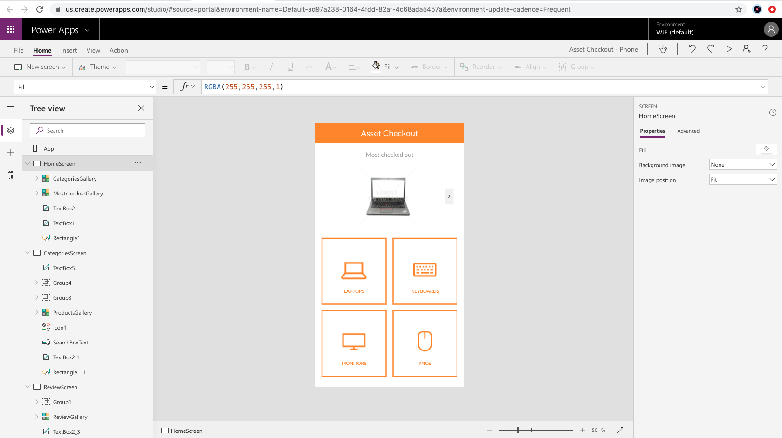
Power Apps Studio
Power Apps Studio is where you can fully develop your apps to make them more effective as a business tool and to make them more attractive.
Left pane - Shows a hierarchical view of all the controls on each screen or a thumbnail for each screen in your app.
Middle pane - Shows the canvas app that you're working on.
Right pane - Where you set options such as the layout, properties, and data sources for certain controls.
Notes:
Power Apps Studio is where you can fully develop your apps to make them more effective as a business tool and to make them more attractive. Power Apps Studio has three panes that make creating apps seem more like building a slide deck in Microsoft PowerPoint:
Left pane - Shows a hierarchical view of all the controls on each screen or a thumbnail for each screen in your app.
Middle pane - Shows the canvas app that you're working on.
Right pane - Where you set options such as the layout, properties, and data sources for certain controls.

Slide 22
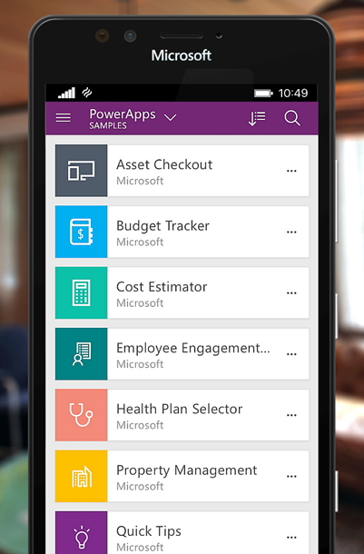
Power Apps Mobile
Power Apps Mobile for Windows, iOS, and Android devices allow you to use all the apps that you've created, and those others have shared with you, on your mobile device.
Notes:
Power Apps Mobile for Windows, iOS, and Android devices allow you to use all the apps that you've created, and those others have shared with you, on your mobile device. You or your users can download the Microsoft Power Apps app from the appropriate app store. When users sign in with their credentials, they will see all apps that have been shared with them. The Power Apps Mobile app only needs to be downloaded once.
When you use apps in Power Apps Mobile, you get the most out of your device's capabilities: camera controls, GPS location, and more.

Slide 23
Exercise
Create your first app in Power Apps
Milestone 3 - Layout of Power App
Milestone 4 - Link Custom Vision model and Power App
Milestone 5 - App accuracy test with new inputs

Slide 24
Exercise
Here is the link to demo video if you need
Notes:
Link to published module on Learn: https://docs.microsoft.com/en-us/learn/modules/learn-pr/wwl-data-ai/classify-images-custom-vision/3-create-image-classifier

Slide 25
Knowledge check

Slide 26
Question 1
You plan to use the Custom Vision service to train an image classification model. You want to create a resource that can only be used for model training, and not for prediction. Which kind of resource should you create in your Azure subscription?
Custom Vision
Cognitive Services
Computer Vision
Notes:
Explanation: Correct: When you create a Custom Vision resource, you can specify whether it is to be used for training, prediction, or both.

Slide 27
Question 1
You plan to use the Custom Vision service to train an image classification model. You want to create a resource that can only be used for model training, and not for prediction. Which kind of resource should you create in your Azure subscription?
Custom Vision
Cognitive Services
Computer Vision
Notes:
Explanation: Correct: When you create a Custom Vision resource, you can specify whether it is to be used for training, prediction, or both.

Slide 28
Question 2
You train an image classification model that achieves less than satisfactory evaluation metrics. How might you improve it?
Reduce the size of the images used to train the model.
Add a new label for "unknown" classes.
Add more images to the training set.
Notes:
Explanation: Correct: Generally, adding more images to the project an retraining the model is likely to improve performance.

Slide 29
Question 2
You train an image classification model that achieves less than satisfactory evaluation metrics. How might you improve it?
Reduce the size of the images used to train the model.
Add a new label for "unknown" classes.
Add more images to the training set.
Notes:
Explanation: Correct: Generally, adding more images to the project an retraining the model is likely to improve performance.

Slide 30
Question 3
Where do you configure and customize your app?
In Power Apps Mobile
In the Power Apps admin center
In Microsoft Dynamics 365
In Power Apps Studio
Notes:
Explanation: You can configure and customize your apps in Power Apps Studio.

Slide 31
Question 3
Where do you configure and customize your app?
In Power Apps Mobile
In the Power Apps admin center
In Microsoft Dynamics 365
In Power Apps Studio
Notes:
Explanation: You can configure and customize your apps in Power Apps Studio.

Slide 32
Summary
Notes:
Knowledge test: https://forms.office.com/r/YabQSUayJu

Slide 33
Summary
Congratulations on creating your app with Power Apps and Custom Vision!
Image classification is used to assign images to categories, or classes.
To create, share, and administer your apps, you will use make.powerapps.com, the Power Apps Studio, and the Power Apps Admin Center.
The power of Power Apps comes from the ability to connect to related technologies in your business. Examples of these are Microsoft Dataverse, Power Automate, Microsoft SharePoint, and other data sources.
You can create an app by using several different methods. Some of these methods include from a template, a data source (like Microsoft SharePoint), or a blank canvas.
Notes:
Congratulations on creating your first app with Power Apps!
In this module, you discovered what Power Apps can do for your business and the building blocks of creating your first app. You then created an app from data in a Microsoft Excel workbook.
Additionally, you learned that:

Slide 34
Next steps
If you want to learn more:
Microsoft Learning Path: Learn more about
Custom Vision,
Canvas App creation,
Azure Health bot by using built-in or custom scenarios,
AI business school for healthcare
The Value of Computer Vision in Healthcare Panel in this video
Notes:
It's a good idea at the end of a project to identify whether you still need the resources you created. Resources left running can cost you money.
If you are continuing on to other modules in this learning path you can keep your resources for use in other labs.
If you have finished learning, you can delete the resource group or individual resources from your Azure subscription

Slide 35
Next steps
Optional Transfer Knowledge activity:
Identify whether you still need the resources you created
If you have finished learning, you can delete the resource group
You can modify your app to analyze images, including generating a descriptive caption, extracting relevant tags, identifying objects, determining image type and metadata, detecting human faces, known brands, and celebrities, and others. You can find out more about using the Computer Vision service here
With Power Apps, you can:
Build an app quickly by using the skills that you already have.
Connect to the cloud services and data sources that you're already using.
Share your apps instantly so that coworkers can use them on their phones and tablets.
Notes:
It's a good idea at the end of a project to identify whether you still need the resources you created. Resources left running can cost you money.
If you are continuing on to other modules in this learning path you can keep your resources for use in other labs.
If you have finished learning, you can delete the resource group or individual resources from your Azure subscription

Slide 36
Thank you!
Let us know your feedback about this workshop!

