Slide 2
WELCOME EVERYONE!
Notes:
Welcome to Microsoft Learn Student Ambassadors Workshop. Today date <07-08-2022>

Slide 3
Leveraging VS Code Source Control for GIT and GitHub
Speaker’s Name
Notes:
The point of discussion for today is <Title> and I will be your host and facilitator

Slide 4
Who is this workshop for?
Everyone!
Notes:
Simple answer is that, this is for everyone beginner, intermediate and advance developer. VS Code is designed to run everywhere and for everyone as we will see in a bit. If you are running Windows, Linux or even MacOS, if you are a web developer, ML/AI engineer, Data Science (Jupyter Notebook), Android developer and even content writers.

Slide 5
Prerequisites
Installed Git
Installed Visual Studio Code
Have an active GitHub account
Notes:
The only thing you need is to have all this set up on your computer, and you don't have to worry about the setup process. I will provide a link for that at the end of this presentation. Just follow along, and you willl still gain valuable knowledge.

Slide 6
Learning objectives
Understands VS Code Interface
Perform basic Git tasks
Initialize
branch actions
Stages
remote
Notes:
I will be showing us around VS Code interface very briefly before we deep dive into performing various Git task using the power of VS Code.

Slide 7
Leveraging VS Code Source Control for GIT and GitHub
Notes:
Let’s dive deep into leveraging the power of VS Code to perform Git and GitHub tasks.

Slide 8
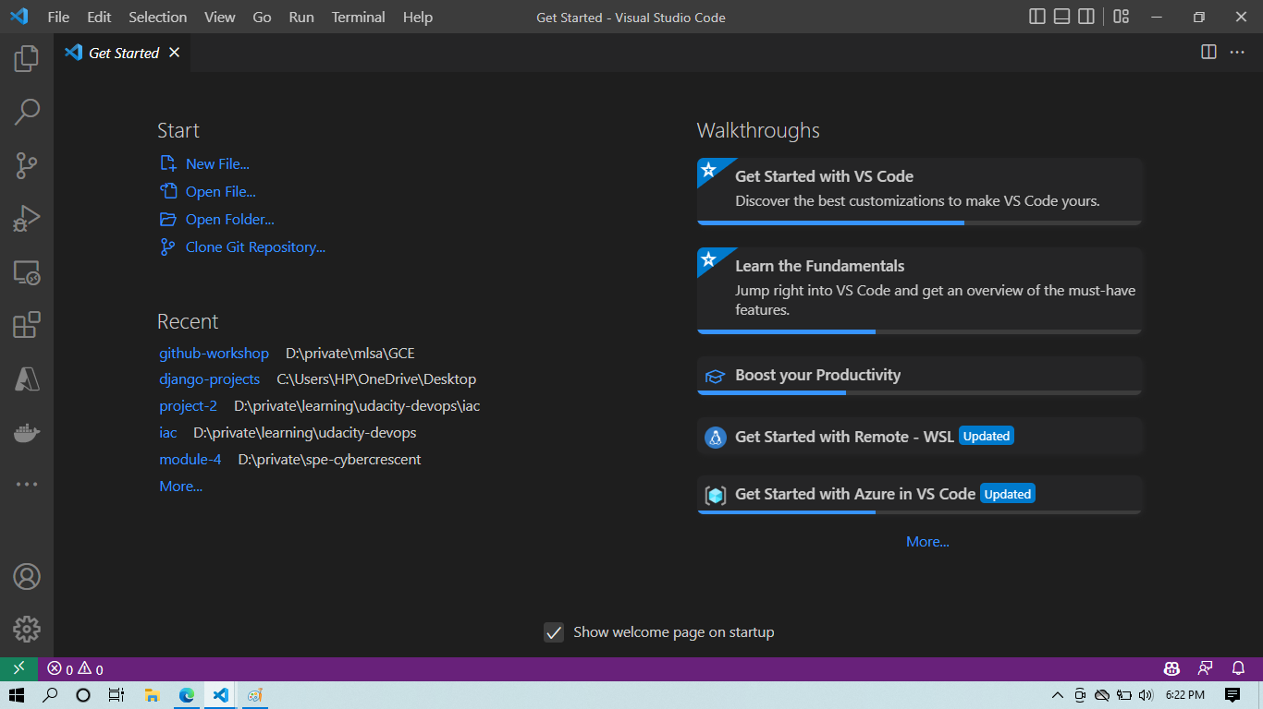
What is VS Code?
Code editing.
Redefined.
Free.
Built on open source.
Runs everywhere.
Notes:
The picture at the right hand side is the VS Code at launch! According to the VS Code official page, VS Code is a free tool that is use to edit codes, refactor codes, it is open source and multi-platform. Which means it runs on Windows, Linux and MacOS. It is free because you don’t have to pay a dime to start using VS Code. Visit the official page, download and start using it to do magic.

Slide 9
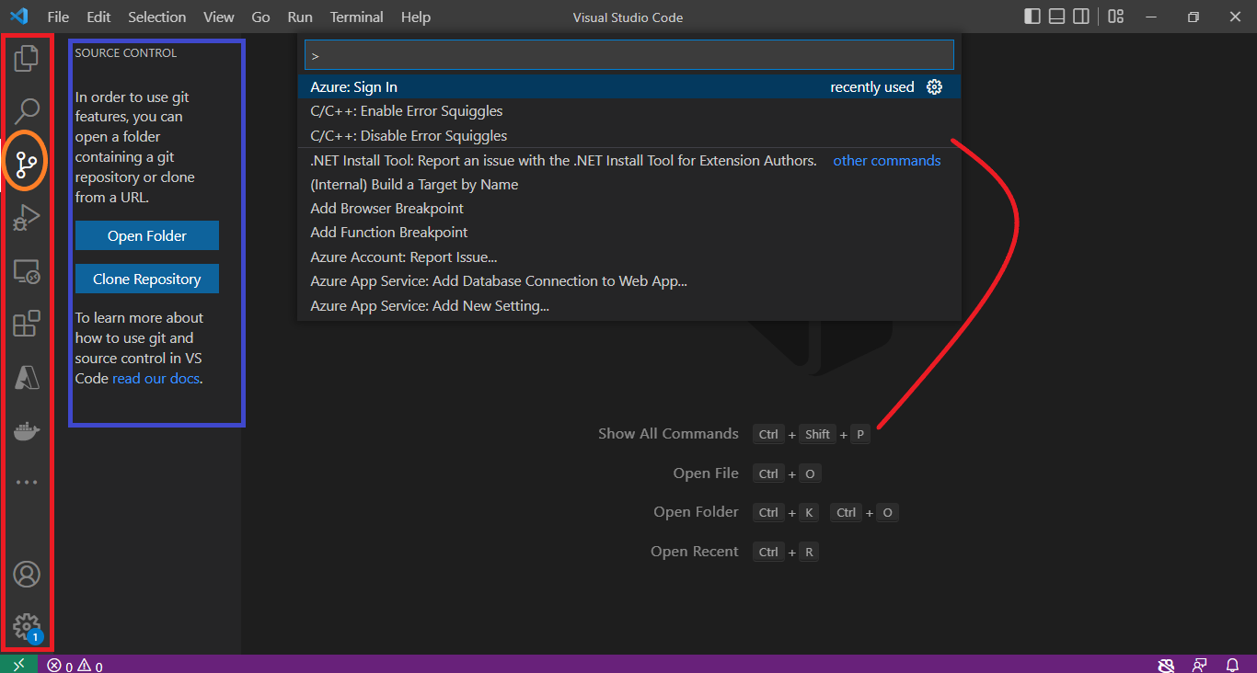
Overview
Notes:
At this point, let's focus on streamlining our learning process. There are key features that require our attention right now.
Sidebar (red rectangle): At the sidebar is where the source control tab live.
Source Control Tab (Orange circle) and its extension (blue region)
Command Pallette (red curve). The curve connect the command to open the pallets. Go to view to open it without the command.

Slide 10
Exercise
Open any empty folder in VS Code
Click the source control tab
Click Initialize repository

Slide 11
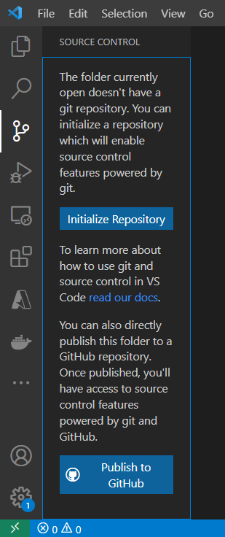
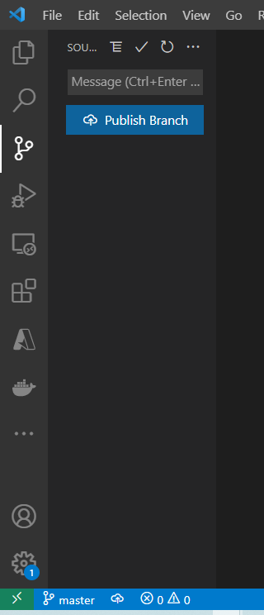
Solution
1
2
Notes:
After opening the empty folder. Clicking the 1 will open up the extension to click the 2 and boom finally gives the expected result if git initially install correctly. Notice the yellow rectangle at the right hand side. It shows the branch created by default for us by git.

Slide 12
Branch
A branch is a new/separate version of the main repository.
Notes:
a branch is a new/separate version of the main repository.

Slide 13
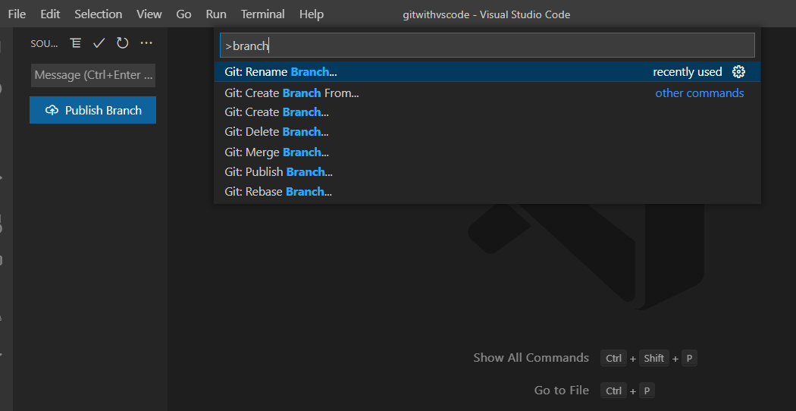
Branch Actions
Rename
New/Create
Switch
Delete
Merge
Notes:
Let's talk about what we can do with the branches in the repository. To see all available actions, press CTRL + SHIFT + P, type "branch" in the command palette, or use the red tag button for quick access.

Slide 14
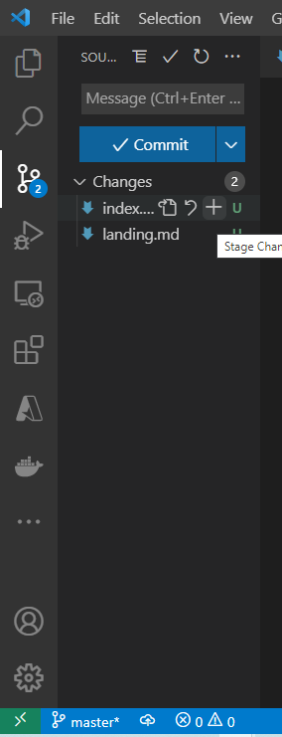
Stages
Add: It adds file contents to the index(staging). This is the temporary addition of the contents into the staging environment
Notes:
Red circle is to stage the code edited (it is the process of adding it to the index head temporarily). It adds file contents to the index(staging). This is the temporary addition of the contents into the staging environment. This command updates the index using the current content found in the working tree, to prepare the content staged for the next commit

Slide 15
Stages
Commit: This record changes permanently to the repository.
Notes:
The yellow box allows you to commit changes and add them permanently to the project. A commit message is required, serving as a description of what you're adding to the source code. This records changes permanently in the repository.

Slide 16
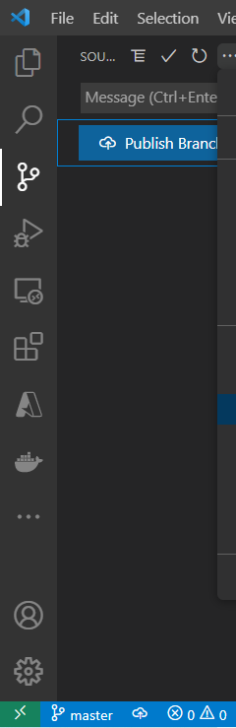
Stages
Remote/Publish: This tool oversees a collection of monitored repositories. It helps you manage the group of repositories (known as "remotes") whose branches you keep an eye on.
Notes:
This tool handles a collection of monitored repositories. It's used for managing the group of repositories, often referred to as "remotes," where you keep an eye on their branches.

Slide 17
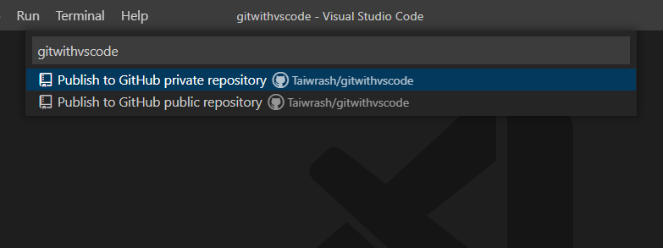
Stages
Public /Private: Public repositories are accessible to everyone on the internet. Private repositories are only accessible to you, people you explicitly share access with
Notes:
In organization repositories, access is usually granted to specific members of the organization. It's important to note that organization owners always have access to all repositories created within the organization.

Slide 18
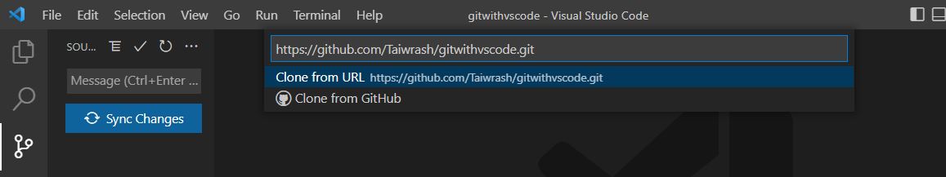
Stages
Clone: This clones a repository into a newly created directory
Notes:
It creates remote-tracking branches for each branch in the cloned repository (visible using git branch –remotes), and creates and checks out an initial branch that is forked from the cloned repository’s currently active branch.

Slide 19
Demo
Rasheed Mudasiru
Notes:
Let’s demonstrate all this tasks in VS Code!

Slide 20
Knowledge Checks

Slide 21
What is the correct command to open the command palette?
A. CTRL + S + P
B. CTRL + ALT + P
C. CTRL + P
D. CTRL + SHIFT + P
E. None of the above

Slide 22
What is the correct command to open the command palette?
A. CTRL + S + P
B. CTRL + ALT + P
C. CTRL + P
D. CTRL + SHIFT + P
E. None of the above

Slide 23
Which of the following action of git requires a message?
A. Add/stage
B. Push
C. Commit
E. None of the above

Slide 24
Which of the following action of git requires a message?
A. Add/stage
B. Push
C. Commit
E. None of the above

Slide 25
Which of the following is not required to use Git in VS Code?
A. Python
B. Git
C. VS Code
E. None of the above

Slide 26
Which of the following is not required to use Git in VS Code?
A. Python
B. Git
C. VS Code
E. None of the above

Slide 27
Summary
You can handle all Git tasks directly within VS Code, without the need to execute a single Git command, simply by leveraging the built-in capabilities of VS Code.

Slide 28
Next Steps
VS Code official documentation on source control feature
Quickstart
VS Code Source Control Basics Video
Git
GitHub

Slide 29
Feedback
Share on social media with hash tags #MSFTAmbassadors, <any other hashtag> and tag @microsoftlearn
Please tell us how you liked this workshop by filling out this survey:
https://aka.ms/workshopomatic-feedback
Notes:
Add any other handles and hashtags here

