Slide 2
Introduction to GitHub Actions
Ayush Tiwari
Sudip Mondal
Sonish Singhal
Notes:
Link to published module on Learn: https://docs.microsoft.com/en-us/learn/modules/learn-pr/github/introduction-to-github/

Slide 3
Prerequisites
A GitHub account

Slide 4
Introduction to Git

Slide 5
Version Control Systems
A way to manage files and directories
Track changes over time
Recall previous versions
Examples of version control systems are Git, SVN, ClearCase, etc.
Notes:
GitHub is a development platform that enables you to host and review code, manage projects, and build software alongside 50 million developers.
Why is everyone building on GitHub? Because it provides the important DevOps features companies and organizations of all sizes need for their public and private projects. Whether it's planning features, fixing bugs, or collaborating on changes, GitHub is the place where the world's software developers gather to make things. And then make them better.
In this module, you learn to use key GitHub features, including issues, notifications, branches, commits, and pull requests.

Slide 6
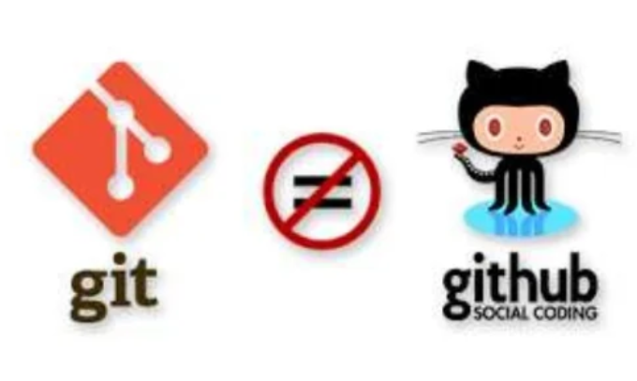
What is Git?
Git is free and opensource distributed version control system.
Can work without internet connection.
It is NOT GITHUB!
Before going to the GitHub let's study some basic concept of git

Slide 7
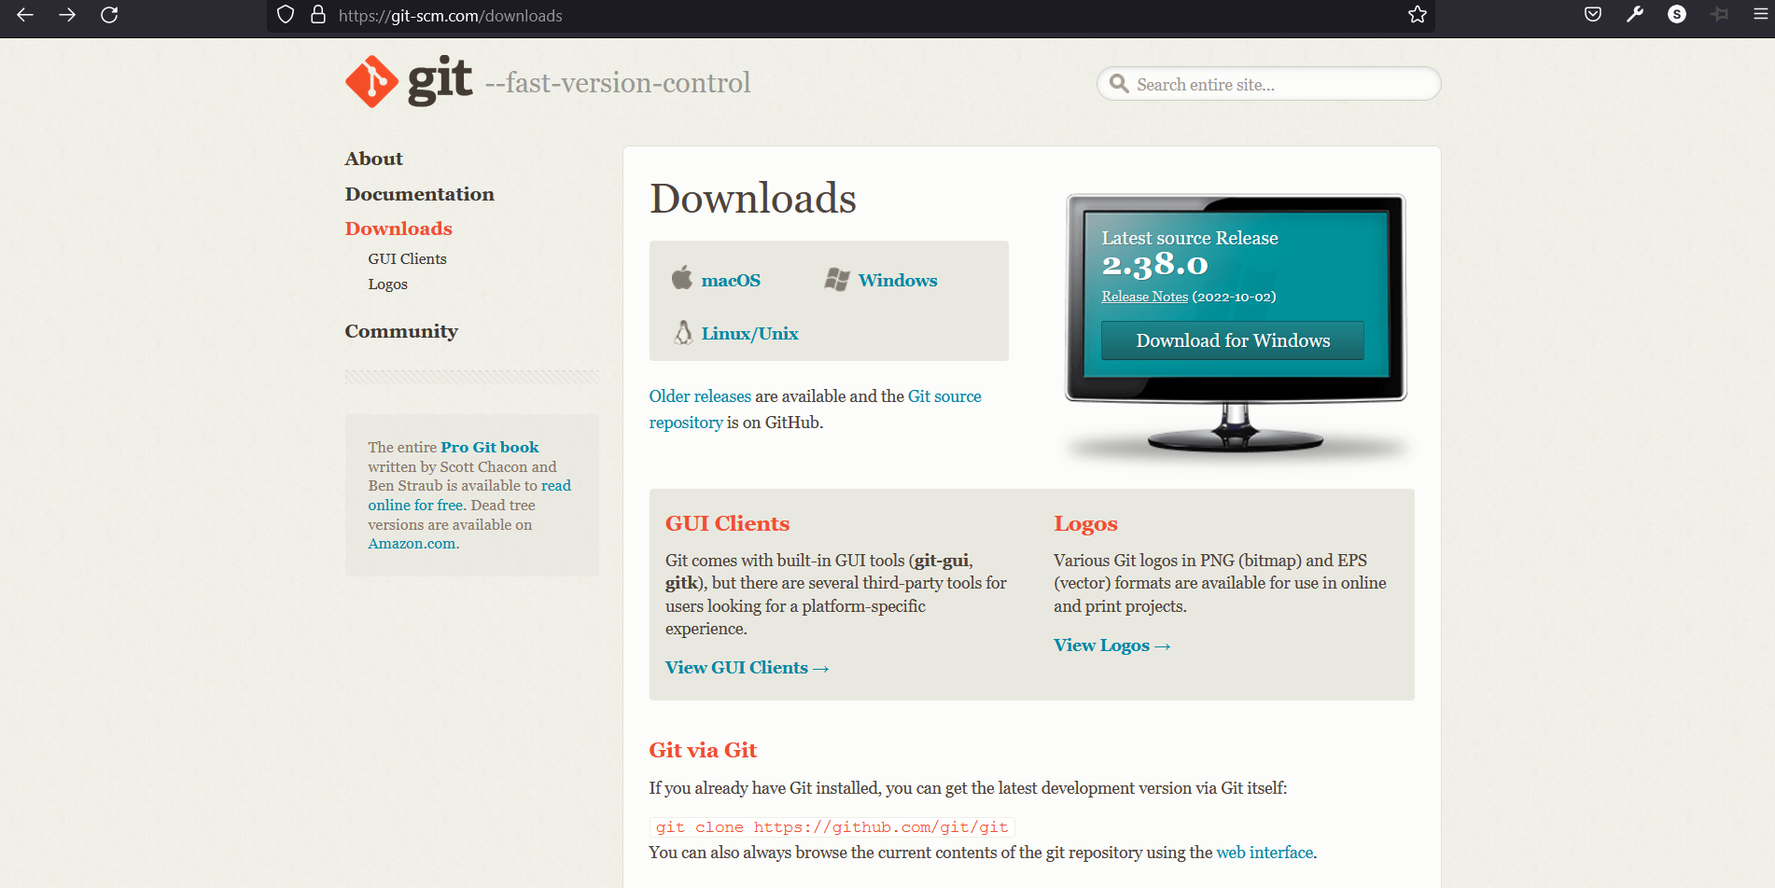
How do I get it?
https://git-scm.com/downloads

Slide 8

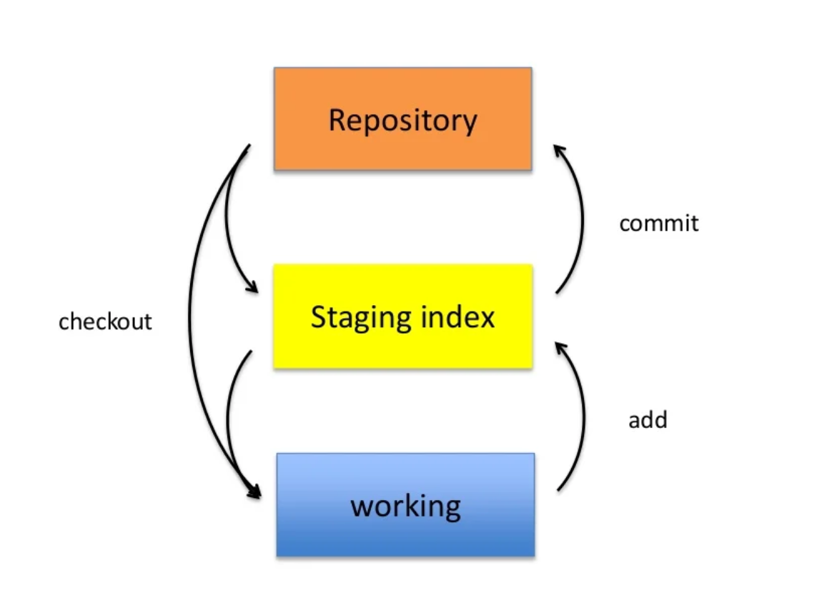
A simple git workflow
To initialize an existing directory as Git repository
git init
Three tree of Architecture of git
git config –global user.name “[username]”
git config –global user.email “[email]”

Slide 9
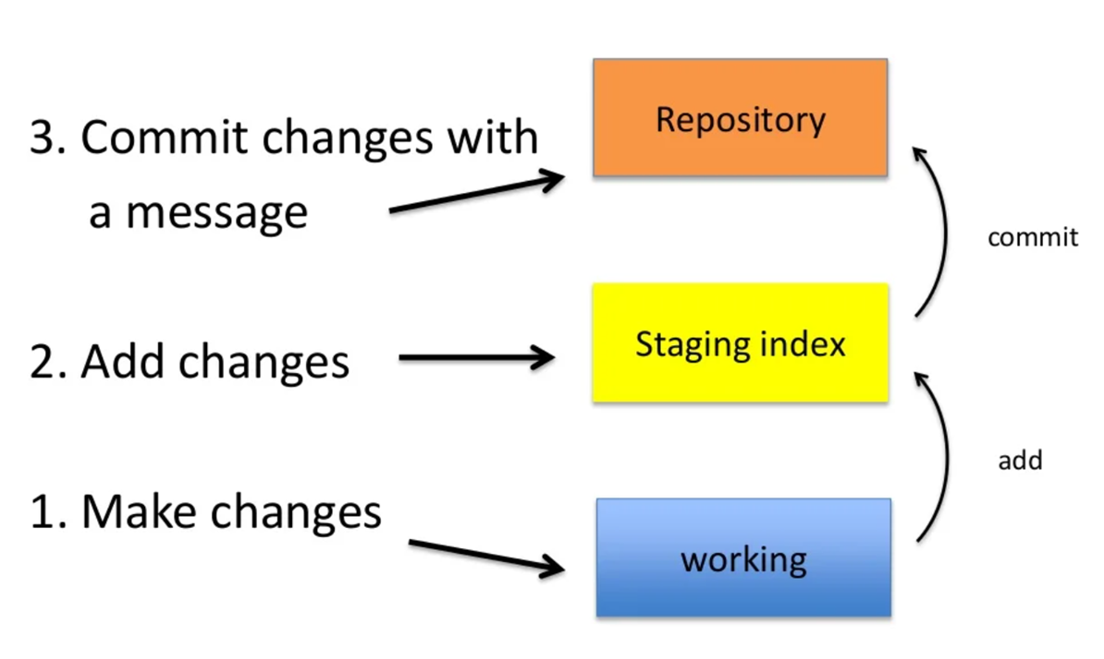
Staging
2. To add a file to staging Area
git add [file]
To add all the files
git add .

Slide 10
Committing
2. To commit your staged content
git commit –m "[present tense descriptive message]"

Slide 11
Introduction to GitHub

Slide 12
GitHub
A platform to host git code repositories
GitHub allows the user to store the repository on remote
To collaborate on projects
Most Popular git host

Slide 13
Remote
To connect the local repo to remote
git remote add origin [url]
To clone the remote repository
git clone [url]
To Transmit local branch commits to the remote branch
git push origin [branch]
To Transmit local branch commits to the remote branch
git clone [url]

Slide 14
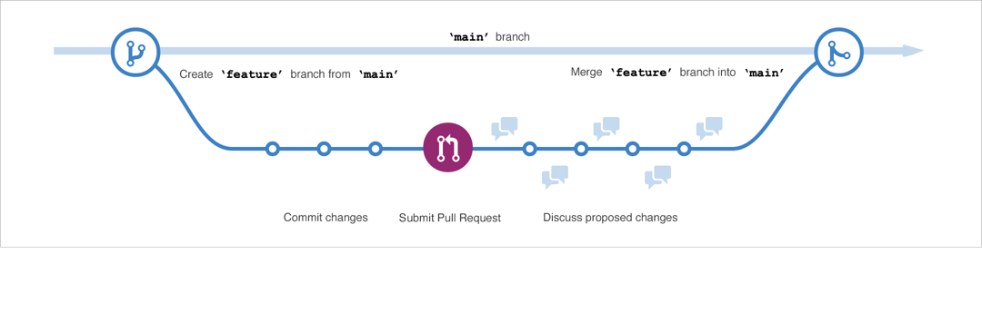
Branching
• Allows one to try new ideas
• If an idea doesn’t work, throw away the branch. If it does work, merge ideas into master branch
To create new branch
git branch [name]
To create new branch
git checkout [branch name]

Slide 15
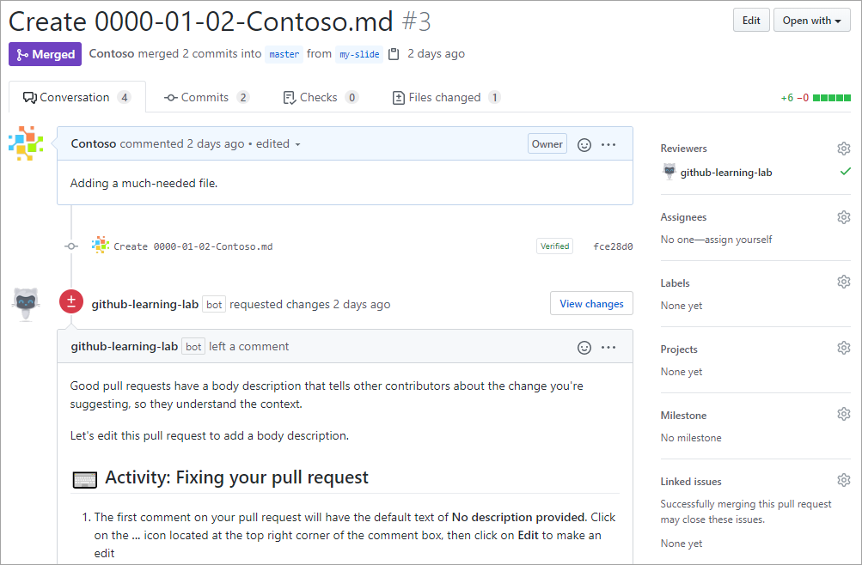
Pull Requests
A pull request is the mechanism used to signal that the commits from one branch are ready to be merged into another branch.
Notes:
A pull request is the mechanism used to signal that the commits from one branch are ready to be merged into another branch. The developer submitting the pull request will often request one or more reviewers to verify the code and approve the merge. These reviewers have the opportunity to comment on changes, add their own, or use the pull request itself for further discussion. Once the changes have been approved (if approval is required), the pull request's source branch (the compare branch) may be merged in to the base branch.
To learn more about GitHub pull requests, see About pull requests.

Slide 16
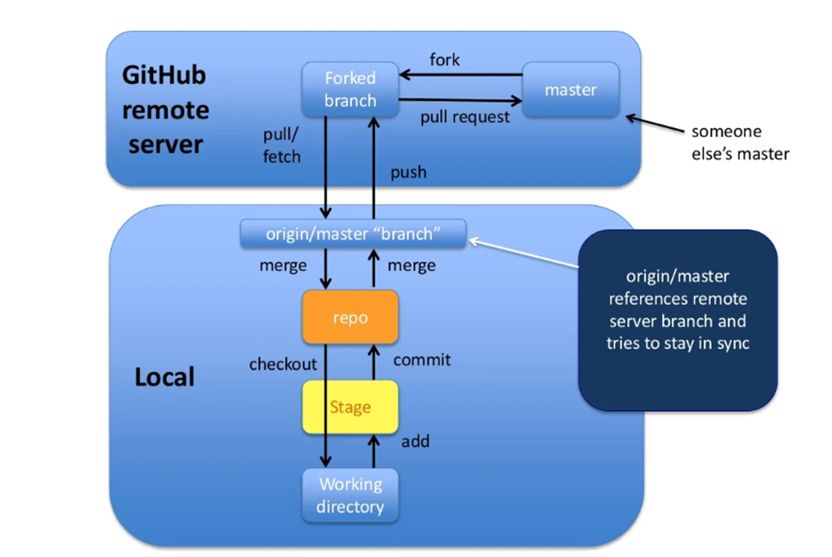
Forking and Pull Request

Slide 17
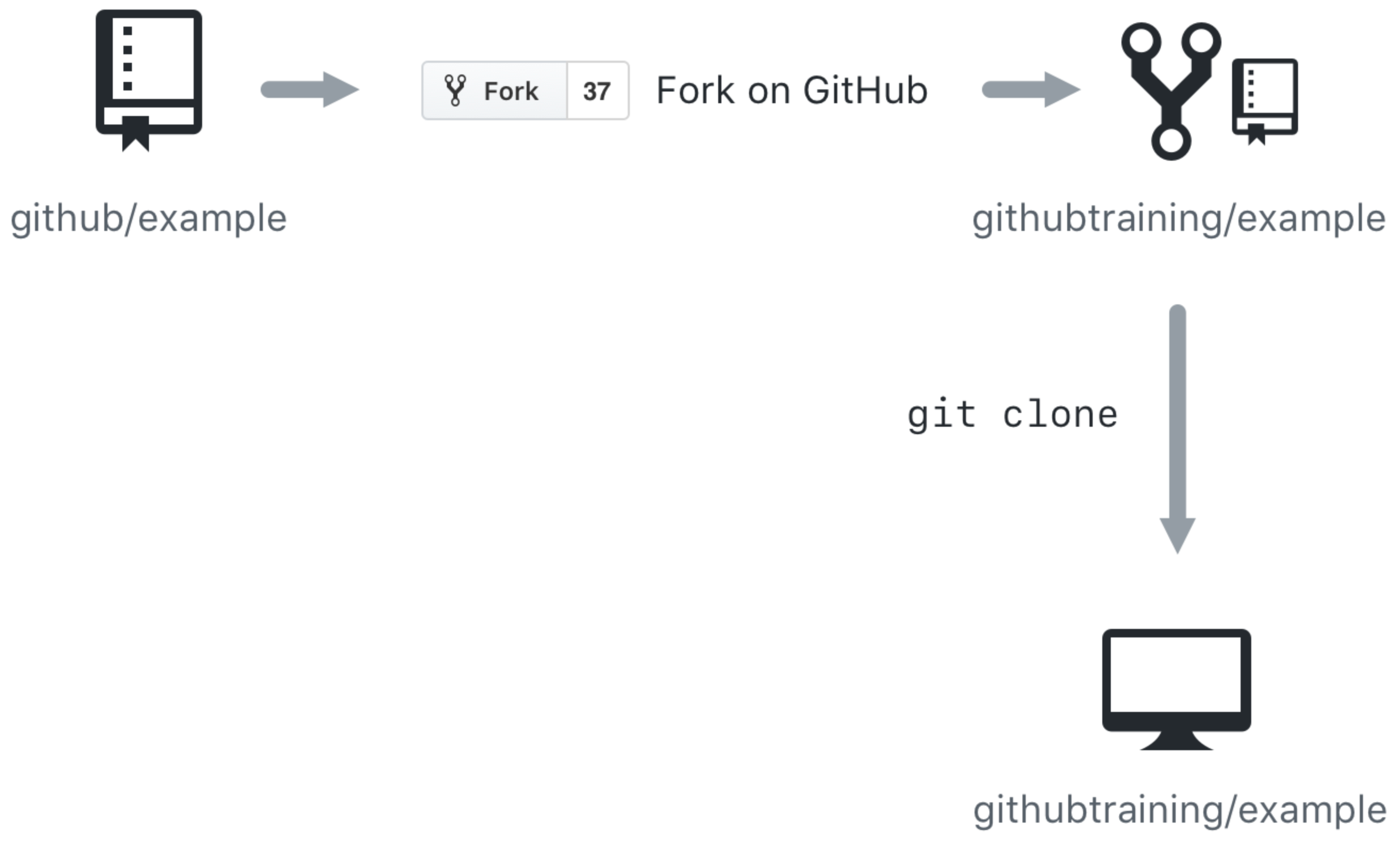
Cloning and forking
GitHub provides multiple ways to copy a repository so that you can work on it.
Cloning a Repository - Cloning a repository will make a copy of the repository and its history on your local machine. If you have write access to the repository you can push changes from your local machine to the remote repository (called the origin) as they're completed. To clone a repository you can use the git clone [url] command or the GitHub CLI's gh repo clone [url] command.
Forking a Repository - Forking a repository makes a copy of the repository in your GitHub account. The parent repository is referred to as the upstream while your forked copy is referred to as the origin. Once you've forked a repository into your GitHub account you can clone it to your local machine. Forking allows you to freely make changes to a project without affecting the original upstream repository. To contribute changes back to the upstream repository you create a pull request from your forked repository. You can also run git commands to ensure that your local copy stays synced with the upstream repository.
Notes:
GitHub provides multiple ways to copy a repository so that you can work on it.
Cloning a Repository - Cloning a repository will make a copy of the repository and its history on your local machine. If you have write access to the repository you can push changes from your local machine to the remote repository (called the origin) as they're completed. To clone a repository you can use the git clone [url] command or the GitHub CLI's gh repo clone [url] command.
Forking a Repository - Forking a repository makes a copy of the repository in your GitHub account. The parent repository is referred to as the upstream while your forked copy is referred to as the origin. Once you've forked a repository into your GitHub account you can clone it to your local machine. Forking allows you to freely make changes to a project without affecting the original upstream repository. To contribute changes back to the upstream repository you create a pull request from your forked repository. You can also run git commands to ensure that your local copy stays synced with the upstream repository.
When would you clone a repository versus fork a repository? If you're working with a repository and have write access you can clone it to your local machine. From there you can make modifications and push your changes directly to the origin repository.
If you need to work with a repository created by another owner such as github/example and don't have write access, you can fork the repository into your GitHub account, and then clone the fork to your local machine. To see this visually, let's assume that your GitHub account is called githubtraining for this example. Using the GitHub website you can fork githubtraining or any other examples into your account. From there you can clone the forked version of the repository to your local machine. These steps are shown in the following image.
Changes can be made to your local copy of githubtraining/example and then pushed back to your remote origin repository (githubtraining/example). The changes can then be submitted to the github/example upstream repository using a pull request as shown next.
To learn more, see Fork a repo.

Slide 18
GitHub for Automation.

Slide 19


Unboxing GitHub
In addition to providing a platform for collaborative software development, GitHub has a lot of other cool stuff to play around, GitHub Actions, Copilot and Codespaces are the hottest of them.
Other exclusive feature include github api, projects, releases, github large file system, marketplace etc.
Notes:
In addition to providing a platform for collaborative software development, GitHub also offers a workflow designed to optimize use of its various features. While this unit offers a cursory overview of important platform components, it's recommended that you first review Understanding the GitHub flow.

Slide 20
Some Prerequisites
Personal Access Tokens
An alternative to using passwords for authentication to GitHub when using the GitHub API or the command line.
Why better than password
Each token has a different set of access control.
Tokens can be set to expire.
More secure, can be reset whenever required.
Used to access GitHub via GitHub API and CLI.
Notes:
As you work with Git and GitHub, you may wonder about the difference between the two.
Git is a distributed version control system (DVCS) that allows multiple developers or other contributors to work on a project. It provides a way to work with one or more local branches and push them to a remote repository. Git is responsible for everything GitHub-related that happens locally on your computer. Key features provided by Git include:
Installed and used on your local machine
Handles version control
Supports branching
To learn more about Git, see Using common Git commands.
GitHub is a cloud platform that uses Git as its core technology. It simplifies the process of collaborating on projects and provides a website, command-line tools, and overall flow that allows developers and users to work together. GitHub acts as the "remote repository" mentioned previously in the Git section.
Key features provided by GitHub include:
Issues
Discussions
Pull requests
Notifications
Labels
Actions
Forks
Projects
To learn more about GitHub, see Getting started with GitHub.

Slide 21

Personal Access Tokens
Personal Access Tokens
An alternative to using passwords for authentication to GitHub when using the GitHub API or the command line.
Why better than password
Each token has a different set of access control.
Tokens can be set to expire.
More secure, can be reset whenever required.
Notes:
As you work with Git and GitHub, you may wonder about the difference between the two.
Git is a distributed version control system (DVCS) that allows multiple developers or other contributors to work on a project. It provides a way to work with one or more local branches and push them to a remote repository. Git is responsible for everything GitHub-related that happens locally on your computer. Key features provided by Git include:
Installed and used on your local machine
Handles version control
Supports branching
To learn more about Git, see Using common Git commands.
GitHub is a cloud platform that uses Git as its core technology. It simplifies the process of collaborating on projects and provides a website, command-line tools, and overall flow that allows developers and users to work together. GitHub acts as the "remote repository" mentioned previously in the Git section.
Key features provided by GitHub include:
Issues
Discussions
Pull requests
Notifications
Labels
Actions
Forks
Projects
To learn more about GitHub, see Getting started with GitHub.

Slide 22
GitHub API
GitHub APIs are provided for you to interact with GitHub. They allow you to create and manage repositories, branches, issues, pull requests, and many more.
Use this to get some public details of your profile:
curl https://api.github.com/users/devkapilbansal
Notes:
As you work with Git and GitHub, you may wonder about the difference between the two.
Git is a distributed version control system (DVCS) that allows multiple developers or other contributors to work on a project. It provides a way to work with one or more local branches and push them to a remote repository. Git is responsible for everything GitHub-related that happens locally on your computer. Key features provided by Git include:
Installed and used on your local machine
Handles version control
Supports branching
To learn more about Git, see Using common Git commands.
GitHub is a cloud platform that uses Git as its core technology. It simplifies the process of collaborating on projects and provides a website, command-line tools, and overall flow that allows developers and users to work together. GitHub acts as the "remote repository" mentioned previously in the Git section.
Key features provided by GitHub include:
Issues
Discussions
Pull requests
Notifications
Labels
Actions
Forks
Projects
To learn more about GitHub, see Getting started with GitHub.

Slide 23
GitHub Secrets
Secrets are encrypted environment variables that you create in an organization, repository, or repository environment.
Just like system variables, these secrets are visible globally on your GitHub machines (runners or codespaces).
Secrets can be maintained separately for GitHub Actions or codespaces.
You can use these secrets within your GitHub workflows.
Secrets are limited to the scope where they are defined. i.e., a repo, or an organization, or maybe specific repos of an organization.
Notes:
As you work with Git and GitHub, you may wonder about the difference between the two.
Git is a distributed version control system (DVCS) that allows multiple developers or other contributors to work on a project. It provides a way to work with one or more local branches and push them to a remote repository. Git is responsible for everything GitHub-related that happens locally on your computer. Key features provided by Git include:
Installed and used on your local machine
Handles version control
Supports branching
To learn more about Git, see Using common Git commands.
GitHub is a cloud platform that uses Git as its core technology. It simplifies the process of collaborating on projects and provides a website, command-line tools, and overall flow that allows developers and users to work together. GitHub acts as the "remote repository" mentioned previously in the Git section.
Key features provided by GitHub include:
Issues
Discussions
Pull requests
Notifications
Labels
Actions
Forks
Projects
To learn more about GitHub, see Getting started with GitHub.

Slide 24
What is DevOps Automation.

Slide 25
What is DevOps Automation ?
DevOps Automation is simply programming workflows for doing tiring and repetitive work. It can be as simple as writing a bash script to automate tasks like deployments.
Some DevOps automation tools include:
GitHub Actions: Create CI/CD pipelines.
Docker: Automate Containers
Maven: Build Tool for Java
Circle CI, Travis CI and many more…
Notes:
As you work with Git and GitHub, you may wonder about the difference between the two.
Git is a distributed version control system (DVCS) that allows multiple developers or other contributors to work on a project. It provides a way to work with one or more local branches and push them to a remote repository. Git is responsible for everything GitHub-related that happens locally on your computer. Key features provided by Git include:
Installed and used on your local machine
Handles version control
Supports branching
To learn more about Git, see Using common Git commands.
GitHub is a cloud platform that uses Git as its core technology. It simplifies the process of collaborating on projects and provides a website, command-line tools, and overall flow that allows developers and users to work together. GitHub acts as the "remote repository" mentioned previously in the Git section.
Key features provided by GitHub include:
Issues
Discussions
Pull requests
Notifications
Labels
Actions
Forks
Projects
To learn more about GitHub, see Getting started with GitHub.

Slide 26
Why do you need DevOps ?
Automation cuts down all your repetitive efforts and speeds up your project development cycle.
You no longer need to perform same task again and again like
Running tests every time you are ready to push.
Build all your code to test if it’s ready for production.
Deploying every time you roll out a new update.
Checking dependencies if anything depreciates.
And a whole bunch of tasks…
Notes:
As you work with Git and GitHub, you may wonder about the difference between the two.
Git is a distributed version control system (DVCS) that allows multiple developers or other contributors to work on a project. It provides a way to work with one or more local branches and push them to a remote repository. Git is responsible for everything GitHub-related that happens locally on your computer. Key features provided by Git include:
Installed and used on your local machine
Handles version control
Supports branching
To learn more about Git, see Using common Git commands.
GitHub is a cloud platform that uses Git as its core technology. It simplifies the process of collaborating on projects and provides a website, command-line tools, and overall flow that allows developers and users to work together. GitHub acts as the "remote repository" mentioned previously in the Git section.
Key features provided by GitHub include:
Issues
Discussions
Pull requests
Notifications
Labels
Actions
Forks
Projects
To learn more about GitHub, see Getting started with GitHub.

Slide 27
What is CI/CD?
Continuous integration and continuous deployment/delivery together form very important aspect of DevOps.
Large projects are easy to go out of hand with large codebase and many contributors, so you need someone to continuously monitor and handle integration of new code.
Either you may have a team to handle that, or make an automation pipeline which can test, monitor and deploy your code throughout the lifecycle of apps.
Notes:
As you work with Git and GitHub, you may wonder about the difference between the two.
Git is a distributed version control system (DVCS) that allows multiple developers or other contributors to work on a project. It provides a way to work with one or more local branches and push them to a remote repository. Git is responsible for everything GitHub-related that happens locally on your computer. Key features provided by Git include:
Installed and used on your local machine
Handles version control
Supports branching
To learn more about Git, see Using common Git commands.
GitHub is a cloud platform that uses Git as its core technology. It simplifies the process of collaborating on projects and provides a website, command-line tools, and overall flow that allows developers and users to work together. GitHub acts as the "remote repository" mentioned previously in the Git section.
Key features provided by GitHub include:
Issues
Discussions
Pull requests
Notifications
Labels
Actions
Forks
Projects
To learn more about GitHub, see Getting started with GitHub.

Slide 28
Continuous Integration
CI means a pipeline that manages new code changes to an app which it regularly builds, tests, and merged to a shared repository.
Continuous Integration may not be limited to this, and can be used to manage other stuff like monitoring dependencies, code linting, and even beautifying code.
Notes:
As you work with Git and GitHub, you may wonder about the difference between the two.
Git is a distributed version control system (DVCS) that allows multiple developers or other contributors to work on a project. It provides a way to work with one or more local branches and push them to a remote repository. Git is responsible for everything GitHub-related that happens locally on your computer. Key features provided by Git include:
Installed and used on your local machine
Handles version control
Supports branching
To learn more about Git, see Using common Git commands.
GitHub is a cloud platform that uses Git as its core technology. It simplifies the process of collaborating on projects and provides a website, command-line tools, and overall flow that allows developers and users to work together. GitHub acts as the "remote repository" mentioned previously in the Git section.
Key features provided by GitHub include:
Issues
Discussions
Pull requests
Notifications
Labels
Actions
Forks
Projects
To learn more about GitHub, see Getting started with GitHub.

Slide 29
Continuous Delivery/Deployment
Continuous delivery is the next extension of continuous integration. The delivery phase is responsible for packaging things together to be delivered to end-users.
This phase runs automated building tools to generate stuff ready for deployment. (The project should be ready for deployment, and CD assures that)
Continuous Deployment is also same as Delivery, but may be thought of as an extension which automates the process of launching build on production to end user.
Notes:
As you work with Git and GitHub, you may wonder about the difference between the two.
Git is a distributed version control system (DVCS) that allows multiple developers or other contributors to work on a project. It provides a way to work with one or more local branches and push them to a remote repository. Git is responsible for everything GitHub-related that happens locally on your computer. Key features provided by Git include:
Installed and used on your local machine
Handles version control
Supports branching
To learn more about Git, see Using common Git commands.
GitHub is a cloud platform that uses Git as its core technology. It simplifies the process of collaborating on projects and provides a website, command-line tools, and overall flow that allows developers and users to work together. GitHub acts as the "remote repository" mentioned previously in the Git section.
Key features provided by GitHub include:
Issues
Discussions
Pull requests
Notifications
Labels
Actions
Forks
Projects
To learn more about GitHub, see Getting started with GitHub.

Slide 30
GitHub Actions

Slide 31
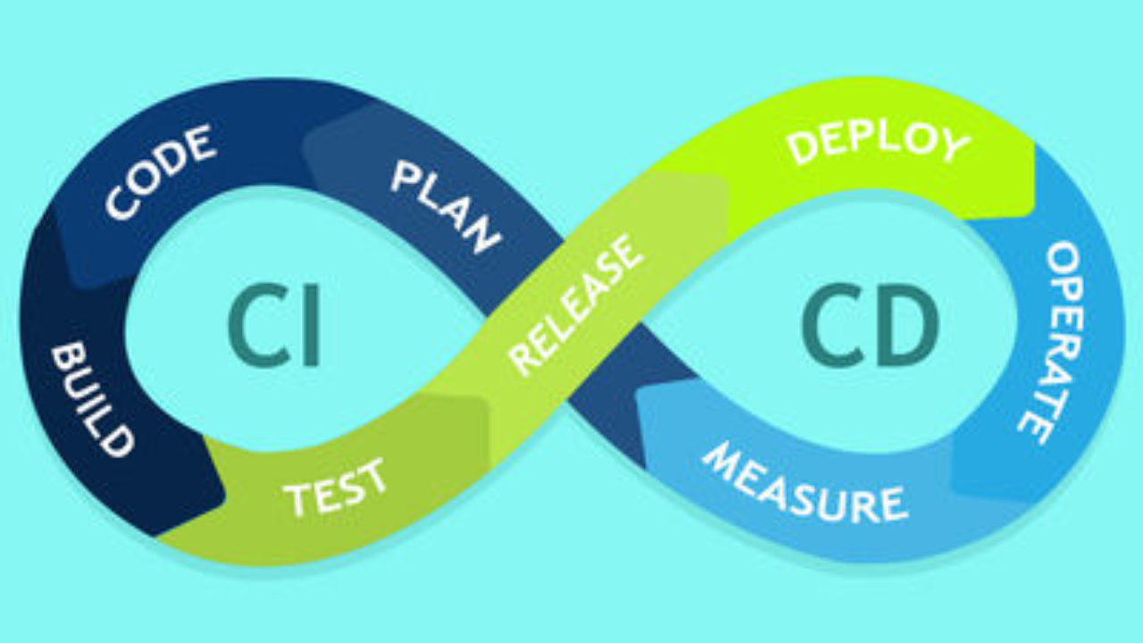
GitHub Actions
GitHub Actions is a continuous integration and continuous delivery (CI/CD) platform that allows you to automate your build, test, and deployment pipeline.
Notes:
As you work with Git and GitHub, you may wonder about the difference between the two.
Git is a distributed version control system (DVCS) that allows multiple developers or other contributors to work on a project. It provides a way to work with one or more local branches and push them to a remote repository. Git is responsible for everything GitHub-related that happens locally on your computer. Key features provided by Git include:
Installed and used on your local machine
Handles version control
Supports branching
To learn more about Git, see Using common Git commands.
GitHub is a cloud platform that uses Git as its core technology. It simplifies the process of collaborating on projects and provides a website, command-line tools, and overall flow that allows developers and users to work together. GitHub acts as the "remote repository" mentioned previously in the Git section.
Key features provided by GitHub include:
Issues
Discussions
Pull requests
Notifications
Labels
Actions
Forks
Projects
To learn more about GitHub, see Getting started with GitHub.

Slide 32
GitHub Actions
You can create workflows that build and test every pull request to your repository, or deploy merged pull requests to production, whatever you want.
GitHub Actions runs on event-based workflow, and provides Linux, windows and macOS instances for you to run a test on environment of your choice.
Notes:
As you work with Git and GitHub, you may wonder about the difference between the two.
Git is a distributed version control system (DVCS) that allows multiple developers or other contributors to work on a project. It provides a way to work with one or more local branches and push them to a remote repository. Git is responsible for everything GitHub-related that happens locally on your computer. Key features provided by Git include:
Installed and used on your local machine
Handles version control
Supports branching
To learn more about Git, see Using common Git commands.
GitHub is a cloud platform that uses Git as its core technology. It simplifies the process of collaborating on projects and provides a website, command-line tools, and overall flow that allows developers and users to work together. GitHub acts as the "remote repository" mentioned previously in the Git section.
Key features provided by GitHub include:
Issues
Discussions
Pull requests
Notifications
Labels
Actions
Forks
Projects
To learn more about GitHub, see Getting started with GitHub.

Slide 33
Components, building a Workflow

Slide 34
Workflow
A workflow is simply an automated process, that runs when triggered by a certain action. It is programmed by you to do a series of specific tasks.
The workflows in GitHub needs to be configured as a YAML file, which is nothing more than a set of instructions for GitHub to do.
An example of workflow could be to test and deploy your application every time a pull request is merged into deployment branch.
Workflow is made collectively by jobs, events, actions and are executed by runners.
Notes:
As you work with Git and GitHub, you may wonder about the difference between the two.
Git is a distributed version control system (DVCS) that allows multiple developers or other contributors to work on a project. It provides a way to work with one or more local branches and push them to a remote repository. Git is responsible for everything GitHub-related that happens locally on your computer. Key features provided by Git include:
Installed and used on your local machine
Handles version control
Supports branching
To learn more about Git, see Using common Git commands.
GitHub is a cloud platform that uses Git as its core technology. It simplifies the process of collaborating on projects and provides a website, command-line tools, and overall flow that allows developers and users to work together. GitHub acts as the "remote repository" mentioned previously in the Git section.
Key features provided by GitHub include:
Issues
Discussions
Pull requests
Notifications
Labels
Actions
Forks
Projects
To learn more about GitHub, see Getting started with GitHub.

Slide 35
Events
An event is a specific activity or action in a repository that triggers a workflow to execute. It may be a commit, a pull request, creating an issue, or just accepting invite to a repository.
For example, the event can originate from GitHub when someone creates a pull request, opens an issue, or pushes a commit to a repository.
You can also trigger a workflow run on a schedule, by posting to a REST API, or manually.
Notes:
As you work with Git and GitHub, you may wonder about the difference between the two.
Git is a distributed version control system (DVCS) that allows multiple developers or other contributors to work on a project. It provides a way to work with one or more local branches and push them to a remote repository. Git is responsible for everything GitHub-related that happens locally on your computer. Key features provided by Git include:
Installed and used on your local machine
Handles version control
Supports branching
To learn more about Git, see Using common Git commands.
GitHub is a cloud platform that uses Git as its core technology. It simplifies the process of collaborating on projects and provides a website, command-line tools, and overall flow that allows developers and users to work together. GitHub acts as the "remote repository" mentioned previously in the Git section.
Key features provided by GitHub include:
Issues
Discussions
Pull requests
Notifications
Labels
Actions
Forks
Projects
To learn more about GitHub, see Getting started with GitHub.

Slide 36
Jobs
A job is a set of steps in a workflow that executes on the same runner.
These are elementary tasks that is done step by step sequentially, and each step may depend on previous steps.
For e.g., one step may build you app, while next one will test it as they are in same job and run on same machine.
Jobs may run a bash script, or actions.
All jobs run on different machines independently, but you can define dependencies between jobs.
Notes:
As you work with Git and GitHub, you may wonder about the difference between the two.
Git is a distributed version control system (DVCS) that allows multiple developers or other contributors to work on a project. It provides a way to work with one or more local branches and push them to a remote repository. Git is responsible for everything GitHub-related that happens locally on your computer. Key features provided by Git include:
Installed and used on your local machine
Handles version control
Supports branching
To learn more about Git, see Using common Git commands.
GitHub is a cloud platform that uses Git as its core technology. It simplifies the process of collaborating on projects and provides a website, command-line tools, and overall flow that allows developers and users to work together. GitHub acts as the "remote repository" mentioned previously in the Git section.
Key features provided by GitHub include:
Issues
Discussions
Pull requests
Notifications
Labels
Actions
Forks
Projects
To learn more about GitHub, see Getting started with GitHub.

Slide 37
Actions
An action is a custom application for the GitHub Actions platform that performs a complex but frequently repeated task. You may use actions to do some task in you workflow.
For e.g., An action can pull your git repository from GitHub, or set up the authentication to your cloud provider etc.
You can write your own actions, or you can find actions to use in your workflows in the GitHub Marketplace.
Notes:
As you work with Git and GitHub, you may wonder about the difference between the two.
Git is a distributed version control system (DVCS) that allows multiple developers or other contributors to work on a project. It provides a way to work with one or more local branches and push them to a remote repository. Git is responsible for everything GitHub-related that happens locally on your computer. Key features provided by Git include:
Installed and used on your local machine
Handles version control
Supports branching
To learn more about Git, see Using common Git commands.
GitHub is a cloud platform that uses Git as its core technology. It simplifies the process of collaborating on projects and provides a website, command-line tools, and overall flow that allows developers and users to work together. GitHub acts as the "remote repository" mentioned previously in the Git section.
Key features provided by GitHub include:
Issues
Discussions
Pull requests
Notifications
Labels
Actions
Forks
Projects
To learn more about GitHub, see Getting started with GitHub.

Slide 38
Runners
A runner is a server that runs your workflow when they are triggered by specified events.
Each runner runs a single job at a time on specified os.
GitHub provides Ubuntu, Windows and macOS runners and each time a runner is assigned fresh machine.
Notes:
As you work with Git and GitHub, you may wonder about the difference between the two.
Git is a distributed version control system (DVCS) that allows multiple developers or other contributors to work on a project. It provides a way to work with one or more local branches and push them to a remote repository. Git is responsible for everything GitHub-related that happens locally on your computer. Key features provided by Git include:
Installed and used on your local machine
Handles version control
Supports branching
To learn more about Git, see Using common Git commands.
GitHub is a cloud platform that uses Git as its core technology. It simplifies the process of collaborating on projects and provides a website, command-line tools, and overall flow that allows developers and users to work together. GitHub acts as the "remote repository" mentioned previously in the Git section.
Key features provided by GitHub include:
Issues
Discussions
Pull requests
Notifications
Labels
Actions
Forks
Projects
To learn more about GitHub, see Getting started with GitHub.

