Slide 1
Microsoft Zero Trust Workshop

Slide 2
Why Zero Trust?

Slide 3

Democratizing intelligence​
Human ambition
Copilot
Agent ecosystem
+
+
Notes:
AI is defining our work relation
AI is moving fast — faster than anything we’ve seen. Every industry is feeling the shift, and it’s opening new possibilities overnight.
This moment is giving rise to what we call the frontier firm: where human ambition and intelligent agents come together to help people do things they simply couldn’t do before.
And that’s the real opportunity — using AI not just to work faster, but to unlock new potential.
Every customer we talk to is on that path, and we’re excited to help you get there, responsibly and securely.

Slide 4
Frontier transformation
82%
1.3B
of leaders expect to use agents in the next 12-18 months to meet demand for workforce capacity*
projected agents that businesses will have by 2028**
*Source: Microsoft Work Trend Index Survey 2025*
**Source: IDC Info Snapshot, Sponsored by Microsoft, 1.3 Billion AI Agents by 2028, Doc. #US53361825, May 2025
Notes:
Show the industry use of agents –
Establishes how influential AI/Agent are becoming standard in business
More than 80% of leaders say they’re already using agents — or will within the next year. The next time we meet, you may have a whole agentic team working alongside you.
And this isn’t a minor shift. IDC projects 1.3 billion agents by 2028 — roughly the population of India.
For every human, there will be multiple agents.
That scale changes everything: how we work, how we secure, and how we build for the future.

Slide 5
AI introduces new security challenges
Agent sprawl
& resource access
Data leaks & oversharing
New AI threats & vulnerabilities
Regulatory
compliance
  82%
80%
88%
55%
of leaders expect to use agents in the next 12–18 months to meet demand for workforce capacity³
of leaders cited
leakage of sensitive
data as their main concern¹
of organizations are
concerned about indirect
prompt injection attacks²
of leaders lack understanding
of how​ AI is and will be
regulated and are seeking guidance¹
First Annual Generative AI study: Business Rewards vs. Security Risks, , Q3 2023, ISMG, N=400
How to Secure Custom-Built AI Agents, Gartner, 17 March 2025, Dionisio Zumerle, Jeremy D’Hoinne
Microsoft Work Trend Index Survey 2025
Notes:
Slide purpose: Show the industry use of agents –
Establishes how influential AI/Agent are becoming standard in business
The rise of the Frontier Firm is unlocking incredible potential — but it’s being driven by a profound technology transformation led by AI and now intelligent agents.
And that transformation is reshaping the security landscape in ways we’ve never seen before.
AI isn’t just helping defenders move faster — it’s helping attackers do the same. Our latest Digital Defense Report shows AI‑automated phishing is now 4.5× more effective, and 80% of leaders say their top concern with generative AI is sensitive data leakage.
At the same time, most security environments are already strained under extreme complexity. Many organizations are running 40, 60, even 80 security tools — disconnected systems that create blind spots and slow response. IDC found more than a quarter of companies use 41–60 tools, and about one in five use 61–80.

Slide 6
AI creates new attack surfaces
Agents
New AI
attack surfaces
AI data and orchestration
Generative AI prompts and responses
Web data and
source context
AI
models
Plug-ins
and functions
Application
Cloud
Network
Traditional
threat vectors
Identity
Data
Endpoints
Notes:
Defining specific complex challenges and new attack surfaces
In addition to the unprecedented challenges organizations are already facing across identity, cloud, endpoints, and data, AI adds entirely new pressure onto the existing threat landscape.
Defenders aren’t starting from zero — they’re already operating in a complex, high‑risk environment. AI accelerates that reality by increasing scale, speed, and automation for both legitimate users and attackers.
But AI doesn’t just intensify traditional threats
— it introduces new ones.
We now have to secure things that simply didn’t exist before: prompts and responses that can be manipulated, data pipelines that fuel models and agents, plugins and integrations that expand attack paths, and autonomous agents that can take action at machine speed. Each of these becomes a new surface attackers can probe, exploit, or poison.
That’s why this moment is different.
The security approaches that worked before aren’t enough on their own in an AI‑ and agent‑driven world.

Slide 7
Microsoft’s approach to Zero Trust
Notes:
Introduction to ZT – 4 core principles
Enable the business to adopt AI and innovation securely
Verify explicitly every request
Apply least privilege everywhere
Assume breach and design for resilience
The challenges of our AI‑ and agent‑driven world necessitate security across your entire digital estate.
Microsoft adopted a Zero Trust organizational strategy to reduce vulnerabilities through authorized, encrypted policies.
(need to tell the audience the purpose of the deck here – we describe ZT – then present steps so they can achieve)

Slide 8


Securing our customers with a Zero Trust approach
Business enablement
Assume
breach
Verify
explicitly
Least-privilege access
Notes:
Let’s walk through the Zero Trust core principles.
1. Business Enablement (new)
AI introduces transformative opportunities – and new risks.
Protecting the business requires a holistic approach that balances security, governance, and innovation.
Zero Trust enables organizations to adopt AI, cloud, and modern work safely and at speed, reducing friction while strengthening protection across the digital estate.
2. Verify explicitly
No user, device, workload, or AI agent is inherently trusted.
Every access request is explicitly authenticated and authorized using all available signals
Identity, device health, data sensitivity, location, and behavior
regardless of where the request originates or what resource it accesses.
Zero Trust teaches us to “never trust, always verify”
3. Least-privilege access
Access is continuously minimized and risk‑adaptive.
Permissions are reduced by default and granted only when needed.
Elevated access requires approval and is time‑bound (just‑in‑time, just‑enough).
Data is classified, labeled, and encrypted.
Networks and workloads are segmented to limit blast radius.
This ensures users, applications, and AI systems can access only what is required for the intended task – and nothing more
4. Assume breach
Breaches are inevitable—resilience is essential.
Infrastructure and AI components are continuously assessed for vulnerabilities.
Real‑time threat detection and response are used to prevent lateral movement.
Controls are designed to contain impact, accelerate recovery, and protect sensitive data—even after compromise.
By assuming breach, organizations shift from reactive defense to continuous containment and resilience.

Slide 9
Zero Trust for AI
Data
Email & documents
Structured data
Identities
Human
Posture and Governance
AI Resources
Agent
Agents
Workload
MCP servers
Access
Controls
Network
Controls
Applications
Endpoints
Cloud-based
Corporate
On-premises
Personal
Threat Protection
External
Infrastructure
Serverless
Containers
PaaS
IaaS

Slide 10
Building a
Zero Trust
Approach

Slide 11

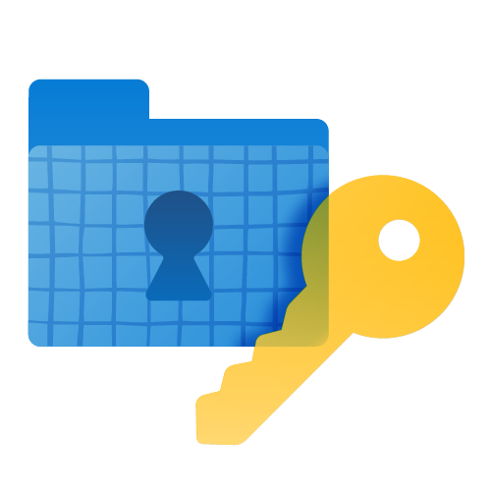
Secure and govern AI with Microsoft
Prepare your environment and implement Zero Trust strategy for secure AI adoption
Discover security, privacy, and safety risks with comprehensive visibility
Protect AI against emerging threats and safeguard sensitive data with end-to-end security
Govern AI usage and systems to comply with
code-of-conduct and regulatory policies
Notes:
First steps to a ZT approach
A comprehensive AI security and governance approach is organized across four operational stages to establish control, visibility, protection, and regulatory alignment.
Prepare - Establish a Zero Trust foundation across identity, access, and data. Define classification, lineage, and governance controls to ensure consistent handling of sensitive information and enforce least-privilege access.
Discover - Maintain visibility into AI usage, prompts, responses, and supporting data. Continuously assess security posture across AI applications, models, orchestration layers, and development pipelines to identify exposure and operational risk.
Protect - Apply data protection, endpoint control, and workload security to reduce misuse, data leakage, and adversarial threats. Implement safety controls to manage content risk and operational integrity.
Govern - Align AI operations with regulatory, legal, and internal policy requirements. Enable audit readiness, lifecycle management, eDiscovery, and communications governance to support accountability and defensibility.
Regulatory Alignment - Supports alignment with emerging frameworks including the EU AI Act, NIST AI Risk Management Framework, ISO 42001, ISO 23894, and internal codes of conduct.
This operating model supports alignment with emerging regulatory and standards frameworks, including the EU AI Act, NIST AI Risk Management Framework, ISO 42001, ISO 23894, and organizational code-of-conduct policies.

Slide 12
Introducing Zero Trust Assessment and Workshops

Slide 13
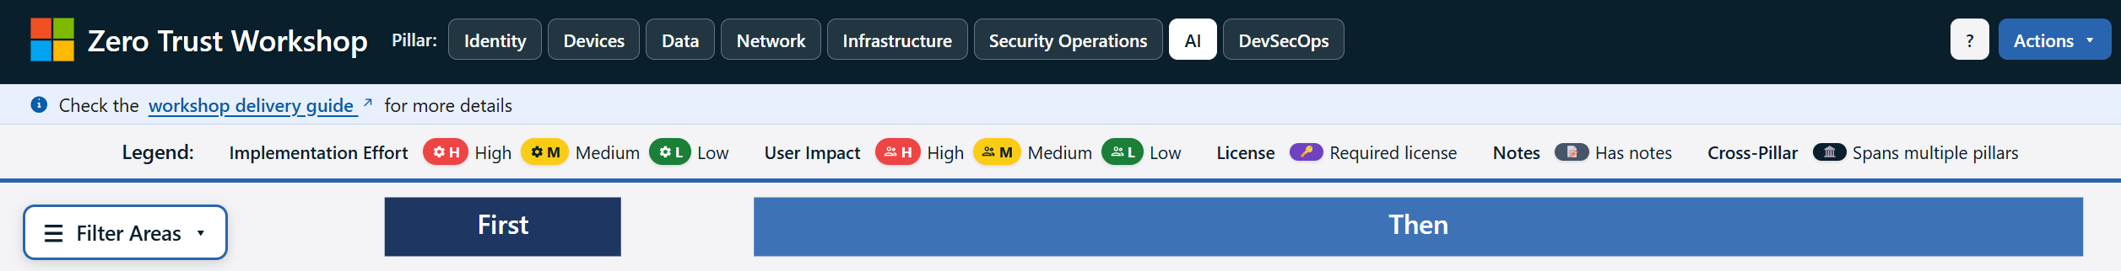
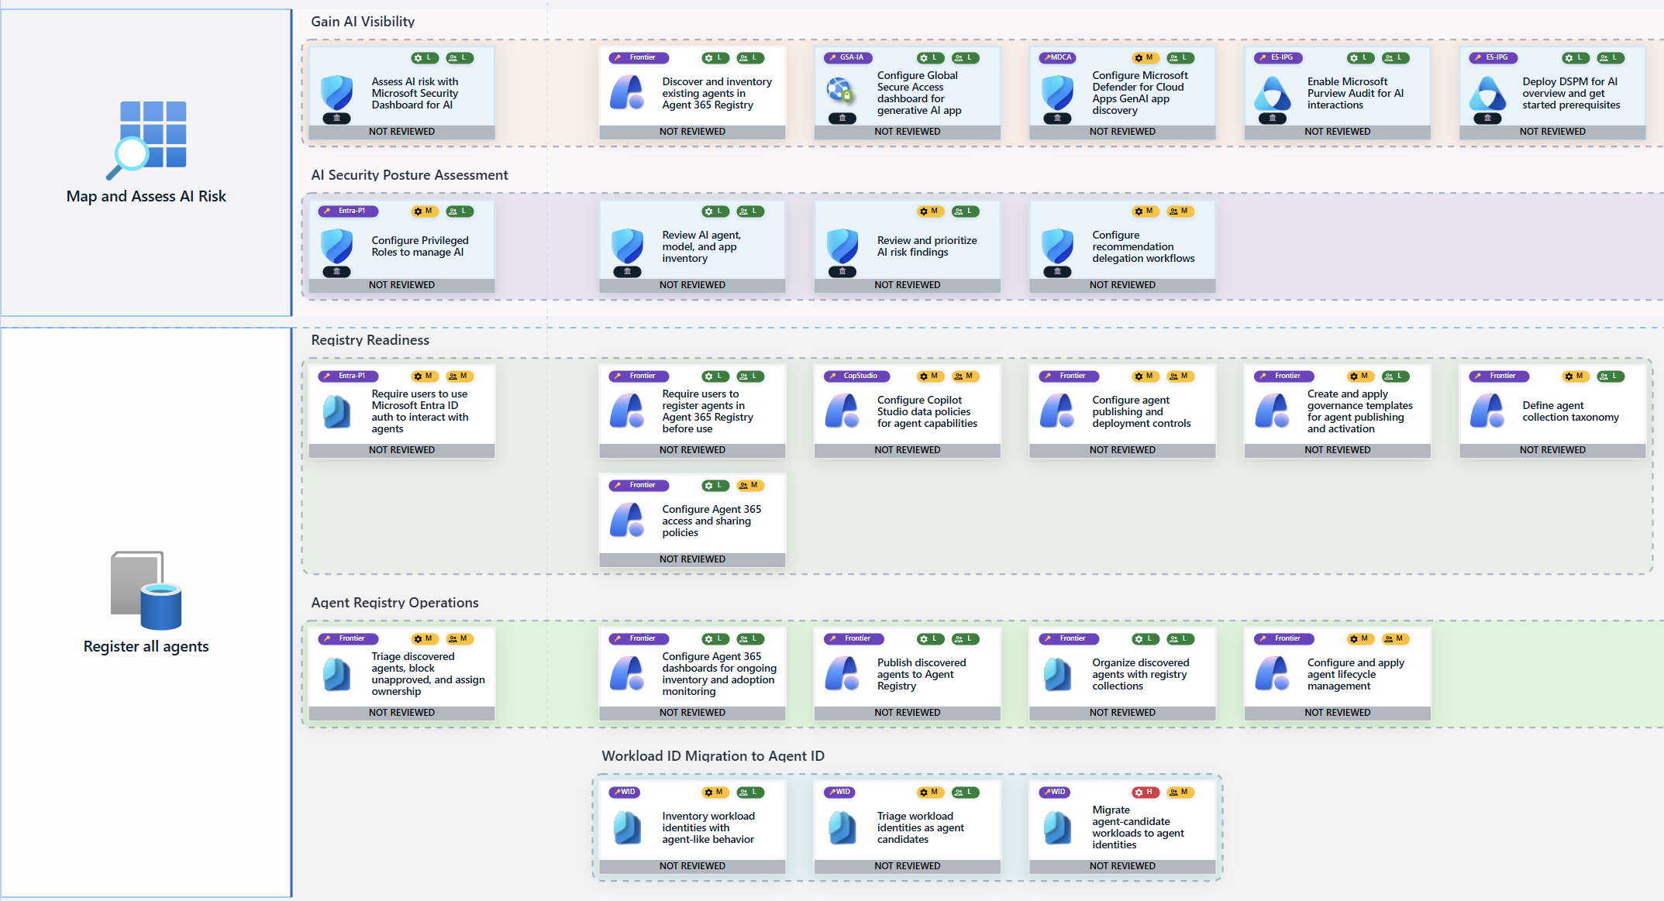
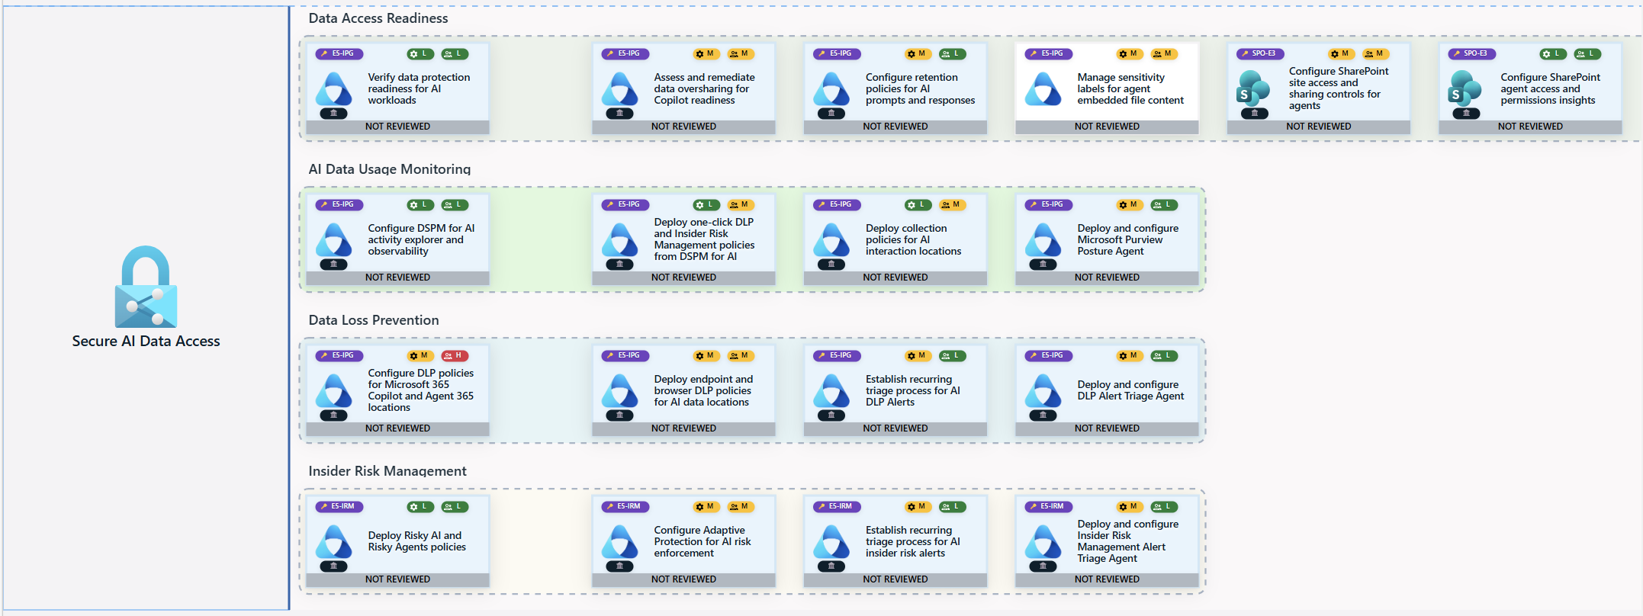
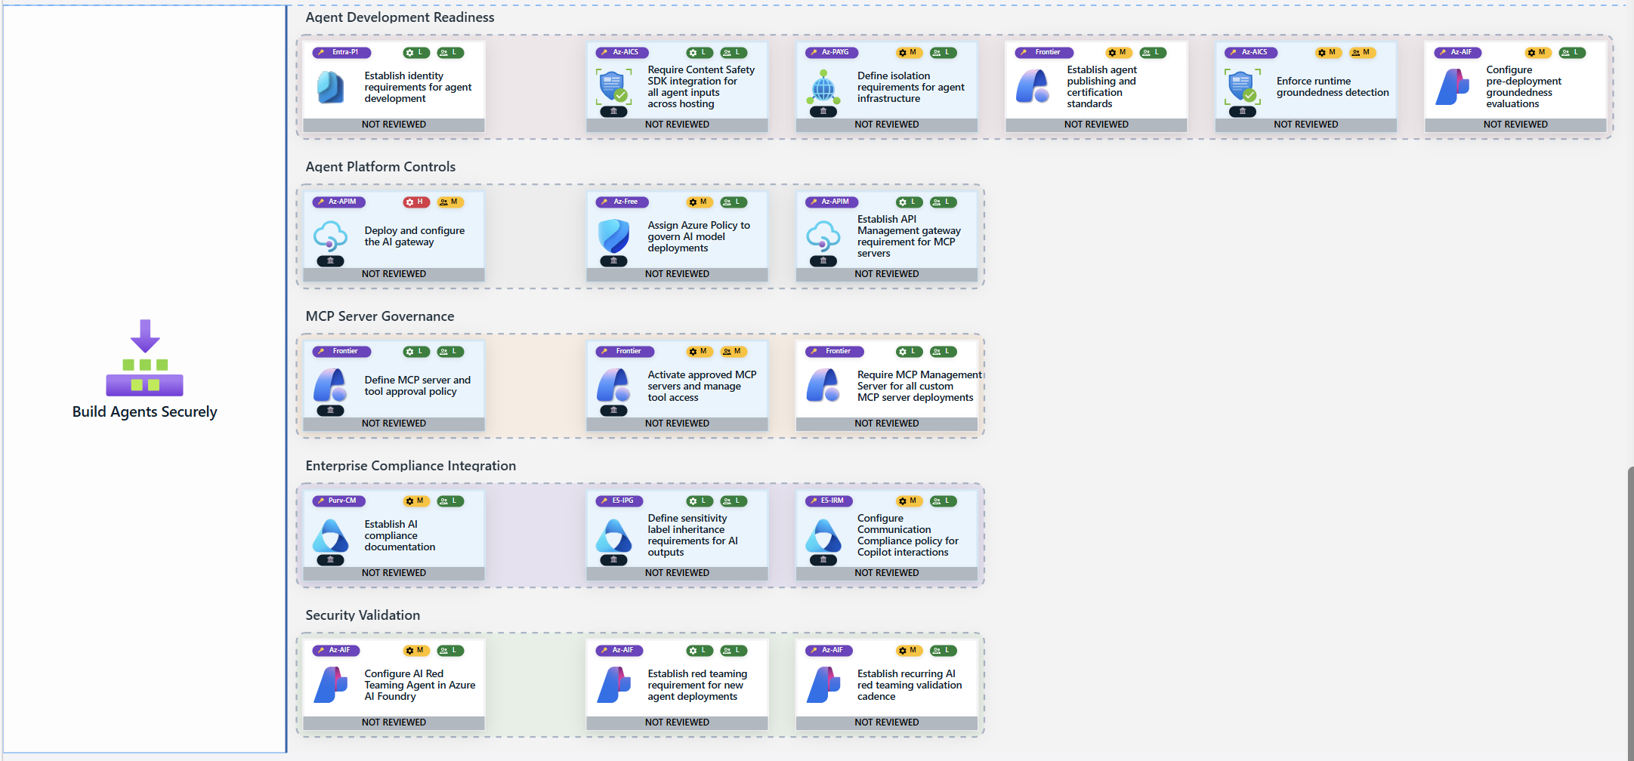
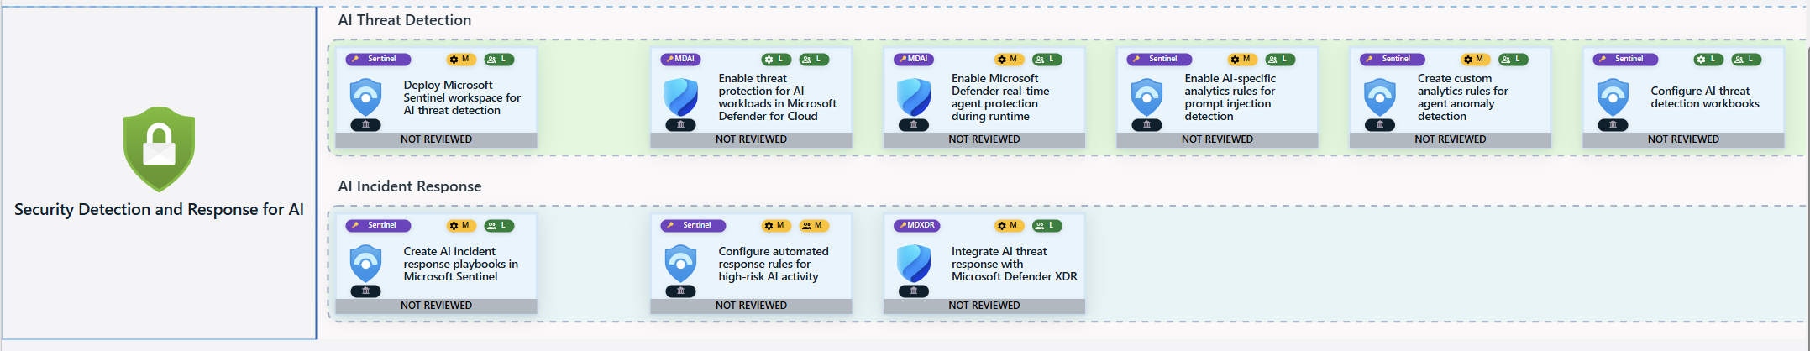
Microsoft Zero Trust
Deployment Workshop
A practical, step-by-step workshop that translates Zero Trust principles into real security capabilities and outcomes including AI security and governance.
Public web resource for all, developed by Microsoft Security: https://zerotrust.microsoft.com
Notes:
ANIMATION
As you discuss this slide, the image on the right side will scroll up to show the breadth of covering in the AI pillar.
Microsoft ZT Deployment Workshop
https://zerotrust.microsoft.com
This is a publicly available resource, developed to enable increased adoption and maturity of a Zero Trust approach. It provides a detailed, visual plan that helps customers implement the how of Zero Trust. Transition from the vision to the actual capabilities to achieve business outcomes.
Designed to be an easy to use tool that can be customized by partners and customers to reflect their individual journeys to modernizing security.
It includes the ability to keep updating each recommendation as progress continues beyond the initial workshop.

Slide 14
Zero Trust Workshop
Pillar Roadmap:
Identity
Devices
Data
Network
Infrastructure
Security Operations
AI
DevSecOps
Register
all Agents
Secure AI Auth & Access
Secure AI Network Access
Secure AI Data Access
Build Security Agents
Security Detection & Response for AI
SWIM LANES
CONTROL GROUPS
CONTROLS

Slide 15

Zero Trust Workshop in action
Identity
Devices
Data
Network
Infrastructure
Security Operations
AI
DevSecOps
4
5
3
3
7
6
7
6
41
Swin
lanes
19
26
6
15
23
21
20
15
145
Control groups
113
133
26
92
147
125
91
91
818
Controls
Create a detailed, customized zero trust roadmap that is relevant to your organization
Measure progress and impact of your ZT journey
Highlight cross-product integrations that are both valuable and may not always be considered by siloed teams
Utilize fully the Microsoft Security features/products you own
Improve your end-to-end security posture

Slide 16


Zero Trust Workshop Flow
  Step 1
  Step 2
  Step 3
  Step 4
  Planning
  Determine which pillars of the workshop your organization would like to have delivered and ensure all necessary teams are able to attend the workshop.
  ZT Assessment
  Run the ZT Assessment PowerShell script on your tenant to confirm a strong security baseline.
  ZT Workshop
  The Zero Trust Workshop is a collaborative effort between customers and Microsoft to develop a Zero Trust Strategy and Deployment Plan for the next 12–24 months.
  Implementation
  Generate insights and reports based on Workshop and Assessment findings to determine which items your organization needs to tackle first.

Slide 17
Microsoft Zero Trust
Assessment Tool
The Zero Trust Assessment transforms this process with automation to test for hundreds of security configuration items aligned with the Secure Future Initiative (SFI) and Zero Trust pillars, then guides you through remediation steps to help operationalize Zero Trust principles.

Slide 18
Step 1: Planning
Determine which pillars of the workshop you would like to have delivered. Organizations can have all pillars delivered or just a subset of them.
Identity | Devices | Data | Network | Infrastructure | Security Operations | AI | DevSecOps
5 hours | 3-6 hours | 4 hours | 4 hours | 4-6 hours | 3.5 hours | 6 hours | 6 hours
Please note that the times listed above are for the full pillar deliveries. If there are certain areas you want to focus on within specific pillars, you can work with your delivery resource to design a more focused workshop that suits your needs. More information can be found here: Delivery Guide

Slide 19
Step 2: Zero Trust Assessment
Run the ZT Assessment script and share the results with your delivery resource. Your delivery resource will be able to use these results to better tailor the Workshop to your organization’s needs. Instructions for how to run the Assessment can be found here: Assessment Guide
To allow your delivery resource ample time to prepare, please share your Assessment findings with your delivery resource 1-2 weeks prior to your Workshop delivery date.

Slide 20
Step 3: Zero Trust Workshop
To maximize workshop effectiveness, please note the recommended audiences for each of the pillars of the Workshop, which can be found here: Delivery Guide

Slide 21
Step 4: Implementation
After completing the Workshop and Assessment, you can generate a report that will provide you with a prioritized implementation roadmap. This roadmap will break down the items you should address immediately and the items that need to be addressed in the next 30/60/90+ days.

Slide 22

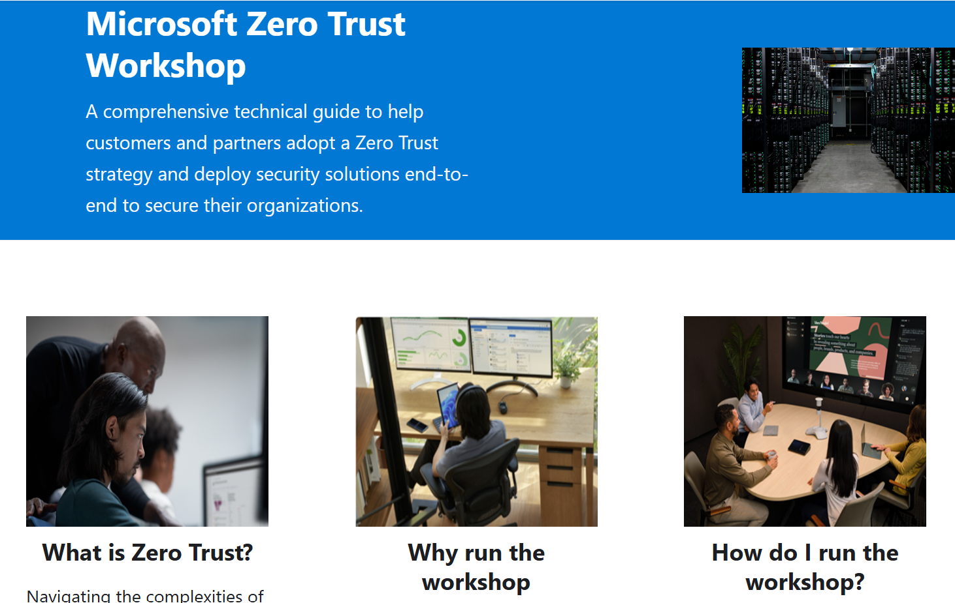
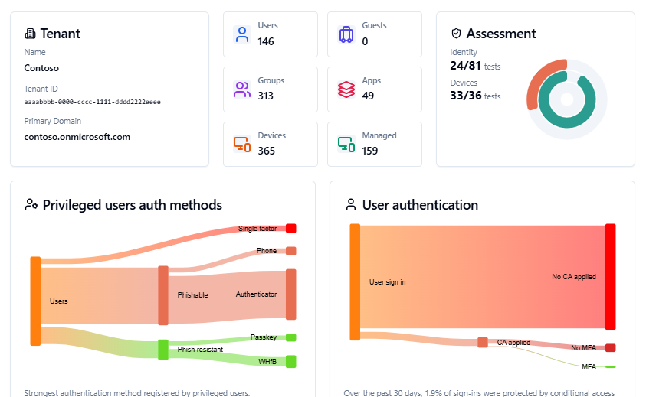
Watch the latest
Mechanics video
Zero Trust Workshop
Zero Trust Assessment
https://aka.ms/zerotrust/AIZTvideo
Zero Trust Security and Strategy
Run your own workshop: https://aka.ms/ZTWorkshop
Schedule a delivery (CAT PM): https://aka.ms/ZTworkshop/request
See a demo https://aka.ms/zerotrust/demo
Learn more and run your own: https://aka.ms/zerotrust/assessment

Slide 23

Get started with a Zero Trust workshop
Visit https://aka.ms/ZTWorkshop
for comprehensive resources to help you on your Zero Trust journey.
Access Comprehensive Guides: Get step-by-step instructions to implement Zero Trust in your organization.
Utilize Expert Resources: Leverage our curated materials, including videos, articles, and tutorials.
Enhance Your Security Posture: Learn how to apply Zero Trust principles to reduce risk and improve compliance.

Slide 24
Appendix

Slide 25
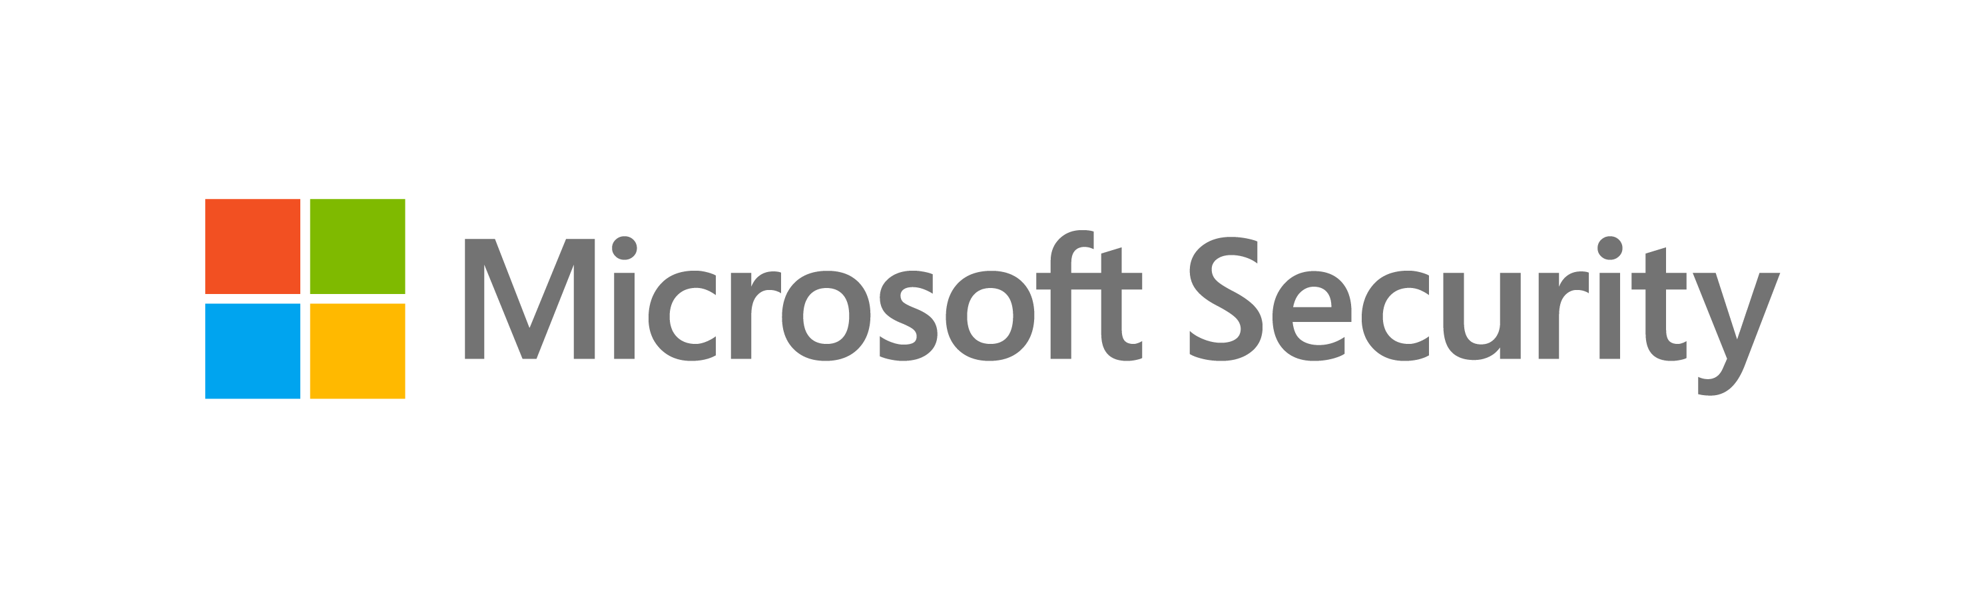



Zero Trust solutions from Microsoft
Policy Optimization
Governance
Data
Compliance
Classify, label, encrypt
Security Posture Assessment
Emails & documents
Productivity Optimization
Structured data
Identities
Microsoft Defender
for Cloud
Microsoft Defender
for Office
Strong authentication
Secure Score
Microsoft Purview
Human
Compliance Manager
Non-human
Microsoft
Entra ID
Adaptive Access
Apps
Request
enhancement
Zero Trust Policies
Network
Microsoft Entra Workload ID
Traffic filtering & segmentation
SaaS
Evaluation
Public
On-premises
Microsoft Entra Agent ID
Enforcement
Private
Microsoft Entra ID
Microsoft Entra ID
Application Proxy
Microsoft Defender for Cloud Apps
Microsoft Entra Internet Access
Endpoints
Infrastructure
Device
compliance
Risk assessment
Microsoft Entra Private Access
Runtime control
Corporate
Serverless
Personal
Containers
Microsoft
Intune
Threat Protection
IaaS
Continuous Assessment
PaaS
Microsoft Defender for Endpoint
Internal Sites
Threat Intelligence
Microsoft Defender for Cloud
Forensics
Response Automation
Microsoft Sentinel
Telemetry/analytics/assessment
JIT & Version Control
Notes:
(Click for Microsoft products)
Talk track:
Microsoft offers a comprehensive portfolio of security solutions which enable every organization to implement an end-to-end Zero Trust strategy.

Slide 26











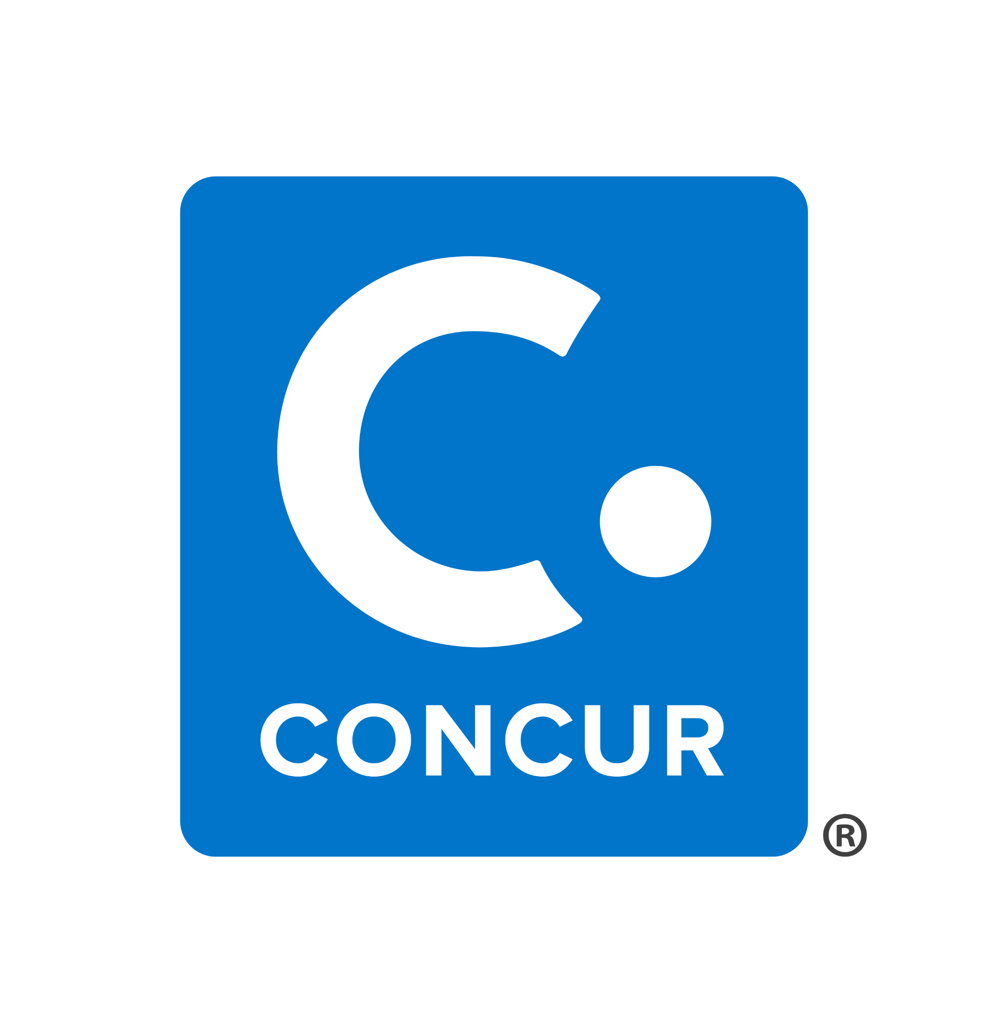

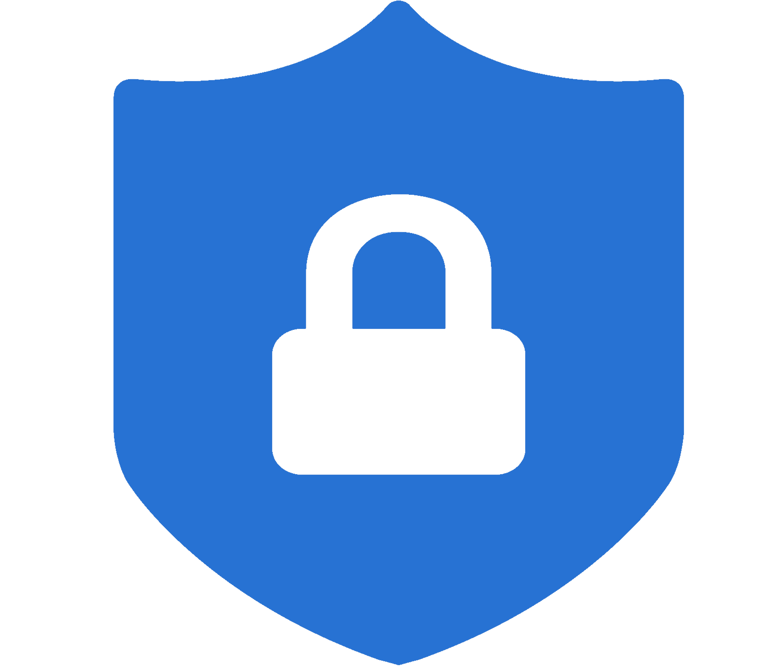
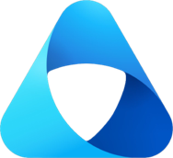



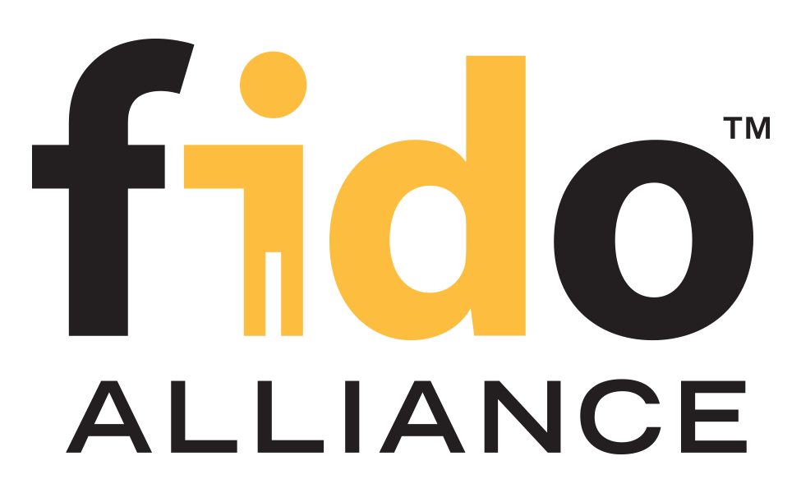
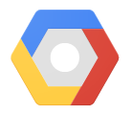







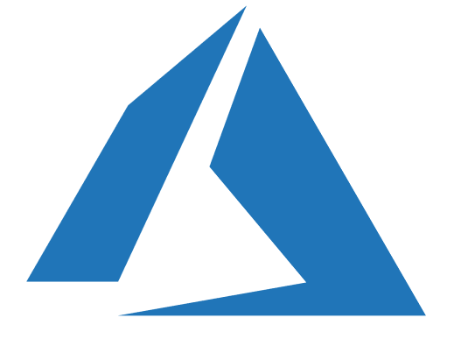


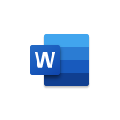


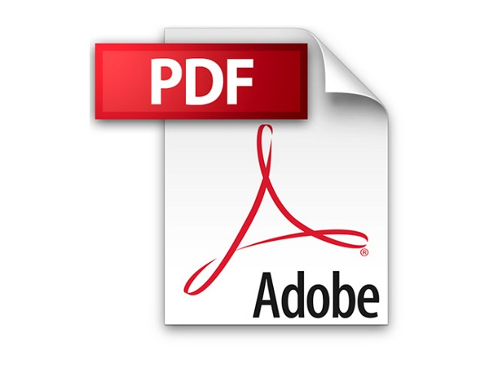



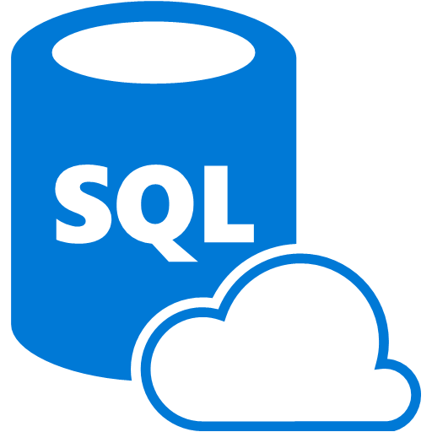
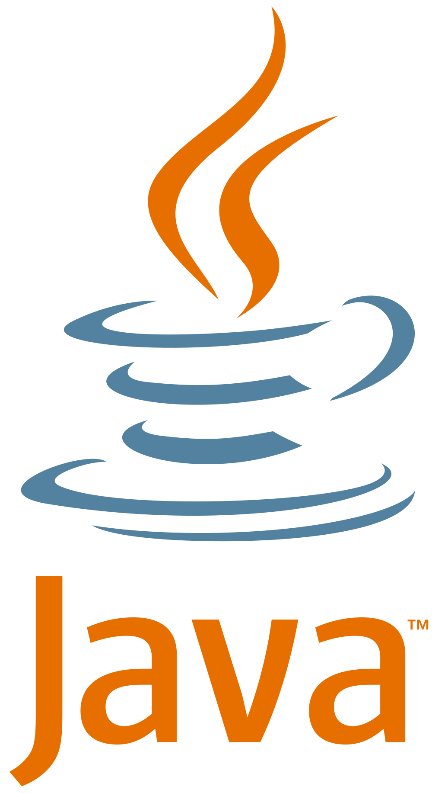

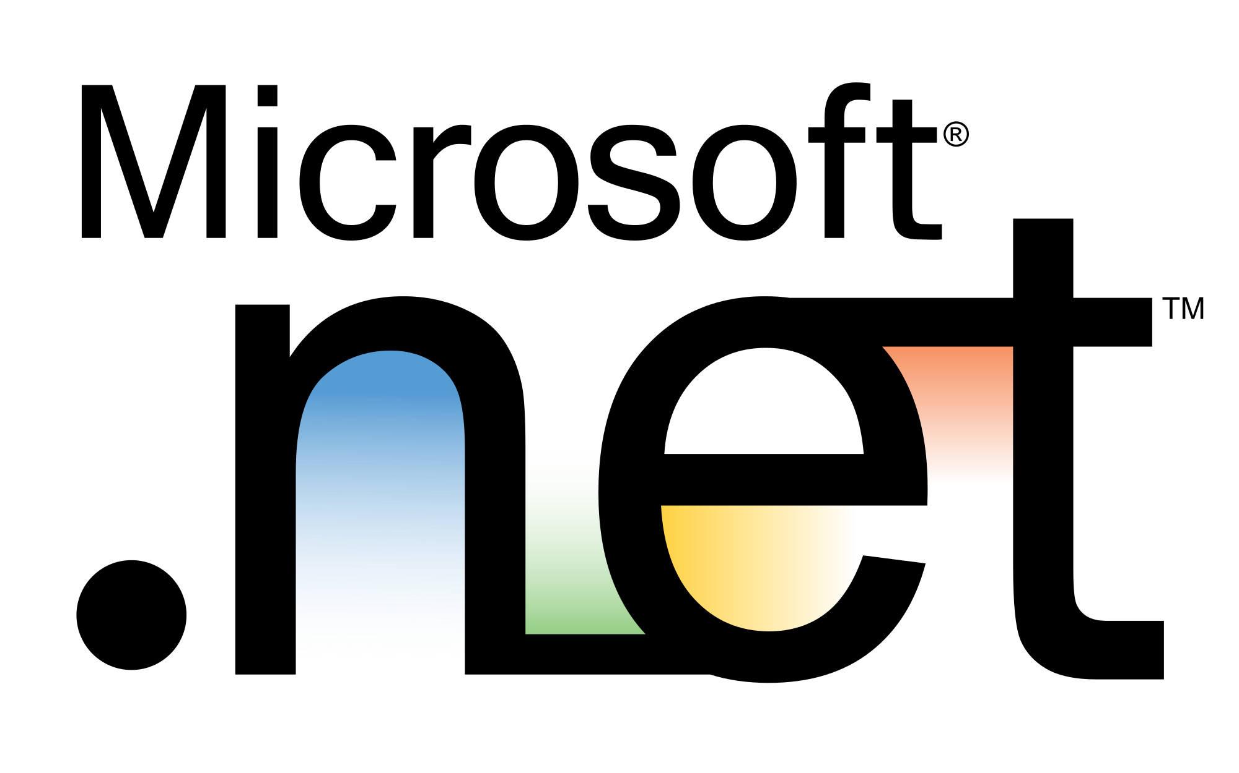

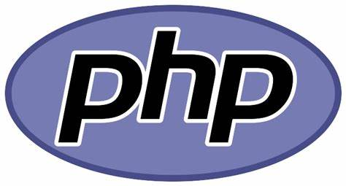
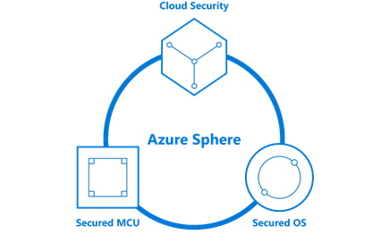

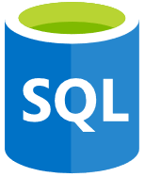

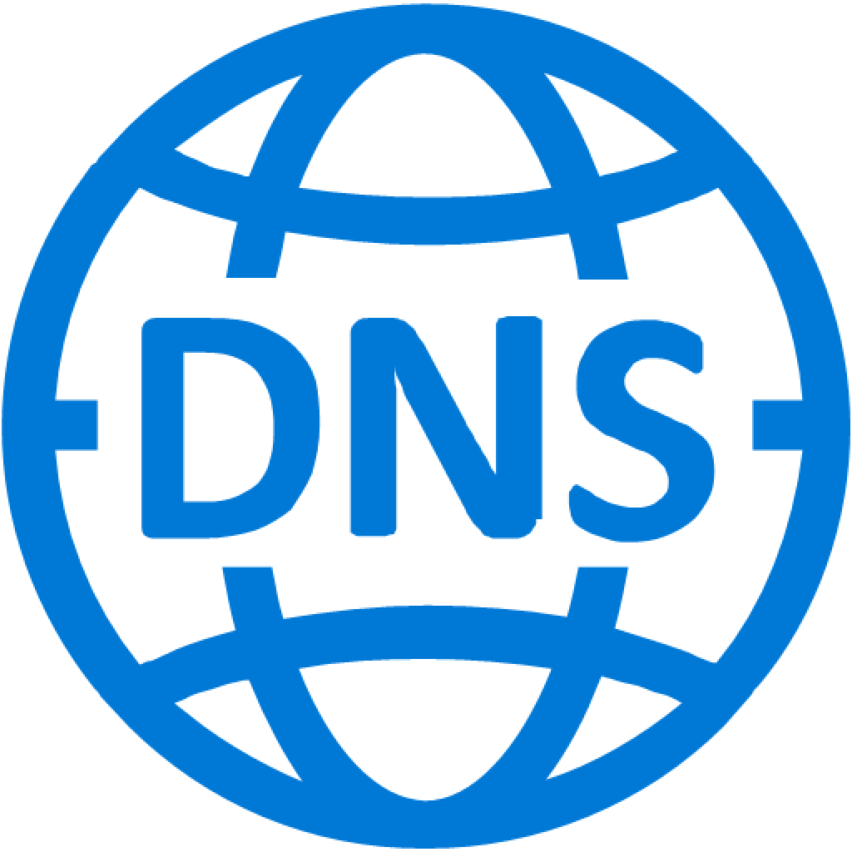

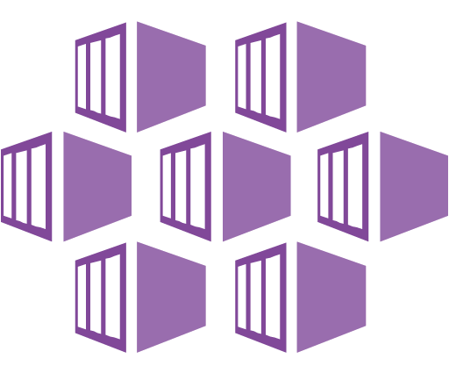
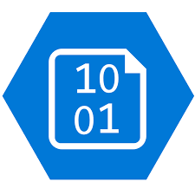
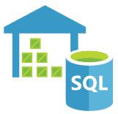


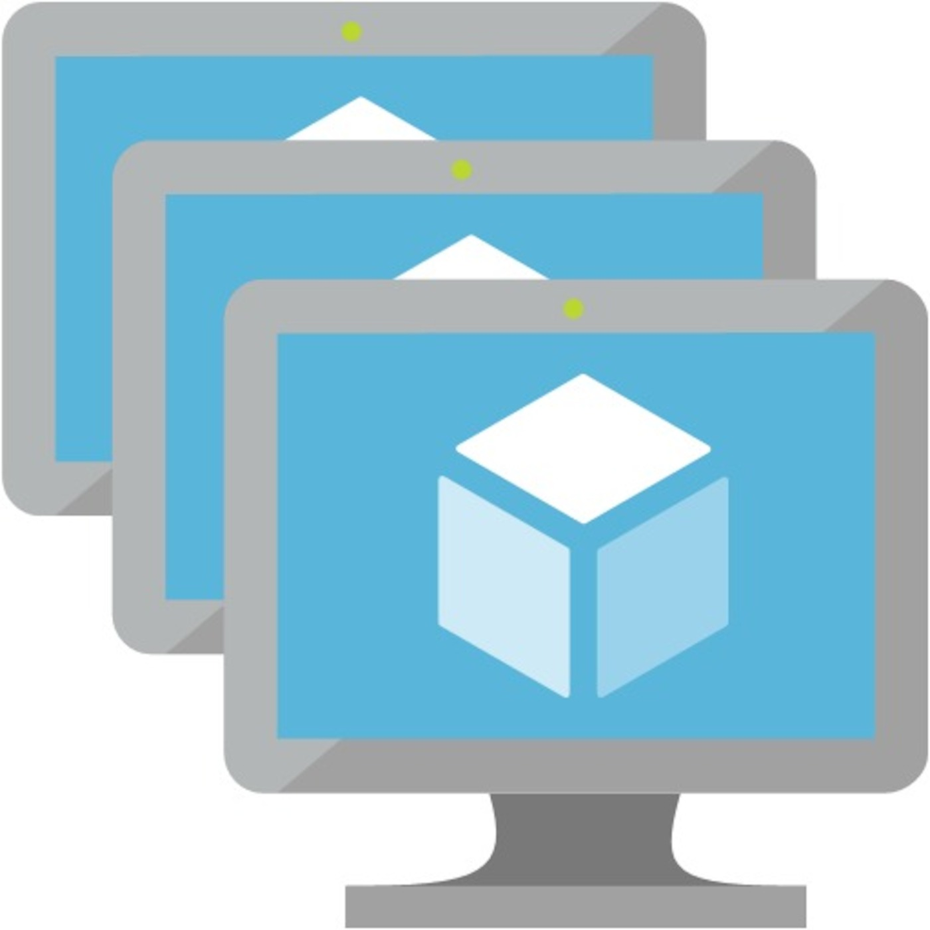
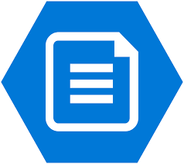

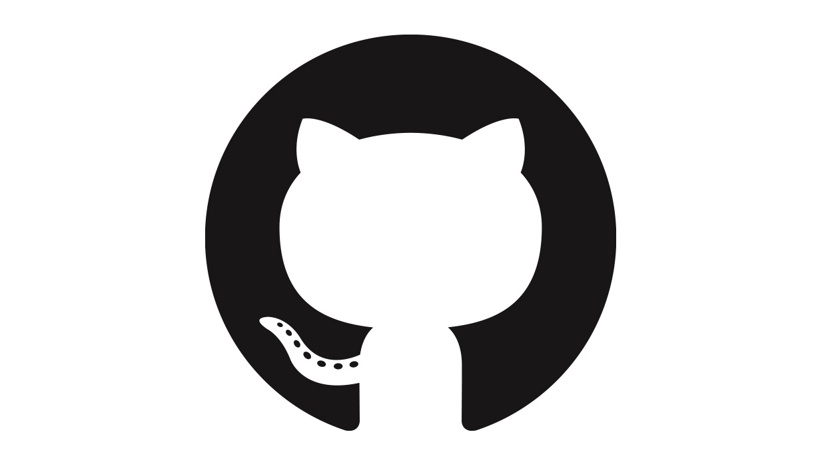

Security Operations (SecOps/SOC)
Software as a Service (SaaS)
Microsoft Security Experts
Managed Security Operations
Using Microsoft Security
Cybersecurity Reference Architecture
Security modernization with Zero Trust Principles
April 2025 – aka.ms/MCRA
Microsoft Defender for Cloud Apps
App Discovery & Risk Scoring (Shadow IT)
Threat Detection & Response
Policy Audit & Enforcement
Session monitoring & control
Defender Experts | Detection and Response Team (DART)
Microsoft Defender XDR
Unified Threat Detection and Response across IT, OT, and IoT Assets
Incident Response | Automation | Threat Hunting | Threat Intelligence
Cloud
Azure, AWS, GCP, On Prem & more
Endpoint
Workstations, Server/VM, Containers, etc.
Office 365
Email, Teams,
and more
Identity
Cloud &
On-Premises
SaaS
Cloud Apps
Data
SQL, DLP, & more
OT/IoT
devices
Other
Tools, Logs,
& Data
This is interactive!
Present Slide
Hover for Description
Click for more information
Microsoft Sentinel
This is interactive!
Present Slide
Hover for Description
Click for more information
Security Guidance
Security Adoption Framework
Security Documentation
Cloud Security Benchmarks
Microsoft Entra Internet Access
Cloud Native SIEM, SOAR, and UEBA
Identity & Access
Conditional Access – Zero Trust Adaptive Access Control based on explicit validation users, session, & endpoint integrity
Endpoints & Devices
Infrastructure and Development Security (across hybrid of IaaS, PaaS, On-Premises)
Information Protection
Microsoft Entra
Microsoft Purview
Data security, loss prevention (DLP), & governance across data lifecycle
Passwordless & MFA
Unified Endpoint Management (UEM)
Defender for Cloud – Cross-Platform Cloud Security Posture Management (CSPM)
Hello for Business
Secure Score
Intune
Configuration Manager
Microsoft Azure
Compliance Dashboard
Verified Identity
On Premises Datacenter(s)
3rd party IaaS & PaaS
Discover
Protect
Passkeys
Azure Marketplace
Azure Firewall
& Firewall Manager
Monitor
Classify
FIDO2 Keys
v
NGFW
Classification Labels
Entra ID Protection
Leaked cred protection
Behavioral Analytics
Extranet
Edge DLP
Azure WAF
File Scanner
(on-premises and cloud)
IPS/IDS/NDR
DDoS Protection
ID Governance
Microsoft Defender for Endpoint
Unified Endpoint Security
VPN & Proxy
Microsoft Entra Private Access & App Proxy
Beyond User VPN
Azure Key Vault
Endpoint Detection & Response (EDR)
Express Route
S3
Microsoft Entra PIM
Private Link
Azure Bastion
Data Governance
External Identities
Web Content Filtering
Intranet
Azure Arc
Azure Lighthouse
Threat & Vuln Management
Azure Backup
Advanced eDiscovery
Defender for Identity
Endpoint Data Loss Protection (DLP)
Azure Stack
Compliance Manager
Active Directory
Security & Other Services
Securing Privileged Access – aka.ms/SPA
Privileged Access Workstations (PAWs) - Secure workstations for administrators, developers, and other sensitive users
Privileged Access Management (PAM)
Cloud Infrastructure Entitlement Management (CIEM)
Microsoft Security Exposure Management – Provides unified view of security posture + attack surface across organization, enabling you to investigate security insights, identify critical assets, reduce attack surfaces and security risk
Windows 11 & 10 Security
IoT and Operational Technology (OT)
Defender for Cloud – Cross-Platform, Multi-Cloud XDR
Detection and response capabilities for infrastructure and development across IaaS, PaaS, and on-premises
People Security
Windows LAPS
Protect Local Admin Account Credentials
Exploit protection
App control
Full Disk Encryption
Attack surface
reduction
Azure Sphere
Microsoft Defender for IoT (and OT)
Attack Simulator
Insider Risk Management
Communication Compliance
Network protection
Credential protection
ICS, SCADA, OT
Internet of Things (IoT)
Industrial IoT (IIoT)
Asset & Vulnerability management
Threat Detection
& Response
Defender for APIs
GitHub Advanced Security & Azure DevOps Security
Secure development and software supply chain
Microsoft Security Copilot
Threat Intelligence – 78+ Trillion signals per day of security context
Service Trust Portal – How Microsoft secures cloud services
Security Development Lifecycle (SDL)
Notes:
BUILD SLIDE VERSION (Animated Build sequence that takes about a dozen clicks)
Key Takeaway: This diagram describes Microsoft’s cybersecurity capabilities. This is part of a series of security architectures available for download at https://aka.ms/MCRA
This diagram is interactive, you can hover over any of the capabilities for a quick description and then click on it for more documentation on the capability.
As we review technical areas, keep in mind that Microsoft takes a holistic integrated approach for capabilities to drive simplicity and effectiveness:
Threat Intelligence – Microsoft capabilities are informed by the same underlying system with 65+ signals per day of context
Single Agent/Control Point – Microsoft capabilities utilize a single endpoint agent or policy control point where possible for multiple different functions (e.g. Microsoft Defender for Cloud Apps performs governance, threat detection, information protection and other for SaaS application, Microsoft Defender for Endpoint is similar for endpoints, etc.)
Consistent Experience – Microsoft capabilities are integrated to provide a consistent experience per role/task/outcome where possible (e.g. a single label for data that is used for security, data retention, and other requirements across clouds, platforms, and operating systems)
CLICK 1 – In the beginning, there were servers and networks…
Most organizations today operate a multi-platform environment with Windows and Linux servers in the datacenters, application containers, and many different generations of applications to protect.
Most organizations started security with a core set of security capabilities at the network edge / egress points to protect extranet and intranet resources.
CLICK 2 – …and Endpoints and Devices
Many organizations take advantage of built-in Windows features and system management to provide basic security hygiene like patching and Active Directory account security and group policy
Microsoft Endpoint Manager (MEM) Configuration Manager and Intune MDM/MAM provide cross-platform unified endpoint management (UEM) and security across Windows, Linux, Mac, iOS, and Android
Windows 11 and 10 Security includes an extensive set of platform capabilities and hardware security integrations to protect against ever-evolving attacks
Microsoft Defender for Endpoint (MDE) – provides advanced endpoint detection and response (EDR) capabilities, Web Content Filtering, Threat and Vulnerability Management, and Data Loss Protection (DLP). This is a cornerstone of XDR capabilities described more in security operations.
CLICK 3 – SaaS Drives Modernization of Identity and Access Security
Organizations first start adopting cloud with Software as a Services (SaaS), and the first app is usually Office 365 for email (or sometimes G Suite). This trend continues today with the adoption of Generative AI like ChatGPT, Microsoft Copilot, Google Bard, and more.
This creates a need for access control beyond the firewall using secure cloud identities (that also extends to mobile/IoT portions of the enterprise estate). Identity is also playing an increasing role in datacenter access control strategies as they modernize to the cloud
While some aren’t aware of it, many organizations have already deployed modern single identity and single sign-on capabilities across their enterprise estate with Entra ID (formerly Azure Active Directory), which is configured during an Office 365 deployment and connected to the existing enterprise identity system via Active Directory
In addition to single sign on (SSO), Microsoft provides critical modern security elements for Entra ID like
Passwordless and MFA – capabilities to simplify the user experience and strengthen security assurances via Hello For Business biometric authentication, Verified Identities, Passkeys , nd other FIDO2 keys
Identity Protection – against highly prevalent attacks with Leaked Credential Protections, Behavioral Analytics, Threat Intelligence integration and more
Entra ID PIM reduces risk by providing just in time access to privileged accounts using approval workflows
Identity Governance helps ensure the right people have access to the right resources
External Identities (Entra ID B2B and B2C) provide security for partner and customer/client/citizen accounts while separating them from enterprise user directories
Additionally, Conditional Access applies Zero Trust principles to access control decisions by explicitly validating trust of users and endpoints requesting access to your resources. This helps build a de facto security perimeter around these modern resources with modern controls and provides simple consistent policy enforcement across them.
Microsoft Defender for Identity (MDI) – provides XDR capabilities for cloud identity services (Entra ID, formerly Azure AD) as well as Active Directory domain, federation, and certificate services
The Service Trust Portal provides information on how Microsoft secures our cloud platforms and reports compliance.
CLICK 4 – Microsoft Entra Private Access & App Proxy
These capabilities extend the modern access control approach (security perimeter) to on-premises resources by simplifying user access to them and modernizing security with Conditional Access (which explicitly validates user and device trust, a Zero Trust principle).
Microsoft Entra Application Proxy is a modern secure replacement to VPN for accessing private apps and resources (via fully https and modern authentication protocols)
Microsoft Entra Private Access is a modern secure replacement to VPN for accessing private apps and resources (via fully qualified domain names (FQDNs) and IP addresses)
CLICK 5 – Datacenters become hybrid Infrastructure spanning multiple clouds (IaaS, PaaS) and on-premises
Most organizations have expanded into a hybrid infrastructure that spans on-premises and one or more clouds providing Infrastructure as a Service (IaaS) and/or Platform as a Service (PaaS) capabilities.
On Azure, Microsoft invested in Azure Marketplace to ensure customers have access to capabilities from popular vendors, often used by customers to extend existing on-premises controls to the cloud.
Microsoft provides Private Link support for Azure Services to help organizations extend private networks to the PaaS services used by applications. While this extends current controls and practices to the cloud, private networks may not be enough to mitigate modern attacks so Microsoft recommends following zero trust principles (https://aka.ms/zerotrust) to modernize your access control strategy using identity, network, application, data, and other controls.
CLICK 6 –Multi-Cloud and Azure Security
Microsoft has invested in a wide range of capabilities to help secure your hybrid multi-cloud environment and the workloads in it. These are built into Azure and several extend across your hybrid infrastructure estate (on-premises, AWS, GCP, and other clouds) using Azure Arc.
Azure Lighthouse provides cross-tenant support in Azure for services, often used by managed service providers and customers with multiple tenants.
Microsoft Defender for Cloud provides a single starting point for managing security and compliance in Azure (and across IaaS and PaaS clouds), including
Secure Score to measure security posture and providing prioritized guidance for improving it such as
Multifactor authentication isn’t required for administrative accounts
VMs exposed directly to the internet
Missing Web Application Firewalls (WAFs) for web applications
Out of date patches and antimalware signatures
…and many others
Compliance Dashboard to help you quickly see and report on compliance status with regulatory guidance (and rapidly improve your compliance)
Azure Firewall is a managed, cloud-based network security service that helps protect your Azure Virtual Network resources.
Azure Firewall Premium is a next generation firewall with capabilities required for highly sensitive and regulated environments (TLS Inspection, IDPS, URL Filtering, Web Categories).
Azure Firewall Manager is a security management service that provides central security policy and route management for cloud-based security perimeters.
Azure Web Application Firewall (WAF) provides centralized protection of your web applications from common exploits and vulnerabilities.
Microsoft has also invested heavily in other Azure security capabilities such as Distributed Denial of Service (DDoS) mitigations, key management, Azure Bastion for securing remote access, ransomware-resistant backup archives in Azure Backup, confidential computing capabilities to protect data while its being processed, and many more.
CLICK 7 – Threat Monitoring for Datacenters and Operational Technology (OT))
Microsoft Threat Intelligence – Through the course of our normal operations, Microsoft processes over 78 trillion signals a day of context that we use to generate threat intelligence to protect our cloud services, IT environment, and customers. Many of the capabilities in this architecture integrate that threat intelligence directly into threat detections, security guidance, and more.
Microsoft Defender for Cloud provides extended detection and response (XDR) capabilities for infrastructure across your hybrid estate as well as operational technology (OT). XDR tools are designed to complement a Security Information and Event Management (SIEM) by providing deep visibility into specific asset types and enhanced detection, response, and recovery capabilities (notably high-quality alerts that have low false positive rates).
Microsoft Defender for Cloud currently covers the most highly used infrastructure services including servers/VMs, storage, databases, DNS, apps services, Kubernetes, container registries, key vault, and resource manager.
Microsoft Defender for IoT helps protect the OT systems that control physical processes like Supervisory Control and Data Acquisition (SCADA) and Industrial Control Systems (ICS) with an agentless approach. Additionally, this capability also protects IoT devices via lightweight a micro agent that supports standard IoT operating systems, such as Linux and RTOS.
CLICK 8 – Security Operations / SOC
To help security operations teams manage active attacks, Microsoft has invested into a complete tooling strategy of XDR + SIEM + Security Data Lake
Microsoft Sentinel is a cloud native SIEM provides broad visibility across your entire estate (IT, OT, IoT) while XDR capabilities provide deep visibility into specific assets to aid in rapid investigation and remediation (Endpoints, Email and Office 365, Identity, SaaS, Azure and multi-cloud Infrastructure)
Microsoft’s XDR tooling includes:
Microsoft Defender for Endpoint (MDE) – described earlier. Like with cloud apps, Microsoft integrates this with other capabilities across our portfolio so you don’t have to run multiple agents/solutions to achieve your endpoint security goals.
Microsoft Defender for Office (MDO) – provides advanced security capabilities across Email, SharePoint Online, OneDrive for Business, Teams, etc.
Microsoft Defender for Identity (MDI) – described earlier
Microsoft Defender for Cloud (MDC) – described earlier
Microsoft is laser focused on reducing analyst fatigue and enabling rapid and effective response to incidents and focuses on
Seamless experiences with Security Orchestration, Automation, and Remediation (SOAR) technologies and integration of toolsets together (natively and by providing APIs).
Rapid and accurate analysis of anomalies with Machine learning (ML) and behavioral analytics (UEBA)
Microsoft also enables our customers with human expertise including
Microsoft Threat Experts – Managed hunting service built into Microsoft 365 Defender with expert level monitoring and analysis to empower and help ensure critical threats in your unique environments don’t get missed.
Microsoft Incident Response – The Detection and Response Team (DART) provides professional services to help investigate incidents in your environment and hunt for potential existing threats
MSSP/MDR providers – Microsoft partners with top experts in the industry to build their expertise on these capabilities so that they can advise and directly support our customers.
Additionally, Microsoft Defender for Cloud Apps (MDCA) provides Cloud Access Security Broker (CASB) capabilities that provide XDR for SaaS applications as well as governance, threat protection, data protection and more for these SaaS apps and the data stored on them. MDCA integrates with other capabilities in Microsoft’s portfolio to extend them to SaaS applications to simplify management and security.
Note: MDCA and MDE illustrate Microsoft’s philosophy of a single agent (or control point) for resources that provide many security services. This helps reduce the performance impact of installing too many security agents (which we have seen can take up to a full CPU Core and 1GB of RAM per endpoint in the worst cases)
CLICK 9 – DevSecOps / Application Security
Microsoft uses our Security Development Lifecycle (SDL) for developing software and our Operational Security Assurance (OSA) framework for operating cloud services. To help customers security applications, we also provide
SDL and OSA documentation – to help with securing your applications and operations.
GitHub Advanced Security and Azure DevOps Security provide DevSecOps and Application development security that integrates natively in the developer workflow including code scanning, secret scanning, alerting, dependency review, security policies, and more.
Microsoft Defender for DevOps and Defender for APIs are Microsoft Defender for Cloud capabilities:
Defender for APIs offers full lifecycle protection, detection, and response coverage for APIs.
Defender for DevOps empowers security teams to manage DevOps security across multi-pipeline environments with comprehensive visibility, posture management, and threat protection across multicloud environments including Azure, AWS, GCP, and on-premises resources.
CLICK 10 – Privileged Access
Microsoft provides prescriptive guidance on securing privileged access (SPA) to help you rapidly protect against those attack techniques (a high impact attack vector frequently used by attackers). This is based on the approach Microsoft uses to protect privileged access in our IT and cloud service environments (internally called Secure Access Workstations or SAWs)
This guidance includes strategy, planning, and implementation documentation to secure Accounts, Devices, Intermediaries, and interfaces. The approach is based on zero trust principles and leverages conditional access for policy enforcement.
Key components of securing privileged access include:
Privileged access workstations (PAWs) to provide safe operating environment for sensitive accounts.
Windows LAPS - Windows Local Administrator Password Solution (LAPS) mitigates lateral traversal attacks by setting and managing random passwords for local administrator accounts on Windows computers
See https://aka.ms/SPA for more information.
CLICK 11 – Information Protection / Data Protection
Microsoft Purview is a family of data governance, risk, and compliance solutions that can help your organization govern, protect, and manage your entire data estate.
Note: Microsoft Purview combines the former Azure Purview and Microsoft 365 compliance solutions and services together into a single brand.
These solutions provide a full lifecycle approach to discovering, classifying, protecting, and monitoring the data your organization relies on to drive mission completion and competitive advantage (in various forms, formats, and locations)
A few key focus areas are:
Protect files regardless of where the data is stored or with whom it’s shared (vs. being limited to protecting files only when on a specific device/location)
A File Scanner to discover and assess existing data in SharePoint sites and fileshares
Data Governance to provide visibility and management of the full information lifecycle
Advanced eDiscovery capabilities to help simplify meeting those legal obligations
Data source coverage – includes a broad range of sources, illustrated in https://learn.microsoft.com/en-us/purview/microsoft-purview-connector-overview
Compliance Manager - helps you manage your compliance requirements for cloud services and workloads.
CLICK 12 – Security Posture Management
Organizations need a security posture management function to actively manage technical risks by identifying, prioritizing, mitigating, and monitoring them. This ‘left of bang’ operational function complements Security Operations (SecOps/SOC) ‘right of bang’ function.
Microsoft Security Exposure Management provides a unified view of security posture + attack surface across organization, enabling you to investigate security insights, identify critical assets, reduce attack surfaces and security risk.
CLICK 13 – People Security
A security program isn’t complete without protecting and educating people + protecting against insider risks (both inadvertent and deliberately malicious). Microsoft invests into these areas with:
Attack Simulator - can be used to run realistic attack scenarios in your organization to help you identify and find vulnerable users, providing micro training by Terranova security to help empower them with security knowledge.
Insider Risk Management - in Microsoft 365 helps minimize internal risks by enabling you to detect, investigate, and act on malicious and inadvertent activities in your organization.
Communications Compliance - helps minimize communication risks by helping you detect, capture, and act on inappropriate messages in your organization
CLICK 14 – Security Copilot
Microsoft Security Copilot further simplifies security by using generative AI to helping automate tasks across security including:
Investigating and summarizing incidents
Exploring risks and managing security posture
Managing and troubleshooting policy and controls
Building scripts & reverse engineering attack scripts
CLICK 15 – Conclusion
This diagram describes significant cybersecurity capabilities, but there are plenty of other security investments Microsoft makes like Security Policy Advisor (https://docs.microsoft.com/DeployOffice/overview-of-security-policy-advisor) and Windows server security features (https://docs.microsoft.com/windows-server/security/security-and-assurance) that didn’t fit on the diagram.
We understand this is a lot of capabilities to plan for, so we developed guidance to help you select the technology most relevant to your current challenges, priorities, and initiatives. This includes prescriptive roadmaps, top security best practices, and integration of security into the cloud adoption framework and well-architected framework.
Feedback
We are always trying to improve everything we do at Microsoft and we need your feedback to do it! You can contact the primary author (Mark Simos) directly on LinkedIn (https://aka.ms/markslist) with any feedback on how to improve it or how you use it, how it helps you, or any other thoughts you have.

