Slide 1
Reporting
META
DWH
Mart
Core
Scope:
Generate PSA objects.(table view USP)
Generate SAT and HUB tables, also USP to load data.
Everything configed in meta table.
Write log.
Out of scope:
Data load to stage from source.
Stage
Sources
https://github.com/microsoftbi/PSA-Generator

Slide 2
Difference
Insert only DWH.
Time stamp: LOAD_DTS
Updated data from source, insert new one directly.
Indicator will be added, I for insert, U for update and D for delete.
Calculate period information by LOAD_DTS.
Updateable DWH.(Merge)
Time stamp: LOAD_DTS, LOAD_END_DTS, IS_CURRENT
Updated data from source, insert new one, then update old record LOAD_END_DTS.
For performance purpose, IS_CURRENT in old record will also set to 0, then new record set to 1.
Get period information directly.

Slide 3
PSA(Persistent Staging Area) data flow
PSA
XXX
XXX_STG
USP_XXX_HIS
Landing zone
USP_XXX_STG
Stage
USP_XXX_HIS
Historical
1 to 1 from source table.
Insert time
Hash diff
Valid from
Valid to
Is current
META
Assumptions:
Data load from source is full load.

Slide 4
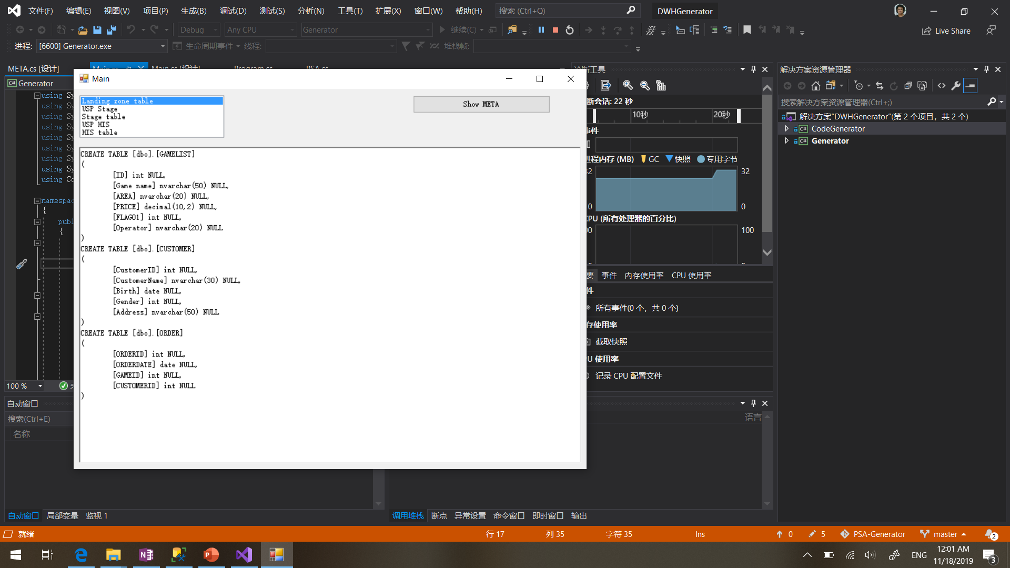

Slide 5
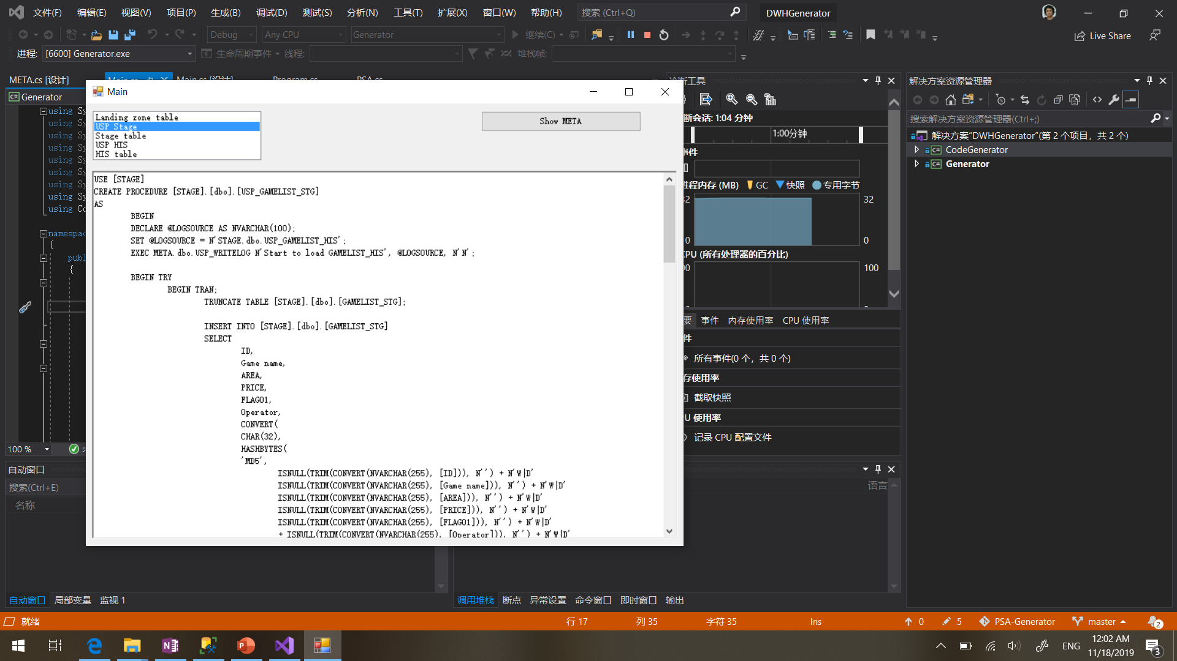

Slide 6
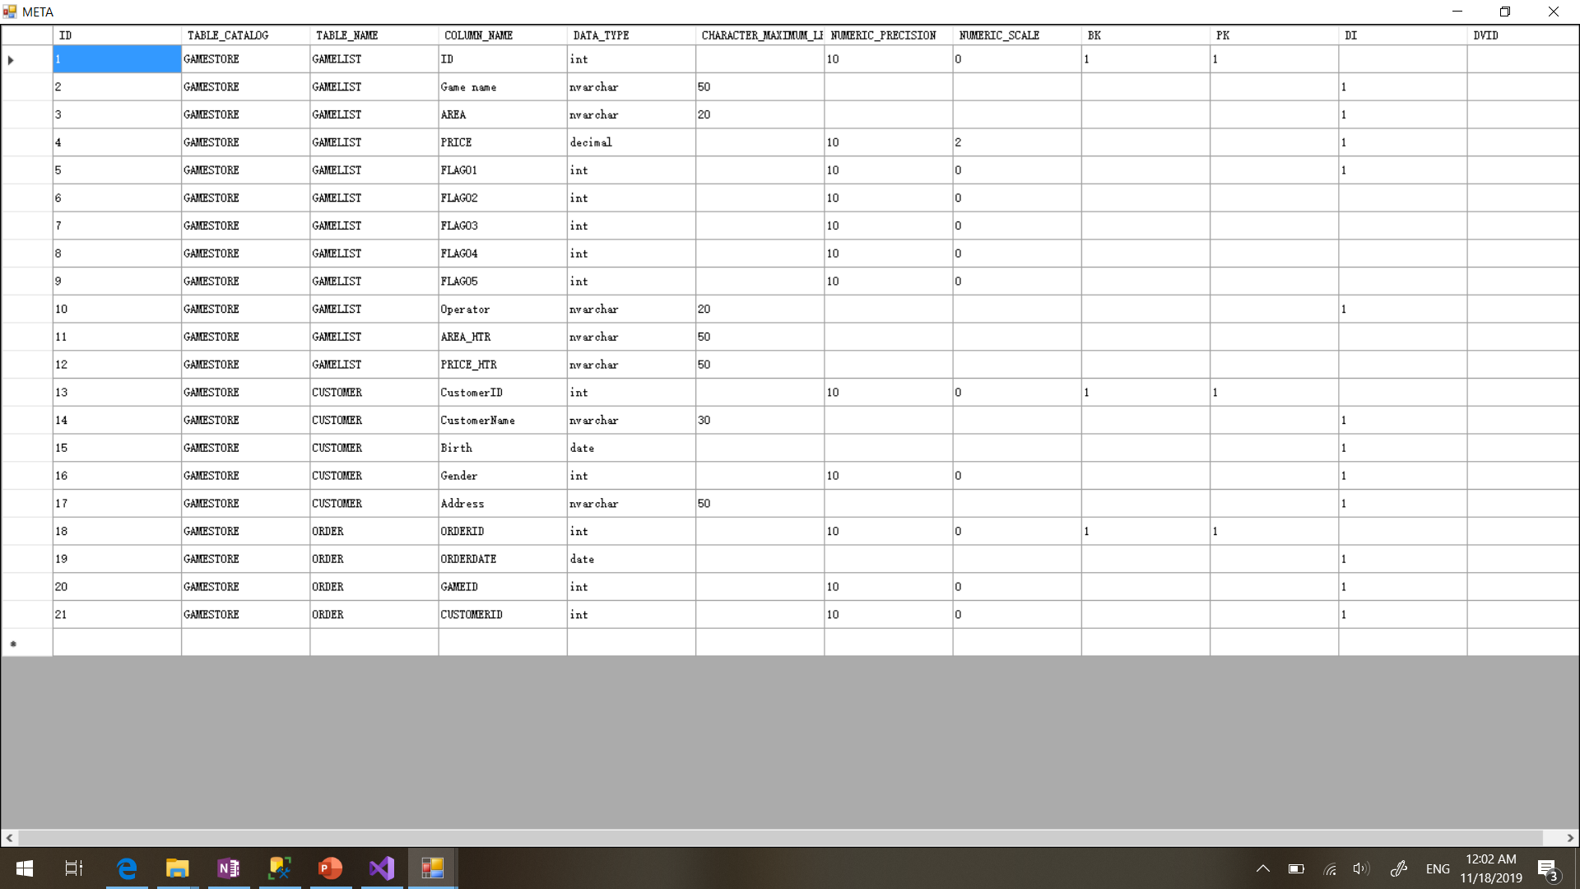

Slide 7
META data management
Including:
Source table schema.
BK, business key, used for generate hash key.
PK, Primary key.
DI, Descriptive information, used for generate hash diff.
DVID, data vault reference ID, map to which table in Data Vault model.
Need a logic to check, about:
If configed as SAT table, if BK is included.
If configed as HUB table, if BK is included, and should no DI fields configed.

Slide 8
Next
Define HUB and SAT tables with META data approach.
https://github.com/microsoftbi/PSA-Generator

