Slide 1

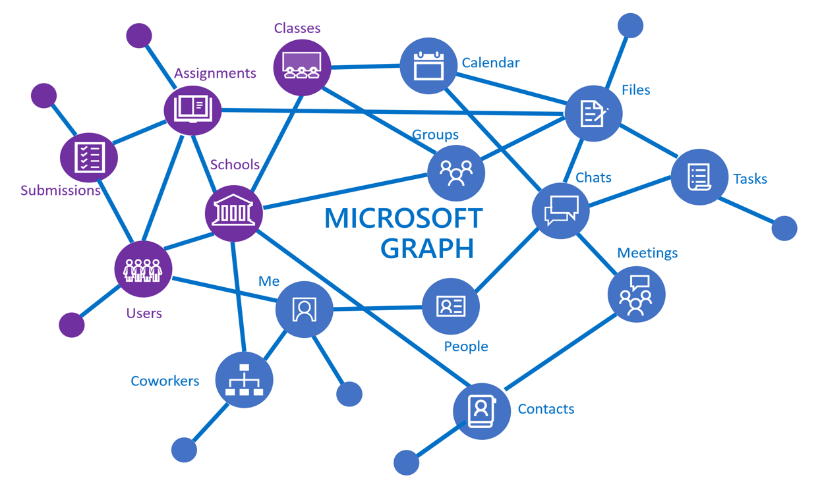




Your app
Call via Teams
Request Teams Call and drive related process

