Slide 1
MICROSOFT WORD
MR. Babalola Elijah - MIA INSTRUCTOR

Slide 2
BRIEF
We shall be working on 38 tasks based on the exam objectives for Exam MO-110: Microsoft Word (Microsoft 365 Apps).
Resources:
Download files listed below before beginning tasks
Project1_datafile.docx in the Project_Files folder
sign_illustration.png in the Project_Files folder

Slide 3
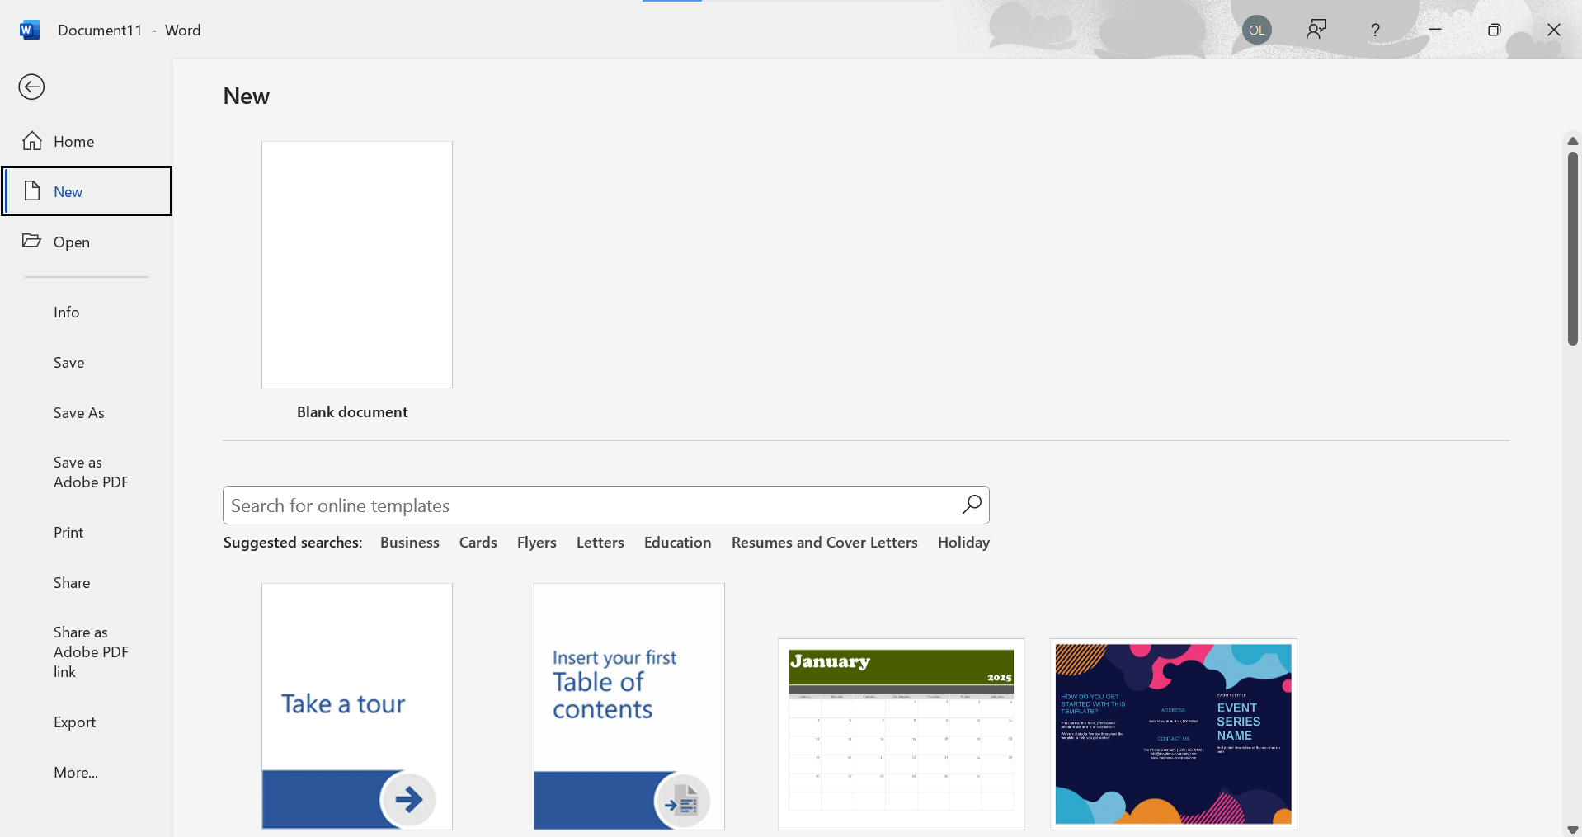
UNDERSTANDING THE INTERFACE
TO START;
To start a document with no format

Slide 4
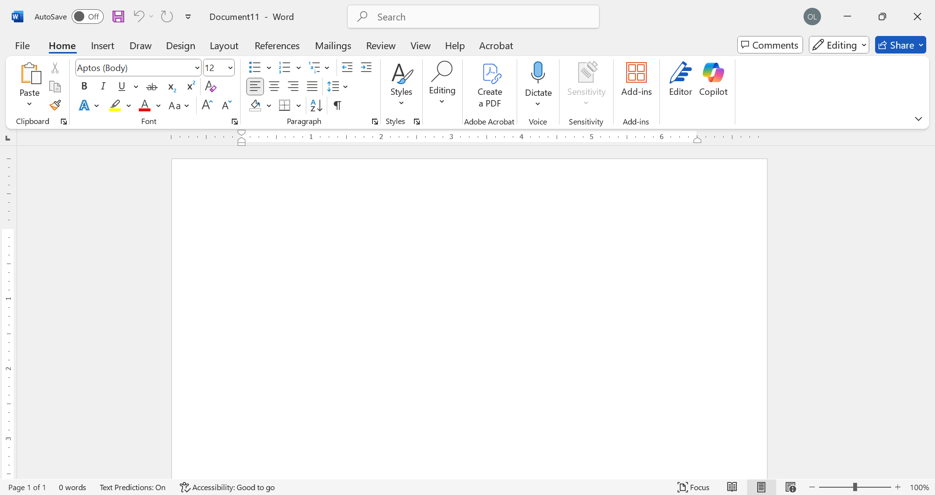
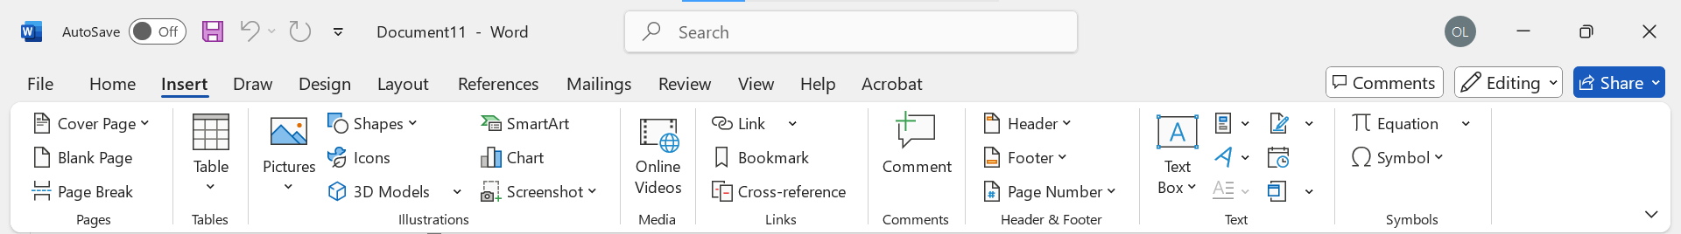
UNDERSTANDING THE INTERFACE
HOME
INSERT
Draw
Design
Layout
References
Mailings
Review
view

Slide 5
TASK 1-4; Tasks
TASK 1
Locate and remove Hidden Properties and Personal Information
TASK 2
Apply built-in character and paragraph styles
TASK 3
Apply formatting by using Format Painter
TASK 4
Apply text effects

Slide 6
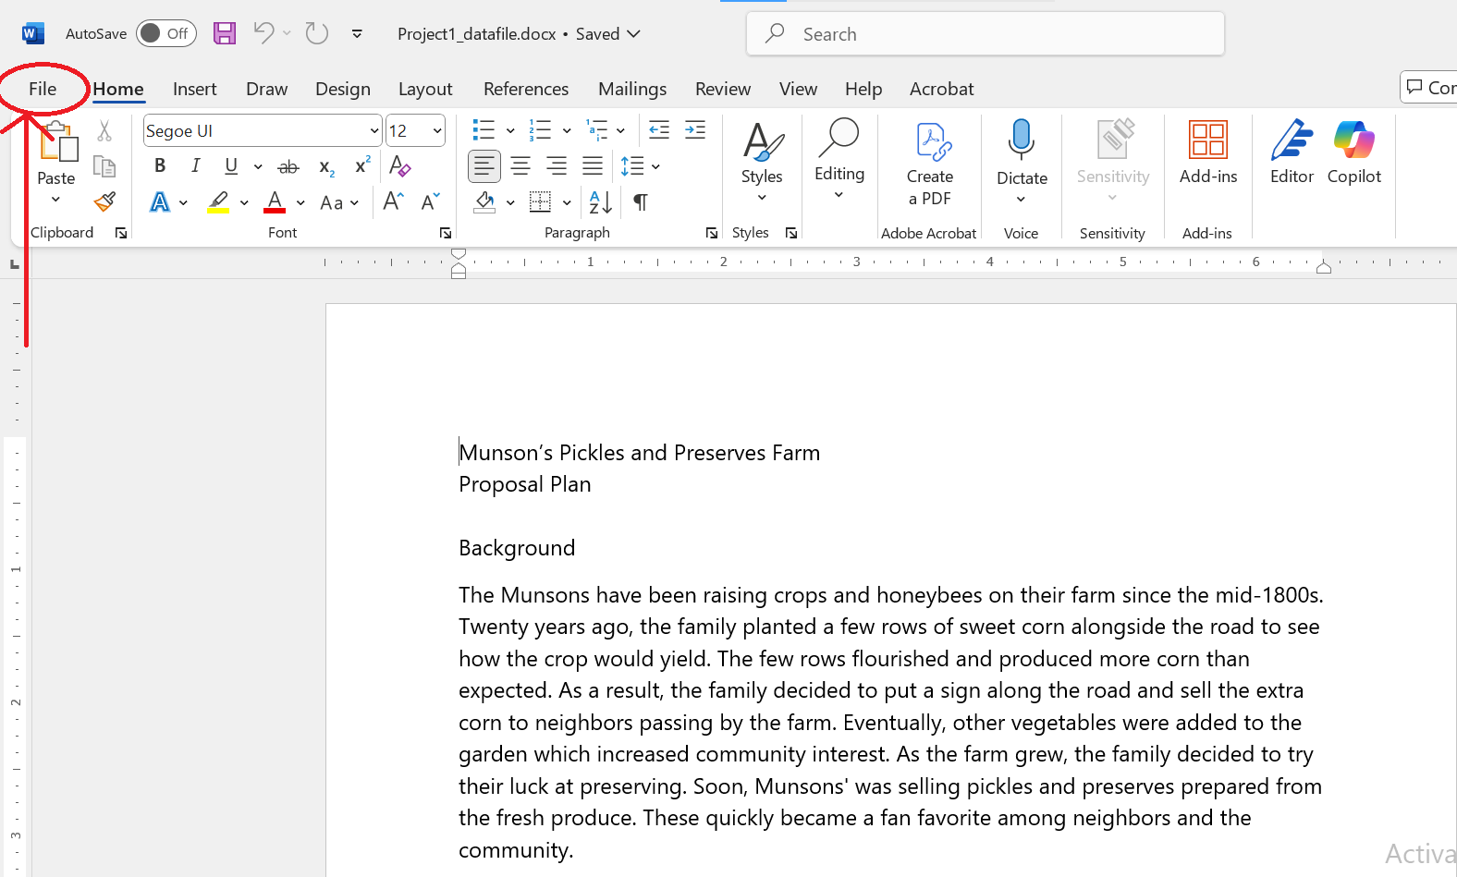
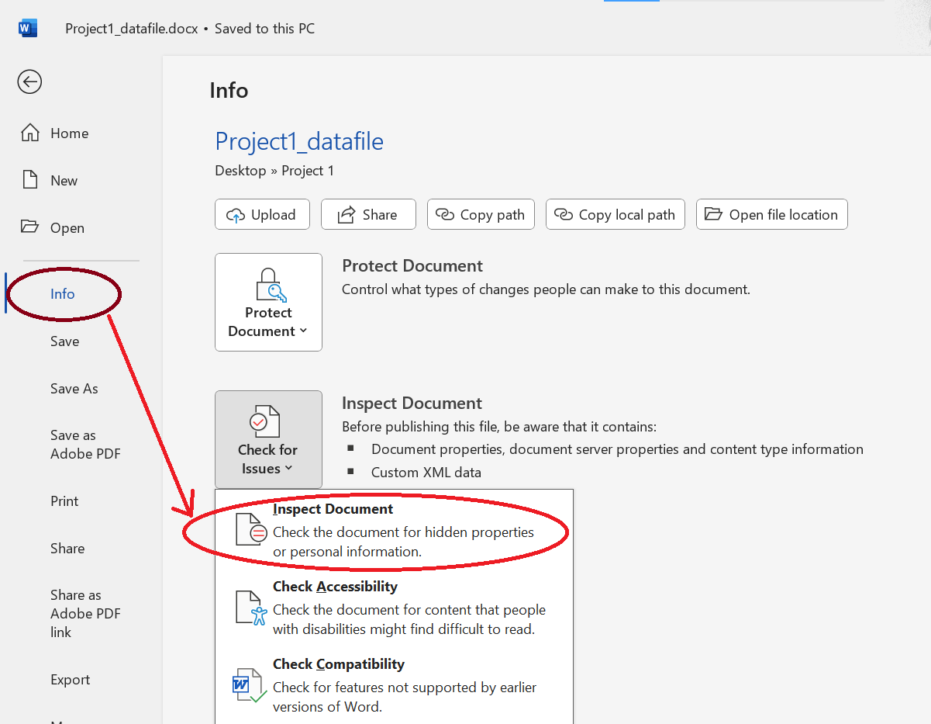
SOLUTION
PROJECT 1;
Locate and remove Hidden Properties and Personal Information
Open Project1_datafile.docx File Info Inspect Document
v

Slide 7
TASK 2; Apply built-in character and paragraph styles
HEADING 1
Home Styles Heading 1
HEADING 2
Home Styles Heading 2
HEADING 3
If Heading 3 is not visible;
Home Styles Heading 2
Apply Styles Type “Heading 3”

Slide 8
TASK 3: Apply formatting by using Format Painter
Use the Format Painter to copy the formatting;
From the source file, copy the formatting of “Identified Plants and Flowers” to the section titles “Greenhouse Option” and “Outsourcing Option”

Slide 9
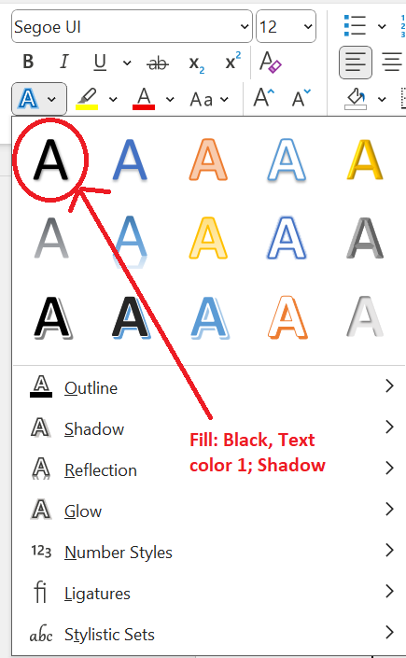
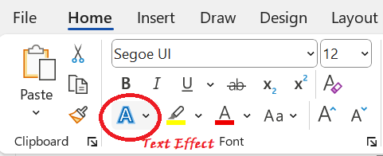
Apply text effects
TASK 4
Home Text Effect Fill: Black, Text Color 1; Shadow

Slide 10
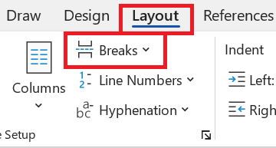
TASK 5: Insert page, section, and column breaks
Layout Breaks

Slide 11
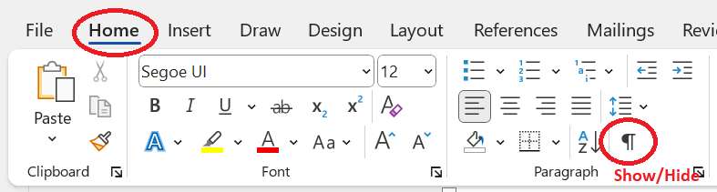
Show and hide formatting symbols and hidden text
TASK 6

Slide 12
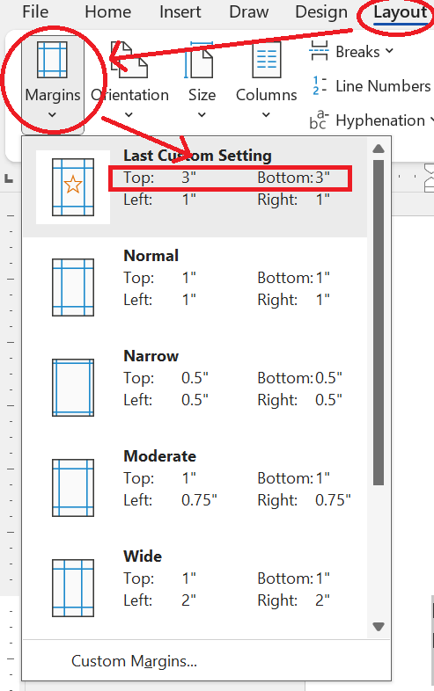
TASK 7
Change Page Setup options for a section
Layout Margin Select your preferred Margin in Inches

Slide 13
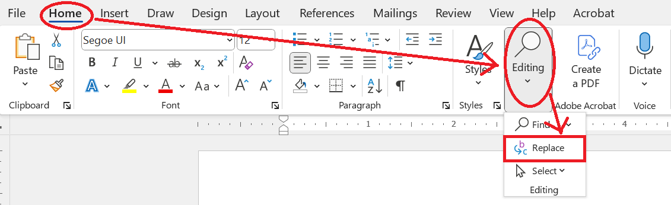
TASK 8: Find and Replace text
HOME EDITING REPLACE

Slide 14
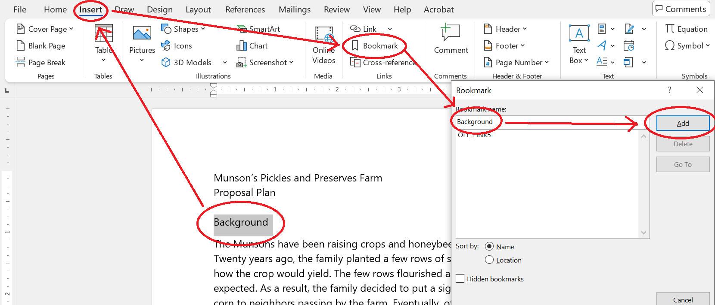
Link to locations within documents [ADDING BOOKMARK]
TASK 9:
Highlight “Background” Insert Bookmark Input the Highlighted word(s)
Add

Slide 15
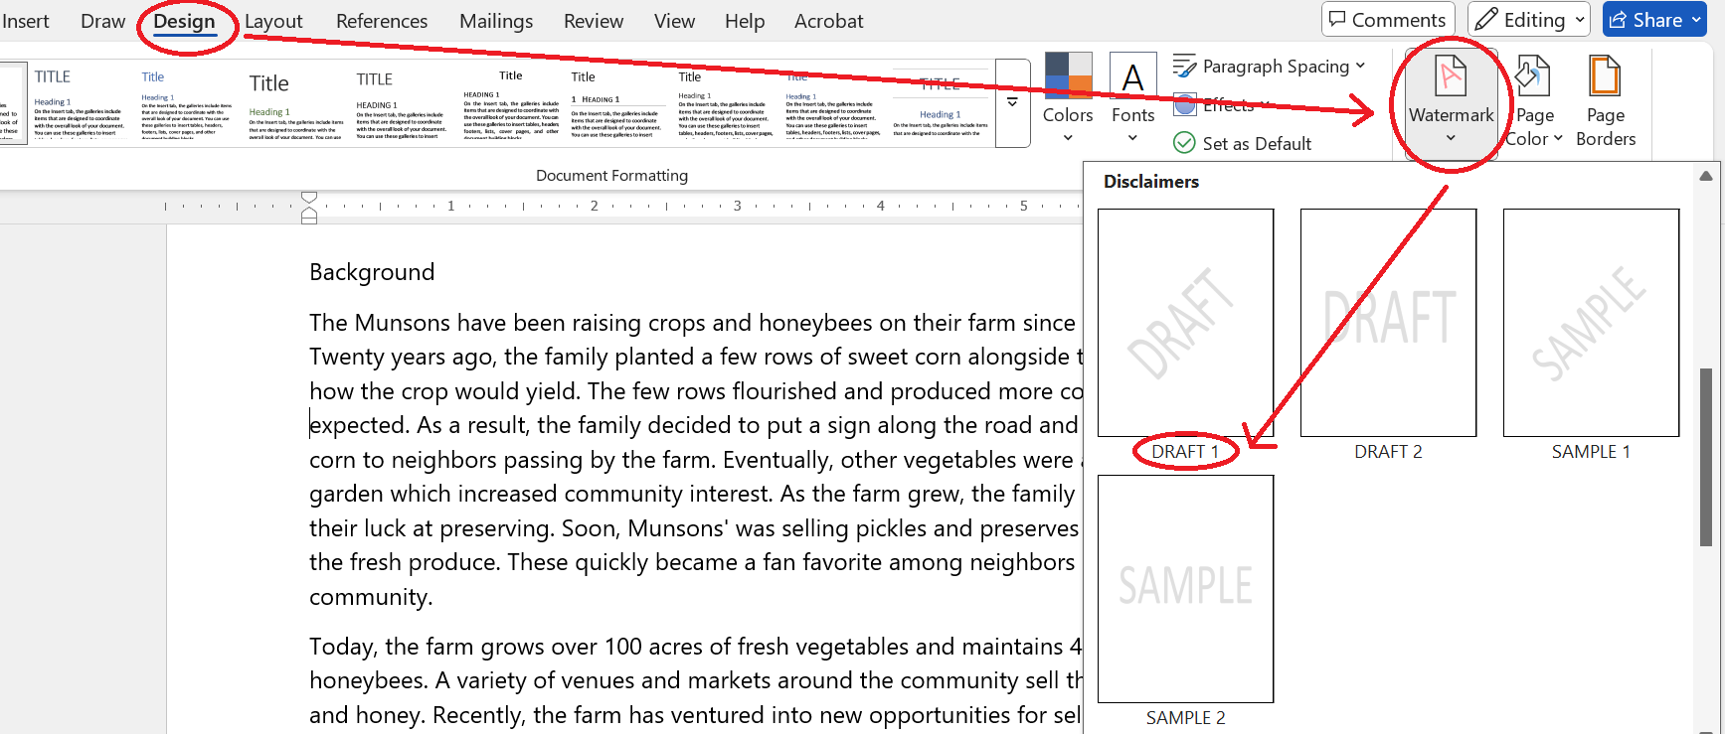
TASK 10: Search for text
TASK 11: Move to specific locations and objects in documents
From the Bookmark dialog click “Go To”
TASK 12: Configure page background elements
Design to; Watermark to; Draft 1

Slide 16
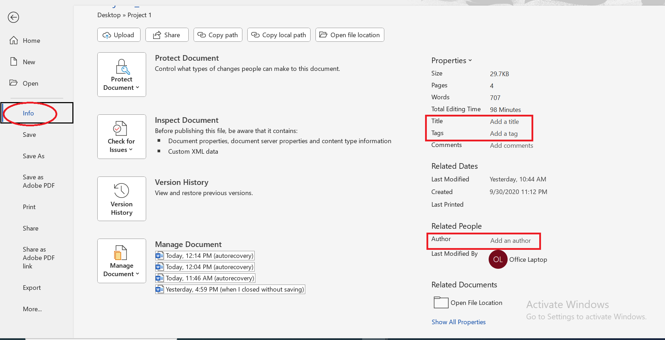
TASK 13
Modify basic document properties [Tittle, Author(s), and Keywords / tags]
File Info

Slide 17
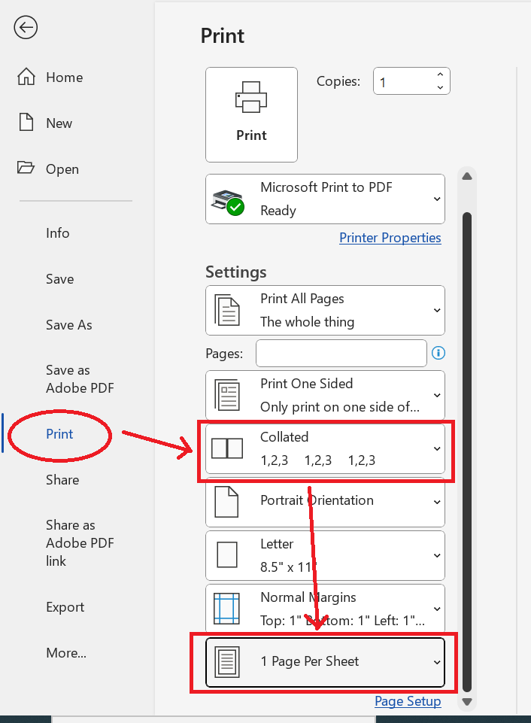
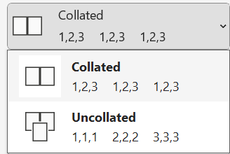
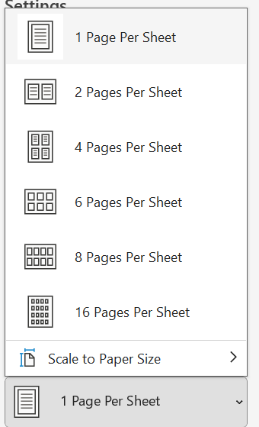
TASK 14
Modify print settings
File Print

Slide 18
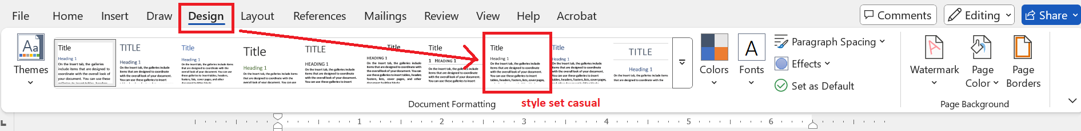
TASK 15
Apply style sets
Design Document Formatting Style Set Casual

Slide 19
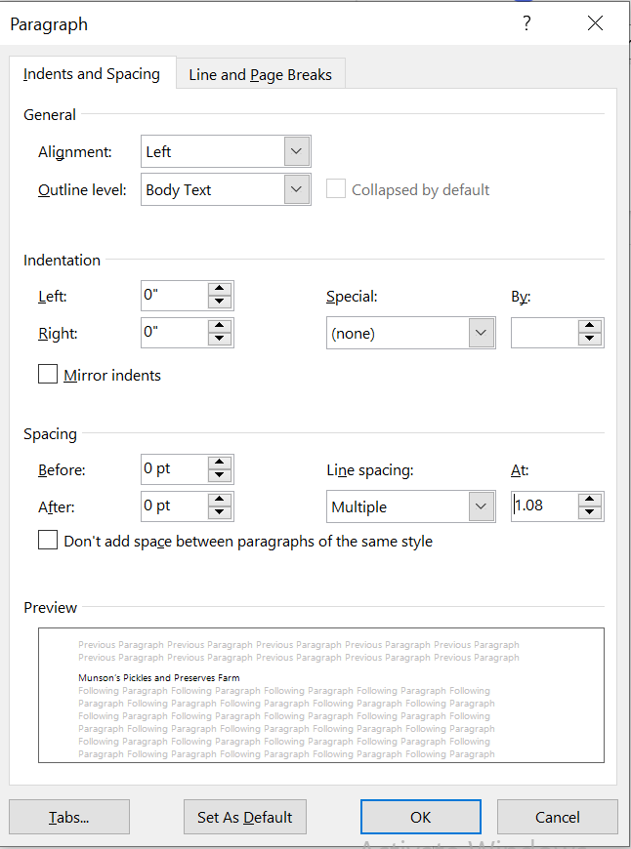
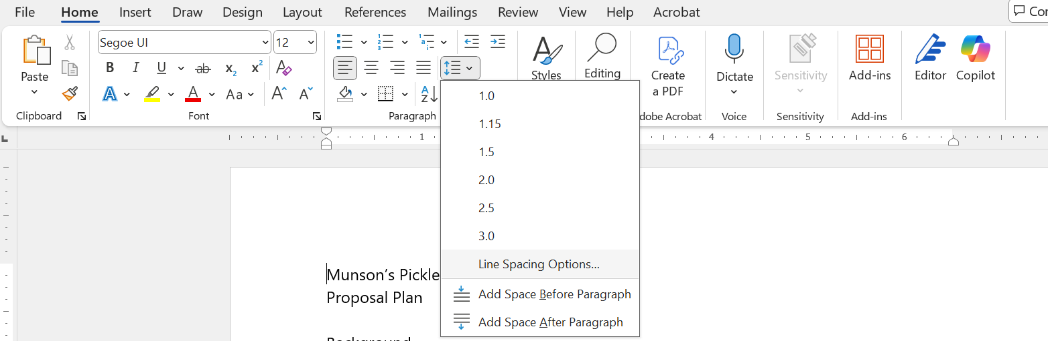
TASK 16
Set line and paragraph spacing and indentation
Home Line Spacing Options Spacing

Slide 20
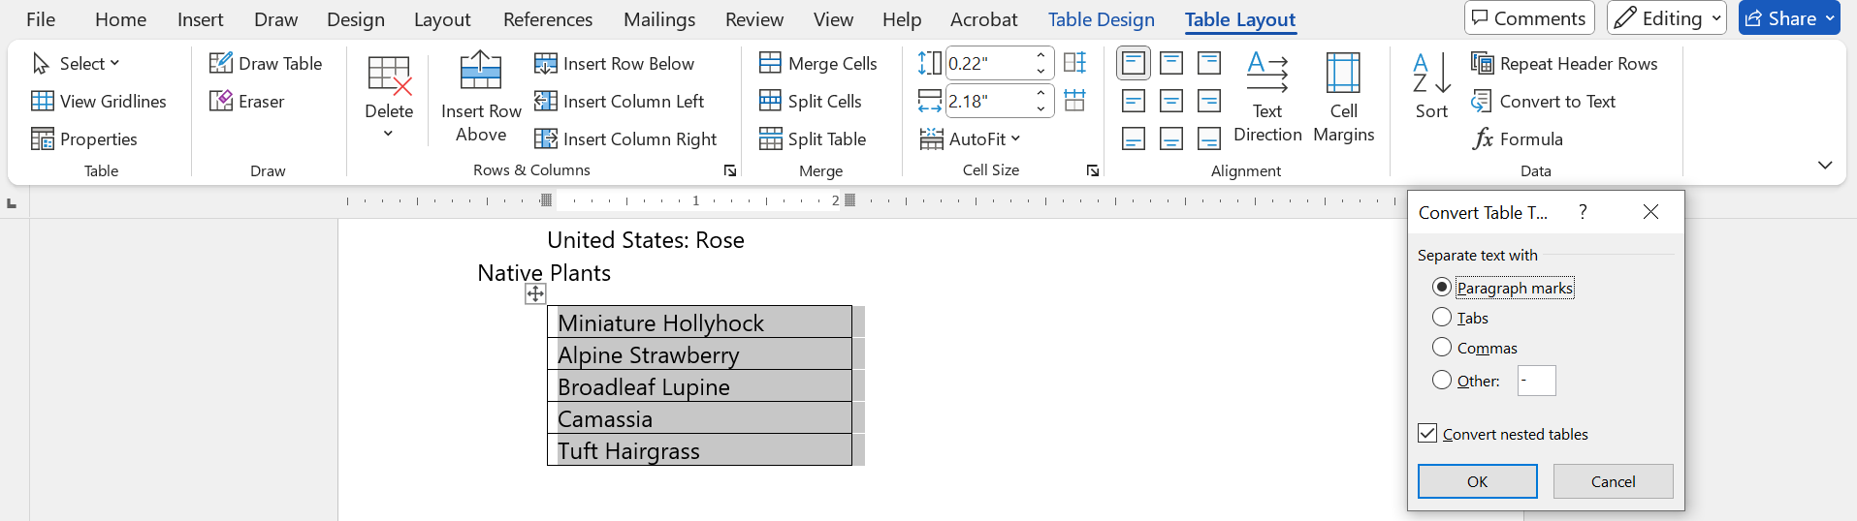
TASK 17
Convert tables to text
Highlight the Target Table Table Layout Convert to Text Paragraph Mark

Slide 21
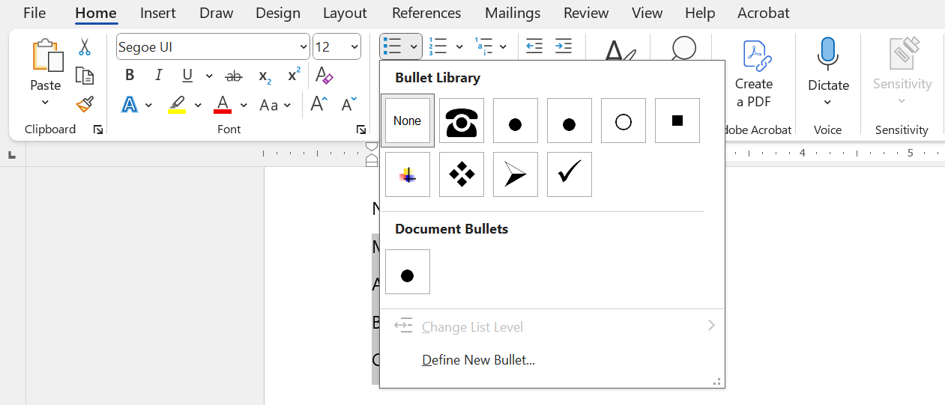
TASK 18 & 19
Format paragraphs as numbered and bulleted lists
Home Bullet Library

Slide 22
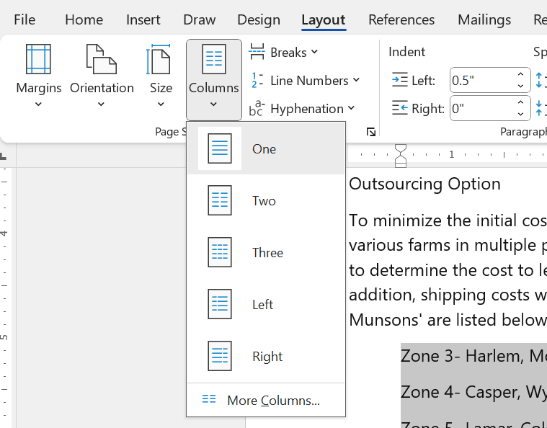
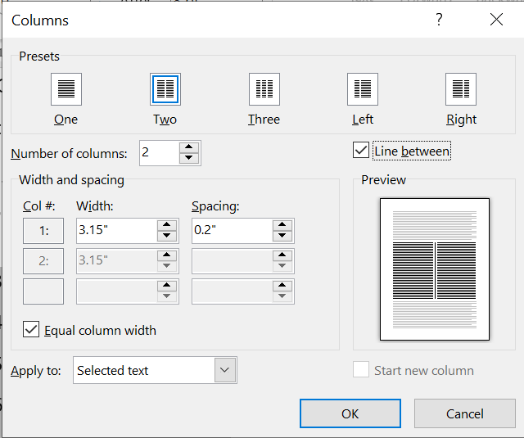
TASK 20
Format text in multiple columns
Layout More Columns

Slide 23
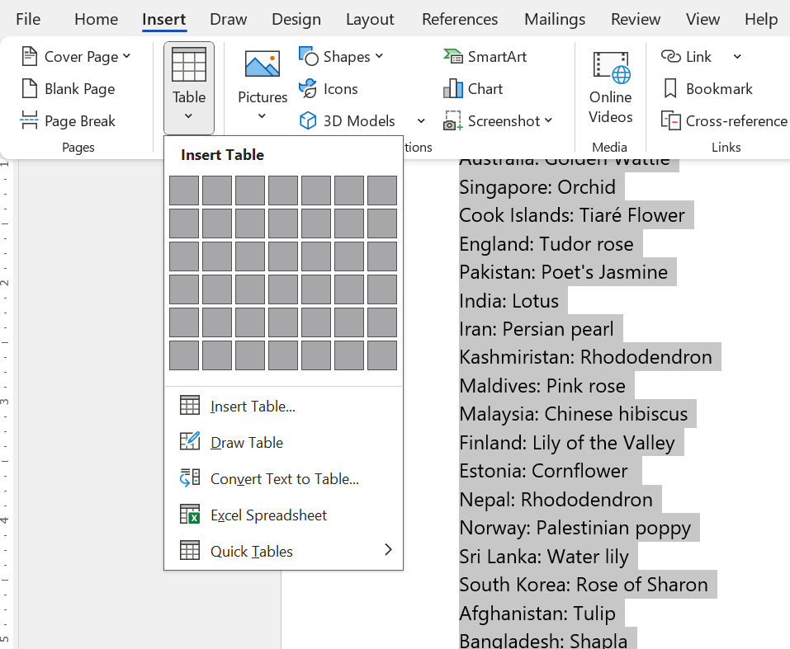
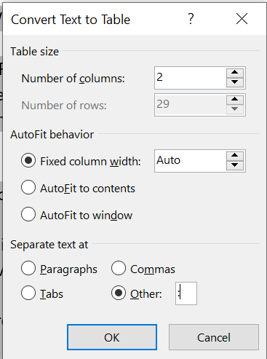
TASK 21
Convert text to tables
Insert Table Convert Text to Table

Slide 24
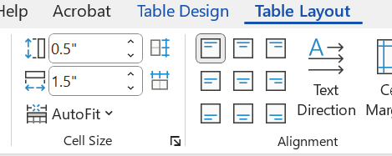
TASK 22
Resize tables, rows, and columns
Table Layout

Slide 25
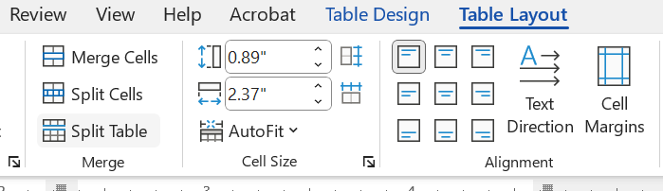
TASK 23
Merge and split cells
Table Layout Merge Cells

Slide 26
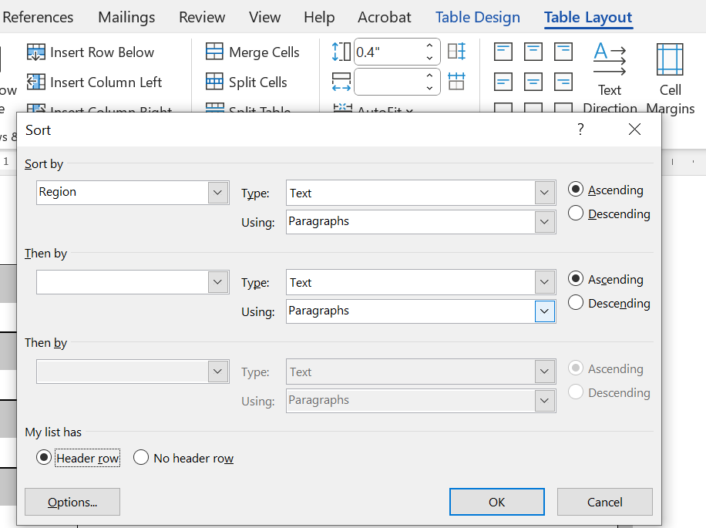
TASK 24
Sort table data
Table Layout Sort

Slide 27
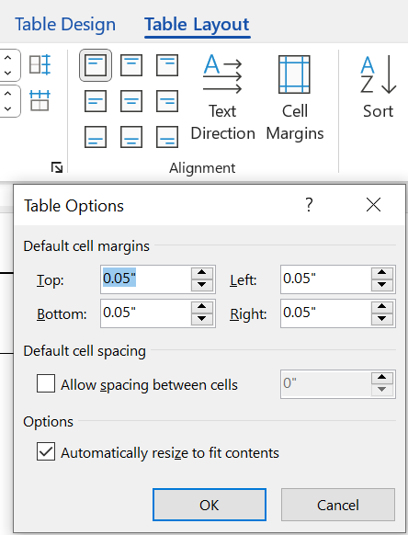
TASK 25
Configure cell margins and spacing
Table Layout Cell Margins Default cell margins

Slide 28
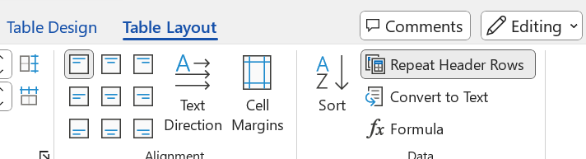
TASK 26
Configure a repeating row header
Table Layout Repeat Header Rows

Slide 29
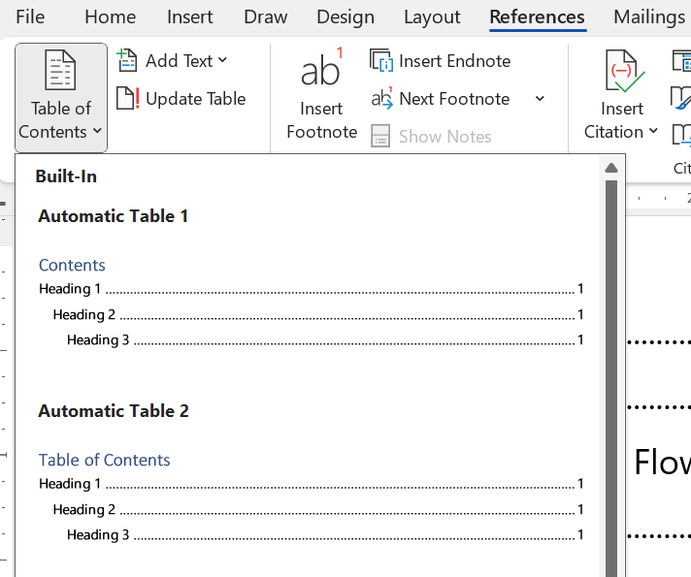
TASK 27
Insert table of contents
References Table of Contents

Slide 30
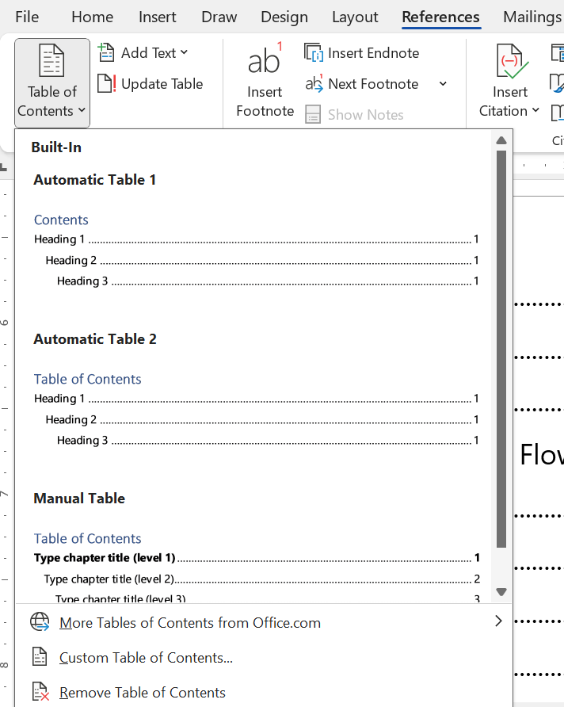
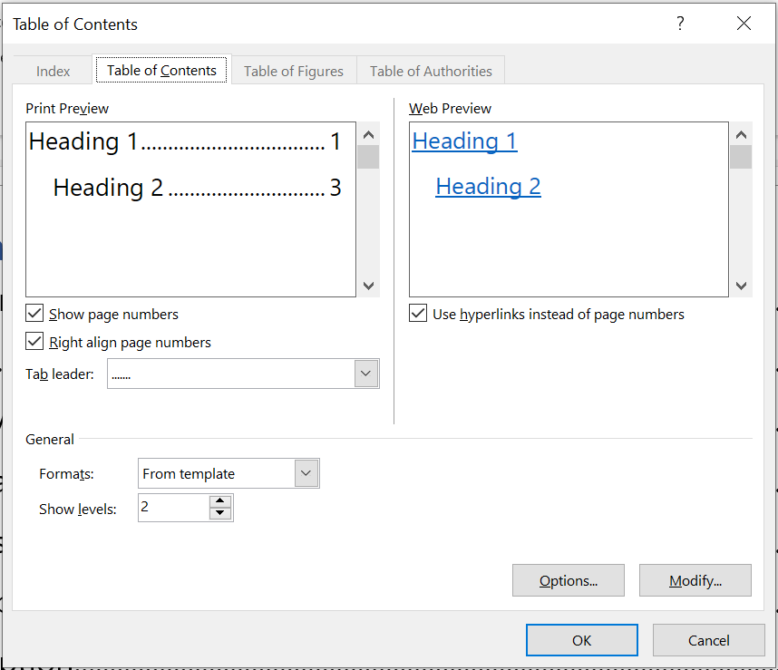
TASK 28
Customize table of contents
References Table of Contents Custom table Content Show levels

Slide 31
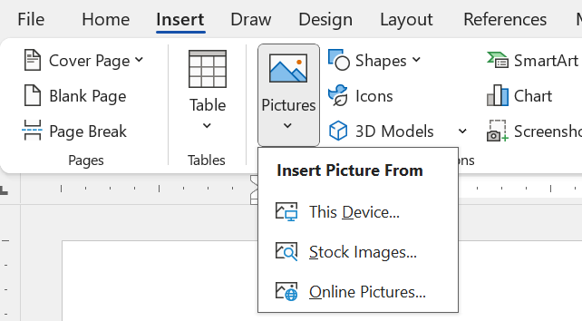
TASK 29
Insert pictures
Insert … From This Device

Slide 32
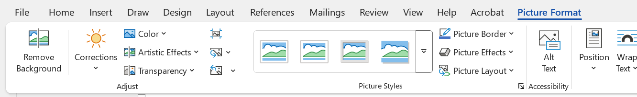
TASK 30
Insert pictures
Picture Format Remove background

Slide 33
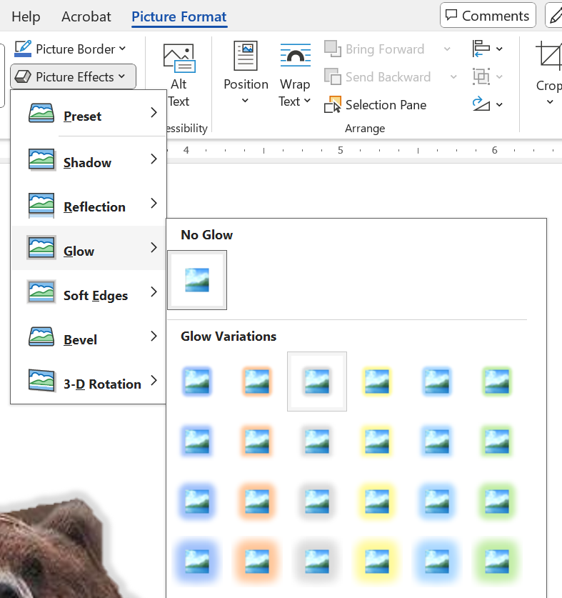
TASK 31
Apply picture effects and picture styles
Picture Format Picture Effect Glow

Slide 34
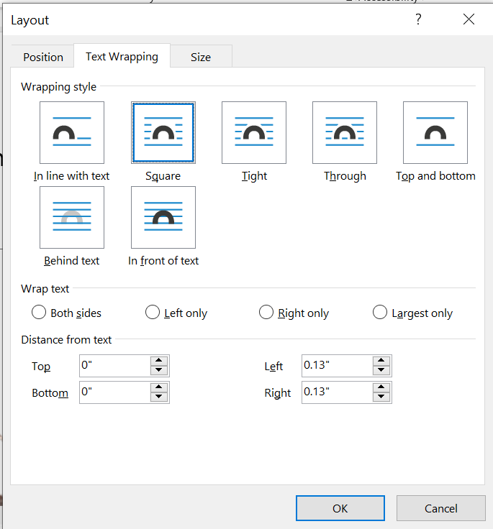
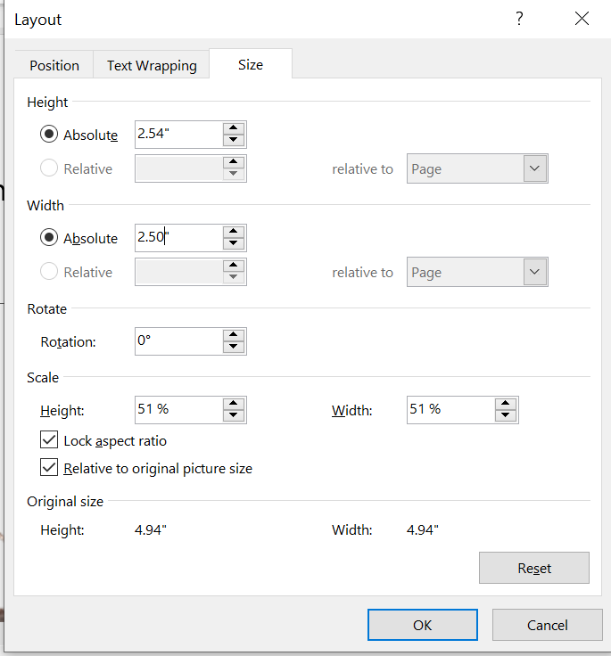
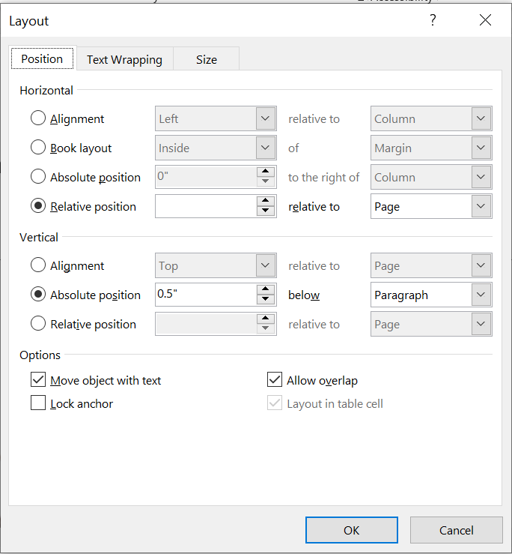
TASK 32
Position objects
Picture wrapping Layout

Slide 35
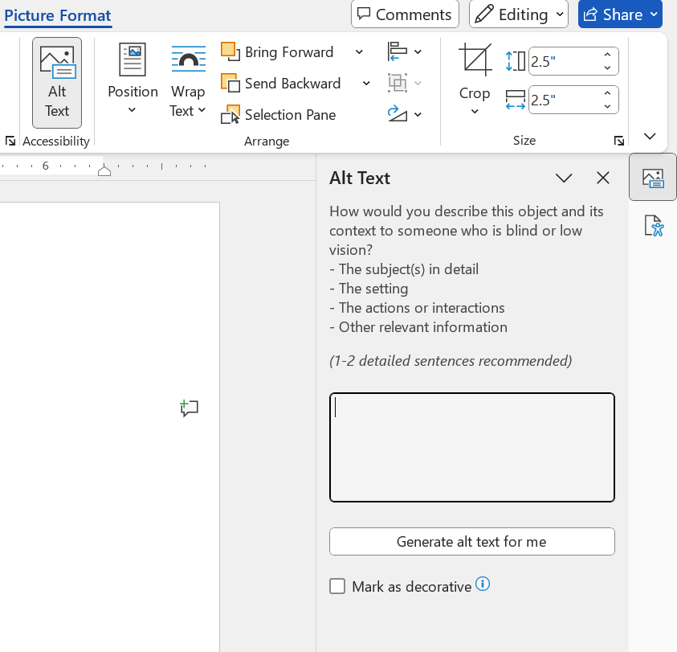
TASK 33
Show and hide formatting symbols and hidden text
Home Hide/Show
TASK 34
Add alternative text to objects for accessibility
Picture Format Alt Text

Slide 36
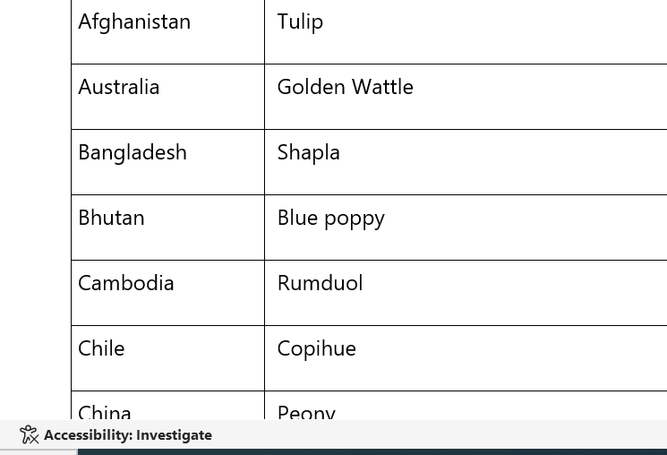
TASK 35
Locate and correct accessibility issues

Slide 37
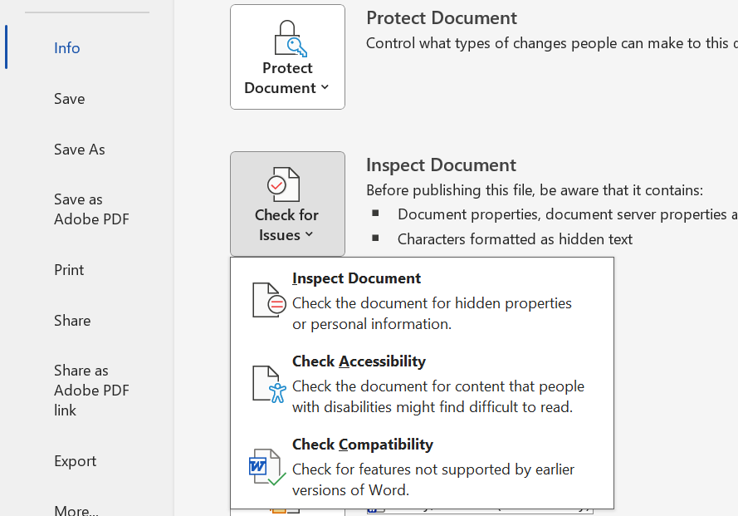
TASK 36
Locate and correct compatibility issues
File Info Inspect Document Check Compatibility

Slide 38
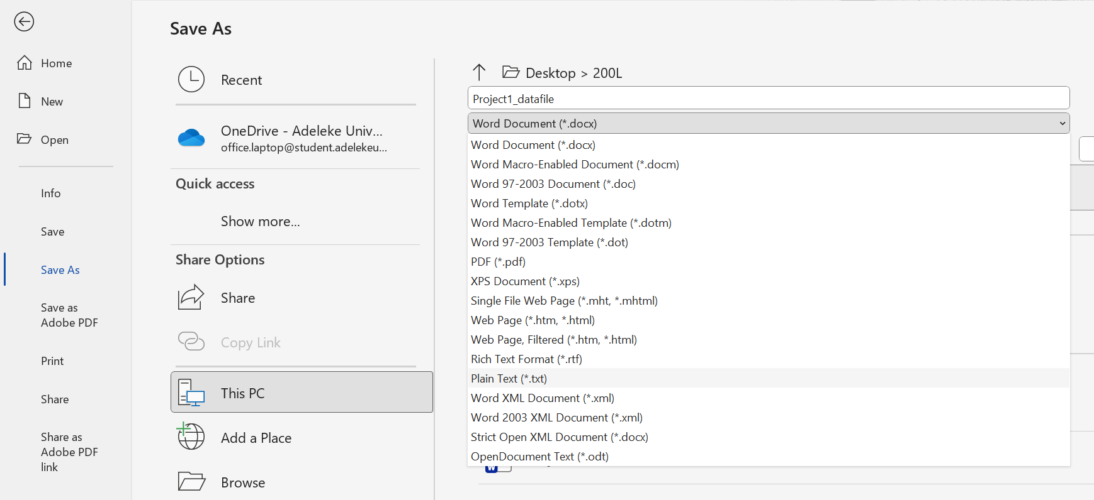
TASK 37
Locate and correct compatibility issues
File Save as PDF

Slide 39
THANK YOU
MIA Team – Adeleke University
Contact this number for any enquiry:
09158715002

