Slide 1
MICROSOFT EXCEL 2
MICROSOFT IMAGINE ACADEMY – ADELEKE UNIVERSITY

Slide 2
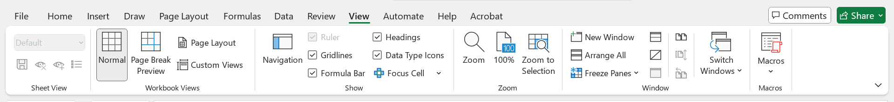
FILE FORMAT AND VIEWS
Change window views (View the Windows Side by Side)
View Window

Slide 3
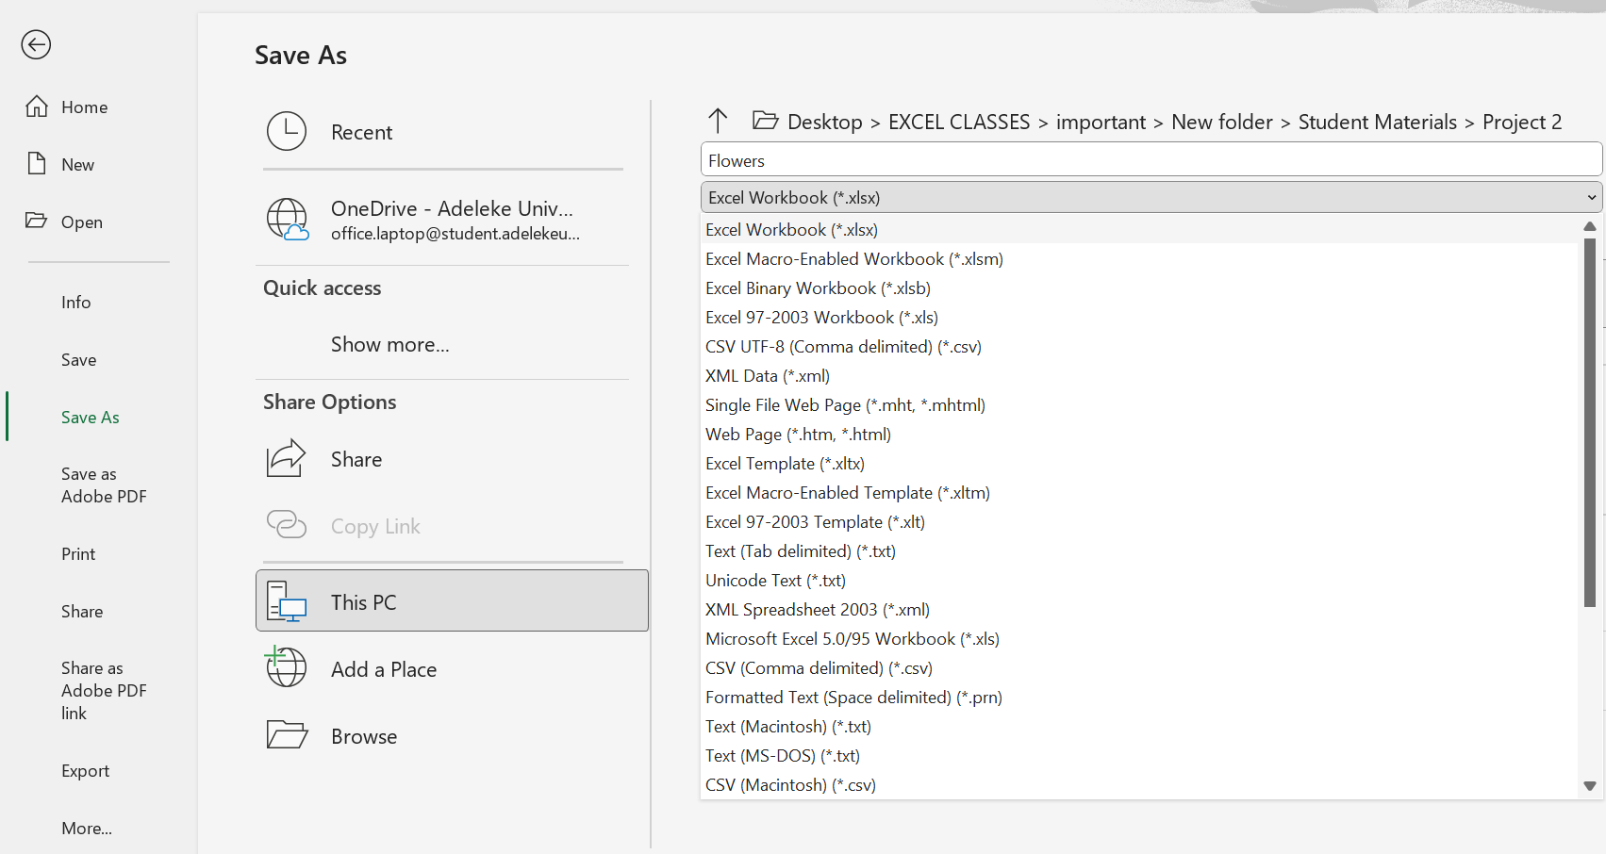
Save workbooks in alternative file formats
File Browse Format

Slide 4
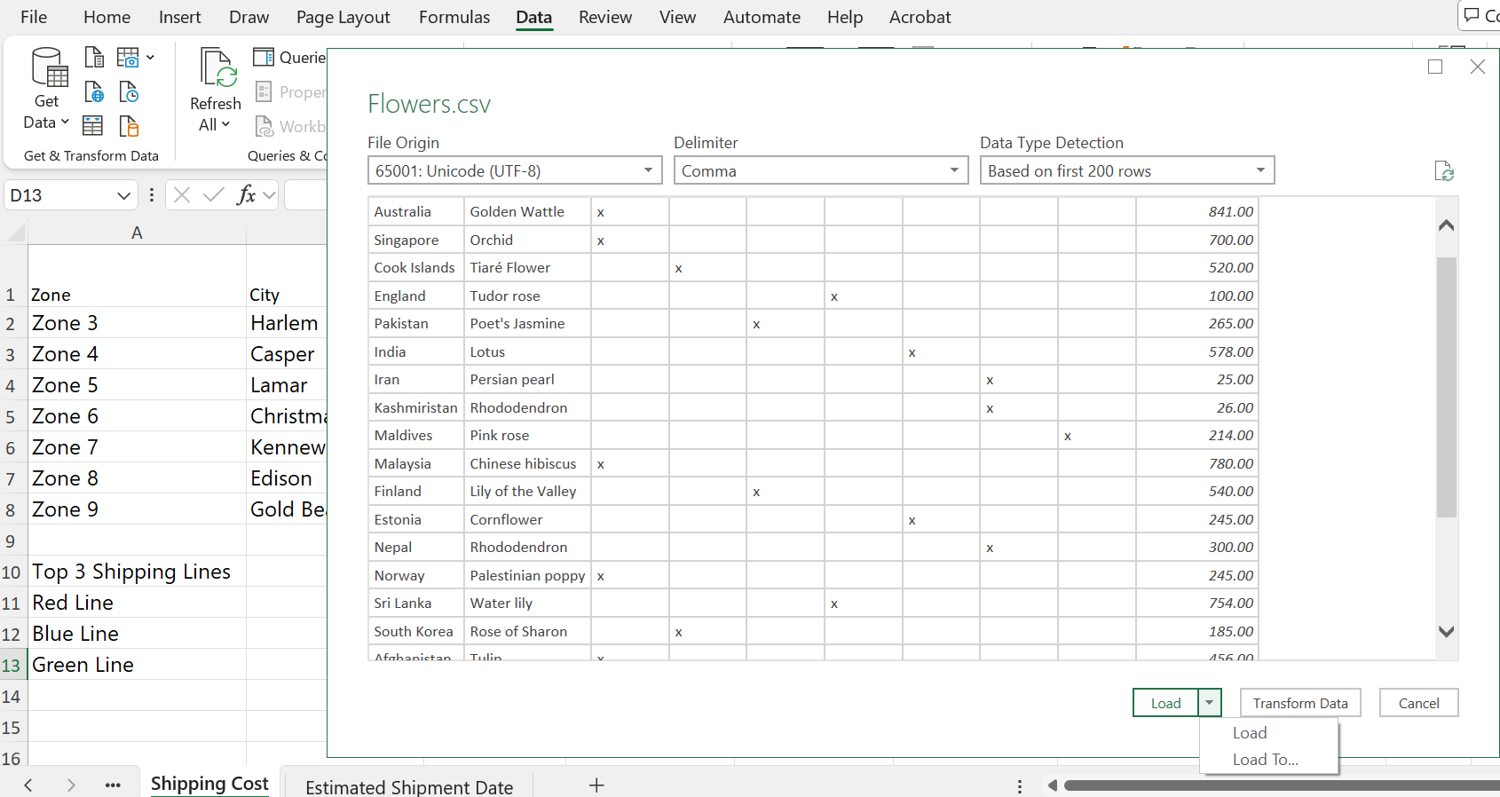
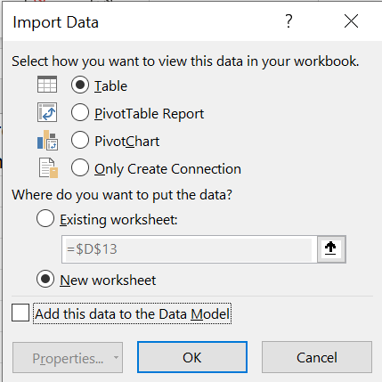
Import data from .csv files
Data From Text/CSV (Get and Transform Data) Load To Import Data

Slide 5
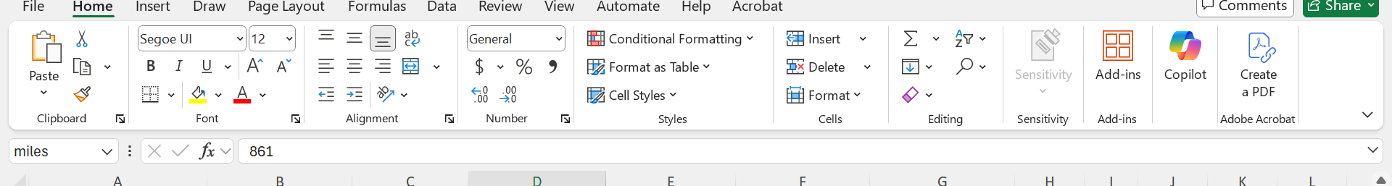
LAYOUT TITLE
Name Box
Function Box
Formular Bar

Slide 6
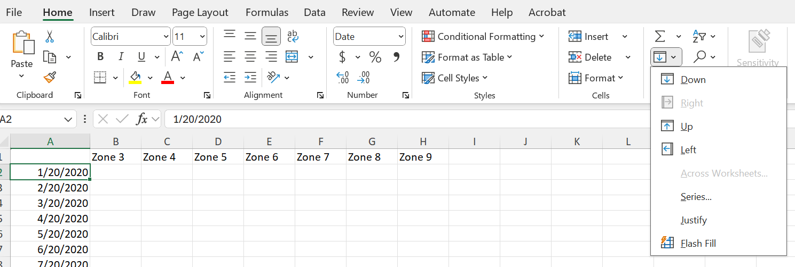
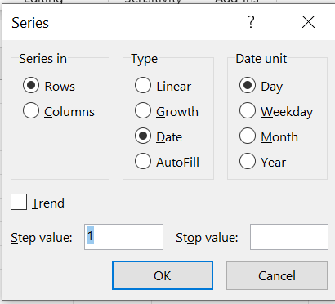
AUTOFILL
Home (Editing Group) Fill Series

Slide 7
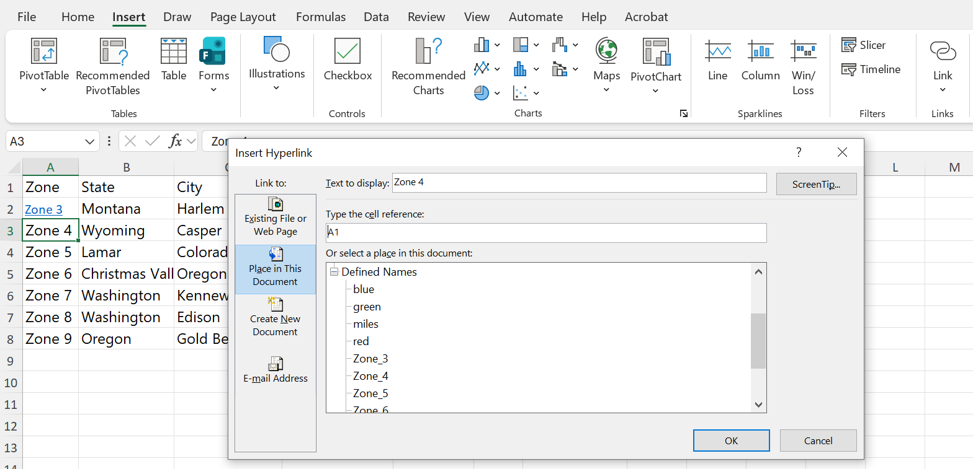
HYPERLINK
Insert Link Place in This Document

Slide 8
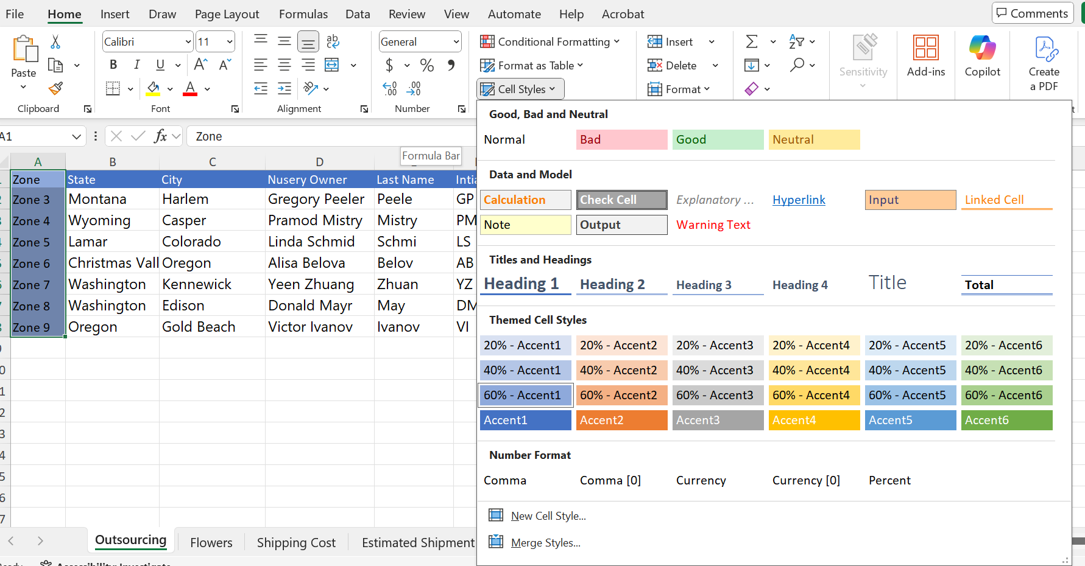
CELL STYLE
Home (Style) Cell Style

Slide 9
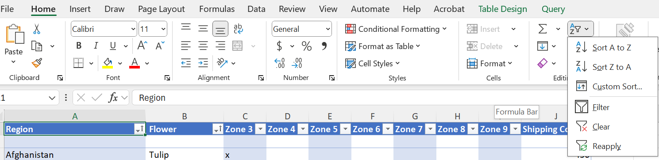
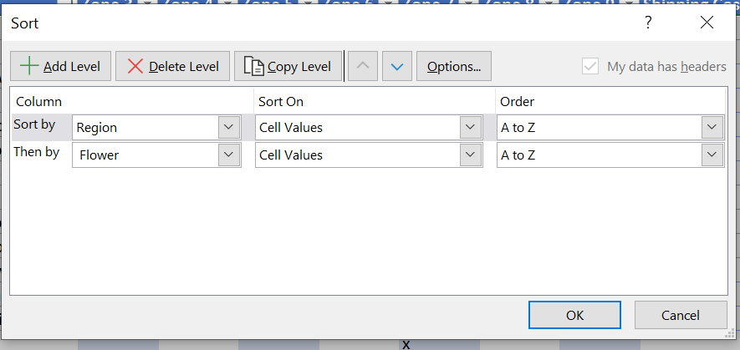
Sort Data by Multiple Column
Home Sort and Filter Custom Sort Add Level

Slide 10
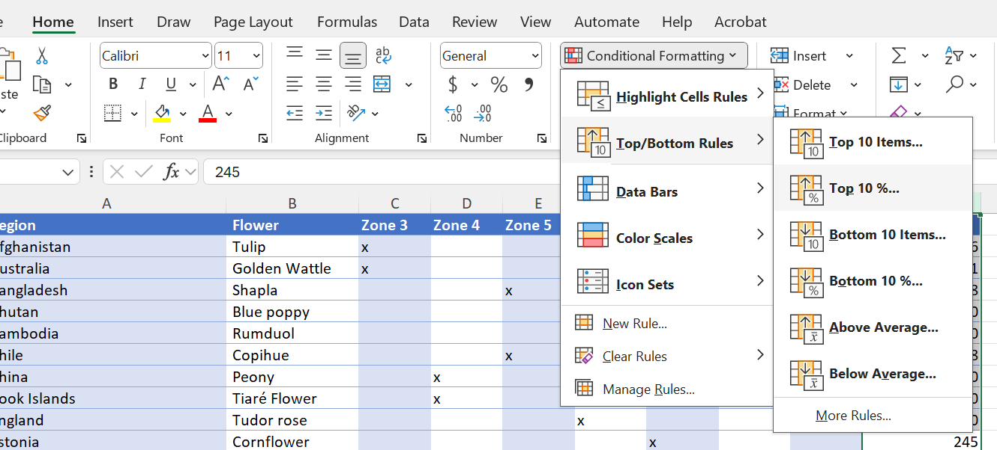
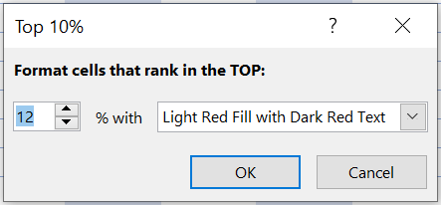
Built-in Conditional Formatting
Home Conditional Formatting Top/Bottom Rules TOP 10%...

Slide 11
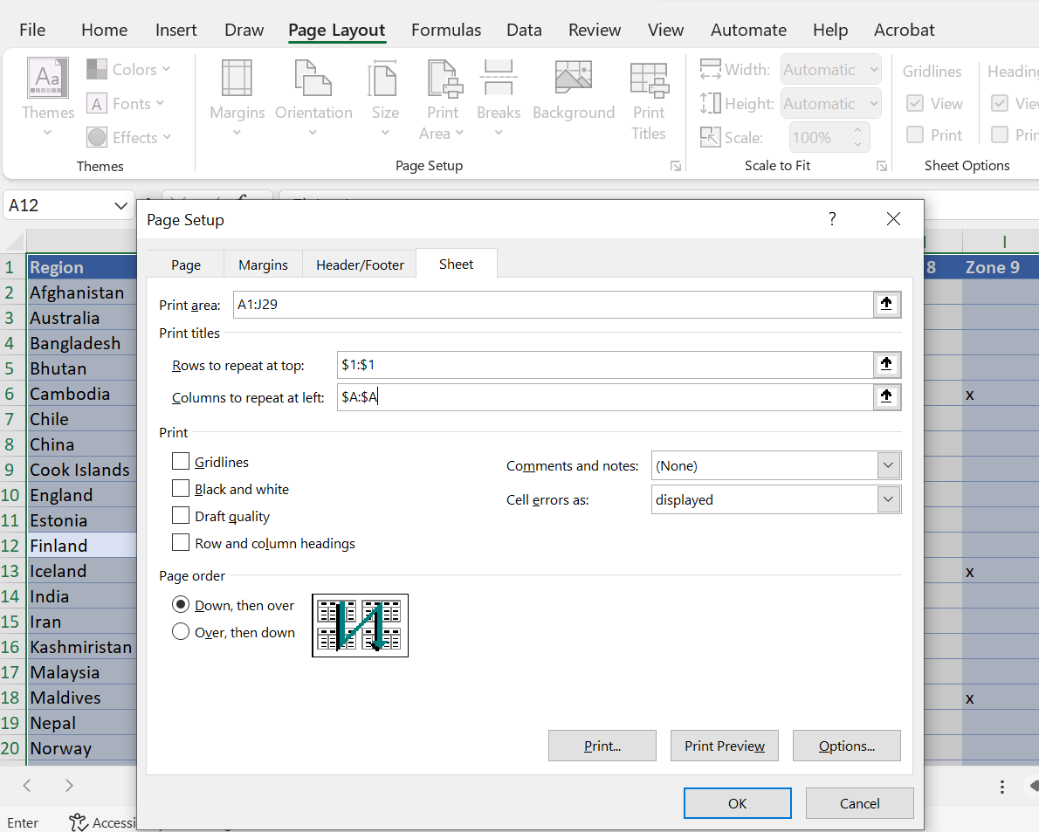
SET UP PRINT AREA
Page Layout Page Setup

