Slide 1
MICROSOFT EXCEL 1
MIA-ADELEKE UNIVERSITY

Slide 2
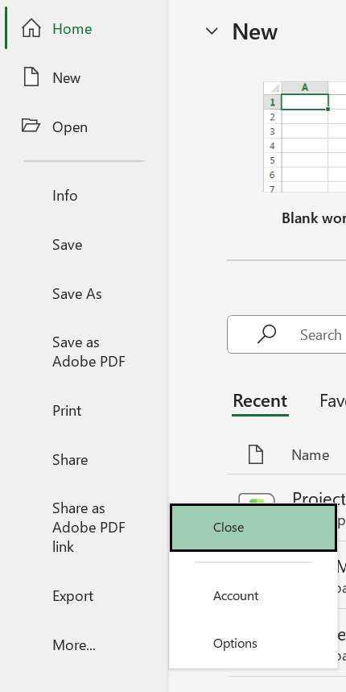
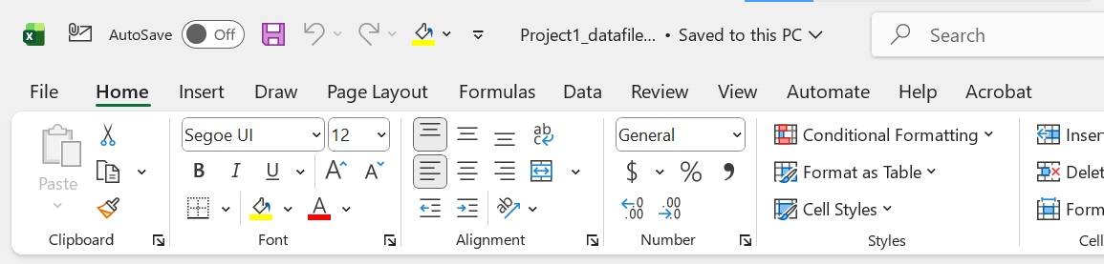
CUSTOMIZING WORK SPACE
Customize The Quick Access Toolbar
File More Options Quick Access ToolBox

Slide 3
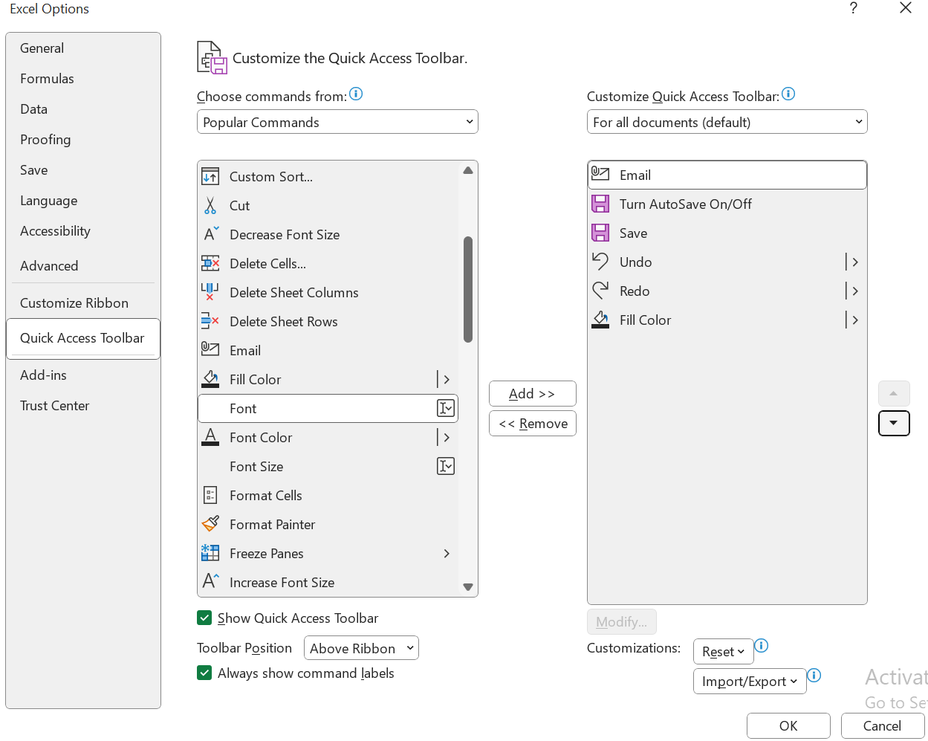

Slide 4
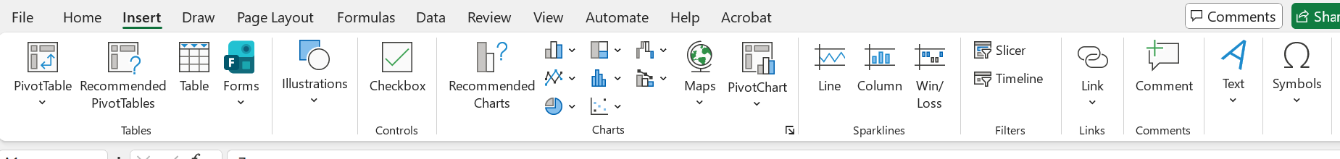
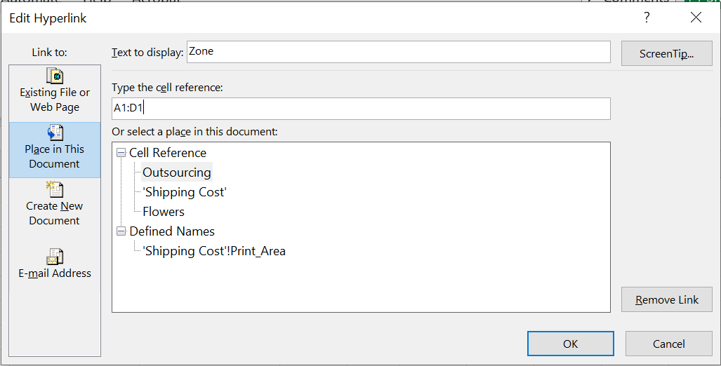
Insert And Remove Hyperlinks
Insert Link Remove Link

Slide 5
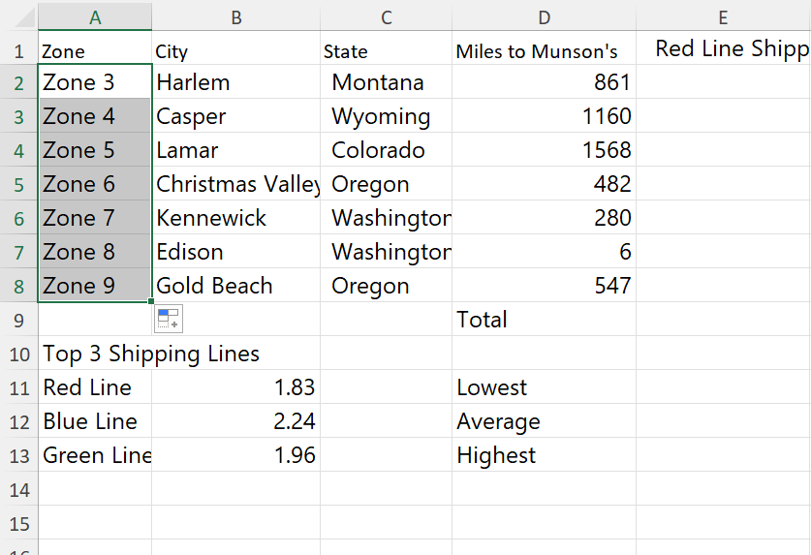
AUTOFILL
Fill Cells By Using Auto Fill

Slide 6
CELL REFERENCING AND AUTOFILL
Type Of Cell Refereces
Relative Reference: Changes when copied. Example D2
Absolute Reference: does not change when copied. Example: $D$2
Mixed Reference: part fixed, part changes Example: $D2 or D$11

Slide 7
FUNCTIONS
SUM
AVERAGE
MIN
MAX etc

Slide 8
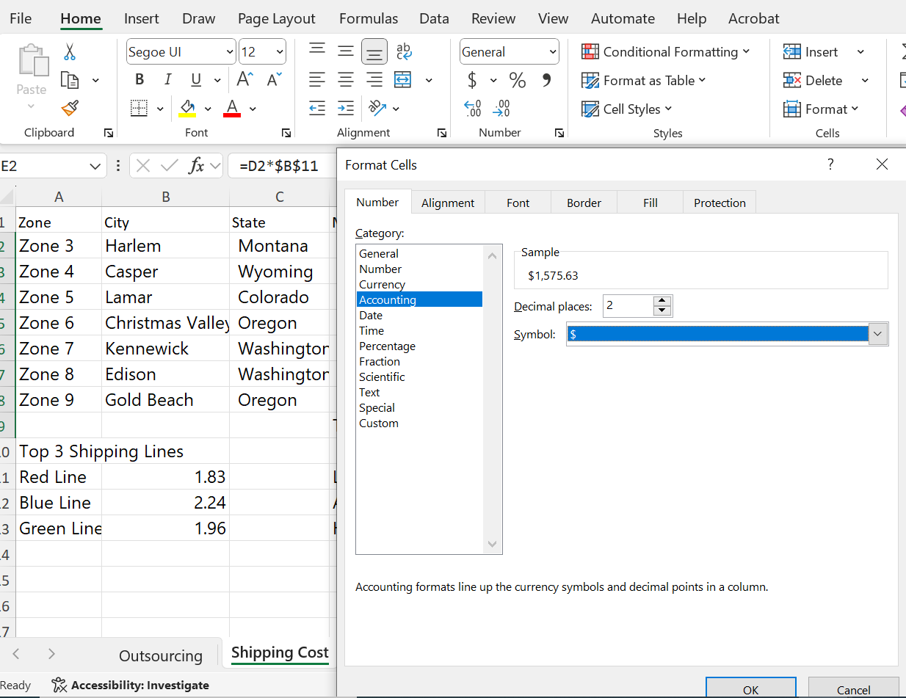
NUMBER FORMATING
Home Number

Slide 9
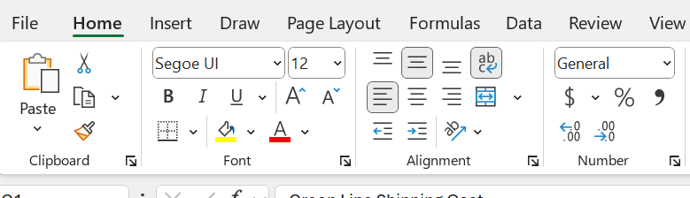
CELL FORMATTING
Wrap Text Within Cells

Slide 10
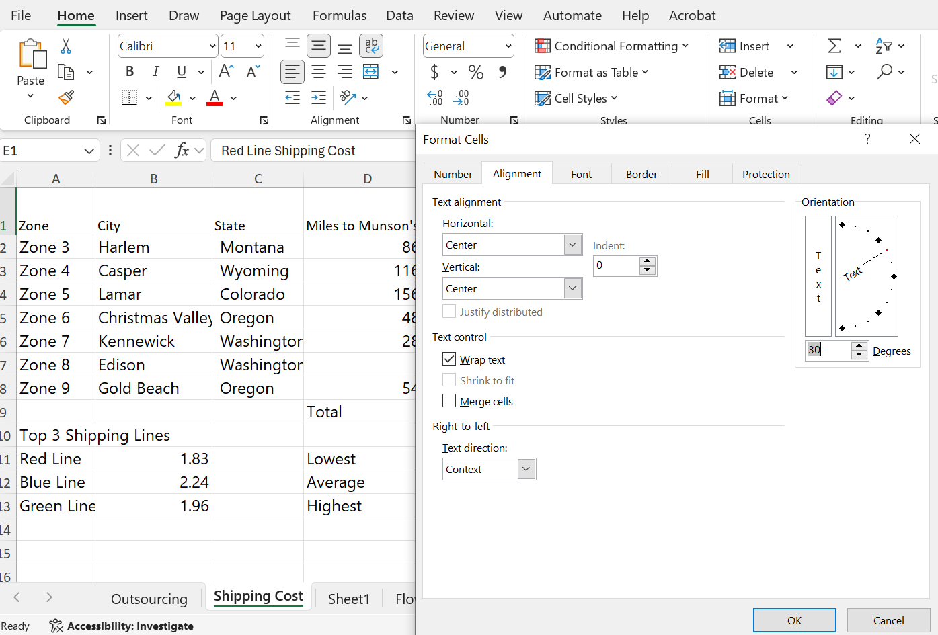
LAYOUT AND ORIENTATION
Modify Cell Alignment, Orientation, And Indentation
Home Orientation

Slide 11
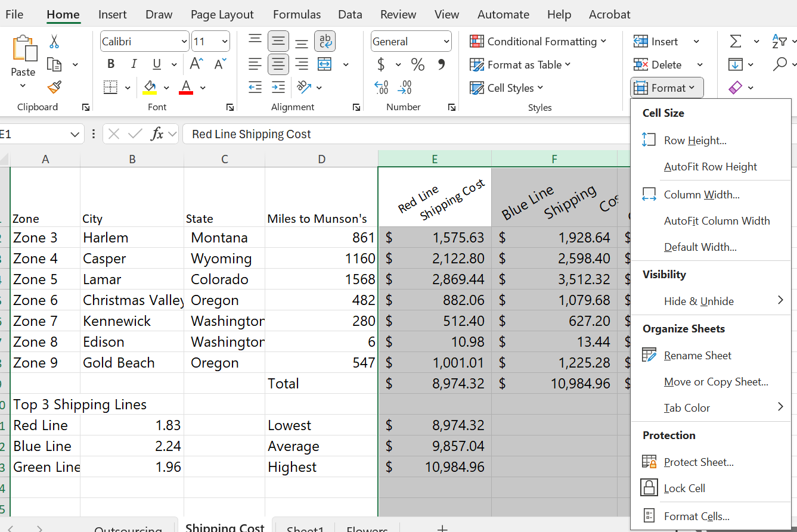
Adjust Row Height And Column Width
Home Format

Slide 12
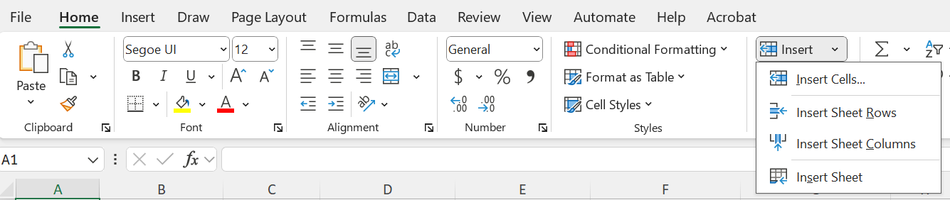
Insert And Delete Cells
Home Insert

Slide 13
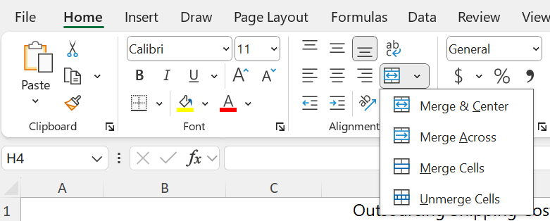
Merge And Unmerge Cells

Slide 14
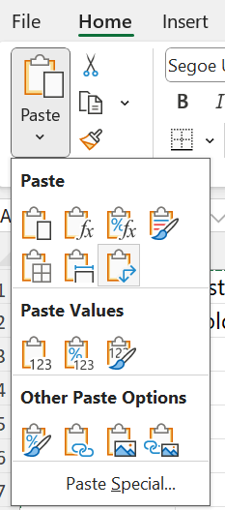
Paste Data By Using Special Paste Options (Transpose)
(Clipboard group) Home Copy Paste Transpose

Slide 15
FUNCTIONS
COUNT() : count the number of cells in a range that contains number
Counta() : count the number of cells in a range that are not empty
COUNTBLANK() : count the number of cells in a range that are empty
COUNTIF() : count the number of cells in a range that meet given condition (Conditional Function eg SUMIF()
CONCAT(), CONCATENATE() and TEXTJOIN()
RIGHT() : return the specified number of a characters from the end of text (string)
LEFT() : return the specified number of a character from the start of text string
UPPER() : Converts a text string to all uppercase letter
LOWER() : Converts a text string to all lower letter
LEN() : Returns the number of characters in a text string

Slide 16
…FUNCTIONS
COUNT() : count the number of cells in a range that contains number
Counta() : count the number of cells in a range that are not empty
COUNTBLANK() : count the number of cells in a range that are empty
COUNTIF() : count the number of cells in a range that meet given condition (Conditional Function eg SUMIF()
CONCAT(), CONCATENATE() and TEXTJOIN()
RIGHT() : return the specified number of a characters from the end of text (string)
LEFT() : return the specified number of a character from the start of text string
UPPER() : Converts a text string to all uppercase letter
LOWER() : Converts a text string to all lower letter
LEN() : Returns the number of characters in a text string

Slide 17
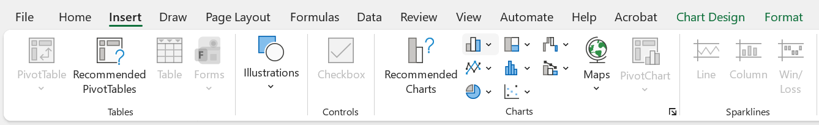
CHART FORMATING
Inserting A Chart
Insert Charts

Slide 18
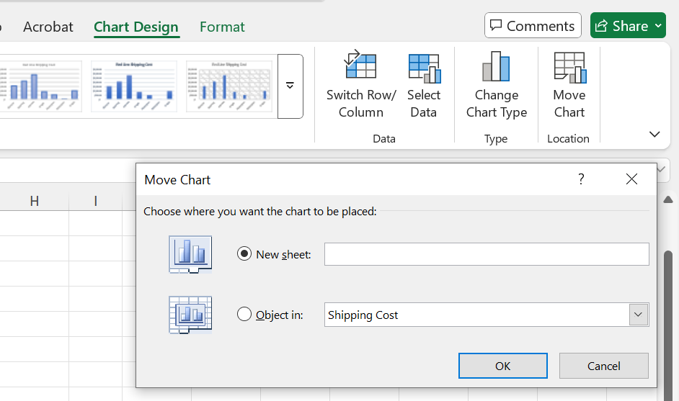
To Move Chart
(Select Chart) Chart Design Move Chart

