Slide 1
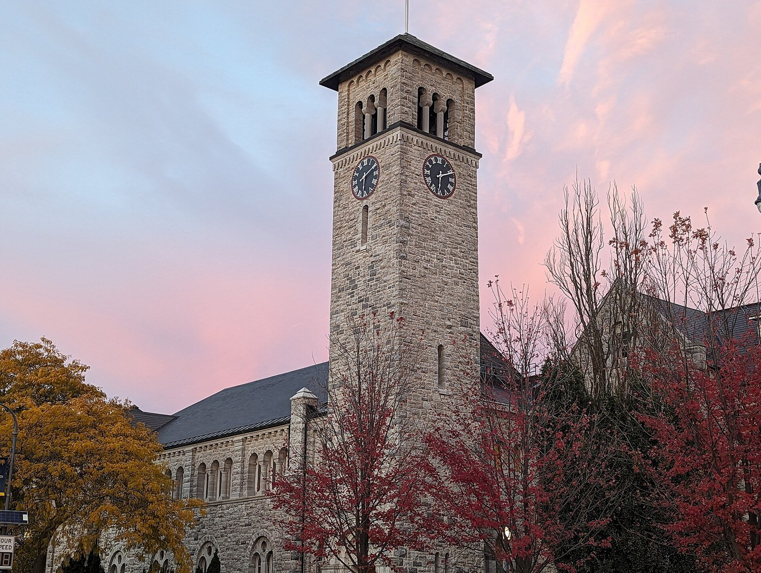



Privacy-Preserving Shopping Intelligence
via Federated and On-Device Learning
How much next-product recommendation quality survives when shopping data never leaves the device?
Group members
Ahmed Sherif
Eid Abdelrihem
Ahmed Abdelhamed
Supervised by
Prof. Rongxing Lu, Queen's University
Prof. Mona Farouk, Cairo University
Prof. Motaz El-Saban, Microsoft (industry mentor)
MSc in Artificial Intelligence and Data Science
School of Computing, Queen's University · October 20, 2026
Grant Hall, Queen's University. Photo: Takipoint123, CC BY-SA 4.0, Wikimedia Commons
Notes:
Good morning. We are presenting our MSc project on privacy-preserving shopping intelligence: can a browser recommend products from shopping behaviour without sending that behaviour to a server, and how much quality does that cost? Twenty minutes: the question, how we built a rigorous answer, the confirmatory result, what we learned after it, privacy, devices, and lessons.

Slide 2

The research question
“How much shopping recommendation quality can be retained when moving from cloud-based to on-device or federated models?”
Why it matters
• A browser (Microsoft Edge) sees shopping behaviour on the device
• Cloud training needs that history on a server, which users and regulators resist
• Most federated-recommendation papers use small datasets and sampled metrics, not real shopping logs
What we answer
• Retention: cloud → federated → on-device
• Value of server pretraining (warm start) and on-device adaptation
• Privacy: cost of DP, leakage audits
• Deployability: INT8, latency, upload bytes
Photo: Bogdan Hoyaux / European Commission, CC BY 4.0, Wikimedia Commons
Privacy-Preserving Shopping Intelligence | MSc Final Presentation, Queen's University
2
Notes:
This is the question from our original proposal. The motivation comes from Microsoft Edge: the browser already sees shopping behaviour. We split the question into five measurable parts.

Slide 3
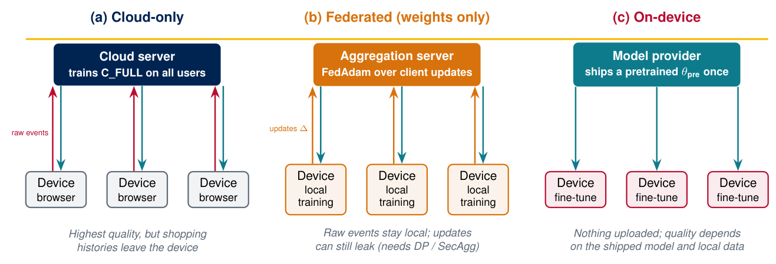
Three ways to deploy a shopping recommender
Every comparison in this project is between these three architectures
Privacy-Preserving Shopping Intelligence | MSc Final Presentation, Queen's University
3
Notes:
Cloud-only gives the quality ceiling but moves raw histories. Federated learning keeps raw events local and sends only model updates — which can still leak. On-device ships a model once and adapts it locally. Our answer is expressed as retention of the cloud reference.

Slide 4
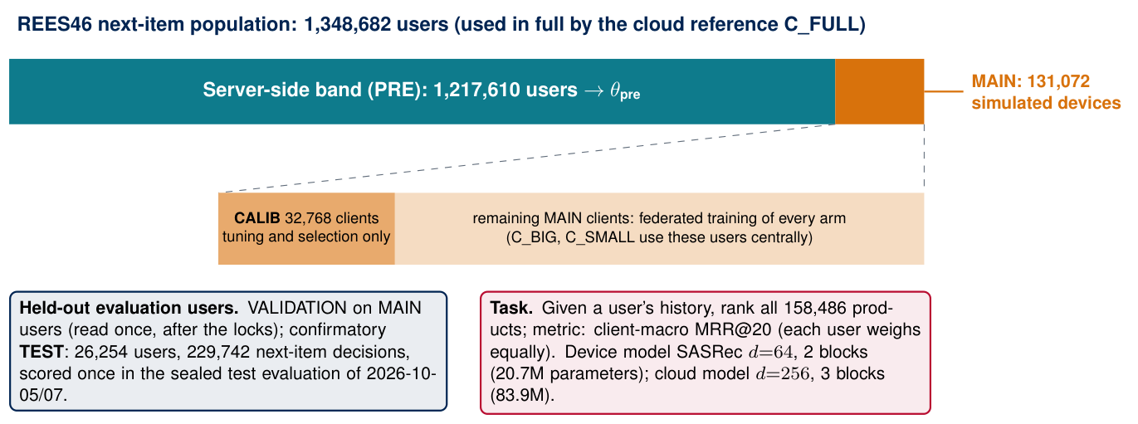
How we built a rigorous answer
Design choices
• REES46 e-commerce log, Oct–Nov 2019
• Rank the full catalogue (158,486 products) — no sampled negatives
• Client-macro MRR@20; retention = model / cloud reference
• SASRec: device d=64 (20.7M) · cloud d=256 (83.9M)
• Pre-registered: every decision locked before one TEST look
• 6 public benchmarks as a second check
Privacy-Preserving Shopping Intelligence | MSc Final Presentation, Queen's University
4
Notes:
1.35 million users. 1.2 million form the server-side band used to pretrain the shipped model; 131,072 are simulated devices. TEST is 26,254 users never touched until a single sealed test evaluation. Pre-registration matters because there are dozens of arms and many possible readings.

Slide 5
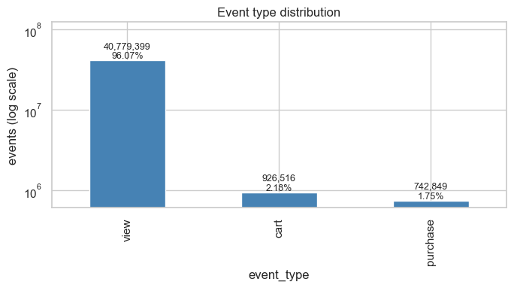
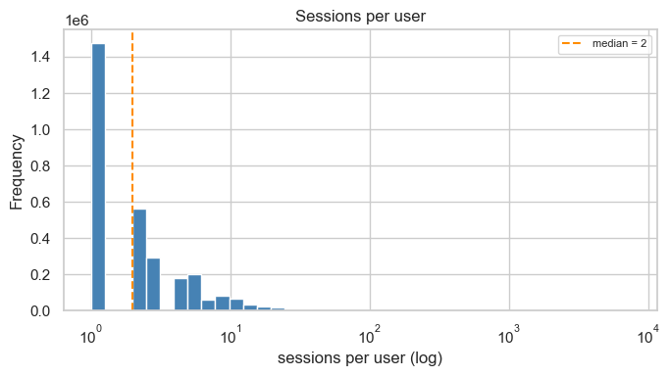
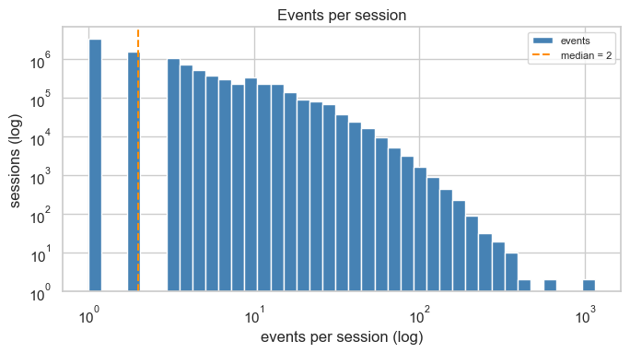
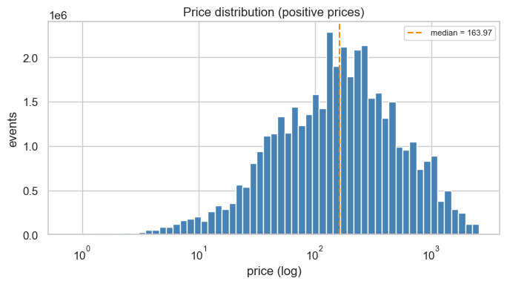
The data: real shopping sessions from one store
REES46, October 2019 month, as plotted by our data-audit notebook
Event types: 96% views, 2.2% carts, 1.8% purchases
Sessions per user: median 2
Events per session: median 2, long tail
Product prices: median 163.97
Privacy-Preserving Shopping Intelligence | MSc Final Presentation, Queen's University
5
Notes:
These four plots come straight from the data-audit notebook of our prototype stage: 42.4 million events in October alone, almost all of them views, with short sessions and a long tail. This is real shopping behaviour, not a benchmark toy.

Slide 6
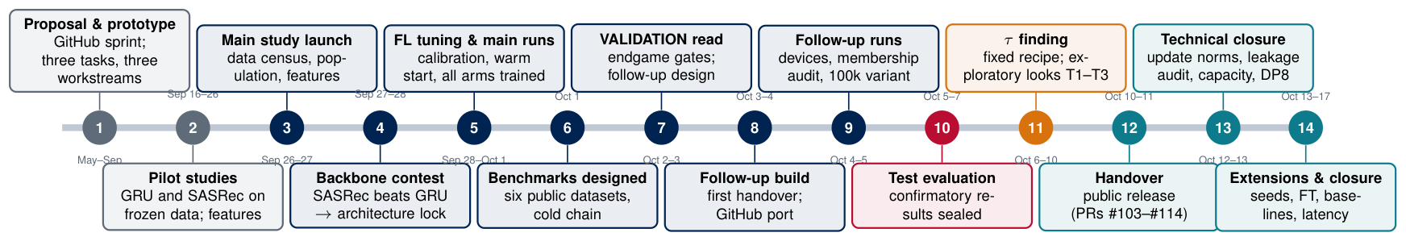
The research journey: 14 phases in five months
From the proposal to the final consolidation
Each phase answered a question raised by the previous one: prototype → stronger backbone → tuned federated recipe → sealed confirmatory test → diagnosis of why federation added nothing → fixed recipe, privacy and device studies → closure.
Privacy-Preserving Shopping Intelligence | MSc Final Presentation, Queen's University
6
Notes:
Our book tells the story in this order. First the prototype stage on GitHub, then the pilot studies, then the pre-registered main study up to the confirmatory test evaluation on 5–7 October, then the post-hoc exploratory work, and finally the technical closure and extensions.

Slide 7
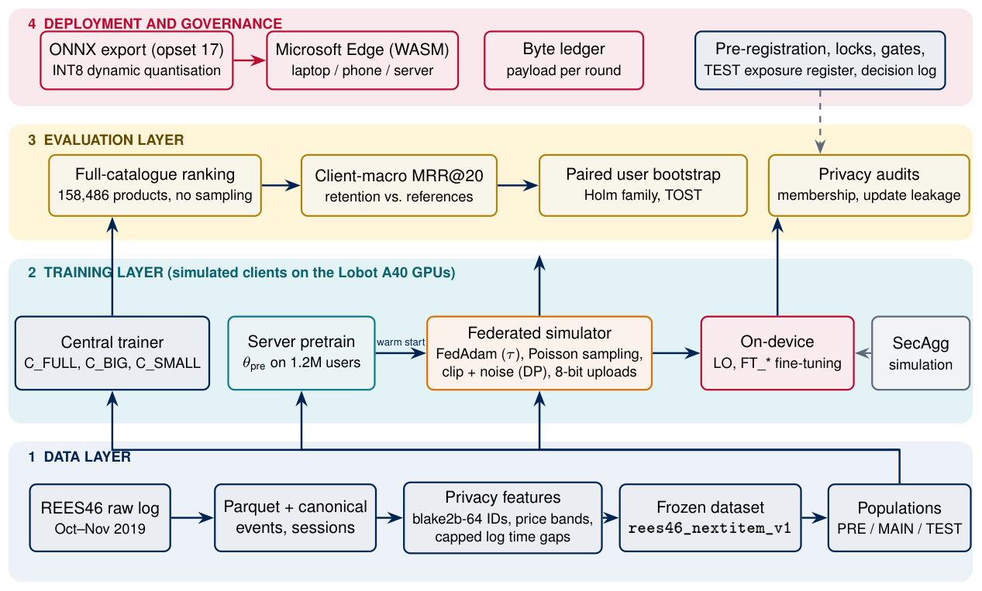
System architecture
Data → training → evaluation → deployment and governance
Privacy-Preserving Shopping Intelligence | MSc Final Presentation, Queen's University
7
Notes:
Four layers. The data layer produces a frozen, hashed dataset. The training layer simulates the federated clients on the Lobot A40 GPUs. The evaluation layer ranks the full catalogue and computes paired bootstrap statistics. Deployment: ONNX, INT8 and Edge WASM; governance wraps everything.

Slide 8
The prototype stage and the system workstream
Prototype stage (Aug–Sep 2026)
System, deployment & security workstream
• Raw October log: 42.4M events → Parquet → canonical events
• Cohort of 388,789 clients; sealed TEST window
• Three tasks (next category, purchase, re-rank)
• The GRU model beat the transition-table baseline
• Federated plumbing with Flower; pilot retention 88.38% (validation)
• Lesson: a label defect and evaluator conventions → need a stronger protocol
• blake2b-64 hashed identifiers; price bands; capped log time gaps
• ONNX export (opset 17) with a dynamic-batch fix
• INT8 dynamic quantisation + benchmark
• Communication byte ledger per round
• Quality-retention registry
• Threat model, secret handling, CI with a lock-file check
Privacy-Preserving Shopping Intelligence | MSc Final Presentation, Queen's University
8
Notes:
The prototype stage built the platform. On the left the prototype; on the right the system, deployment and security workstream. Its main lesson was methodological: small definition errors can flip conclusions, which motivated the pre-registered main study.

Slide 9
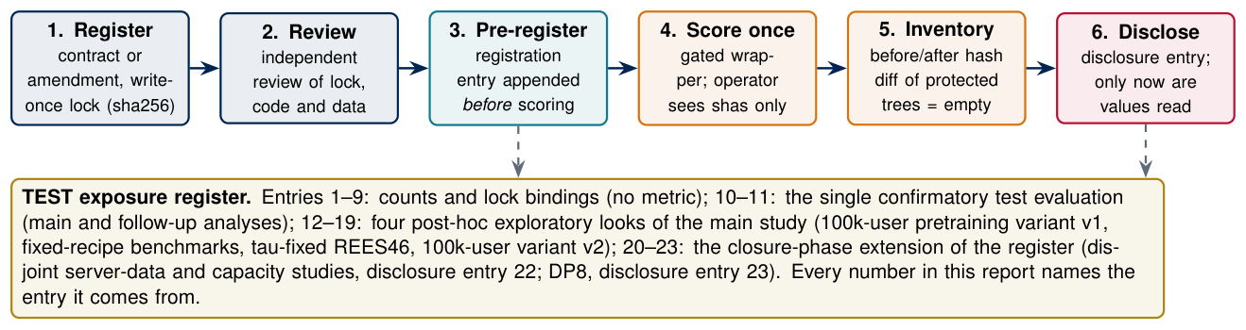
Main study: backbone contest and the gated test protocol
Backbone contest (validation)
• GRU family mean 0.1569
• SASRec family mean 0.1612
• Outcome DECISIVE_STABLE → architecture lock on SASRec
Why so much protocol?
• 33 main-analysis contrasts, a Holm family of 18, two seeds, many arms — easy to fool ourselves
• Selection only on calibration data; main-population validation read once; TEST read once in a sealed evaluation
• Every later exploratory test look is a numbered, disclosed register entry (12–23)
Privacy-Preserving Shopping Intelligence | MSc Final Presentation, Queen's University
9
Notes:
In our contest SASRec scored higher than GRU on validation, and the architecture was locked. The protocol on the right: register, review, pre-register the look, score once, check the inventory, then disclose. This is what makes the confirmatory numbers credible.

Slide 10
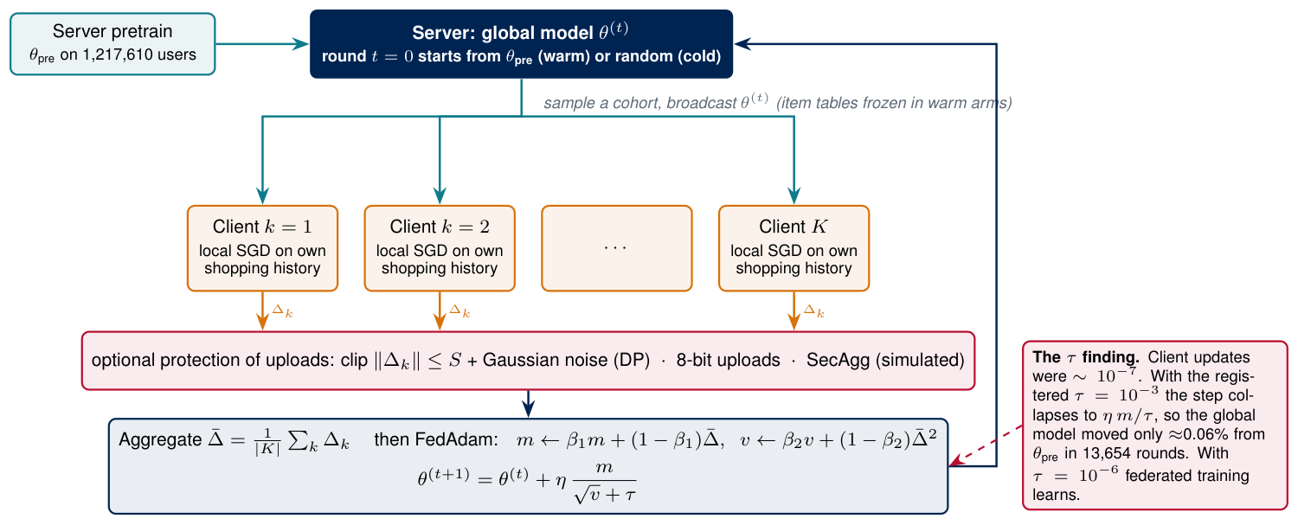
The federated recipe: warm-started FedAdam
Privacy-Preserving Shopping Intelligence | MSc Final Presentation, Queen's University
10
Notes:
Each round the server broadcasts the model, clients train on their own history, optional DP, quantisation and simulated secure aggregation protect the uploads, and FedAdam updates the global model. The red box is the post-hoc finding we will come back to: tau.

Slide 11
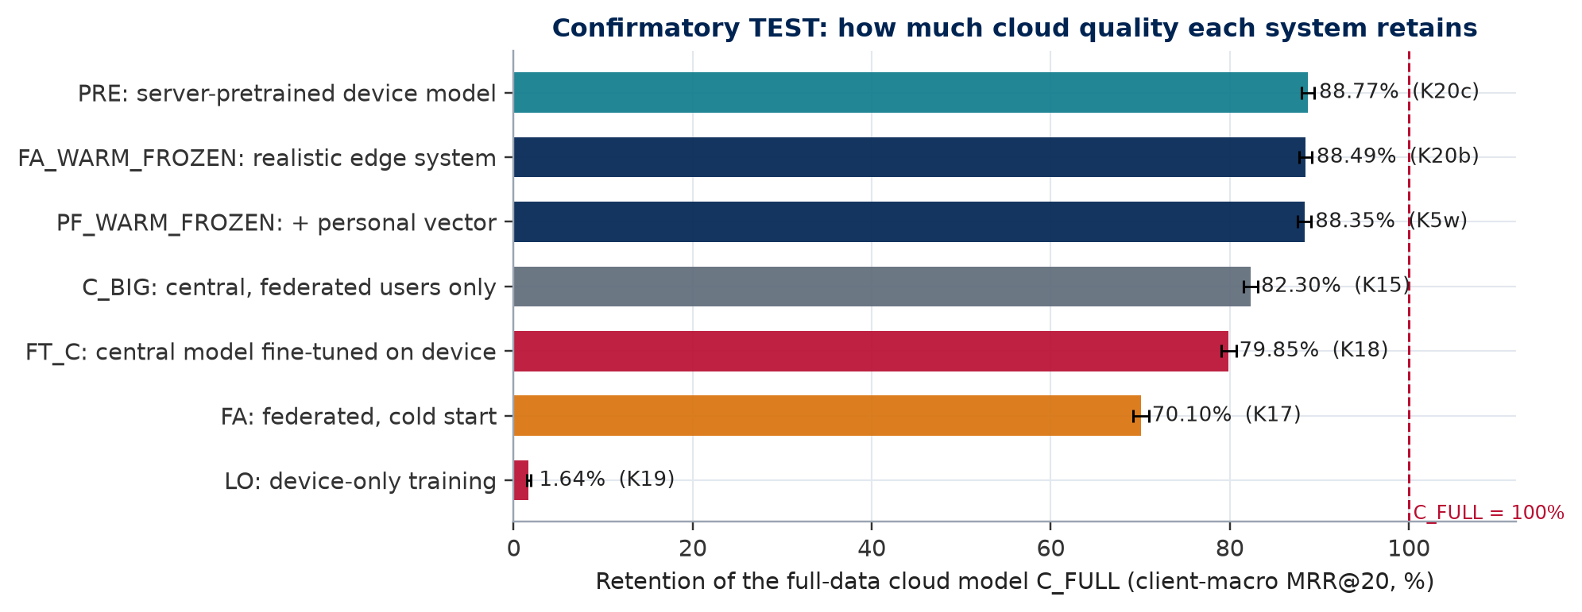
Confirmatory answer: how much cloud quality survives
REES46 TEST, 26,254 users, client-macro MRR@20
(confirmatory result)
Key numbers
• Realistic edge system (warm FL, frozen tables): 88.49% [87.73, 89.18]
• Pretrained model alone: 88.77%
• Cold federated: 70.10%
• Device-only training: 1.64% of C_FULL
• Warm start over cold FL: +0.0331 MRR@20
Privacy-Preserving Shopping Intelligence | MSc Final Presentation, Queen's University
11
Notes:
The headline: the realistic edge system keeps 88.49 percent of the full-data cloud model, with a confidence interval of 87.73 to 89.18. But notice the pretrained model alone already keeps 88.77 percent. Device-only training collapses.

Slide 12
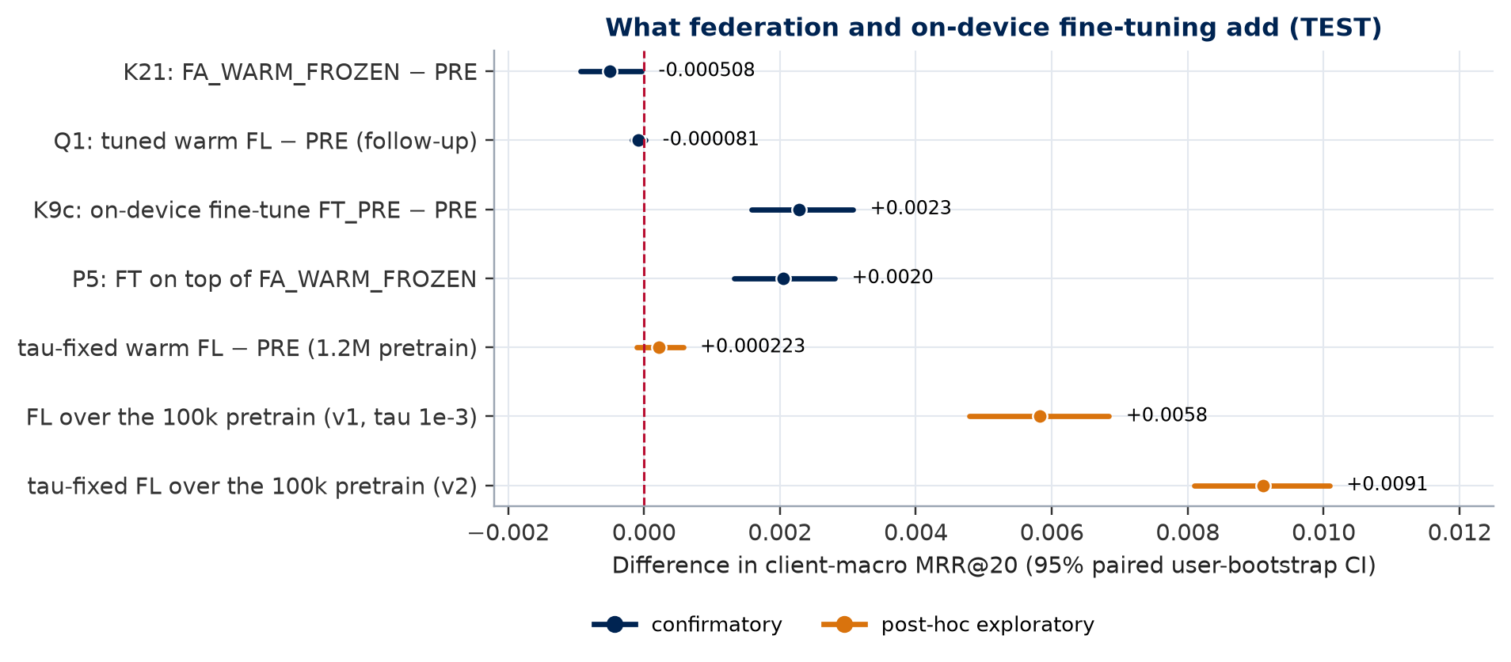
What federation and fine-tuning add
Differences in MRR@20 with 95% paired-bootstrap CIs
Reading
• K21 FL − PRE: −0.000508 [−0.000933, −0.000037]: slightly worse than the pretrain alone
• Q1 tuned warm FL − PRE: EQUIVALENT (±0.0005)
• K9c on-device fine-tune: +0.002283 — the deployable gain
• Orange: post-hoc looks (next slides)
Privacy-Preserving Shopping Intelligence | MSc Final Presentation, Queen's University
12
Notes:
Federation on top of the 1.2-million-user pretrain changes MRR by minus 0.0005; the tuned follow-up recipe is statistically equivalent to the pretrain. On-device fine-tuning gives a small but significant gain. So why did federation add nothing?

Slide 13
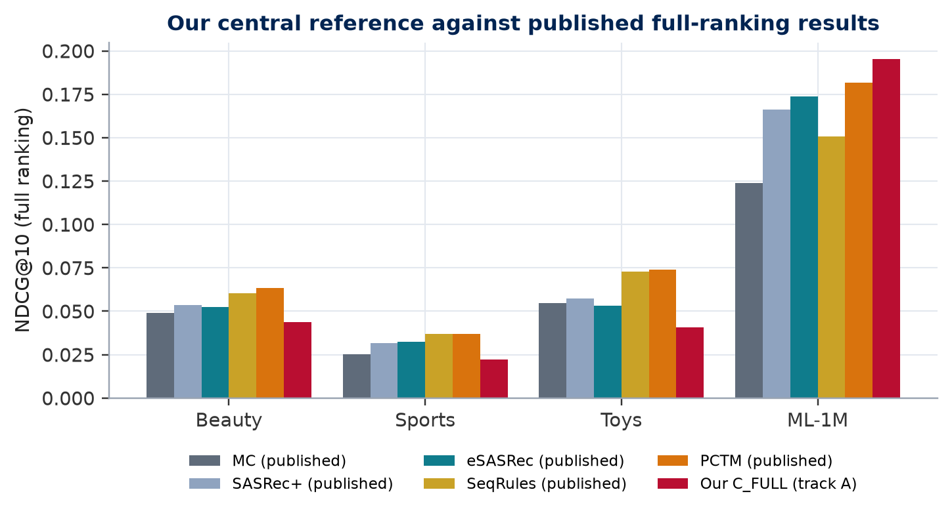
Benchmarks: our cloud reference vs published results
Full-catalogue NDCG@10 on public datasets
Confirmatory benchmark looks
• C_FULL wins on every dataset; every FL arm far below it
• ML-1M: C_FULL 0.1936 vs published eSASRec 0.1739
• Confirmatory FL retention only 13–77%
• → something in the federated recipe was wrong
Privacy-Preserving Shopping Intelligence | MSc Final Presentation, Queen's University
13
Notes:
On public benchmarks our central reference is competitive with published full-ranking results, and above eSASRec on MovieLens-1M. But federated arms were far below the cloud model — a hint that the recipe, not federation itself, was the problem.

Slide 14
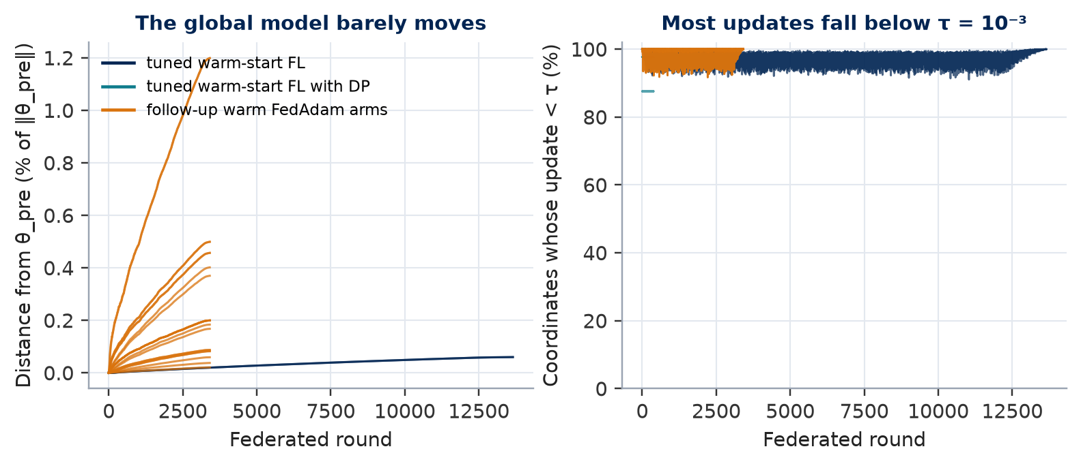
Diagnosis: FedAdam's τ silently froze federated training
(exploratory result)
Mechanism
• FedAdam step ∝ m / (√v + τ)
• Client updates ≈ 10⁻⁷, registered τ = 10⁻³
• → server step 20–100× too small
• Tuned model moved ≈ 0.06% from θ_pre in 13,654 rounds
• Confirmatory results stay as registered; the fix is exploratory
Privacy-Preserving Shopping Intelligence | MSc Final Presentation, Queen's University
14
Notes:
After the test evaluation we measured the update norms. Almost all coordinates were below tau, so the server step collapsed. This does not change the confirmatory result — it explains it. Everything from here is labelled post-hoc exploratory.

Slide 15
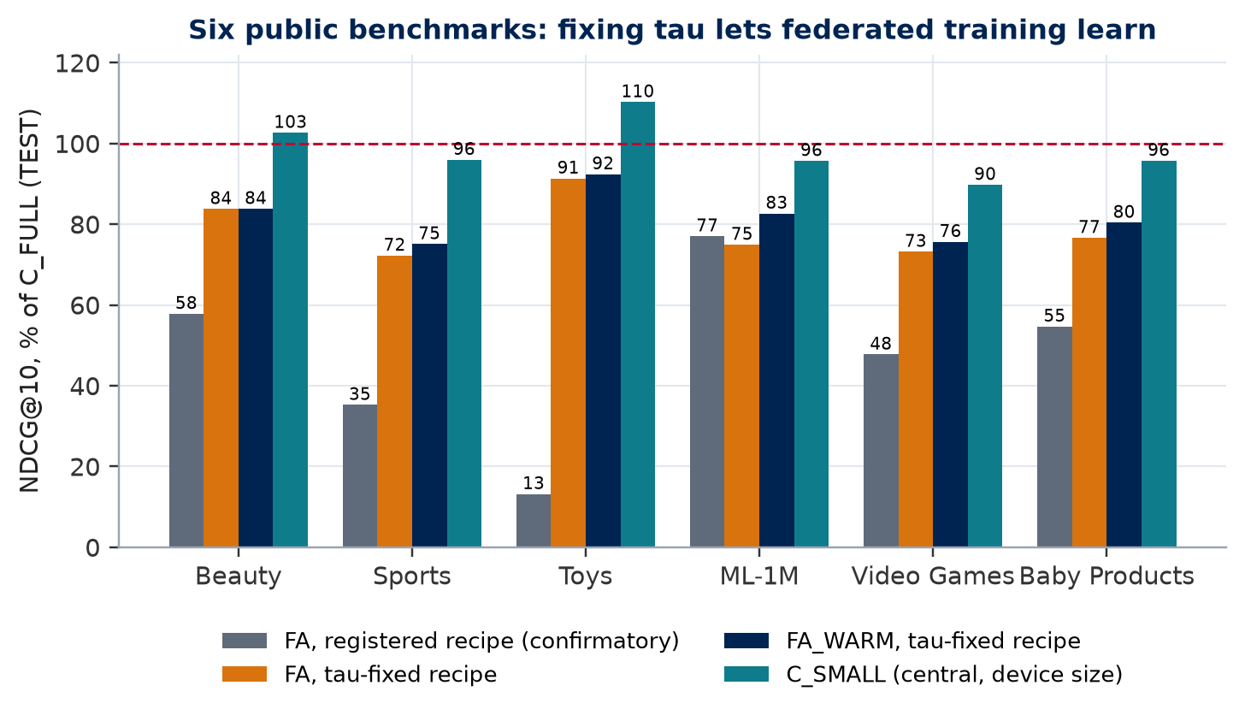
With τ fixed, federated training learns
Six public benchmarks, TEST (exploratory look)
(exploratory result)
What changed
• Warm FL: 75–92% of C_FULL (was 13–77%)
• C_SMALL (device size, central) 90–110%: size is not the bottleneck
• On REES46 the fix changes nothing (+0.00022, CI includes 0)
• Caveat: τ changed together with budget / item tables
Privacy-Preserving Shopping Intelligence | MSc Final Presentation, Queen's University
15
Notes:
With tau 1e-6, federated models reach 75 to 92 percent of the cloud model on all six benchmarks. On REES46 the strong pretrain still leaves nothing for federation to add, so the confirmatory answer is robust.

Slide 16
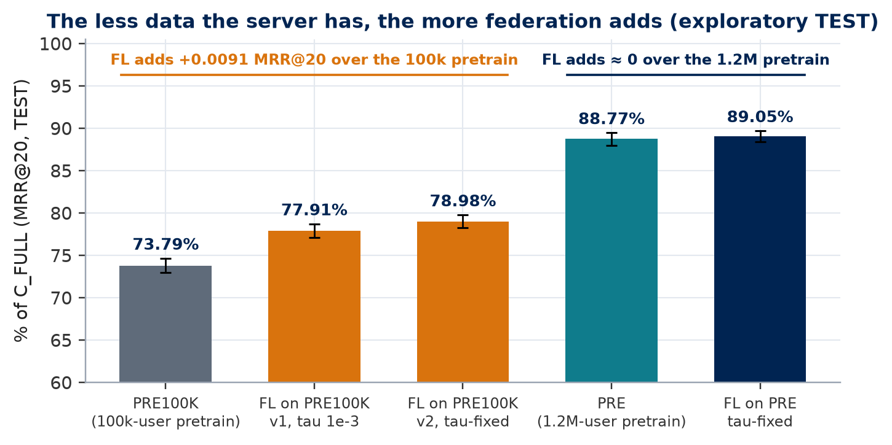
The value of federation depends on the server's data
(exploratory result)
Evidence
• 100k-user pretrain: FL adds +0.0091 MRR@20
• 1.2M-user pretrain: FL adds ≈ 0
• Disjoint server data (50%): warm beats cold by 27–55% on Amazon data
• Exception: MovieLens-1M (6,040 users)
• Federation cost at matched size ≈ 14–22%
Privacy-Preserving Shopping Intelligence | MSc Final Presentation, Queen's University
16
Notes:
This is the main scientific message: the less the server already knows, the more federation helps. With a weak pretrain federation adds a lot; with a strong one it adds almost nothing.

Slide 17
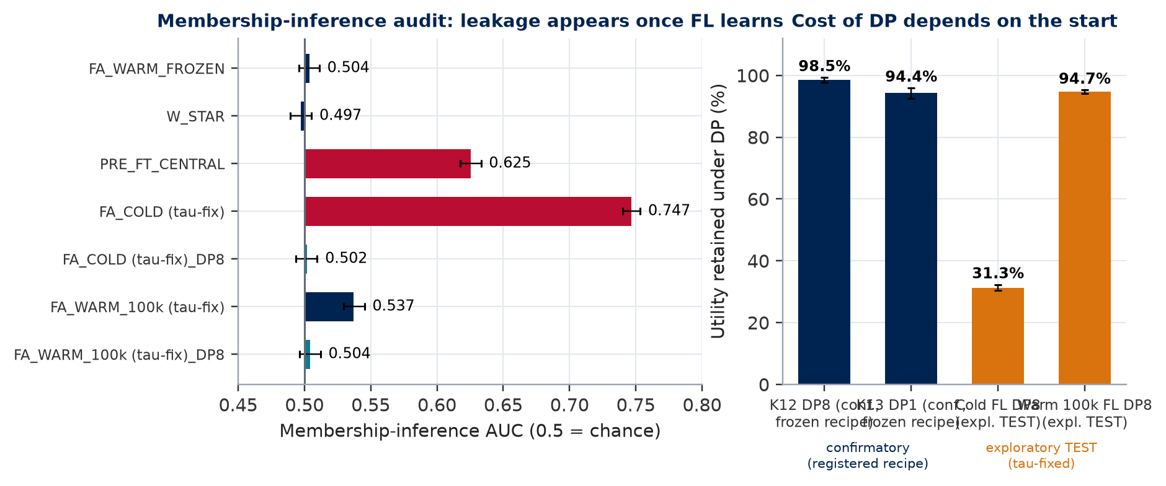
Privacy: learning leaks, and the guarantees need care
Findings
• FL that really learns leaks membership (AUC 0.747)
• DP at ε = 8 removes the measured leak; cost small on warm, large on cold
• Audit corrections: legacy DP seed was public → no formal DP guarantee
• Update-leakage attack: 2.625 pp > 2 pp threshold (negative)
• Secure aggregation: simulation only (< 1% upload overhead)
Privacy-Preserving Shopping Intelligence | MSc Final Presentation, Queen's University
17
Notes:
Once federation learns, a membership attack succeeds with AUC 0.747; DP at epsilon 8 removes it, cheaply on a warm start and expensively on a cold one. Our closure audit is honest about limits: the legacy DP used a public seed, so we claim measurements, not a formal guarantee.

Slide 18
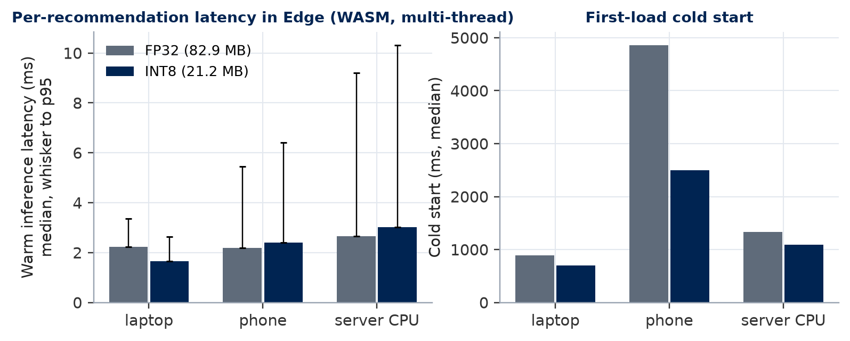
On-device feasibility in Microsoft Edge
ONNX Runtime WebAssembly, laptop / phone / server CPU
Deployability
• INT8 model: 82.9 MB → 21.2 MB
• INT8 and 8-bit uploads: no measurable quality cost (K16, K14)
• Warm median latency 1.7–5.1 ms per query
• Phone cold start ≈ 2.5 s with INT8
Privacy-Preserving Shopping Intelligence | MSc Final Presentation, Queen's University
18
Notes:
The device model runs in the browser in a few milliseconds per recommendation. INT8 cuts the model four times with no measurable quality loss, which makes on-device deployment realistic.

Slide 19
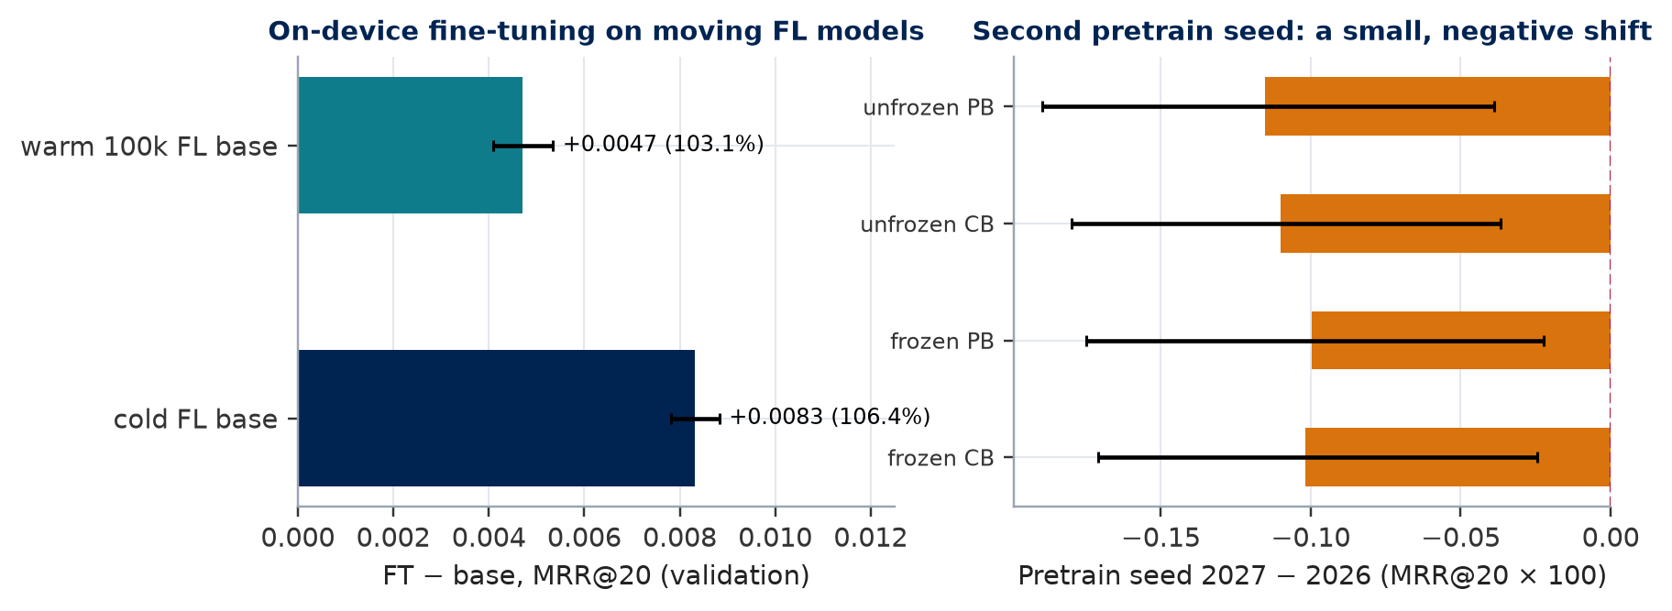
Closure experiments
Technical closure and extensions, 12–17 October
What closure added
• Second pretrain seed: small negative shift (−0.10 pts)
• Fine-tuning moving FL models: +3–6%
• Training-free baselines: best MC 0.1366 (validation)
• Stopped / not run: DP-FTRL, canary restart, TEST2
• All results labelled; nothing re-scored
Privacy-Preserving Shopping Intelligence | MSc Final Presentation, Queen's University
19
Notes:
The closure phase verified everything, added second-seed and fine-tuning studies and simple baselines, and documented what was stopped. Negative and incomplete results are reported, not hidden.

Slide 20
What we learned
What worked
What did not
• Warm start from a server pretrain: biggest single gain
• On-device fine-tuning: small, significant, cheap
• INT8 / 8-bit uploads: free compression
• Pre-registration: kept the main answer honest
• Full-catalogue evaluation: comparable with published work
• A badly scaled τ froze FL — invisible in the protocol
• FL over a strong pretrain: no added value
• Device-only training: unusable
• Legacy DP randomness: no formal guarantee
• Several studies stopped for time (DP-FTRL, TEST2)
Privacy-Preserving Shopping Intelligence | MSc Final Presentation, Queen's University
20
Notes:
On the left what worked, on the right what did not. The tau lesson is general: a protocol can be perfectly controlled and still lock in a mis-scaled optimiser.

Slide 21

Conclusion and future work
Answer
Future work
• A warm-started on-device/federated system retains 88.49% of the cloud model
• Whether federation pays off depends on the server-side pretrain and a correctly scaled optimiser
• Fine-tune on the device; federate when the server knows little
• Privacy must be engineered and audited, not assumed
• Distil a large teacher into the device model
• DP with secret randomness at full scale
• Real secure aggregation
• December-2019 replication (TEST2)
• Real-device field trial in Edge
Privacy-Preserving Shopping Intelligence | MSc Final Presentation, Queen's University
Photo: European Commission, CC BY 4.0, Wikimedia Commons
21
Notes:
To answer the question: about 88.5 percent of cloud quality survives on the registered recipe. Federation is worth it when the server knows little and the optimiser is scaled correctly; on-device fine-tuning is the deployable gain.

Slide 22
Thank you
Questions and discussion
Digilians 2026, Group 8, Queen's University
Code: github.com/microsoftproject26/
Privacy-Preserving-Shopping-Intelligence
Photo: Takipoint123, CC BY-SA 4.0, Wikimedia Commons
Notes:
Thank you. We are happy to take questions.

