Slide 1
Project: PreVir 18-09-2025

Slide 2
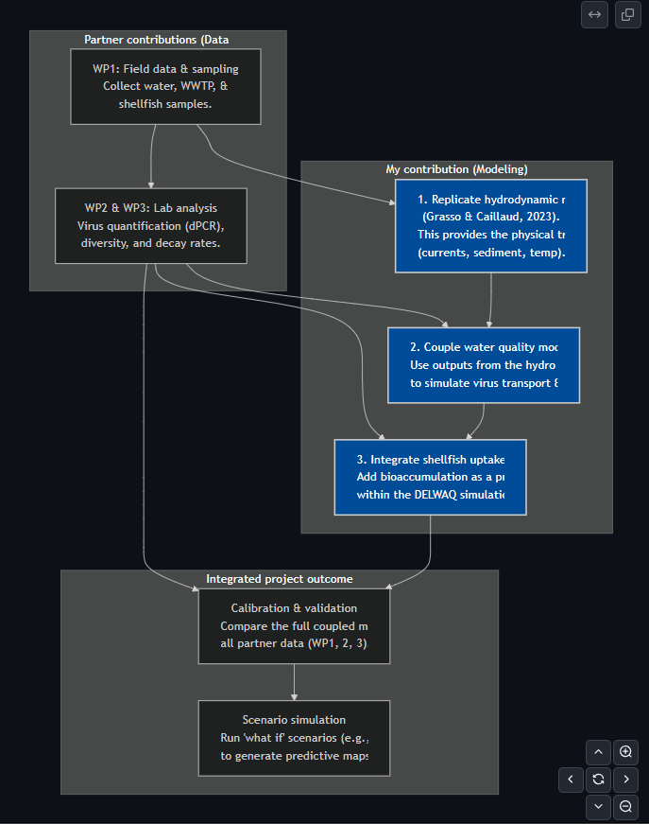
Modelling concept.
Build the hydrodynamic Model
Create/acquire the digital map for the estuaries.
Set up the physical forces driving water movement (tides, river flow, etc.).
Run initial simulations to ensure the model is stable before adding biology.
IF the existing model by Grasso & Caillaud is suitable we may use their model outputs instead of running it ourselves.
2. Develop the virus & shellfish modules
Water quality model:
Integrate the virus decay / behavior from WP3 lab data
Decay in relation to T, salinity, TSS, virus genotype
Add parameters for how viruses attach to sediment particles.
Preference size, type?
Connect this virus tracking module to the hydrodynamic model.
Shellfish uptake module:
Code the biological rules for how oysters filter and accumulate viruses.
Integrate the module so it acts as a virus sink in the water model.
Prepare it for validation against the real oyster data from WP2.
3. Calibrate and validate
Align model with measurements for both water and shellfish.
Analyze which factors (like specific decay rates or filtration efficiency) have the most significant impact on the results.
4. Run scenarios
Set up and simulate various "what if" scenarios (e.g., major rainfall events, wastewater spills).
Generate the final project outputs, such as predictive contamination maps and risk assessment charts.

Slide 3
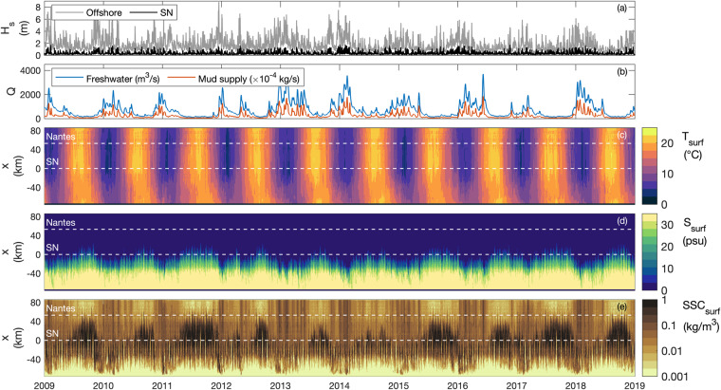
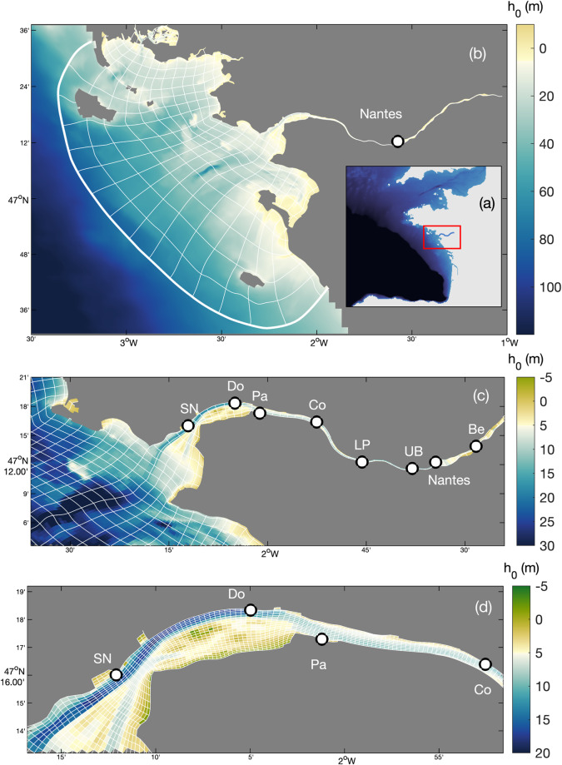
Fig. 2 Numerical hindcast of the Loire Estuary (2009–2018). (a) Significant wave height H_{s} at the offshore model boundary (grey) and at Saint Nazaire ‘SN’ (black), and (b) Loire River discharge Q at the upstream model boundary for freshwater (blue) and mud supply (orange). Width-averaged along-estuary transects of surface: (c) temperature T_{surf}, (d) salinity S_{surf}, and (e) suspended sediment concentration SSC_{surf}. In (c–e), white-dashed lines represent Saint Nazaire ‘SN’ and Nantes locations, at x = 0 and 53 km respectively.

