Slide 1
Project: previr

Slide 2
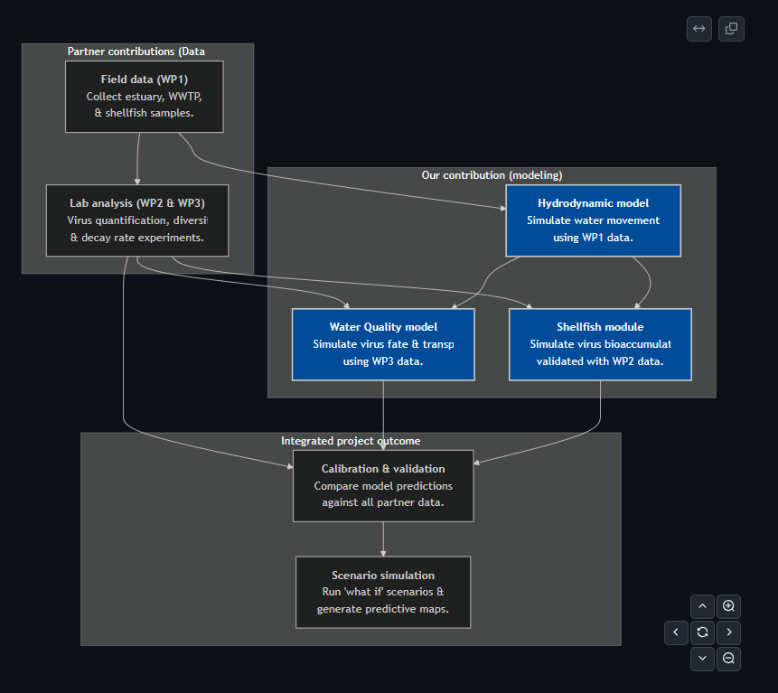
Modelling concept.
Build the Hydrodynamic Model
Create/acquire the digital map for the estuaries.
Set up the physical forces driving water movement (tides, river flow, etc.).
Run initial simulations to ensure the model is stable before adding biology.
2. Develop the virus & shellfish modules
Water quality model:
Integrate the virus decay formulas from WP3 lab data (based on temp/light).
Add parameters for how viruses attach to sediment particles.
Connect this virus tracking module to the hydrodynamic model.
Shellfish uptake module:
Code the biological rules for how oysters filter and accumulate viruses.
Integrate the module so it acts as a virus sink in the water model.
Prepare it for validation against the real oyster data from WP2.
3. Calibrate and validate
Align model with measurements for both water and shellfish.
Analyze which factors (like specific decay rates or filtration efficiency) have the most significant impact on the results.
4. Run Predictive Scenarios
Set up and simulate various "what if" scenarios (e.g., major rainfall events, wastewater spills).
Generate the final project outputs, such as predictive contamination maps and risk assessment charts.

