Slide 1
Legacy Type Mapping with MicroStream
What if i have to change my data definition (Classes)?

Slide 2
Topics
How does MicroStream handle datatypes?
What happend if we do some changes in the entity?
What changes can be handled automatically by MicroStream?
Sources
https://manual.docs.microstream.one/data-store/legacy-type-mapping
https://manual.docs.microstream.one/data-store/legacy-type-mapping#automatic-mapping

Slide 3
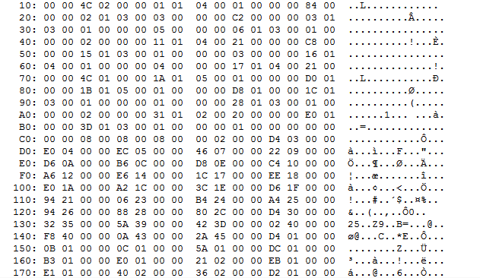
How does MicroStream handles Datatypes?
PersistenceTypeDictionary
Storage
0000000000000000005 int
{
primitive 32 bit integer signed,
}
…
…
…
0000000000001000066 one.microstream.hackathonuidemo.microstream.domain.Customer
{
java.lang.String one.microstream.lazydemo.domain.Customer#id,
java.lang.String one.microstream.lazydemo.domain.Customer#lastname,
java.lang.String one.microstream.lazydemo.domain.Customer#firstname,
java.lang.String one.microstream.lazydemo.domain.Customer#mail,
java.lang.String one.microstream.lazydemo.domain.Customer#gender,
}
Each entry in the storage has a TypeID (WHAT) and a ObjectID (WHICH)
Each type in the storage has ist own type entry in the dictionary
If there is an existing block of binary data in the storage e.g. TypeID 1000066 but this type is missing in the dictionary the storage will not start. Take care about your “PersistenceTypeDictionary” it has to be in sync.

Slide 4
What datatypes are supported
https://manual.docs.microstream.one/data-store/addendum/supported-java-features
https://manual.docs.microstream.one/data-store/addendum/specialized-type-handlers

Slide 5
Lets add an attribut to „Customer“
PersistenceTypeDictionary
Storage
0000000000001000066 one.microstream.hackathonuidemo.microstream.domain.Customer
{
java.lang.String one.microstream.lazydemo.domain.Customer#id,
java.lang.String one.microstream.lazydemo.domain.Customer#lastname,
java.lang.String one.microstream.lazydemo.domain.Customer#firstname,
java.lang.String one.microstream.lazydemo.domain.Customer#mail,
java.lang.String one.microstream.lazydemo.domain.Customer#gender,
}
0000000000001000067 one.microstream.hackathonuidemo.microstream.domain.Customer
{
java.lang.String one.microstream.lazydemo.domain.Customer#id,
java.lang.String one.microstream.lazydemo.domain.Customer#lastname,
java.lang.String one.microstream.lazydemo.domain.Customer#firstname,
java.lang.String one.microstream.lazydemo.domain.Customer#mail,
java.lang.String one.microstream.lazydemo.domain.Customer#gender,
java.lang.String one.microstream.lazydemo.domain.Customer#ipAddress,
}
„OLD“
„NEW“
After adding, removing or moving attributes a new Type with a TypeID occurs in the dictionary
Everytime an „OLD“ object is loaded it will be automated transformed to the „NEW“ version of the object
Keep in mind, after removing an attribut the is data is also gone!

Slide 6
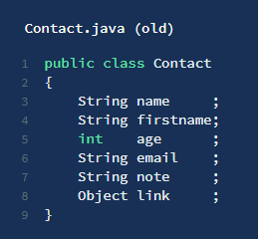
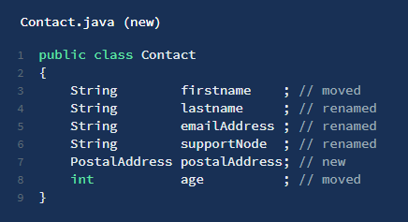
What changes can be handled automatically?
Basicaly the heuristic attempts to automatically detect which fields are new, have been removed, reordered or altered.

Slide 7
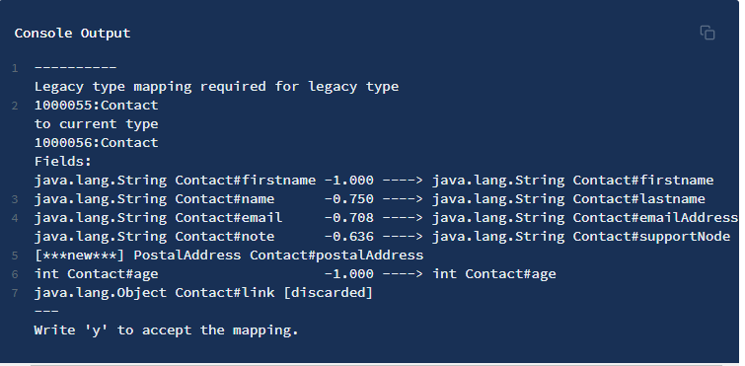
What changes can be handled automatically?

Slide 8
What changes can be handled automatically?
What the heuristic is doing now is something like this:
String “firstname” is equal in both classes, so it has to be the same, pretty much as int age.
“name” and “lastname” is pretty similar, type is the same too. If there is nothing better for the two, they probably belong together. Same with the other two fields.
In the end, the ominous “link” and “postalAddress” remain. The heuristic can not make sense of that, so it assumes that one thing falls away and the other one is added.
In this particular example, that worked perfectly. Well done, heuristic.

Slide 9
Best Practice
During the development when are we able to delete the storage and let it recreate this should be first choice. We would recommend to create some mockup classes and data to create a nice and clear storage on startup.
Changes of multiple attributes in one class should be done step by step instead of doing them all at once.
Creating a backup of the storage before updating should be natural.
Keep in mind, datatype changes requires a special migration logic in most cases and can´t be done automatically. In this particular case:
First create the new attribute
Start the application and transfer the data from the old attribute to the new attribute.
Shutdown application and remove old attribute
Done

Slide 10






