Slide 1

WELCOME!
Open & reproducible microbiome data analysis spring school
Wageningen, The Netherlands, May 28-30, 2018

Slide 2
Opportunity to Connect!
CEAB (Centre d'Estudis Avançats de Blanes)
University of Helsinki
Wageningen University & Research
University of Bonn, Institute of Animal Science
Vrije Universiteit
INRA
Radboud University Medical Center
NIOZ
University of Milan
Maastricht University
Leiden University Medical Centre (LUMC)
RIVM (National Institute for Public Health and Environment)
Amsterdam Medical Centrum

Slide 3
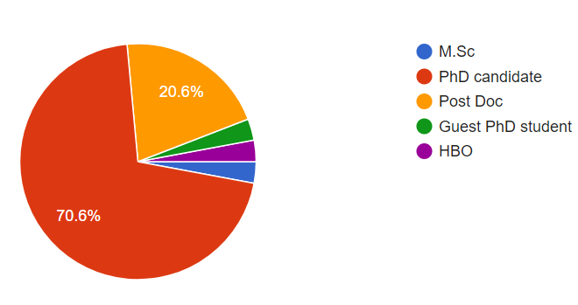
From entry level to more seasoned researchers

Slide 4
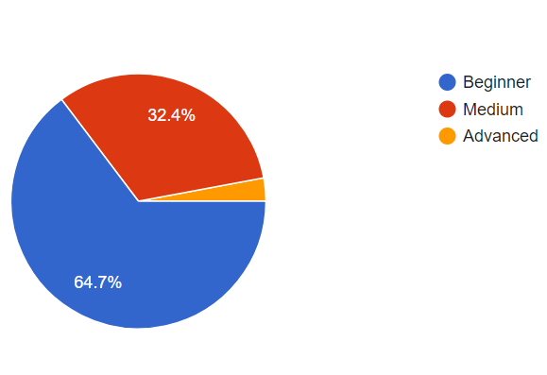
Experience with 16S rRNA gene analysis

Slide 5
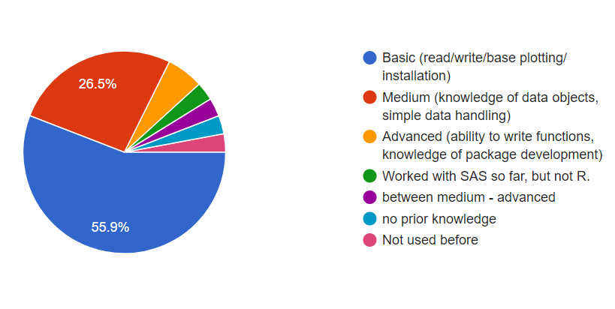
Amongst us we have different skills sets

Slide 6
Work together Share knowledge Share codes Awesome networking opportunity Have fun!

Slide 8
WELCOME!
DAY 2
Open & reproducible microbiome data analysis spring school
Wageningen, The Netherlands, May 28-30, 2018

Slide 9
Making sense of OTU/ASVs/sOTUs
Essential properties of taxonomic profiling data, Reproducibility, Microbiome and Phyloseq BioC/R packages
Open & reproducible microbiome data analysis spring school
Wageningen, The Netherlands, May 28-30, 2018
Sudarshan A. Shetty
Laboratory of Microbiology,
Wageningen University & Research

Slide 10







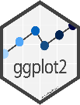
General Workflow
Sampling, DNA prep, controls for kits/reagents used
Library prep, randomisation of samples in libraries
Sequencing output Raw data *.fastq
Planning study set-up
Create mapping file
Pre-processing OTU tables
Processing raw reads using NG-tax
Taxonomic composition
Output of NG-Tax
(*.biom, *.tre)
Alpha diversities
Unique OTUs, Abundances, Taxonomic assignments
Beta diversities
Numerous other tools
https://microsud.github.io/Tools-Microbiome-Anlaysis/
Data visualisation
Core microbiota
Statistical analysis
Correlation analysis
Ecological network inference

Slide 11
Operational taxonomic units/Amplicon sequence variants/subOTU
>sOTU/ASV1
TACGGAGGGTGCAAGCGTTGTCCGGAATCACTGGGTGTAAAGGGTGTGTAGGTGGATCTGTAAGTCAGAGGTGAAAGCCCACAGCTTAACTGTGGAACTGCCTTTGATACTGCTGATCTTGAGTACTGGAGGGGCTGCTAGAATTCGTGG
>sOTU/ASV2
TACGGAGGGTGCAAGCGTTGTCCGGAATCACTGGGTGTAAAGGGTGTGTAGGTGGATCTGTAAGTCAGAGGTGAAAGCCCACAGCTTAACTGTGGAACTGCCTTTGATACTGCTGATCTTGAGTACTGGAGGGGCTGCTAGAATTCGTGG
>sOTU/ASV3
TACGGAGGGTGCAAGCGTTGTCCGGAATCACTGGGTGTAAAGGGTGTGTAGGTGGATCTGTAAGTCAGAGGTGAAAGCCCACAGCTTAACTGTGGAACTGCCTTTGATACTGCTGATCTTGAGTACTGGAGGGGCTGCTAGAATTCGTGG
>sOTU/ASV4
TACGGAGGGTGCAAGCGTTGTCCGGAATCACTGGGTGTAAAGGGTGTGTAGGTGGATCTGTAAGTCAGAGGTGAAAGCCCACAGCTTAACTGTGGAACTGCCTTTGATACTGCTGATCTTGAGTACTGGAGGGGCTGCTAGAATTCGTGG
Sequences contain information! These can be searched in databases to identify which bacteria they are related to...

Slide 12
Bacterial Taxonomy
Taxonomy
Principles of scientific classification and naming of organisms.
Classification
Following rules of taxonomy and using evidence from polyphasic approaches (genotypic, chemotaxonomic and phenotypic methods) to organize similar organisms into groups.
Nomenclature
Systematically naming the organisms following principles of taxonomy.
The databases have information stored on classification of sequences!
However, bacterial taxonomic classification is not perfect!

Slide 13
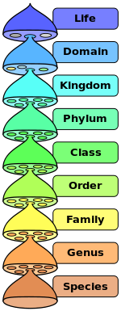

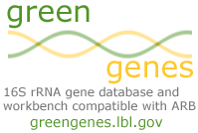


The bacterial classification and challenges
Commonly used public databases with taxonomic information
Ecosystem specific curated databases
HITdb - Human Intestinal 16S rRNA gene reference taxonomy
MiDAS 2.0 - wastewater treatment systems and Anaerobic digestors
Strain!
https://bmcgenomics.biomedcentral.com/articles/10.1186/s12864-017-3501-4

Slide 14
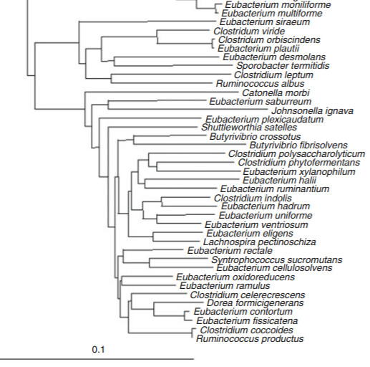
Case of Eubacterium
Can be found in three families Eubacteriaceae Erysipelotrichaceae Lachnospiraceae
Careful in interpreting function from 16S rRNA gene based classification at Genus level!
Wade W.G. (2006) The Genus Eubacterium and Related Genera. In: Dworkin M., Falkow S., Rosenberg E., Schleifer KH., Stackebrandt E. (eds) The Prokaryotes. Springer, New York, NY

Slide 15
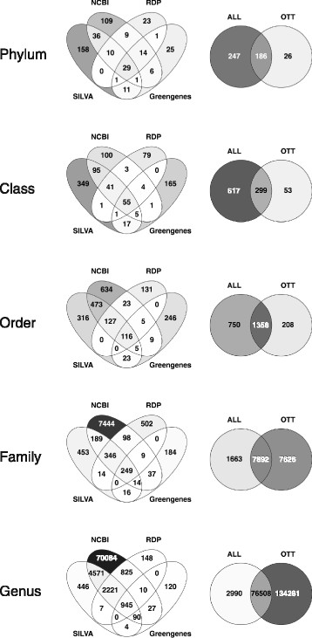
Different databases, different potential
Shared and non-shared taxonomic identities
Important to choose the right database!!
Balvočiūtė, Monika, and Daniel H. Huson. "SILVA, RDP, Greengenes, NCBI and OTT—how do these taxonomies compare?." BMC genomics 18.2 (2017): 114.

Slide 16
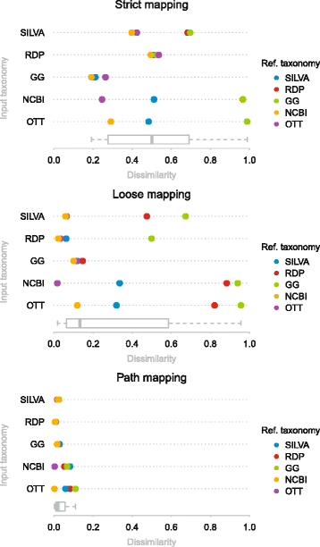
Different databases, different potential
There are some cases where taxonomic classifications at the finest level are different between each of these databases.
Important to choose the right database!!
Balvočiūtė, Monika, and Daniel H. Huson. "SILVA, RDP, Greengenes, NCBI and OTT—how do these taxonomies compare?." BMC genomics 18.2 (2017): 114.

Slide 17
Questions?

Slide 18
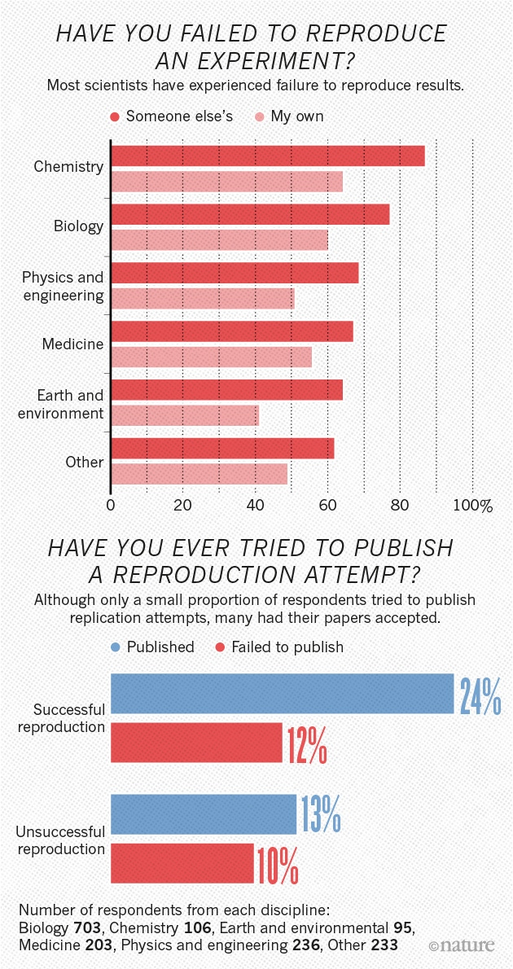
Reproducibility
Even reproducing self experiments is a concern!
Organization of data
Documentation of codes
Guide to analysis for others to reproduce the results
We will cover this in detail during hands-on training.
https://www.nature.com/news/1-500-scientists-lift-the-lid-on-reproducibility-1.19970

Slide 19

Why reproducibility is important?
Society needs good scientists
Because reproducibility is the right thing to do!
Because it is the foundation of science!
Because the world would be a better place if everyone worked transparently and reproducibly!
Bla..Bla.. Bla..Bla.. Bla..Bla.. Bla..Bla.. The world in not an ideal place!
Markowetz, Florian. "Five selfish reasons to work reproducibly." Genome biology 16.1 (2015): 274.

Slide 20
Help yourself by ensuring reproducibility
Five Selfish Reasons:
Reproducibility helps to avoid disaster
Reproducibility makes it easier to write papers
Reproducibility helps reviewers see it your way
Reproducibility enables continuity of your work
Reproducibility helps to build your reputation
Markowetz, Florian. "Five selfish reasons to work reproducibly." Genome biology 16.1 (2015): 274.

Slide 21
Why use R?
Variety of statistical tools available.
High flexibility and modularity.
Helps adhere to current best practices (markdown, etc.)
Makes sharing easy.
If you check the functions, you know what you are doing.
Its not a magical tool!!

Slide 22
Reproducibility tools in R
Rmarkdown: Literate programing (combining codes with text)
Knitr: Generating reports from codes and text (Rmarkdown files).
Packrat: Make projects resilient to software/package updates.
R community is awesome, several tutorials, resources available online freely. Every problem encountered, search it online and you will find solution(s)!

Slide 23
Questions?

Slide 24
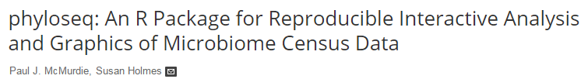
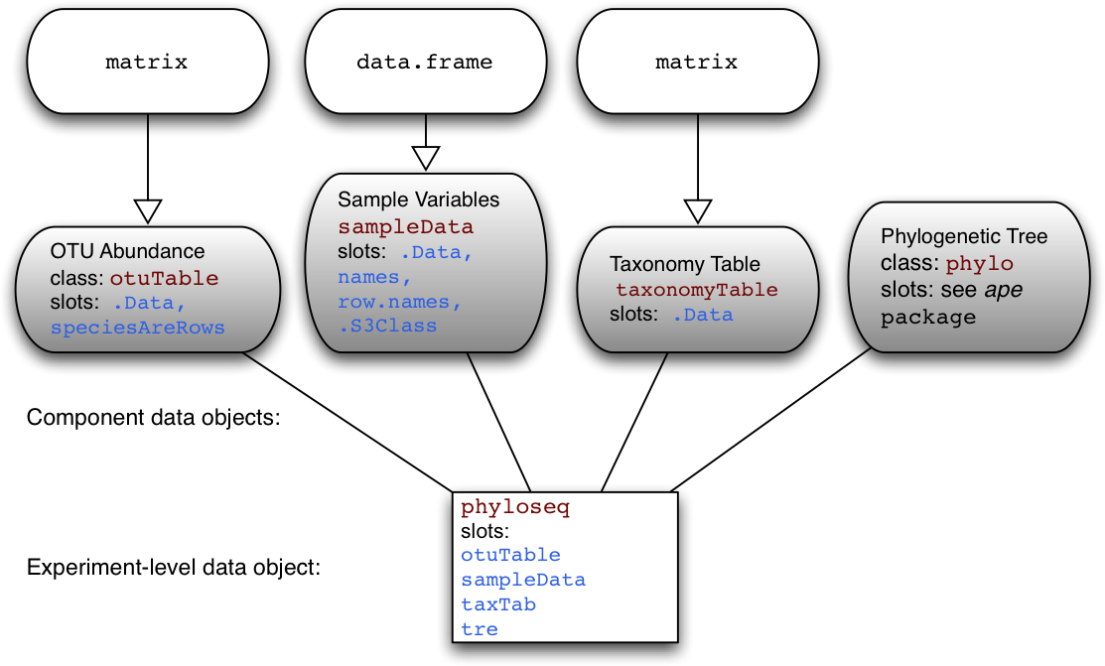
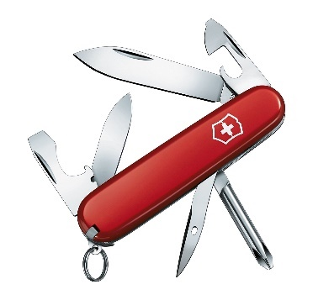
.biom file has both OTU and taxonomy infor
Phyloseq object

Slide 25
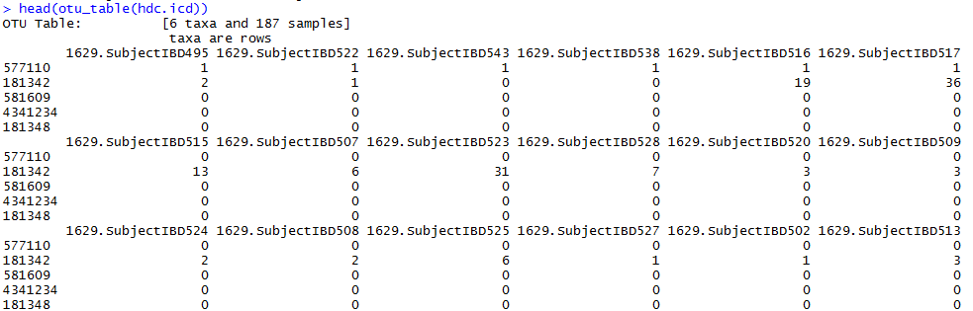
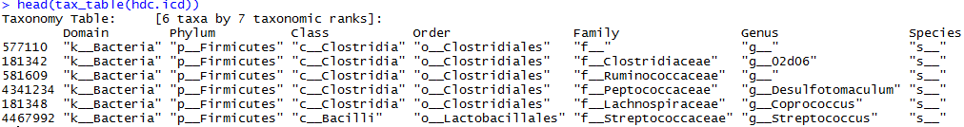
Data types
OTU table
Taxonomy table

Slide 26
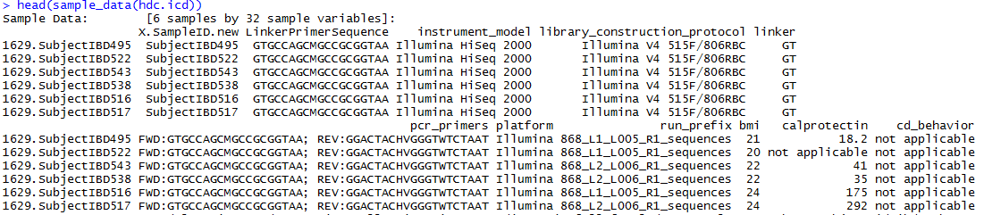
Data types
Metadata

Slide 27
Questions?

Slide 28

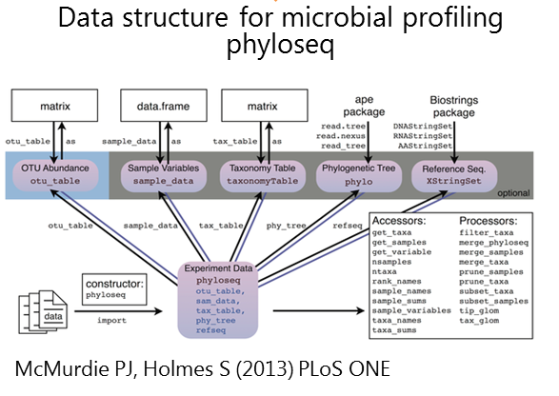
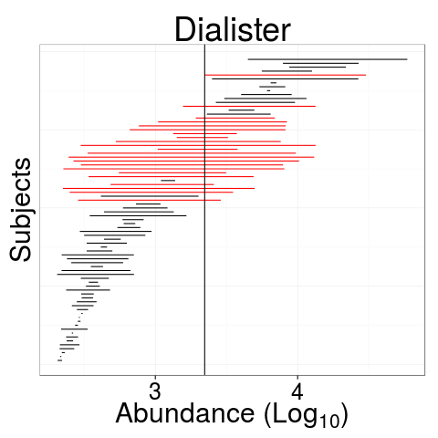
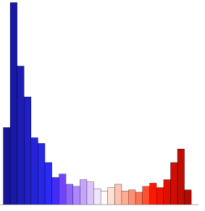
Microbiome R package
R/Bioconductor package for the analysis of 16S microbiome profiling data (Lahti, Shetty et al.).
GitHub: http://microbiome.github.io/microbiome/
Diversity, Stability, Core, Visualization...
Extending the phyloseq data format & tools

Slide 29
Microbiome R package
The package provides a scalable exploration of large-scale microbial community analysis.
Extends the Phyloseq toolkit to further standardize and development of best practices.
Package complements existing tools.
In some cases, provides alternative solutions.
Expected to streamline and improve complementarity in microbiome analysis.
Serve as a useful resource and teaching tool for beginners in microbial ecology.

Slide 30
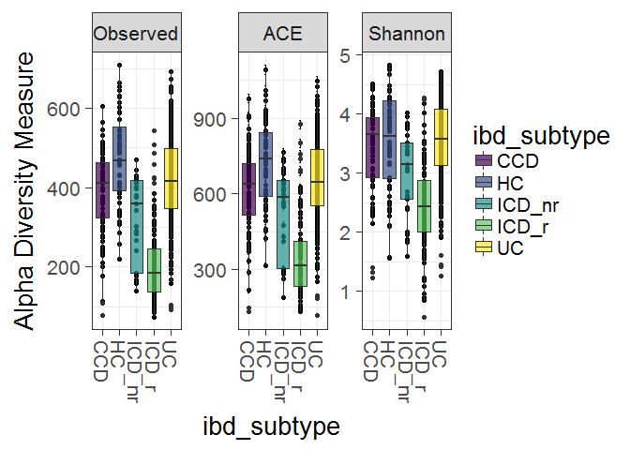
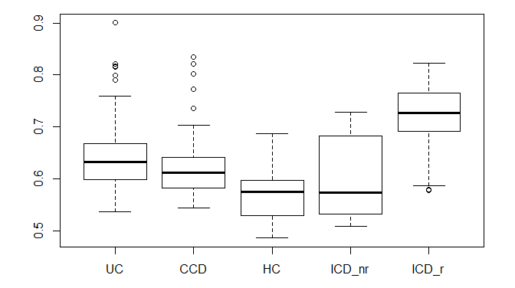
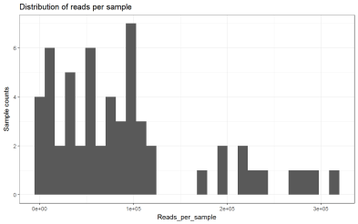
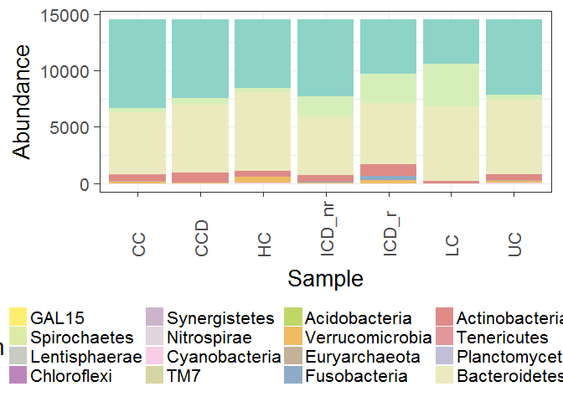
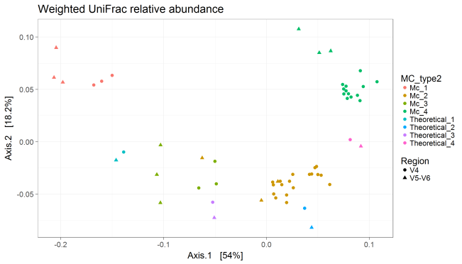
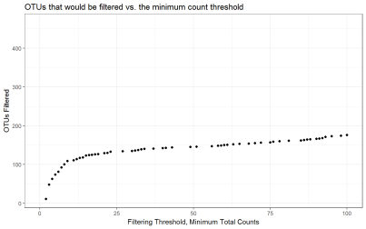
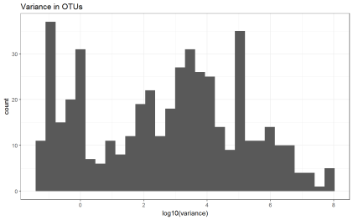
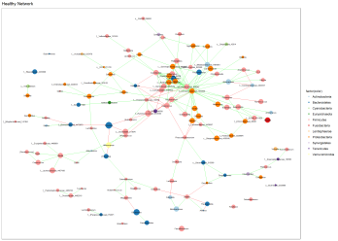
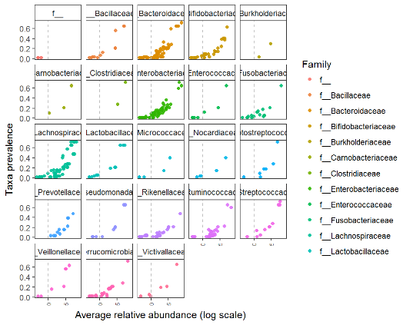
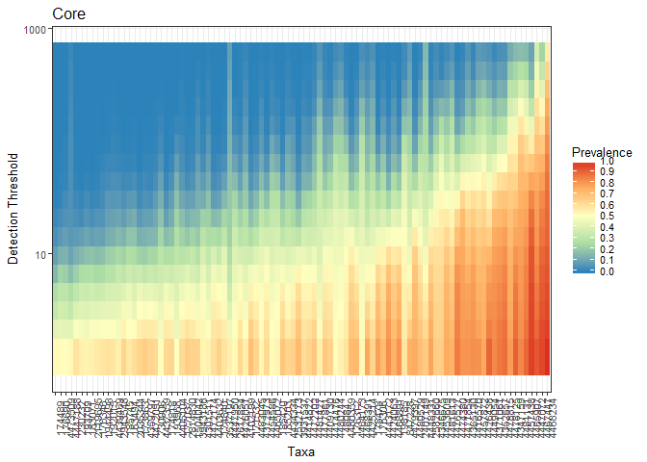
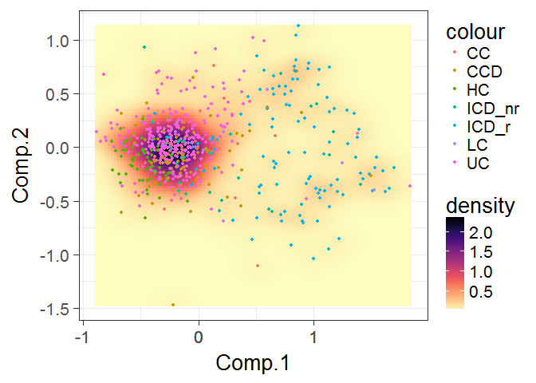
Phyloseq object
Alpha diversity
Beta diversity
Sequence data exploration
Distribution of sequencing depth
Ordination analysis
Composition
Assessing data loss using filtering criteria
Checking variance distribution in data
Network inference
OTU prevalence
Core microbiota
Microbiota landscape

Slide 31


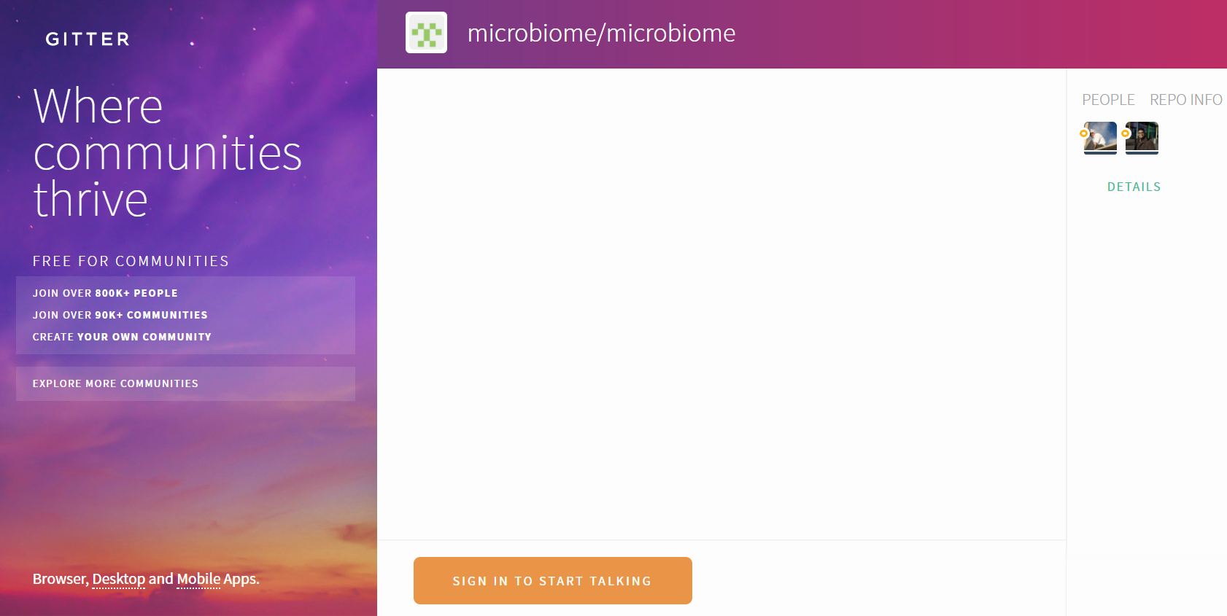

https://github.com/microbiome/microbiome
Subscribe to the mailing list (microbiome-devel@googlegroups.com)
Chat with us on
@gutmicrobe
@antagomir

Slide 32
Acknowledgement
Financial Support to microbiome project:
Academy of Finland (grants 256950 and 295741).
University of Turku, Dept. of Mathematics and Statistics.
VIB Lab for Bioinformatics and (eco-) systems biology, VIB/KU Leuven, Belgium.
Molecular Ecology group, Laboratory of Microbiology, Wageningen UR, Netherlands.
Department of Veterinary Bioscience, University of Helsinki, Finland.

Slide 33
Questions?

