Slide 1
Analytics
Presented by:
Pramod Kumar Singh

Slide 2
Why Analytics Important?
Analytics is as important as having business objective.
This is the only way to measure your success or failure.
If we don’t do analytics we can not detect early failure.
We also can not achieve efficiency and improve desired output.

Slide 3
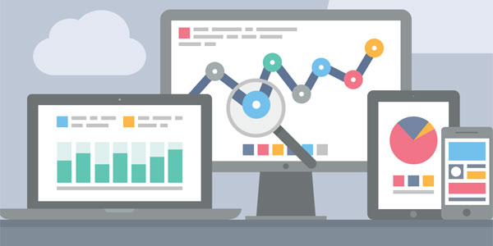
What is Analytics?
Systematic computational analysis of data or statistics
Analytics uses mathematics, statistics, predictive modeling and machine-learning techniques to find meaningful patterns and knowledge in recorded data.

Slide 4
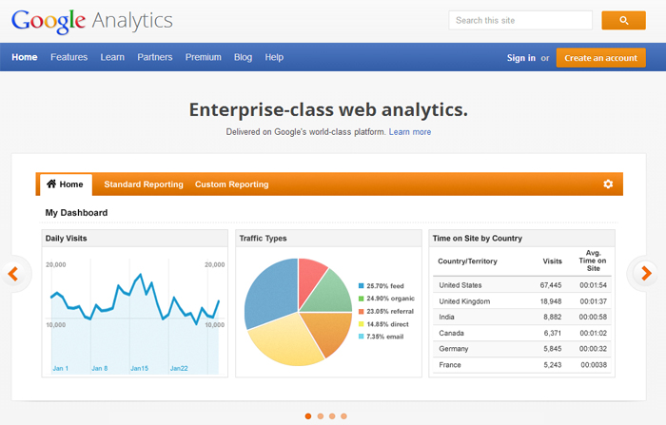

Slide 5
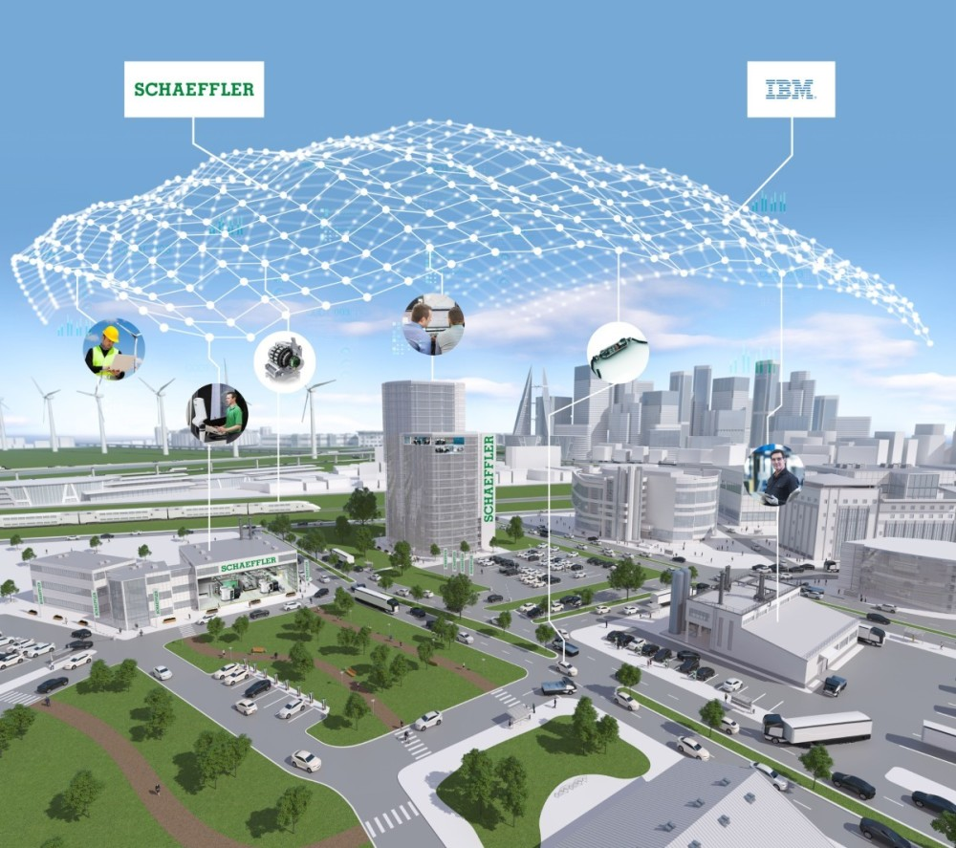

Slide 6
Analytics types:
Predictive Analytics
Preventive Analytics

Slide 7
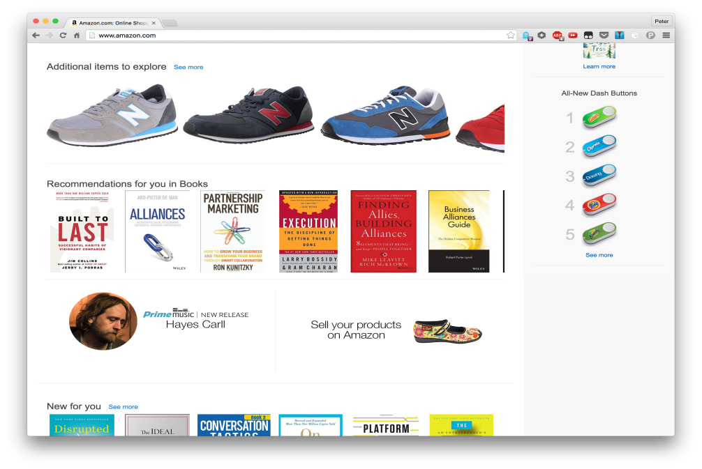
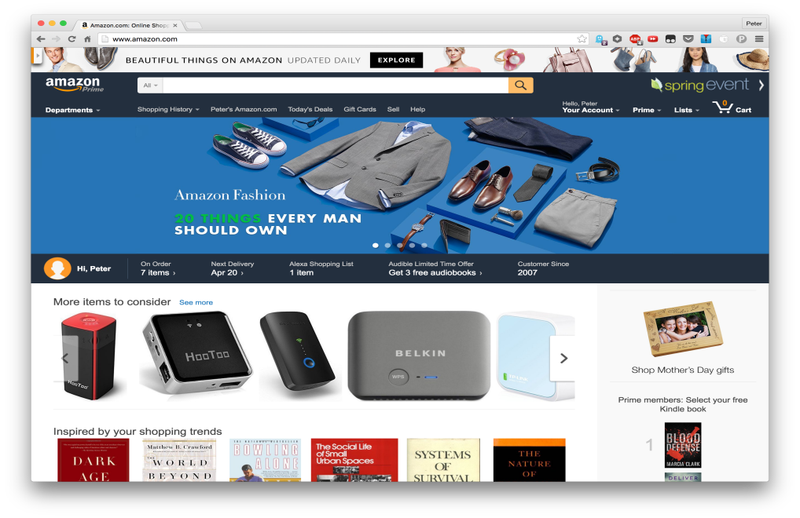
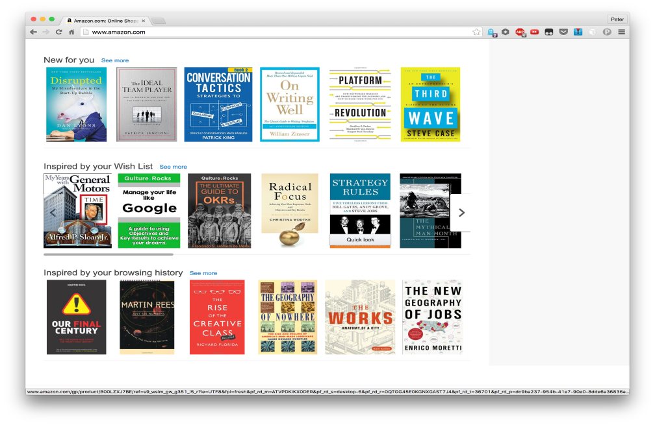
Examples of Predictive Analytics 1. Ecommerce Example

Slide 8

2. Industrial Example

Slide 9
Advantages of Predictive Analytics
Secure a competitive stronghold
Increase sales and retain customers competitively
Maintain business integrity by managing fraud
Advance your core business capability competitively
Meet today’s escalating consumer expectations
Do more than evaluate the past—learn from it

Slide 10
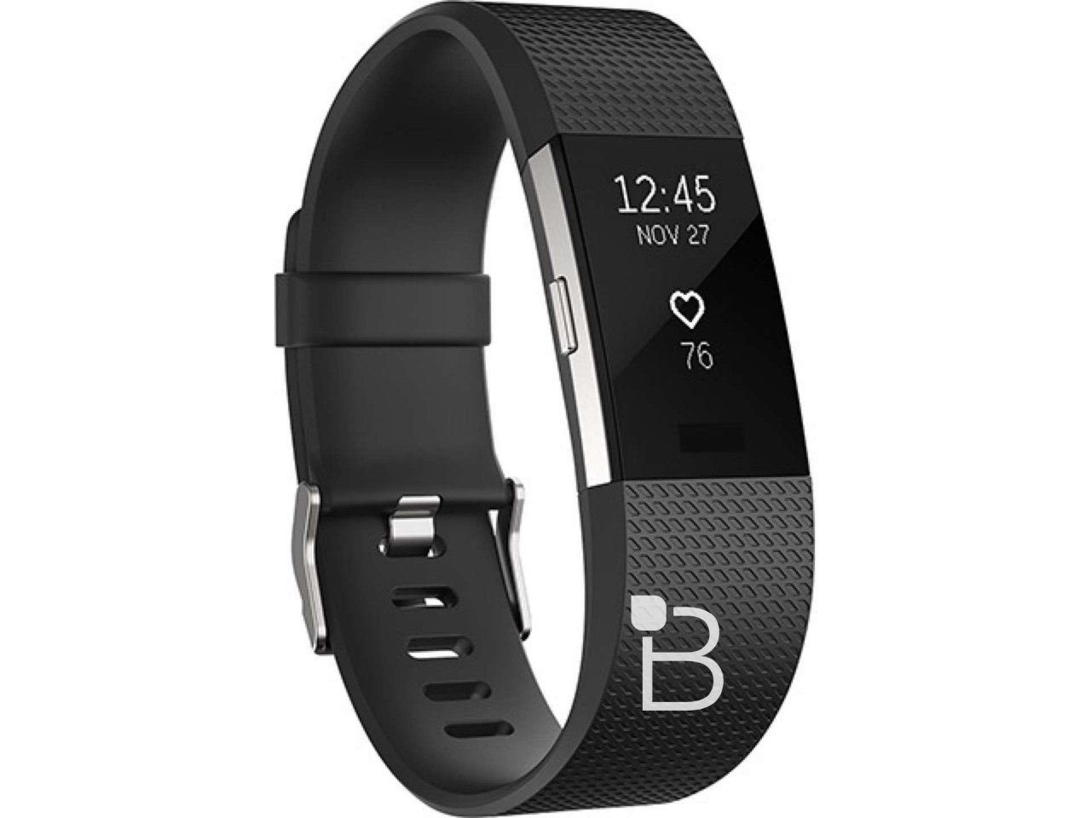
Examples of Preventive Analytics
Healthcare example:
Fit bit, iPhone, Android or another device and apps that measure such things as heart rate, blood pressure, exercise. frequency, and duration.

Slide 11

Industrial example:
The IIoT connects sensors to analytic and other systems to automatically improve performance, safety, reliability, and energy efficiency by:
Collecting data from sensors.
Interpreting this data.
Presenting this actionable information.
Take corrective action.

Slide 12
Advantages of Preventive Analytics
Efficient supply chain logistics
Proactive preventative maintenance
Measure – Monitor – Control
Optimise equipment efficiency
Guaranteed Return On Investment

Slide 13
Analytics in Predix
Analytics Framework Service:
The Analytics Framework includes the following services for developing and embedding advanced analyses in your app:
Analytics Catalog
Runtime Orchestration to configure, execute, validate and monitor analytics to run as a single unit.
Job Scheduler lets you schedule execution of an orchestration or an individual analytic at time-based intervals.

Slide 14
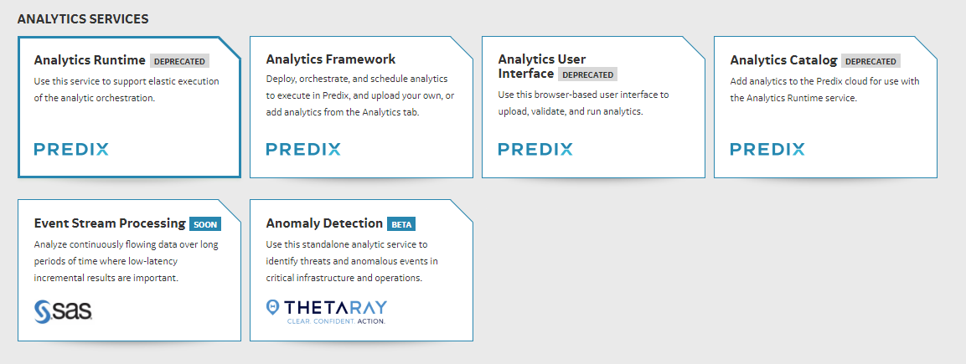

Slide 15
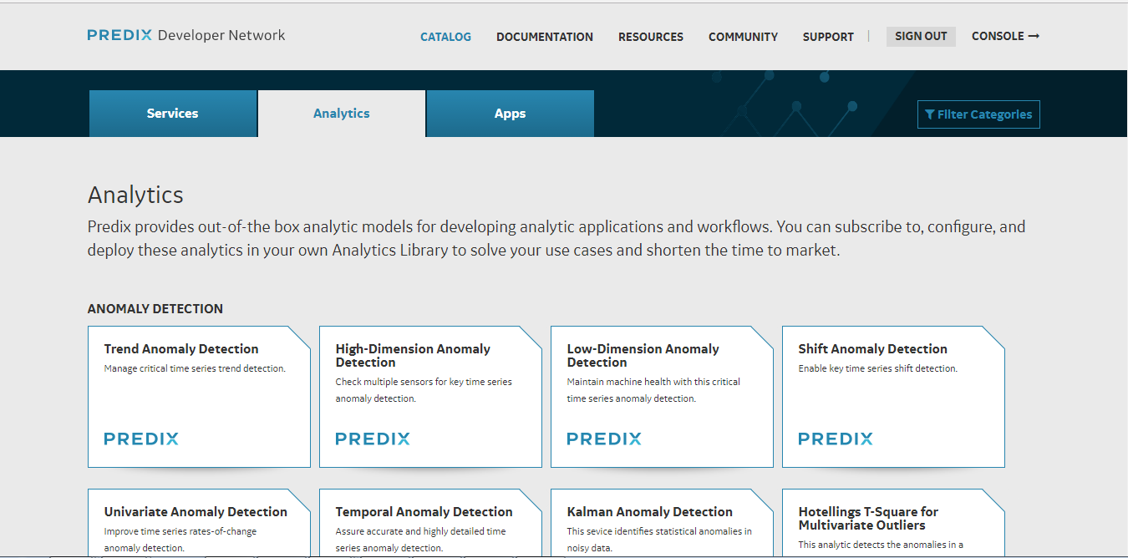
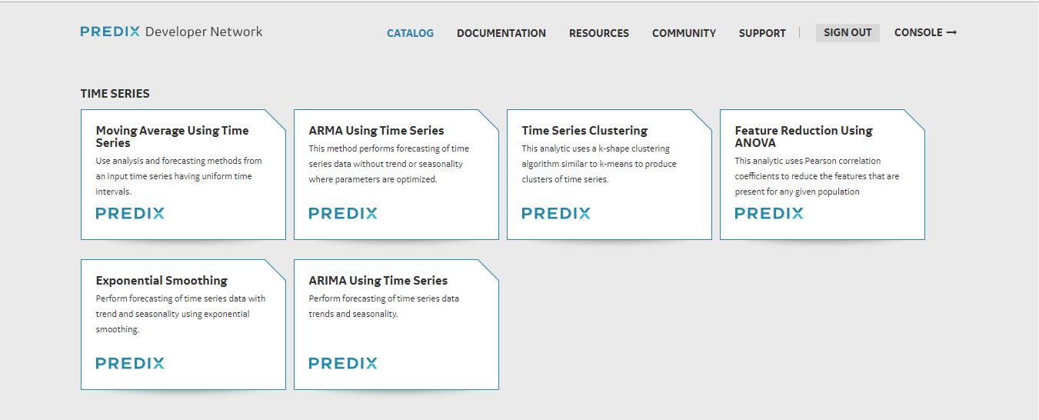

Slide 16
Using 3rd Party Analytics in Predix
Example:
demo-adder: A simple analytic that takes 2 numbers as input and returns their sum. It has been implemented in Java, Matlab (r2011b), and Python.
Code:

Slide 17

Orchestration
Orchestration describes the arranging and coordination of automated tasks, ultimately resulting in a consolidated process or workflow.
A collection of simple orchestration workflow files for use with Predix Analytics.
Orchestration with one Catalog analytic
Orchestration with one third-party analytic
Orchestration with one Catalog analytic and one third-party analytic

Slide 18
Orchestration Types:
One step orchestration :
Ex: An orchestration using a single timeseries demo adder to add 2 timeseries arrays.
Multi step orchestration :
Ex: An orchestration that adds 3 timeseries arrays by running the timeseries demo adder twice.

Slide 19
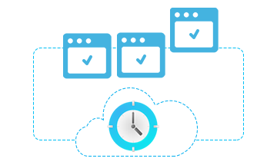
Scheduler
The scheduler provides the ability to schedule the execution of analytics or orchestrations of analytics on time-based intervals, also called a job.
You can create a job, retrieve both job definitions and history, update definitions, and delete jobs.

Slide 20


Slide 21


