Slide 1
HOSPITAL MANAGEMENT SYSTEM
Bingham University as case study

Slide 2
BRIEF OVERVIEW
Hospitals are essential part of our lives, providing us with medical facilities. It is necessary for the hospitals to keep track of its daily activities & records of its patients, doctors, nurses, and other staff so that there will be smooth running of the institution

Slide 3
PROBLEMs AT HAND
Traditional data storage is prone to data lose
Students easily forget their clinic card numbers

Slide 4
Why I’m doing this
Lives of staff and students are at stake
Technology is substituting almost every manual day-to-day tasks, why not follow the trend
Passion for coding

Slide 5
What the system will do
The system can register all patients
The system can show registered patients
The system can update their records
The system can keep track of birth rate and death rate
It can carry out a dynamic search for all records
It can keep track of admitted and discharged patients
It can enable staff to have a real-time chat
It can delete patients record

Slide 6
LITERATURE REVIEW
According to National Academy Press, 15 Jan 1997, Computer-based patient records, as defined by the committee, could positively affect the quality of patient care in at least four ways…

Slide 7
LITERATURE REVIEW
Improving both the quality of and access to patient care data
Allow providers to integrate information about patients over time and between settings of care
They make medical knowledge more accessible for use by practitioners when needed.
They provide decision support to practitioners.

Slide 8
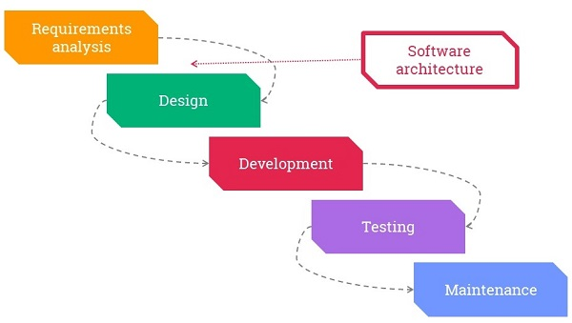
RESEARCH METHODOLOGY
AGILE!!!

Slide 9
WHY AGILE?
Modularity
Iterative
Time-bound
Incremental
People-oriented
Collaborative

Slide 10
APPLICATION MODULES
DASHBOARD
REGISTRATION
ADMISSIONS
ADMIN
LOGS
PATIENTS
CHAT

Slide 11

Use case
Login
Admin
Register
Search
Delete
Chat

Slide 12
DATA COLLECTION METHOD
Primary data collection method

Slide 13
DATABASE SCHEMA
Straight from the docs…
…NoSQL databases are built to allow the insertion of data without a predefined schema. That makes it easy to make significant application changes in real-time, without worrying about service interruptions – which means development is faster, code integration is more reliable, and less database administrator time is needed. (MongoDB, 2007)

Slide 14
TECHNOLOGIES USED
FRONTEND
HTML
CSS
JAVASCRIPT
ANGULAR JS

Slide 15
TECHNOLOGIES USED
BACKEND
NODE JS
EXPRESS JS
MONGODB
SOCKET IO
RESTful API Services

Slide 16
LIMITAtIONs & improvements
Security is not highly enforced
The application needs much optimization when it goes live on the internet (Perfomance issues)
The UI is terrible, because I’m bad at it

Slide 17
THANK YOU!

