Slide 1
Data Lake Without a Data Platform
Real-Time Aggregation at 1,500 messages/sec

Slide 2

What if you need Data Lake behaviour — but without the platform?

Slide 3

About Me
Distributed systems — designing and operating high-throughput, event-driven architectures in production
Engineering Manager — leading backend teams, balancing technical direction with delivery
Telecommunications domain — building data pipelines for telco device telemetry at scale
Founder of Hypercube

Slide 4
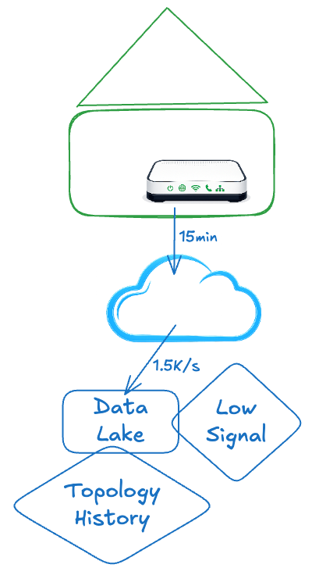
Business Requirement
The challenge: aggregate telemetry from dozens of home gateways — in near real-time.
The constraints:
~1.5M devices in homes
Home gateway data on every 15 minutes
Raw event retention: 72 hours
Pattern detection window: 48 hours
The business needs to know:
Is this device experiencing low signal?
How looks like the network topology in the past?

Slide 5
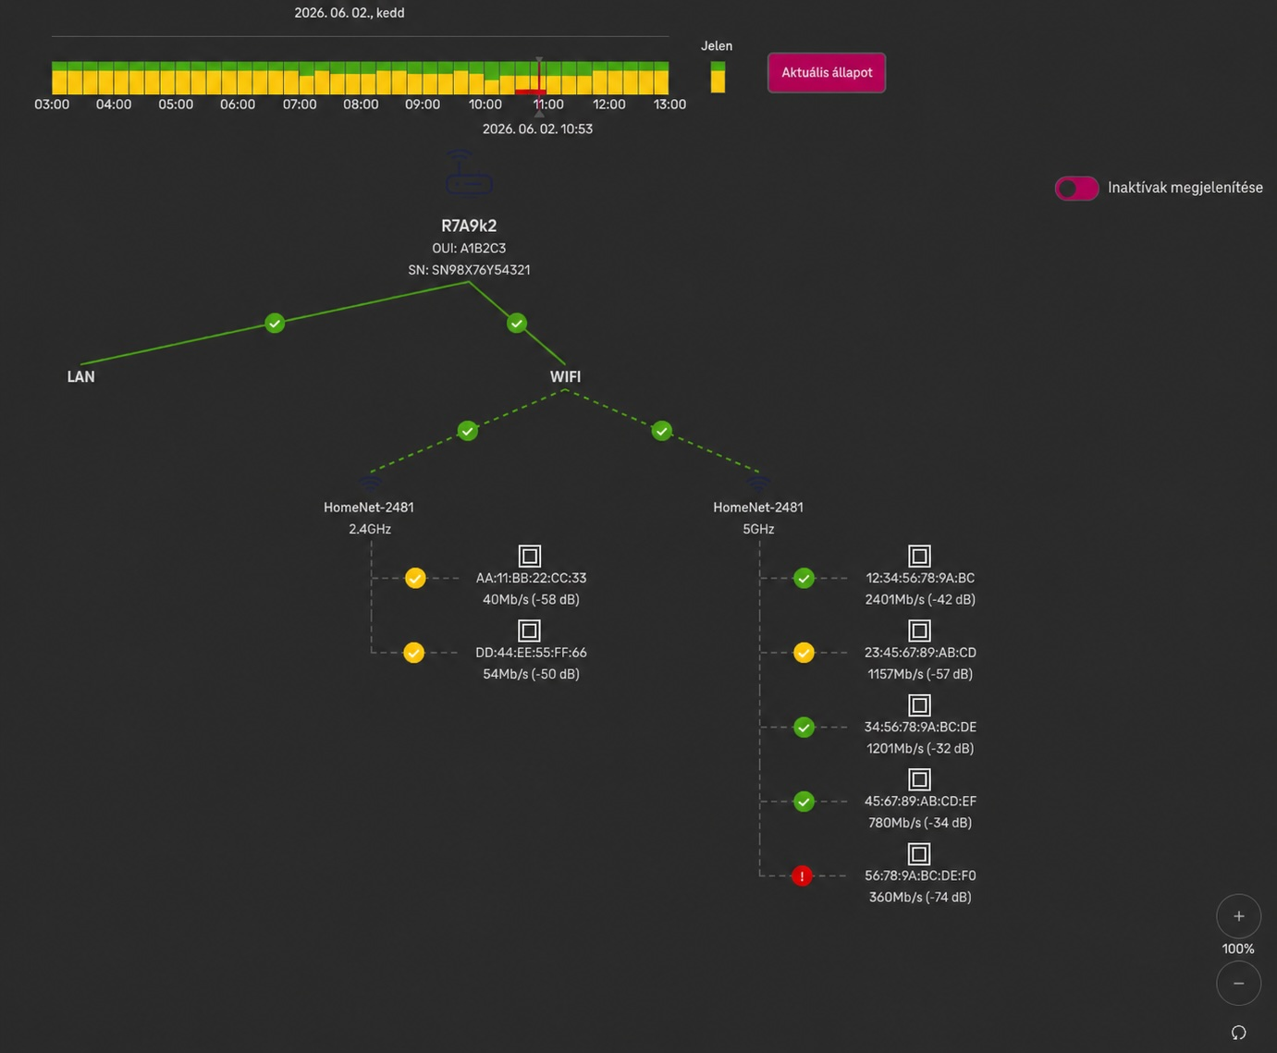

Slide 6
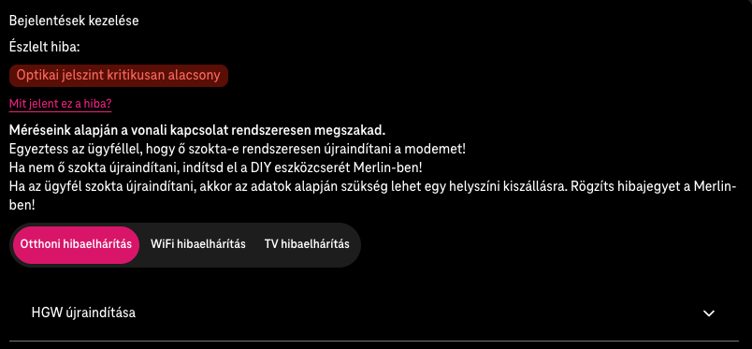

Slide 7
First Tries
Attempt 1 · Apache Spark
The technically correct choice. Kafka → Spark → MongoDB.
What went wrong:
Operational overhead: constant tuning of memory.
Resource contention: running Spark on the same infra as the application caused unpredictable failures
No metrics.

Slide 8
First Tries
Attempt 2 · Scheduled Aggregation Jobs
Simpler: Kafka → MongoDB raw collection → batch job every 60 seconds.
What went wrong:
Aggregation throughput < ingestion throughput — the queue never caught up
Lag grew from minutes to hours
Again: no monitoring.

Slide 9


Slide 10
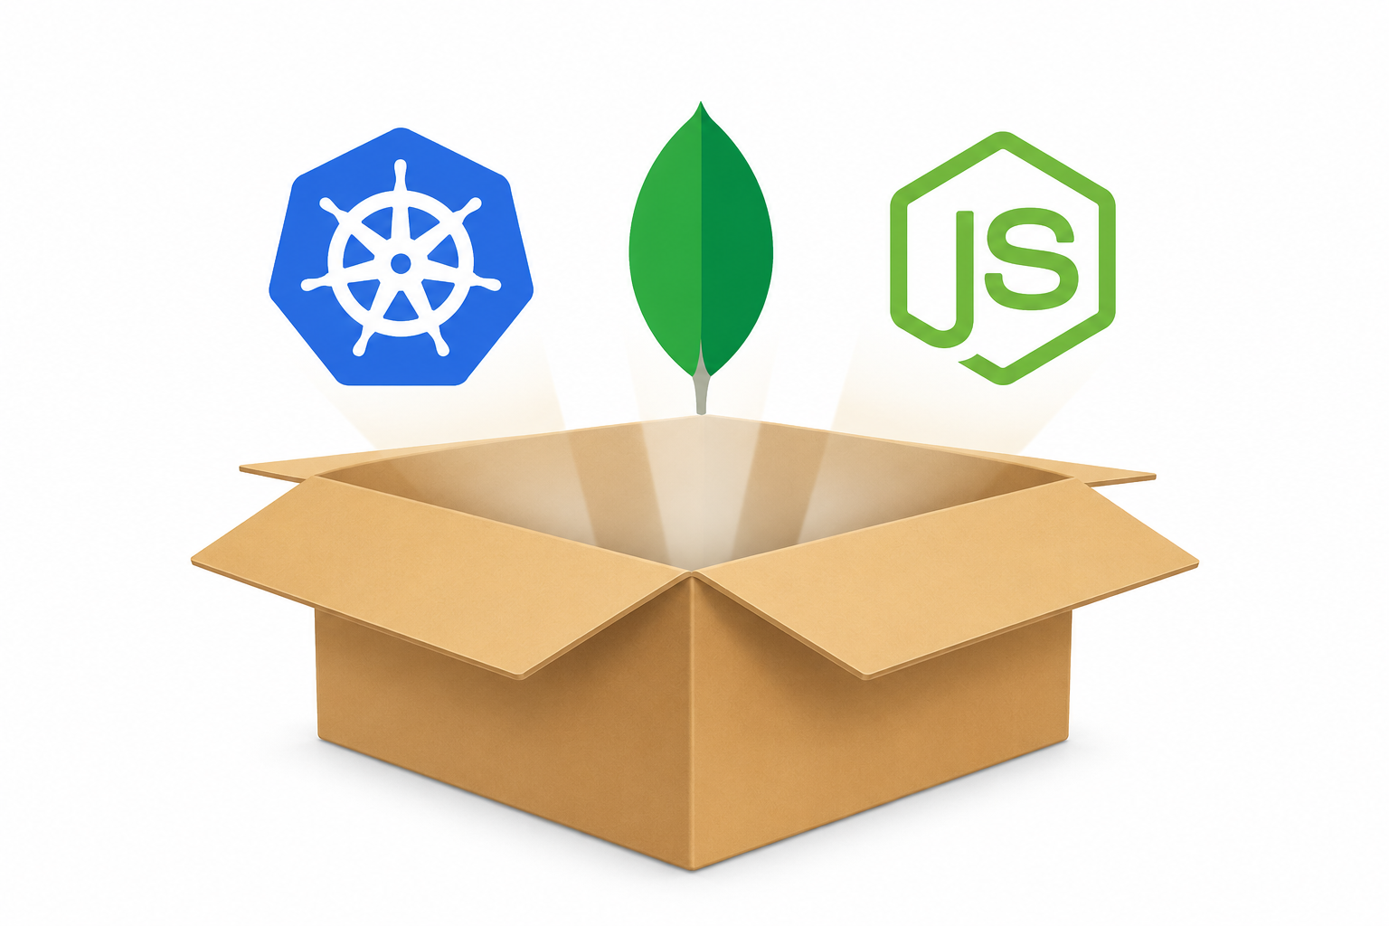
What's in the Box?
Layer | Technology
Orchestration | Kubernetes
Message stream | Apache Kafka
Storage | MongoDB (replica set)
Event processing | MongoDB Change Streams
Application | Node.js
Observability | Prometheus + Grafana

Slide 11
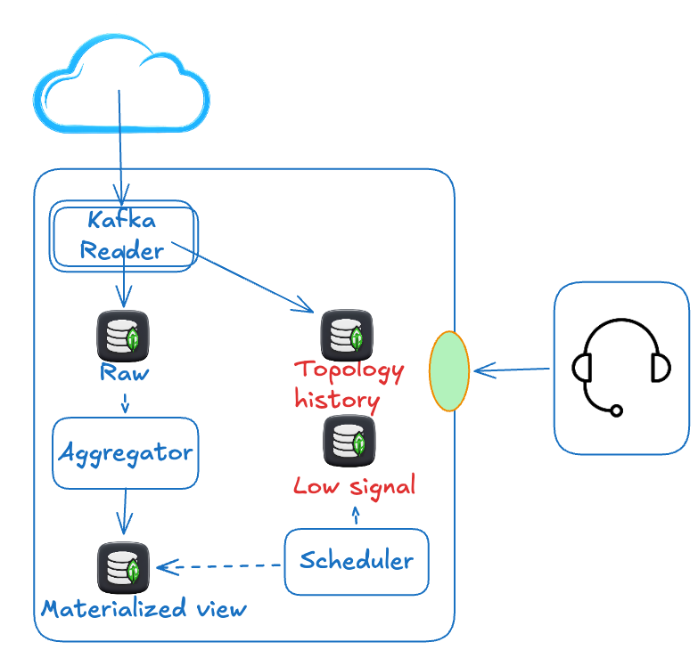
Solution
Change stream with resume token
Micro-batch
Single processor instance to aggregate data
Scheduled jobs
Notes:
Decision
Why it matters
- Change Streams
- Events flow in real-time, no re-scanning
Micro-batch (200–500ms)
Reduces MongoDB round-trips 200–500×
Resume token
Crash-safe, no data loss on restart
Single processor instance
No distributed consensus needed
Scheduled jobs
Backfill, cleanup, and complex metric recalculation

Slide 12
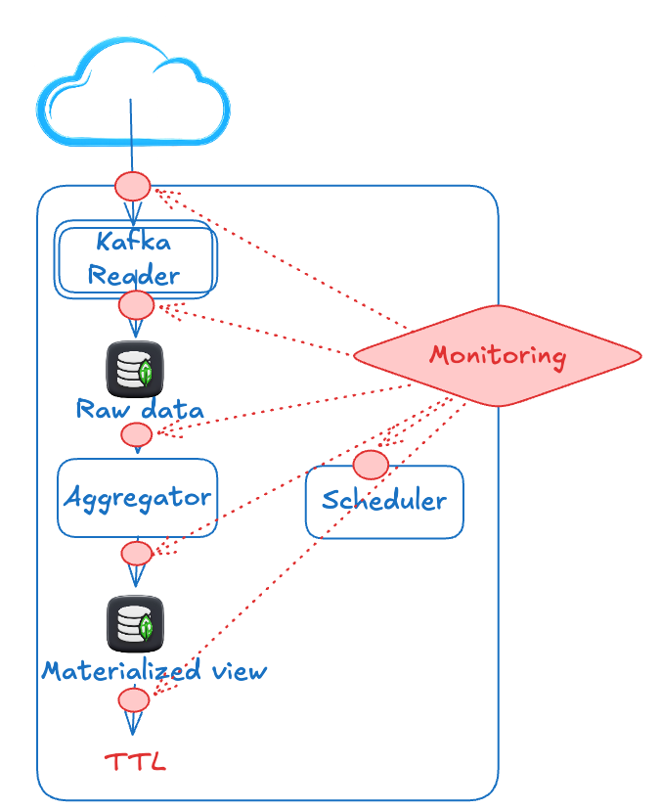
Monitoring
” Visibility is not optional. It's the architecture.”
Every element of the pipeline needs its own monitoring and alerts.
Events/sec · Event lag - are we keeping up with the producer?
Batch size · Flush frequency - how full is the micro-batch window?
Change stream lag - time between INSERT and aggregation write

Slide 13
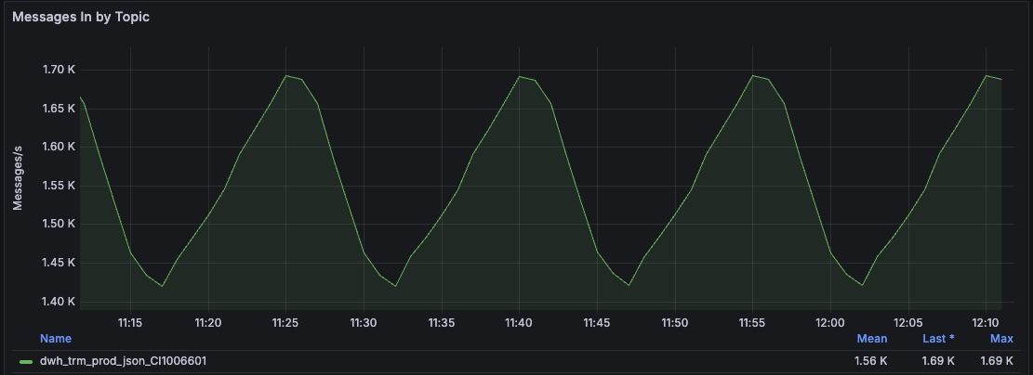
Kafka throughput

Slide 14
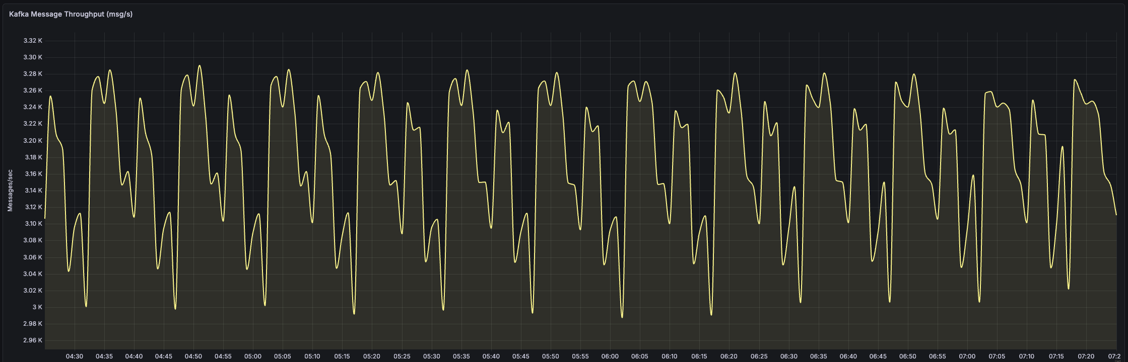
Kafka reading

Slide 15
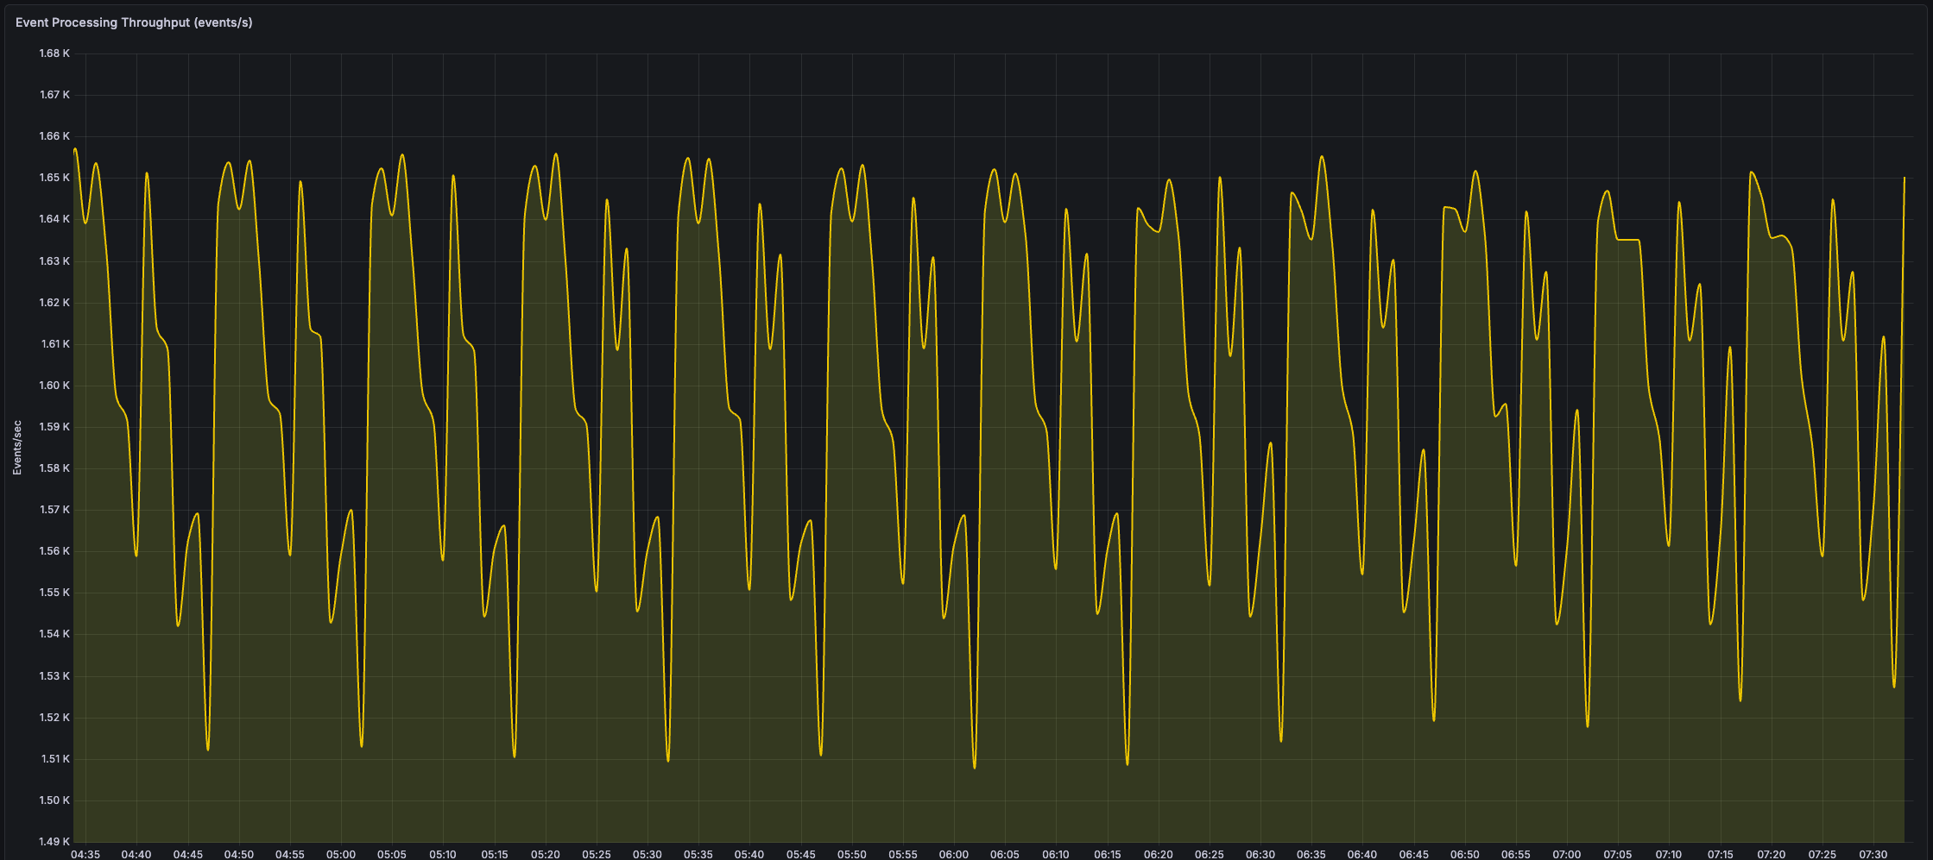
MongoDB Change Stream

Slide 16
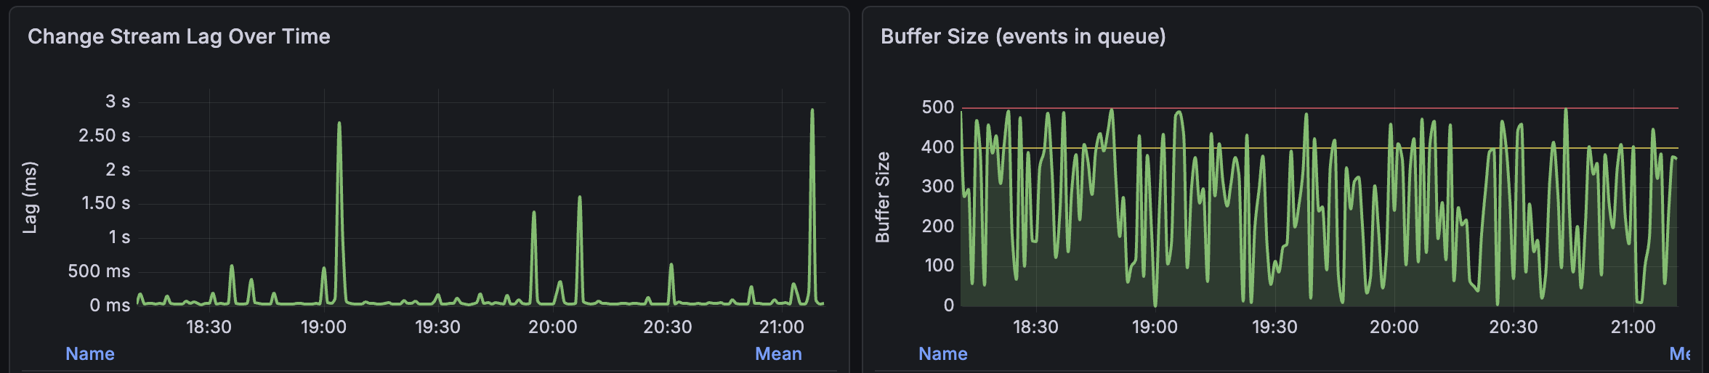
Change Stream lag and buffer

Slide 17
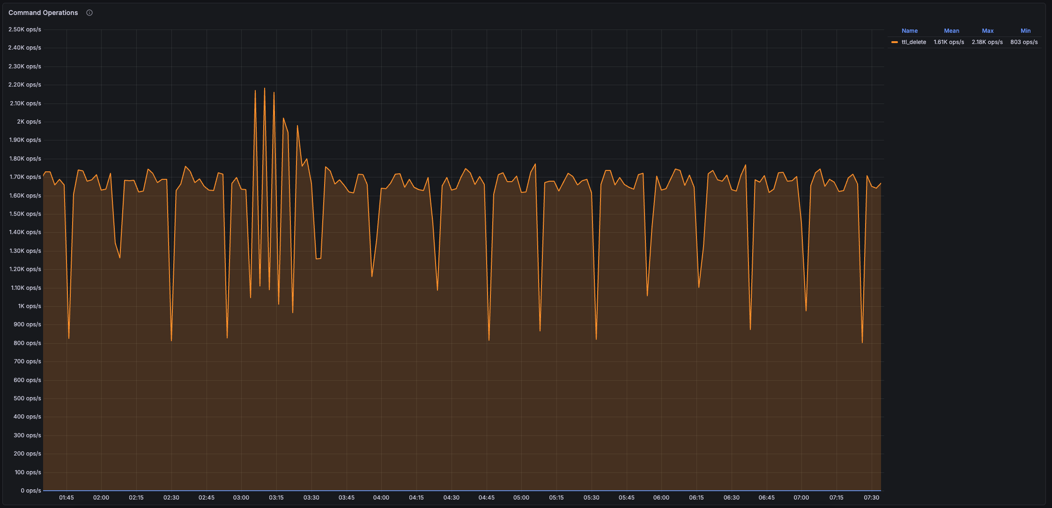
TTL

Slide 18
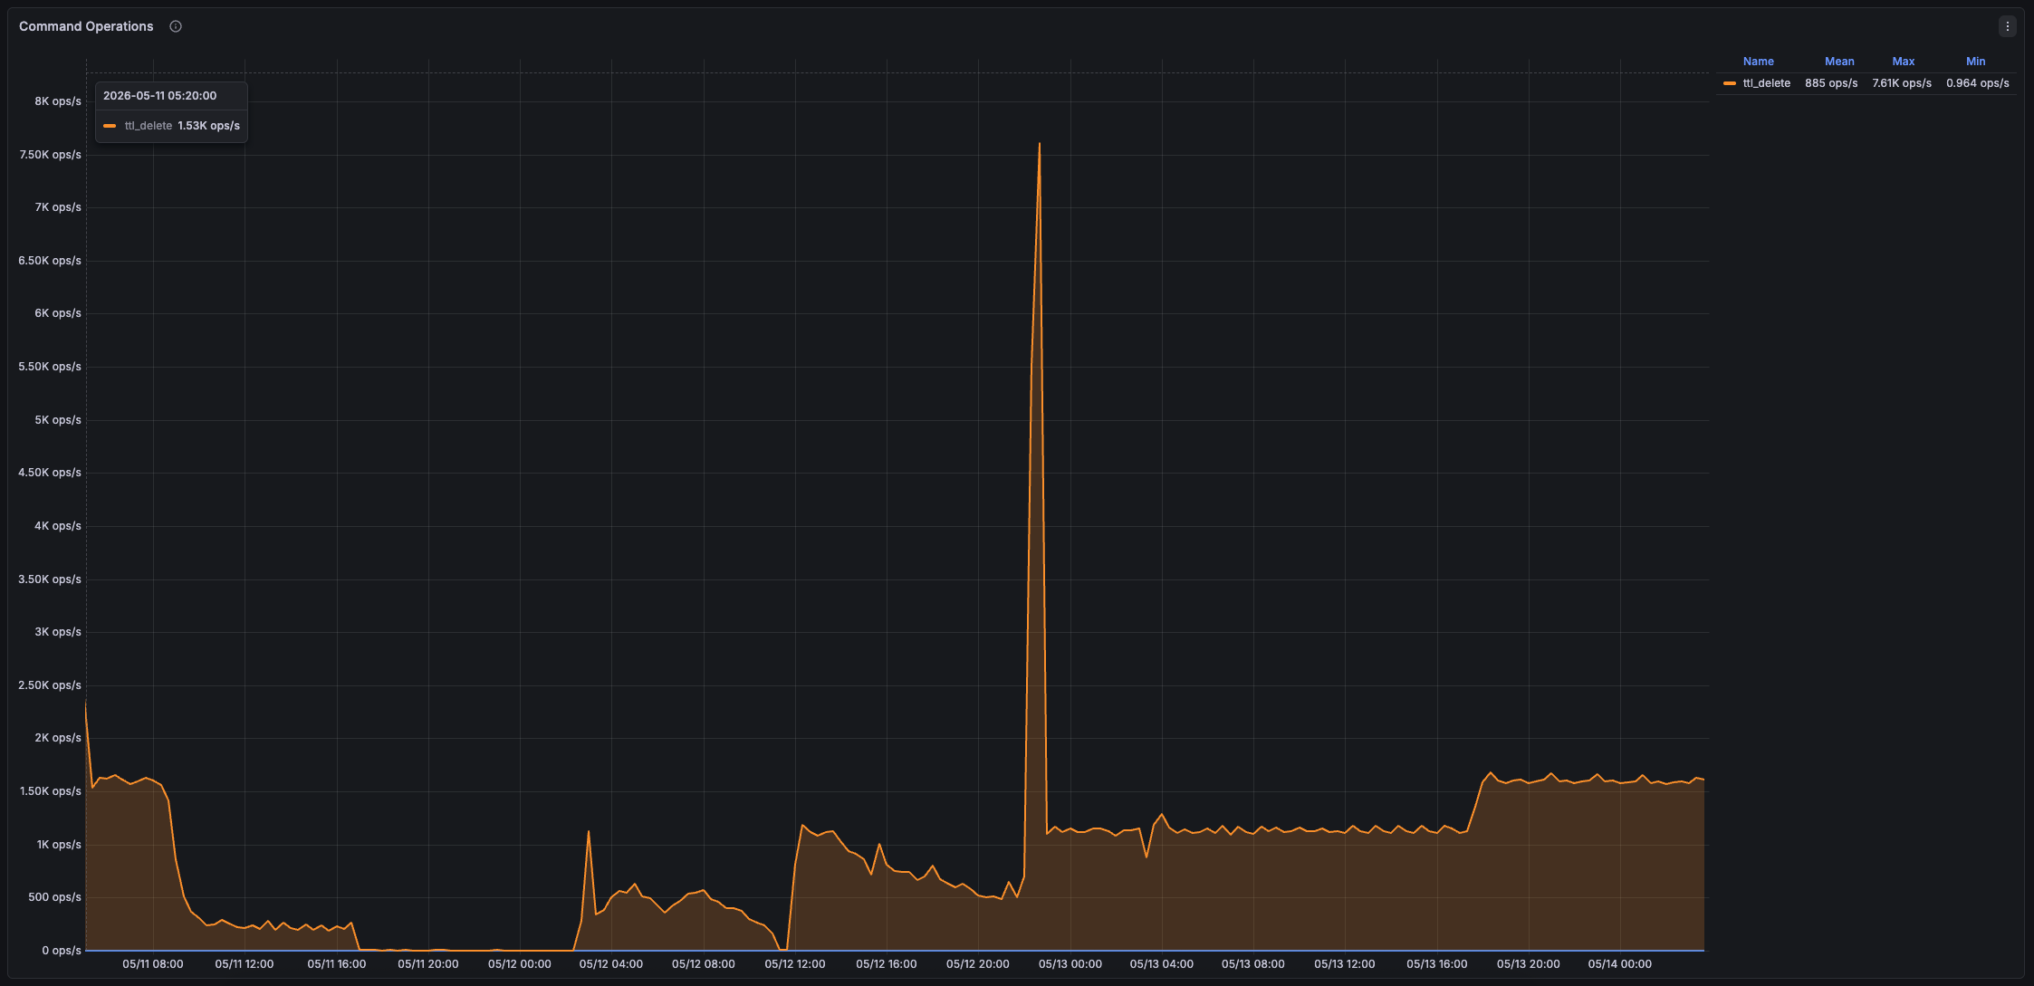
TTL / broken

Slide 19


Thank You — Questions Welcome over a Beer 🍺
@medium

