Slide 1
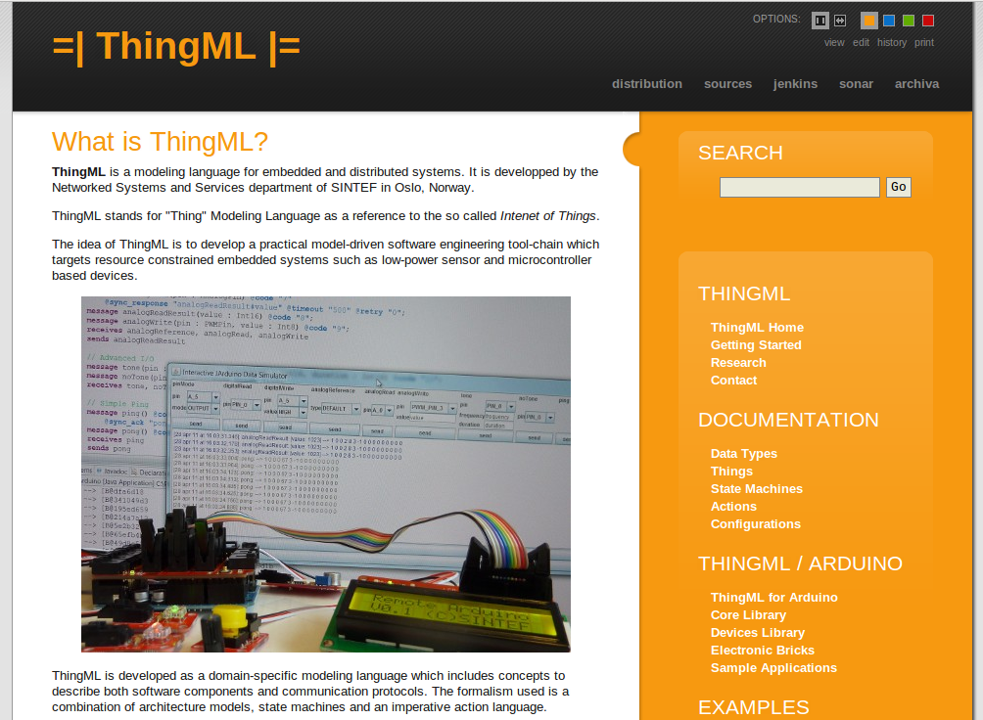
ThingML

Slide 2
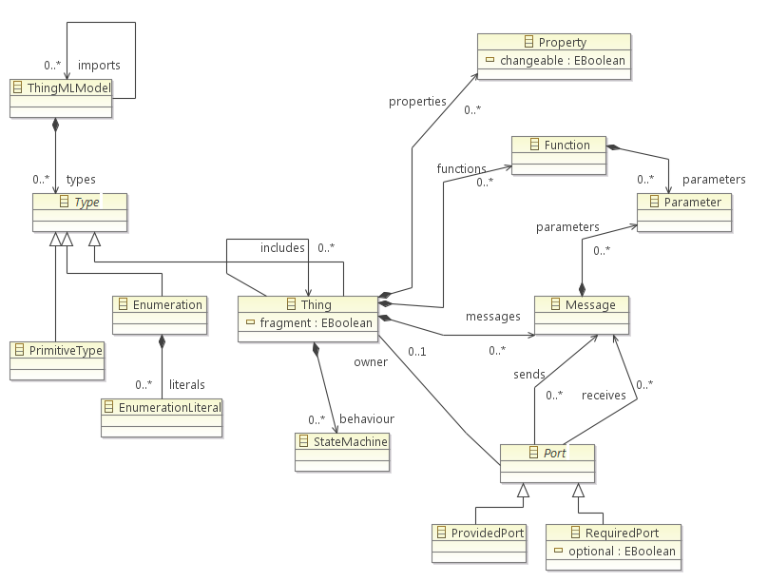

Slide 3
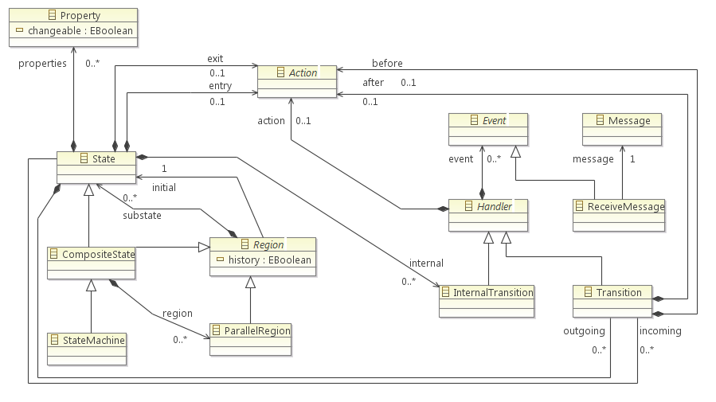

Slide 4
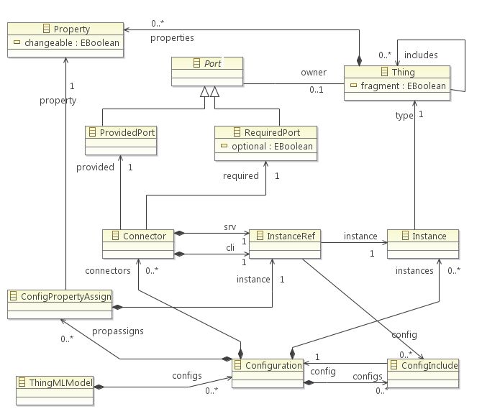

Slide 5
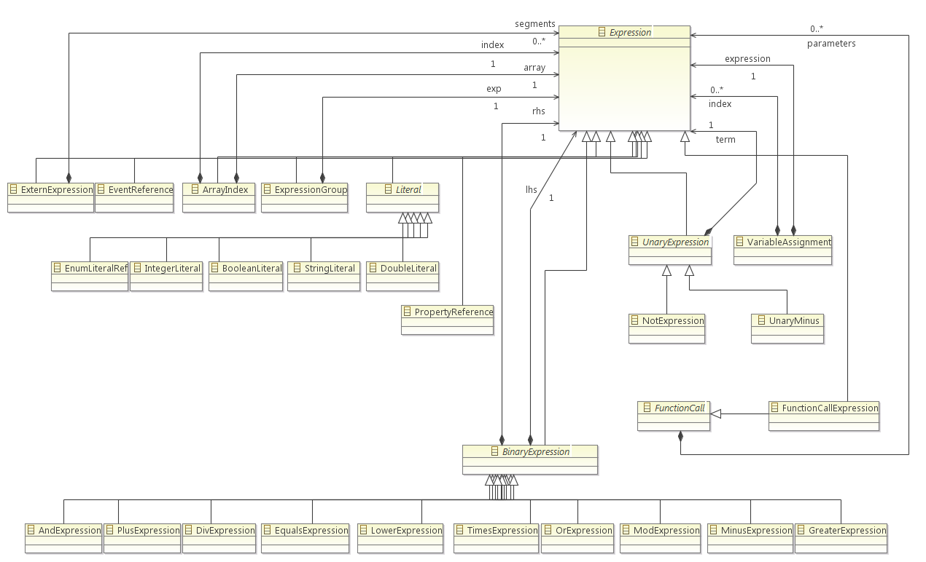

Slide 6
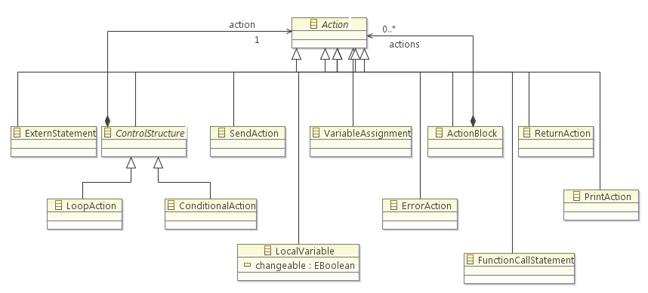

Slide 7
ThingML code generation framework
Configuration
Thing(s)
ThingML Model
Generated code
(4)
Connectors / Channels
Ports / Messages / Thing API
(3)
(5)
Message queuing / FIFOs
State Machine Implementation
(2)
(6)
Scheduling / Dispatch
Actions/Expressions/Functions
(1)
(7)
Initialization and "Main"
ThingML code generation framework
With 8 different variation points
(8)
Projects structure / build script

Slide 8
(1) Actions / Expressions / Functions
Scope
Depends only on the target language
Can be reused for different platforms
Implementation
Visitor on the ThingML meta-model
Customizable by
Implementing a new visitor for a new language
Inheriting from an exiting visitor and overriding some of its methods

Slide 9
(2) State machine implementation
Scope
Specific to a specific state machine implementation strategy.
Can generate either the complete state machine in the target language or leverage a state machine framework on the target platform
Implementation
Abstract state machine code generator
A set of reusable helpers to calculate states, transitions and events according to the common ThingML semantics.
Customization
Implement the abstract state machine generator

Slide 10
(3) Ports / Messages / Thing APIs
Scope
Depends on the language best practices
Depends on how components should be "packaged" on the target platform
Can generate any custom API for the Things
Can generate towards exiting middleware / OS
Can/should produce "manually usable" APIs
Different generators can be used for different things
Implementation
Visitor on the "Thing" part of the metamodel
Helpers to collapse fragments and gathers all the elements of a thing (messages, ports, functions, etc).
Customization
Implement a new visitor for a new target language / platform
Inherit from an existing visitor for light customization

Slide 11
(4) Connectors / channels
Scope
Depends on how messages are transported from on thing to the next using the Things APIs
Can be local and/or remote, includes the serialization, transport through networks and deserialization
Different generators can be used for different ports
Implementation
Abstract generator for serialization, deserialization and transport
Customization
Implement new concrete generators
Easy to reuse serialization and just override transport

Slide 12
(5) Message Queuing / FIFOs
Scope
Asynchronous behaviour of messages
Can target existing message frameworks or middleware or use custom made FIFOs
Different generators can be used for different ports
Implementation
Abstract generator which can be customized
Helpers to calculate the sets of messages to be handled (combines fragments and prunes unused messages).
Customization
Inherit and implement the abstract generator

Slide 13
(6) Scheduling / Dispatch
Scope
Implements the main loop of the program, schedules the activation of the components and dispatches the incoming messages
Relies on underlying OS and libraries of the target platform.
Can generate a custom scheduler for microcontroller applications.
Implementation
Template + Helper
Customization
Create of modify an existing template

Slide 14
(7) Initialization and "main"
Scope
Generate the entry point and initialize the components and connectors
Depends on the target languages and traget frameworks
Implementation
Template + Helper providing the set of components and connectors to instantiate
Customization
Create or modify a template

Slide 15
(9) Project structure / build script
Scope
Produce the right file structure, additional project files and/or build scripts
Can be customize to fit a specific target environment (makefiles, maven files, etc)
Implementation
Abstract generator with access to buffers containing all the generated code.
Customization
Create a concrete generator. Possibility to use templates.

Slide 16
projects / modules
dependencies
Compilers
Model
Framework
Javascript
…
C / C++
Java
Standalone Editor
Parser
Registry
Command line
Compiler
Eclipse Plugins

