Slide 1
ADC Characterization
Michela Conti
Maria Cristina Ragusa

Slide 2

Project flowchart
dual-port RAM 1024x32
CONVST
SCLK
SPI_master_AD7810
FIFOwidth10_depth?
Histogrammer
RAM_count
sclk
ss
D_en
ADC_dout
r_data
rd_en
full
empty
ram_adr
rd_en
ram_data_out
ram_wr_en
ram_adr
ram_data_in
wr_en
w_adr
data_in
r_adr
Dout
MISO
[9:0]
hist_data_out
UART_data_out
wr_en
w_data
[9:0]
clk
clk
clk
clk
UART
uart_rx
riceve comandi dal pc:
S = send data
R = reset count
TX
invia dati della RAM al pc
clk

Slide 3
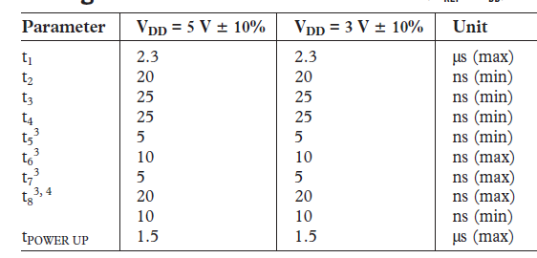
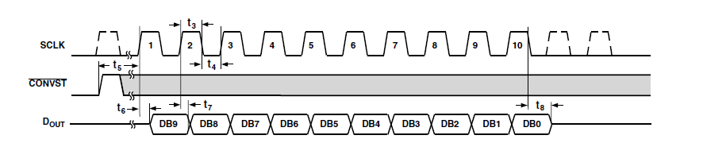
SPI
25 ns
25 ns => Tsclk = 50 ns fsclk = 20 MHz
CONVST
SCLK
SPI_master_AD7810
Dout
sclk
ss
D_en
ADC_dout
MISO
[9:0]
clk
convst T – 5 ns ??
rst

Slide 4
SPI FSM
START_CONV
CONVST = 0
sclk leading edge +
SPI TRANSFER
IDLE
CPOL = 0
busy = 0
wait
STOP_CONV

Slide 5
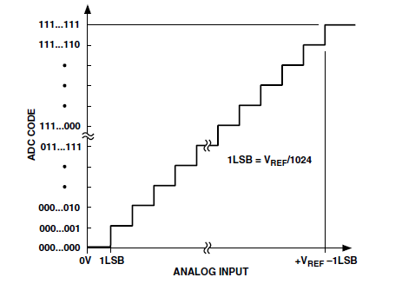

$2^{10}$=1024
10 ns
100ns

Slide 6
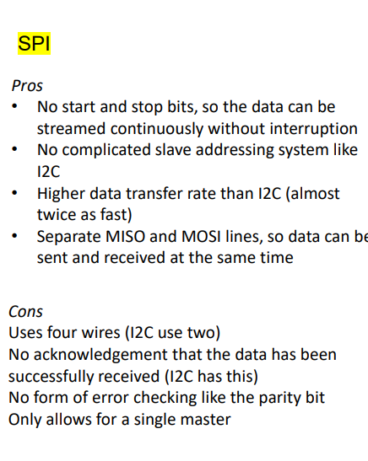
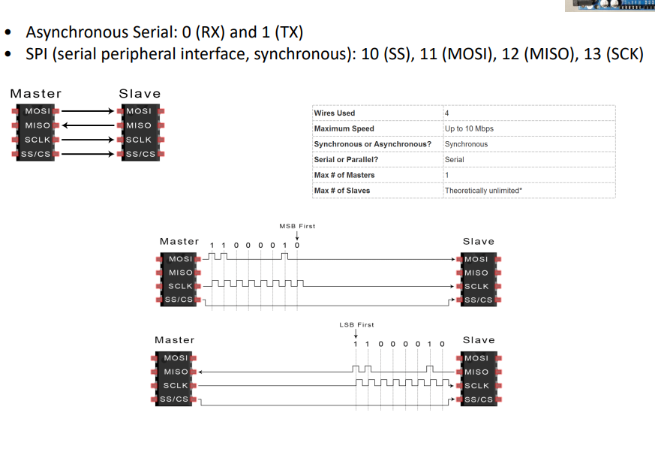

Slide 7
FIFO
IP
FIFOwidth10_depth?
w_data
wr_en
r_data
rd_en
full
empty
WrPtr
RdPtr
Counters
clk
Central Memory
Dual Port memory
Registers
BRam
LUT

Slide 8
FIFO BLOCK DIAGRAM
Read
Interface
Write
Interface
Write data
Read data
Read
data
Write
data
Dual port memory array
Write Address
Read Address
Read
enable
Write
Enable
Write
Pointer
Compare
Logic
Read
Pointer
Full
Full
Empty
Empty

Slide 9
-FIFO EMPTY wrPtr = RdPtr
-FIFO FULL
Never happen
slow data processing speed
incorrect sizing of depth FIFO
FREEZE
CIRCULAR BUFFER
DAQ
Sensor
FIFO
decouples event processing times from acquisition times

Slide 10
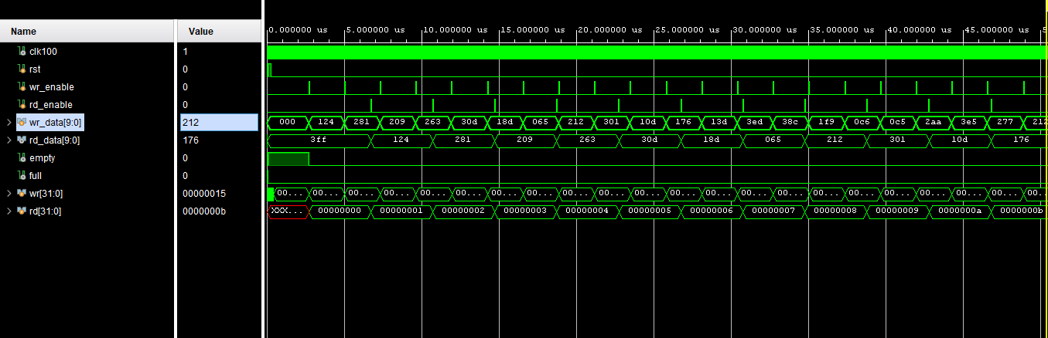

Choice of depth
The choice of depth is a compromise between:
Maximum clock frequency: 100 MHz -> 1 bit 10ns -> 10 bit 100ns
Expected average event frequency
Power
Per il reset metto10 bit a zero in esadecimale 3FF
$2,3 μs=2300 ns$
2300+100ns

