Slide 1
Generative AI

Slide 2
W4 Agenda
On Premise LLMs
  Why local LLMs are important?
  How to launch LLM locally?

Slide 3
On Premise LLMs

Slide 4
Why local LLMs are important?

Slide 5


Local LLMs – Pros and Cons
Full data privacy
Can work offline
Ability to use underutilzed infrastructure e.g. Priv GPUs
Usually limited to smaller models, with 3-20B params on normal GPUs
Much slower than SaaS solutions
Needs very high utilization and optimization to be actually cheaper than small SaaS LLMs

Slide 6
LLMs you can run locally on a private GPU 12-16 GB (with some quantization)
Gemma 3 12B
LLaMA 13B
Falcon 7B
Bielik-11B-v2

Slide 7
What is Quantization??
Definition
Converting model weights from higher-precision (e.g. FP16 or FP32)
down to fewer bits (e.g. 8-bit, 4-bit) to reduce memory usage and computational overhead
Why It Matters
Lower VRAM Requirements: Fits larger models on smaller GPUs.
Faster Inference: Fewer bits to process speeds up forward passes.
Energy Efficiency: Reduced compute demands save power.
Approaches
Uniform Quantization: Single scale factor per block of weights.
Advanced “K-Quant” Methods: Multiple scales or per-channel scaling for better accuracy at the same bit depth.
Trade-Offs
Size vs. Accuracy: Fewer bits can degrade model performance.
Implementation Complexity: Complex quantization methods often require specialized tooling.

Slide 8
Deploying LLMs locally

Slide 9
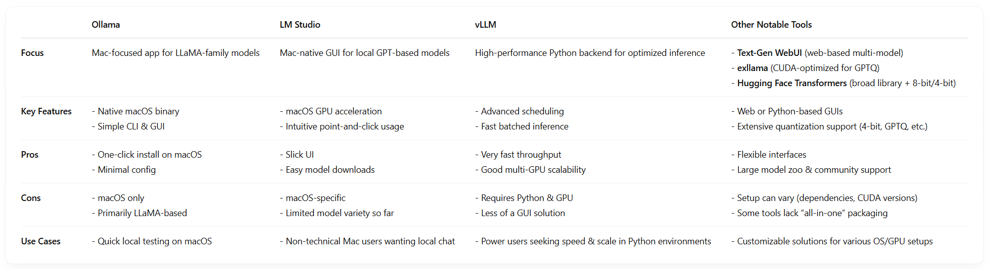
How can you run LMMs locally?

Slide 10
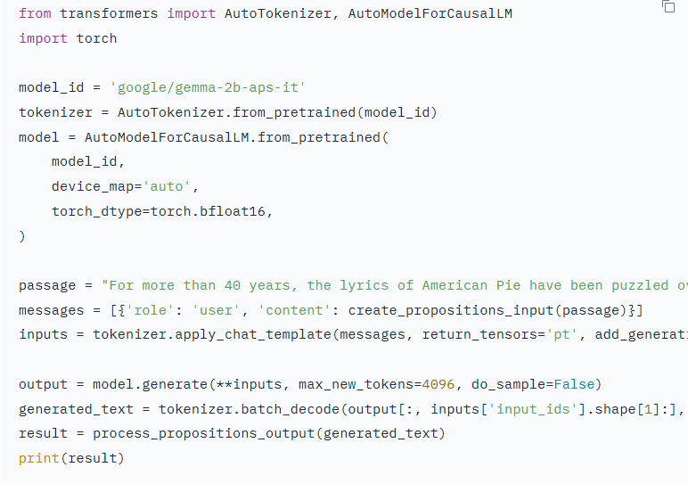
Hugging face transformers example

Slide 11
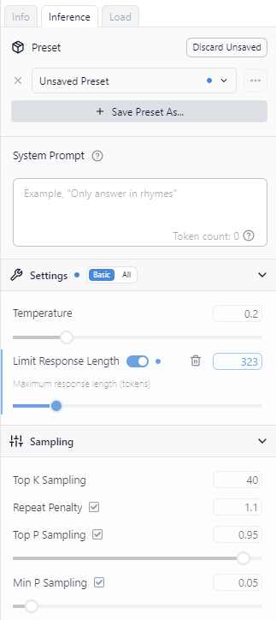
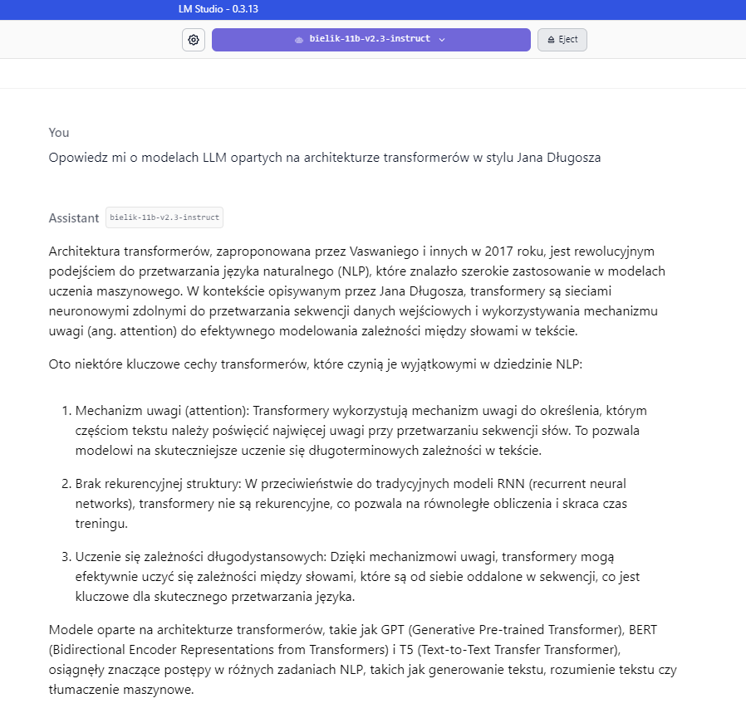
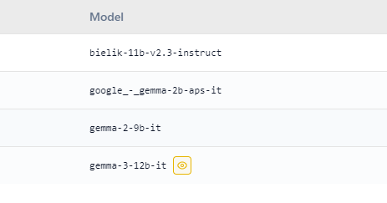
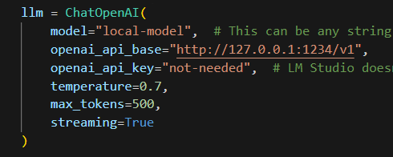
LM Studio example
Choose model
Setup hyperparams
Chat using API or UI

Slide 12
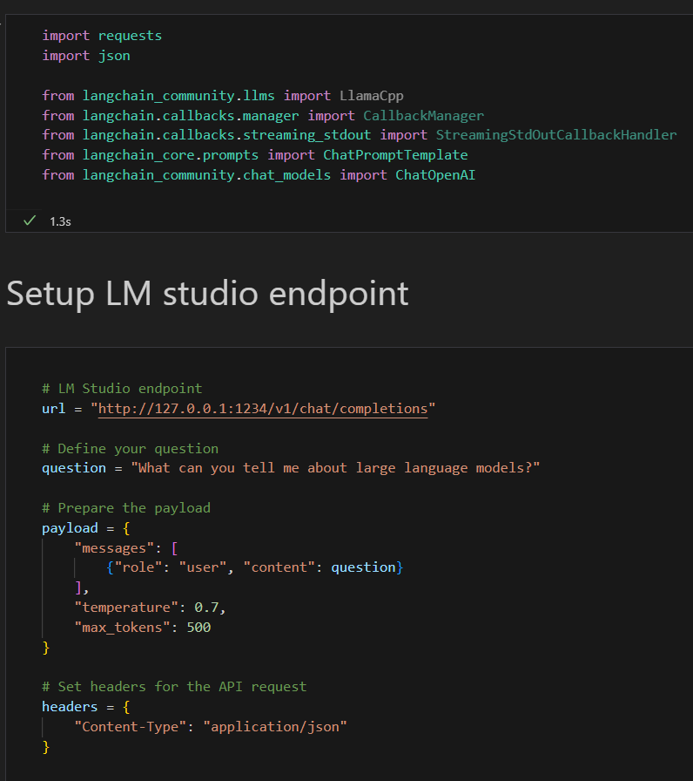
LM Studio exercise
Start with Bonus-on-premise-LLMs.py

Slide 13
GenAI Voice Solutions

Slide 14
What are Voice AI Solutions?
Voice AI enables natural spoken conversations between humans and AI systems
Combines Speech Recognition (STT), Language Models (LLM), and Speech Synthesis (TTS)
Goal: Create human-like conversational experiences without typing
Key Components:
Speech-to-Text (STT): Converts spoken audio into text (e.g., Whisper, Deepgram)
Large Language Model (LLM): Processes text, generates intelligent responses
Text-to-Speech (TTS): Converts text responses into natural-sounding audio

Slide 15
Voice AI Use Cases
Real-world applications of conversational voice AI
Customer Service & Support
AI phone agents for 24/7 customer support (e.g., banks, airlines, telecom)
Appointment scheduling and reservation systems
Healthcare
Patient intake and symptom screening via voice
Medication reminders and health monitoring assistants
Smart Assistants & IoT
Home automation voice control (Alexa, Google Home, Siri)
In-car voice assistants for navigation and entertainment
Enterprise & Productivity
Voice-driven meeting transcription and note-taking
Hands-free data entry and workflow automation

Slide 16
Voice AI Architectures
Two main approaches to building voice AI systems
3-Phase Pipeline (STT → LLM → TTS)
Audio → Speech-to-Text → LLM processes text → Text-to-Speech → Audio
Each component is separate and can be optimized independently
Total latency = STT latency + LLM latency + TTS latency (typically 1-3+ seconds)
Realtime Voice-to-Voice (Speech-to-Speech)
Single model processes audio directly without intermediate text conversion
Examples: GPT-4o Realtime API, Gemini 2.0 Live, Moshi by Kyutai
Native understanding of tone, emotion, and paralinguistic cues
Latency as low as 200-500ms for near-instant responses

Slide 17
3-Phase vs Realtime: Pros and Cons
3-Phase Pipeline (STT-LLM-TTS)
Realtime Voice-to-Voice
Flexible: swap components easily
Mature ecosystem with many providers
Better text accuracy for complex content
Easier to debug and monitor each step
Works with any LLM (GPT-4, Claude, etc.)
Higher latency (1-3+ seconds total)
Loses audio context (tone, emotion)
Cannot handle overlapping speech well
Ultra-low latency (~200-500ms)
Natural interruption handling
Preserves emotional/tonal context
More human-like conversations
Better for real-time interactions
Limited model options currently
Higher compute costs
Less control over individual steps

Slide 18
Handling Streaming & Interruptions
Critical techniques for responsive voice AI
Streaming for Low Latency
Stream STT results incrementally (partial transcripts)
Use LLM streaming to start TTS before full response is generated
Chunk TTS audio and play as it’s generated (don’t wait for full audio)
Result: User hears response while it’s still being generated
Handling Interruptions (Barge-in)
Voice Activity Detection (VAD): Detect when user starts speaking
Immediately stop current TTS playback when interruption detected
Cancel pending LLM generation to save resources
Process new user input and restart the pipeline
Best Practices
Use WebSockets or gRPC for real-time bidirectional communication
Implement echo cancellation to avoid AI hearing its own voice
Buffer management: balance between latency and audio quality

