Slide 1
AI Agents

Slide 2
What is an AI Agent?

Slide 3
What makes LLMs Agentic
What Are AI Agents?
Autonomous systems powered by AI that can perceive their environment, make decisions, and take actions
Combine LLMs with the ability to use tools and execute tasks over multiple steps
Designed to achieve specific goals with varying degrees of autonomy
LLM serves as the `brain` of the system, but it also be connected to classical programs, databases, email etc
Key Capabilities
Contextual Memory: Short and long-term memory systems
Reasoning: Ability to make logical inferences
Learning: Improving performance through experience
Multimodal Understanding: Processing different types of inputs (text, images, etc.)

Slide 4
Interacting with online world through tools and iterative improvements is what makes Agentic LLMs so powerful
Iterative Decision Making
Plan-Execute-Reflect Loop: Form a plan, take actions, evaluate results
Self-Correction: Adjust strategy based on feedback and outcomes
Decomposition: Break complex tasks into manageable subtasks
Memory Management: Maintain context across multiple decision points
Re-planning: Update approach when facing unexpected obstacles
How AI Agents Use Tools
Tool Integration: Access to APIs, databases, code execution, web browsing
Tool Selection: Choose appropriate tools based on the current task requirements
Tool Chaining: Coordinate multiple tools to solve complex problems
Tool Augmentation: Overcome LLM limitations (computation, up-to-date info, specific actions)

Slide 5
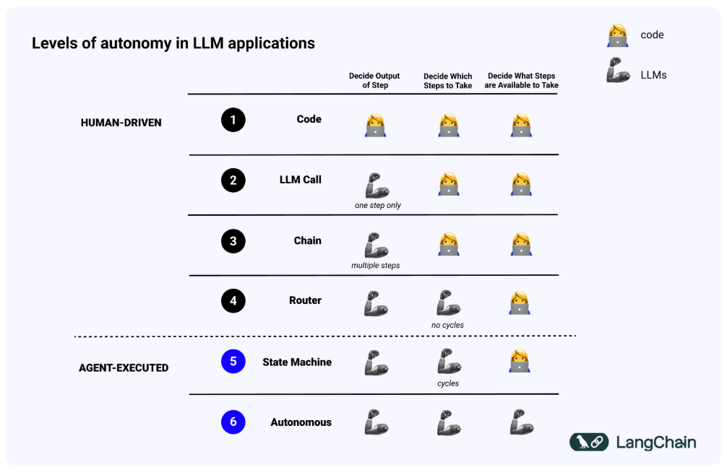
Levels of Autonomy in LLM applications
Everything below this line is currently called an agent
Level 6 Autonomy without any control is still extremely rare

Slide 6
Empowering LLMs to take actions with tools

Slide 7
Why do agents need tools?
LLMs are more powerfull than just chatbots -> tools allow them to interact with online world through API, Databases, Email or anything that you can trigger with a script
Tools also enable them to leverage more data for answers, by query API, SQL Databases etc
Tools can improve reliability where LLMs typically fail e.g. Math, Physics, Word Counting, Dates processing -> if LLMs are smart enough to use a calculator why should they try to replicate it??

Slide 8
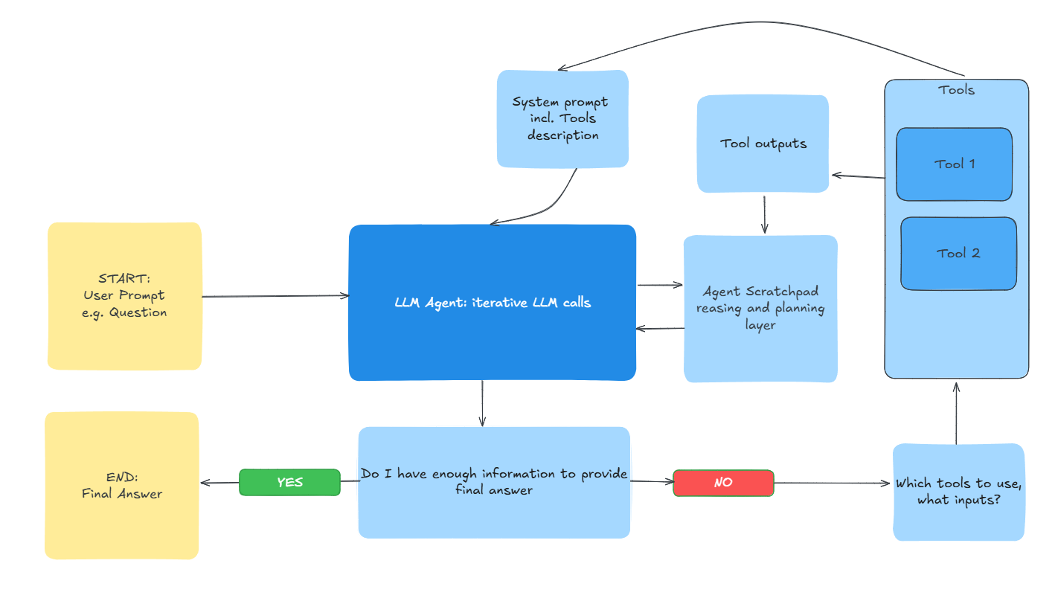
How to convert LLM calls into iterative LLM Agent?

Slide 9
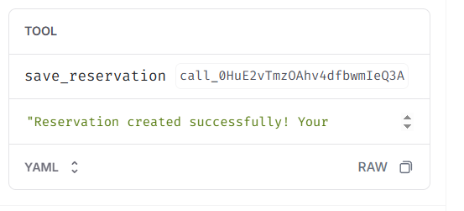
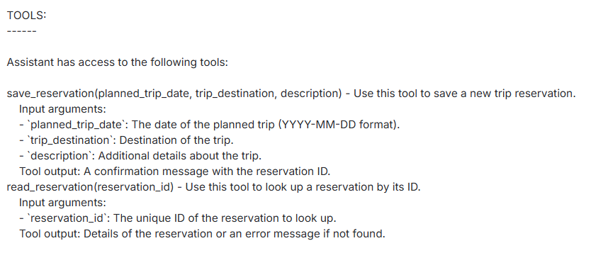
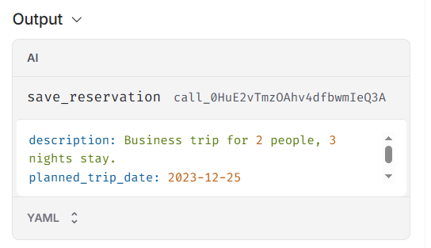

How tools work from LLM calling perspective
Call #1
Call #2
LLM sees available tools in prompt together with usage guideliness
1st call output is fed to tool, triggering an execution and a tool output
LLM decides to use tool -> 1st output is just a tool trigger
Tool output is fed to 2nd LLM call to power final response, or trigerring another iteration

Slide 10
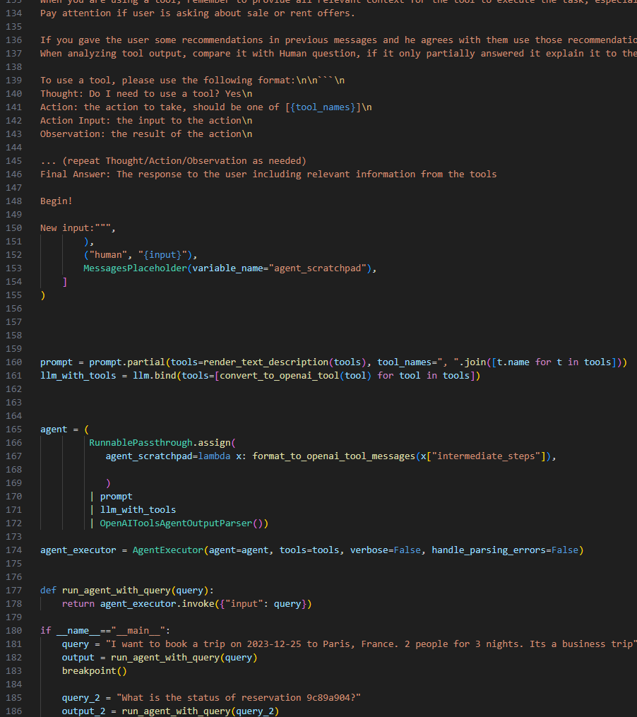
Jupyter exercise Reranking
Start with W3-agent_with_tools_BLANK.py

