Slide 1
Generative AI

Slide 2

About me
Graduated Koźmiński University in Finance&Accounting
Self-taught Data Scientist with 8 yrs of experience
Currently working as Senior Data Scientist at Shelf
Focus on NLP, unstructured data, similarity exploration, data enrichments and pricing
Enthusiast of building AI Agents and orchestrating complex LLM pipelines combined with classic ML models

Slide 3
Course Goals
What to expect?
What not to expect?
Exploring GenAI use cases and challenges with focus on LLMs
Introduction to basic LLM and NLP theory
Introduction to Large Language Models
Learning how to build first models with popular frameworks such as spacy
Improving Python skills
Group assigment to explore one of LLM use cases at home
Building foundations and a roadmap for further learning
Extensive NLP and Machine Learning Theory lectures
Learning to code in Python from scratch
Becoming NLP expert in 20 hrs
Learning from slides alone

Slide 4
Course Agenda
W1 – Introduction to GenAI and NLP Theory fundamentals
W2 – LLM toolkit
W3 – AI Agents and LLM flow orchestration
W4 – Course assignment & LLM productization

Slide 5

Course Agenda
GenAI & NLP
LLM Toolkit
AI Agents
Assignment & Productization
Gen AI Intro
What is GenAI?
Why LLMs?
Voice generation
NLP Theory
Transformers & Attention
Tokenization and embeddings
Showcasing meaning in vectors
Semantic similarity and its pitfalls
BERT finetuning experiment
LLM training and fine-tuning
Voice Generation
Giving our chatbot a voice
LLM Basics
Prompt Engineering
How does next word search work?
General LLM usage tips
LLM Context enrichment
Retrieval Augmented Generation („RAG”)
Vector Databases
Hybrid search with ChromaDB / Elastic search
Classic NLP & LLMs synergy
Named Entity Recognition
CrossEncoders as Rerankers and Evaluators
How to find best models?
Fine tuning Xencoder for evaluation
Agent Basics
6 levels of LLM Autonomy
Tool usage
`Reasoning` proces
LLM Flow orchestration
How to improve results with multiple LLM-calls
Building first flow with LangChain and eval with LangSmith
ChatBots
Why are chatbots most popular LLM use case?
How to enable chatbots take actions and access data?
Building level 5 autonomy Chat Bot
Assignments Presentation
Discussing Results
Lessons learned & Challenges
LLMs in production
Evaluating user feedback
Optimizing cost and latency
On-Premise LLMs
When is it worth launching LLMs locally?
Launching <10B LLM locally with LM Studio

Slide 6
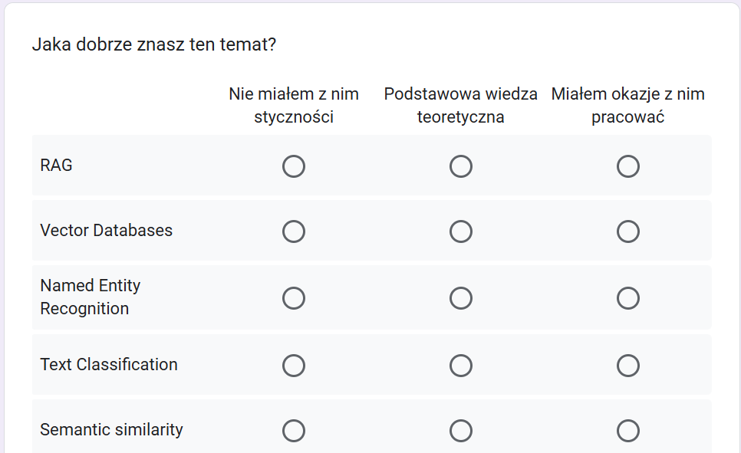
Intro questionnaire
Questionnaire Link

Slide 7
W1 Agenda
Introduction to GenAI
Why do LLMs and NLP dominate AI?
NLP Theory basics:
  Tokenization and Embeddings
  Semantic similarity
  Transformers & Attention
  Training and Fine-tuning LLMs

Slide 8
Introduction Generative AI

Slide 9
What is Gen AI?
Definition:
AI that generates new content—text, images, music—by learning patterns in large datasets.
Most popular Generative Models:
Includes techniques like GANs (Generative Adversarial Networks), VAEs (Variational Autoencoders), and Transformers.
How It Works: Learns the probability distribution of training data to create novel outputs.
Key Use Cases: From writing assistance (ChatGPT) to image creation (DALL·E) and product design.
Ethical & Practical Considerations: Highlights issues around bias, copyright, and authenticity in AI-generated content.

Slide 10
What differentiates GenAI from classic ML?
 | Classic ML | Gen AI
Task Orientation | Primarily focused on classification or regression (predicting labels/values). | Generates new data (text, images, audio) by modeling underlying data distributions
Model Architecture | Often uses discriminative models (e.g., logistic regression, CNNs for classification). | Employs generative models (e.g., GANs, VAEs, Transformers) to create novel outputs
Learning Approach | Learns decision boundaries or function approximations. | Learns the probability distribution of data, enabling synthesis of new, realistic samples.
Data Requirements | Needs labeled data for supervised tasks, or unlabeled data for clustering. | Still benefits from large, diverse datasets—often leveraging self-supervised or unsupervised pretraining.
Applications & Challenges | Price prediction, fraud detection, image classification, recommendation systems. | Creative content generation, language translation, design prototyping—raises ethical questions around bias, copyright, and authenticity.

Slide 11
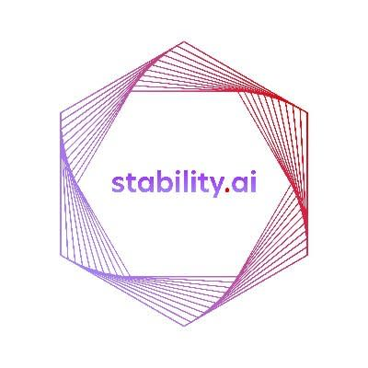
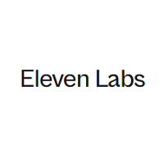

Generative AI seems to have human like capabilities
Chat GPT
Stable Diffusion
Prime Voice AI
Generate human-like conversations and answer
Answer complex queries on any topic
Great at writing and refactoring code
Text-to-image generation
Accelerates creative process
Still some way to go before replacing actual graphic designers
Mimic any voice and maintain emotions
Potential to replace lectors and dubbing

Slide 12
GenAI in audio creates or transforms audio content, such as music, speech, and sound effects, rather than simply reproducing or manipulating existing clips.
Text-to-Speech (TTS) and Voice Cloning
  Personal Assistants (e.g., Alexa, Siri): Generate natural-sounding responses.
  Voice Over for Videos: Rapidly produce narration in multiple languages.
Music Generation and Composition
  Background Music for Games & Media: Automatically create mood-specific soundtracks.
  Personalized Playlists: AI-composed music tailored to individual taste.
Voice-Driven Applications
  Real-time Translation: Automatically generate speech in another language with a matching vocal profile.
  Conversational AI: Enhance chatbots with lifelike voice and emotional intonation.
Sound Effect (SFX) Generation
  Video Games & Films: Create realistic or stylized soundscapes without the need for large libraries.
  Virtual Reality: Dynamically generate immersive, context-aware audio.

Slide 13
GenAI in image generation uses machine learning models (e.g., GANs, diffusion models) to produce new images from scratch or modify existing images in novel ways.
Text-to-Image Generation
  Marketing & Advertising: Rapid generation of branded visuals without a photo shoot.
  Creative Tools: Artists use AI to visualize concepts or mood boards instantly.
Image Editing & Inpainting
  Photo Restoration: Filling in missing or corrupted parts of images.
  Retouching: Removing unwanted objects or enhancing image details.
Face Synthesis & Manipulation
  Virtual Avatars: Generating lifelike human faces for games, social media, or training data.
  Deepfake Content: Swapping faces or altering facial expressions in images.
Data Augmentation
  Training Datasets: Generating new samples to improve model robustness (e.g., for object detection).

Slide 14
GenAI in text generation trains models to produce written content, such as articles, chat responses, summaries, or code, based on input prompts or context
Content Creation & Copywriting
  Marketing & Advertising: Quickly generate product descriptions, headlines, and taglines.
  Journalism & Blogging: Draft articles or summaries, reducing research and writing time
Conversational Agents & Chatbots
  Customer Support: Provide real-time, context-aware responses to frequently asked questions.
  Personal Assistants: Manage schedules, compose emails, and interact naturally with users
Code Generation & Programming Assistance
  Automated Code Suggestions: Speed up coding tasks and reduce errors.
  Documentation: Generate inline comments and user guides for software projects.
Text Summarization & Translation
  Document Summaries: Extract key insights from long reports or articles.
  Multilingual Support: Provide translations for global audiences or cross-border collaboration.

Slide 15
GenAI also present a wide range of issues
Intellectual property
Limitless fake news
An image generation model processes thousands of images – is it a digital age equivalent of an artist visiting The Louvre or is it actually profiting from artists’ talent for free?
Autogenerating content is nearly free, how can we control its quality? If fake news is a problem when someone has to spend time making it up, how can we handle endless, autogenerated fake news?
Cheating and plagiarism
Impersonation
Can students find information and learn faster or will they just auto-generate their homework?
Generative speech and video makes it easier to create fake videos. How will we validate if we are speaking to the actual person if his voice can be copied with a few seconds recording?
Handling these issue in the future can become a whole new industry

Slide 16
Artificial Intelligence will not replace programmers and engineers…
… but programmers leveraging AI to make their work more efficient will replace ones who don’t

Slide 17
Why do LLMs dominate GenAI revolution?

Slide 18
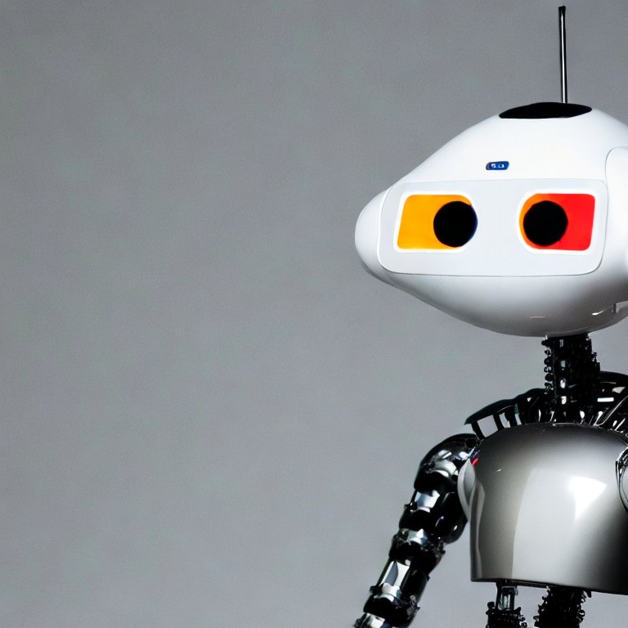
Is there something odd about this picture?
Source: Stable Diffusion

Slide 19
Can you image Artificial Intelligence without a conversation?
As speech is our primary form of communication we require this ability from an Artificial Intelligence
For decades you could communicate with a computer only by knowing how to code
Recent breakthroughs in NLP help computers grasp the human language, which increases their accessibility
Source: Stable Diffusion

Slide 20
Advantages of language as a medium for intelligence
Language is central to human communication and knowledge sharing.
Once Computers learned to minic conversations they are perceived as inteligent
Language is a bridge allowing to join all possible abstract concepts.
This allows LLMs to leverage language as a medium to memorize and estimate most probable outcomes
Since the invention of the internet text data has been growing expotentially.
This allowed to build vast datasets… but may be more tricky in the future
The flexibility of language itself, allows to train versatile models, which can perform complex task without specific training.
This lifted most of barriers for classical ML models.

Slide 21
Natural Language Processing theory

Slide 22

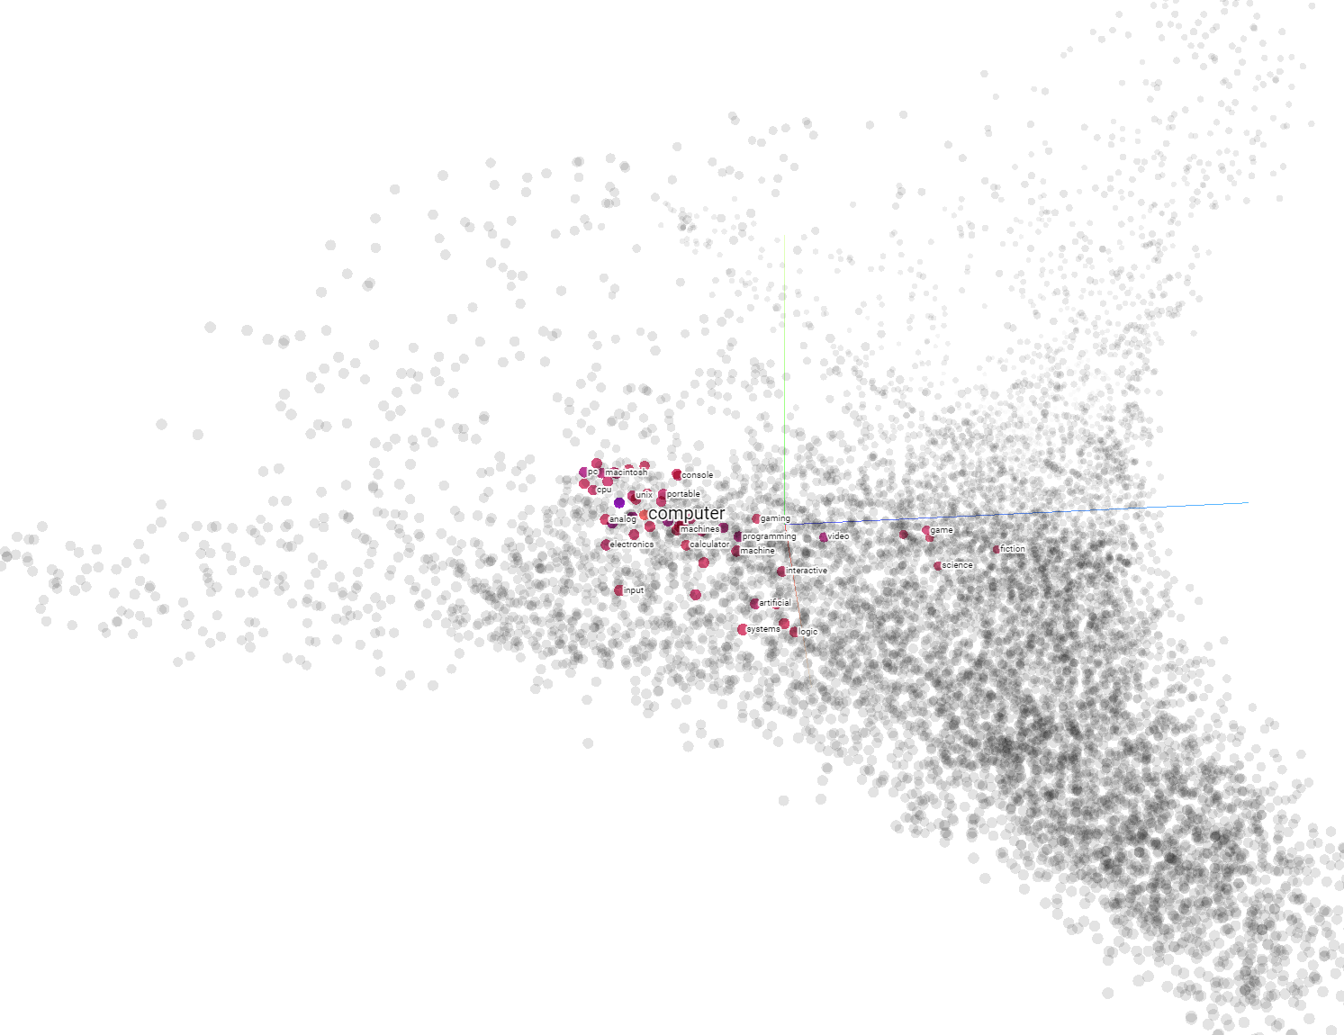
At the end of the day a computer can only understand vectors
Word2Vec vectors
Machines rely on numbers and are not able to understand characters and words
Converting words and sentences to vectors is the foundation of NLP
Even current State-of-the-art solutions, which often reach near human performance are still based on vectors
Enormous increase in computing power over the last few years fuelled rapid development of NLP in last decade

Slide 23
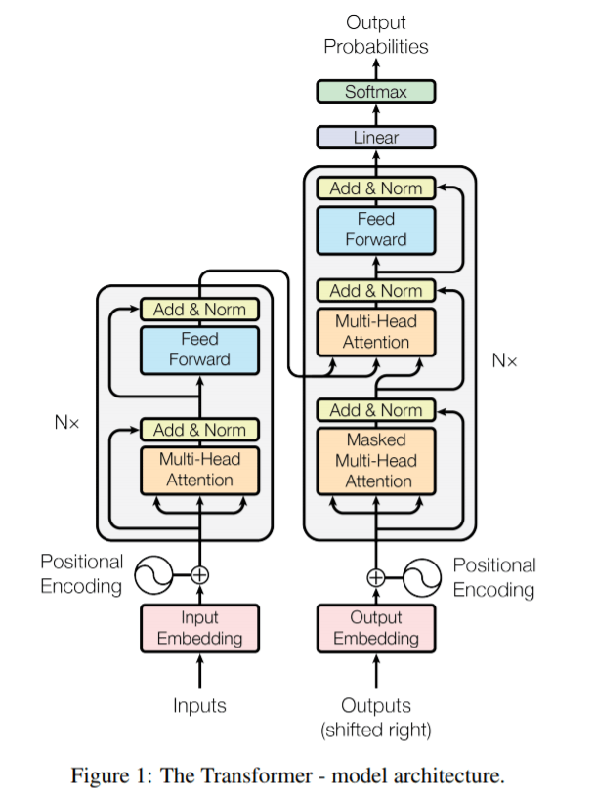
How do machines learn to convert language to vectors?
GPT3 model architecture
Computers learn to „understand” language by imitating humans – similar to a child learning new words
Predicting the most probable word in a sequence is how transformer-based NLP models are trained to convert language to vectors
This ability to learn requires complex architecture – GPT3 has about 175B parameters, and GTP4 will be 500X larger

Slide 24
Tokenization

Slide 25
Tokenization – BERT example
SoTA Tokenizers are more complex in handling words
They will have some most common words in their vocabulary
But for less frequent ones are represented by multiple tokens
Some words can not be present in tokenizer vocab, they would et an OOV token
in BERT tokenizer case they would probably still be tokenized as chars
BERT Tokenizer example
Spell has its own token – 6297
Mispelled will be tokenized as [3335, 11880, 3709], which corresponds to [‘miss’, ‘##pel’, ‘##led’]

Slide 26
Word vectors and similarity

Slide 27
How to vectorize words
Translating words into vectors might sound abstrack at first but with a text corpus large enought we can vectorize words based on the context they appear in
We can approach word vectors by word-by-word approach if we want to classify their meaning
Or any other context e.g. word-by-doc if we want to Focus on task-specific vectors, which will allow us to use text vectorization to classify text by its domain
Data Science is popular these days
Quality of data is popular issue among companies
Co-occurrence matrix allows gives us a meaningful word vector based on words context
 | popular | science | quality
data | 2 | 1 | 1

Slide 28
How to measure similarity
Measuring vector similarity is challenging, especially in high dimensionality
While Euclidean distance is easily applicable for 2D data it performs badly with higher dimensions
Cosine distance is most popular in measuring similarity
It is based on vectors direction and ranges from -1 (opposing vectors) to 1 (proportional vectors), while orthogonal vectors have a similarity of 0.
speed
frequency in science articles
v2
velocity
v1
Euclidean distance
v1-v3
Euclidean distance
v2-v3
Cosine distance
v1-v3
sprinter
v3
Cosine distance
v2-v3
frequency in sport articles

Slide 29
Word vectors allow us to actually extract relations between words
Word vector space
If we take two word pairs – (Poland, Warsaw) and (England, London) both these pairs will create a similar vector
This is the product of similar context they are present in
If we have a large corpus of news, and articles there will be multiple coocurences of phrases like
„{Warsaw/London} is the capital city of {Poland, England}”
Poland
England
Warsaw
London
Word vectors are not just some abstract conversion of words, to numbers. As they are based on words context and coocurence vectors keep some of this information

Slide 30
How did embedding methods start?
word2vec (Google, 2013)
Continuous bag-of-words (CBOW): the model learns to predict the center word given some context words.
Continuous skip-gram / Skip-gram with negative sampling (SGNS) : the model learns to predict the words surrounding a given input word.
Global Vectors (GloVe) (Stanford, 2014) : factorizes the logarithm of the corpus's word co-occurrence matrix, similar to the count matrix you’ve used before.
fastText (Facebook, 2016): based on the skip-gram model and takes into account the structure of words by representing words as an n-gram of characters. It supports out-of-vocabulary (OOV) words.
Classical (non Deep learning) word embeddings were an important step in NLP development and are great for understanding the basics, but they are not used that much in real life use cases anymore

Slide 31
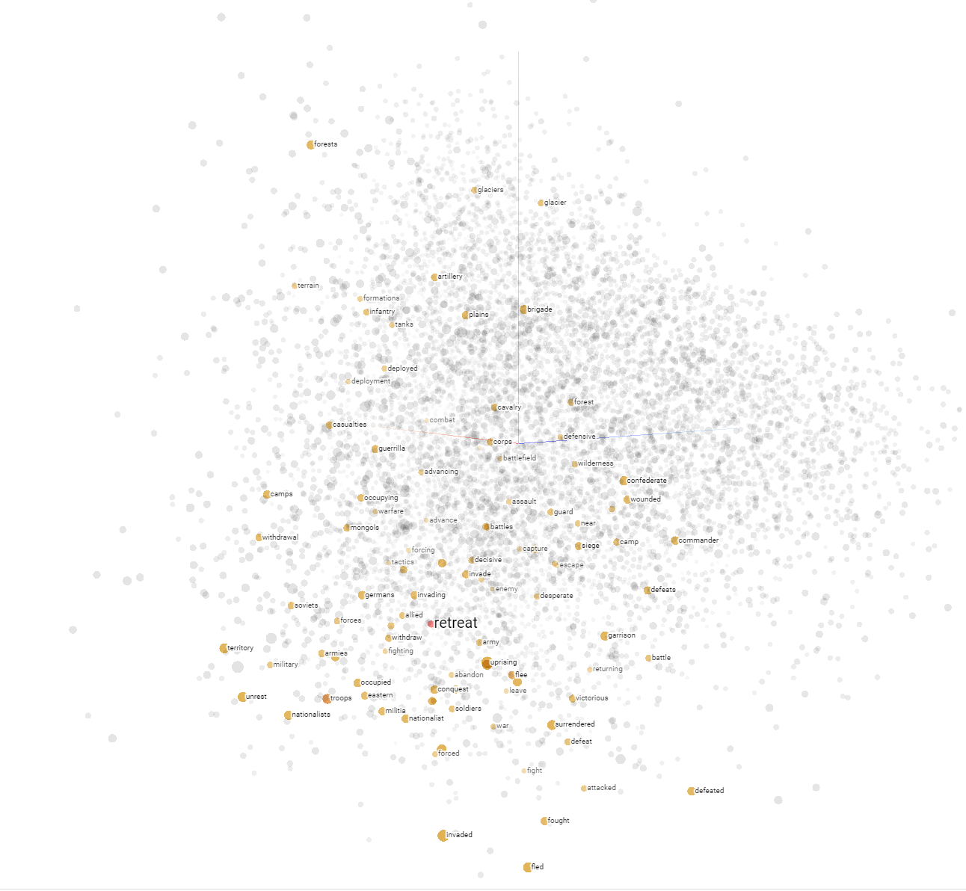
Visualizing vectors – dimensionality reduction
Multi-dimensional vectors are hard to visualize as we can see only 3D
With word vectors they tend to have hundreds of dimensions
Depending on the task, majority of the information might be hidden within ~5% of dimensions only
We use Dimensionality Reduction algorithms to visualize similarities in high-dimensional space without loosing too much information
Most commonly used algorithms include T-SNE or PCA
Explained variance represents loss of information due to dimensionality reduction
Experiment yourself on https://projector.tensorflow.org/

Slide 32
Leveraging Neural Neutworks in embeddings
Specialized & Sentence-Level Embedding Models
There are multiple ways of word embeddings, but leveraging Deep Learning for this task is becoming more and more common
This is an example of a self-supervised task. It is unsupervised itself, as we have no labeled data for the correct embeddings. However the corpus we use for training provides necessary contex, which has some similarities to a supervised learning problem
Embeddings are often created as by-product of a supervised NLP task, this allows us to guide our embeddings to match our specific objective
Instructor (2022–2023)
A family of embedding models that incorporate “instruction” prompts to produce task-relevant embeddings (e.g., in the “sentence-transformers” library on Hugging Face).
OpenAI Embeddings: text-embedding-ada-002 (2022+)
A specialized model available through OpenAI’s API to create embeddings for semantic search, clustering, classification, etc.
Currently one of the most commonly used API-based embedding solutions.
Cohere Embeddings (2021–present)
Cohere offers text-embedding endpoints via API with a focus on enterprise use.

Slide 33
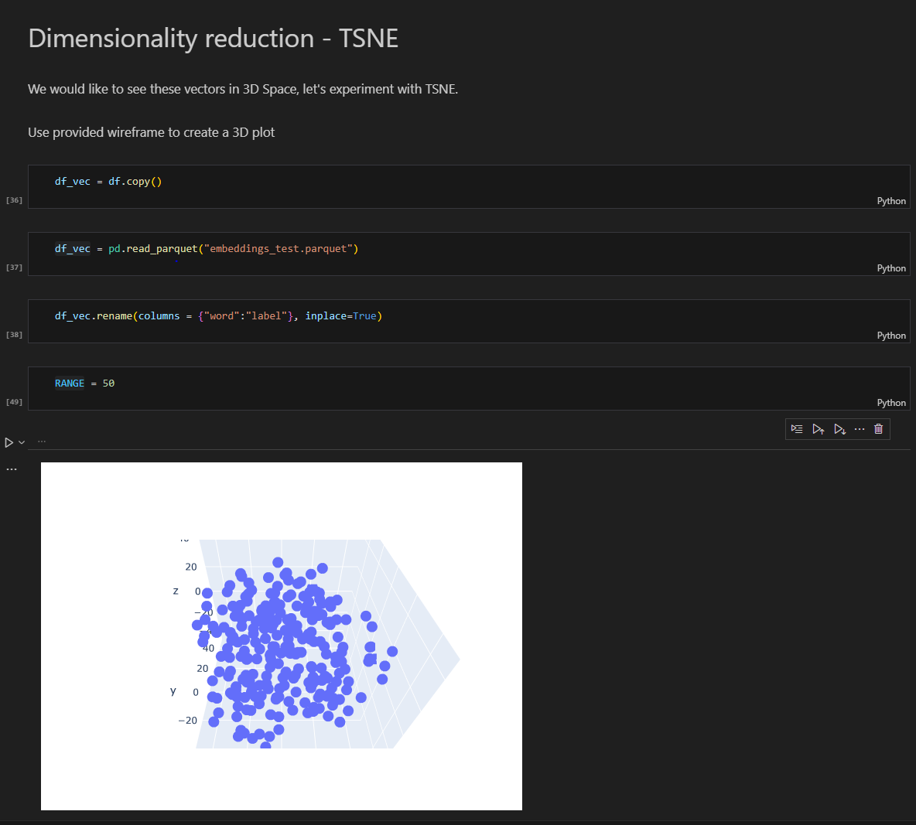
Jupyter notebook part 2:
Proceed to notebook `W1-tokenization-and-vectorization`

Slide 34


Semantic similarity – advantages and pitfalls
Deeper Textual Understanding: Semantic embeddings capture the contextual and relational meaning of words or phrases, providing a more nuanced understanding than simple keyword matching.
Robust to Synonyms and Polysemy: By mapping semantically similar terms closer together, embedding-based similarity can handle synonyms and words with multiple meanings more effectively than strict keyword-based approaches.
Continuous Representation: Representing text in a continuous vector space allows for smooth comparisons and enables mathematical operations (e.g., vector arithmetic) that can reveal relationships between concepts.
Semantic similarity != meaning: Semantic embeddings usually focus on general context of the sentence, and tend to loose the most important details in more nuanced examples
Domain Adaptation Challenges: Off-the-shelf embeddings may not capture domain-specific vocabulary or nuances well, necessitating domain-specific fine-tuning or retraining.
Lack of Explainability: Similarity scores derived from embeddings can be difficult to interpret, making it challenging to understand why certain texts are considered similar.

Slide 35
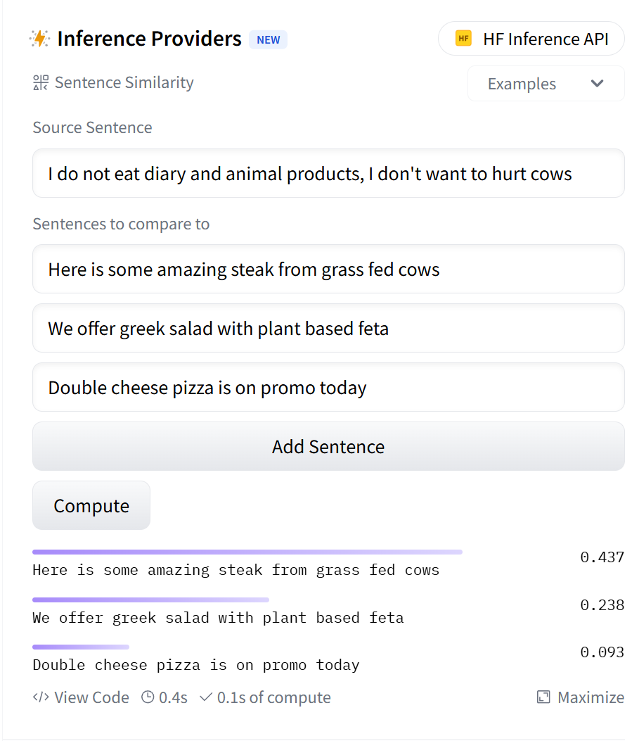
Semantic similarity – vectors DO NOT reason

Slide 36
Which sentences are closest?
I am looking for a red Ferrari
This Blue Lamborghini sounds great
Here are red sport shoes
Passat 1.9 TDI has the best engine

Slide 37
Which sentences are closest?
Aby odpowiedzieć na to pytanie musimy przeanalizować art. 10 pkt. 8 kodeksu podstępowania cywilnego
Art. 100 kodeksu podstępowania cywilnego mówi o problemie zadłużenia
W kodeksie cywilnym, artykule 8 jest mowa o karze 10 zł
Chodzi tutaj o artykuł 10, pkt 8 kodeksu postępowania cywilnego, który wznawia postępowanie po 10 dniach

Slide 38
Sequence models

Slide 39
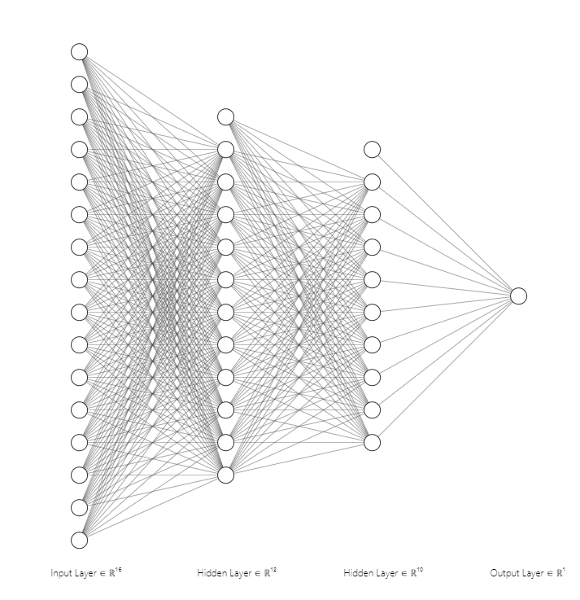
Intro to Deep Neural Networks
Deep Neural Networks can learn complex patterns and handle language data well
Another advantage of DNNs is the fact, that their training process creates langiage embeddings as a side-product
We can extract embeddings (with different dimensionality) by disecting one of hidden layers
Deep Neural Network diagram

Slide 40
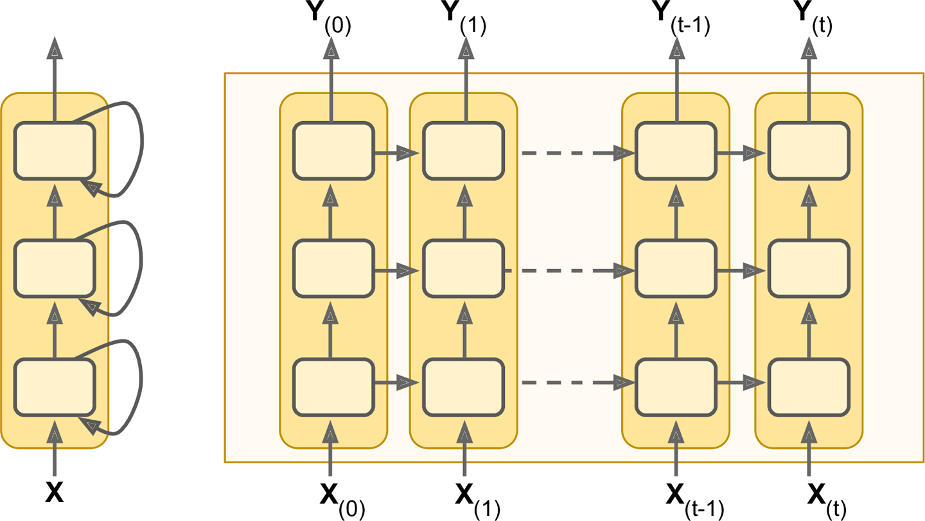
Reccurent Neural Networks
RNNs is a DNN architecture created specially for sequential data such as timeseries or language
It has the ability to „remember” outputs from previous steps
More advanced cells like LSTMs and GRUs make the „memory” aspect of Neural Networks even more robust
Recurrent Neural Networks
Source: https://www.oreilly.com/

Slide 41
Attention & Transformers

Slide 42
Sequence models shortcomings
Reccurent models rely strongly on sequentiality, where output of previous state is essential for calculating next state
This makes parallelization impossible and creates issues when working with larger sequence lenghts
This sequential approach also looses information with the distance. Majority of the information at the begging of the text will be lost towards the end
Key RNN challenges
No paralel computing
Loss of information
Vanishing gradients

Slide 43
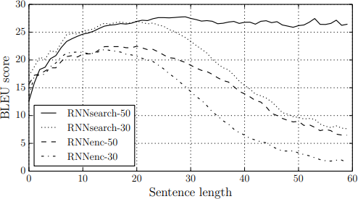
How to implement attention to sequential models
Performance on BLEU translation benchmark by sentence lenghth
One way to fix RNNs issue with longer
sequences is to apply attention mechanism
Traditionally all previous hidden states are combined into one vector
Attention mechanism allows to summarize all previous states in a more meaningfull way creating a context vector
Source: „Neural Machine Translation by Jointly Learning to Align and Translate” Dzmitry Bahdanau

Slide 44
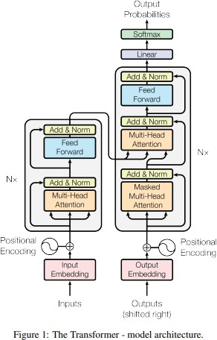
Transformers
Transformer models are a type of Neural Network architecture designed to process sequential data first introduced in "Attention Is All You Need" by Vaswani et al. in 2017.
Despite their initial use in NLP, they are very versatile and widely adapter in other areas of ML
They are able to process input sequences in paralel
Their attention mechanism allows to avoid loss of key information, even if is high distance apart within the sequence
Source „Attention Is All You Need" by Vaswani et al. in 2017.

Slide 45
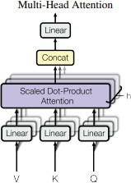
Transformers – high level overview
Encoder:
Processes the input data (e.g. a sentence) and converts it into a set of attention-based representations. These representations capture the context and relationships between different elements in the input.
Decoder:
Generates the output data (e.g., the translated sentence in another language) step by step. It uses the representations from the encoder and the previously generated outputs to predict the next element in the sequence.
Decoder
Encoder
Each Encoder layer consist of 2 sublayers:
Multi-head self-attention mechanism
Fully connected feed-forward
Network
Each Encoder layer consist of 2 sublayers already present in Decoder + an additional sublayer:
3. Masked Multi-Head attention to prevent positions from attending to subsequent positions
The masking together with output embeddings offset guarantees that the model does not cheat by peeking at future tokens
Source „Attention Is All You Need" by Vaswani et al. in 2017.

Slide 46
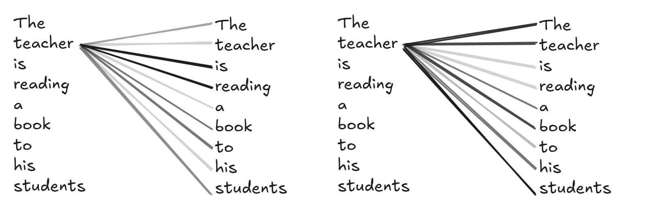
Transformers – What does multi-head attention mean?
Attention layer 1: focus on verbs
Attention layer 2: focus on nouns and relations

Slide 47
Transformers – Self Attention
This mechanism allows the model to weigh the importance of different parts of the input when processing a particular element. For example, in a sentence, the importance or relevance of other words when considering a specific word.
- Attention Scores: The model computes scores to determine how much focus to put on other parts of the input for each word in the sequence.
- Attention Weights: These scores are then normalized to form a distribution (using functions like softmax), so that they add up to one.
-Contextual Representation: Each word's representation is then updated by summing up the representations of all words, weighted by these attention weights. This process ensures that each word’s new representation is a blend of its own and others' based on their relevance.

Slide 48
Transformers – how are next words selected?
When a Transformer-based language model (such as GPT) generates text, it does so by predicting the probability distribution of the next token given the context
Context encoding: The model processes the input tokens (or the previously generated tokens in the conversation) through its attention layers, producing contextualized representations.
Token probability distribution: On the final layer, the model outputs a probability distribution across all possible tokens in its vocabulary for the next position.
Sampling or selection: A specific sampling or selection strategy is used to pick the next token from that probability distribution.
Top k sampling example
Machine Learning as an important …
word | proba
Topic | 50%
Domain | 30%
Concept | 15%
Technology | 10%
k – controls how many samples we include in the draw
t – controls how we approach probability distribution, when 0 it will always* select the most probabilistic token

Slide 49
Transformers can work in 3 different setups
Decoder Only
Encoder-Only
Decoder-Encoder
Examples
GPT family (e.g., GPT-2, GPT-3, GPT-4)
LLaMA (Meta)
BLOOM (BigScience)
PaLM (Google)
They process text in a unidirectional manner.
Used for generative language tasks like next-word prediction, story generation, or code generation.
Examples
BERT (Google)
RoBERTa (Meta)
DistilBERT (Hugging Face)
They typically process the entire input simultaneously (bidirectionally)
Since there is no decoder, they they produce a contextualized representation of the input (vector), not text
Examples
T5 (Google)
BART (Facebook/Meta)
Often used for sequence-to-sequence tasks like machine translation, summarization, question-answer generation

Slide 50
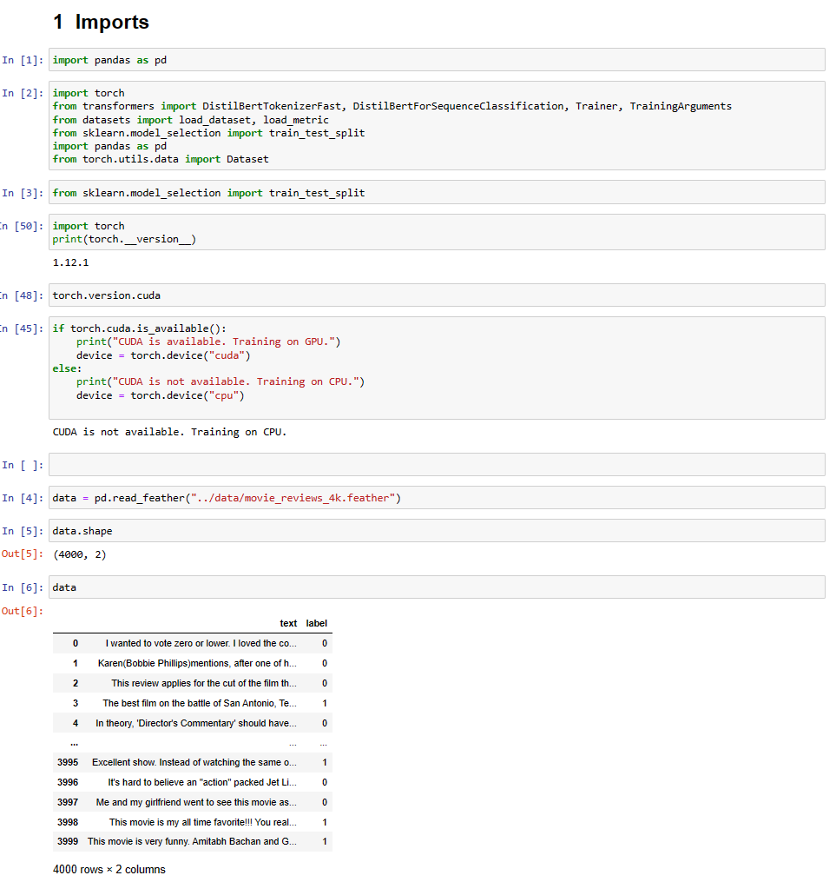
Transformer fine-tuning exercise
Go to Sentiment_classification_with_BERT.ipynb where we will leverage Transfer Learning with BERT model in our own tweet sentiment classification
  Transformers & Attention

Slide 51
Large Language Models Training and finetuning

Slide 52
What are LLMs?
Large Language Models (LLMs) are Generative AI models designed to understand, generate, and interact with human language. They can process and generate text, answering questions, creating content, and even engaging in conversation.
LLMs are trained on vast datasets of text from the internet, including books, articles, and websites, using deep learning techniques. This training enables them to learn language patterns, grammar, and context. Despite their impressive abilities the training is still focused on next word prediction
They are used in a variety of applications such as chatbots, content creation, language translation, and sentiment analysis. LLMs are integral to enhancing human-computer interaction and automating complex language tasks.
Most popular LLMs include the pioneers in the domain such as Google’s BERT and OpenAi’s GPTs. Models from challengers such as Claude or open sourced models from Mistral AI are also catching up in performance.

Slide 53
Key LLM training steps
Data Preparation & Tokenization
Model Architecture Design
Pre Training
Fine Tuning & RLFH
  Collection of a vast and diverse datasets such as books, websites, and other textual materials.
  Preprocessing of this data to clean and format it for training
  Tokenizing text into format procesable by models
  Transformer architecture allowed rapid growth of LLMs
  Different architectures and model sizes (params) have significant impact on performance
  BERT uses Bidirectional Encoder only architecture
  GPT uses Decoder only uni-directional architecture
  T5 keeps whole Encoder-Decoder setup
  The model undergoes unsupervised learning, where it learns to predict the next word in a sentence by being fed large amounts of text.
  This stage is critical for the model to learn language patterns, grammar, context, and general world knowledge.
  Model is further trained on specific tasks and datasets in supervised learning setup
  The model receives feedback from human trainers to correct mistakes and improve its understanding.
  This iterative process helps in refining the model's responses and reducing biases.

Slide 54
Reinforced learning from human feedback
Reinforced learning logic
Reinforced learning logic
Agent
Intruct fine-tuned LLM
  Rank different answers from trained models
  Maximize helpfulness and relevance
  Minimize harm
  Avoid dangerous topics
Human Feedback
State change
Reward
Action
Environment
Human aligned LLM

Slide 55
Memory requirements
Approximate GPU RAM to train 1B params
Memory needed to train model - weights, optimizer, calculating backpropagation
GPT 3.5:
175 billion
-> 4 200 GB
GPT 4:
1.76 trillion parameters
-> 42 240 GB
24GB
Memory needed to store model
4GB

Slide 56
How LLMs changed ML
LLM Development
Classic ML
No ML expertise needed
No training examples and clear loss function
Reasonable output without training
All communication with model based on natural language prompt
Model aims to follow prompt instructions - loss function is not that clear and easy to change
ML expertise needed to get started
Training samples needed
Needs to be trained for a specific task
All communication with model based on natural language prompt
Model aims to minimize a loss function

Slide 57
Evaluating LLM performance

Slide 58
Human labeled benchmark datasets
GLUE (General Language Understanding Evaluation) and SuperGLUE Benchmarks:
  Designed to evaluate natural language understanding (NLU).
  Includes a series of tasks like sentiment analysis, question answering, and textual entailment.
  SuperGLUE is an advanced version of GLUE with more challenging tasks.
BLEU (Bilingual Evaluation Understudy) Score for Translation Tasks:
  Commonly used for evaluating the quality of machine-translated text compared to human translations.
  Focuses on how many words and phrases in the machine translation appear in the human translation.
  Commonly used for text translation
ROUGE (Recall-Oriented Understudy for Gisting Evaluation)
  Set of metrics for evaluating automatic summarization and machine translation software in natural language processing.
  It compares an automatically produced summary or translation against a set of reference summaries, typically human-generated, using measures such as the overlap in unigrams, bigrams, trigrams, and longest common subsequences.
  Commonly used for summarization tasks

Slide 59
Massive models bechmark
Massive Multitask Language Understanding (MMLU)
Big-Bench
Comprehensive evaluation framework designed to assess the performance of language models across a wide range of subjects and tasks.
It includes over 50 different tasks covering a diverse set of topics such as science, humanities, social sciences, and professional domains, aimed at testing the depth and breadth of a model's understanding.
MMLU is known for its challenging nature, requiring models to not only understand the nuances of human language but also to demonstrate knowledge and reasoning abilities across various disciplines.
BIG-bench (Beyond the Imitation Game Benchmark) is an extensive benchmark designed to evaluate and push the limits of large-scale language models in areas like reasoning, creativity, and understanding.
It encompasses a diverse range of tasks, over 200 in total, that cover a wide array of domains including mathematics, common sense reasoning, linguistics, and even ethical judgment.
BIG-bench is unique in its focus on tasks that are challenging for current models, aiming to identify the limitations of existing AI and guide future research in natural language understanding and generation.

Slide 60
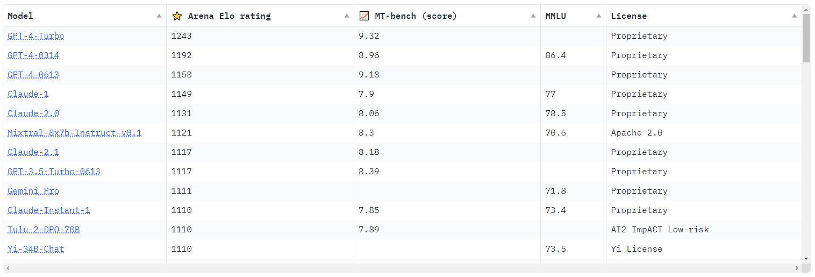




Chatbot Arena
Chatbot ELO (2024-01-07)

Slide 61
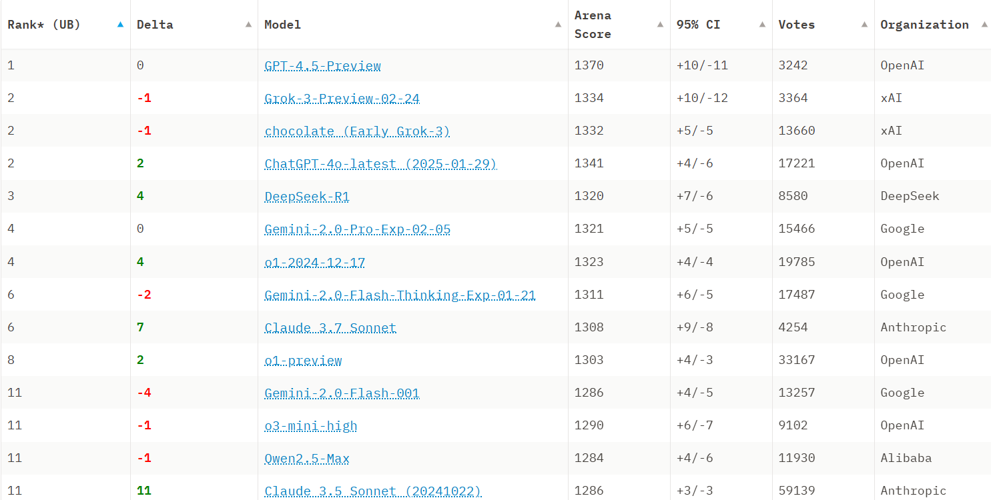


Chatbot Arena
Chatbot ELO (2025-03-06)
33

Slide 62
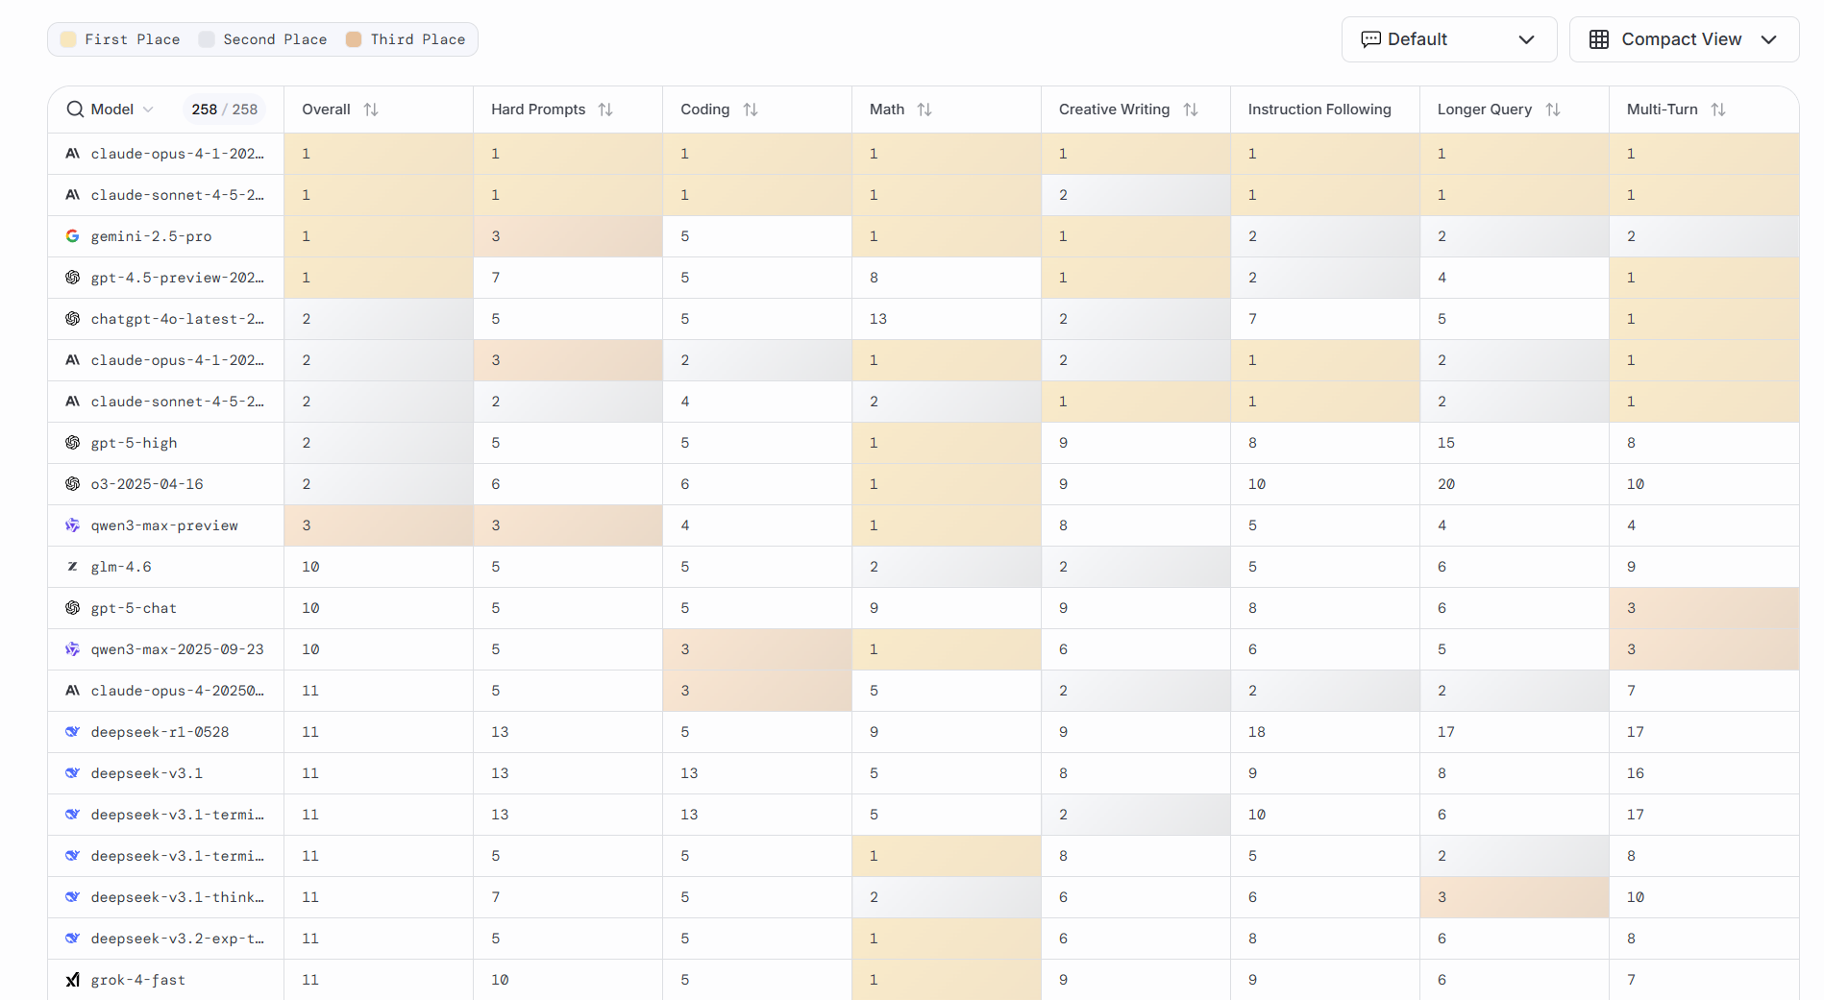

Chatbot Arena
Chatbot ELO (2025-10-24)

Slide 63
Tuning LLMs

Slide 64
Model Fine-tuning
Single task fine tuning
Parameter Efficient Fine Tuning (PEFT)
Retraining all model params on task specific data
Possible with as little as 1k examples
Requires significant compute resources and creates a completely separate model for each task
May lead to catastrophic forgetting, which is basically an equivalent of overfitting
Retraining specific part of model params, with keeping majority of model frozen
Significantly less compute intensive, 90% of params remain frozen and the remaining <10% can be stored for each task and swapped at inference
Combines general knowledge with new task, reduces risk of catastrophic forgetting

Slide 65
PEFT methods
Reparametrization
Additive
Retrain part of models params using lower dimension
LoRA is one of most popular use-cases combining model base params, with ones trained for a specific task
Add trainable layers or parameters to model
In “Soft Prompts” prompt tuning additional training happens at input level
Adapters add additional model layers fine-tuned for specific task, while the backbone models are frozen

Slide 66
LoRA: Low Rank Adaption of LLMs
Training
Freeze original model weights
Replace part of original weight with 2 rank decomposition matrices (with lower dimensionality)
Train weights only for the smaller matrices
Inference:
Multiply low rank matrices, to get a matrix with same dimenstions as original weights
Add product of this multiplication to original weights
Encoder
Training
B
A
Original weights
A X B
Embeddings

Slide 67
Soft prompts fine tuning
Add additional embeddings, which do not correspond to any token representation
They will form context embeddings, which help to guide input prompt toward desired outcomes
Analysing their vector representation in relation to actual words can provide some basic context
Soft-Prompts
Trained embeddings, not representing actual tokens
Embeddings from tokenized text
x_{a}
x_{b}
x_{c}
x_{d}
x_{e}
x₁
x₂
x₃
x₄
x_{n}
+
…

