Slide 1
Update 1
SimQC
A browser-based quantum circuit simulator with stepwise inspection and AI-assisted explanation
CSE299.3 Group #1
● Aoutul Nabi Purna
● Shishir Dhar
● Shihab Sharar
● Md. Iftikhar Alam Hrithik
Department of Electrical and Computer Engineering · North South University, Dhaka
Group 1 · CSE299.3: Aoutul Nabi Purna · Shishir Dhar · Shihab Sharar · Md. Iftikhar Alam Hrithik
01 / 18

Slide 2
Team Introduction
Group 1 Members
AP
Aoutul Nabi Purna
aoutul.purna.241@northsouth.edu
Dept. of ECE · North South University
SD
Shishir Dhar
shishir.dhar.241@northsouth.edu
Dept. of ECE · North South University
SS
Shihab Sharar
shihab.sharar.241@northsouth.edu
Dept. of ECE · North South University
MH
Md. Iftikhar Alam Hrithik
iftikhar.hrithik.241@northsouth.edu
Dept. of ECE · North South University
Group 1 · CSE299.3 — Aoutul Nabi Purna · Shishir Dhar · Shihab Sharar · Md. Iftikhar Alam Hrithik
02 / 18

Slide 3
Intro to Qubits
Group 1 · CSE299.3 — Aoutul Nabi Purna · Shishir Dhar · Shihab Sharar · Md. Iftikhar Alam Hrithik
03 / 18

Slide 4
MATH 01 · STATE VECTORS
From one qubit to many: the state vector
THE 2-QUBIT STATE
THE 3-QUBIT STATE
|ψ> = α|00> + β|01> + γ|10> + δ|11>
|ψ> = a₀|000> + a₁|001> + … + a₇|111>
( α β γ δ )
( a₀ a₁ a₂ … a₇ )
4 complex values
8 complex values
KRONECKER (TENSOR) PRODUCT — BUILDING THE FULL VECTOR
The full state vector is constructed from the single-qubit vectors:
|0> ⊗ |0> = ( 1 0 ) ⊗ ( 1 0 ) = ( 1 0 0 0 )
m entries ⊗ n entries → m · n entries
Memory check: n qubits need 2ⁿ complex values — 2 · 2ⁿ numbers to store them.
Group 1 · CSE299.3 — Aoutul Nabi Purna · Shishir Dhar · Shihab Sharar · Md. Iftikhar Alam Hrithik
04 / 18

Slide 5
MATH 02 · GATE MATRICES
One gate on 3 qubits = an 8×8 matrix
THE COST
WHERE THE WASTE IS
To manipulate a 2ⁿ vector we need a 2ⁿ × 2ⁿ matrix:
gate on q0 only → H ⊗ I ⊗ I
1 qubit → 2 × 2
2 qubits → 4 × 4
3 qubits → 8 × 8
64 entries — × 2 for imaginary part
…and to touch only 1 qubit, the other 2 must be left alone.
■ H block □ zeros
Identity keeps q1, q2 untouched — and fills the matrix with 0s.
Bottom line: unnecessarily large — only 16 of 64 entries are non-zero, the rest is 0s.
Group 1 · CSE299.3 — Aoutul Nabi Purna · Shishir Dhar · Shihab Sharar · Md. Iftikhar Alam Hrithik
05 / 18

Slide 6
MATH 03 · A NAIVE IDEA
The shortcut that falls apart
THE IDEA
WHY IT FALLS APART
Never look at the whole state when applying a gate.
One multi-qubit gate mixes the qubits for good:
H ⊗ H → CNOT → ( 0.707, 0, 0, 0.707 )
Apply each gate qubit-wise — like classical bits.
This state can no longer be written as two single-qubit vectors — qubit-wise bookkeeping dies here.
Kronecker everything together only at the very end.
Falls apart exactly when: a multi-qubit gate has already acted — the state is entangled.
Group 1 · CSE299.3 — Aoutul Nabi Purna · Shishir Dhar · Shihab Sharar · Md. Iftikhar Alam Hrithik
06 / 18

Slide 7
MATH 04 · THE FIX
Group the amplitudes, multiply small
GROUP BY UNCHANGED BITS
THE MATHS
3-qubit state, gate on q0 → pair up amplitudes sharing the same q1 q2:
Instead of one 8×8 multiplication:
4 × ( 2×2 )
( a₀ a₁ )
( a₂ a₃ )
( a₄ a₅ )
( a₆ a₇ )
( a₀ a₁ ) → H · ( a₀ a₁ ) … same for all 4 groups
same (q1 q2) → one group · q0 mixes inside the pair
four tiny multiplications, one per group
Win: four 2×2 multiplications give the exact same result — the 8×8 is never built.
Group 1 · CSE299.3 — Aoutul Nabi Purna · Shishir Dhar · Shihab Sharar · Md. Iftikhar Alam Hrithik
07 / 18

Slide 8
MATH 05 · SCALING UP
Two-qubit gates: bigger groups, same trick
GROUPS OF FOUR
THE MATHS
2-qubit gate on q0 q1, q2 fixed → group amplitudes by the fixed q2:
Instead of one 8×8 multiplication:
2 × ( 4×4 )
( a₀ a₁ a₂ a₃ )
q2 = 0
q2 = 1
general: a k-qubit gate on n qubits → 2^{n−k} groups, each a 2^{k} × 2^{k} multiplication
( a₄ a₅ a₆ a₇ )
Same rule as before: bigger gate → bigger groups, fewer of them — still no giant matrix.
Group 1 · CSE299.3 — Aoutul Nabi Purna · Shishir Dhar · Shihab Sharar · Md. Iftikhar Alam Hrithik
08 / 18

Slide 9
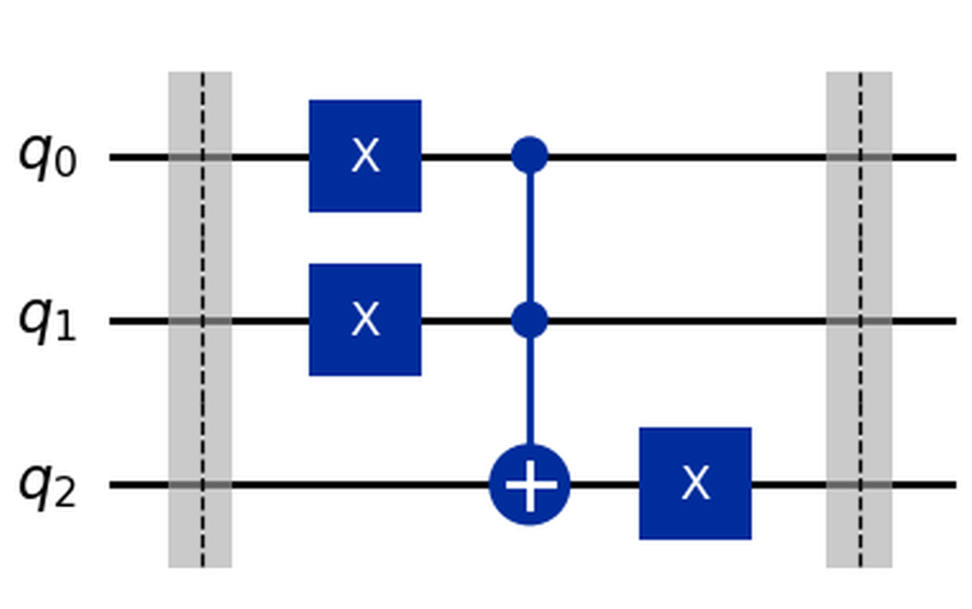
DESIGN 01 · CIRCUIT MODEL
Lines are time, not wires
Each line is a progression along time — each segment can be a different amount of time.
Not like Logisim: no splitting a wire to use it in multiple places.
2 bits go into an AND gate and produce a new bit — here that cannot happen.
No feedback circuits — so the design changed a lot from what we first expected.
In short: the diagram is a timeline of the state — not a circuit of wires.
Group 1 · CSE299.3 — Aoutul Nabi Purna · Shishir Dhar · Shihab Sharar · Md. Iftikhar Alam Hrithik
09 / 18

Slide 10
DESIGN 02 · DECISIONS
Ground rules we locked in
NO MATHS IN THE UI
RAW ARRAYS AT RUNTIME
The UI never computes — all maths stays completely out of the UI.
Objects only to set up and test — then flattened to raw Float64Arrays.
BIG ENDIAN IN THE UI
LITTLE ENDIAN IN JS
Matches the standard diagram conventions (q0 leftmost).
Keeps the index maths on the computation side simple.
Why now: locked before build-out — so the maths, the UI and the code never disagree.
Group 1 · CSE299.3 — Aoutul Nabi Purna · Shishir Dhar · Shihab Sharar · Md. Iftikhar Alam Hrithik
10 / 18

Slide 11
No Cloning Theorem
Group 1 · CSE299.3 — Aoutul Nabi Purna · Shishir Dhar · Shihab Sharar · Md. Iftikhar Alam Hrithik
11 / 18

Slide 12
Mathematics Core
Group 1 · CSE299.3 — Aoutul Nabi Purna · Shishir Dhar · Shihab Sharar · Md. Iftikhar Alam Hrithik
12 / 18

Slide 13
GATES 01 · SUPERPOSITION
Hadamard: from definite to 50/50
THE MATRIX
equal superposition
H = (1/√2) · [ 1 1 ]
[ 1 −1 ]
|0>
H
|0>
|1>
1/√2 ≈ 0.707
definite state
THE EQUATION
50%
50%
H |0> = (1/√2) · ( |0> + |1> )
IN OUR KERNEL
One small 2×2 matrix updates pairs of amplitudes — a giant 2ⁿ×2ⁿ matrix is never built. Cost: O(2ⁿ) per gate.
Plain words: a qubit in a definite 0 becomes a fair coin — equal parts 0 and 1. That's superposition.
Group 1 · CSE299.3 — Aoutul Nabi Purna · Shishir Dhar · Shihab Sharar · Md. Iftikhar Alam Hrithik
13 / 18
Notes:
• Open by saying: this single 2×2 matrix is what makes quantum computing work
• A definite bit (|0>) becomes an equal superposition — 50% chance of either outcome
• The number 1/√2 ≈ 0.707 will appear throughout the talk — that's where it comes from
• In our kernel we never build the full 2ⁿ×2ⁿ matrix — we apply the 2×2 to amplitude pairs, cost O(2ⁿ) per gate
• Advance to next slide after: "and that's every gate in quantum computing"

Slide 14
GATES 02 · ENTANGLEMENT
CNOT: two qubits stop being independent
control = 1 → FLIP target
control = 0 → do nothing
THE RECIPE
WHAT THOSE NUMBERS MEAN
H on q0 → CNOT (q0 → q1) → Bell state
50%
50%
measured amplitudes:
( 0.707, 0, 0, 0.707 )
0%
0%
|00>
|01>
|10>
|11>
50% |00> · 50% |11> · 0% mixed — perfectly correlated qubits
A DETAIL WE PROVED
In our kernel CNOT isn't even a multiplication — it's pure amplitude swapping. Zero floating-point ops. Verified against the textbook method: identical to 10⁻¹².
Two gates — and already the state can't be reasoned about in your head. Now imagine 10 qubits.
Group 1 · CSE299.3 — Aoutul Nabi Purna · Shishir Dhar · Shihab Sharar · Md. Iftikhar Alam Hrithik
14 / 18
Notes:
• CNOT rule: control qubit decides whether target flips
• Recipe: H on q0 then CNOT(q0→q1) on |00> produces the Bell state (0.707, 0, 0, 0.707)
• Histogram: 50% |00> + 50% |11>, zero mixed states — perfect correlation
• Kernel detail: CNOT is pure amplitude swapping (a permutation), no floating-point ops
• Verified against textbook matrix method to 10^-12
• Pivot line for the talk: "Now imagine 10 qubits" — bridge to next slide

Slide 15
THE GAP
Correct math, zero intuition
WHAT OUR SIMULATOR SHOWS
WHAT A STUDENT NEEDS
|00>
: 0.7071
"q0 and q1 are perfectly correlated — always identical. CNOT copied the superposition into a joint state. That's entanglement, and you can't see it in the numbers."
|01>
: 0.0000
|10>
: 0.0000
?
|11>
: 0.7071
The numbers are right — the understanding is missing. And it never scales: 10 qubits = 1,024 amplitudes · 20 qubits = over a million. → That's where the AI module comes in.
Group 1 · CSE299.3 — Aoutul Nabi Purna · Shishir Dhar · Shihab Sharar · Md. Iftikhar Alam Hrithik
15 / 18
Notes:
• The contrast IS the slide: the numbers are mathematically correct but reveal nothing
• Left panel looks like a debug console — shows what the simulator outputs
• Right card spells out what those numbers actually mean in plain language
• The "?" arrow is the bridge — the gap between computation and intuition
• Scaling point: 10 qubits = 1,024 amplitudes, 20 qubits = over a million — human inspection impossible
• Bridge to next slide: "that's where the AI module comes in"

Slide 16
AI 01 · LOCAL INFRASTRUCTURE
A pretrained model, on our own laptop
We don't build a brain — we download an already-trained, open-license model file and run it on our own hardware. Nothing leaves our machine.
SimQC frontend
fetch localhost:11434
Ollama — the player
loads
GGUF model file — the MP3
llama.cpp = the hidden engine inside Ollama · quantization: 15 GB → 4.7 GB, MP3-style
Model | File size | Where it runs | Speed | Our role
3B | 1.9 GB | 100% GPU (4 GB VRAM) | ~40 tok/s | Default
7B | 4.7 GB | split GPU + RAM | 12–20 tok/s | Quality checks
14B | 9 GB | doesn't fit locally | — | Later: free Colab
our GPU: RTX 3050 · 4 GB VRAM
our RAM: 16 GB
choice driven by measurement, not guessing
Group 1 · CSE299.3 — Aoutul Nabi Purna · Shishir Dhar · Shihab Sharar · Md. Iftikhar Alam Hrithik
16 / 18
Notes:
• Key principle: we don't train, we download and run
• Analogy: Ollama is the music player, GGUF is the MP3, llama.cpp is the engine
• Quantization shrinks a 15 GB model to 4.7 GB with minimal quality loss — MP3-style
• Hardware decision table: 3B is default (100% GPU, ~40 tok/s), 7B for quality checks, 14B parked on Colab
• The 3B row is highlighted blue because it's the chosen default
• Bottom chips: remind the audience of the hardware constraint and that the choice was measured, not guessed

Slide 17
AI 02 · GROUNDED, NOT GUESSED
Our simulator fact-checks our AI
STEP 1
STEP 2
STEP 3
STEP 4
Core computes
Core briefs the AI
AI narrates
Grounded output
state after every gate — exact amplitudes (0.707, 0, 0, 0.707)
probabilities + entanglement flags — small summaries, never raw million-amplitude dumps
"q0 and q1 are perfectly correlated — always identical"
the explanation can only describe what was actually computed
The AI never invents numbers — it explains ours. That's why our explainer won't hallucinate.
NEXT:
feed circuit data
→
measure accuracy (eval harness)
→
fine-tune on data our simulator auto-generates (LoRA on Colab)
"SimQC: the simulator computes, the AI explains — neither does the other's job."
Group 1 · CSE299.3 — Aoutul Nabi Purna · Shishir Dhar · Shihab Sharar · Md. Iftikhar Alam Hrithik
17 / 18
Notes:
• Four-step pipeline: core computes → core briefs AI → AI narrates → grounded output
• Key insight: the simulator already computes exact amplitudes — it's a ground-truth oracle
• The AI gets small summaries (probabilities + entanglement flags), never raw million-amplitude dumps
• Why this prevents hallucination: the AI can only describe what was actually computed
• Roadmap: feed circuit data → eval harness → fine-tune on simulator-generated data via LoRA on Colab
• Closing line: "the simulator computes, the AI explains — neither does the other's job"

Slide 18
Thank you!
● Aoutul Nabi Purna
● Shishir Dhar
● Shihab Sharar
● Md. Iftikhar Alam Hrithik
{aoutul.purna.241, shishir.dhar.241, shihab.sharar.241, iftikhar.hrithik.241}@northsouth.edu
SimQC: Group 1 · CSE299.3 · North South University
Group 1 · CSE299.3 — Aoutul Nabi Purna · Shishir Dhar · Shihab Sharar · Md. Iftikhar Alam Hrithik
18 / 18

