Slide 1
Music Recommendation with Collaborative Filtering
Jay Patel, Michael Yen, Patrick Hickey
Team 4

Slide 2
Problem Statement
How to best recommend new songs to users based on rating history
Goal: Accurate rating prediction and top N item recommendations
Challenges:
Massive Dataset (User/Item Matrix does not fit in memory)
Very Sparse Matrix

Slide 3
Dataset Description
Amazon Music Subset
Users: 23,958
Items: 33,083
Ratings: 305,453
Matrix Sparsity: 0.9996

Slide 4
Data Pre-Processing
Remove all users with < 5 ratings
Remove all items with < 3 ratings
Attempt to create User/Item Matrix
Problem: Doesn’t fit in memory
Solution: Create dictionary with {user, [(item_1, rating_1), (item_2, rating_2), …]} key pair
Create User/Item Dictionary
Create 80/20 Train/Test split by ratings per user
Assists with sparsity issue

Slide 5
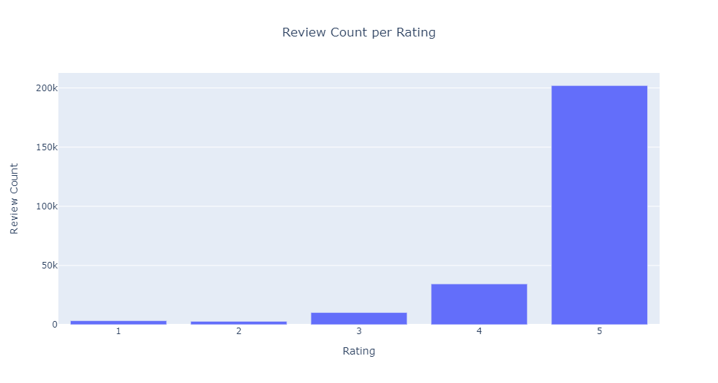
Data Description

Slide 6
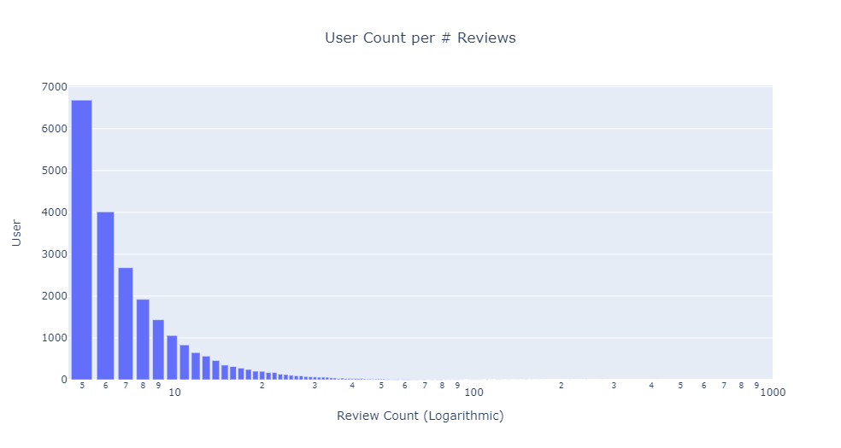
Data Description (Continued)

Slide 7
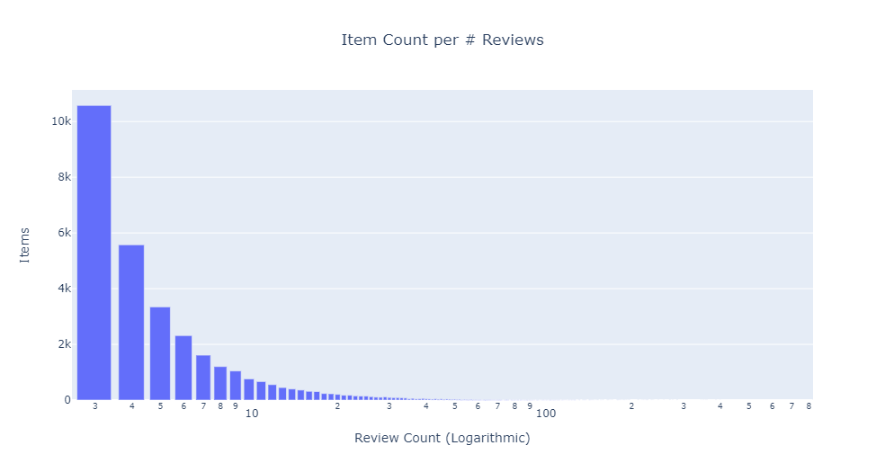
Data Description (Continued)

Slide 8
User-Based CF
Input: Train and Test Dictionary with previously mentioned structure {user, [(item_1, rating_1), (item_2, rating_2), …]}
Our Approach to Base Algorithm
Large and Sparse Matrix takes too long to compute
Training Rating Dict -> Subtracted Row Mean Dict -> Cosine Similarity Dict -> Predicted Ratings Dict
Standard library functions don’t support using dict
implemented dot product and norms for cosine similarity dictionary calculation

Slide 9
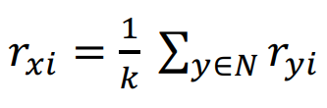
Rating Prediction - Average Rating (U-U)
Average Rating: for k most cosine similar users, if item is rated, get rating r from original rating dictionary
Results:
MAE: 0.302
RMSE: 0.616
Notes:
MAE: 0.3018942794053998
RMSE: 0.6164998586378024

Slide 10
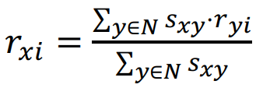
Rating Prediction - Similarity weighted rating (U-U)
Similarity Weighted: for k most cosine similar users, if item is rated, get rating r from original rating dictionary and cosine similarity s from cosine similarity dictionary
Modification - case: user u has 0 similar users that rated the specified item i due to matrix sparsity
Take the average rating of other items for that user u as the rating for item i
Results:
MAE: 0.306
RMSE: 0.653
Notes:
MAE: 0.3059962035270823
RMSE: 0.6527567831022184

Slide 11
Item-Based CF
Input: Train and Test Dictionary with previously mentioned structure {item, [(user_1, rating_1), (user_2, rating_2), …]}
Our Approach to Base Algorithm
Large and Sparse Matrix takes too long to compute
Training Rating Dict -> Subtracted Row Mean Dict -> Cosine Similarity Dict -> Predicted Ratings Dict
Standard library functions don’t support using dict
implemented dot product and norms for cosine similarity dictionary calculation

Slide 12
Rating Prediction - Average Rating (I-I)
Average Rating: for k most cosine similar items, if the user has rated this item, get rating r from original rating dictionary
Results:
MAE: 0.346
RMSE: 0.655
Notes:
MAE: 0.3459191787917298
RMSE: 0.6549484435193651

Slide 13
Rating Prediction - Similarity weighted rating (I-I)
Similarity Weighted: for k most cosine similar items, if the user has rated the item, get rating r from original rating dictionary and cosine similarity s from cosine similarity dictionary
Modification - case: item i has 0 similar items as rated by the user u due to matrix sparsity
Take the average rating of users that rated item i as the rating for user u
Results:
MAE: 0.328
RMSE: 0.671
Notes:
MAE: 0.32840656892151987
RMSE: 0.6707227605110283

Slide 14
Rating Prediction Results
 | MAE | RMSE
U-U avg | 0.3018942794053998 | 0.6164998586378024
U-U sim | 0.3059962035270823 | 0.6527567831022184
I-I avg | 0.3459191787917298 | 0.6549484435193651
I-I sim | 0.32840656892151987 | 0.6707227605110283
Notes:
U-u avg performed the best
Overall u-u methods did better than i-i
We suspect this may be due to more ratings per user than ratings per item

Slide 15
U-U Top 10 Recommended Items Results
Take top 100 users with the most reviews
Predict ratings using U-U for all unrated and testing items for that user
Using both average and similarity weighted
Sort and take the top k (k = 10)
Calculate Evaluation Metrics (Based on how many predictions were in testing set)
Precision:
Average: 0.00200
Similarity Weighted: 0.00300
Recall:
Average: 0.00070
Similarity Weighted: 0.00120
F-Score:
Average: 0.00104
Similarity Weighted: 0.00171
NDCG:
Average: 0.00964
Similarity Weighted: 0.01562
Notes:
Sparse matrix and lots of items rated 5 which makes it hard to get hits (makes it hard to recommend an item in the training set out of all the highly rated items) but we still managed to get a few hits
Needle in haystack
Working on item item but results expected to be similar to user user
Most users have 1 item in the testing set

Slide 16
I-I Top 10 Recommended Items Results
Take top 100 users with the most reviews
Predict ratings using I-I for all unrated and testing items for that user
Using both average and similarity weighted
Sort and take the top k (k = 10)
Calculate Evaluation Metrics (Based on how many predictions were in testing set)
Precision:
Average: -
Similarity Weighted: -
Recall:
Average: -
Similarity Weighted: -
F-Score:
Average: -
Similarity Weighted: -
NDCG:
Average: -
Similarity Weighted: -

Slide 17
Top 10 Results
 | Precision | Recall | F-measure | NDCG
U-U avg | 0.00200 | 0.00070 | 0.00104 | 0.00964
U-U sim | 0.00300 | 0.00120 | 0.00171 | 0.01562
I-I avg | 0.00100 | 0.00011 | 0.00020 | 0.00301
I-I sim | 0.00300 | 0.00055 | 0.00091 | 0.019871

Slide 18
Insights
Massive datasets require alternative methods of calculation
User-User CF outperformed Item-Item CF
Likely due to having more ratings per user than ratings per item
Top k recommendations difficult with very sparse matrices
Notes:
Difficult to recommend an item the user actually bought

Slide 19
References
https://cseweb.ucsd.edu/~jmcauley/datasets/amazon_v2/
Class Slides (10-recsys1)

Slide 20
Thank you.
Questions?

