Slide 1

Reduced Order Modelling for Aeroelastic Simulations
Department of Mechanics, Structures and Materials
Aircraft Design Pathway
Author:
Billton Joseph Vitus
Tutors:
Prof. Joseph Morlier
Oriol Chandre-Vila
Research Project Presentation
2nd April, 2021

Slide 2
Table of Contents
1) Introduction
2) Aim/ Objective
3) Problem at Hand and its Solution
4) State of the Art
5) Methodology
6) Results
7) Conclusion

Slide 3
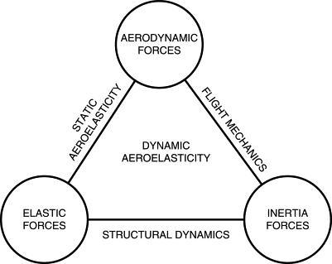
Introduction
Aeroelasticity
Coupling between the aerodynamic forces, inertial and elastic forces of a structure.
Aeroelasticity Simulations
1) Complexity: Coupling of two physics heavy phenomena
2) Expensive: Requirement of time and computational
resources.
Figure 1: Collar Triangle for Aeroelasticity
Image source: https://www.sciencedirect.com/topics/engineering/aeroelasticity/

Slide 4
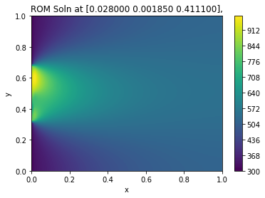
AIM/ Objective
Aim
Investigate the techniques of Reduced Order Modelling for different physical phenomena to reduce computation costs with minimal compromise in accuracy.
Objective
1) Do a literature survey on the many ROM methodologies available.
2) Select one suitable ROM technique based on efficiency, ease of use, implementation etc.
3) Apply the chosen methodology to a physical problem as a test case and expand it to an aeroelastic application.
Figure 2: ROM Output from a 2D heat equation

Slide 5
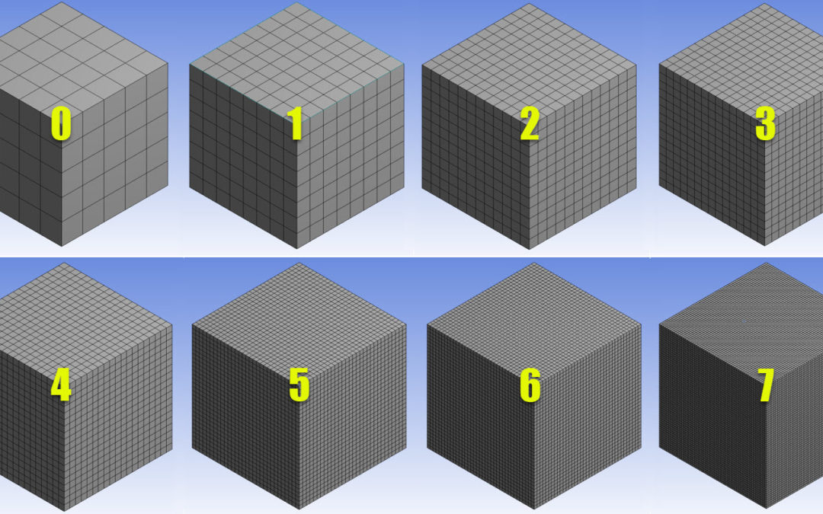
Time? Accuracy?
At 0, solution is quick, but inaccurate.
At 7, solution is highly accurate, but simulation takes a lot of time.
Best scenario for accuracy is 7 and for computation time it’s 0.
Figure 3: Meshes of different refinements
Is the best scenario achievable?
Image source: https://cfd.ninja/tag/fine-mesh/

Slide 6
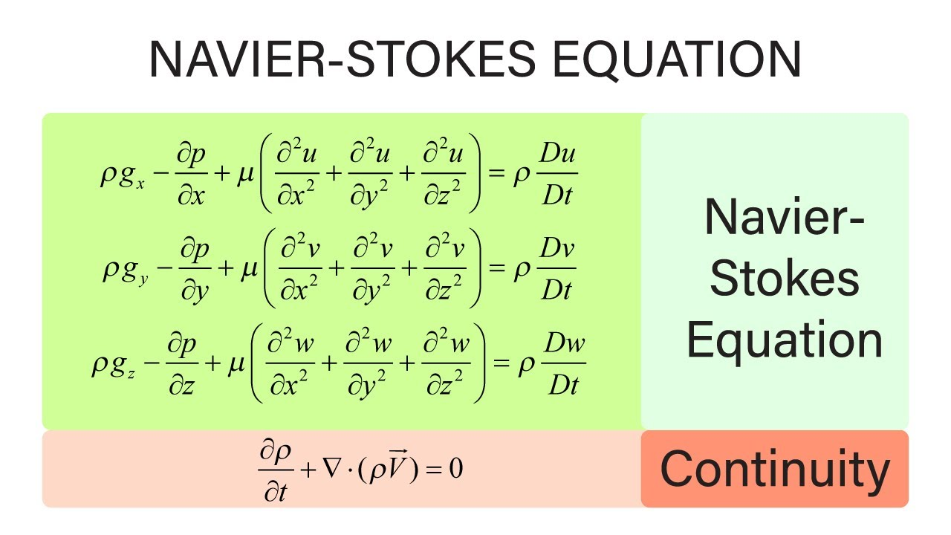
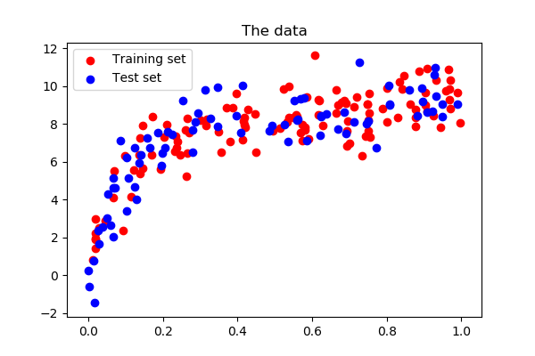
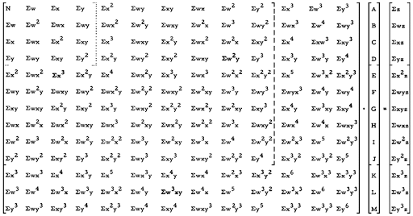
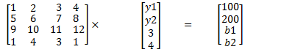
Reduced order modelling
Physics driven modelling
Data driven modelling
Image source: https://scipy-lectures.org/packages/scikit-learn/index.html

Slide 7
State of the Art
Out of all the mathematical formulations available for reduced order modelling, Proper Orthogonal Decomposition (POD) with Galerkin projection is widely used in industrial and academic studies. (Berkooz, ARFM, 1993; Willcox, AIAA, 2002; ). The POD-Galerkin method involves solving the physics equation in the reduced basis, followed by expansion into the full domain.
Non Intrusive ROMs counter the challenges faced by intrusive ROMs – better stability, reduction in complexity of code manipulation, more accurate estimation in non-linear problems and have been quite successful while using an RBF interpolation method. (Xiao, IJNMF, 2015; Audouze, NMPDE, 2013).
NI-ROMS are quite helpful in scenarios where original source code is not available or it is too complicated to modify.
Application of NI-ROMs were studied in the fields of Heat Convection- Diffusion and Aeroelasticity, showing good correlation between ROM solution and high fidelity solution. (Halder, AIAA,2020; Rogers, IPSE,2012)
Thus the choice of ROM for this study is the POD-RBF NI-ROM

Slide 8
ROM Creation Methodology
POD-Galerkin [Chandre-Vila, 2019]
POD-RBF
Sample n points using LHS
snapshot matrix using Greedy Algorithm
Perform a POD over snapshot matrix
Error correction of ROM
Solve in reduced base
Kriging Interpolation
Create Snapshot Matrix
Perform POD over Snapshot Matrix
Set up RBF
RBF Interpolation
Error correction of ROM
Sample n points using LHS

Slide 9
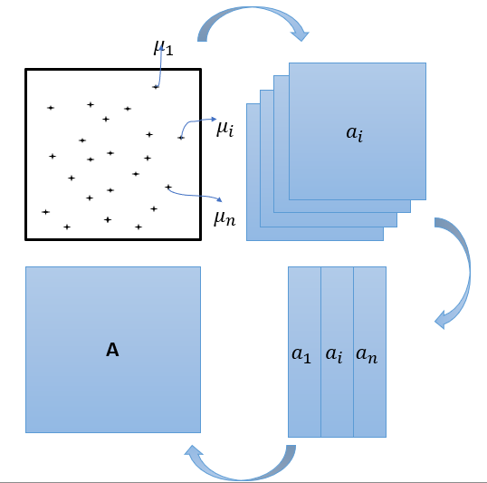
Creation of Snapshot Matrix
Snapshot matrix – culmination of high fidelity solutions at different input parameters.
Parameters sampled using Latin Hypercube Sampling
All parameters sampled are unique, thus representing the entire parameter domain, centered around the middle.
Individual snapshots stacked horizontally to form snapshot matrix.
Out of all the sampled parameters, 80% of the solutions are used for training and 20% are used for testing.
Figure 4: Snapshot matrix creation methodology

Slide 10
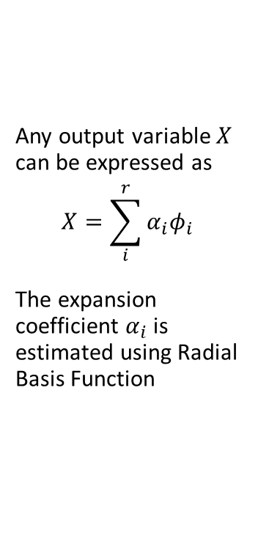
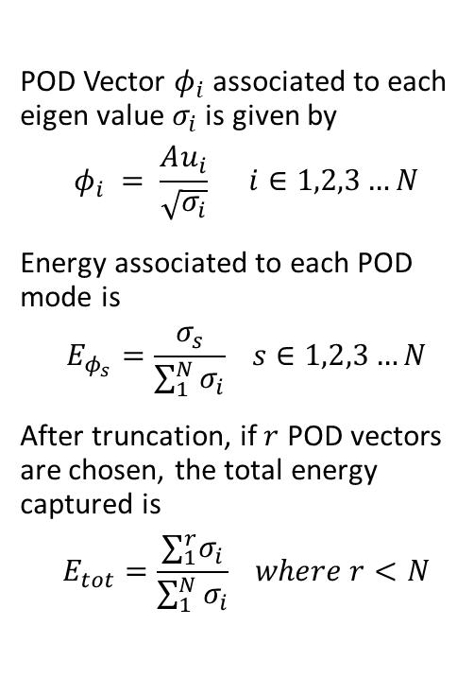
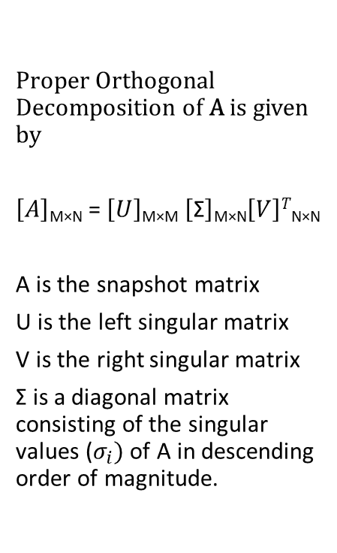
Estimating Reduced Basis
Proper Orthogonal Decomposition of A is given by
$\left[A\right]$_{M×N} = $\left[U\right]$_{M×M} $\left[\text{Σ}\right]$_{M×N}$\left[V\right]T$_{N×N}
A is the snapshot matrix
U is the left singular matrix
V is the right singular matrix
$\text{Σ}$ is a diagonal matrix consisting of the singular values ($σ_{i})$ of A in descending order of magnitude.
POD Vector $φ_{i}$ associated to each eigen value $σ_{i}$ is given by
$$φ_{i} = \frac{Au_{i}}{\sqrt{σ_{i}}} i∈1,2,3…N$$
Energy associated to each POD mode is
$$E_{φ_{s}}=\frac{σ_{s}}{\sum_{1}^{N}{σ_{i}}} s∈1,2,3…N$$
After truncation, if $r$ POD vectors are chosen, the total energy captured is
$$E_{tot}=\frac{∑_{1}^{r}σ_{i}}{\sum_{1}^{N}{σ_{i}}} where r<N$$
Any output variable $X$ can be expressed as
$$X=\sum_{i}^{r}{α_{i}φ_{i}}$$
The expansion coefficient $α_{i}$ is estimated using Radial Basis Function
POD
POD
(2)
POD
(5)
…(1)
(3)
(4)

Slide 11
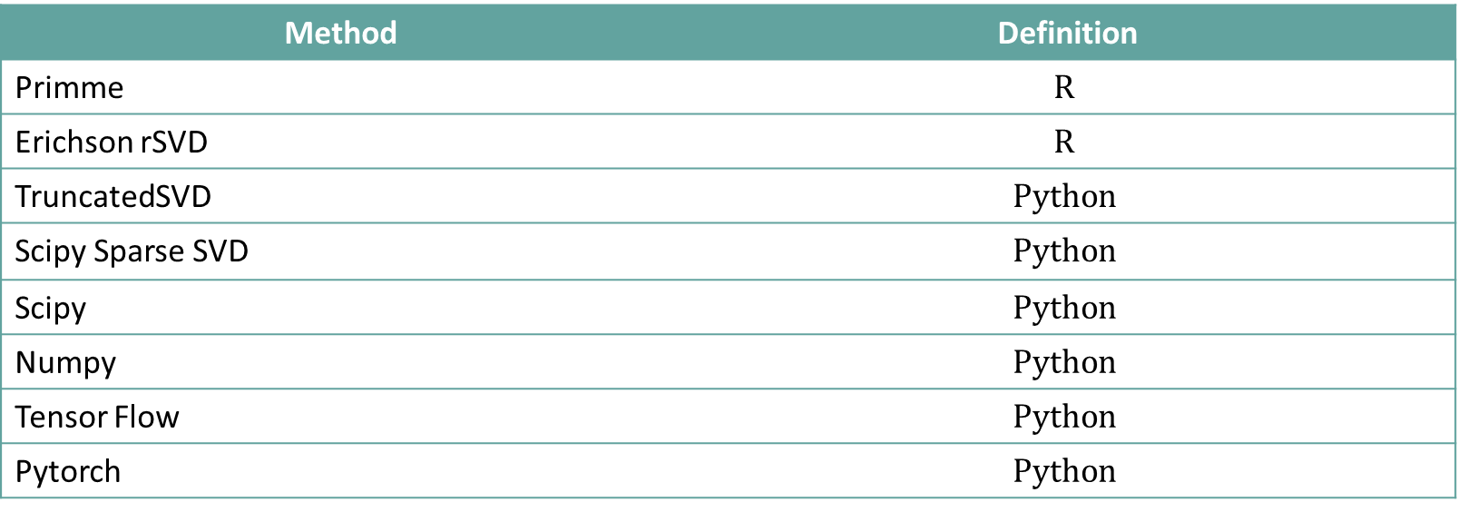
Methods to perform POD
Method | Definition
Primme | $$R$$
Erichson rSVD | $$R$$
TruncatedSVD | $$Python$$
Scipy Sparse SVD | $$Python$$
Scipy | $$Python$$
Numpy | $$Python$$
Tensor Flow | $$Python$$
Pytorch | $$Python$$
Table 1: Most commonly available methods to perform a POD on a dataset.

Slide 12
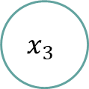
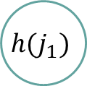
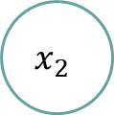

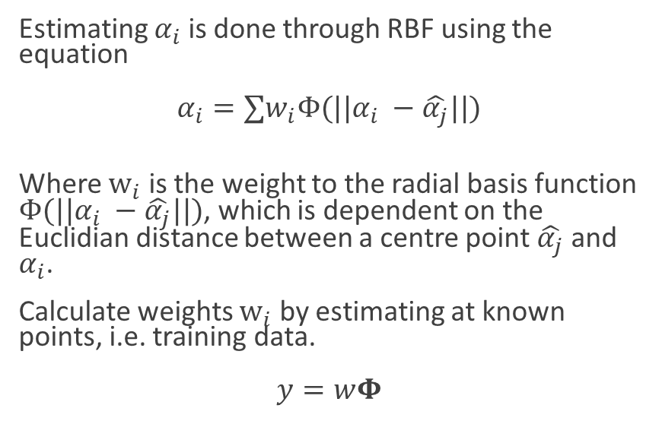
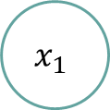

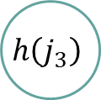

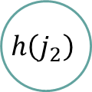
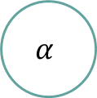
Radial Basis Function
Estimating $α_{i}$ is done through RBF using the equation
$α_{i}=∑w_{i}Φ(||α_{i} −\hat{α_{j}}||)$
Where $w_{i}$ is the weight to the radial basis function $Φ(||α_{i} −\hat{α_{j}}||)$, which is dependent on the Euclidian distance between a centre point $\hat{α_{j}}$ and $α_{i}$.
Calculate weights $w_{i}$ by estimating at known points, i.e. training data.
$y=wΦ$
$$x_{1}$$
$$h(j_{1})$$
$$w_{1}$$
$$x_{2}$$
$$h\left(j_{2}\right)$$
$$w_{2}$$
$$α$$
$$w_{3}$$
$$x_{3}$$
$$h\left(j_{3}\right)$$
Input Layer
Hidden Layer
Output Layer
In the end we have successfully mapped input parameters to the solution space!

Slide 13
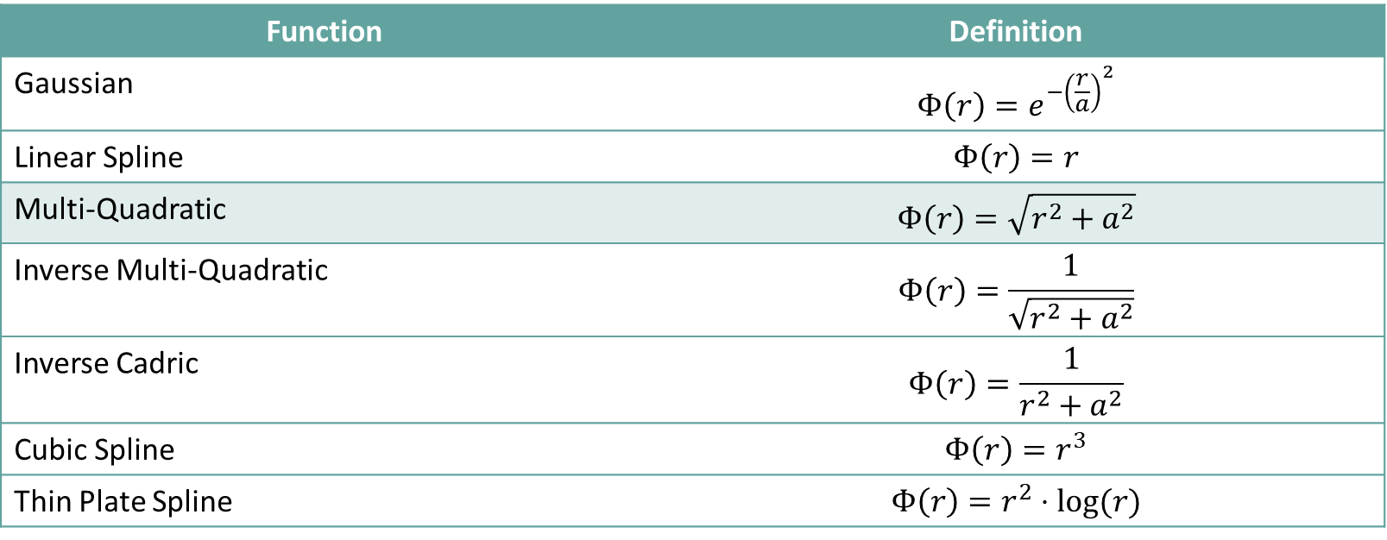
Radial Basis Function
Function | Definition
Gaussian | $$Φ\left(r\right)=e^{−{\left(\frac{r}{a}\right)}^{2}}$$
Linear Spline | $$Φ\left(r\right)=r$$
Multi-Quadratic | $$Φ\left(r\right)=\sqrt{r^{2}+a^{2}}$$
Inverse Multi-Quadratic | $$Φ\left(r\right)=\frac{1}{\sqrt{r^{2}+a^{2}}}$$
Inverse Cadric | $$Φ\left(r\right)=\frac{1}{r^{2}+a^{2}}$$
Cubic Spline | $$Φ\left(r\right)=r^{3}$$
Thin Plate Spline | $$Φ\left(r\right)=r^{2}⋅log⁡(r)$$
Table 2: Commonly used RBF Functions

Slide 14

EZyRB Library
Python library for model order reduction.
Uses POD-RBF methodology discussed before for model order reduction.
Inputs: Solution Matrix, Parameter Matrix
Ideal choice – versatility with any data, irrespective of 1-equation problems or 2-equation.
Open source: https://github.com/mathLab/EZyRB

Slide 15
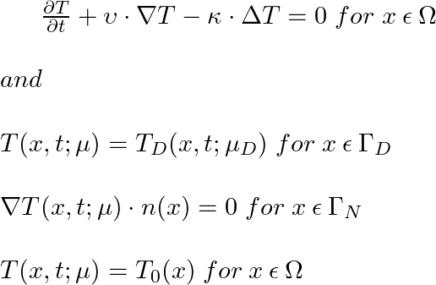
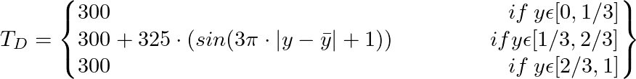




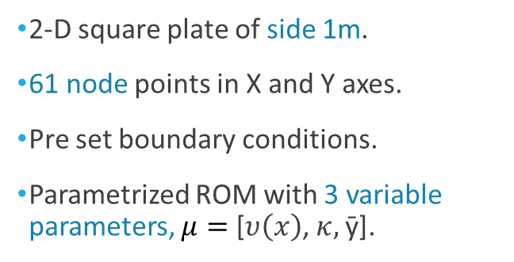



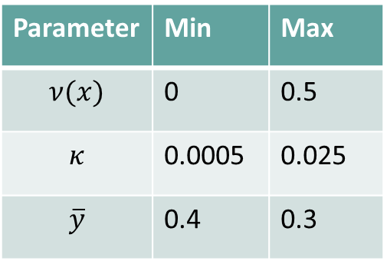


ROM for a Convection-Diffusion Problem
2-D square plate of side 1m.
61 node points in X and Y axes.
Pre set boundary conditions.
Parametrized ROM with 3 variable parameters, $μ=$ [$υ\left(x\right)$, $κ,$ȳ].
Parameter | Min | Max
$$ν(x)$$ | 0 | 0.5
$$κ$$ | 0.0005 | 0.025
$$\overline{y}$$ | 0.4 | 0.3
$$1$$
$$Γ_{N}$$
$$Y$$
$$Γ_{D}$$
$$Γ_{N}$$
$$Γ_{N}$$
$$0$$
$$X$$
$$1$$
Figure 5: Domain of the 2-D heat problem.

Slide 16
Snapshot Matrix – Convergence (contd.)
Figure 6: Time taken to create the snapshot matrix based vs dimension.
Figure 7: Average RMS error vs dimension.

Slide 17
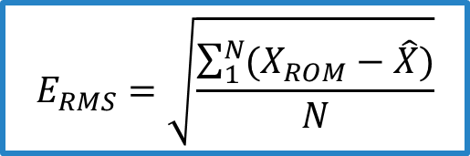
Snapshot Matrix - Convergence
No. of Columns | Snapshot Time (sec) | Training Time (sec) | Online Time (sec) | Average RMSE (K) | Speedup
25 | 40 | 0.014 | 0.002 | 15.229 | 713.361
50 | 69 | 0.031 | 0.004 | 9.1922 | 353.631
75 | 105 | 0.130 | 0.005 | 9.3693 | 265.799
100 | 151 | 0.308 | 0.005 | 7.7766 | 246.947
200 | 299 | 0.515 | 0.014 | 5.7632 | 95.698
300 | 444 | 0.917 | 0.024 | 6.0724 | 59.277
400 | 860 | 1.851 | 0.028 | 4.6645 | 62.454
500 | 1129 | 7.549 | 0.027 | 4.6304 | 51.189
600 | 1237 | 12.443 | 0.040 | 4.3107 | 34.276
700 | 995 | 20.097 | 0.051 | 3.5206 | 26.365
800 | 1131 | 31.669 | 0.058 | 3.067 | 24.607
900 | 1298 | 43.503 | 0.071 | 3.0574 | 18.695
1000 | 1501 | 62.700 | 0.072 | 2.8922 | 19.664
Snapshot
Test
80:20 Training Set
$$E_{RMS}=\sqrt{\frac{\sum_{1}^{N}{(X_{ROM}−\hat{X})}}{N}}$$
Table 3: Properties of Snapshot matrix with varying dimensions.

Slide 18
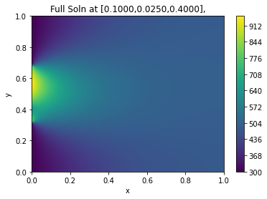
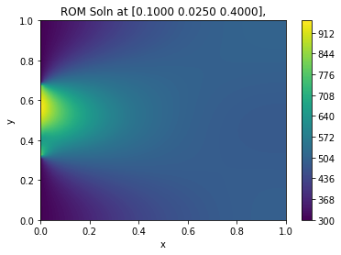
Results: Advection-Diffusion ROM
a) High fidelity solution for a set of parameters.
b) ROM solution for the same set of parameters.
Figure 8: Comparison of the 1)high fidelity solution and b)ROM solution at $ν$ = 0.1, $κ$ = 0.025 and $\overline{y}=0.4.$

Slide 19
Comparison w/ previous works
Parameter | POD-Galerkin [Chandre-Vila, 2019] | POD-Tensor Flow-GP [Li, 2019] | POD-RBF
Online Time | 0.6713 sec | 0.06 sec | 0.005 sec
Max Error | 4.0912% | - | 6.345%
Average Error | 1.4358% | - | 0.9270%
RMSE | - | 4.7461 K | 8.5934 K
Time reduction | 85% | 90% | 99.6%
Table 4: Comparing the efficiency of the POD-RBF ROM with previously used methodology.

Slide 20
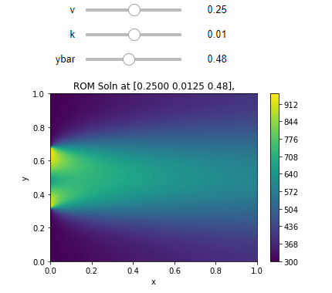
Parametric Widget
Creation of an interactive widget.
Set up based with an emphasis on instantaneous results – focus on higher speedup.
Available on GitHub/ Binder.
Figure 9: A snippet of the widget created using sliders.

Slide 21
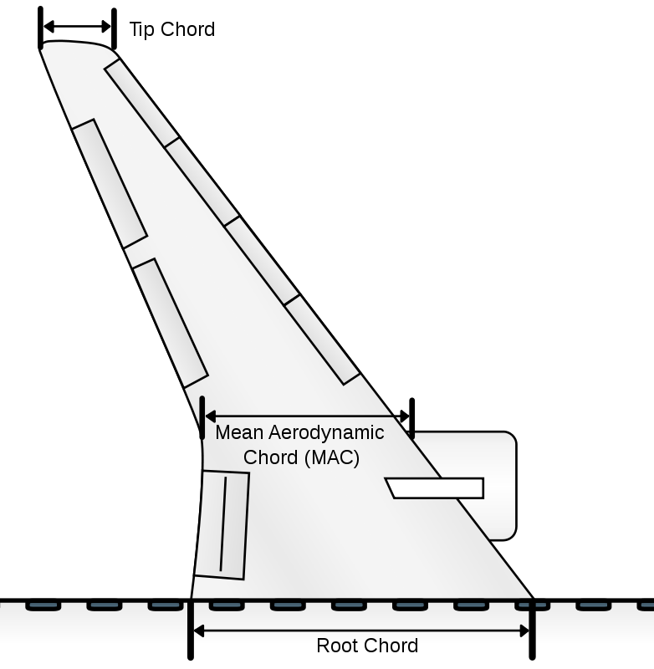


ROM for Aeroelastic Simulations
Structural Equation:
$$K⋅u=F_{s}$$
Aerodynamic Equation (VLM) :
$$A⋅Γ=F_{A}$$
Coupling:
$$F_{S}=H^{−1}F_{A}$$
Parameter | Minimum | Maximum
Skin Thickness (mm) | 1.45 | 15
Rib Thickness (mm) | 1.45 | 15
LE Spar Thickness (mm) | 4.35 | 90
TE Spar Thickness (mm) | 4.35 | 90
Wing Span ($m$) | 34 | 80
Wing Area $(m^{2}$) | 122 | 845
Figure 10: Swept back wing geometry used for aeroelasticity ROM.
Image source: https://en.wikipedia.org/wiki/Chord_(aeronautics)#/media/File:Aircraft_chord.svg

Slide 22
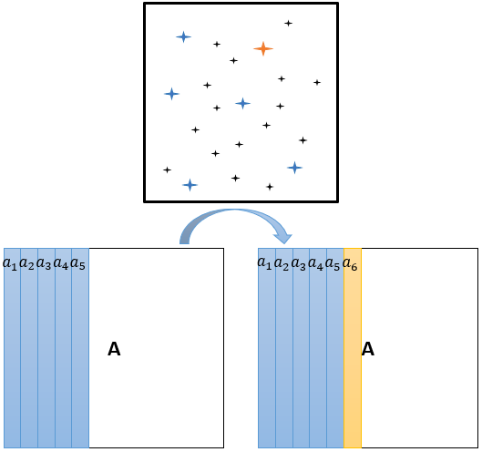
Snapshot Matrix – Greedy Algorithm
Column by Column addition of solution vectors to snapshot matrix.
Iterative procedure to include point of maximum error/residual to the snapshot matrix.
ROM residuals calculated at each step for unsampled parameters.
Iteration is run till average residual is lesser than threshold.
Although time consuming, snapshot matrix has optimal number of columns for least error.
Figure 11: Visual representation of Greedy Algorithm. Blue points represent pre-sampled points, the Orange point represents the point of max residual and the black points are unsampled points [Chandre-Vila, 2019].

Slide 23
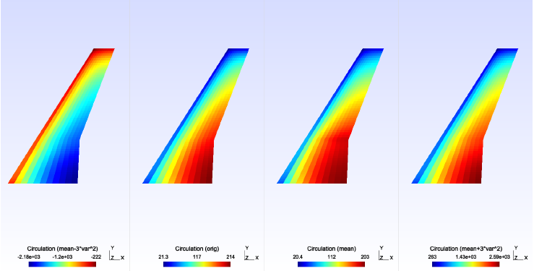
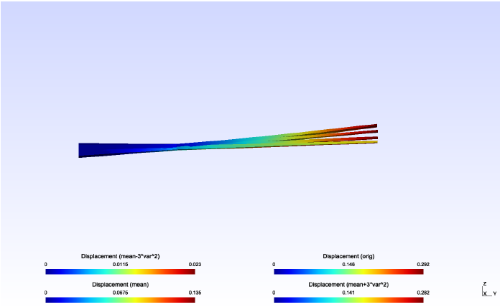
Results: Aeroelasticity ROM
Figure 12: Circulation contours plotted over the wing geometry.
Figure 13: Deformation contours plotted over the wing geometry.

Slide 24
Conclusions
Study and application of the NI-ROM was successful.
Massive improvements in computation times were observed with minimal loss of accuracy.
Future work-
Implement Greedy Algorithm
Expand NI-ROM to aeroelasticity simulations.
Introduce non-linearity in simulations.

Slide 25
Bibliography
D. Xiao, F. Fang, C. Pain, G. Hu (2015). Non-intrusive reduced-order modelling of the Navier-Stokes equations based on RBF interpolation. Int. J. Numer. Methods Fluids 79 580–595. doi: 0.1002/fld.406.
C. Audouze, F. De Vuyst, P. Nair (2013). Nonintrusive Reduced-Order Modeling of Parametrized Time- Dependent Partial Differential Equations, Numer. Methods Partial Differ. Equasion 29 (5) 1587–1628. doi:10.1002/num.21768.
Berkooz, G., Holmes, P., & Lumley, J. L. (1993). The proper orthogonal decomposition in the analysis of turbulent flows. Annual review of fluid mechanics, 25(1), 539-575.
Halder, R., Damodaran, M., & Khoo, B. C. (2020). Signal Interpolation Augmented Linear Nonintrusive Reduced-Order Model for Aeroelastic Applications. AIAA Journal, 58(1), 426-444.
Rogers, C. A., Kassab, A. J., Divo, E. A., Ostrowski, Z., & Bialecki, R. A. (2012). An inverse POD-RBF network approach to parameter estimation in mechanics. Inverse Problems in Science and Engineering, 20(5), 749-767. doi:10.1080/17415977.2012.693080 doi:10.2514/1.j058529
Chandre-Vila, O. (2018). Structural Wing Model Reduction in Fluid-Structure Interactions. Retrieved March 20, 2021, from https://github.com/mid2SUPAERO/PGD-ROM_CHANDRE
Chandre-Vila, O. (2019). POD+K for Real-Time Aeroelastic Pre-design Problem. Retrieved March 20, 2021, from https://github.com/mid2SUPAERO/POD-K_v2-CHANDRE
Li, Y., and Morlier, J. (2019). Parameterised PDE Prediction. Retrieved March 20, 2021, from https://github.com/mid2SUPAERO/SFE_Yaduo_LI.

