Slide 1
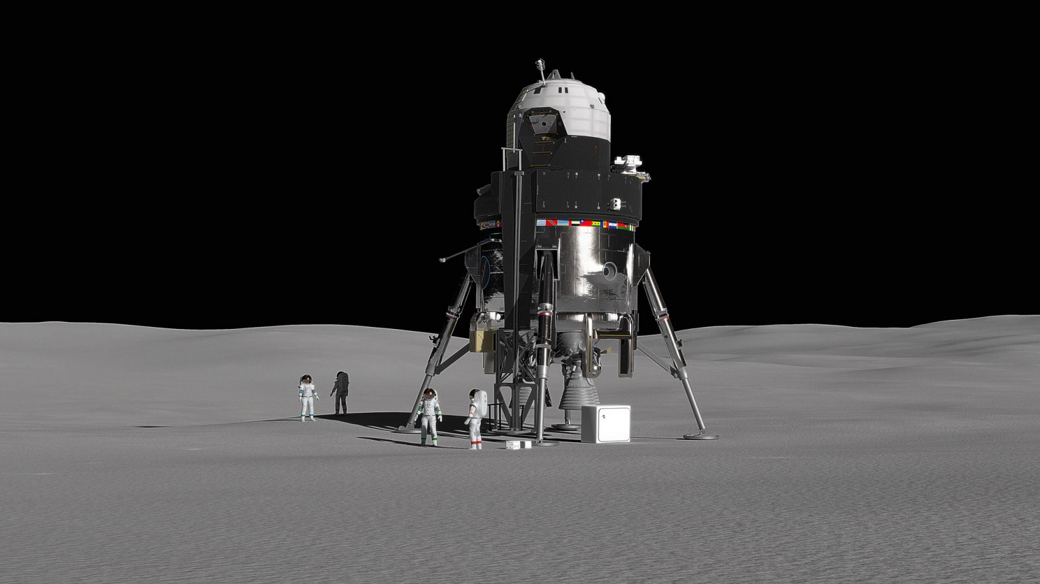
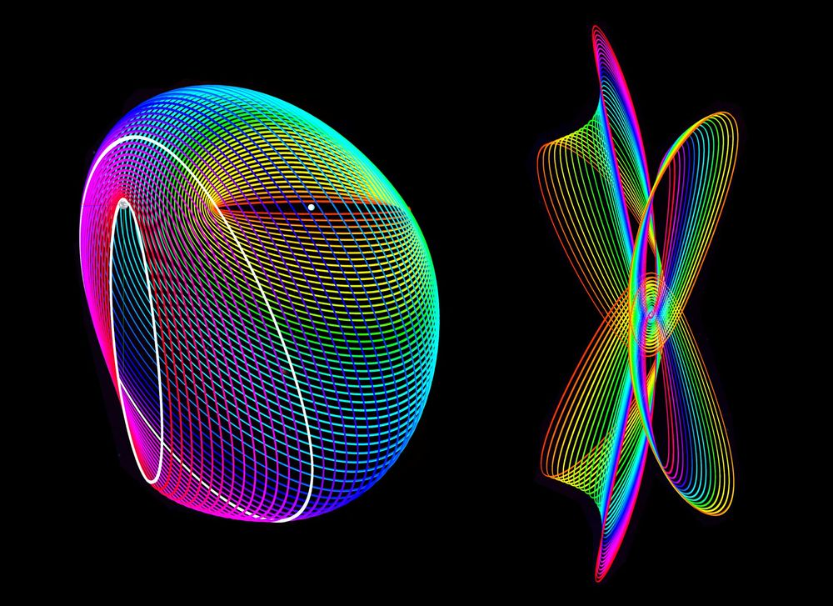
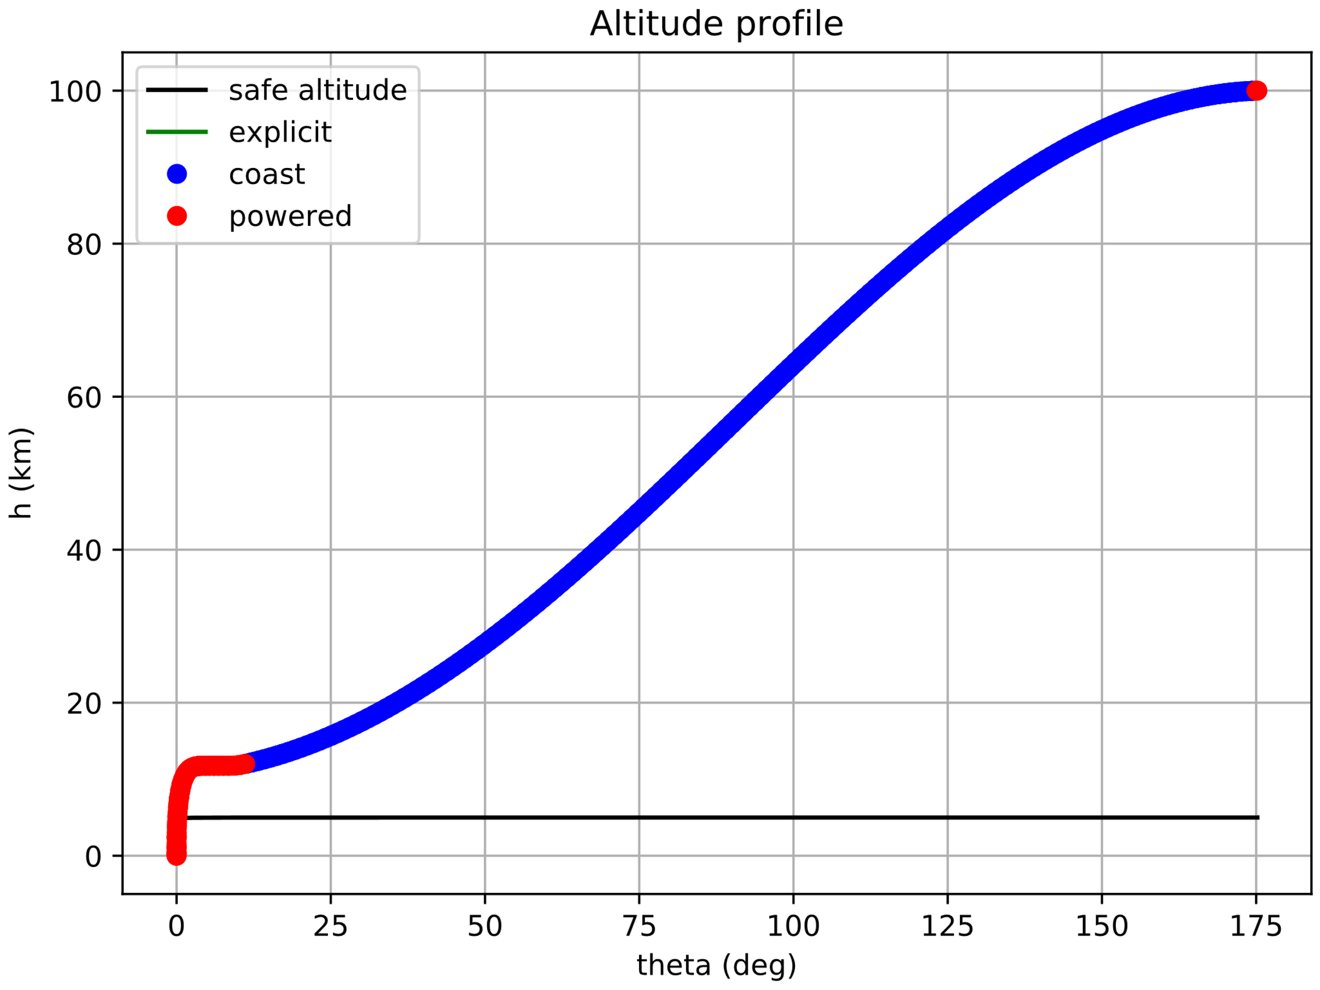
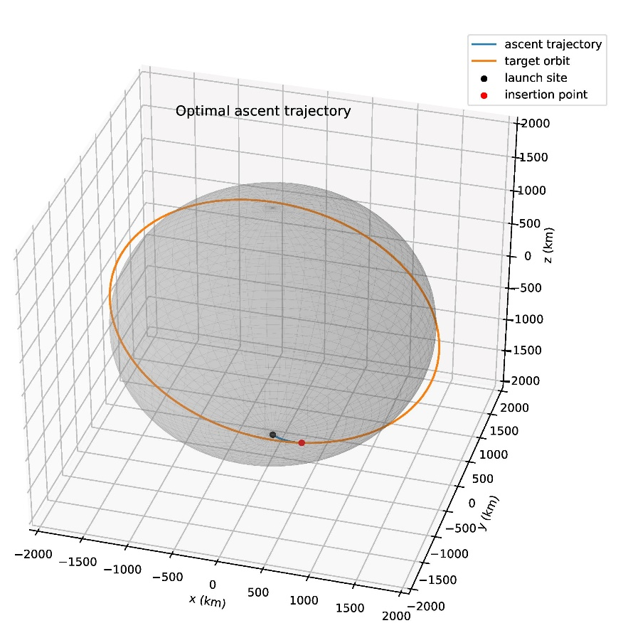
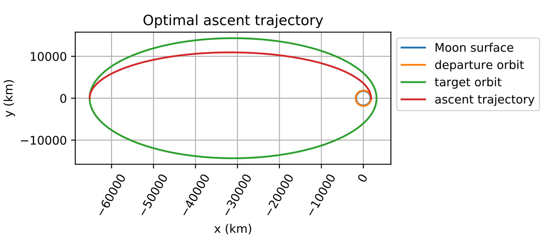
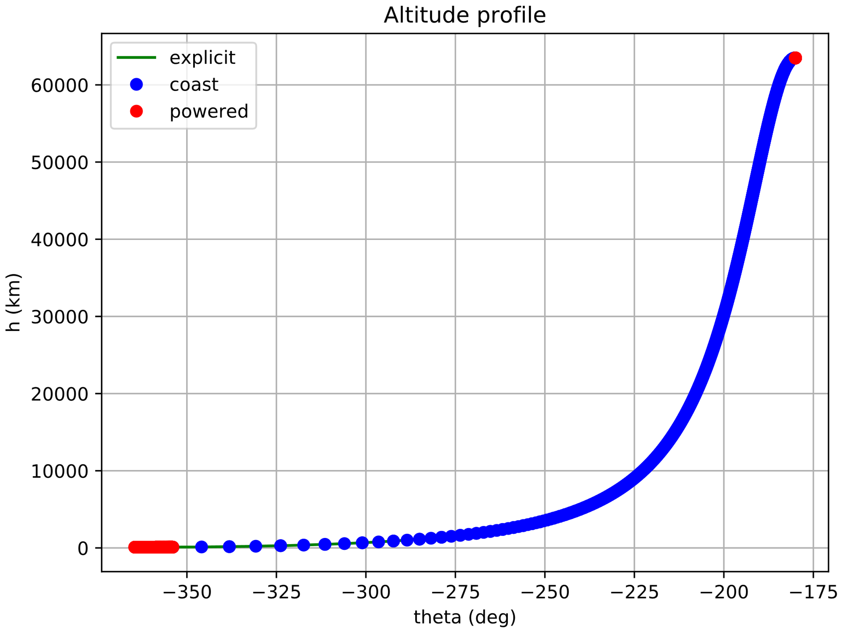
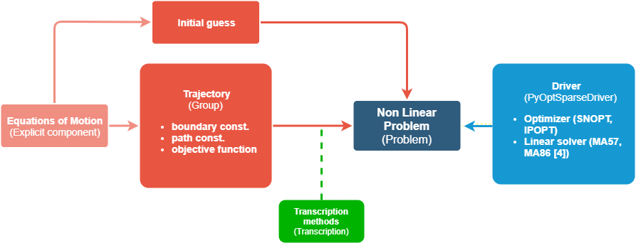
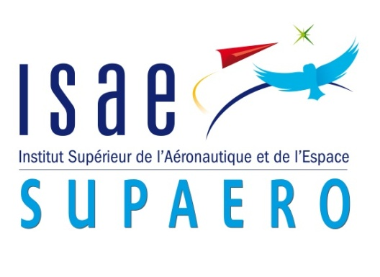

Optimal control of Trajectory of reusable launcher in OpenMDAO/dymos
Alberto FOSSÀ¹; Giuliana Elena MICELI²
1-2: ISAE-SUPAERO, Université de Toulouse, France
1. alberto.fossa@student.isae-supaero.fr, 2. giuliana-elena.miceli@student.isae-supaero.fr
1. Introduction
3. Results
This study is focused on the analysis of new ascent and descent trajectories from the Moon surface to different possible lunar orbits, such as Low Lunar Orbits (LLO) and Near Rectilinear Halo Orbits (NRHO). The objective is to provide a possible answer to the questions arisen after the renewed interest in the Moon exploration and in-situ resources exploitation, as demonstrated by the current development of the Lunar Orbital Platform-Gateway (LOP-G) and the Space Launch System (SLS). The main objective is to determine the most fuel-efficient trajectory for a given final orbit suitable for a crewed reusable launcher, for which different constraints and safety requirements must be taken into account.
The principal tools used to achieve the final goal are OpenMDAO and Dymos, two Python libraries that provide a user-friendly and powerful interface for solving optimal control problems through different numerical techniques.
For the results shown here the following parameters have been used:
Lunar surface to Low Lunar Orbit
2D Ascent and Descent Case
Four scenarios: Constant Thrust, Variable Thrust, Variable thrust with constrained minimum safe altitude (a), Ascent/Descent with constrained vertical take-off/landing.
3D Ascent Case (b)
(a) (b)
Low Lunar Orbit to Highly Elliptical Orbit
The Highly Elliptical Halo Orbit computation is a first step toward the modeling of the LLO-NRHO trajectory. Indeed, the simulation still considers a two-body problem and a fix common reference frame for the departure and arrival orbits.
2D Ascent Case
Surrogate models
The project is placed in the context of a future reusable launcher design, all the disciplines involved will be dynamically optimized with a multidisciplinary optimization method. In order to speed up the iterative process related to the overall optimization, the results coming from the trajectory block are given using a surrogate model such as one implemented in the SMT [6] python library. It consists in a grid containing all the possible results obtainable by the trajectory, considering all the intervals value of ISP and twr. A limited number of solution are computed taking couples of ISP-twr values with a Latin Hypercube Distribution, then the remaining cases are found interpolating the point previously obtained.
 | Units | Values | Interval
Isp | s | 450.0 | [256.98, 513.95]
twr | - | 2.1 | [1.1, 4.0]
m₀ | kg | 1.0 | Constant
Orbit altitude | Units | Value
H_{LLO} | km | 100
Credits: Lockheed Martin
Credits: Purdue University
2. Methods & Development
The optimal control problem is solved through a direct method. It is transcribed into a Nonlinear Programming problem (NLP) and solved with an iterative routine. The states and controls are discretized in time and then approximated with an interpolating polynomial to fit the discrete data. High-Order Gauss-Lobatto and Radau Pseudospectral are the transcription methods mostly used and thus implemented in different libraries. The open-source, Python-based Dymos library [1] takes advantage of the OpenMDAO [2] framework to perform such a transcription and solves the resulting NLP problem wrapping an external gradient-based solver such as IPOPT [3-4] or SNOPT [5]. Throughout this work the optimal transfer trajectories are obtained as solutions of a continuous-time optimal control problem arisen from the equations of motion (EOMs) that describe the spacecraft dynamics under the restricted two-body problem assumption. A transcription method is then applied to convert the optimal control problem into the corresponding NLP problem which is then numerically solved with an appropriate iterative algorithm. Since the main goal is to find the most fuel-efficient ascent trajectory the resulting objective function is given by:
$$J = −m(t_{f})$$
Orbit radii | Units | Value
Periapsis_{HEO} | km | 3150.00
Apoapsis_{HEO} | km | 65227.39
4. Conclusion and Future Work
References
E. S. Hendricks et al. “Simultaneous Propulsion System and Trajectory Optimization”, 2017.
J. S. Gray, et al. “OpenMDAO: an open-source framework for multidisciplinary design, analysis, and optimization”, 2019.
A. Wӓchter et al. “On the implementation of an interior-point filter line-search algorithm for large-scale nonlinear programming”, 2006.
HSL, A collection of Fortran codes for large scale scientific computation.
P. Gill et al. “SNOPT: An SQP Algorithm for Large-Scale Con-strained Optimization”, 2005.
Mohamed Amine Bouhlel et al. “A Python surrogate modeling framework with derivatives”, 2019.
The work done during the second semester of the Master focused on the lunar surface – LLO transfer, analyzing different possible scenarios.
The new goal is to be able to complete the LLO-NRHO simulations in order to compute a full transfer from the surface of the Moon to the LOP-G. Then, the future development will focus on the solution of the optimal control in the CR3BP for the Earth-Moon system.

