Slide 1

S2 Project Short Presentation
Optimal control of Trajectory of reusable launcher in OpenMDAO/dymos
Students:
Alberto Fossà
Giuliana Elena Miceli
Tutors:
Laurent Beauregard
Joseph Morlier
Stéphanie Lizy-Destrez
9 May 2019

Slide 2
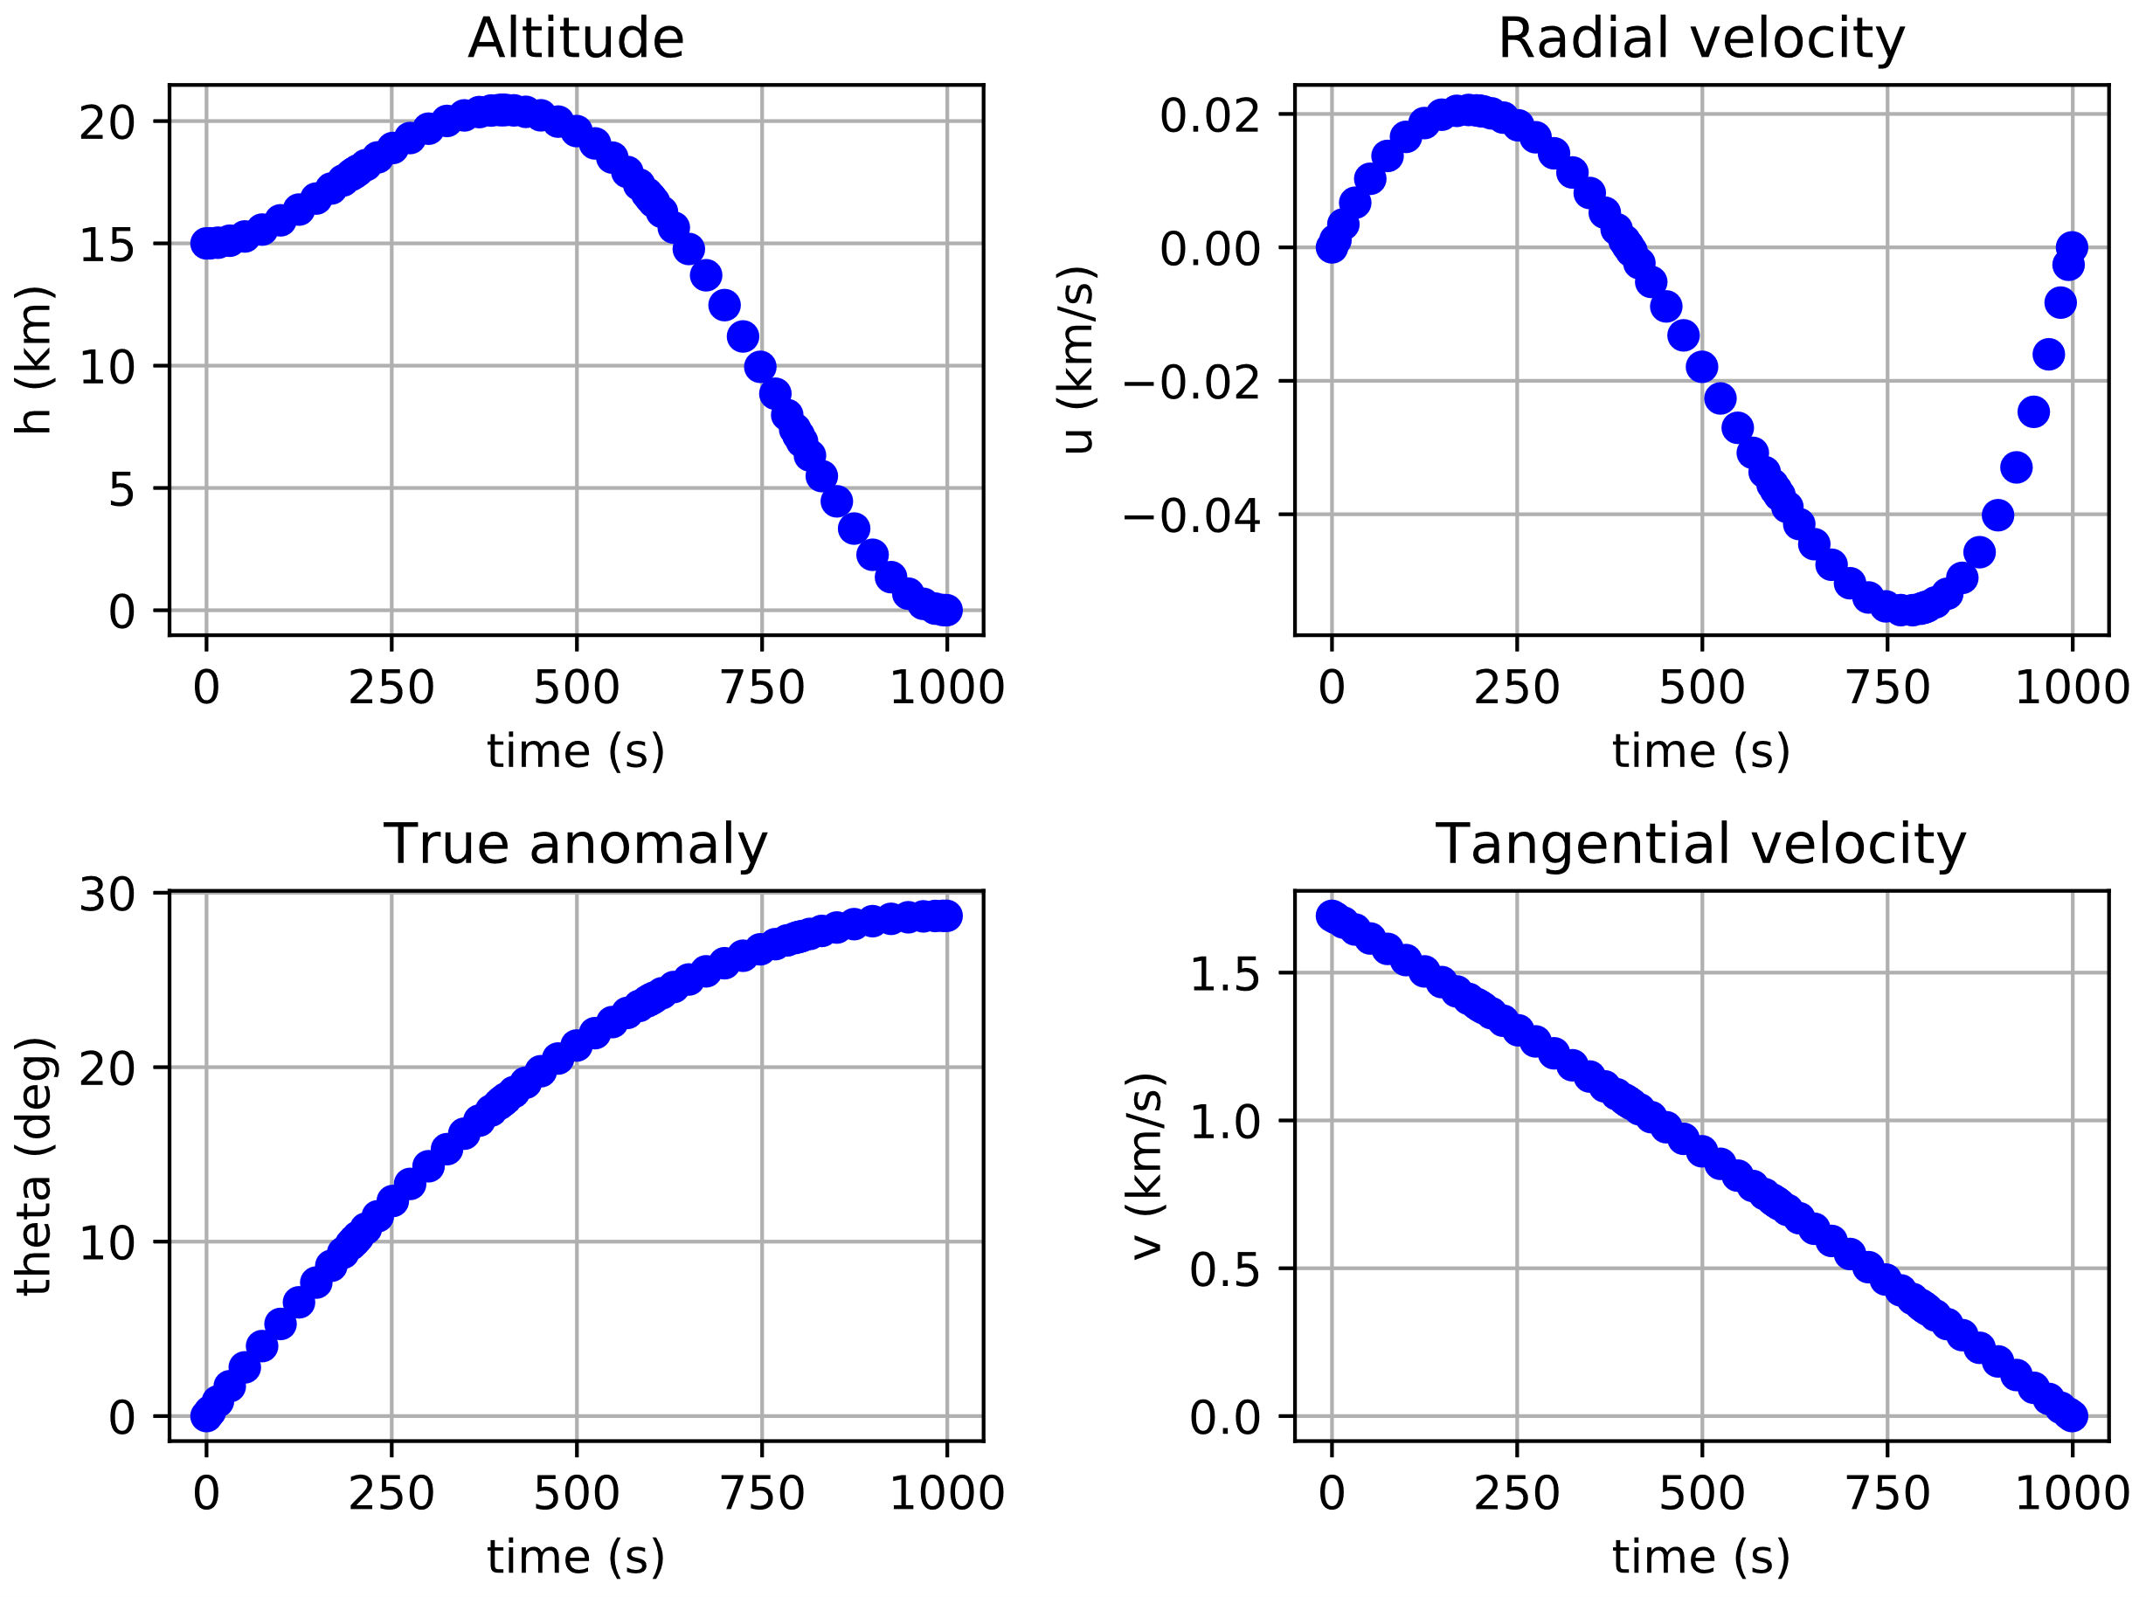
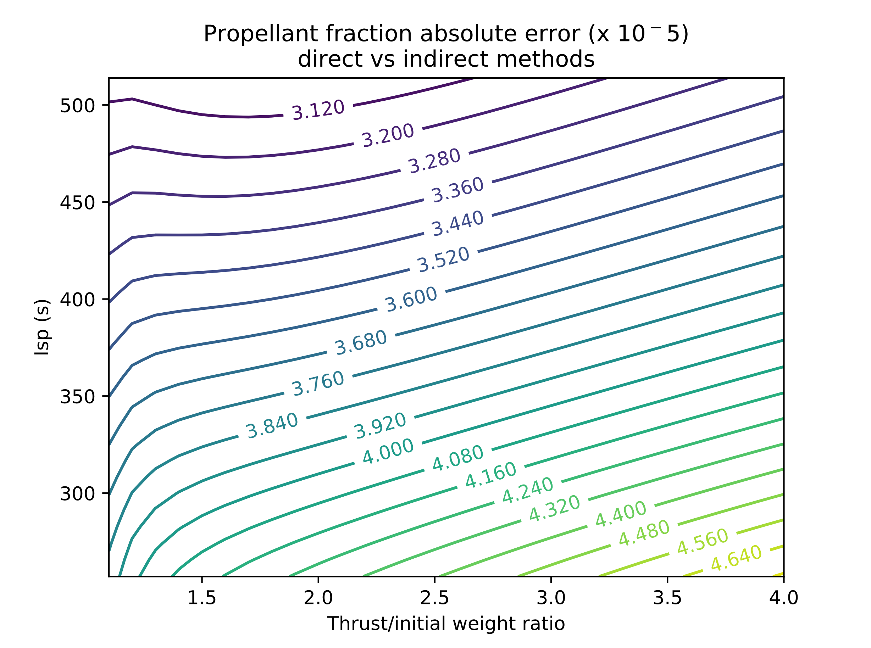
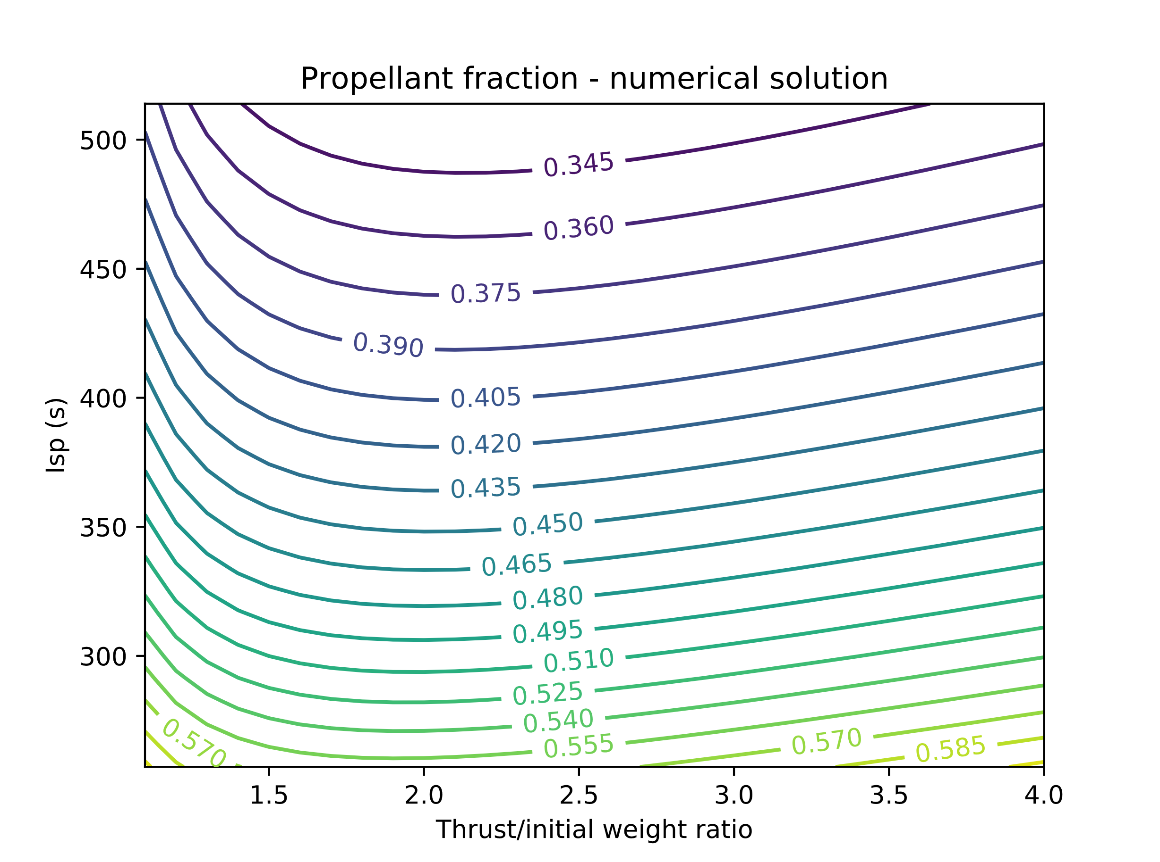
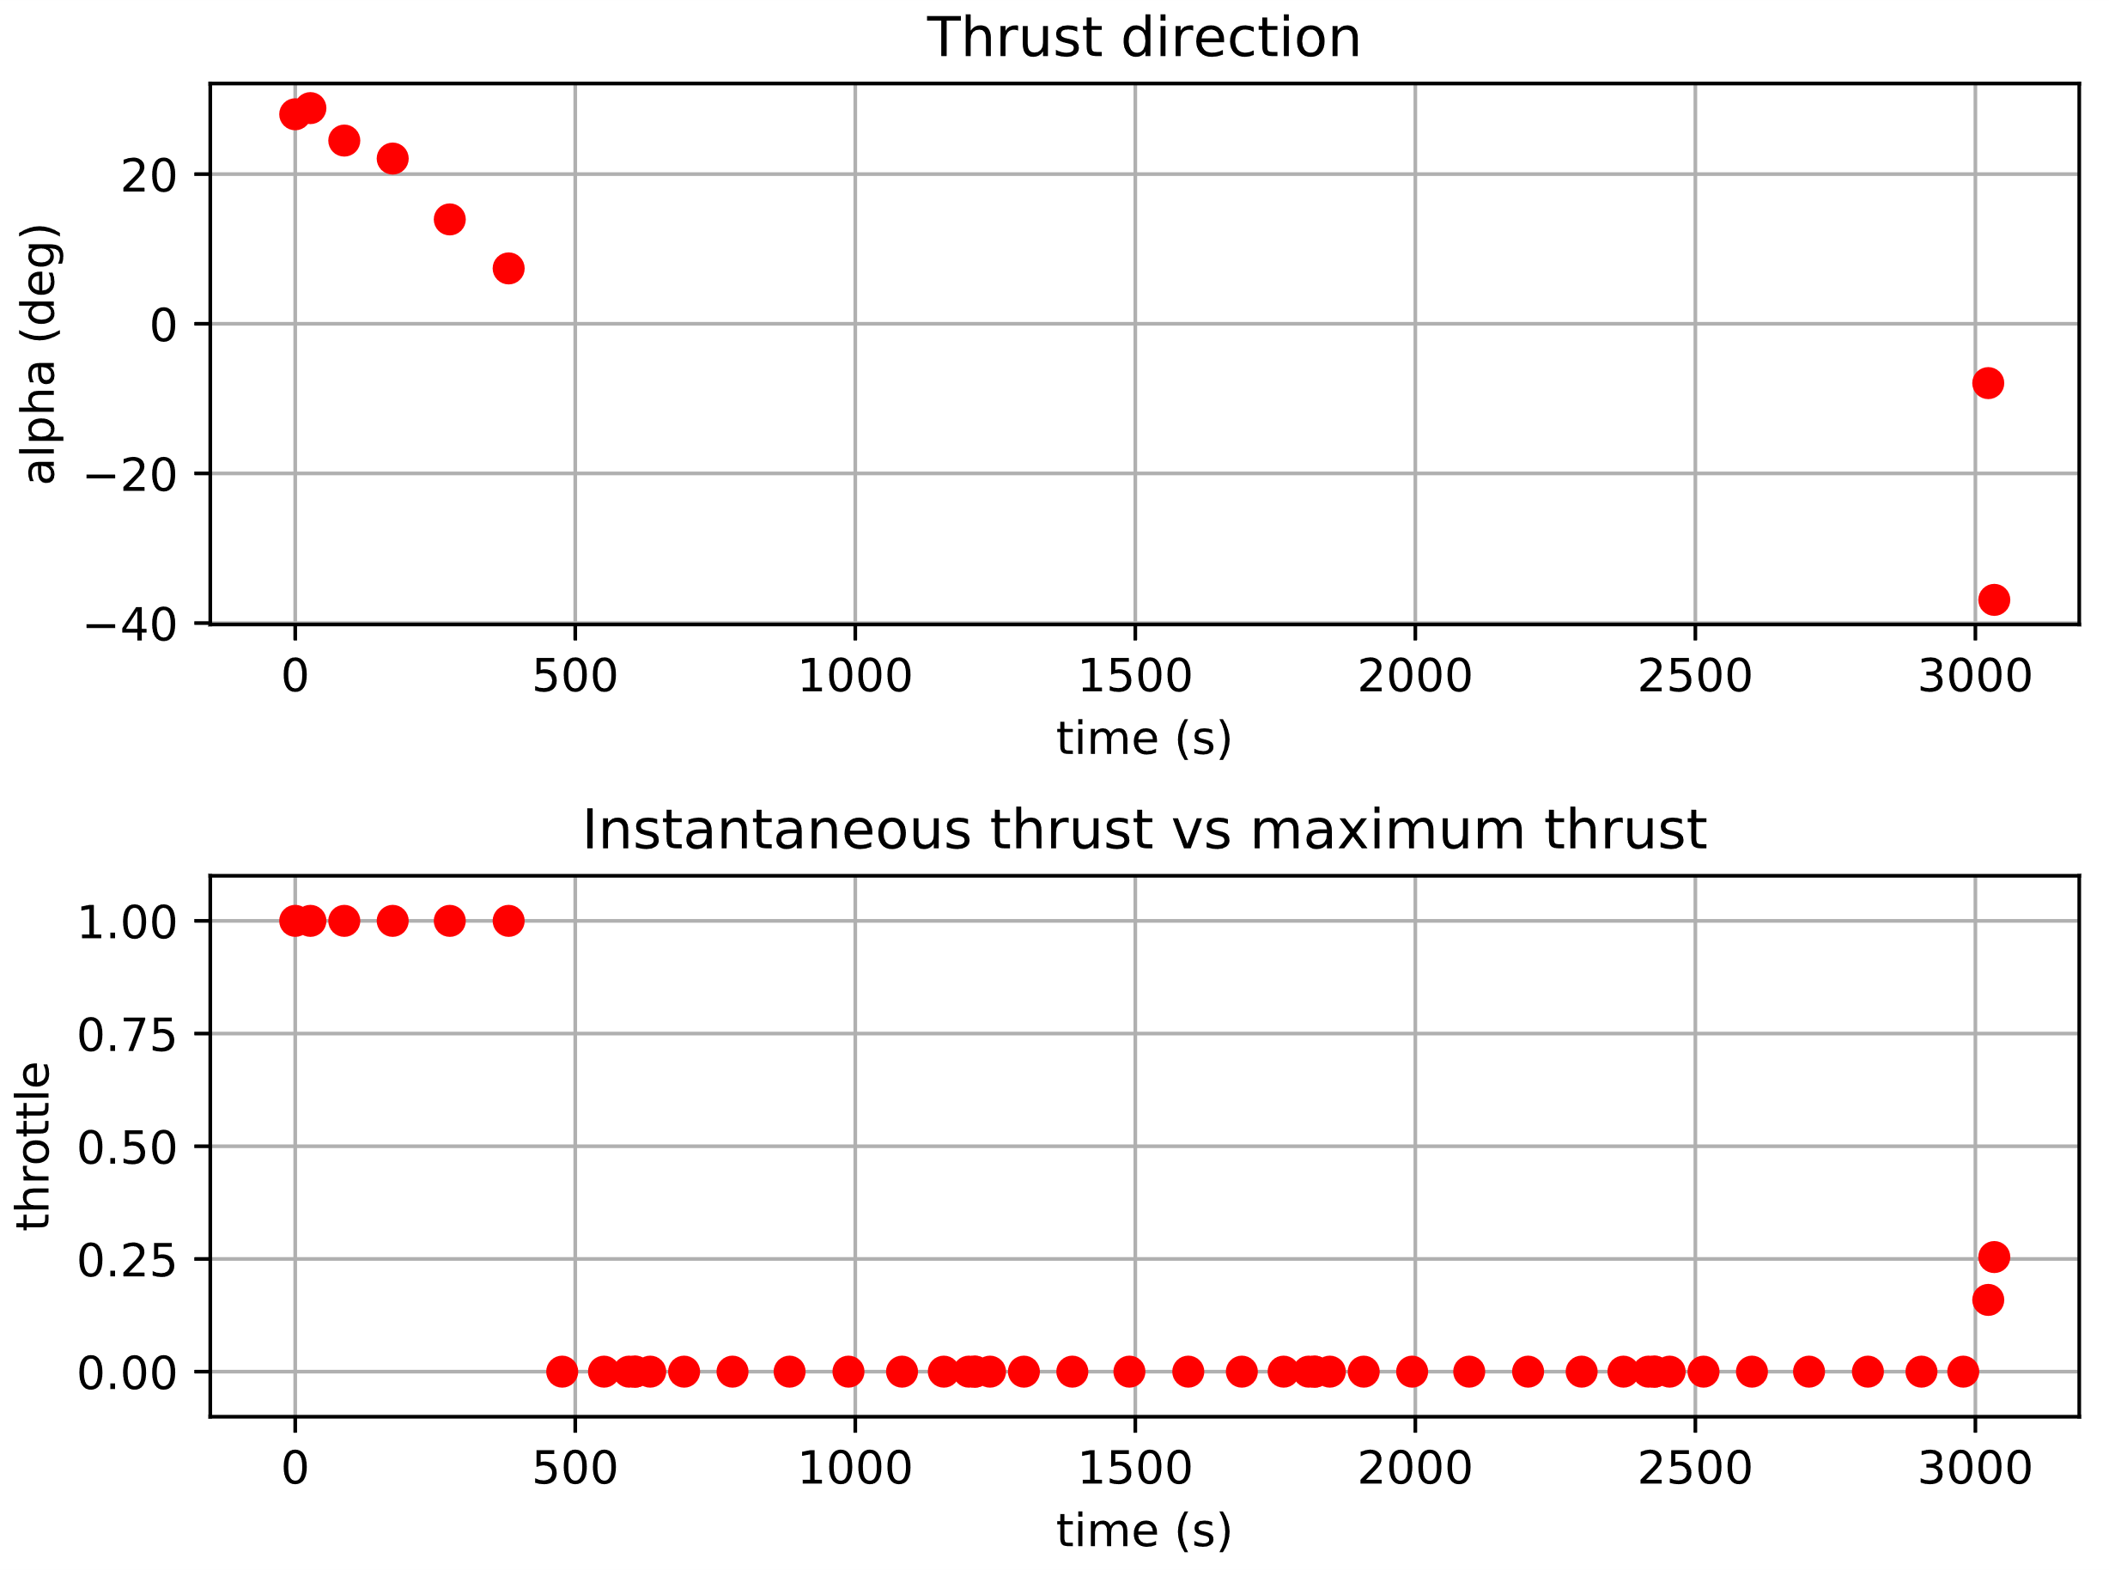
Two months achievements
Achieved goals:
Ascent trajectory with variable thrust
Comparison between direct and indirect methods
Descent trajectory without constraints

Slide 3
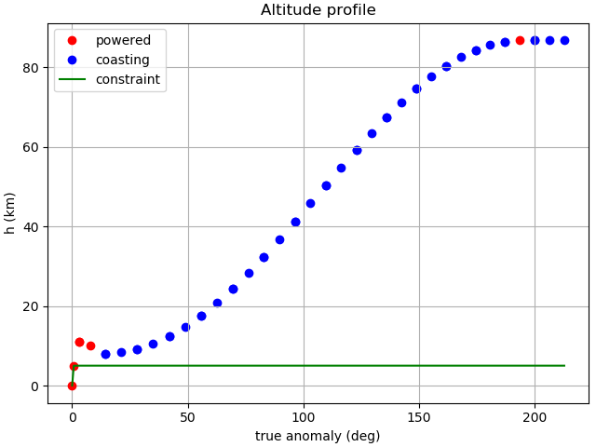
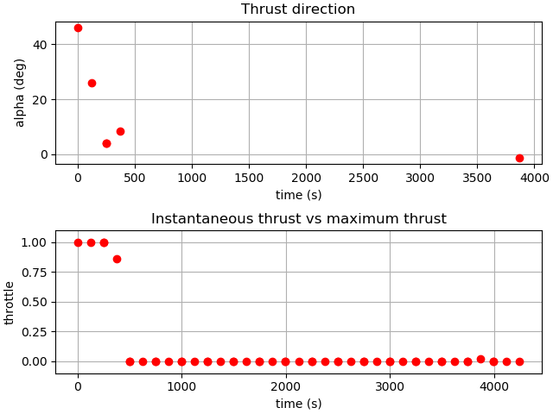
Last achievements
IPOPT constrained trajectory simulation:

Slide 4
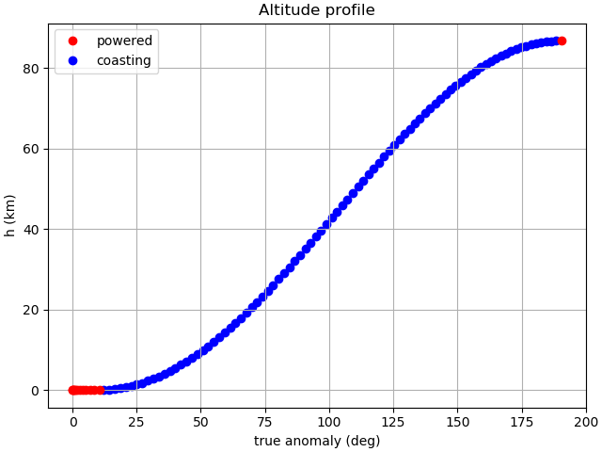
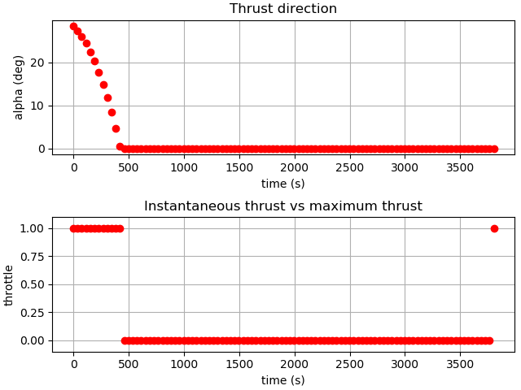
Last achievements
Comparison with ideal trajectory:

Slide 5
Thank you for your attention!
Questions?

