Slide 1

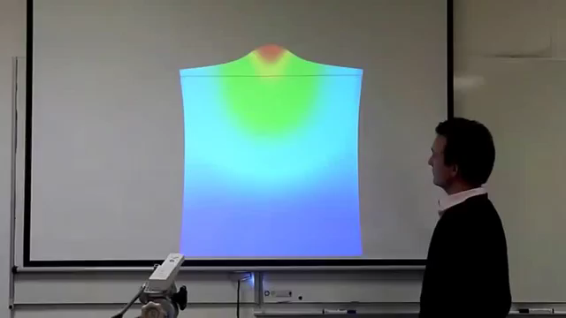


Structural Wing Model Reduction in Fluid-Structure Interactions
STUDENT:
Oriol CHANDRE VILA
TUTORS:
Joseph MORLIER and Sylvain DUBREUIL (ONERA)
Project of Innovation and Research (PIR)
Spring 2018
[Amsallem, International Journal for Numerical Methods in Engineering, 2014]

Slide 2
Table of Contents
Introduction
Aim and Objectives
State of the Art: ROM
Results
Integration of ROM to Aeroelasticity
Future work
Structural Wing Model Reduction in Fluid-Structure Interactions | Oriol CHANDRE VILA

Slide 3
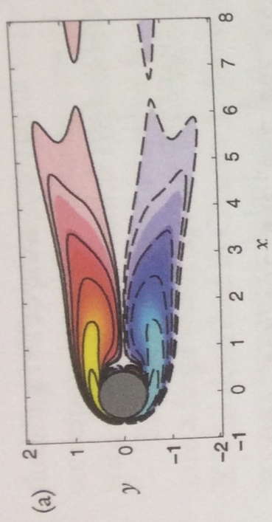

Introduction
Aeroelasticity
Coupling between aerodynamic forces, inertial forces and elastic forces.
Current issues due to models dimension. Why the ROM?
The calculations have a high cost in time and computational power.
Mean vorticity field
[Kutz et al., Chpt 9, SIAM, 2016]
[Kutz et al., Chpt 9, SIAM, 2016)
Structural Wing Model Reduction in Fluid-Structure Interactions | Oriol CHANDRE VILA

Slide 4
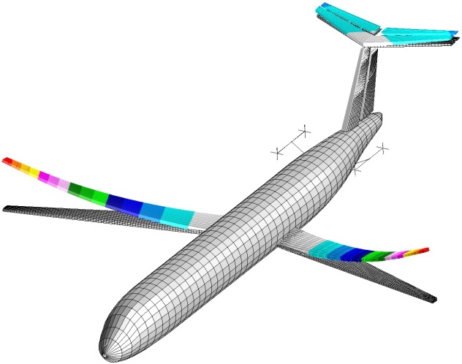
Aim & Objectives
Aim
To study the use of Reduced Order Models (hereafter ROM) in order to lighten the computational requirement in fluid-structure problems simulations
Objectives
To study different ROM methodologies.
To apply ROM techniques to a simple problem.
To define a strategy for fluid-structure interactions problems.
Source [8]
Structural Wing Model Reduction in Fluid-Structure Interactions | Oriol CHANDRE VILA

Slide 5
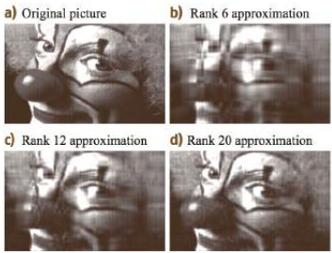
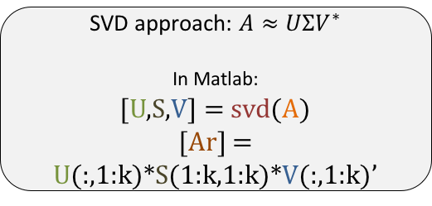
State of the Art: ROM
Principal Component Analysis (PCA)
[Kutz, Chpt 15, Oxford University Press, 2013]
Possible correlated variables
(Observations)
Values of linearly uncorrelated variables
(Principal Components)
Orthogonal Transformation
Widely used in the actuality.
Limitations:
The results depend on the scaling variables.
The applicability is limited by certain assumptions.
No differentiation between classes.
Used in different disciplines:
SVD in Algebra
POD in Mechanical Engineering.
SVD approach: $A≈UΣV^{∗}$
In Matlab:
[U,S,V] = svd(A)
[Ar] = U(:,1:k)*S(1:k,1:k)*V(:,1:k)’
Structural Wing Model Reduction in Fluid-Structure Interactions | Oriol CHANDRE VILA

Slide 6
State of the Art: ROM
Dynamic Mode Decomposition (DMD)
[Kutz, SIAM, 2016]
[Kutz, Chpt 20, Oxford University Press, 2013]
AIM:
To take advantage of the low dimensionality in the experimental data.
WHAT DOES DMD PROVIDE?
A decomposition of experimental data into a set of dynamic modes.
HOW DOES IT WORK?
DMD computes the eigenvalues and eigenvectors of the linear model.
DMD is not a ROM itself, it is more a strategy. However, it uses ROM (usually SVD) to perform a low-rank truncation of the data.
ADVANTAGES:
No equations are needed.
The future state is known for all time.
WHEN DOES IT FAIL?
Data matrix is full rank
No suitable low dimensional structure.
Structural Wing Model Reduction in Fluid-Structure Interactions | Oriol CHANDRE VILA

Slide 7

State of the Art: ROM
Proper Generalized Decomposition (PGD)
[Chinesta et al., Springer, 2014]
Fast ONLINE solution of a recurring problem.
PGD is a numerical method for solving boundary value problems.
Its biggest advantage is the ability to work in a Parameterized approach.
The vectors R(x), S(y), T(z),$⋯$, Z(n) are robustly computed offline.
The vectors R(x), S(y), T(z), ⋯ , Z(n) are robustly computed offline.
PGD is not a ROM itself, it is more a strategy. However, it can use ROM to economize the vectors solutions R, S, T,$⋯$, Z .
Structural Wing Model Reduction in Fluid-Structure Interactions | Oriol CHANDRE VILA

Slide 8
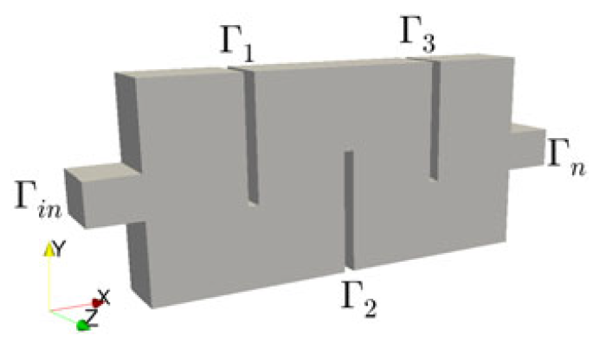
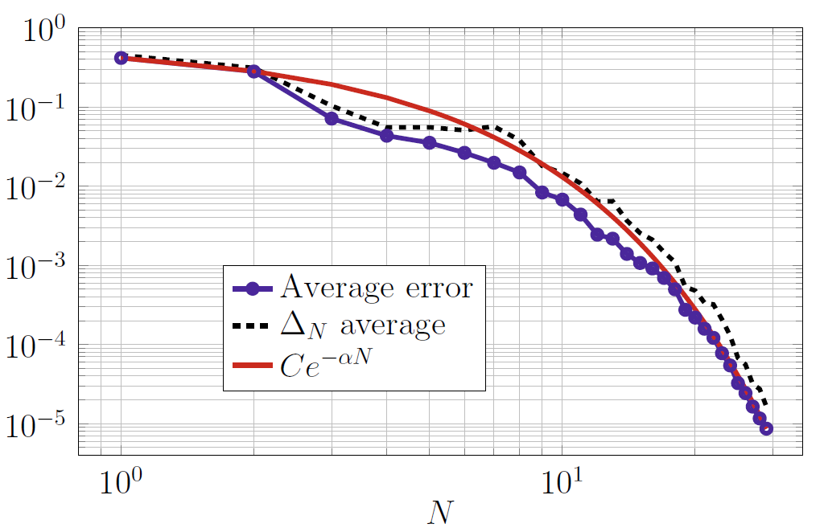
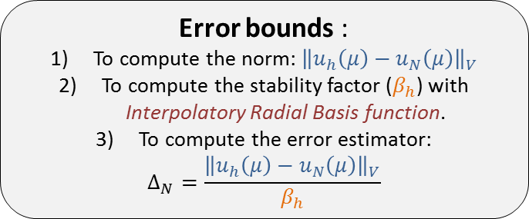
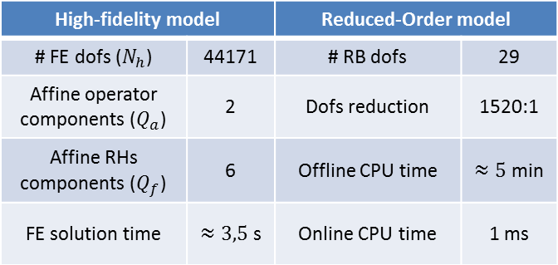
State of the Art: ROM
Analysis of Performance of ROM
[Quarteroni et al., Springer, 2016]
Galerkin Reduced Basis (G-RB) + POD or Greedy Algorithm.
The parametric dependence of the PDE solution is exploited.
PROBLEM: Steady heat conduction-convection problem.
Table 2. Computational details for HF and RB models. [Quarteroni et al., Chpt 3, Springer, 2016]
High-fidelity model |  | Reduced-Order model
# FE dofs ($N_{h}$) | 44171 | # RB dofs | 29
Affine operator components ($Q_{a}$) | 2 | Dofs reduction | 1520:1
Affine RHs components ($Q_{f}$) | 6 | Offline CPU time | $≈5$ min
FE solution time | $≈3,5$ s | Online CPU time | 1 ms
Error bounds :
To compute the norm: ${\left\|u_{h}\left(μ\right)−u_{N}\left(μ\right)\right\|}_{V}$
To compute the stability factor ($β_{h}$) with Interpolatory Radial Basis function.
To compute the error estimator:
$$Δ_{N}=\frac{{\left\|u_{h}\left(μ\right)−u_{N}\left(μ\right)\right\|}_{V}}{β_{h}}$$
Figure 1. Comparison of the average error and bound error estimator computed on a set of 350 random values. [Quarteroni et al., Chpt 3, Springer, 2016]
Structural Wing Model Reduction in Fluid-Structure Interactions | Oriol CHANDRE VILA

Slide 9
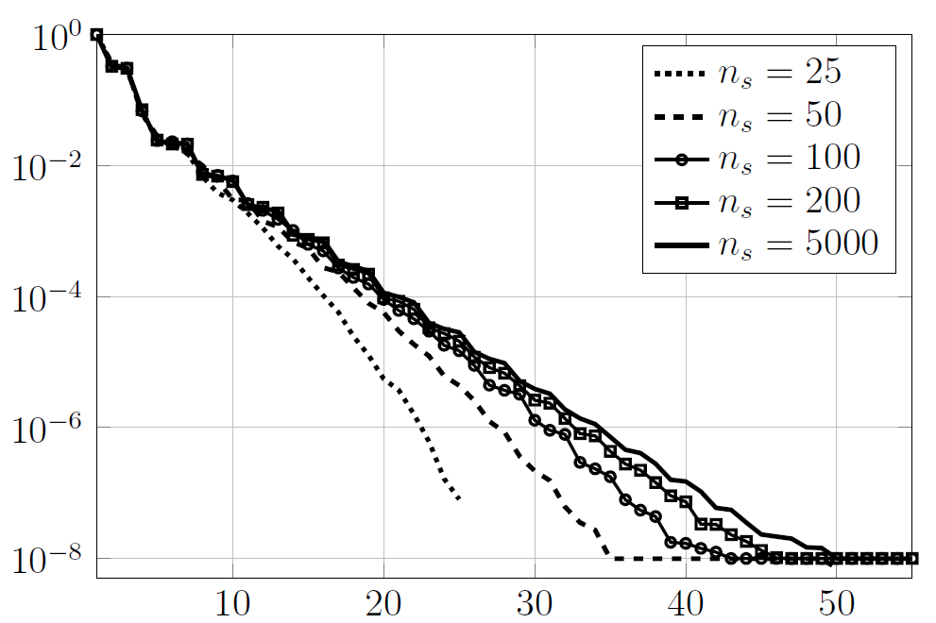
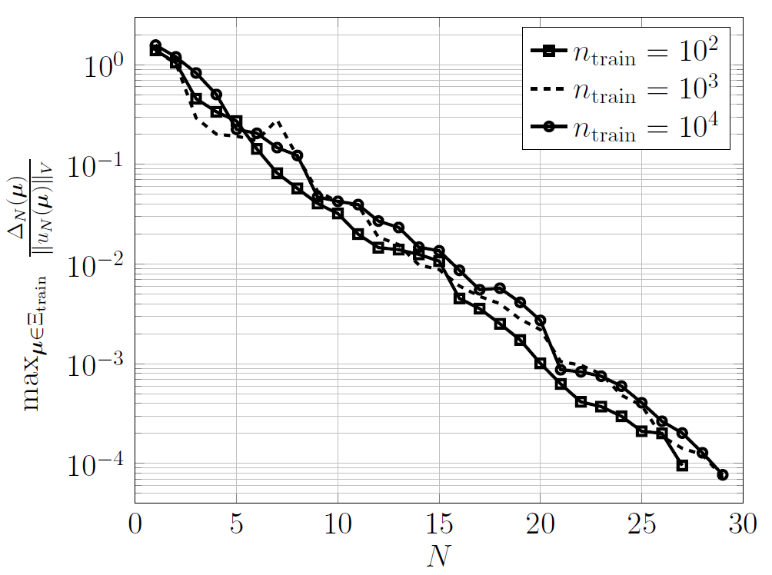
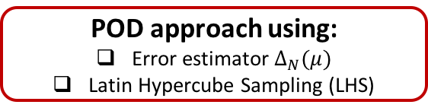
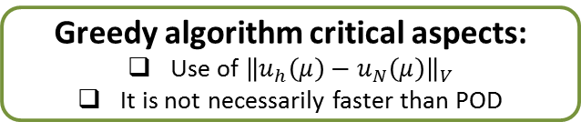
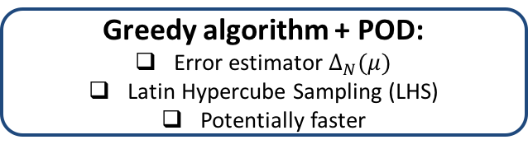
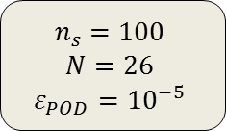
State of the Art: ROM
POD approach using:
Error estimator $Δ_{N}(μ)$
Latin Hypercube Sampling (LHS)
Greedy algorithm critical aspects:
Use of ${\left\|u_{h}\left(μ\right)−u_{N}\left(μ\right)\right\|}_{V}$
It is not necessarily faster than POD
Greedy algorithm + POD:
Error estimator $Δ_{N}(μ)$
Latin Hypercube Sampling (LHS)
Potentially faster
$$n_{s}=100$$
$$N=26$$
$$ε_{POD}={10}^{−5}$$
Figure 2. First 55 singular values of the correlation matrix obtained by LHS. [Quarteroni et al., Chpt 6, Springer, 2016]
Figure 3. Convergence history of the greedy algorithm. [Quarteroni et al., Chpt 7, Springer, 2016]
Structural Wing Model Reduction in Fluid-Structure Interactions | Oriol CHANDRE VILA

Slide 10
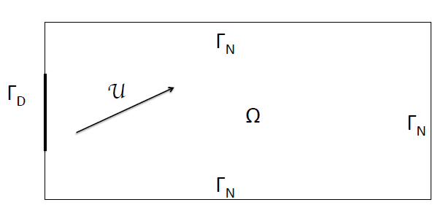




Results
Advection-Diffusion problem definition
[Amsallem, International Journal for Numerical Methods in Engineering, 2014]
BOUNDARY
CONDITIONS
Steady Advection-Diffusion
$$𝒰⋅∇𝒯−κ⋅∆𝒯=0$$
Steady Advection-Diffusion
𝒰⋅𝛻𝒯−𝜅⋅∆𝒯=0
$𝒰=\left[\begin{matrix}𝒰_{1} \\ 𝒰_{2}\end{matrix}\right]=\left[\begin{matrix}𝒰_{1} \\ 0\end{matrix}\right]$ ;${ 𝒰}_{1}ε [0;0,5]$
𝒰=[■8(𝒰_1@𝒰_2 )]=[■8(𝒰_1@0)] ;〖 𝒰〗_1 𝜖 [0;0,5]
$$κ ε [0;0,025]$$
𝜅 𝜖 [0;0,025]
$$x=\left(x,y\right)∈\left[0,1\right]×[0,1]$$
𝒙=(𝑥,𝑦)∈[0,1]×[0,1]
$$\left\{\begin{aligned}𝒯\left(x;μ\right)=𝒯_{D}\left(y;\overline{y}\right) \\ ∇𝒯\left(x;μ\right)⋅n\left(x\right)=0\end{aligned}\right.$$
{█(𝒯(𝒙;𝝁)=𝒯_𝐷 (𝑦;𝑦 ̅ )@𝛻𝒯(𝒙;𝝁)⋅𝒏(𝒙)=0)┤
$$𝒯_{D}\left(y,t;\overline{y}\right)=\left\{\begin{aligned}300 \\ 300+325{\left(\sin\left(3⋅π⋅\left|y−\overline{y}\right|\right)+1\right)}^{ } \\ 300\end{aligned}\right.$$
𝒯_𝐷 (𝑦,𝑡;𝑦 ̅ )={█(300@300+325(sin⁡(3⋅𝜋⋅|𝑦−𝑦 ̅ |)+1)^ @300)┤
$$\overline{y}∈[0,4;0,6]$$
𝑦 ̅∈[0,4;0,6]
$$u_{2}∈[0;0,5]$$
if $y∈[0;1/3]$
if $y∈[1/3;2/3]$
if $y∈[2/3;1]$
$$\overline{y}=0,4$$
Structural Wing Model Reduction in Fluid-Structure Interactions | Oriol CHANDRE VILA

Slide 11
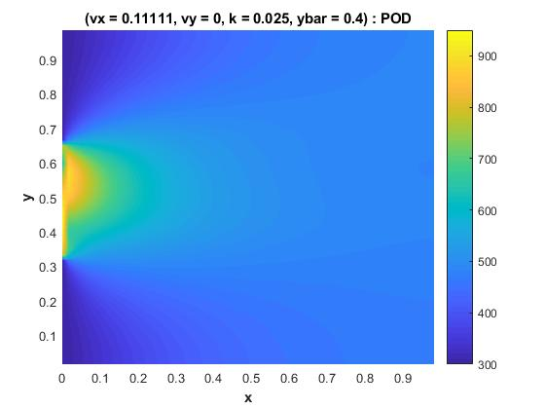
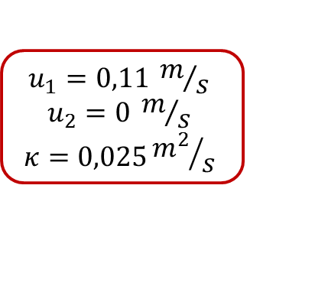
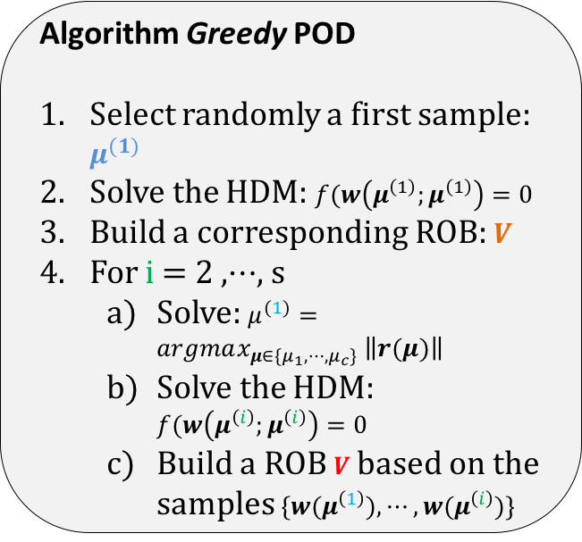
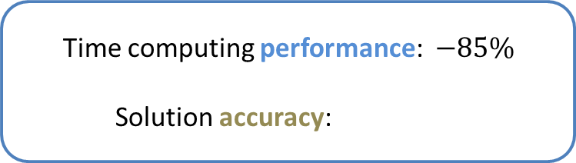
Results
Advection-Diffusion problem: POD
Algorithm Greedy POD
Select randomly a first sample: $μ^{(1)}$
Solve the HDM: $f(w\left(μ^{\left(1\right)};μ^{\left(1\right)}\right)=0$
Build a corresponding ROB: $V$
For i = 2 ,$⋯$, s
Solve: $μ^{(1)}=argmax_{μ∈\{μ_{1},⋯,μ_{c}\}} \left\|r(μ)\right\|$
Solve the HDM: $f(w\left(μ^{\left(i\right)};μ^{\left(i\right)}\right)=0$
Build a ROB $V$based on the samples $\{w(μ^{\left(1\right)}),⋯,{w(μ}^{\left(i\right)})\}$
Time computing performance: $−85\%$
Solution accuracy:
[Amsallem, International Journal for Numerical Methods in Engineering, 2014]
$$E_{max}^{ }=7\%$$
$$E_{avg}=1\%$$
V size:
3487 x 10 =
34870 terms
$$u_{1}=0,11 m/s$$
$$u_{2}=0 m/s$$
$$κ=0,025{m^{2}}/s$$
Structural Wing Model Reduction in Fluid-Structure Interactions | Oriol CHANDRE VILA

Slide 12


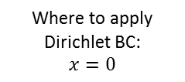

Results
Advection-Diffusion problem: PGD
2 diffusion eq. + 2 advection eq.
5 coordinates: $x, y, u_{1},u_{2}, κ$
AA = cell(5,4)
$$\int_{Ω}^{ }{{𝒯 }^{∗}\left(u ∇𝒯−κ Δ𝒯 \right)dxdydu_{1}du_{2}dκ=0}$$
$$𝒯^{n}\left(x,y,u_{1},u_{2},κ\right)= \sum_{i=1}^{n−1}{X_{i}\left(x\right)Y_{i}\left(y\right)U_{i}\left(u_{1}\right)V_{i}\left(u_{2}\right)K_{i}\left(κ\right)}+R\left(x\right)S\left(y\right)T\left(u_{1}\right)W\left(u_{2}\right)Z\left(κ\right)$$
BB = cell(5,1)
RHS: Source terms
N_NT = cell(5,1)
Mass matrices
Dirichlet = cell(5,1)
Where to apply Dirichlet BC:
$$x=0$$
GG = cell(5,1)
A priori known terms, to enforce the Dirichlet BC
The search of a less intrusive method
A non-symmetry induced by the convection terms.
GG {2} =${ 𝒯}_{D} (y; \overline{y})$
Residual Minimization Technique for PGD
$$\min{ }{\left\|A⋅X−F\right\|}^{2}$$
Neumann BC
D1x(end,end) = 0;
D1y(1,1) = 0; D1y(end,end) = 0;
[Chinesta et al., Springer, 2014]
Structural Wing Model Reduction in Fluid-Structure Interactions | Oriol CHANDRE VILA

Slide 13
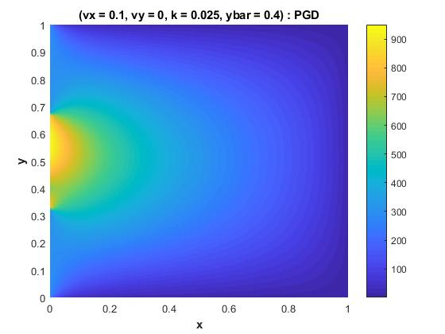
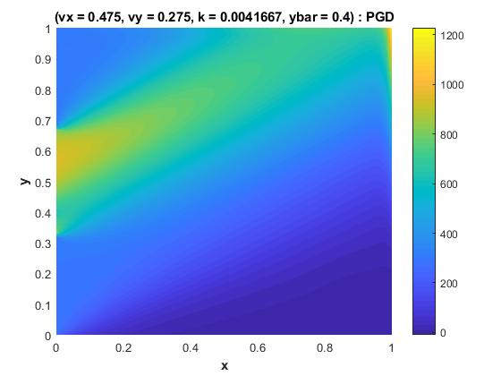
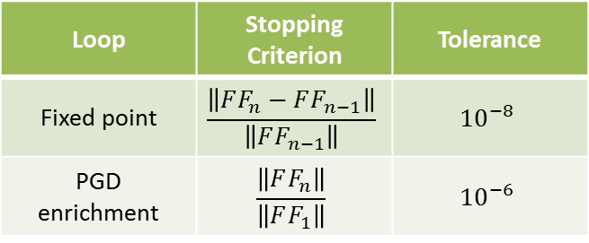
Results
Advection-Diffusion problem: PGD
Loop | Stopping Criterion | Tolerance
Fixed point | $$\frac{\left\|FF_{n}−FF_{n−1}\right\|}{\left\|FF_{n−1}\right\|}$$ | $${10}^{−8}$$
PGD enrichment | $$\frac{\left\|FF_{n}\right\|}{\left\|FF_{1}\right\|}$$ | $${10}^{−6}$$
OFFLINE
!!!
Computing time:
43min 25s
FF size: 292500 terms
alph = ones(size(FF{1},2),1);
alpha = FF{3}(5,:) .* FF{4}(1,:) .* FF{5}(15,:) .* alph';
T = FF{2} * diag(alpha) * FF{1}';
ONLINE
Computing time:
0,1 – 0,5 s
Structural Wing Model Reduction in Fluid-Structure Interactions | Oriol CHANDRE VILA

Slide 14
Conclusions
PGD → a lot of cases of the same (normally expensive) problem are expected.
DMD → simulations in time domain. We need a film of snapshots to create the reduced model.
POD
PGD
The most interesting PGD’s approach is the Parametric PGD.
PGD allows to introduce Boundary Conditions as extra-coordinates of the problem.
The Stopping Criterion and Tolerance effectiveness should be evaluated for each problem.
Structural Wing Model Reduction in Fluid-Structure Interactions | Oriol CHANDRE VILA

Slide 15
Future work
Modification of the Stopping Criterion.
SUMMER INTERSHIP IN ONERA
Application of the strategy into OpenAeroStruct.
SUMMER INTERSHIP IN ONERA
Link to the GitHub Project
Structural Wing Model Reduction in Fluid-Structure Interactions | Oriol CHANDRE VILA

Slide 16
References
[1] Kutz, J.N., Brunton, S.L., Brunton, B.W. and Proctor, J.L., "Dynamic Mode Decomposition: Data-Driven Modeling of Complex Systems", 1st ed., SIAM, Philadelphia, 2016.
[2] Kutz, J. N., "Data-Driven Modeling & Scientific Computation: Methods for Complex Systems & Big Data", 1st ed., Oxford University Press, Oxford, 2013.
[3] Chinesta, F., Keunings, R. and Leygue, A., "The Proper Generalized Decomposition for Advanced Numerical Simulations: A primer", 1st ed., Springer, 2014.
[4] Quarteroni, A., Manzoni, A. and Negri, F., "Reduced Basis Methods for Partial Differential Equations. An Introduction", Unitext, vol. 92. Springer, 2016.
[5] Amsallem, D., “An Adaptive and Efficient Greedy Procedure for the Optimal Training of Parametric Reduced-Order Models”, International Journal for Numerical Methods in Engineering, 2014.
[6] http://www.dlr.de/ae/en/desktopdefault.aspx/tabid-1596/
Structural Wing Model Reduction in Fluid-Structure Interactions | Oriol CHANDRE VILA

