Slide 1

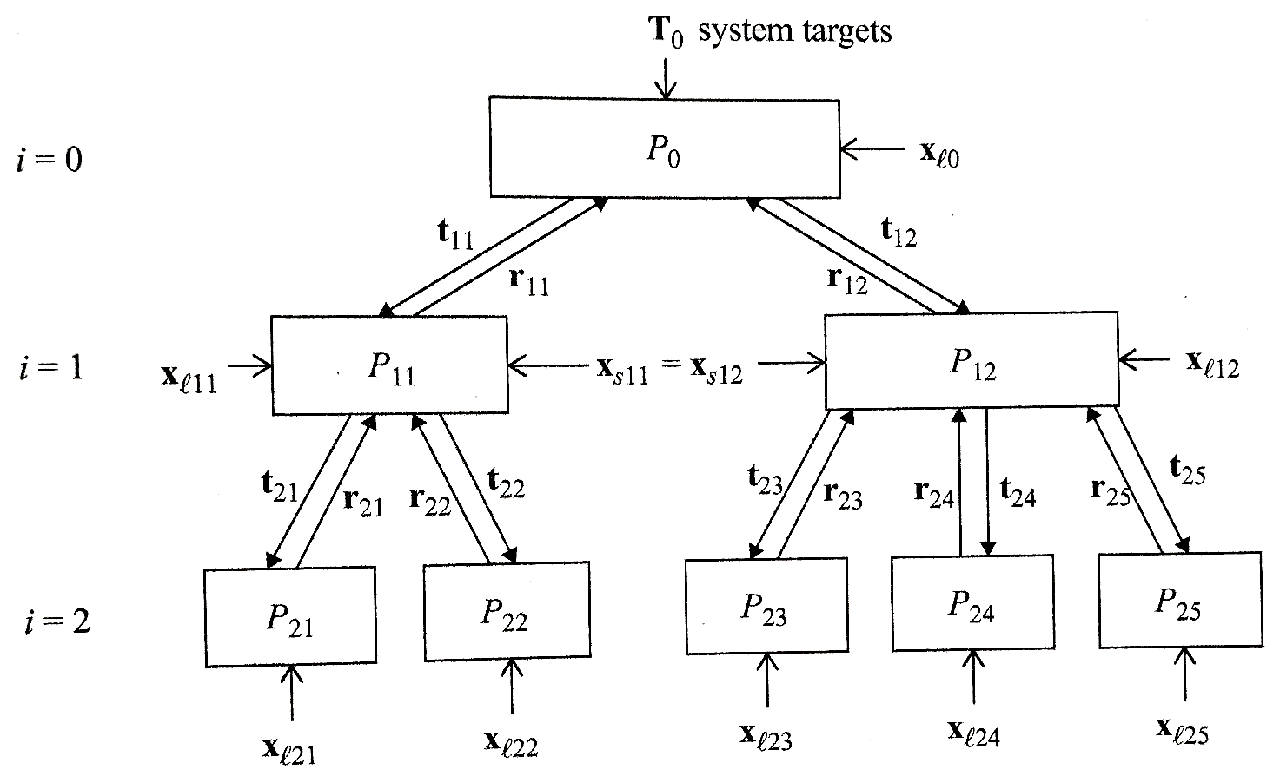
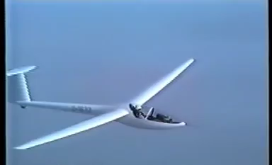
Integrated structural and control system design (Co-Design) for robust flutter performance
Student: Giovanni Filippi
Advisor: Joseph Morlier
Toulouse, 29-06-2018

Slide 2
Introduction
All subsystems are coupled:
Sequential approach
Suboptimal results
Need for an integrated design approach

Slide 3
Principles of optimal design Modeling and Computation – Systems design
Principle of decomposition:
break the problem into simpler problem pieces
solve each subproblem separately
coordinate the subproblems solution
Decomposition-based design optimization
=
multidisciplinary design optimization (MDO)
[1] P. Y. Papalambros, D. J. Wilde, and L. Papke. System design. Principle of optimal design - Modeling and Computation, pp. 355-420, 2017.

Slide 4
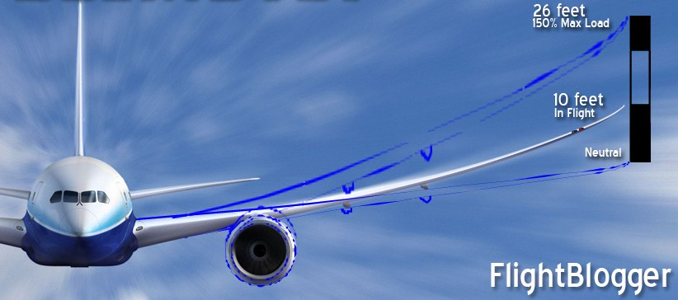
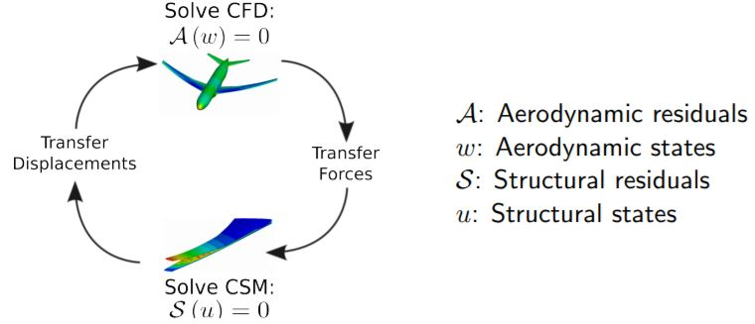
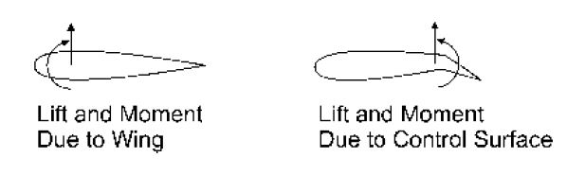
The importance of aerostructural coupling
+ control law:
[3] J. R. Wright, J. E. Cooper. Introduction to Aircraft Aeroelasticity and Loads. 2007.

Slide 5
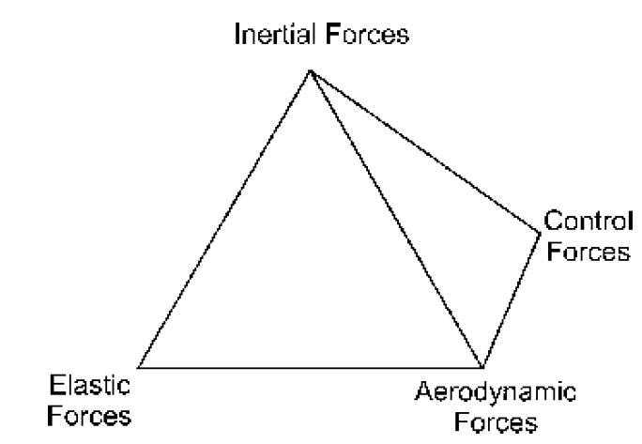
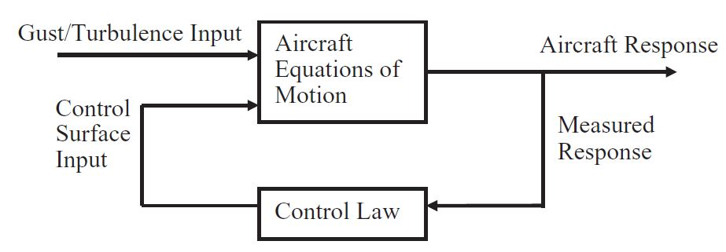
Aeroservoelasticy
Improvement of the handling and stability
Loads alleviation
flutter suppression systems that enable aircraft to fly beyond the flutter speed
A simple PI controller can reduces the gust response and increases the flutter speed

Slide 6
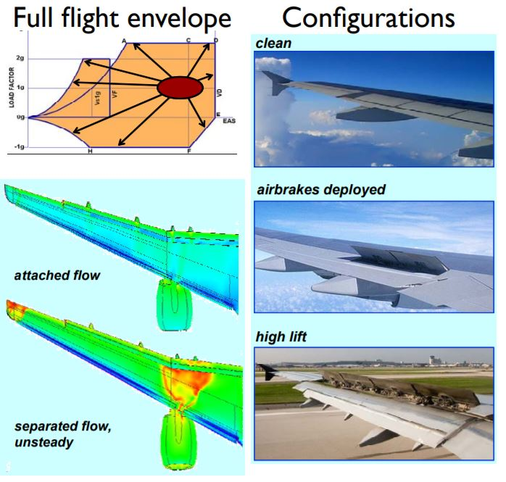
MDO - example
Next generation MDO will be computationally demanding:
50 flight points
100 mass cases
10 configurations
5 maneuvers
20 gusts
4 control laws
20 million analyses
[2] L. MartinHigh. Fidelity Multidisciplinary Design Optimization of Aircraft Configurations. August 10, 2012.

Slide 7
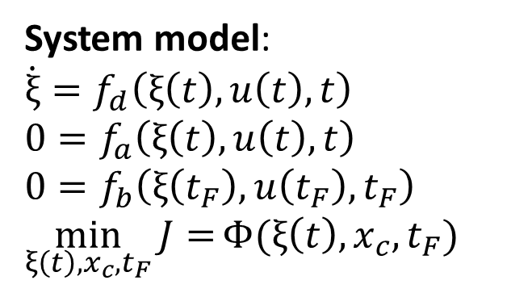
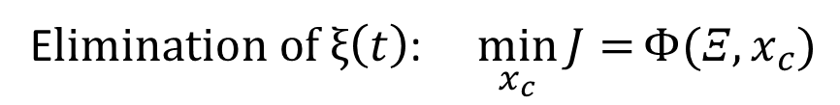
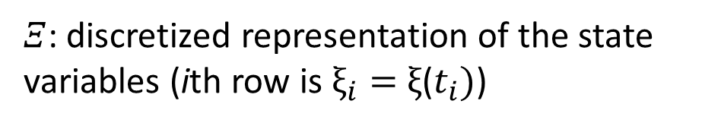
Direct Transcription method
System model:
$$\dot{ξ}=f_{d}\left(ξ\left(t\right),u\left(t\right),t\right)$$
$$0=f_{a}\left(ξ\left(t\right),u\left(t\right),t\right)$$
$$0=f_{b}\left(ξ\left(t_{F}\right),u\left(t_{F}\right),t_{F}\right)$$
$$\min_{ξ\left(t\right),x_{c},t_{F}}{J=}Φ(ξ\left(t\right),x_{c},t_{F})$$
E$limination of ξ\left(t\right)$: $\min_{x_{c}}{J=}Φ(Ξ,x_{c})$
$Ξ$: discretized representation of the state variables (ith row is $ξ_{i}=$ $ξ$($t_{i})$)
[4] J. T. Allison, T. Guo, Z. Han. Co-Design of an Active Suspension Using Simultaneous Dynamic Optimization. ASME Journal of Mechanical Design, Aug 2014.

Slide 8
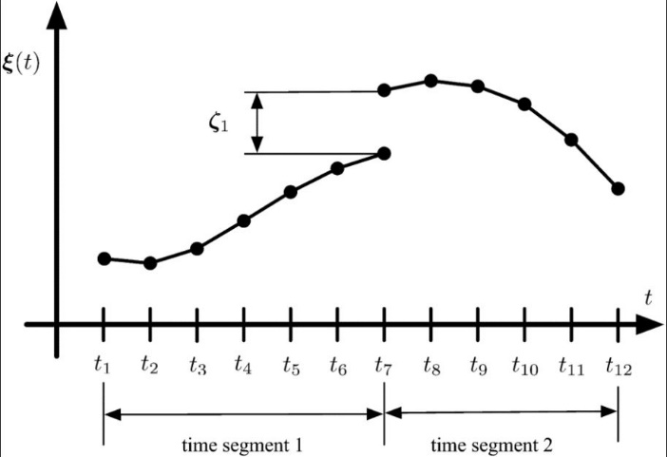
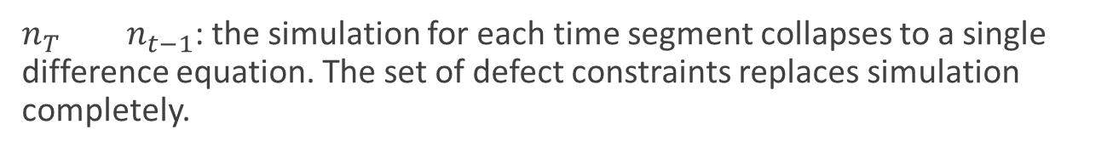
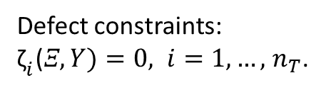
Defect constraints: ${\text{ζ}}_{i}\text{(}Ξ,Y)=0, i=1,…,$ $n_{T}$.
$n_{T}$ $n_{t−1}$: the simulation for each time segment collapses to a single difference equation. The set of defect constraints replaces simulation completely.
Differential equations
Discretization
Conversion into a system of algebraic equations.

Slide 9
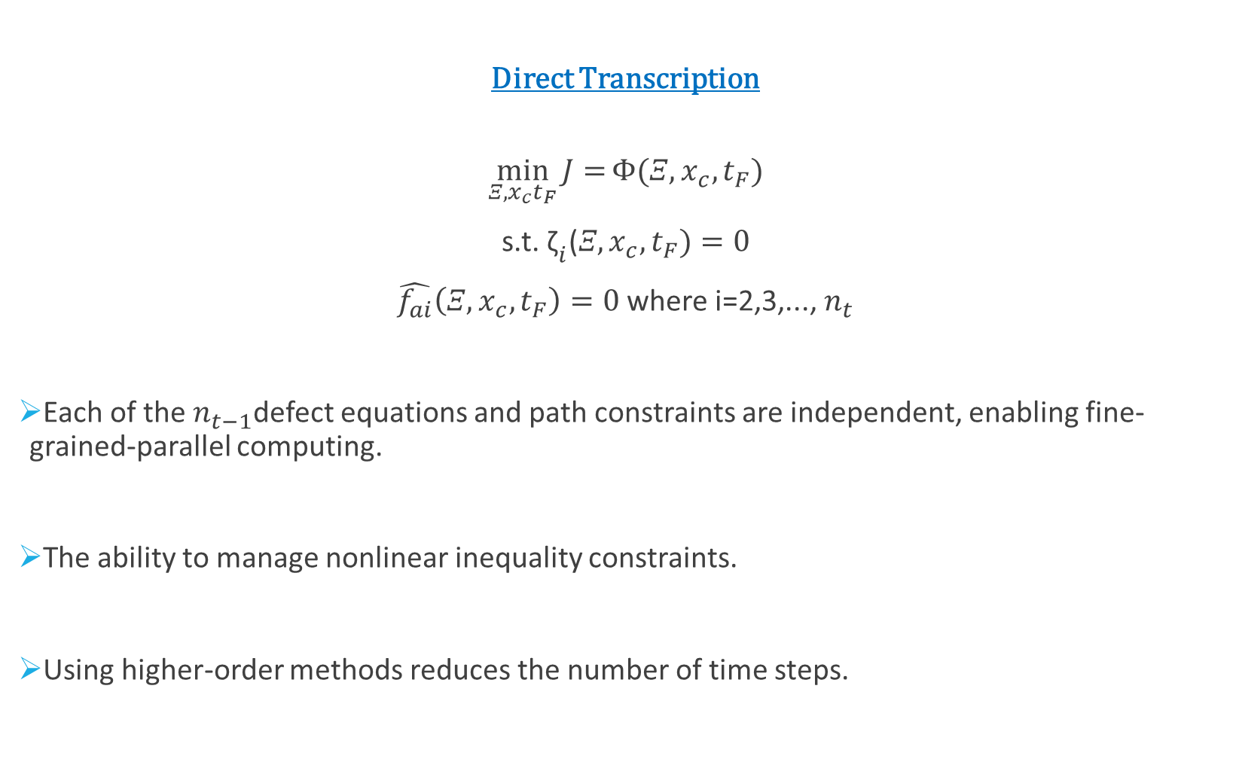
Direct Transcription
$$\min_{Ξ,x_{c}t_{F}}{J=}Φ(Ξ,x_{c},t_{F})$$
s.t. ${\text{ζ}}_{i}\text{(}Ξ,x_{c},t_{F})=0$
$\hat{f_{ai}}\left(Ξ,x_{c},t_{F}\right)=0$ where i=2,3,..., $n_{t}$
Each of the $n_{t−1}$defect equations and path constraints are independent, enabling fine-grained-parallel computing.
The ability to manage nonlinear inequality constraints.
Using higher-order methods reduces the number of time steps.

Slide 10
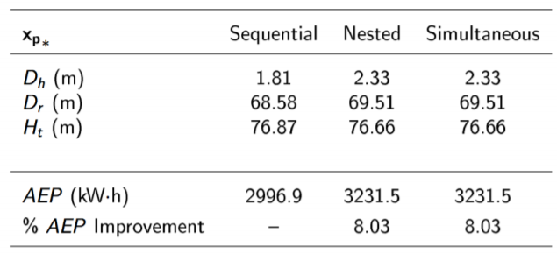
Direct Transcription - example
HAWT* co-design results show significant improvement over sequential design performance
**
*horizontal axis wind turbine
**AEP: Annualized energy production, kW・h
[5] J. T. Allison, A. Deshmukh. Integrated Physical and Control System Design for Horizontal Axis Wind Turbines. University of Illinois at Urbana-Champaign.

Slide 11
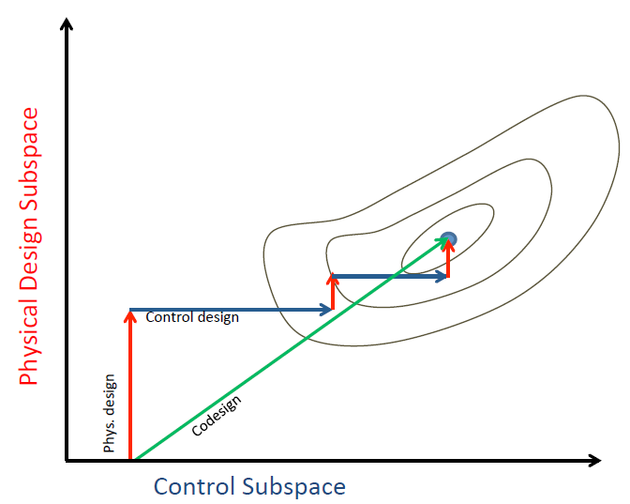
Co-Design: Integrated Physical and Control System Design [5]
Navigate physical and control design subspaces simultaneously.
System optimal designs
[5] J. T. Allison, A. Deshmukh. Integrated Physical and Control System Design for Horizontal Axis Wind Turbines. University of Illinois at Urbana-Champaign.

Slide 12
Utillizing Co-Design in Systems Engineering
Significant potential for
Enhancing design integration
Improving system performance, capitalize on passive dynamics in an active system
Tailor structural/mechanical/control system designs: system optimality

Slide 13
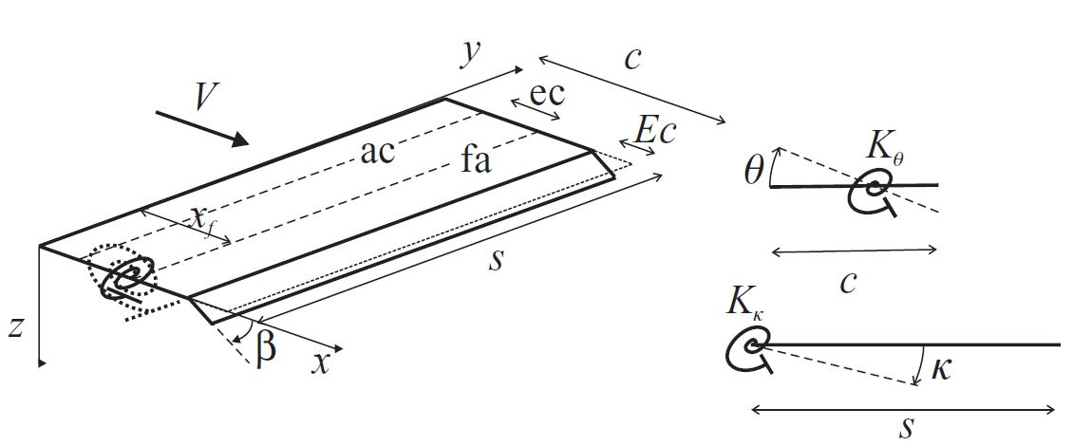
Wing model
Degrees of freedom:
pitch θ and flap κ
[3] J. R. Wright, J. E. Cooper. Introduction to Aircraft Aeroelasticity and Loads. 2007.

Slide 14
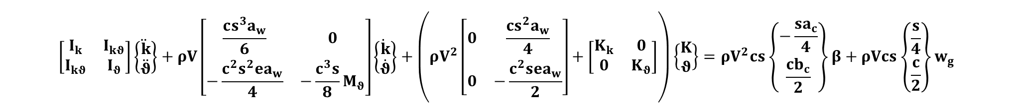
Mathematical modelling
$$\left[\begin{matrix}I_{k} & I_{kθ} \\ I_{kθ} & I_{θ}\end{matrix}\right]\left\{\begin{matrix}\ddot{k} \\ \ddot{θ}\end{matrix}\right\}+ρV\left[\begin{matrix}\frac{cs^{3}a_{w}}{6} & 0 \\ −\frac{c^{2}s^{2}ea_{w}}{4} & −\frac{c^{3}s}{8}M_{θ}\end{matrix}\right]\left\{\begin{matrix}\dot{k} \\ \dot{θ}\end{matrix}\right\}+\left(ρV^{2}\left[\begin{matrix}0 & \frac{cs^{2}a_{w}}{4} \\ 0 & −\frac{c^{2}sea_{w}}{2}\end{matrix}\right]+\left[\begin{matrix}K_{k} & 0 \\ 0 & K_{θ}\end{matrix}\right]\right)\left\{\begin{matrix}K \\ θ\end{matrix}\right\}=ρV^{2}cs\left\{\begin{matrix}−\frac{sa_{c}}{4} \\ \frac{cb_{c}}{2}\end{matrix}\right\}β+ρVcs\left\{\begin{matrix}\frac{s}{4} \\ \frac{c}{2}\end{matrix}\right\}w_{g}$$
structural inertia
aerodynamic damping
aerodynamic stiffness
structural stiffness
control surface angle
gust term
$$A\ddot{q}+ρVB\dot{q}+\left(ρV^{2}C+E\right)q=gβ+hw_{g}$$

Slide 15

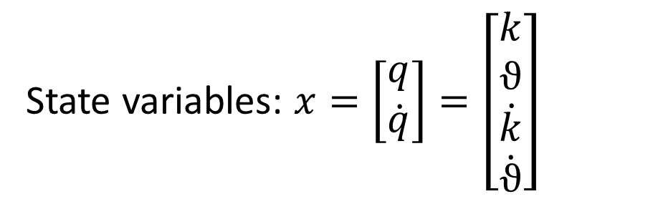
State space modelling
$$\left[\begin{matrix}\dot{q} \\ \ddot{q}\end{matrix}\right]=\left[\begin{matrix}0 & I \\ {−A}^{−1}(ρV^{2}C+E) & {−A}^{−1}(ρVB)\end{matrix}\right]+\left[\begin{matrix}q \\ \dot{q}\end{matrix}\right]+\left[\begin{matrix}0 \\ A^{−1}g\end{matrix}\right]β+\left[\begin{matrix}0 \\ A^{−1}h\end{matrix}\right]w_{g}$$
$$\dot{x}=A_{s}x+B_{s}u+E_{s}w_{g}$$
State variables: $x=\left[\begin{matrix}q \\ \dot{q}\end{matrix}\right]=\left[\begin{matrix}k \\ ϑ \\ \dot{k} \\ \dot{ϑ}\end{matrix}\right]$
Control variable: u=𝛽

Slide 16
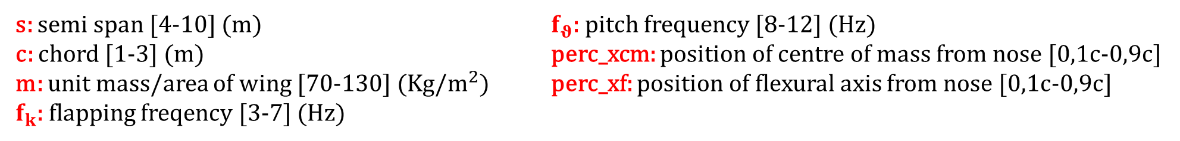
Design variables
s: semi span [4-10] (m) $f_{θ}$: pitch frequency [8-12] (Hz)
c: chord [1-3] (m) perc_xcm: position of centre of mass from nose [0,1c-0,9c] m: unit mass/area of wing [70-130] (Kg/$m^{2}$) perc_xf: position of flexural axis from nose [0,1c-0,9c]
$f_{k}$: flapping freqency [3-7] (Hz)

Slide 17
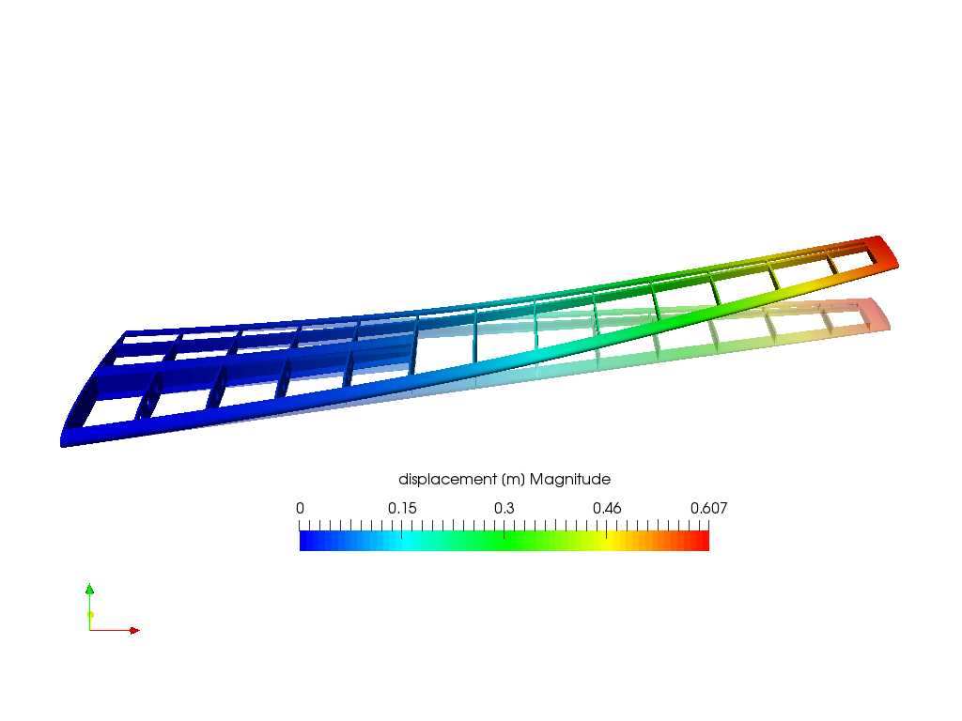
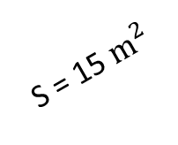
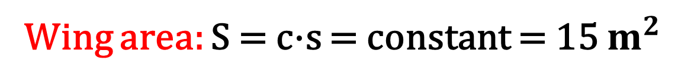
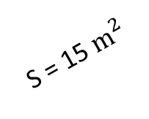
Constraints
Eccentricity between flexural axis and aerodynamic center:
0,1 < e < 1
Wing area: S = c·s = constant = 15 $m^{2}$
S = 15 $m^{2}$
S = 15 $m^{2}$
Maximum vertical displacement: z = k·s + ϑ·xf < 1 m
z < 1 m

Slide 18
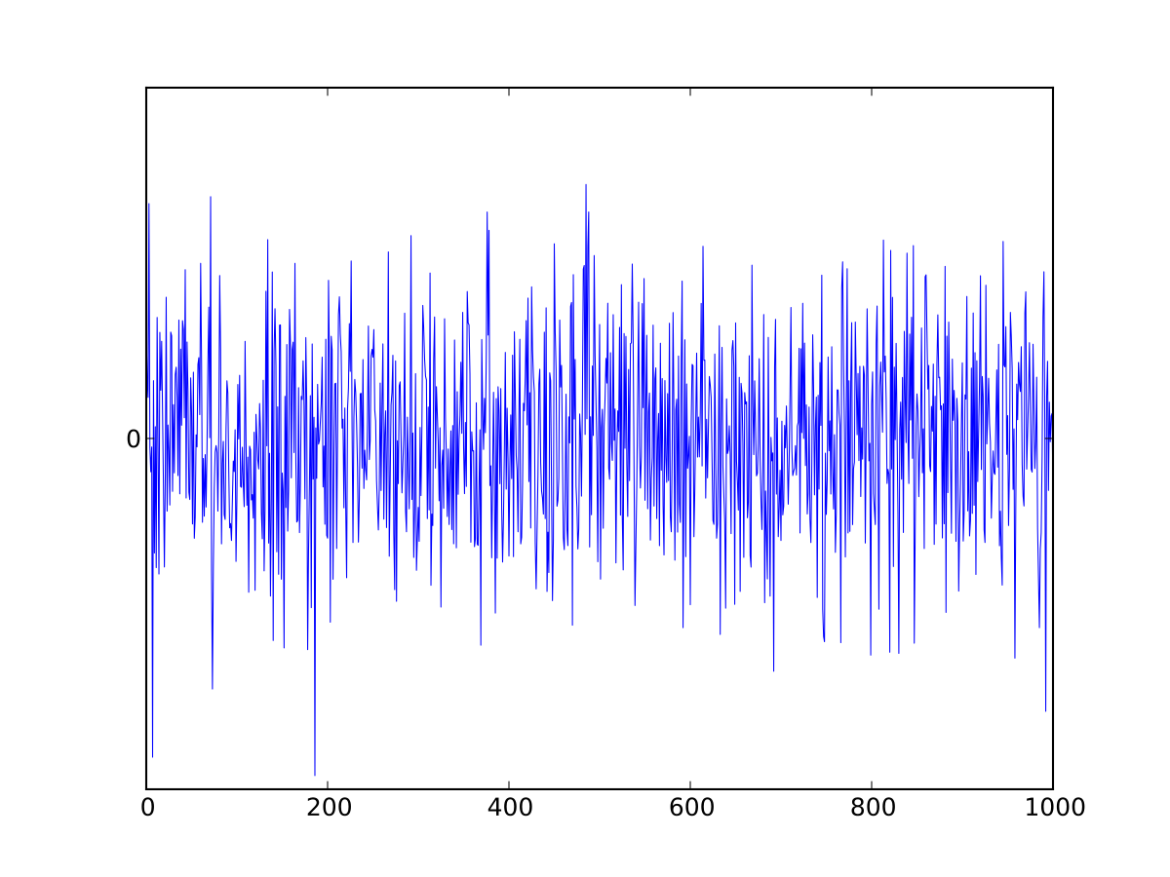
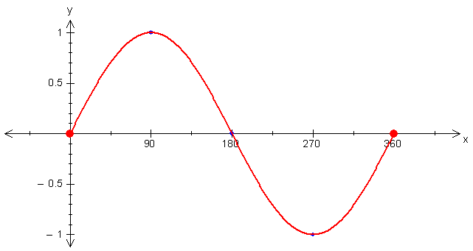
Input excitation
gust ‘1-cosine’
random turbulence

Slide 19
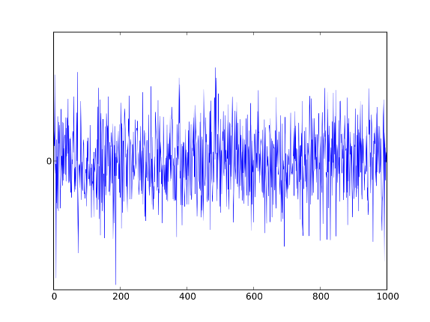
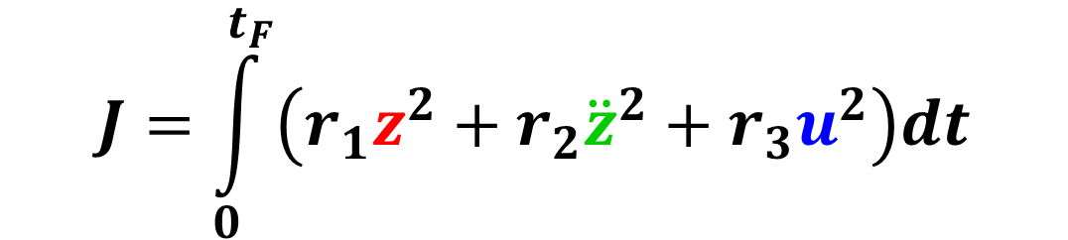
Objective function
handling
+
comfort
+
control cost
$$J=\int_{0}^{t_{F}}{\left(r_{1}z^{2}+r_{2}{\ddot{z}}^{2}+r_{3}u^{2}\right)dt}$$
$$J=J_{gust}+J_{turb}$$

Slide 20
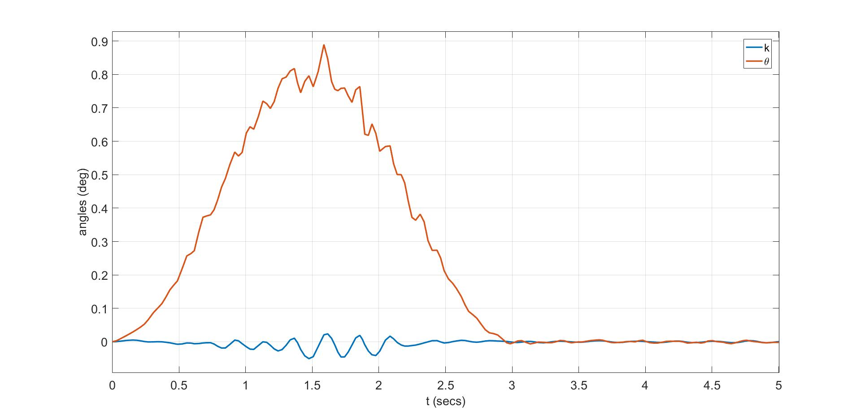
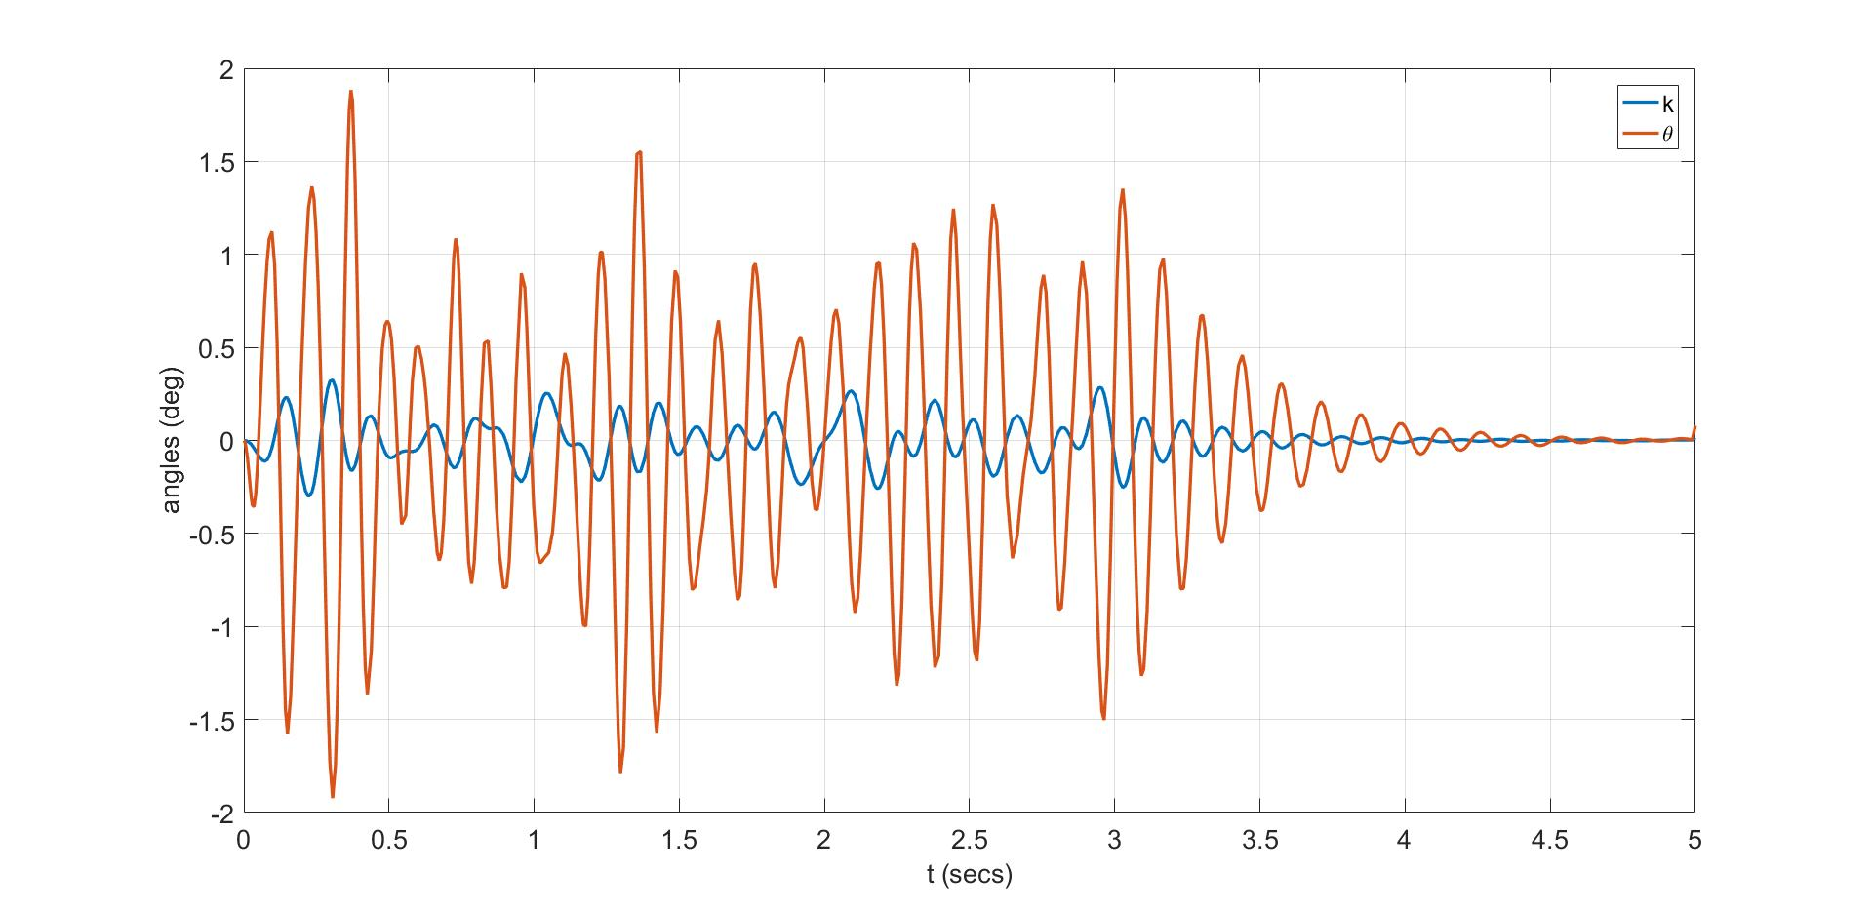
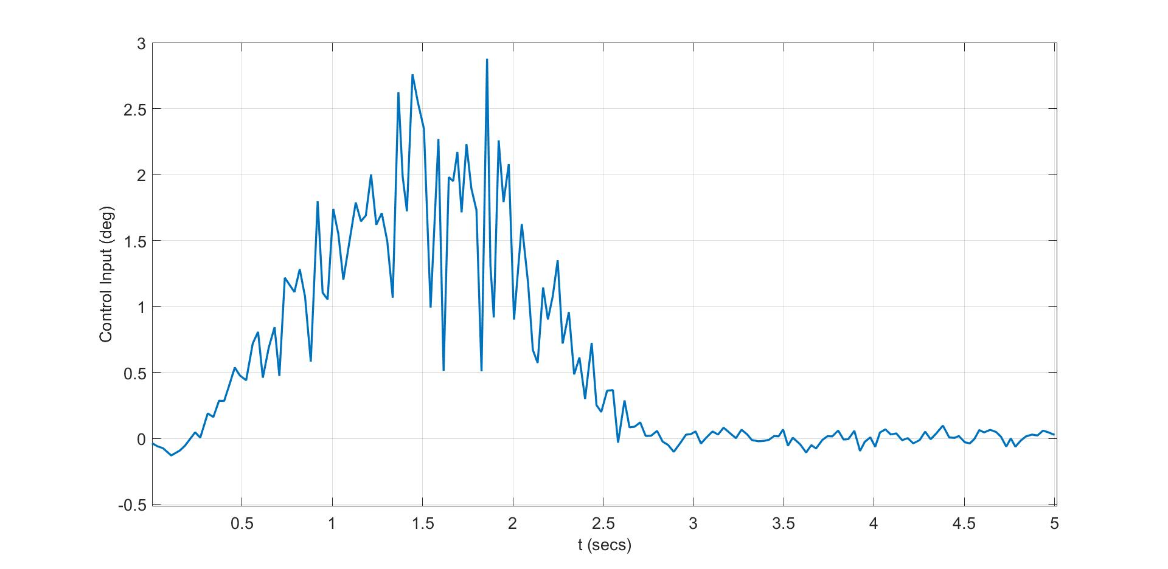
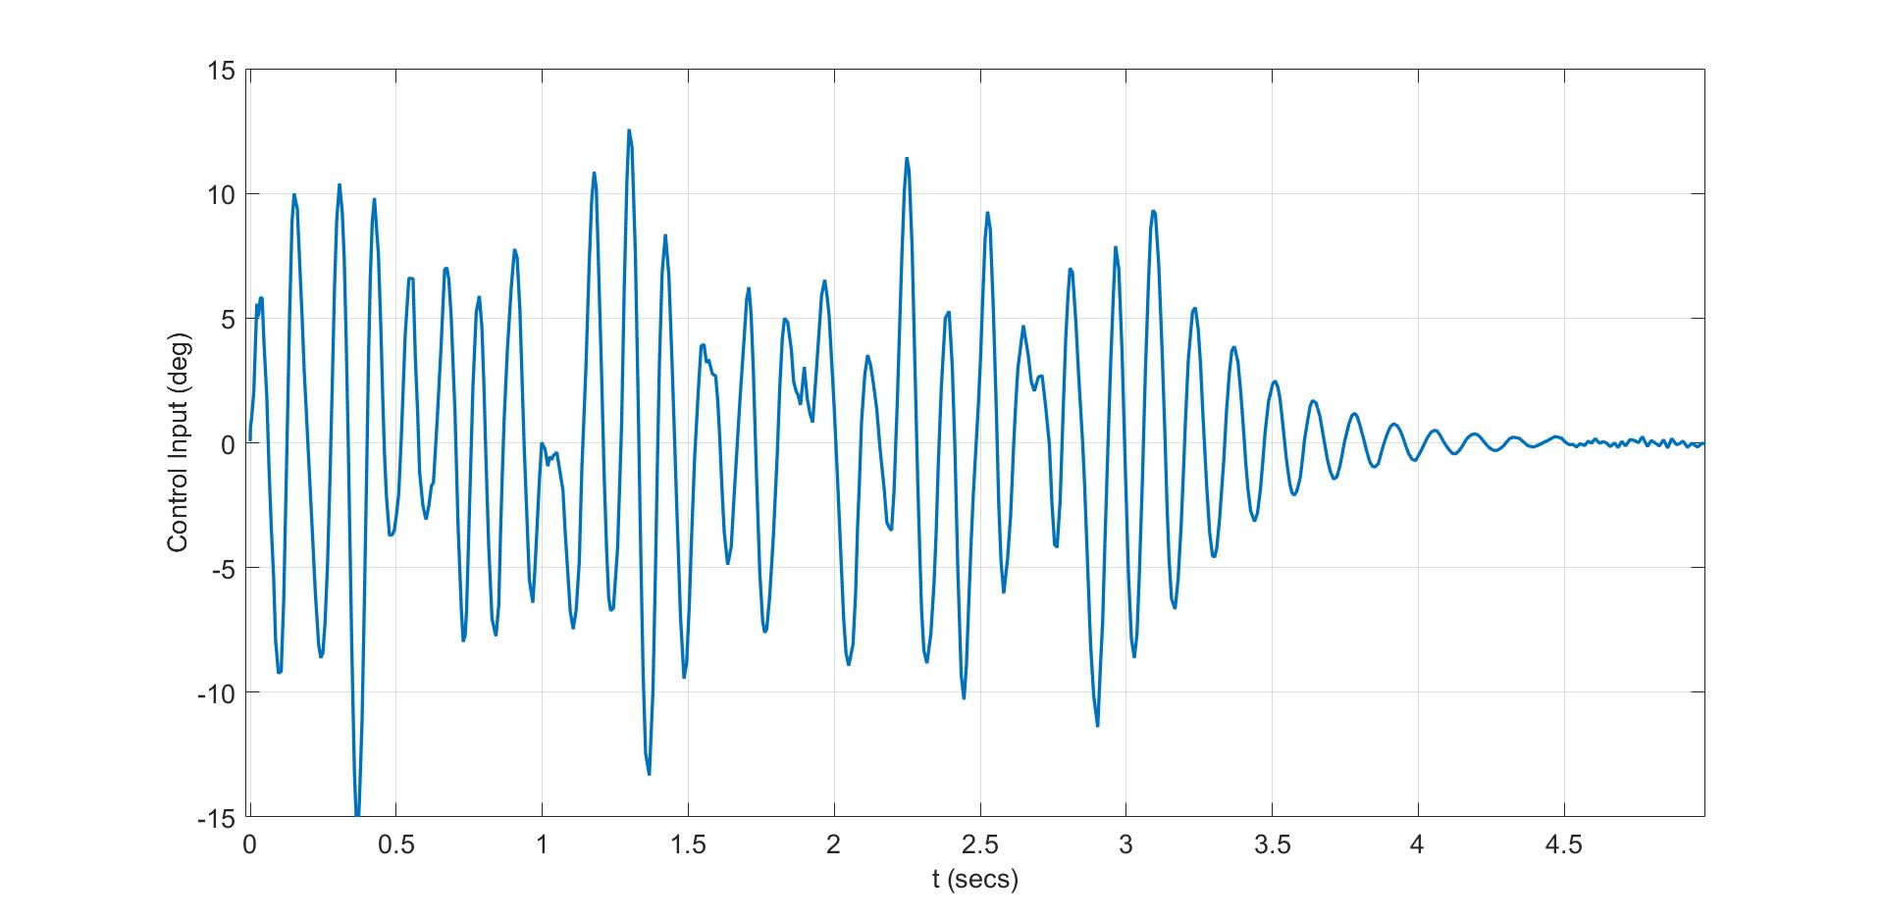
System response – sequential optimization
“1-cosine” gust input
Random turbulence input

Slide 21
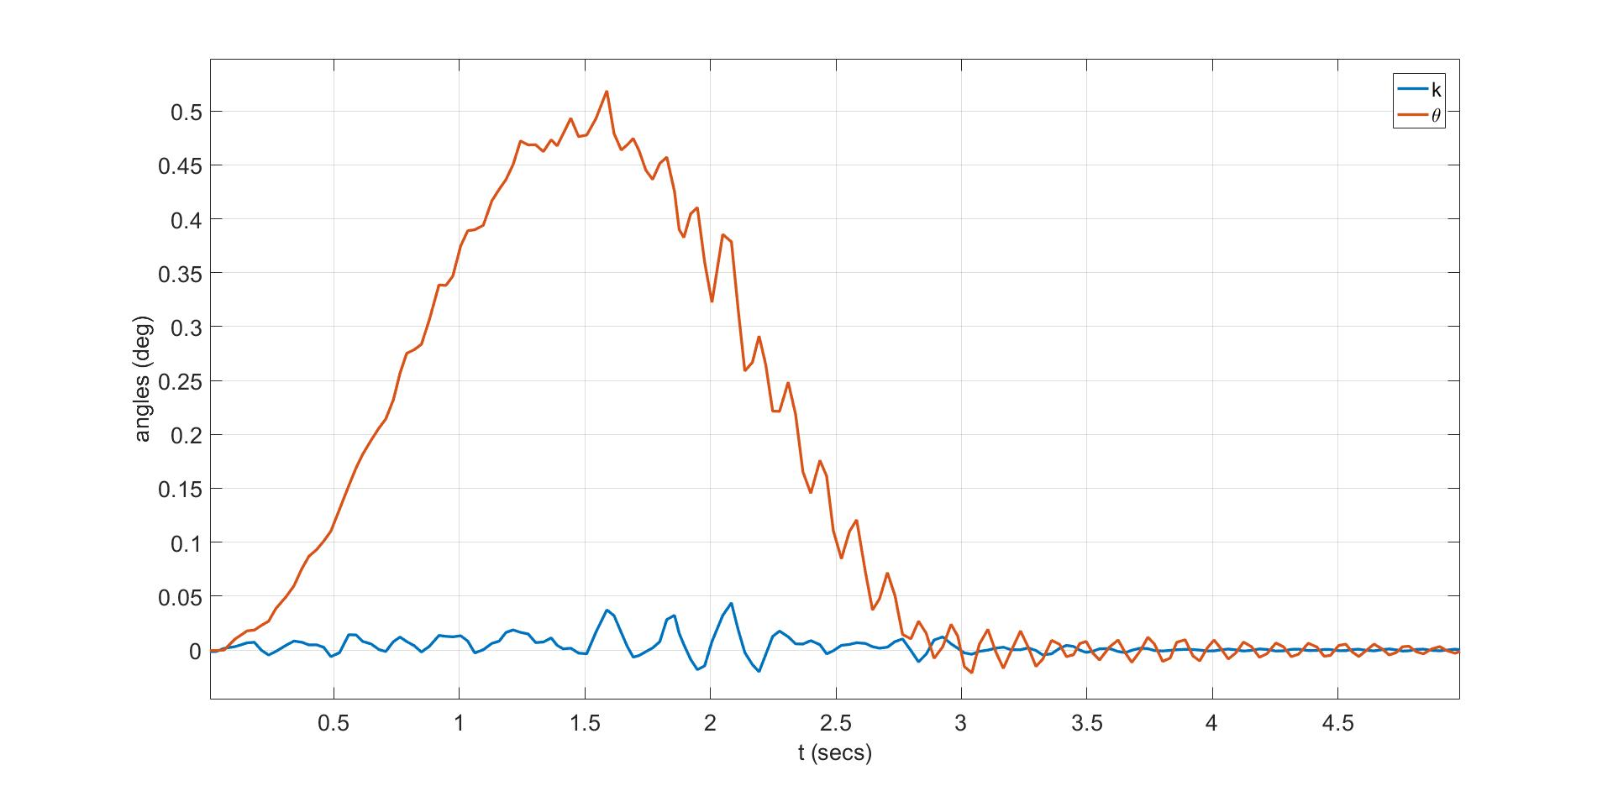
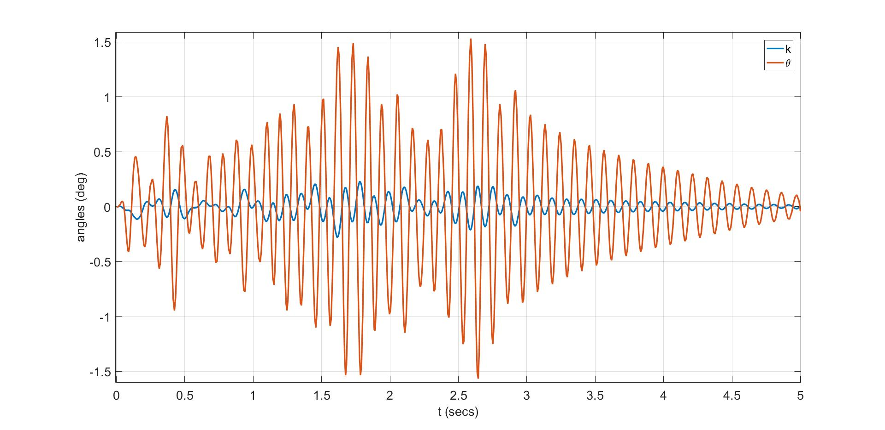
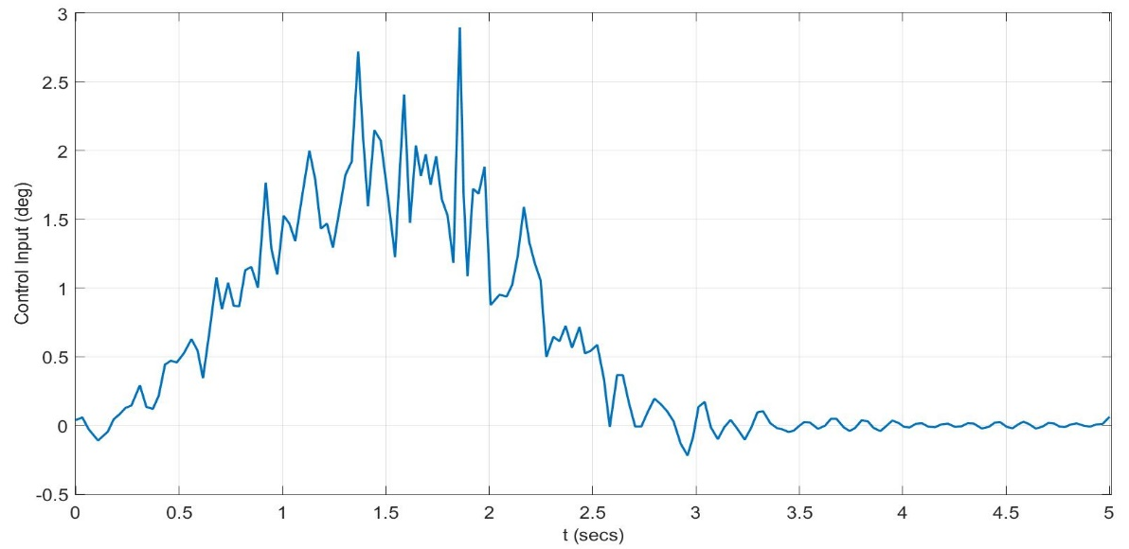
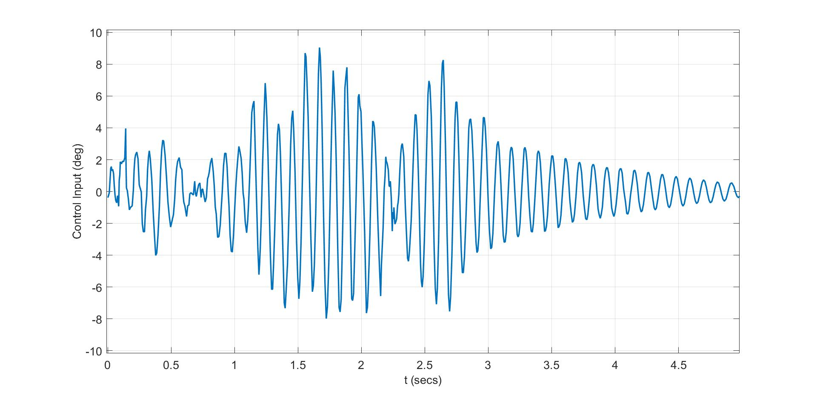
System response - simultaneous optimization
“1-cosine” gust input
Random turbulence input

Slide 22
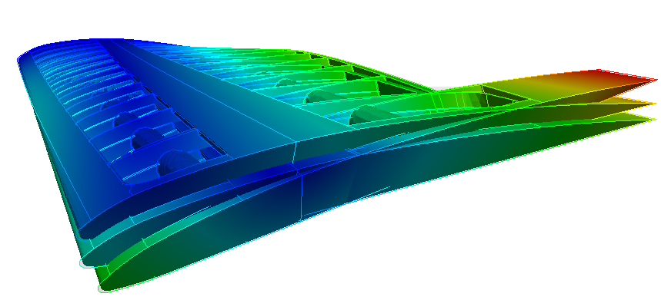
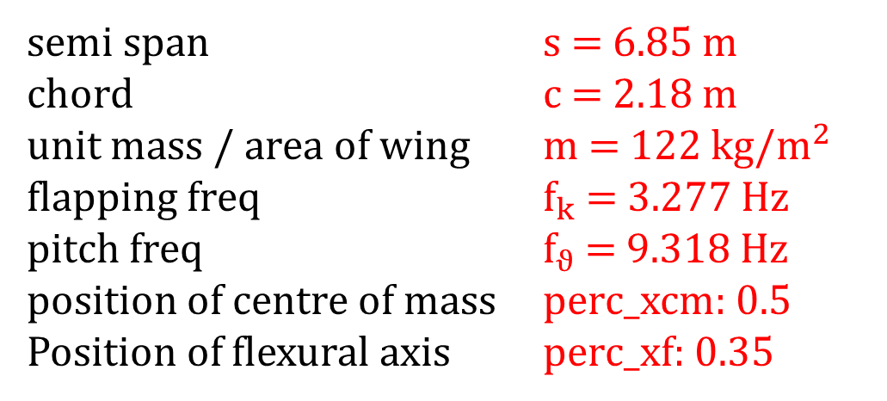
Objective function values
Sequential optimization: J = 16.48
Simulataneous optimization: J = 4.67
Gain: 28,33 %
Design optimal point
semi span s = 6.85 m
chord c = 2.18 m
unit mass / area of wing m = 122 kg/$m^{2}$
flapping freq $f_{k}$ = 3.277 Hz
pitch freq $f_{ϑ}$ = 9.318 Hz
position of centre of mass perc_xcm: 0.5
Position of flexural axis perc_xf: 0.35

Slide 23
References
[1] P. Y. Papalambros, D. J. Wilde, and L. Papke. System design. Principle of optimal design - Modeling and Computation, pp. 355-420, 2017.
[2] L. Martin. High Fidelity Multidisciplinary Design Optimization of Aircraft Configurations. University of Michigan, August 10, 2012.
[3] J. R. Wright, J. E. Cooper. Introduction to Aircraft Aeroelasticity and Loads. 2007.
[4] J. T. Allison, T. Guo, Z. Han. Co-Design of an Active Suspension Using Simultaneous Dynamic Optimization. ASME Journal of Mechanical Design, 136(8), p. 081003, Aug 2014.
[5] J. T. Allison, A. Deshmukh. Integrated Physical and Control System Design for Horizontal Axis Wind Turbines. University of Illinois at Urbana-Champaign.

