Slide 1
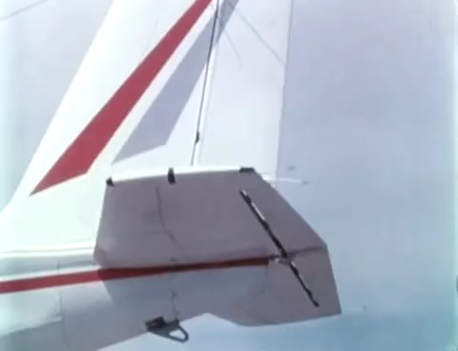

advisors: Prof J.Morlier and PhD E.Duriez student: Francesco Marzagalli
PIR – Project innovation et recherche
Aerostructural optimisation in OpenAeroStruct
with an additional constraint on flutter

Slide 2
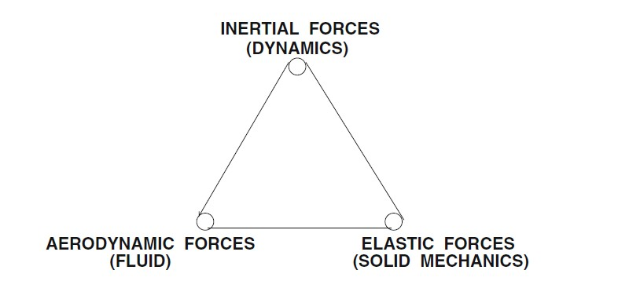

Introduction to Flutter
What is flutter? [1].
Flutter is an aeroelastic phenomenon which leads to dynamic instability
What are the causes? Interactions and couplings between inertia, elasticity, and unsteady aerodynamic forces
What the consequences?
Unstable oscillations that may lead to structural failure
[2].
“The most dramatic physical phenomenon in the field of aeroelasticity is flutter, a
dynamic instability which often leads to catastrophic structural failure” [2]. . This could occur for any structure where aerodynamics plays an important role, as witnessed by Tokaoma bridge in 1940
[1]. https://github.com/mid2SUPAERO/Outputs/blob/master/Flutter_ISAE_7_2019.pdf
[2]. Earl H. Dowell - A Modern Course in Aeroelasticity – Spring

Slide 3
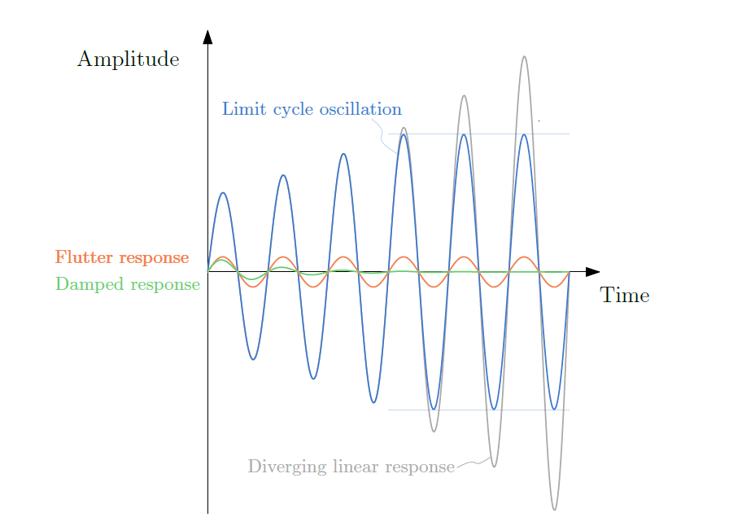
The flight condition in which the system damping vanishes, resulting in this self-sustained oscillation, represents the flutter point [3]. This is illustrated in the following pictures, where we can see the undumped increasing oscillations:
As It is an undesirable phenomenon, flutter must be avoided. Its computations are typically performed only after an initial detailed design of the aircraft is completed, because they require the vehicle stiffness, mass, and aerodynamic models to be available [3]. . Hence, here it comes the importance of optimizing the design adding a constraint on flutter, in this way performance can be improved and post – project costs can be avoided.
[3]. Flutter and Post-Flutter Constraints in Aircraft Design Optimization - Eirikur Jonsson, Cristina Riso, Christopher A. Lupp, Carlos E. S. Cesnik, Joaquim R. R. A. Martins, and Bogdan I. Epureanu

Slide 4
Work Enviroment
Multi-disciplinary design optimization (MDO) is a field of engineering that uses optimization methods to solve design problems incorporating a number of disciplines. It is also known as multidisciplinary system design optimization (MSDO) [4]. In this case study the discipline of interest are Aerodynamics and Structures
OpenAeroStruct [5] is a lightweight Python tool that performs aerostructural optimization of lifting surfaces using OpenMDAO [6]. It uses a vortex lattice method (VLM) for the aerodynamics analysis and a spatial beam model with 6-DOF per element for the structural analysis.
OpenAeroStruct performs a multidisciplinary analysis (MDA) between aerodynamics and structure, the purpose is minimizing a given function, (as CD, total weight or fuel burn) choosing the value of the design variables (as the angle of attack, the twist, or the thickness of the panels), respecting some given constraint.
Available constraints on OAS are represented by a structural failure criterion (i.e. Von Mises) and aerodynamics criterions (ie fixed CL, or L=W)
[4]. https://en.wikipedia.org/wiki/Multidisciplinary_design_optimization
[5]. http://github.com/mdolab/OpenAeroStruct
[6]. http://openmdao.org

Slide 5
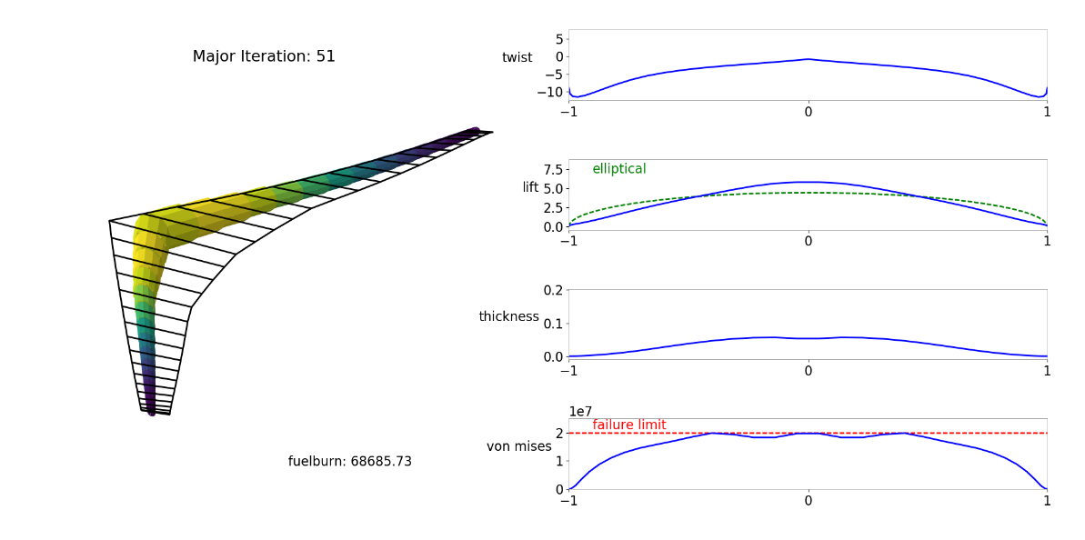
Once the optimization is finished it is possible to access all the data of the optimized aircraft and to visualize them as follows:
[5].
What is missing?
Since Flutter is a dangerous issue for aircraft stability and safety, the path I will follow is trying to add to OpenAeroStruct a new constraint that ensures the absence of flutter in the considered flight conditions.

Slide 6
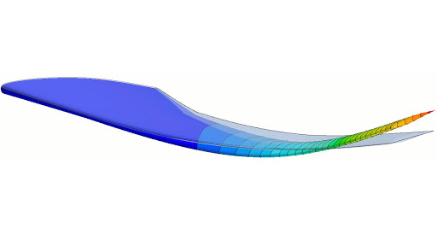
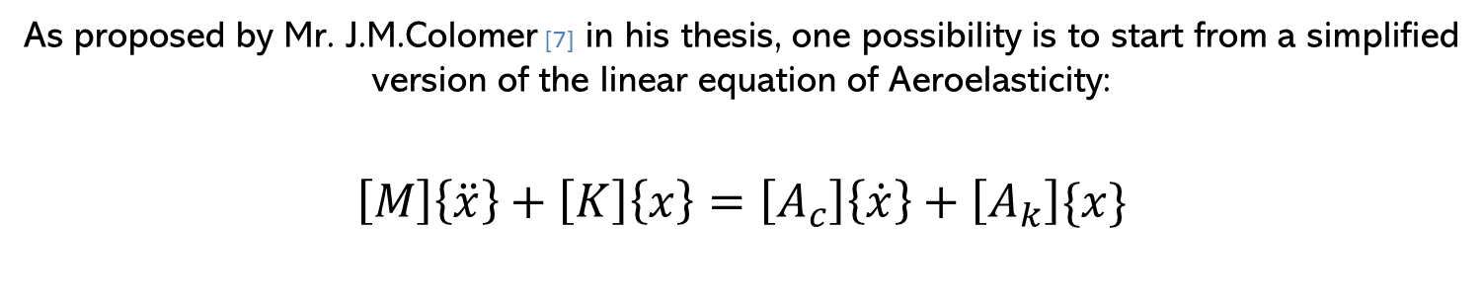
As proposed by Mr. J.M.Colomer [7] in his thesis, one possibility is to start from a simplified version of the linear equation of Aeroelasticity: $$\left[M\right]\left\{\ddot{x}\right\}+\left[K\right]\left\{x\right\}=\left[A_{c}\right]\left\{\dot{x}\right\}+\left[A_{k}\right]\{x\}$$
Where inertial and elastic forces on the left are equal on the aerodynamics one on the right. Supposing the solution to be harmonic and considering an artificial damping it has is possible to write the equation in a simpler way.
[7]. Similitude Aéroélastique d’un démonstrateur en vol via l’optimisation Multidisciplinaire – Joan Mas Colomer

Slide 7
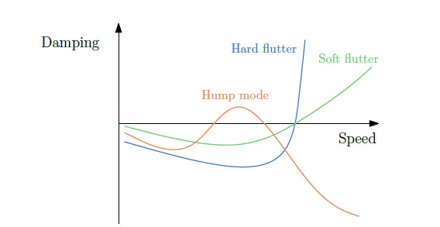
The solution is then seeked for when the damping is zero becasue this is the flutter point. Passing throught the modal basis and solving a complex eigenvaule problem the flutter modes can be calculated, and the relation between the damping and the speed can be found. The picture gives insights into this solution [8].
Once this velocity is known it can be used as constraint in the optimization problem!
[8]. Flutter and Post-Flutter Constraints in Aircraft Design Optimization - Eirikur Jonsson, Cristina Riso, Christopher A. Lupp, Carlos E. S. Cesnik, Joaquim R. R. A. Martins, and Bogdan I. Epureanu

Slide 8
What will follow?
The work of the next months will be:
Trying to model the flutter equation in a simple way
Adding this modelisation in OpenAeroStruct
Including flutter as constraint in the optimization process throught OpenMDAO
Obtaining the outputs values from the optimization and commenting them

Slide 9
Francesco Marzagalli
Thank for your precious attention!

