Slide 1
Learning Aerodynamics Through Data to Improve Optimization Algorithms
PIR defense by
Mario Leupolt*
Tutor: Prof. Joseph Morlier°
24/05/2021
*mario.leupolt@student.isae-supaero.fr
°joseph.morlier@isae-supaero.fr

Slide 2
Content
Introduction
Background
Methodology
Results
Conclusion

Slide 3
Introduction
airfoil geometry crucial part of design process
obtaining of aerodynamic coefficients:
windtunnel
simulations
expensive and time consuming
neural networks
existing database:
two surrogate models already built
that use this database
GOAL
Develop neural networks to predict aerodynamic coefficients as precisely as possible
WHY?
improve optimization algorithms
Scalar and graph predictions
[1] A. I. J. Forrester, A. Sobester, and A. J. Keane. „Engineering design via surrogate modelling“. Wiley, 2008.
[2] D. P. Raymer. “Aircraft design: A conceptual approach”. AIAA, 1992
[3] Bouhlel, M. A., He, S., and Martins, J. R. R. A., “mSANN Model Benchmarks,” Mendeley Data, 2019. https://doi.org/10. 17632/ngpd634smf.1.

Slide 4
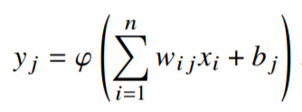
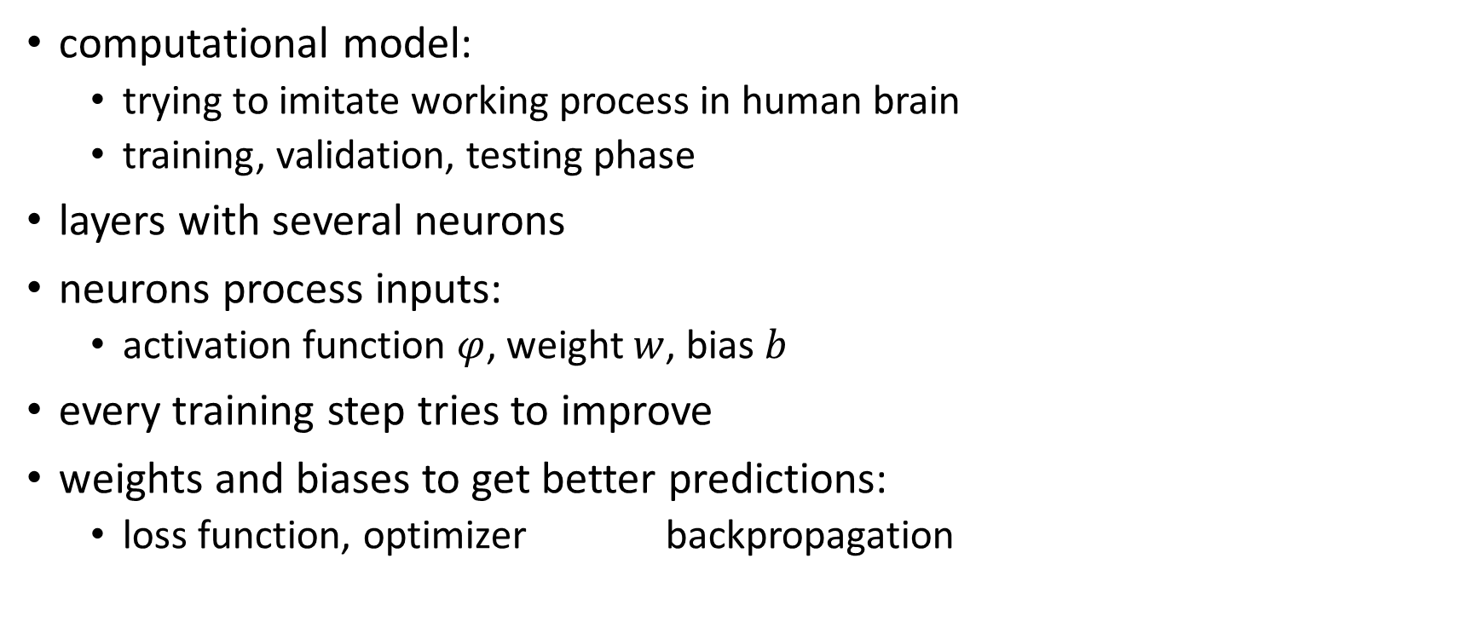
Background – Neural Networks
computational model:
trying to imitate working process in human brain
training, validation, testing phase
layers with several neurons
neurons process inputs:
activation function $φ$, weight $w$, bias $b$
every training step tries to improve
weights and biases to get better predictions:
loss function, optimizer backpropagation
Input Layer
Hidden Layer
Output Layer
[simple architecture of a neural network]
[1] Michelucci, U., “Applied Deep Learning,” Springer Science, 2018.

Slide 5
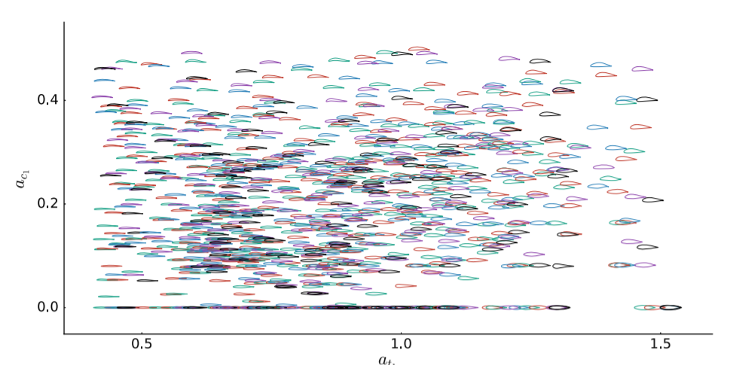
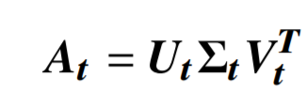
Background - Parameterisation
input in neural networks: camber and thickness mode shapes
from thickness and camber lines of 1172 airfoils from UIUC database:
Singular Value
Decomposition (SVD)
[distribution of UIUC airfoils on the base of first camber and thickness mode shape]
[1]
[1] J. Li, M. Amine Bouhlel, and J. R. R. A. Martins. Data-based approach for fast airfoil analysis and optimization. AIAA Journal, February 2019

Slide 6
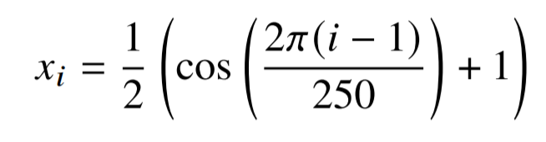
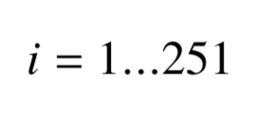
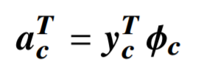
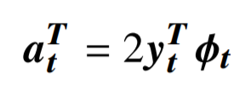
Background - Parameterisation
How to obtain mode shapes out of a random airfoil geometry?
Interpolation with cubic B-Spline
Uniform distribution scheme of coordinate points
Calculation of camber and thickness line
matrix multiplication from camber and thickness modes with camber and thickness lines

Slide 7
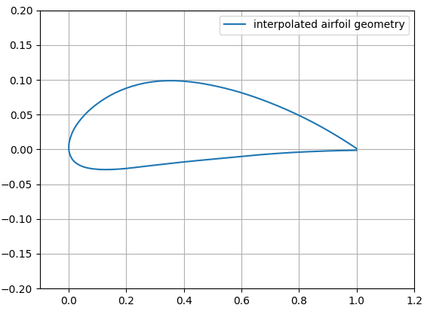
Background - Parameterisation
How to obtain mode shapes out of a random airfoil geometry?
Interpolation with cubic B-Spline
Uniform distribution scheme of coordinate points
Calculation of camber and thickness line
matrix multiplication from camber and thickness modes with camber and thickness lines

Slide 8
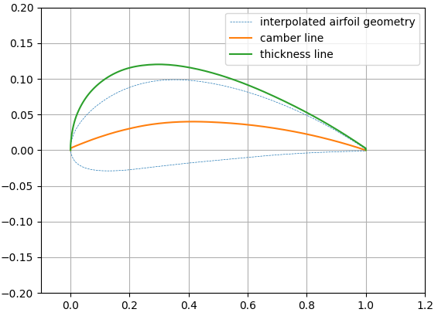
Background - Parameterisation
How to obtain mode shapes out of a random airfoil geometry?
Interpolation with cubic B-Spline
Uniform distribution scheme of coordinate points
Calculation of camber and thickness line
matrix multiplication from camber and thickness modes with camber and thickness lines

Slide 9
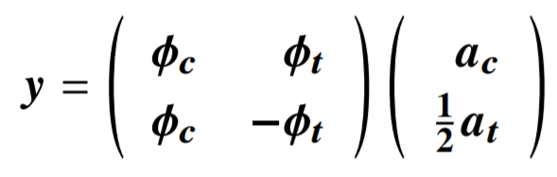
Background - Parameterisation
How to get back from the mode shapes to the airfoil geometry?
matrix multiplication from camber and thickness mode shapes with mode matrix

Slide 10
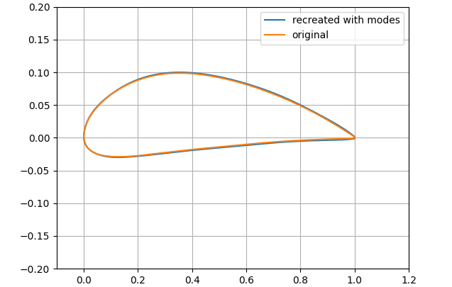
Background - Parameterisation
How to get back from the mode shapes to the airfoil geometry?
matrix multiplication from camber and thickness mode shapes with mode matrix

Slide 11

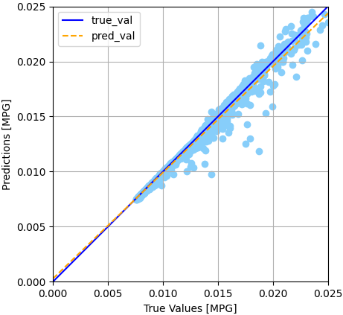
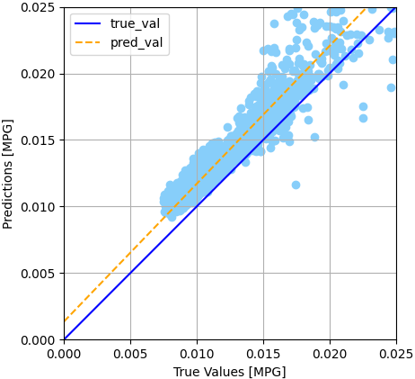
Methodology -
[2]
deep learning API that uses the platform tensorflow
determination if separate models or one model for all coefficients:
Networks with simple architecture
CONCLUSION:
separate models
improvement of architecture
[prediction quality Cd single]
[prediction quality Cd all]
[1] Keras documentary. Online accessed on 05/05/2021. https://keras.io/about/.
[2] Keras logo. Online accessed on 07/05/202. https://keras.io/

Slide 12
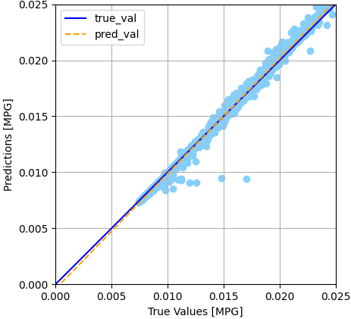
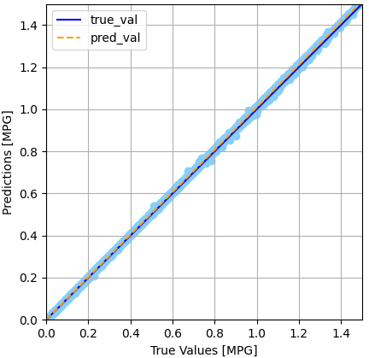
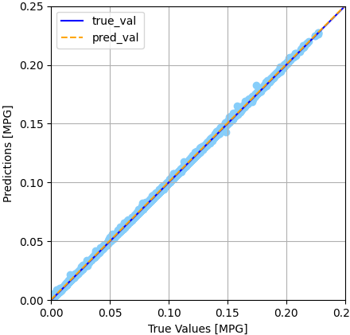
Methodology -
two approaches with k-cross validation:
architecture from paper as base for hyperparameter study
Long-Short Term Memory (LSTM) layers
hyperparameter study brought best results base for final architecture
[prediction quality Cd]
[prediction quality Cl]
[prediction quality Cm]
[1] Hochreiter, S., and Schmidhuber, J., “Long Short-Term Memory,” Neural Computation, 1997.
[2] Refaeilzadeh, P., Tang, L., and Liu, H., “Cross-Validation,” Springer US, 2009.

Slide 13
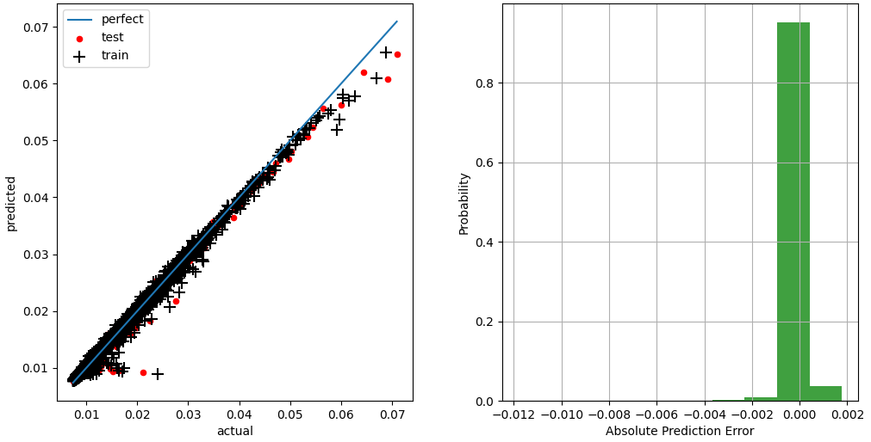
Methodology - SMT
SMT – collection of surrogate modelling, sampling and benchmark functions
emphasises the use of gradient
information
Construction of separate GENN*:
multilayer perceptron
incorporate gradient information
during training phase
[prediction quality Cd]
[distribution of absolute error Cd]
[1] M. A. Bouhlel, J. T. Hwang, N. Bartoli, R. Lafage, J. Morlier, and J. R. R. A. Martins. A python surrogate modeling framework with derivatives. page 102662, 2019
*Gradient Enhanced Neural Network

Slide 14

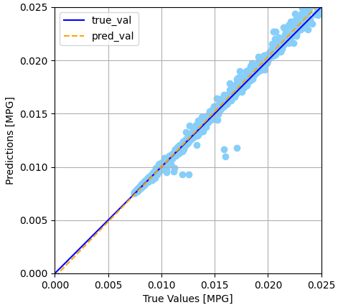
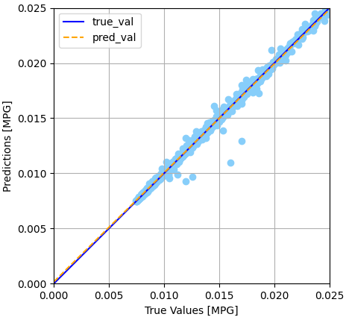
Methodology –
[2]
online platform: predictions and solving optimization problems
network for all coefficients and separate networks for each coefficient
first optimization of an airfoil using the mode shapes
ASSUMPTION:
separate models will deliver better predictions
[prediction quality Cd all]
[prediction quality Cd single]
[1] Monolith. Online accessed on 05/05/2021. https://www.monolithai.com/industry/reduce-testing.
[2] Monolith logo. online accessed on 07/05/2021. https://www.monolithai.com/

Slide 15
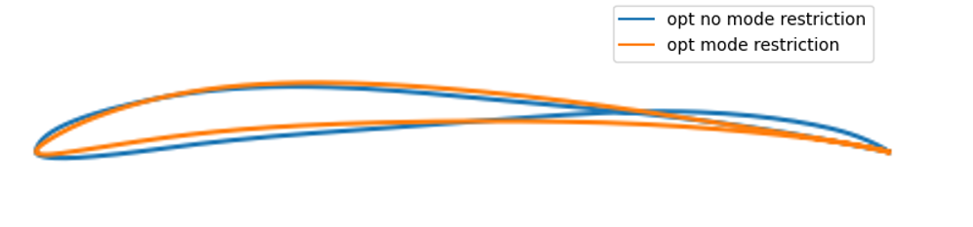
Results – Optimization Monolith AI
optimization with and without mode shape bounds:
target: best lift to drag ratio at a certain Mach number and angle of attack
[optimization results]
CONCLUSION:
no bounds: unrealistic airfoil shape
bounds: more realistic; still sharp trailing edge
FUTURE WORK:
Define optimal mode shape bounds for optimization

Slide 16
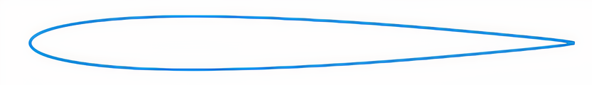
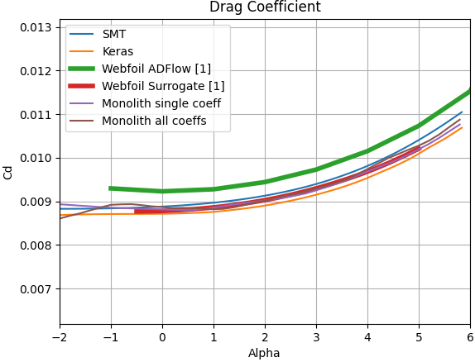
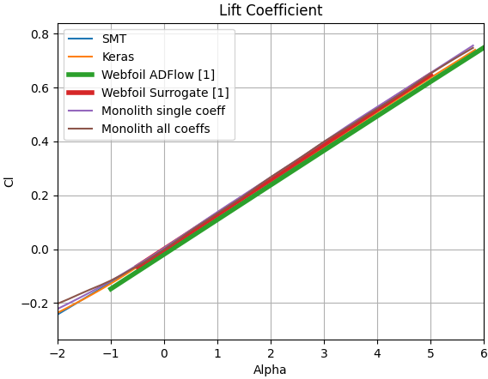
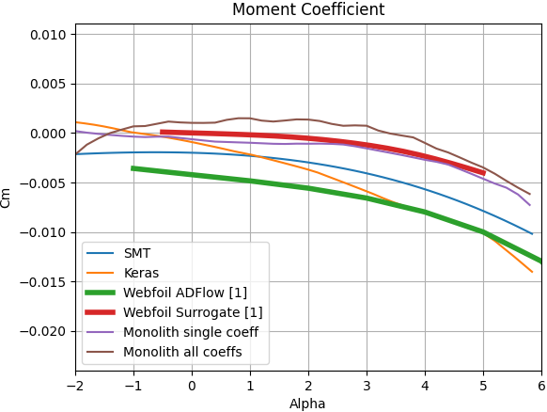
Results - Models
prediction of the aerodynamic coefficients at Ma = 0.5 over alpha
comparison to the results from Webfoils surrogate model and ADFlow results (calculated coefficients for database) ^{[1]}
NACA0012
[1] University of Michigan, “Webfoil,” 2021. URL http://webfoil.engin.umich.edu/, online accessed on 16/06/2021.

Slide 17
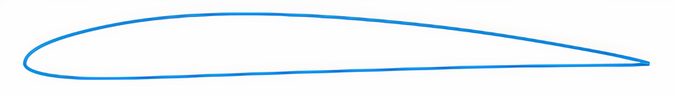
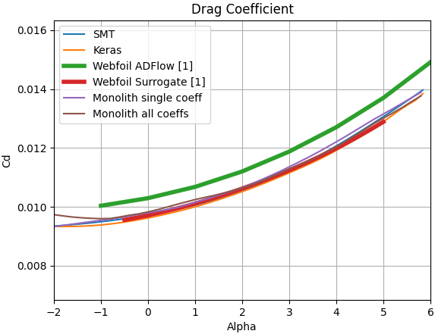
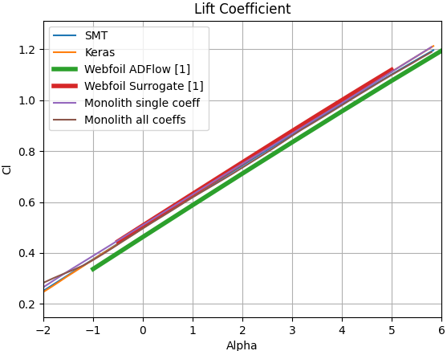
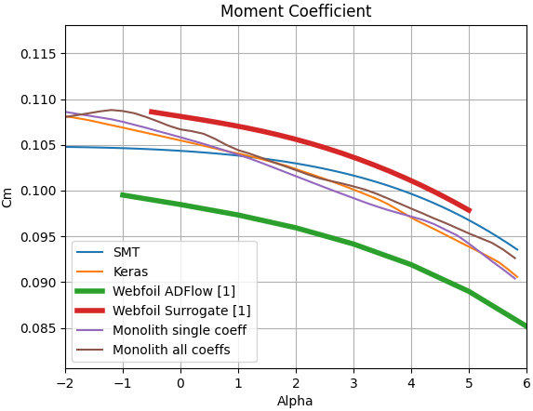
Results - Models
prediction of the aerodynamic coefficients at Ma = 0.5 over alpha
comparison to the results from Webfoils surrogate model and ADFlow results (calculated coefficients for database) ^{[1]}
NACA4412
[1] University of Michigan, “Webfoil,” 2021. URL http://webfoil.engin.umich.edu/, online accessed on 16/06/2021.

Slide 18
Conclusion
mode shape bounds must be applied
SMT delivers best predictions incorporate in optimization algorithms
FUTURE WORK:
define optimal mode shape bounds for optimization
improve the SMT models
incorporate the predictions from the SMT models in optimization algorithms

Slide 19
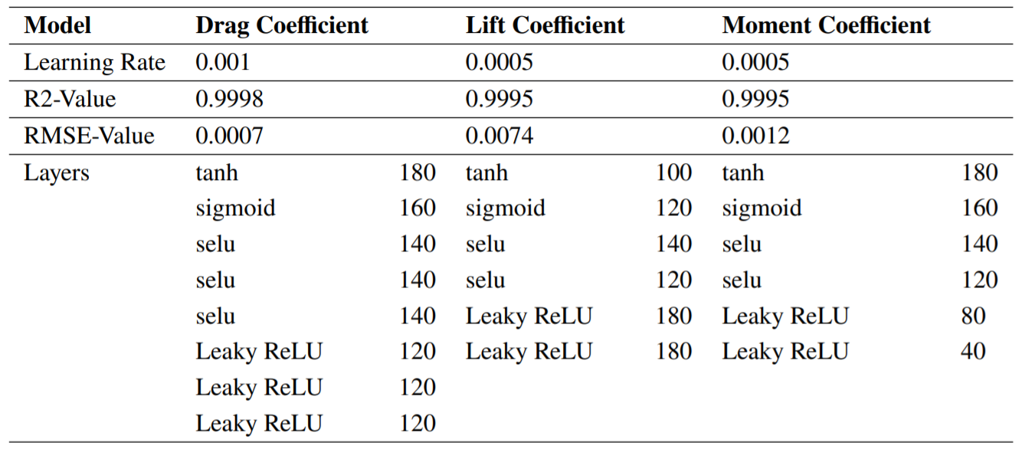
Appendix
final architecture for the models in Keras

