Slide 1



Model Reduction in Aeroelasticity for Preliminary Design
Oriol CHANDRE VILA
Supervisors:
Joseph MORLIER (ISAE SUPAERO)
Sylvain DUBREUIL (ONERA)
March 13th, 2019
Notes:
Good morning to everybody. I’m Oriol Chandre and I’m presenting my Research Project. My supervisors are Joseph Morlier from ISAE SUPAERO and Sylvain Dubreuil from ONERA.
PLAY the idea is to use Model Reduction Techniques in a Preliminary phase, being able to evaluate different configurations in real time in the field of Aeroelasticity.

Slide 2
Aim and Goals
AIM:
To study the use of Reduced Order Models (hereafter ROM) in order to lighten the computational requirement in fluid-structure problems simulations.
GOALS:
To create a tool for exploring the design domain in real time for Preliminary Aircraft Design.
To apply ROM strategies to the actual solvers.
Model Reduction in Aeroelasticity for a Preliminary Design | Oriol CHANDRE VILA
Notes:
So : why doing this project? The idea is to lighten the computational requirements in Aeroelasticity in order to achieve faster solutions. Aeroelasticity is a field that couples inertial, elastic, and aerodynamic forces.
Obviously in the industry there are already solvers used in a Preliminary Stage that involves a reduced problem, but we are interested in new approaches in order to do this exploration of the domain in real-time.

Slide 3
Overview of the Project
February 2018
June 2018
September 2018
March 2019
PIR
PIE
Reduced Order Modeling For Real Time Aeroelastic Simulation
Study of differents methodologies.
Selection of one methodology.
GitHub
Internship in ONERA
Application of the selected approach to a fluid-structure interaction code.
GitHub
Model Reduction in Aeroelasticity for Preliminary Design
Improvement on the ONERA internship’s code.
Application to OpenAeroStruct (v2).
Model Reduction in Aeroelasticity for a Preliminary Design | Oriol CHANDRE VILA
Notes:
First of all, let me just focus you. This presentation is part of a Parcours Recherche in Aeroelasticity that I have been doing for the last year.
It has been divided in 3 parts:
First of all, I studied differents Reduced Models Techniques within the framework of the PIR.
Then, I did an internship in ONERA this summer where I applied the selected methodology to a fluid-structure code.
Finally, this 3rd part which focuses on the improvement of the code produced during the summer and (if possible) introducing to a more industrial code.

Slide 4
Table of Contents
Methodology
ROM
POD
Offline Phase Algorithm
Online Phase Algorithm
Kriging
Application to the Static Aeroelasticity
Applied Solution
Definition of the Problem
Results
Conclusions
Future Steps
Model Reduction in Aeroelasticity for a Preliminary Design | Oriol CHANDRE VILA
Notes:
So, the presentation is organized as follows:
we’ll treat the methodology
followed by the application to Static Aeroelasticity
and some conclusions of the process.
Finally, I have itemized the future steps for this project.

Slide 5
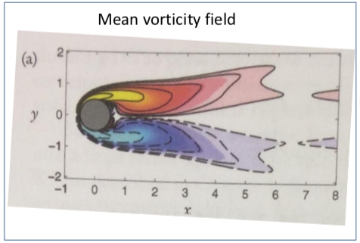
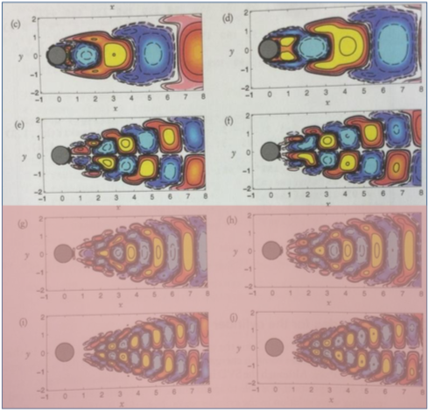
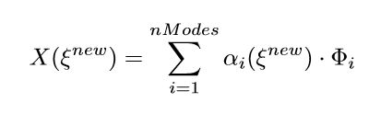
| Methodology | Application to Static Aeroelasticity | Conclusions | Future Steps |
Methodology: ROM
Reduced Order Methods (ROM) in a nutshell
[Rozza, SISSA, 2017]
M(ξ) ⋅ X(ξ) = f(ξ)
Offline: very expensive preprocessing.
( )^{N}: “truth” high order method - to be accelerated
Online: extremely fast real-time input-output evaluation thanks to an efficient assembly of problem operators.
( )_{N}: ROM - the accelerator
[Kutz et al., SIAM, 2016]
Model Reduction in Aeroelasticity for a Preliminary Design | Oriol CHANDRE VILA
Notes:
So what are the Reduced Order Methods? First of all, we can say that a complex solution could be expressed in a composition of different modes. The idea of the Reduced Methods is to reproduced an approximate solution by taking into account just the most important modes. This ROM techniques can be also seen as an accelerator.
This strategy proposes two stages: an offline phase where a very expensive model is calculated, but only once. And an online phase, where a reduced and approximate solution is compute in almost real-time.
The idea is to do an addition of all the information inside \alpha_i for each mode \Phi_i.
Through several strategies studied during the last year, we adopted the Proper Orthogonal Decomposition.

Slide 6
| Methodology | Application to Static Aeroelasticity | Conclusions | Future Steps |
Methodology: POD
Principal Component Analysis (PCA)
SVD in Algebra
POD in Mechanical Engineering
[Kutz, Chpt 15, Oxford University Press, 2013]
Orthogonal Transformation
Observation
Singular Values
Linear parametric problem:
M(ξ) ⋅ X(ξ) = f(ξ)
Observation matrix:
O = X(ξ⁽¹⁾) ……. X(ξ^{(nObs)})
O = L · ∑· R^{T}
L = [...,k]
∑ = [k, k]
R = [k,...]
O_{r} = L · ∑· R^{T}
k: # Reduction modes
Model Reduction in Aeroelasticity for a Preliminary Design | Oriol CHANDRE VILA
Notes:
Well, the POD receives differents names such as Principal Component Analysis or Singular Values Decomposition.
The idea behind is the following:
If we have a linear parametric problem Mx=f, where \Xi is a known parameter.
We can save for different values of \Xi the solution of the problem in a matrix O.
This matrix is called Observation Matrix.
Then, by an orthogonal transformation, we can decomposed the matrix in three:
L: Left Singular vectors of O
\Sigma: Singular values of O
R: Right Singular vectors of O
In order to compute the reduced matrix, we are just taking into account till the “k” ordre.
In our problem we are interested for the matrix L (Left Singular Vectors), and we can calculated it by different methods. We have selected the Greedy Algorithm.

Slide 7

| Methodology | Application to Static Aeroelasticity | Conclusions | Future Steps |
Methodology: Offline Phase Algo
Select randomly a first sample: ξ⁽¹⁾
Solve the problem: X(ξ⁽¹⁾)
Build the Reduced Base (RB): L
for i = 2, … , k
for j = 1, … , nCandidates
Evaluate the candidate and ξ^{(i)}=argmax ‖ r(ξ^{(j)}) ‖
Solve the problem: X(ξ^{(i)})
Rebuild L on the samples {X(ξ⁽¹⁾),X(ξ⁽²⁾), … ,X(ξ^{(i)})}
Problem: M(ξ) ⋅ X(ξ) = f(ξ)
Construction of the L by Greedy Algorithm
[Amsallem, International Journal for Numerical Methods in Engineering, 2014]
ξ_{y}
ξ_{x}
O
Model Reduction in Aeroelasticity for a Preliminary Design | Oriol CHANDRE VILA
Notes:
The idea of this algorithm is to find the worst point at each iteration, to compute the real problem at that point and to add the real solution to the base.
For illustrating the algorithm, I use this graph. \Xi_X and \Xi_Y are two components of the sample \Xi.
So we first select a random point (the pink one), we solve the problem and we perform the SVD process to built L.
Then, the iterative process begins: within all the points we search where the residu is maximum, we solve the problem at that point (imagine the red cross) and we add the solution to the reduced base by performing the SVD to the samples, so to the matrix O.
At the moment that we add the real solution, the error there should be 0; so one a point is added to the Greedy it will not be used again (the grey cross)

Slide 8

| Methodology | Application to Static Aeroelasticity | Conclusions | Future Steps |
Methodology: Online Phase Algo
[Kutz, Chpt 15, Oxford University Press, 2013]
Φ ? ≡ L
How can we compute…
Reduction Problem Resolution
Interpolating the coefficient at the points {ξ⁽¹⁾,ξ⁽²⁾, … ,ξ^{(i)}}
Model Reduction in Aeroelasticity for a Preliminary Design | Oriol CHANDRE VILA
Notes:
Once the reduced base is created, we should wonder how can we implement the Online Phase Algo. From the bibliography, we know that the problem can be expressed as it is shown in the first equation.
Here, a first question emerges: what is X(\Xi new)? It is the approximate solution for a new sample \Xi and it can be constructed as it shown in the second equation (which is the same as presented in the slide 5).
But…from all these symbols, what is is \Phi? It is basically the matrix of modes SO singular vectors SO it is the Reduced Base L calculated with the Greedy Algorithm!
Finally, how can we compute the coefficients \alpha_i ? Here, we should consider two options.
The first one, to use a reduction problem resolution but we should modify all the code.
The second one, to interpolate the coefficients for all the points.
This last option is the one that we have chosen.

Slide 9
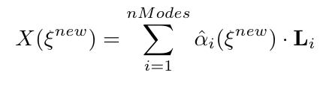
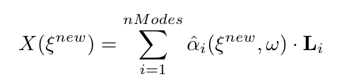
| Methodology | Application to Static Aeroelasticity | Conclusions | Future Steps |
Methodology: Kriging
[Rasmussen et al., the MIT Press, 2006]
[Matheron, Masson, 1965]
Substitution Models
Linear Regression
Interpolating Models
Kriging Models
Model Reduction in Aeroelasticity for a Preliminary Design | Oriol CHANDRE VILA
Notes:
One possibility is to use the so-called Substitution Models. There are two big families:
The Linear regression: but since we are searching the real point, we rejected this solution.
Interpolation Models: since it is an interpolation, we add the hat to notation. And the method selected is the Kriging. Largely used in Aerospace Eng, it uses a Gaussian formulation that allows us to model the values by the mean value and prior variance. Finally, it is really important to notice that at the moment we can estimate the variance of a solution, we know the error of interpolation. Since \alpha_i is a Gaussian Vector, X(\Xi_new) it is so too.

Slide 10
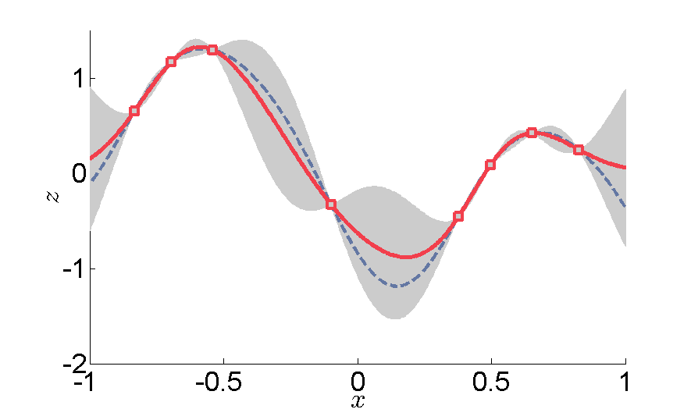
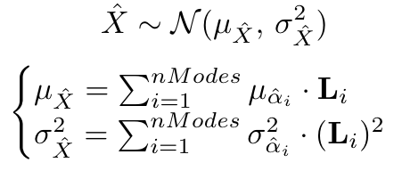
| Methodology | Application to Static Aeroelasticity | Conclusions | Future Steps |
Methodology: Kriging
[Wahba et al., SIAM, 1990]
Model Reduction in Aeroelasticity for a Preliminary Design | Oriol CHANDRE VILA
Notes:
The Kriging Models can be seen as the following graph. The red line drives for the Kriging Interpolation while the dashed blue line drives for the real solution. The dark zone symbolizes the variance of the solution. So, it means the error of interpolation.
This Interpolated Value can be expressed (as mentioned) as a Gaussian Vector of the mean value \mu and the variance \sigma2. Then for the global mean value, we do the addition of all the mean values projected to the corresponding mode. And the same principle for the global variance.

Slide 11
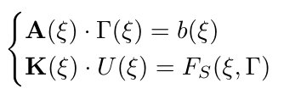
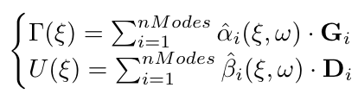
| Methodology | Application to Static Aeroelasticity | Conclusions | Future Steps |
Application to Static Aeroelasticity
So it is possible to estimate the variance
Fixed-point iteration within the Greedy ⇒ We converged it for the Reduced Problem.
Real code → Verified and Validated
VLM
FEM
Model Reduction in Aeroelasticity for a Preliminary Design | Oriol CHANDRE VILA
Notes:
After presenting the methodology for a linear problem Mx=f, now I’m presenting how we apply it to a problem of STATIC Aeroelasticity. Since it is static, we are just mapping the Space (so a coupling in Space it is needed).
Thus, the Preliminary Design methodology is based in two linear parametric problems: the Aerodynamic and the Structure Problem. Again, just let me focus in the fact that it is not an optimization problem (there are no differential codes). The idea is a code for exploring the design space in real time.
The Aerodynamic System is the AIC matrix multiplies the circulation vector, equals to the RHS vector. The Circulation vector follows Gaussian distribution since we will use a Kriging model to interpolate the system.
For the Structures System, the Stiffness matrix multiplies the Displacement vector and they equals to the a force term that depends on the Aerodynamic problem and the point analyzed. The Displacement vector is also a random variable.
For the coupling, we interpolate the mesh for converging the Reduced Problem inside the Greedy Algorithm, so when creating the Reduced Base.
This Reduced Methodology is applied to a code made by my supervisor Sylvain Dubreuil which has been verified and validated by him too.
This code is based in a VLM Horseshoe, so the flow field is considered as incompressible, inviscid and irrotational. Besides, the influence of thickness on aerodynamic forces are neglected.
For the Structural part, a Finite Element Method is used. Specifically a Discrete Kirchoff Triangles for plates method. This method assumes small deformations and small displacements of curved or plane mean structures. They are finite elements plans which do not take into account the geometrical curve of the mean structures. The formulation is thus simplified by it and the reduced number of degrees of freedom.

Slide 12
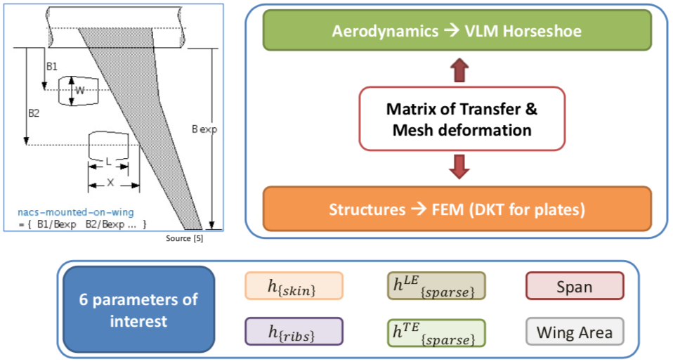
| Methodology | Application to Static Aeroelasticity | Conclusions | Future Steps |
Application to Static Aeroelasticity: Problem
ξ | Min | Max
h_{{skin}} [mm] | 1.45 | 30
h_{{ribs}} [mm] | 1.45 | 15
h_{{sparse}} [mm] | 4.35 | 90
h_{{sparse}} [mm] | 4.35 | 90
Span [m] | 34 | 80
Wing Area [m²] | 122 | 845
^{LE}
^{TE}
Source [8]
Model Reduction in Aeroelasticity for a Preliminary Design | Oriol CHANDRE VILA
Notes:
So, the problem studied is the following. We consider a typical Airbus wing and we are doing the coupling between both disciplines thanks to a Transfer Matrix and the mesh deformation. We have considered 6 parameters of interest and the range of them are presented in the table. I would like to just add a short word to these values: they cover from a A320 wing to a A380 wing.

Slide 13
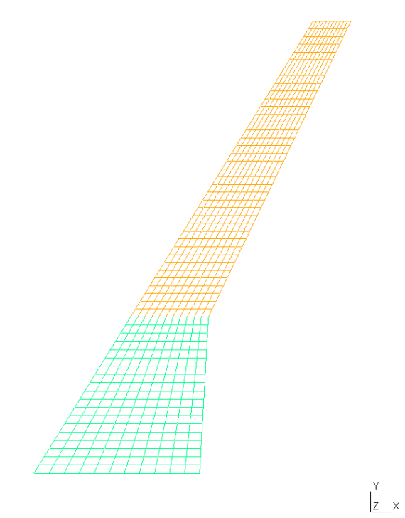
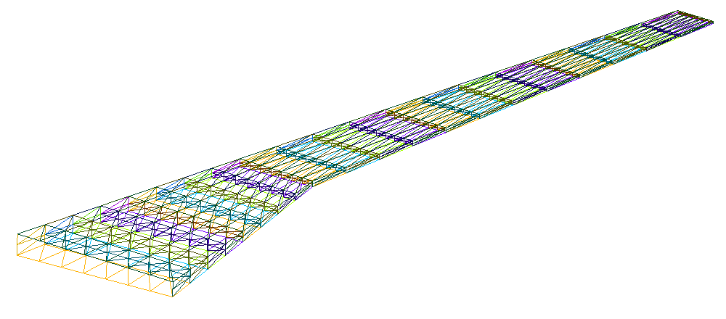
| Methodology | Application to Static Aeroelasticity | Conclusions | Future Steps |
Application to Static Aeroelasticity: Results
VLM mesh
FEM mesh
nSamples = 10 | nCandidates = 50 | nKriging = 150
Aeroelastic code solver ≈ 1min
Offline code ≈ 7h30
Online code ≈ 0.3 s
Model Reduction in Aeroelasticity for a Preliminary Design | Oriol CHANDRE VILA
Notes:
Finally, we can apreciate both meshes and it has been proved that with a hyper expensive calculation, we are able to reduce the time of resolution of the problem from a minute to several seconds. This gain in time for a Preliminary Design can be really appreciated.
Finally, just add that for the results that we will run right now I have computed the Offline code using 10 samples (so the Reduced Base is 10th-order), evaluating 50 candidates and, then, sharpening the Kriging by adding up to 150 points. This has been considered due to the enormous domain.

Slide 14
| Methodology | Application to Static Aeroelasticity | Conclusions | Future Steps |
Conclusions
Two nature of errors:
Reduced Problem.
Interpolation Error.
Parametric study:
nSamples (base dimension) drives the accuracy of the RB. For improving the results, we could...
Use more modes (higher nSamples).
Reduce the domain of the problem.
Implement another method to converge the Reduced Problem inside the Greedy Algorithm.
nCandidates + nKriging: points of interpolation.
Saving in computation time for the real time simulation.
Model Reduction in Aeroelasticity for a Preliminary Design | Oriol CHANDRE VILA
Notes:
To conclude, we can disaggregate two error nature: one due to action of Reduction the Problem (we are not including information that are part of the solution) and another one due to the interpolation method (which thanks to the Kriging Model can be estimated).
To improve the first source of errors, we identify the importance of the number of samples. For improving the results, we could augment the order of the Reduced Problem, we could reduce the problem (which is not really interesting in a Preliminary Stage) or substituting the fixed-point iteration method of the Greedy Algorithm.
To improve the Interpolation Error, we could augment the number of candidates. This added to a higher number of samples will results in more point to the Kriging and more points analyzed while building the Reduced Base. Obviusly, we could also enlarged the number of Kriging points.
Finally, the gain in time, as said, it is clear. And we could imagine a situation that this application could really be useful. If we imagine a room with Aerodynamic and Mechanical Engineers, the solutions and possible discussions could be evaluated in real time, allowing the Preliminary to progress faster.

Slide 15



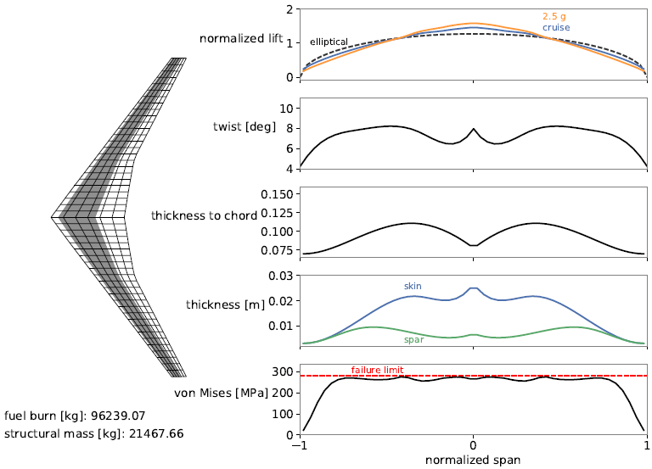
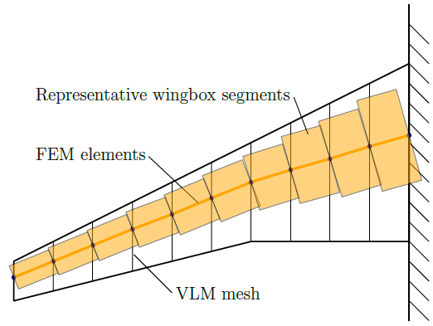
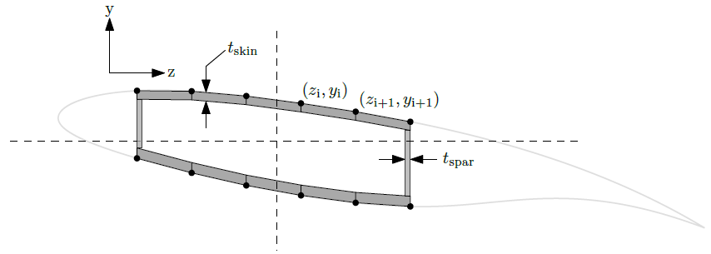
| Methodology | Application to Static Aeroelasticity | Conclusions | Future Steps |
Future Steps
OpenAeroStruct_v2: VLM + Wingbox FEM
→ Optimizer:
Reduced Base using POD+Kriging methodology for 17 parameters:
4 for Aerodynamics
4 for Structures
3 for Fuel Data
6 for Mission Requirements
[Jasa et al., Structural and Multidisciplinary Optimization, 2018]
[Chauhan et al., EngOpt, 2018]
Model Reduction in Aeroelasticity for a Preliminary Design | Oriol CHANDRE VILA
Notes:
The application to a more industrial solver could not be treated finally in this project, but it should be really interesting to perform a study in OpenAeroStruct. Which is an open-source low-fidelity aerostructural analysis and optimization tool made by the University of Michigan. The solver optimizes the design by using the NASA software of OpenMDAO. In this version, a wingbox is introduced and, for a basic case, we could define up to 17 parameters.

Slide 16
References
[1] Kutz, J.N., Brunton, S.L., Brunton, B.W. and Proctor, J.L., "Dynamic Mode Decomposition: Data-Driven Modeling of Complex Systems", 1st ed., SIAM, Philadelphia, 2016.
[2] Rozza, G., Ballarin, F., Mada, Y., “Reduced order methods for parametric Fluid-Structure Interaction problems: applications to haemodynamics”, SISSA International School for Advanced Studies, 2017.
[3] Kutz, J. N., "Data-Driven Modeling & Scientific Computation: Methods for Complex Systems & Big Data", 1st ed., Oxford University Press, Oxford, 2013.
[4] Amsallem, D., “An Adaptive and Efficient Greedy Procedure for the Optimal Training of Parametric Reduced-Order Models”, International Journal for Numerical Methods in Engineering, 2014.
[5] Rasmussen, C.E., Williams, C.K.I., “Gaussian Processes for Machine Learning”, the MIT Press, 2006.
[6] Matheron, G., “Les variables régionalisées et leur estimation: Une application de la théorie des fonctions aléatoires aux sciences de la nature”, Masson, 1965.
[7] Wahba, G., "Spline Models for Observational Data", Society for Industrial and Applied Mathematics (SIAM), 1990.
[8] http://www.dlr.de/ae/en/desktopdefault.aspx/tabid-1596/
[9] Jasa, J.P., Hwang, J.T., Martins J.R.R.A., “Open-Source Coupled Aerostructural Optimization using Python”, Structural and Multidisciplinary Optimization, 2018.
[10] Chauhan, S.S., Martins J.R.R.A., “Low-Fidelity Aerostructural Optimization of Aircraft Wings with a Simplified Wingbox Model Using OpenAeroStruct”, EngOpt 2018 Proceedings of the 6th International Conference on Engineering Optimization, Springer, 2018.
Model Reduction in Aeroelasticity for a Preliminary Design | Oriol CHANDRE VILA

Slide 17
THANK YOU FOR THE ATTENTION

Slide 18
Application to Static Aeroelasticity: Applied Solution
Definition of the Domain.
Build the Reduced Base (RB) G and D with a Greedy Algorithm.
Improve the Kriging functions adding more points with the updated RB.
for i = 1, … , (nKriging - nSamples)
while error > 5%
[G⁻¹·A·G]·Г = [G⁻¹·b] → F_{a} = f(Г) → F_{s} = H⁻¹·F_{a}
[D⁻¹·K·D]·U = [D⁻¹·F_{s}]
error =max{(‖Γ_{o} - Γ‖/‖Γ‖),(‖u_{o} - u‖/‖u‖)}
new_nodes = old_nodes + U
Recompute A, b → Redo the process…
Save Г, U and the i-point coordinates.
Create the Kriging functions: α for Г, β for U.
Save the Kriging functions.
Algorithm of the OFFLINE Phase
Model Reduction in Aeroelasticity for a Preliminary Design | Oriol CHANDRE VILA

