Slide 1

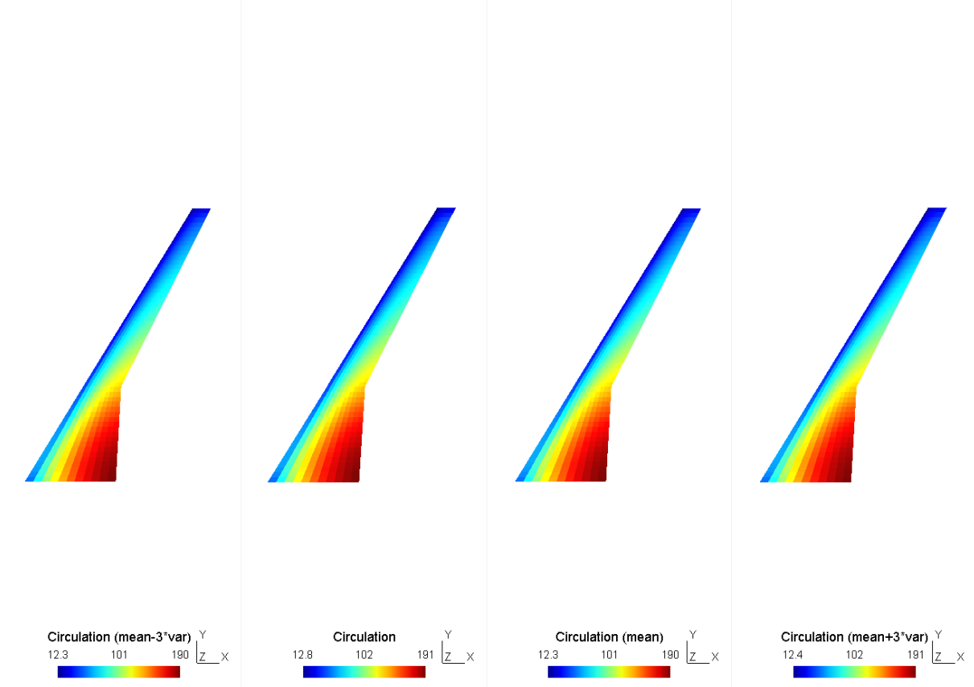


Internship Reporting
STUDENT:
Oriol CHANDRE VILA
TUTORS:
Joseph MORLIER (ISAE-SUPAERO) and Sylvain DUBREUIL (ONERA)
ONERA, Toulouse
Summer 2018

Slide 2
Table of Contents
Introduction
Aim and Objectives
State of the Art
Results
Future work
Internship Reporting | Oriol CHANDRE VILA

Slide 3
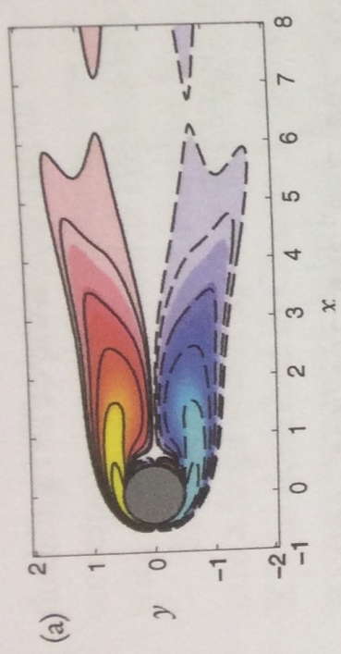

Introduction
Aeroelasticity
Coupling between aerodynamic forces, inertial forces and elastic forces.
Current issues due to models dimension. Why the ROM?
The calculations have a high cost in time and computational power.
Mean vorticity field
[Kutz et al., Chpt 9, SIAM, 2016]
[Kutz et al., Chpt 9, SIAM, 2016)
Internship Reporting | Oriol CHANDRE VILA

Slide 4
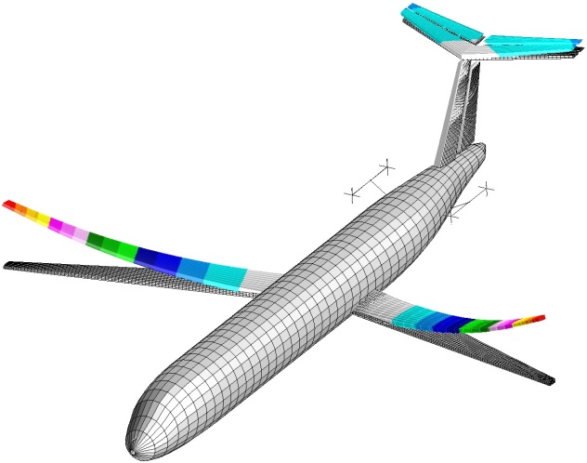
Aim & Objectives
Aim
To implement an approach Greedy+POD to an aeroelastic code in order to lighten the further simulations.
Objectives
To apply the abovementioned technique to the proposed problem.
To analyse the results.
Source [5]
Internship Reporting | Oriol CHANDRE VILA

Slide 5
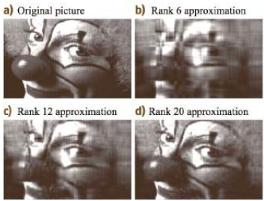
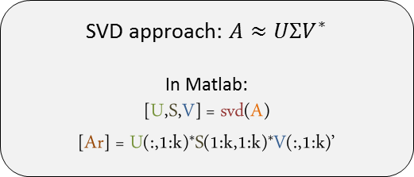
State of the Art
Principal Component Analysis (PCA)
[Kutz, Chpt 15, Oxford University Press, 2013]
Possible correlated variables
(Observations)
Values of linearly uncorrelated variables
(Principal Components)
Orthogonal Transformation
Widely used in the actuality.
Limitations:
The results depend on the scaling variables.
The applicability is limited by certain assumptions.
No differentiation between classes.
Used in different disciplines:
SVD in Algebra
POD in Mechanical Engineering.
SVD approach: $A≈UΣV^{∗}$
In Matlab:
[U,S,V] = svd(A)
[Ar] = U(:,1:k)*S(1:k,1:k)*V(:,1:k)’
Internship Reporting | Oriol CHANDRE VILA

Slide 6
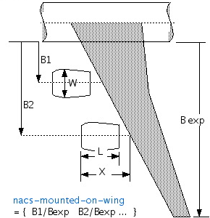




Results
Aero structure problem
Aerodynamics → VLM Horseshoe
Matrix of Transfer & Mesh deformation
Structures → FEM (DKT for plates)
Source [5]
6 parameters of interest
$$h_{\left\{skin\right\}}$$
$${h_{}^{LE}}_{\left\{sparse\right\}}$$
Span
$$h_{\left\{ribs\right\}}$$
$${h_{}^{TE}}_{\left\{sparse\right\}}$$
Wing Area
Internship Reporting | Oriol CHANDRE VILA

Slide 7
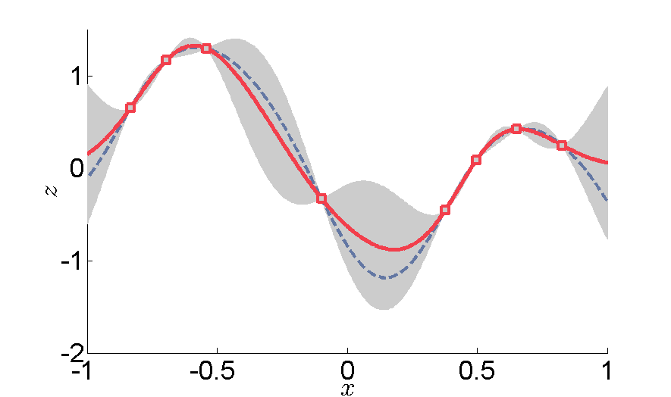

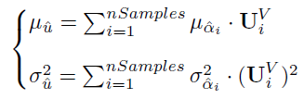
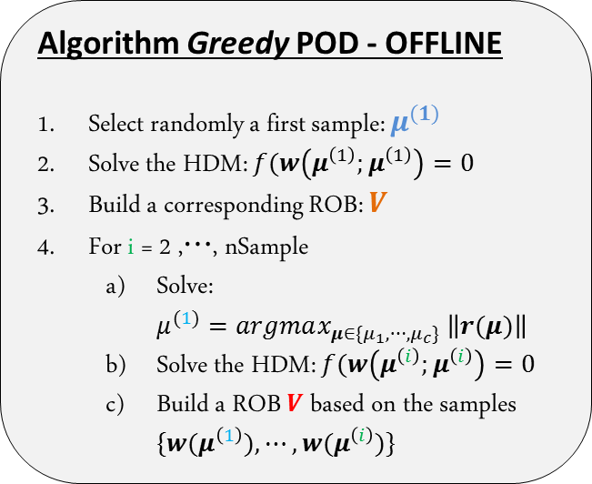
Results
Aero structure problem
Algorithm Greedy POD - OFFLINE
Select randomly a first sample: $μ^{(1)}$
Solve the HDM: $f(w\left(μ^{\left(1\right)};μ^{\left(1\right)}\right)=0$
Build a corresponding ROB: $V$
For i = 2 ,$⋯$, nSample
Solve: $μ^{(1)}=argmax_{μ∈\{μ_{1},⋯,μ_{c}\}} \left\|r(μ)\right\|$
Solve the HDM: $f(w\left(μ^{\left(i\right)};μ^{\left(i\right)}\right)=0$
Build a ROB $V$based on the samples $\{w(μ^{\left(1\right)}),⋯,{w(μ}^{\left(i\right)})\}$
V size:
Circulation: 627 x nSamples
Displacement: 2988 x nSamples
[Amsallem, International Journal for Numerical Methods in Engineering, 2014]
KRIGING: nSamples functions
Approximation ONLINE
[Wahba et al., SIAM, 1990]
Internship Reporting | Oriol CHANDRE VILA

Slide 8
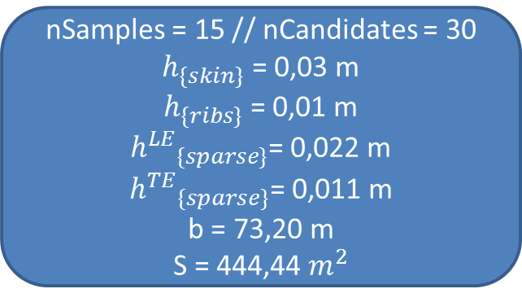
Results
Aero structure problem
nSamples = 15 // nCandidates = 30
$h_{\{skin\}}$ = 0,03 m
$h_{\{ribs\}}$ = 0,01 m
${h^{LE}}_{\{sparse\}}^{}$= 0,022 m
${h^{TE}}_{\{sparse\}}^{}$= 0,011 m
b = 73,20 m
S = 444,44 $m^{2}$
Internship Reporting | Oriol CHANDRE VILA

Slide 9
Results
Aero structure problem
Internship Reporting | Oriol CHANDRE VILA

Slide 10
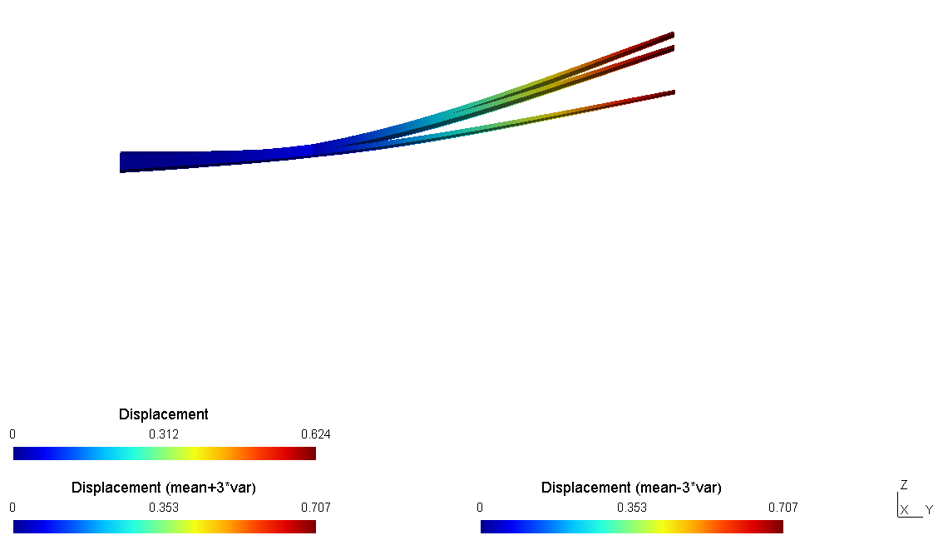
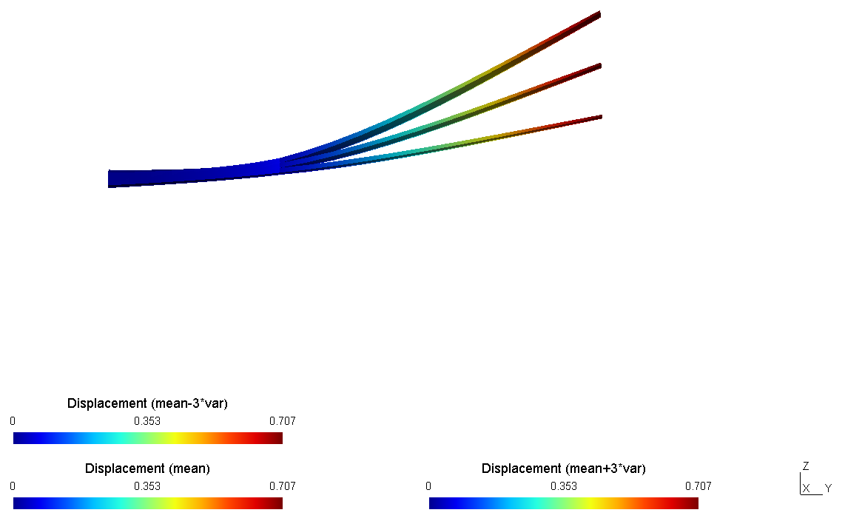
Results
Aero structure problem
Internship Reporting | Oriol CHANDRE VILA

Slide 11
Conclusions and Future work
CONCLUSIONS
Saving computation time in a real time simulation.
nSamples drives the accuracy of the RB.
Kriging procedure → acceptable variance values
In displacement approximation → real solution is not localized between the limits
FUTURE WORK?
Introduction of the reduced base methodology to the solver OpenAeroStruct.
Link to the GitHub Project
Internship Reporting | Oriol CHANDRE VILA

Slide 12
References
[1] Kutz, J.N., Brunton, S.L., Brunton, B.W. and Proctor, J.L., "Dynamic Mode Decomposition: Data-Driven Modeling of Complex Systems", 1st ed., SIAM, Philadelphia, 2016.
[2] Kutz, J. N., "Data-Driven Modeling & Scientific Computation: Methods for Complex Systems & Big Data", 1st ed., Oxford University Press, Oxford, 2013.
[3] Amsallem, D., “An Adaptive and Efficient Greedy Procedure for the Optimal Training of Parametric Reduced-Order Models”, International Journal for Numerical Methods in Engineering, 2014.
[4] Wahba, G., "Spline Models for Observational Data", Society for Industrial and Applied Mathematics (SIAM), 1990.
[5] http://www.dlr.de/ae/en/desktopdefault.aspx/tabid-1596/
[6] http://www.lissys.demon.co.uk/pug/c03.html
Internship Reporting | Oriol CHANDRE VILA

