Slide 1

Mesh-less Methods for Topology Optimization
Presented by:
Navpreet KAUR
(Major: Structures + ADO)
Supervisors:
Joseph MORLIER
31/03/2020

Slide 2
Outline of the Presentation
Summary of the previous work
Introduction
Problem definition (Test Cases)
Work done and Results
Conclusion
References

Slide 3
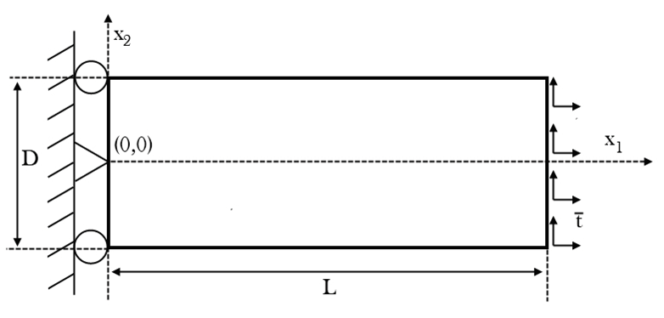
Summary
Mesh-less methods
EFG
Why not mesh-based methods?
MLPG
Previous Nodal
Distributions
Uniform
Random
Test Case
Semi-random
Proposed Nodal Distributions
Latin hyper-cube sampling (LHS)
Halton
Sobol
Notes:
In order to define the uniform mesh for complex structures or for a discontinuous structure or problem with moving boundaries or large deformations, mesh-based methods are not the best option available as it can result into very high errors and can impose the time burden on the solution. That is why the mesh-less methods come into play as these methods utilize the nodal mesh generation approach in which there is no need to define the elements linked by nodes to approximate the solution.
In the previous study, six different nodal distributions were studied out of which three were proposed and rest were already proposed

Slide 4
Summary
Conclusion
Uniform distribution is the best.
Notes:
. By carrying out the analysis with all the six nodal distributions, it was found out that uniform distributions is the best.

Slide 5
Outline of the Presentation
Summary of the previous work
Introduction
Problem definition (Test Cases)
Work done and Results
Conclusion
References

Slide 6
Introduction
Topology Optimization
Physical Problem
EFG
Method
Optimization Problem
Overvelde’s
algorithm
Notes:
Topology optimization is composed of two components: the physical problem and the optimization problem.
The state of art for the mesh-less method is done in the last semester.
Coming to the part of the topology optimization, there are various methods that has been proposed in literature for topology optimisation but the principles or algorithms by which these methods work are universal. For example, The Homogenization method; Evolutionary Structural Optimization(ESO); Solid Isotropic Material with Penalization(SIMP) etc.
The optimiser that is used in this work has been originally proposed by Overvelde[1] that is discussed in the later slide

Slide 7
Introduction
Element Free Galerkin
(EFG) Method
How it works?
Features
Nodal mesh generation
Generation of shape function through the nodes
Discretized equations based on global/weak form
Global matrix assembly
Essential boundary conditions (EBCs) or support conditions.
Solution for displacement
Solution for stress and strain
Not a true mesh-free method.
Based on Moving Least Squares (MLS) approximation.
Based on the global weak form.
Background mesh is required to evaluate the integrals.
Required to impose the EBCs.

Slide 8
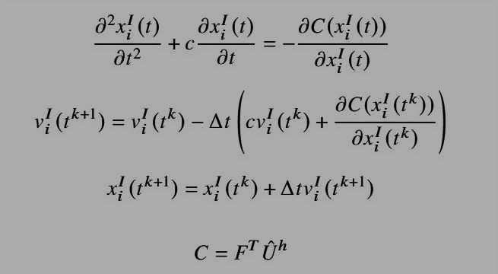
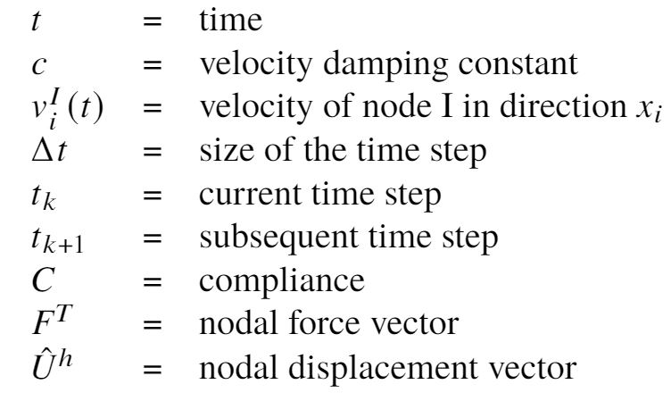
Introduction
Overvelde’s optimization algorithm
He proposed flow-inspired topology optimization method.
The optimizer used is based on a steepest descend and a fixed step given by the following equations:
Notes:
Since the EFG method is used to solve the physical problem, the interaction between the nodal distribution and the background mesh resulted into the discontinuities in the distribution of the material. As a result, the same nodal positions are not appropriate design variables for the optimization problem. Therefore, he defined: the discretization nodes are fixed and are used in the EFG method to solve the physical problem and mass nodes are used to describe the material distribution using a density function which will determine the stiffness.

Slide 9
Introduction
Applications of topology optimization
Solid
mechanics
Fracture mechanics
Fluid
Mechanics
Thermodynamics
many more….

Slide 10
Introduction
Comparison Parameter
Compliance:
The variable, C , denoting the compliance given by following equation, indicates the quality of the structure and it depends on the shape of the structure.
The layout with the lowest value of compliance is the optimal layout of the structure.
Where,

Slide 11
Outline of the Presentation
Summary of the previous work
Introduction
Problem definition (Test Cases)
Work done and Results
Conclusion
References

Slide 12
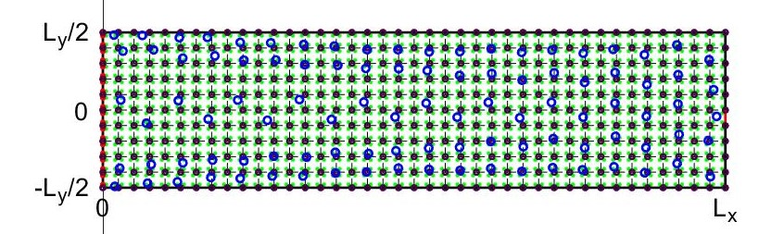
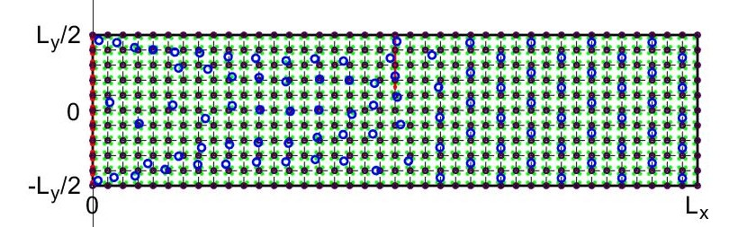
Problem Definition
Test Cases
Test Case 1: Cantilever beam with dimensions 4∗1 and a downwards point load of magnitude 0.1 acting at (4,0).
Test Case 2: Cantilever beam with dimensions 4∗1 and a uniformly distributed load of 0.1 per length dimension over its length taken as load of magnitude 0.4 pointed downwards at (2,0.5).

Slide 13
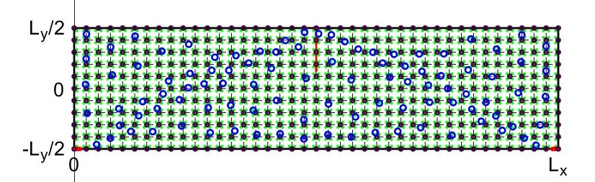
Problem Definition
Test Case 3: Simply supported beam with dimensions 4∗1 and a downwards point load of magnitude 0.4 acting at (2,0.5).
Parameters | Values
Elasticity modulus, E | 1 MPa
Poisson ratio | 0.3
Nodes in x-direction | 41
Nodes in y-direction | 11
Physical problem nodal distribution | Uniform
Mass nodes in x-direction | 20
Mass nodes in y-direction | 5
Volume fraction | 0.45
Maximum number of iterations | 100

Slide 14
Outline of the Presentation
Summary of the previous work
Introduction
Problem definition (Test Cases)
Work done and Results
Conclusion
References

Slide 15
Work done and Results
The work done is divided into three parts given as under:
Effect of different nodal distributions.
Effect of number of mass nodes.
Effect of volume fraction

Slide 16
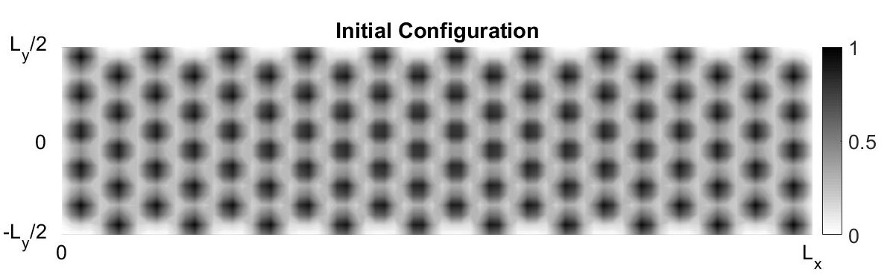
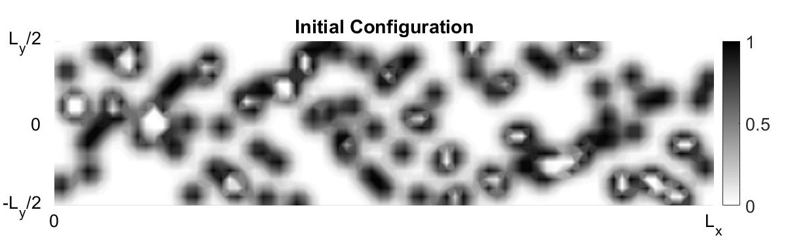
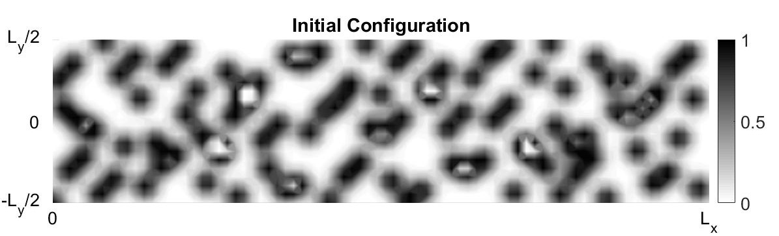
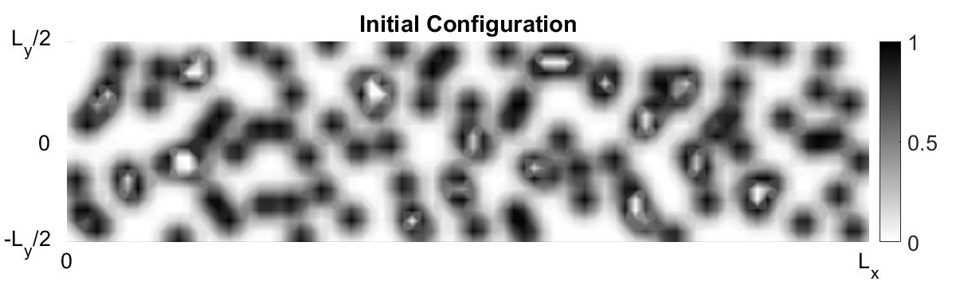
Work done and Results
Effect of different nodal distributions (1/5)
Uniform
LHS
Halton
Sobol
Initial Configuration of the mass nodes for all the test cases
Notes:
In order to study the effect of distribution of the mass nodes on the topology optimization, all the three test cases are discretized using all of the above proposed distributions for mass nodes i.e., LHS; Halton sampling and Sobol sampling. Since, the proposed distributions are a type of random distributions, therefore the results are compared to only previously obtained results for uniform distribution.

Slide 17
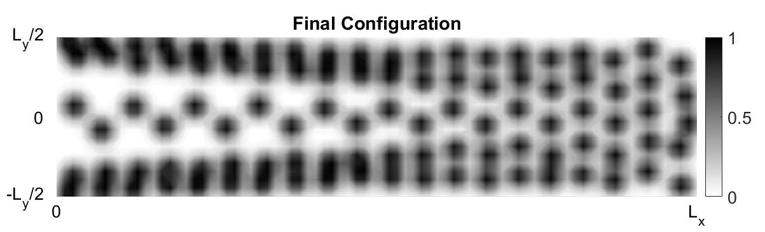
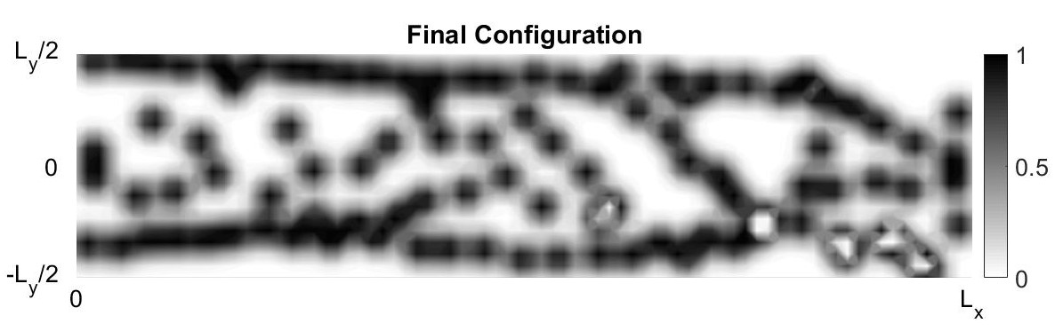
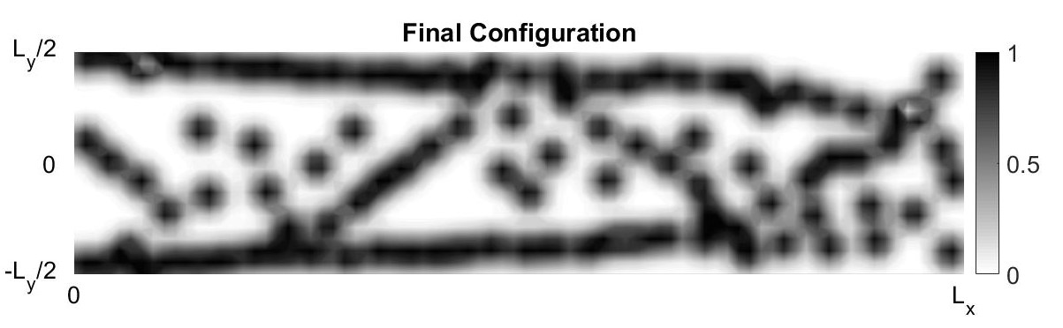
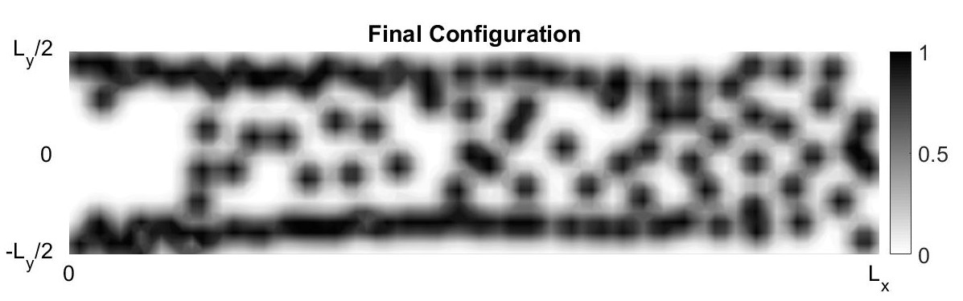
Work done and Results
Effect of different nodal distributions (2/5)
Effect of different nodal distributions.
Uniform
LHS
Halton
Sobol
Test Case 1: Final Configuration of the mass nodes
Notes:
For test case 1, it can be observed from that the sobol sampling is more in conformity with the uniform distribution than the others.

Slide 18
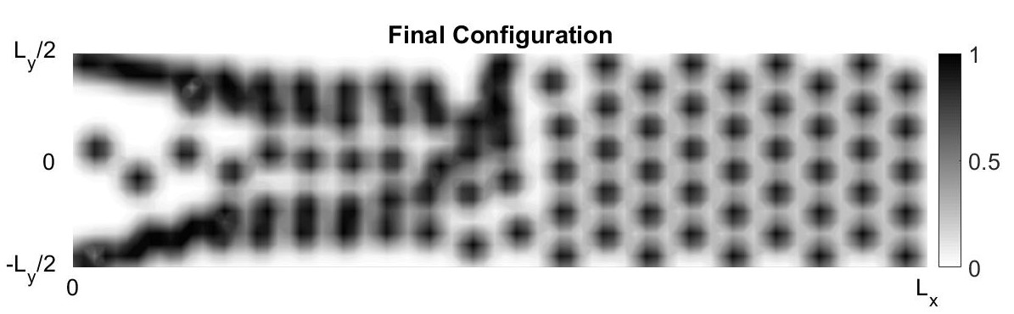
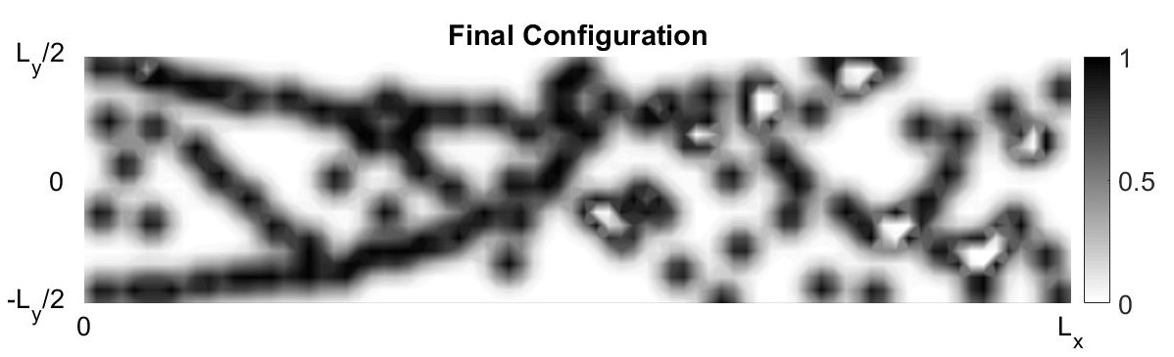
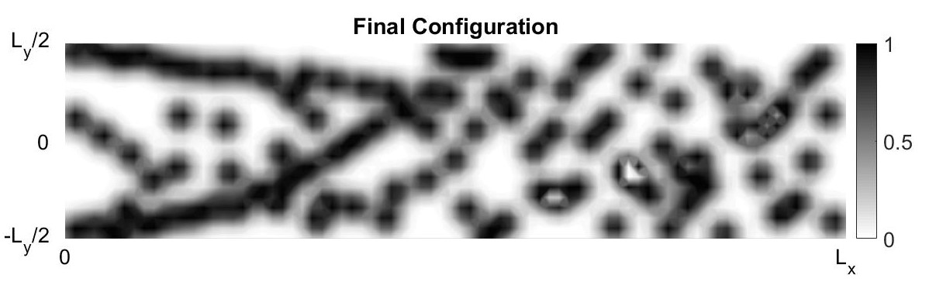
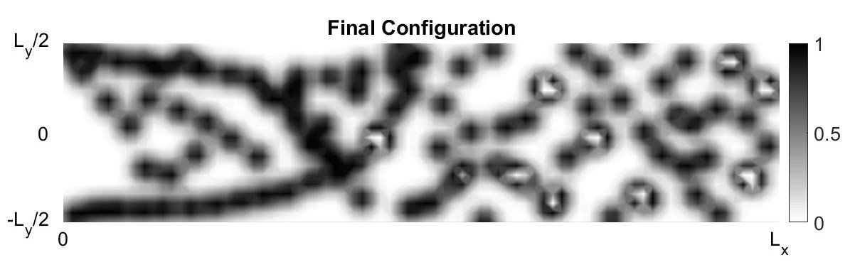
Work done and Results
Effect of different nodal distributions (3/5)
Effect of different nodal distributions.
Uniform
LHS
Halton
Sobol
Test Case 2: Final Configuration of the mass nodes
Notes:
For test case 2, it can be observed that the sobol sampling and the halton sampling represents a better fit to the uniform distribution than LHS.

Slide 19
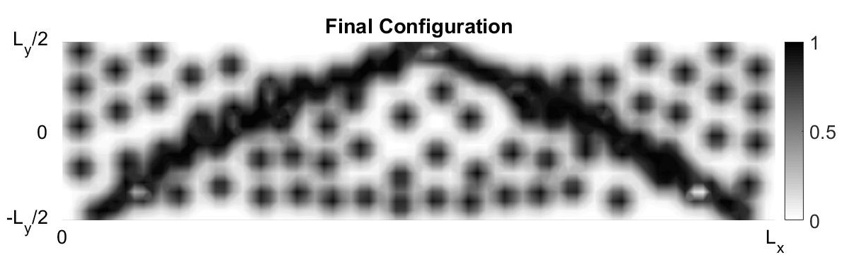
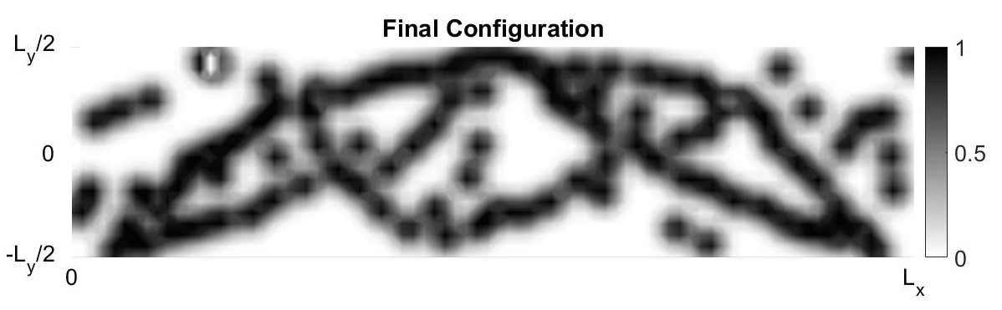
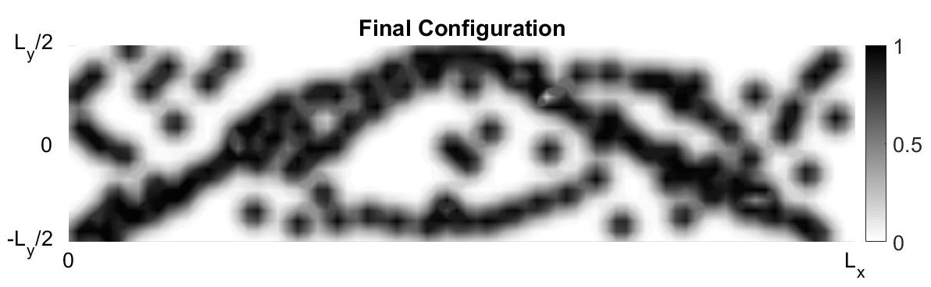
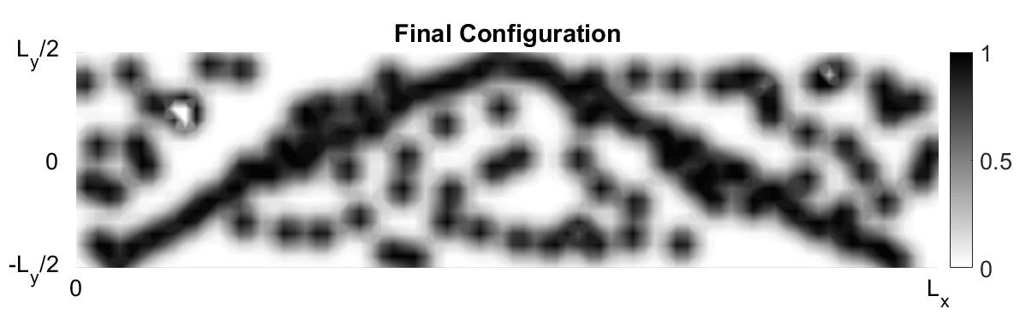
Work done and Results
Effect of different nodal distributions (4/5)
Effect of different nodal distributions.
Uniform
LHS
Halton
Sobol
Test Case 3: Final Configuration of the mass nodes
Notes:
Similarly, for test case 3, it can be observed from Fig.6 that the sobol sampling and the halton sampling represent a better fit to the uniform distribution than LHS

Slide 20
Work done and Results
Effect of different nodal distributions (5/5)
Effect of different nodal distributions.
Distribution | Compliance
 | Test Case 1 | Test Case 2 | Test Case 3
Uniform distribution | 10.9594 | 25.6064 | 6.3891
Latin hyper-cube sampling | 13.5946 | 29.094 | 6.2976
Halton sampling | 9.853 | 26.5032 | 6.5041
Sobol sampling | 11.1686 | 28.4425 | 7.1609
Compliance values of the test cases for all the distributions
Notes:
From the Table, it can be seen that:
for test case 1, Halton sampling is the most optimal layout;
for test case 2, uniform distribution has the lowest compliance value and
for test case 3, LHS represents the optimal layout with a lowest compliance values.
It can also be observed that compliance value of Halton sampling in each test case has very insignificant difference from the respective lowest compliance values.

Slide 21
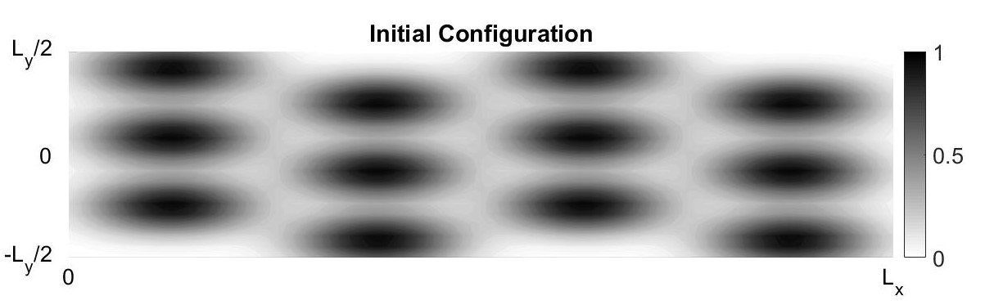
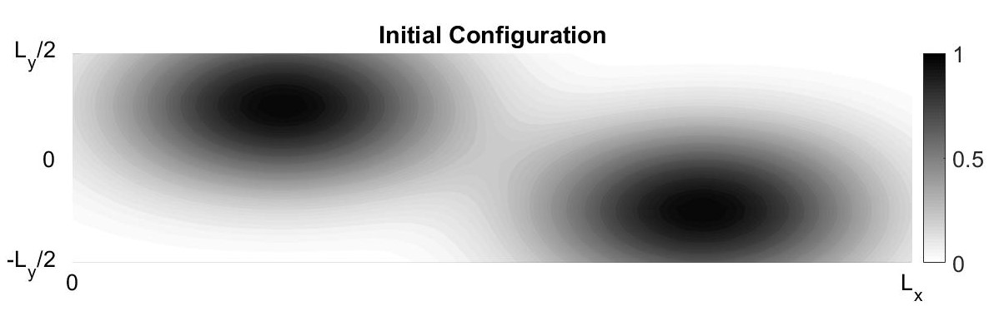
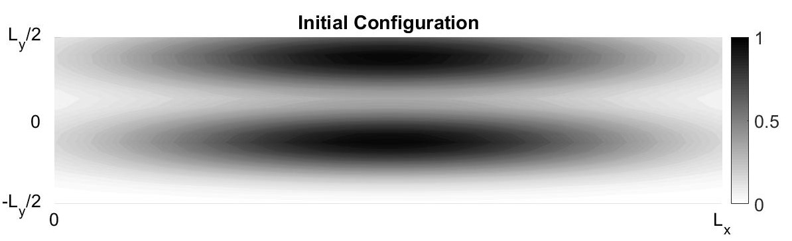
Work done and Results
Effect of number of mass nodes (1/5)
Mass Nodes: 12
Mass Nodes: 2l
Mass Nodes: 2t
Initial Configuration of the mass nodes for all the test cases (l: longitudinal and t: transverse)
Notes:
When the final configurations for all the distributions shown previously (Slide 17-19) are compared to their respective initial configuration(Slide 16), it can be observed that there are some mass nodes whose contribution to the final layout configuration is insignificant. Therefore, it leads to the exhaustion of the given resources.
In order to comply with the constraint of conservation of the resources, the number of mass nodes are decreased in this section.
For all the test cases, there are three cases taken:
first, the number of mass nodes are taken as12 distributed along both the axis (1graph unit=1mass node);
the number of nodes are taken as 2 distributed longitudinally and
the number of nodes are taken as 2 but distributed transversely
Also, the mass nodes are uniformly distributed in this part.

Slide 22
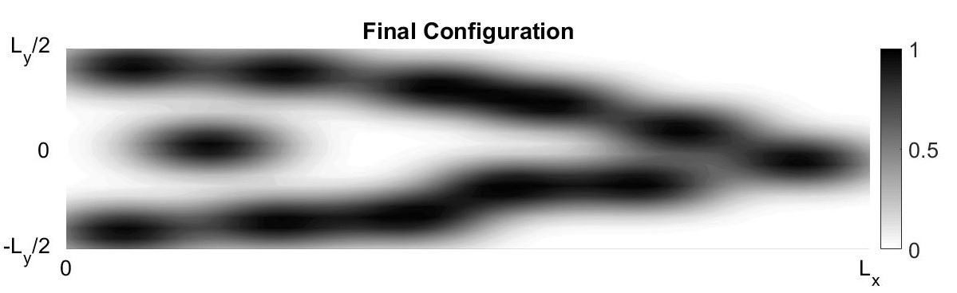
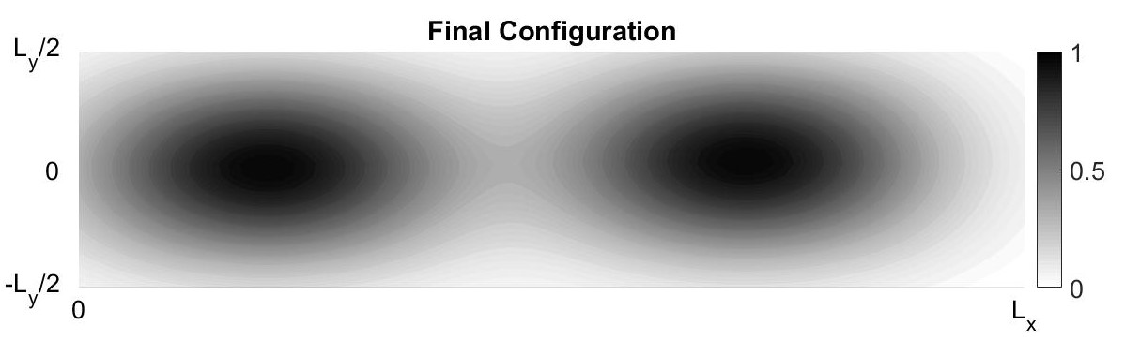
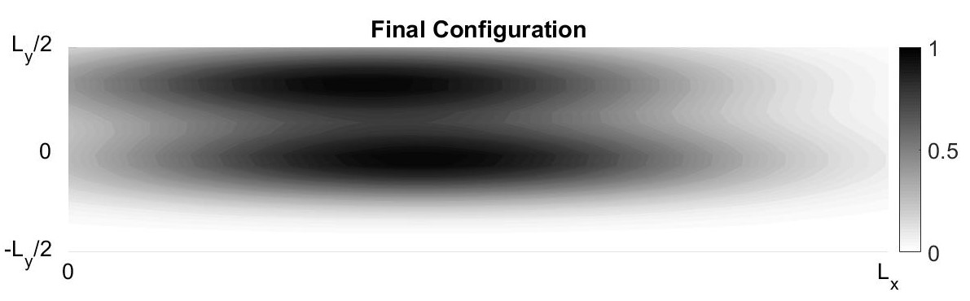
Work done and Results
Effect of number of mass nodes (2/5)
Mass Nodes: 12
Mass Nodes: 2l
Mass Nodes: 2t
Test Case 1: Final Configuration of the mass nodes
Notes:
From all the results displayed in Slide 22-24, it can be observed that, when the number of nodes is 12, the layout is more optimized than the other two cases with 2 mass nodes and from the above table, the same observation is made.

Slide 23
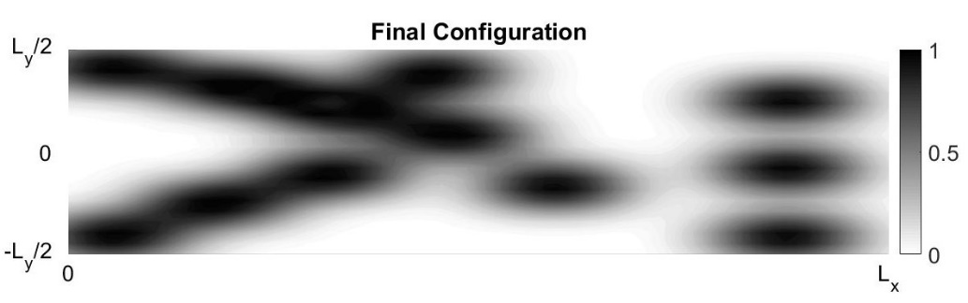
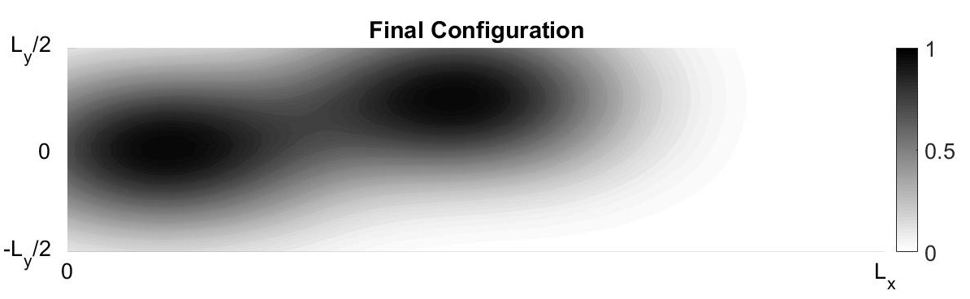
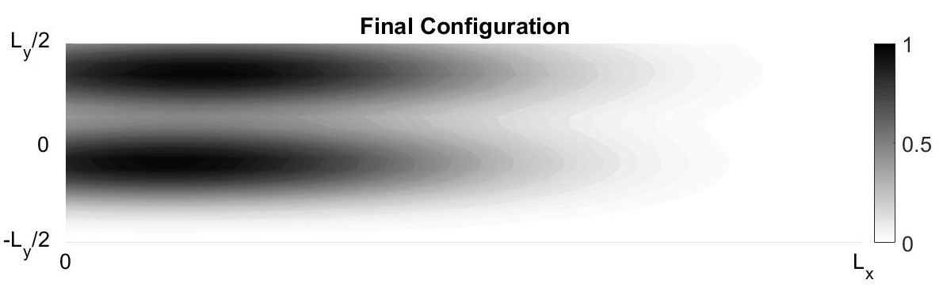
Work done and Results
Effect of number of mass nodes (3/5)
Mass Nodes: 12
Mass Nodes: 2l
Mass Nodes: 2t
Test Case 2: Final Configuration of the mass nodes

Slide 24
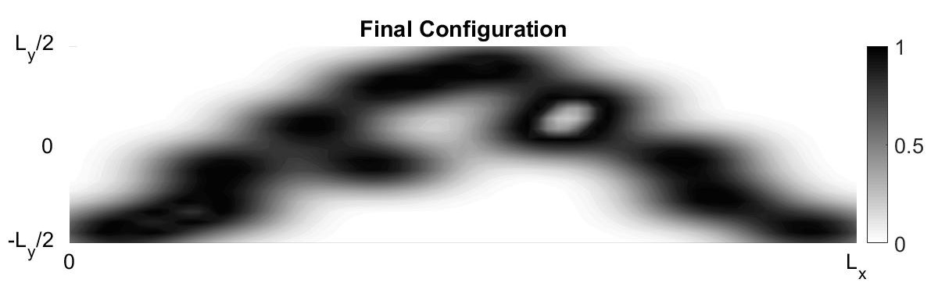
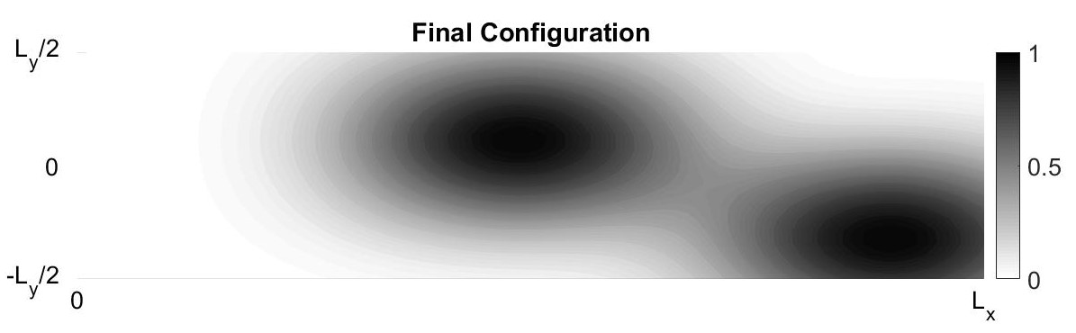
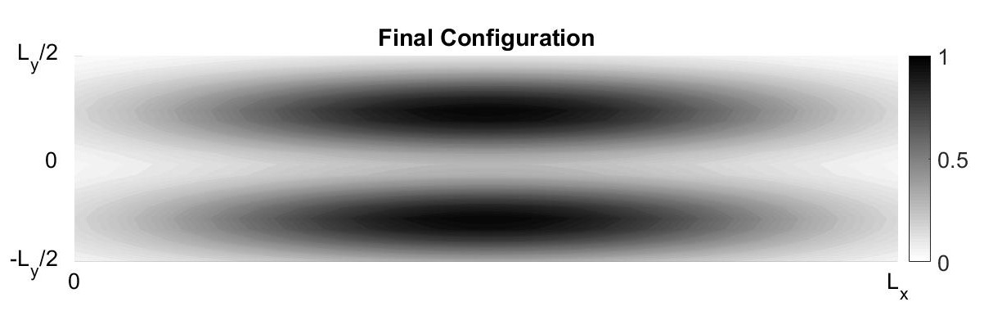
Work done and Results
Effect of number of mass nodes (4/5)
Mass Nodes: 12
Mass Nodes: 2l
Mass Nodes: 2t
Test Case 3: Final Configuration of the mass nodes

Slide 25
Work done and Results
Effect of number of mass nodes (5/5)
Number of mass nodes | Compliance
 | Test Case 1 | Test Case 2 | Test Case 3
12 | 14.8492 | 23.5927 | 5.6417
2 (longitudinally) | 163.1374 | 69.3215 | 320.719
2 (transversely) | 123.1777 | 40.8771 | 107.7707
Compliance values of the test cases for different number of mass nodes
Notes:
From the Table, it can be seen that:
the compliance values of test cases with 2(longitudinally) are very large and hence, generates a very bad optimal solution.
the solution with 2(transversely) is better than with 2(longitudinally) but still not a very good solution.
Also, Test Case 2 and Test Case 3 with 12 mass nodes gives lower compliance values than with the default number of mass nodes(100) given by previous section.

Slide 26
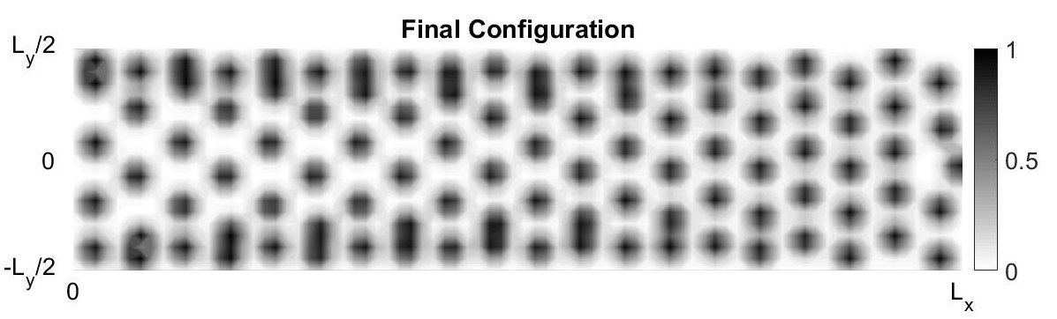
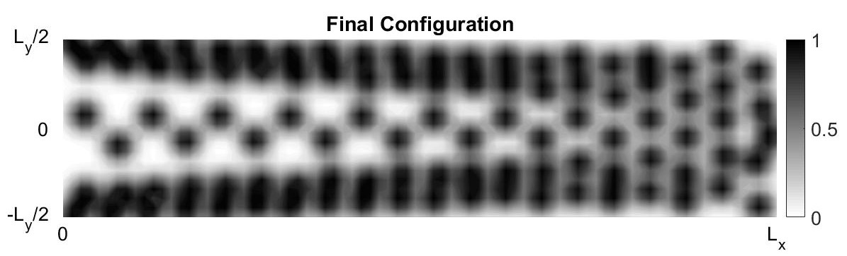
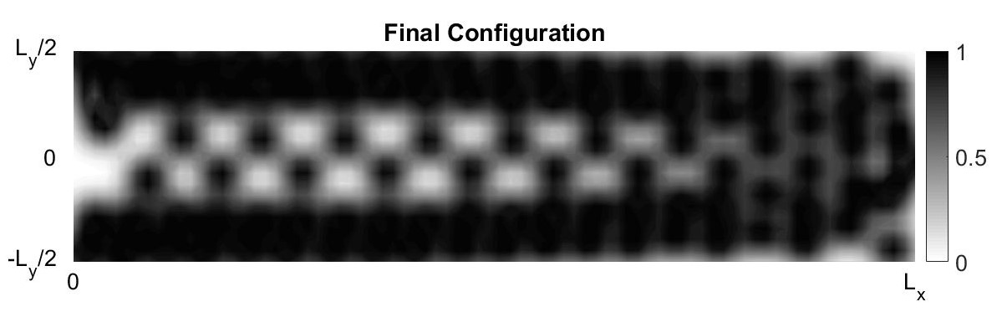
Work done and Results
Effect of Volume fraction (1/4)
VF: 0.30
VF: 0.60
VF: 0.90
Test Case 1: Final Configuration of the mass nodes
Notes:
In this part, the effect of volume fraction on the topology optimization is studied by taking different values for all the three test cases.
Results displayed in Slide 26-28, represents the evolution of the structure as the volume fraction is increased. The concentration of mass increases especially at the loading elements.

Slide 27
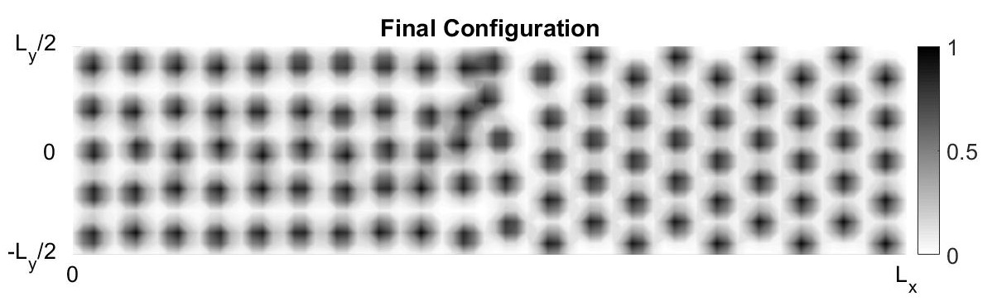
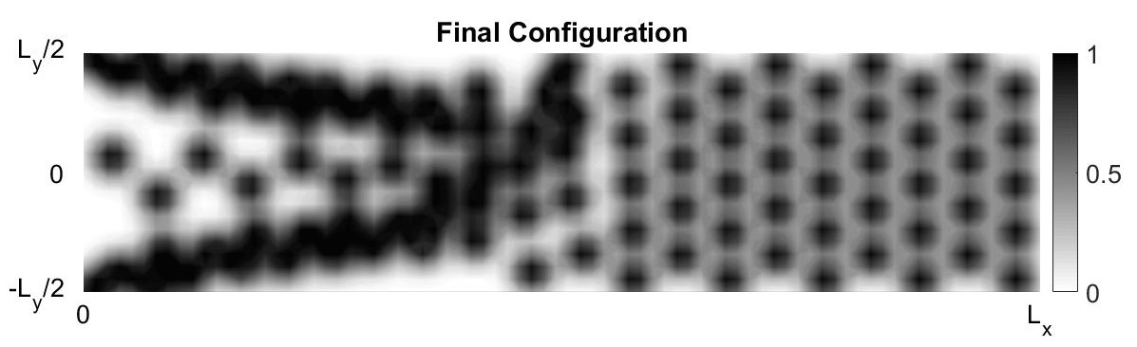
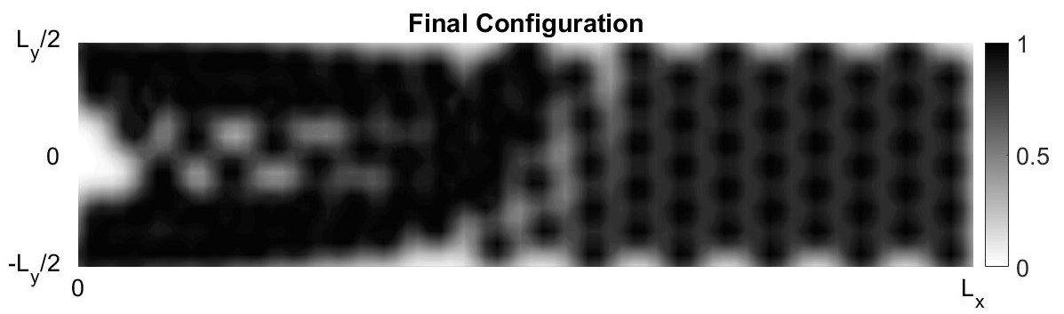
Work done and Results
Effect of Volume fraction (2/4)
VF: 0.30
VF: 0.60
VF: 0.90
Test Case 2: Final Configuration of the mass nodes

Slide 28
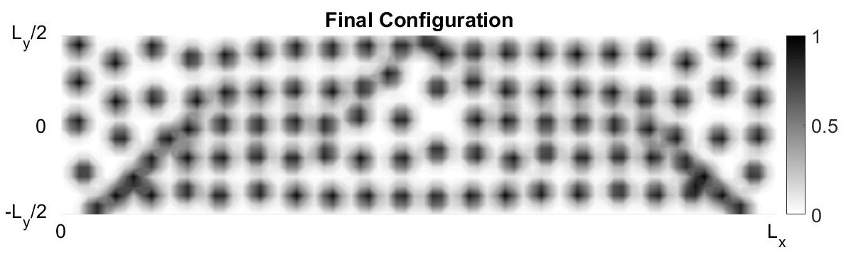
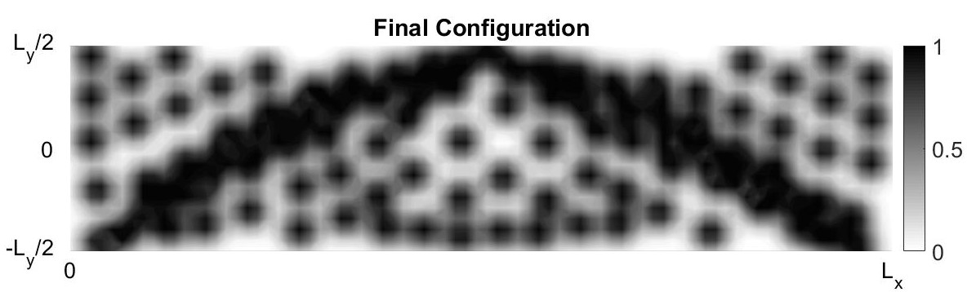
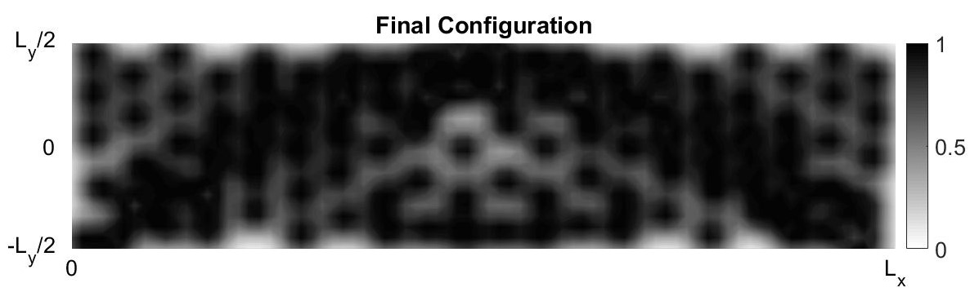
Work done and Results
Effect of Volume fraction (3/4)
VF: 0.30
VF: 0.60
VF: 0.90
Test Case 3: Final Configuration of the mass nodes

Slide 29
Work done and Results
Effect of Volume fraction (4/4)
Volume fraction | Compliance
 | Test Case 1 | Test Case 2 | Test Case 3
0.10 | 158.1652 | 696.0642 | 488.4714
0.30 | 27.5743 | 56.8228 | 15.9878
0.60 | 6.8811 | 16.185 | 4.1764
0.90 | 3.5286 | 8.2824 | 2.4353
Compliance values of the test cases for different values of volume fraction
Notes:
Table above gives the compliance values for different values of volume fraction and It can be observed that the high compliance values are obtained with volume fraction as 0.10 and as the volume fraction is increased, there is a significant decrease in the compliance values.

Slide 30
Conclusion
For the effect of different distributions of mass nodes, there is a trade off between Halton sampling and uniform distribution for all the three test cases.
From the results of the effect of varying number of mass nodes, it can be concluded that the given resources should be used wisely in order to find the optimal solution.
For the effect of volume fraction, it can be deduced that as the volume fraction is increased, there is a significant decrease in the compliance values.
It is also observed that, Test Case 2, the mass nodes positioned after the point of application of load does not play a significant role in analysis of the problem. Therefore, the Test Case 2 is very ill-conditioned.
The optimal structure for the Test Case 1 and Test Case 3(different boundary condition at one end) are put in comparison with the analytical benchmark solution given by Rozvany[6] and the former is in accordance with the latter to a great extent.
The results obtained can be considered as a criterion in the state of art of the topology optimization.

Slide 31
References
[1] Overvelde, J. T. B., “The Moving Node Approach in Topology Optimization - An Exploration to a Flow-inspired Meshless Method-based Topology Optimization Method,” Master’s Thesis - Delft University of Technology, 2012.
[2] Nguyen, V. P., Rabczuk, T., Bordas, S., and Duflot, M., “Meshless methods: a review and computer implementation aspects,” Mathematics and Computers in Simulation, Vol. 79, No. 3, 2008, pp. 763–813.
[3] Daxini, S. D., and Prajapati, J. M., “A Review on Recent Contribution of Meshfree Methods to Structure and Fracture Mechanics Applications,”The Scientific World Journal, 2014, p. 13
[4] Cho, S., and Kwak, J., “Topology design optimization of geometrically nonlinear structures using meshfree method,”Computer Methods in Applied Mechanics and Engineering, Vol. 195, No. 44–47, 2006, pp. 5909–5925..
[5] Belytschko, Lu, Y. Y., and Gu, L., “Element-free Galerkin methods,” Int. J. Numer. Methods Eng., Vol. 37, 1994, pp. 229–256.
[6] Rozvany, G. I. N., “Exact analytical solutions for some popular benchmark problems in topology optimization,” Structural Optimization, Vol. 15, 1998, pp. 42–48.
[7] Raze, G., “Topology Optimization,” https://github.com/GhislainRaze/Topology-Optimization, 2017
[8] Tang, B., “Orthogonal Array-Based Latin Hypercubes,” Journal of the American Statistical Association, Vol. 88, 1993, pp.1392–1397.
[9] Halton, J., “Algorithm 247: Radical-inverse quasi-random point sequence,” Communications of the ACM, Vol. 7, 1964, pp.701–705.
[10] Sobol, I. M., “Distribution of points in a cube and approximate evaluation of integrals,” U.S.S.R Comput. Maths. Math. Phys. Vol. 7, 1967, pp. 86–112.

Slide 32
Thank you
Questions?

