Slide 1



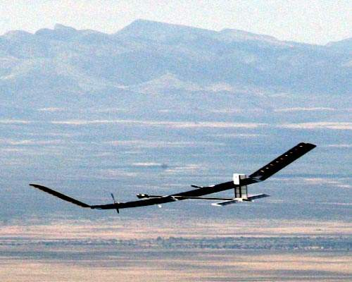
Multidisciplinary Design Optimization of a HALE drone regarding environmental impact
Edouard Duriez
Pr Joseph Morlier

Slide 2
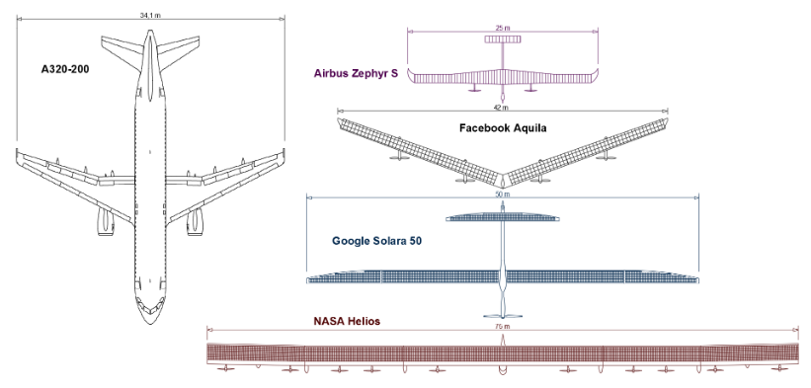
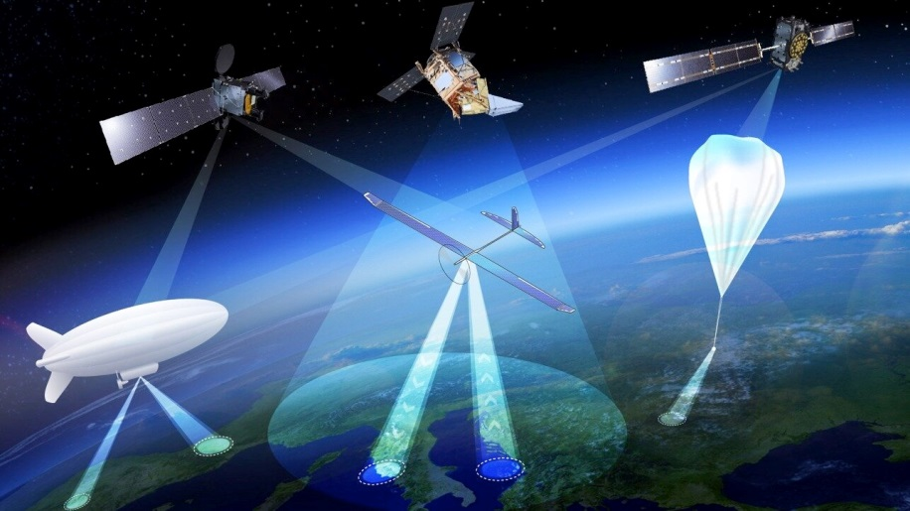
I/Introduction
II/Background
III/Model
IV/Results
V/Conlusion
ECO-HALE
Use : pseudo-satellite
-Earth-observation
-Earth monitoring
-Communication
=> Long flight
Assets
-Repairable
-Flexible
-Permanent coverage
-cheaper*
-Environmental friendly?
Drawbacks
-Technical complexity
-Smaller coverage
Principle
-Solar powered
-Large-span
-Batteries
https://www.esa.int/Applications/Navigation/Crossing_drones_with_satellites_ESA_eyes_high-altitude_aerial_platforms
Kirsch, B., & Montagnier, O. (2018). Maîtriser la conception des drones solaires à voilure souple : Vers l’avènement des pseudo-satellites à hautes altitudes (HAPS). Technologie Et Innovation, 3(3). doi:10.21494/iste.op.2018.0252
*Gonzalo, J., López, D., Domínguez, D., García, A., Escapa, A., 2018. On the capabilities and limitations of high altitude pseudo-satellites. Progress in Aerospace Sciences 98, 37–56. https://doi.org/10.1016/j.paerosci.2018.03.006
Notes:
Large span : example NASA helios (75m) (A320: 35m)
Smaller coverage : altitude 20km compared to 400km
Cheaper : price/kgCU /10

Slide 3
I/Introduction
II/Background
III/Model
IV/Results
V/Conlusion
I/Introduction
II/Background
III/Model
IV/Results
V/Conclusion

Slide 4
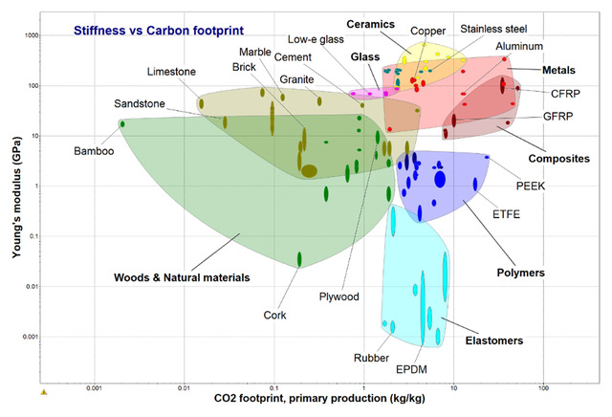
Subject/aims
I/Introduction
II/Background
III/Model
IV/Results
V/Conlusion
Optimize the environmental impact of a HALE drone : eco-design
Include material selection in MDO
Select optimal material in a big database : CES Selector
Significant computing time improvement compared to « brutal force »
Material | E (GPA) | Density (kg/m3) | CO2 (kg/kg)
Stainless steel | 200 | 7750 | 3.4
Aluminum | 72.5 | 2800 | 8.2
GFRP | 21.4 | 1860 | 6.2
CFRP | 55 | 1565 | 48
Sandwich | 42.5 | 500-560 | 40-45
Ashby, M.F., Miller, A., Rutter, F., Seymour, C., Wegst, U.G.K., n.d. The CES Eco Selector – Background Reading 24.
Notes:
Environmental impact : mostly materials impact, as fuel-less. Focuss on global warming -> CO2 emissions

Slide 5
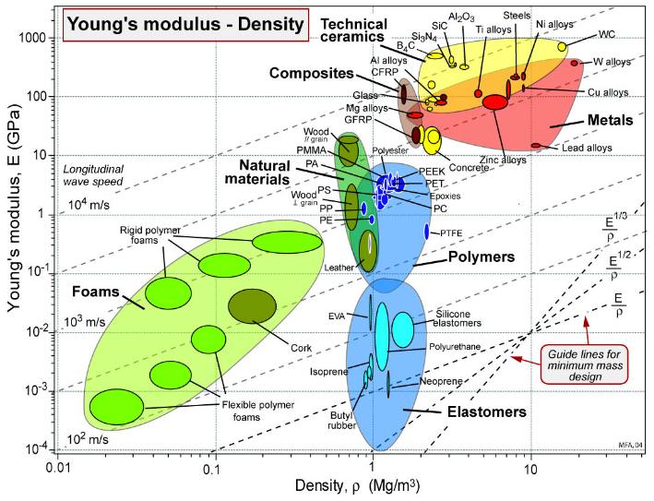
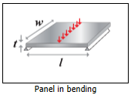
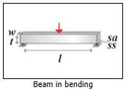
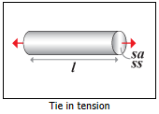
State of the art: Ashby’s method
I/Introduction
II/Background
III/Model
IV/Results
V/Conlusion
One part at a time, one loading case at a time
Ashby, M. F. (2005). Materials selection in mechanical design. Amsterdam: Elsevier Butterworth-Heinemann.

Slide 6
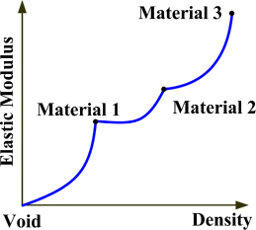
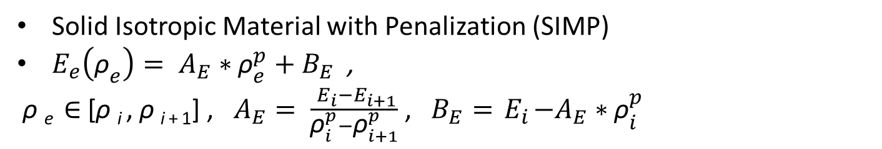
State of the art : SIMP
I/Introduction
II/Background
III/Model
IV/Results
V/Conlusion
Solid Isotropic Material with Penalization (SIMP)
$E_{e}\left({\text{ρ}}_{e}\right)= A_{E}∗{\text{ρ}}_{e}^{p}+B_{E}$ ,
ρ _{e} ∈ [ρ _{i} , ρ _{i + 1}] , $A_{E}= \frac{{ E}_{i}−E_{i+1}}{{\text{ρ}}_{i}^{p}−{\text{ρ}}_{i+1}^{p}}$ , $B_{E}={ E}_{i}−A_{E}∗{\text{ρ}}_{i}^{p}$
Zuo, W., & Saitou, K. (2016). Multi-material topology optimization using ordered SIMP interpolation. Structural and Multidisciplinary Optimization, 55(2), 477-491. doi:10.1007/s00158-016-1513-3

Slide 7
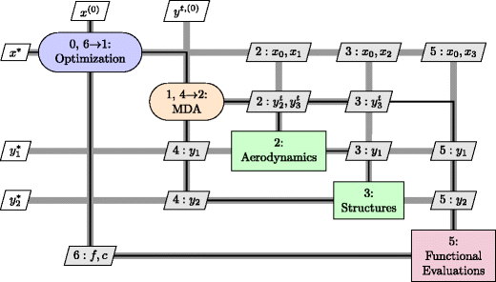
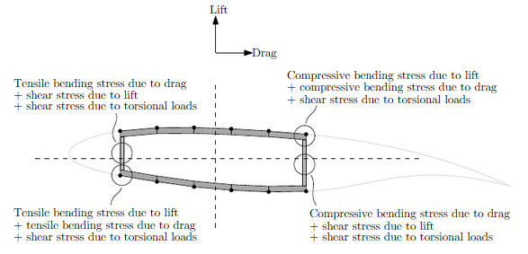
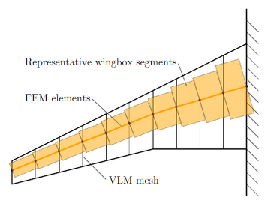
Technical context: OpenAeroStruct
I/Introduction
II/Background
III/Model
IV/Results
V/Conlusion
Low fidelity tool for aerostructural MDO, based on OpenMDAO framework (NASA). Optimizer used : SLSQP
Derivatives by adjoint method with analytic gradients
Aerodynamics : vortex lattice method (VLM)
Structure: 1D finite element analysis with wingbox elements.
Chauhan, S. & R. R. A. Martins, J. (2018). Low-Fidelity Aerostructural Optimization of Aircraft Wings with a Simplified Wingbox Model Using OpenAeroStruct. 418-431. 10.1007/978-3-319-97773-7_38.
Gray, J., Moore, K., & Naylor, B. (2010). OpenMDAO: An Open Source Framework for Multidisciplinary Analysis and Optimization. 13th AIAA/ISSMO Multidisciplinary Analysis Optimization Conference. doi:10.2514/6.2010-9101
Jasa, J. P., Hwang, J. T., & Martins, J. R. R. A. (2018). Open-source coupled aerostructural optimization using Python. Structural and Multidisciplinary Optimization, 57(4), 1815–1827. doi: 10.1007/s00158-018-1912-8
Notes:
We chose to keep analytical gradients => work

Slide 8
OpenAeroStruct new formulation
I/Introduction
II/Background
III/Model
IV/Results
V/Conlusion
 | Initial formulation | New formulation
Objective function | Fuel burn | CO2 impact of the drone
Constraints | Mechanical failure Range by Breguet equation Flight (L=W) | Enough power Simple buckling constraint Mechanical failure Flight (L=W)
Design variables | Thicknesses Twist Thickness to chord ratio | Thicknesses Twist Thickness to chord ratio Density
Notes:
Combine with previous

Slide 9
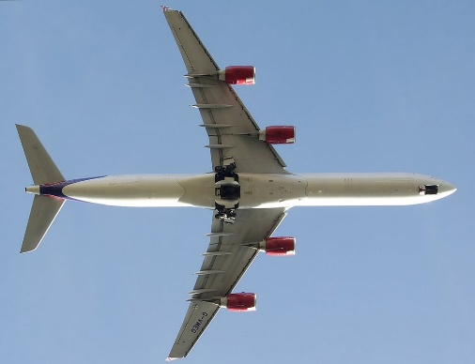
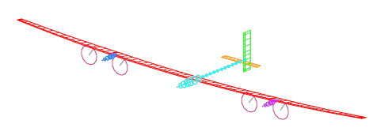
I/Introduction
II/Background
III/Model
IV/Results
V/Conlusion
OpenAeroStruct new formulation
Change commercial aircraft into HALE drone with same characteristics as FBHALE for comparison.
Power balance depending on mass, payload and avionics -> constraint on wing surface
Added mass of solar panels, batteries (worst case : 13h night), avionics, propulsion
CO2 impact of solar panels and batteries
Colas, D., Roberts, N. H., & Suryakumar, V. S. (2018). HALE Multidisciplinary Design Optimization Part I: Solar-Powered Single and Multiple-Boom Aircraft. 2018 Aviation Technology, Integration, and Operations Conference. doi:10.2514/6.2018-3028
Wetzel, T., & Borchers, S. (2014). Update of energy payback time and greenhouse gas emission data for crystalline silicon photovoltaic modules. Progress in Photovoltaics: Research and Applications, 23(10), 1429–1435. doi: 10.1002/pip.2548
Hao, H., Mu, Z., Jiang, S., Liu, Z., & Zhao, F. (2017). GHG Emissions from the Production of Lithium-Ion Batteries for Electric Vehicles in China. Sustainability, 9(4), 504. doi: 10.3390/su9040504
Notes:
FBHALE: higher fidelity, AIAA best paper : XFOIL, XROTOR, ASWING, Co-blade
ecoHALE lower fidelity

Slide 10
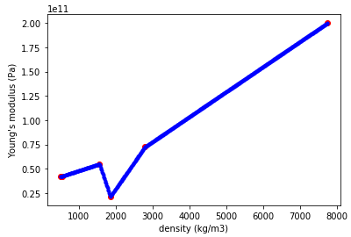
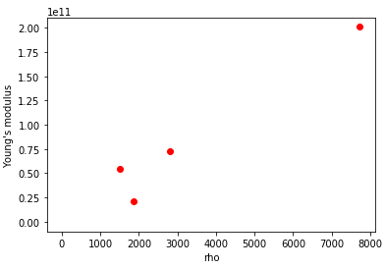
Material design variable
I/Introduction
II/Background
III/Model
IV/Results
V/Conlusion
OpenAeroStruct only accepts continuous design variables
-> Material variable needed to be made continuous
All material characteristics are introduced as a function of density, and linearly interpoled between two real materials. -> only one material design variable : density
CFRP:
E=55MPa
ρ=1565kg/m3
CO2=48kg/kg
Aluminum:
E=72.5MPa
ρ=2800kg/m3
CO2=8.2kg/kg
Steel:
E=200MPa
ρ=7750kg/m3
CO2=3.4kg/kg
GFRP:
E=21.4MPa
ρ=1860kg/m3
CO2=6.2kg/kg
Sandwich:
E=42.5MPa
ρ=500-560kg/m3
CO2=40-45kg/kg

Slide 11
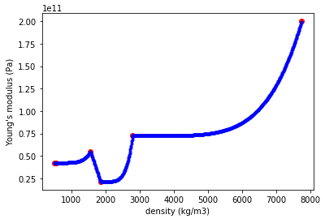
Material design variable
I/Introduction
II/Background
III/Model
IV/Results
V/Conlusion
The optimum could be an unexisting material.
A power term is added at the end of convergence in order to force it to a real material. (negative curvature for CO2, as smaller CO2 is advantageous)
P=1
P=5
Notes:
Combine with previous? Or evoluting slide?

Slide 12
I/Introduction
II/Background
III/Model
IV/Results
V/Conlusion
New formulation : design variables
Variable | Bondaries | Lowest starting value | Highest starting value | Number of starting values | unit
Skin thickness | 0,0001-0,1 | 0,001 | 0,0016 | 7 | m
Spar thickness | 0,0001-0,1 | 0,0001 | 0,0001 | 1 | m
Wing span | 1-1000 | 55 | 65 | 3 | m
Wing chord | 1,4-500 | 1,5 | 1,5 | 1 | m
Wing taper | 0,3-0,99 | 0,3 | 0,3 | 1 | -
Wing thickness over chord ratio | 0,01-0,4 | 0,11 | 0,17 | 3 | -
Twist | -30 - +30 | +15 | +15 | 1 | °
Density | 400-8000 | 1250 | 2000 | 2 | Kg/m3
12

Slide 13
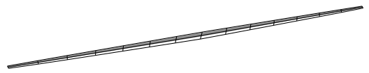
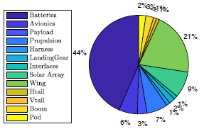
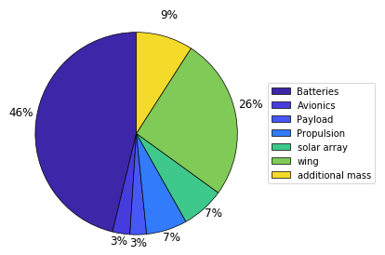
I/Introduction
II/Background
III/Model
IV/Results
V/Conlusion
Validation : Comparison with FBHALE
Fixed mass comparison with FBHALE:
Variable | Modified OpenAeroStruct | FBHALE
Total mass (kg) | 378 | 320
Wing surface (m²) | 87 | 72
Aspect ratio | 94 | 29
CL | 1.31 | 1.33
13
Simple buckling, 1-cosine gust, flutter and snowball effect
Notes:
Not right geometry, but right mass breakup between batteries, solar array, structure and propulsion

Slide 14
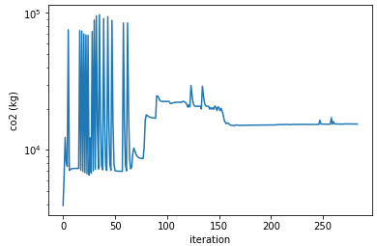
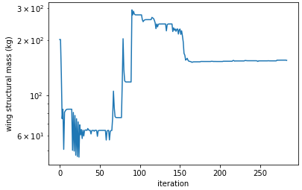
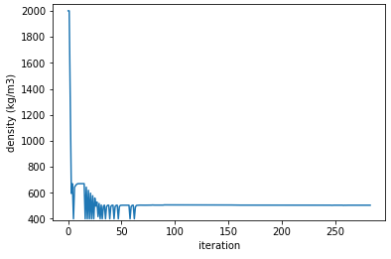
I/Introduction
II/Background
III/Model
IV/Results
V/Conlusion
Results : convergence graphs
CO2 (*10-4 kg)
Wing structural mass (kg)
Density (*10-3 kg/m3)
Notes:
Delete?

Slide 15
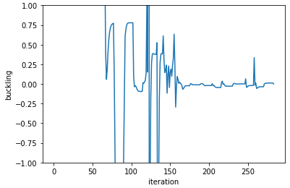
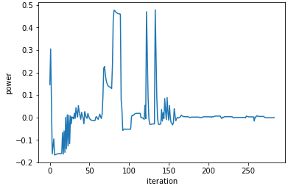
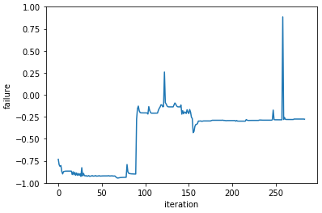
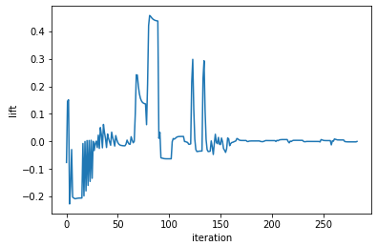
I/Introduction
II/Background
III/Model
IV/Results
V/Conlusion
Results : convergence graphs
CO2 (*10-4 kg)
Wing structural mass (kg)
Density (*10-3 kg/m3)
Buckling constraint:
Influence on skin thickness
Power constraint:
Influence on wing surface
Failure constraint:
Inactive because of buckling constraint
Lift=weight constraint:
Global influence
15
Constraints normalized
Notes:
Delete?

Slide 16
I/Introduction
II/Background
III/Model
IV/Results
V/Conlusion
Results : final design
Constraints | Final value
Buckling | 5.4 E-5
Failure | -0.28
Power | 1.3 E-6
Lift | -7.3 E-7
Design variables | Final value
Span (m) | 108
Chord (m) | 1.4
Taper ratio | 0.36
Density(kg/m3) | 505
Skin thickness (mm) | 1-6
Spar thickness(mm) | 0.2
Wing twist(°) | 12-30
T/C ratio | 0.02-0.15
Objective and other results | Final value
CO2 emissions (kg) | 15421
Total mass (kg) | 473
Battery + PV mass (kg) | 226
Payload + avionics mass (kg) | 20.5
Wing Structure mass (kg) | 155
The final material is a sandwich panel (UD CFRP – expanded PS foam – UD CFRP)
=> The same material as FBHALE

Slide 17
I/Introduction
II/Background
III/Model
IV/Results
V/Conlusion
Results : density sensitivity
Change in material CO2 => change in optimal material
Big co2 change necessary for small rho change
Material data | CFRP - PS foam | CFRP - cork
Density | 504.5 | 560.5
CO2/kg | 44.9 | 44.9 / CO2ratio
Other material data | identical
CO2 ratio | Optimal material
1 | CFRP - PS foam
1.1 | CFRP - PS foam
1.2 | CFRP - PS foam
1.3 | CFRP - cork
1.4 | CFRP - cork
1.5 | CFRP - cork
1.6 | CFRP - cork
17

Slide 18
I/Introduction
II/Background
III/Model
IV/Results
V/Conlusion
Results : comments
Model very sensitive to the input data (snowball effect)
Optimal material in terms of CO2 very close to optimal material in terms of weight
->battery heaviest impact on CO2
CO2 emitted by material must be significantly lower for an eco-material to be a good substitute.
18

Slide 19

I/Introduction
II/Background
III/Model
IV/Results
V/Conlusion
Conclusion : Eco-design in the MDO loop
OpenAeroStruct derived for HALE drones
Material selection integrated to MDO as a continuous variable
Method can be adapted to any aerostructure / MDO
HALE drones could be a cleaner alternative to satellites (no launch) => important to make them as clean as possible.
19
Paper soon submitted to SMO!

Slide 20
Conclusion : Next steps
I/Introduction
II/Background
III/Model
IV/Results
V/Conlusion
Multi-material structure
Improve model (gust, buckling)
Adapt to bigger material database
Speed up process (other material variable)

Slide 21
QUESTIONS ?

Slide 22
Technical context: OpenAeroStruct
I/Introduction
II/Background
III/Model
IV/Results
V/Conlusion
Low fidelity tool for aerostructural MDO, based on OpenMDAO framework (NASA). Solver used : NonLinearBlocksGaussSiedel
Gradient optimization: derivatives obtained by couple adjoint method
Aero : vortex lattice method (VLM)
Structure (lifting surfaces): 1D finite element analysis with wingbox elements.
Objective function : Fuel burn
Design variables : thicknesses, twist, thickness to chord ratio
Gray, J., Moore, K., & Naylor, B. (2010). OpenMDAO: An Open Source Framework for Multidisciplinary Analysis and Optimization. 13th AIAA/ISSMO Multidisciplinary Analysis Optimization Conference. doi:10.2514/6.2010-9101
Jasa, J. P., Hwang, J. T., & Martins, J. R. R. A. (2018). Open-source coupled aerostructural optimization using Python. Structural and Multidisciplinary Optimization, 57(4), 1815–1827. doi: 10.1007/s00158-018-1912-8

Slide 23
Technical context : OpenAeroStruct
I/Introduction
II/Background
III/Model
IV/Results
V/Conlusion
Constraints : - mechanical failure
- range by Breguet equation
- flight (L=W)
Two test cases: - Cruise flight: Ma=0,85
- Maneuver: Ma=0,64; 2,5g
Chauhan, S. & R. R. A. Martins, J. (2018). Low-Fidelity Aerostructural Optimization of Aircraft Wings with a Simplified Wingbox Model Using OpenAeroStruct. 418-431. 10.1007/978-3-319-97773-7_38.
Notes:
Combine with previous

Slide 24
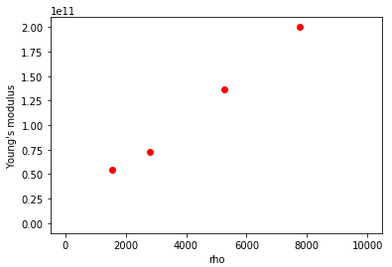
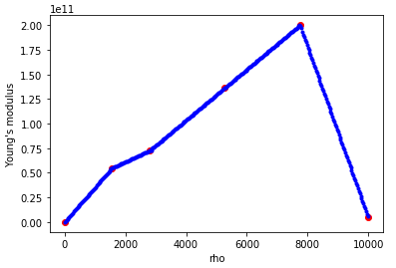
New formulation : Continuous material
I/Introduction
II/Background
III/Model
IV/Results
V/Conlusion
OpenAeroStruct only accepts continuous design variables
-> Material variable needed to be made continuous
All material characteristics are introduced as a function of density, and linearly interpoled between two real materials.

