Slide 1
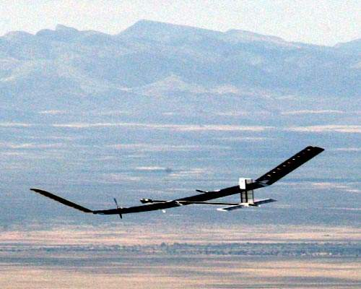
Multidisciplinary Optimization of a HALE drone regarding environmental impact
Edouard Duriez

Slide 2
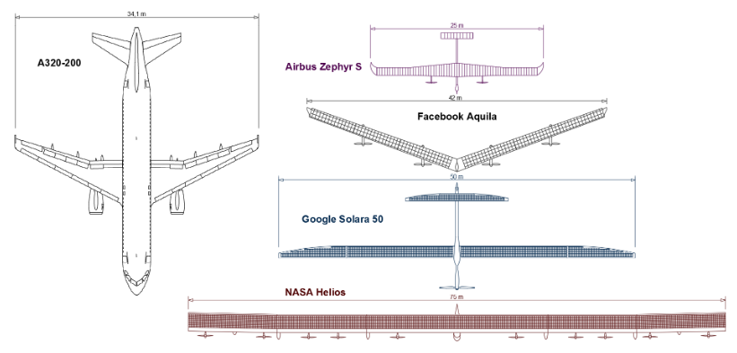
ECO Hale
Principle: Solar energy -> large span, energy storage
Pseudo-satellite: weather forecast, earth observation, communication, earth monitoring...
Assets: Flexible, repositionable, permanent coverage, cheaper (price/payload kg divided by 4), lower environmental impact?
Drawbacks: Technique complexity, smaller coverage (20km altitude instead of 400+km)
Kirsch, B., & Montagnier, O. (2018). Maîtriser la conception des drones solaires à voilure souple : Vers l’avènement des pseudo-satellites à hautes altitudes (HAPS). Technologie Et Innovation, 3(3). doi:10.21494/iste.op.2018.0252

Slide 3
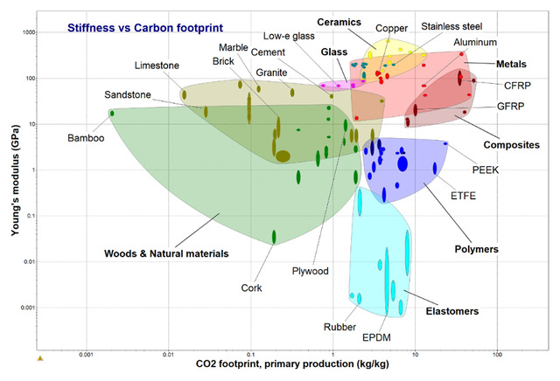
Subject/aims
Optimize the environmental impact of a HALE drone (mostly materials impact, as fuel-less) : ecodesign
Include material selection in MDO
Find the optimal material in a big database, for a given structure.
Have a significant computing time improvement compared to a « brutal force » strategy.
Material | E (GPA) | Density (kg/m3) | CO2 (kg/kg)
Stainless steel | 200 | 7750 | 3.4
Aluminum | 72.5 | 2800 | 8.2
GFRP | 21.4 | 1860 | 6.2
CFRP | 55 | 1565 | 48
Sandwich | 4-40 | 60-600 | 35-45
Colas, D., Roberts, N. H., & Suryakumar, V. S. (2018). HALE Multidisciplinary Design Optimization Part I: Solar-Powered Single and Multiple-Boom Aircraft. 2018 Aviation Technology, Integration, and Operations Conference. doi:10.2514/6.2018-3028

Slide 4
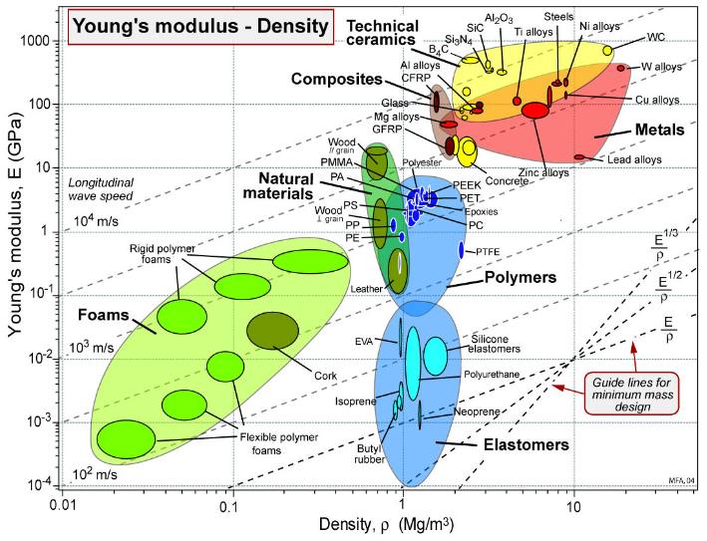
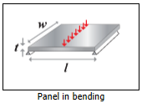
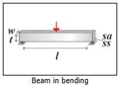
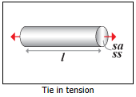
State of the art: Ashby’s method
One part at a time, one loading case at a time
Ashby, M. F. (2005). Materials selection in mechanical design. Amsterdam: Elsevier Butterworth-Heinemann.

Slide 5
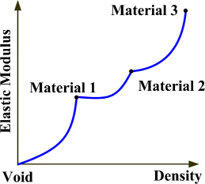
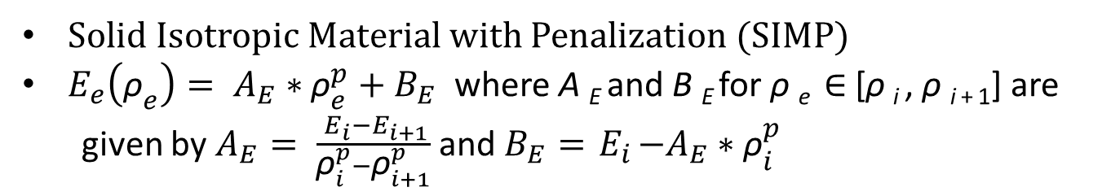
State of the art : SIMP
Solid Isotropic Material with Penalization (SIMP)
$E_{e}\left({\text{ρ}}_{e}\right)= A_{E}∗{\text{ρ}}_{e}^{p}+B_{E}$ where A _{E} and B _{E} for ρ _{e} ∈ [ρ _{i} , ρ _{i + 1}] are
given by $A_{E}= \frac{{ E}_{i}−E_{i+1}}{{\text{ρ}}_{i}^{p}−{\text{ρ}}_{i+1}^{p}}$ and $B_{E}={ E}_{i}−A_{E}∗{\text{ρ}}_{i}^{p}$
Zuo, W., & Saitou, K. (2016). Multi-material topology optimization using ordered SIMP interpolation. Structural and Multidisciplinary Optimization, 55(2), 477-491. doi:10.1007/s00158-016-1513-3

Slide 6
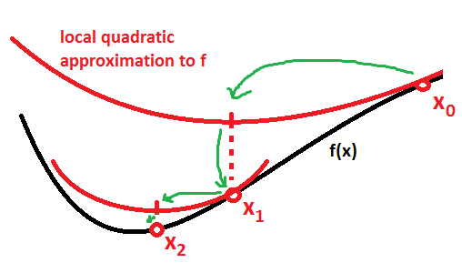
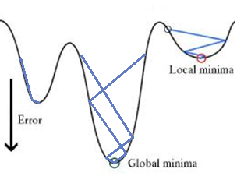
Theoretical context: SLSQP
SLSQP (Sequential Least SQuares Programming) : Python implementation of sequential quadratic programming (SQP).
SQP: iterative method for constrained non-linear optimization, using a quadratic approximation of the model at each iteration.
Differentiability: Objective function and constraints must be differentiable twice. (with SLSQP, derivatives can be approximated with finite differences)
Convergence: If convex function, otherwise, multistart
Kraft, D. (1988). A software package for sequential quadratic programming. Tech. Rep. DFVLR-FB 88-28, DLR German Aerospace Center — Institute for Flight Mechanics, Koln, Germany.

Slide 7
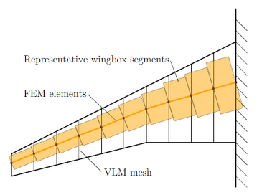
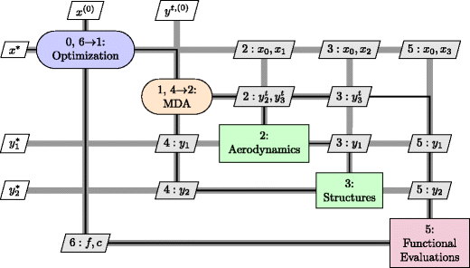
Technical context: OpenAeroStruct
Low fidelity tool for aerostructural MDO, based on OpenMDAO framework (NASA). Solver used : NonLinearBlocksGaussSiedel
Gradient optimization: derivatives optained by couple adjoint method
Aero : vortex lattice method (VLM)
Structure (lifting surfaces): 1D finite element analysis with wingbox elements.
Objective function : Fuel burn
Design variables : thicknesses, twist, thickness to chord ratio
Gray, J., Moore, K., & Naylor, B. (2010). OpenMDAO: An Open Source Framework for Multidisciplinary Analysis and Optimization. 13th AIAA/ISSMO Multidisciplinary Analysis Optimization Conference. doi:10.2514/6.2010-9101
Jasa, J. P., Hwang, J. T., & Martins, J. R. R. A. (2018). Open-source coupled aerostructural optimization using Python. Structural and Multidisciplinary Optimization, 57(4), 1815–1827. doi: 10.1007/s00158-018-1912-8

Slide 8
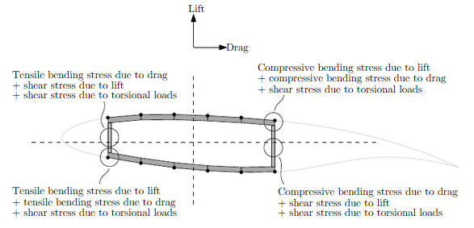
Technical context : OpenAeroStruct
Constraints : - mechanical failure
- range by Breguet equation
- flight (L=W)
Two test cases: - Cruise flight: Ma=0,85
- Manoeuvre: Ma=0,64; 2,5g
Chauhan, S. & R. R. A. Martins, J. (2018). Low-Fidelity Aerostructural Optimization of Aircraft Wings with a Simplified Wingbox Model Using OpenAeroStruct. 418-431. 10.1007/978-3-319-97773-7_38.

Slide 9
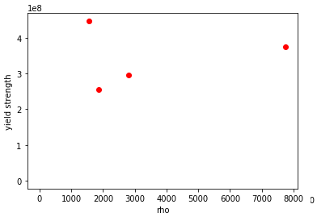
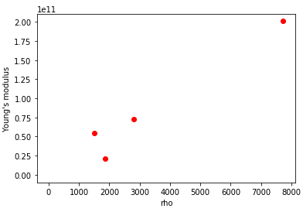
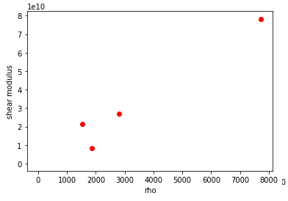
New formulation : OpenAeroStruct
Objective function : CO2 impact of the drone
Design variables : material variable accessed by density
-> only one material design variable
CFRP:
E=55MPa
ρ=1565kg/m3
CO2=48kg/kg
Aluminm:
E=72.5MPa
ρ=2800kg/m3
CO2=8.2kg/kg
Steel:
E=200MPa
ρ=7750kg/m3
CO2=3.4kg/kg
GFRP:
E=21.4MPa
ρ=1860kg/m3
CO2=6.2kg/kg
Sandwich:
E=4-40MPa
ρ=60-600kg/m3
CO2=35-45kg/kg

Slide 10
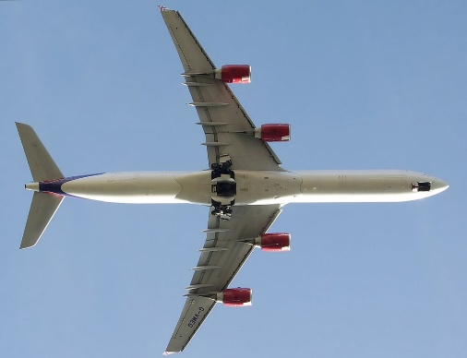
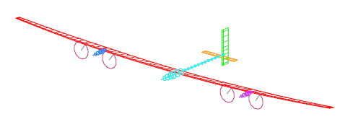
New formulation : OpenAeroStruct
Change commercial aircraft into HALE drone with same caracteristics to FBHALE for comparison.
Power balance depending on mass, payload and avionics -> constraint on wing surface
Added mass of solar panels, batteries (worst case : 13h night), avionics, propulsion
Range constraint deleted
CO2 impact of solar panels and batteries
Simple buckling constraint
Only one case: much lower speed, with gust
Colas, D., Roberts, N. H., & Suryakumar, V. S. (2018). HALE Multidisciplinary Design Optimization Part I: Solar-Powered Single and Multiple-Boom Aircraft. 2018 Aviation Technology, Integration, and Operations Conference. doi:10.2514/6.2018-3028
Wetzel, T., & Borchers, S. (2014). Update of energy payback time and greenhouse gas emission data for crystalline silicon photovoltaic modules. Progress in Photovoltaics: Research and Applications, 23(10), 1429–1435. doi: 10.1002/pip.2548
Hao, H., Mu, Z., Jiang, S., Liu, Z., & Zhao, F. (2017). GHG Emissions from the Production of Lithium-Ion Batteries for Electric Vehicles in China. Sustainability, 9(4), 504. doi: 10.3390/su9040504

Slide 11
New formulation : design variables
Variable | Bondaries | X0 | X1 | X2 | X3 | … | Xn | unit
Skin thickness | 0,0001-0,1 | 0,001 | 0,003 | 0,001 | 0,001 |  | 0,01 | m
Spar thickness | 0,0001-0,1 | 0,001 | 0,001 | 0,003 | 0,001 |  | 0,01 | m
Wing span | 1-1000 | 50 | 50 | 50 | 50 |  | 50 | m
Wing chord | 1-500 | 2 | 2 | 2 | 2 |  | 2 | m
Wing taper | 0,01-0,99 | 0,1 | 0,1 | 0,1 | 0,1 |  | 0,1 | -
Wing thickness over chord ratio | 0,01-0,2 | 0,1 | 0,1 | 0,1 | 0,1 |  | 0,1 | -
Twist | -15 - 15 | 5 | 5 | 5 | 5 |  | 5 | °
Density | 50-8200 | 50 | 50 | 50 | 500 |  | 8200 | Kg/m3
11

Slide 12
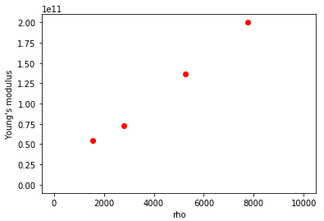
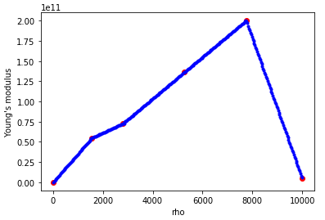
New formulation : Continuous material
OpenAeroStruct only accepts continuous design variables
-> Material variable needed to be made continuous
All material characteristics are introduced as a function of density, and linearly interpoled between two real materials.
Fake material added on each side

Slide 13
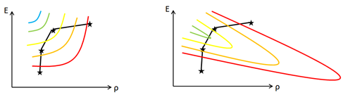
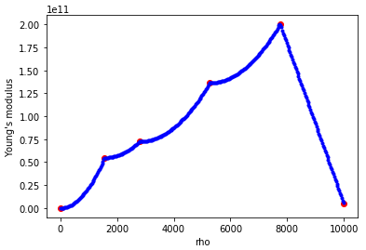
New formulation : Force convergence to a real material
The optimum could be an unexisting material.
A power term is added at the end of convergence in order to force it to a real material. (negative curvature for CO2, as smaller CO2 is advantageous)
P=1
P>1

Slide 14
Validation : Comparison with FBHALE
Fixed mass comparison with FBHALE:
Variable | Modified OpenAeroStruct | FBHALE
Span (m) | 48 | 45
Chord (m) | 1,04 | 1,6
Taper | 0,08 | 0,3
Total mass (kg) | 107 | 320
Battery+PV mass (kg + %total) | 54(50%) | 170 (53%)
Payload+avionics mass (kg + %total) | 20,5 (19%) | 28 (9%)
Wing Structure mass (kg + %total) | 30 (28%) | 67 (21%)
14
Simple buckling and snowball effect

Slide 15
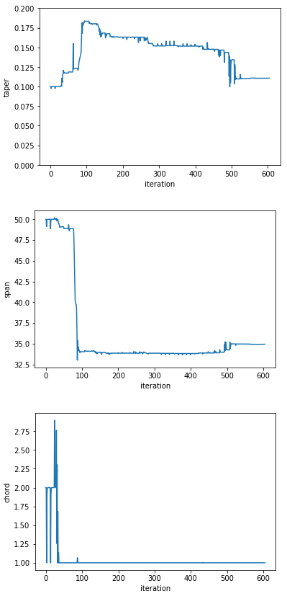
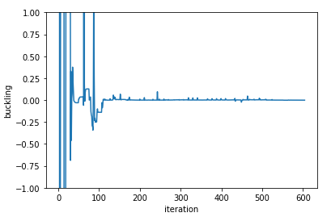
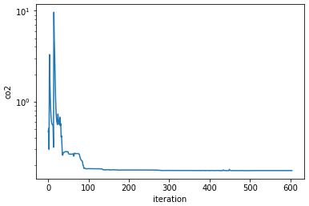
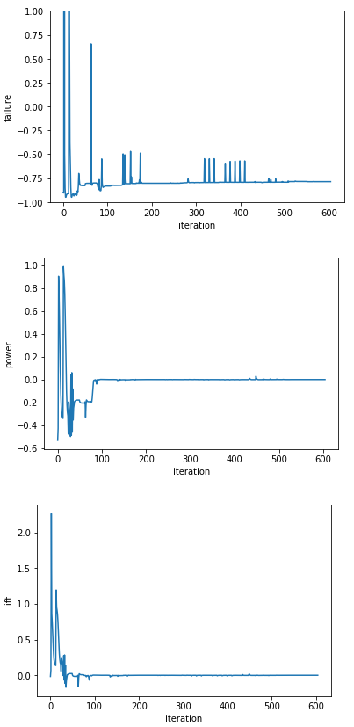
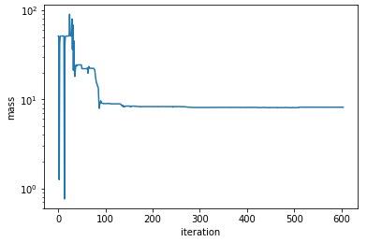
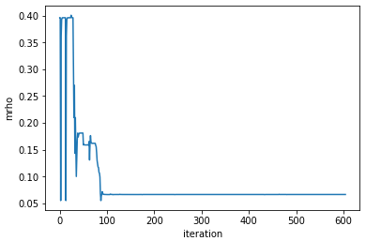
Results : convergence graphs
Buckling constraint:
Influence on skin thickness
CO2 (*10-4 kg)
Taper ratio
Failure constraint:
Inactive because of buckling constraint
Wing structural mass (kg)
Span (m)
Power constraint:
Influence on wing surface
density
(*10-3 kg/m3)
Chord(m)
Lift=weight constraint:
Global influence
15
Constraints normalized

Slide 16
Results : final design
Constraints | Final value
Buckling | -8,7 E-4
Failure | -0,79
Power | -1,3 E-5
Lift | 4,3 E-7
Design variables | Final value
Span (m) | 35
Chord (m) | 1,0
Taper ratio | 0,11
Density(kg/m3) | 66
Skin thickness (mm) | 2-9
Spar thickness(mm) | 0,2-2
Wing twist(°) | 4-15
T/C ratio | 0,07-0,2
Objective and other results | Final value
CO2 emissions (kg) | 1729
Total mass (kg) | 69
Battery+PV mass (kg) | 39
Payload+avionics mass (kg) | 20,5
Wing Structure mass (kg) | 8,2
The final material is a sandwich panel (UD CFRP – expanded PS foam – UD CFRP)

Slide 17
Results : comments
Model very sensitive to the input data (snowball effect)
Optimal material in terms of CO2 very close to optimal material in terms of weight
->battery heaviest impact on CO2
CO2 emitted by material has noticeable effect
17

Slide 18

Conclusion : Ecodesign in the MDO loop
HALE drones could be a cleaner alternative to satellites (no launch) => important to make them as clean as possible.
Method can be adapted to any aerostructure
18

Slide 19
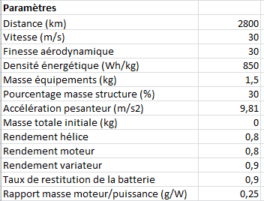
Adapt ecoHALE to Mermoz case
High enough photovoltaic productivity => no surface constraint
Range taken into account through night hours (2800km=26h*30m/s)
Fuel cell modules taken into account as propulsion density (kg/W)?
Batteries -> hydrogen tanks (850Wh/kg)
Input Data changes | Value
Motor propeller efficiency | 0,64
Propulsion density | 0,25g/W
Air properties | Altitude 0
W0 | 1,5kg
19

Slide 20
Adapt ecoHALE to Mermoz case : test
Result | Mermoz in OpenAeroStruct | Mermoz
Total mass (kg) | 32,9 | 19,5
Structural mass (%) | 44 | 30
Span (m) | 3,08 | 3,6
AR | 14,1 | 15
Power (W) | 542 | 280
L/D ratio | 27,9 | 29,5
Interpretation :
OAS : inter-stringer=25 cm used for buckling (bigger than chord!)
=> Skin too thick => too much structural weight => higher angle of attack and power
20

Slide 21
THE END

Slide 22
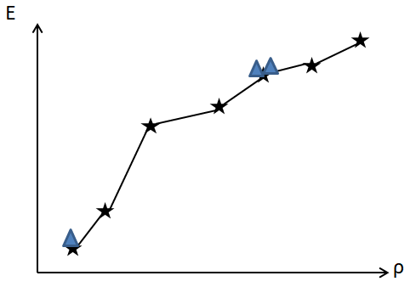
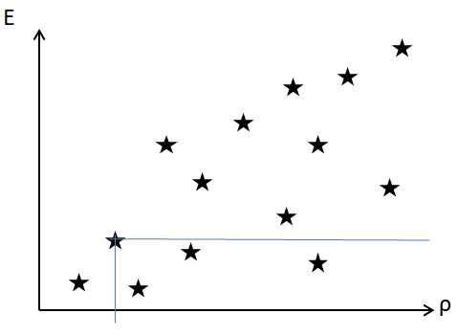
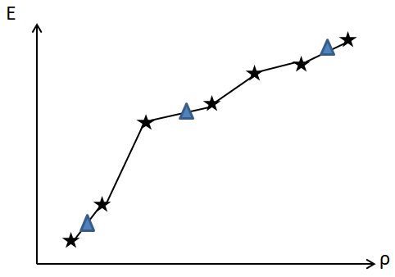
Conclusion : Next steps
Adapt to big material database
Example of strategy:
Keep only pareto optimal materials
Multistart MDOs
Choose best material
Speed up process. Example : access materials through other variables
M=13500
M=16000

