Slide 1

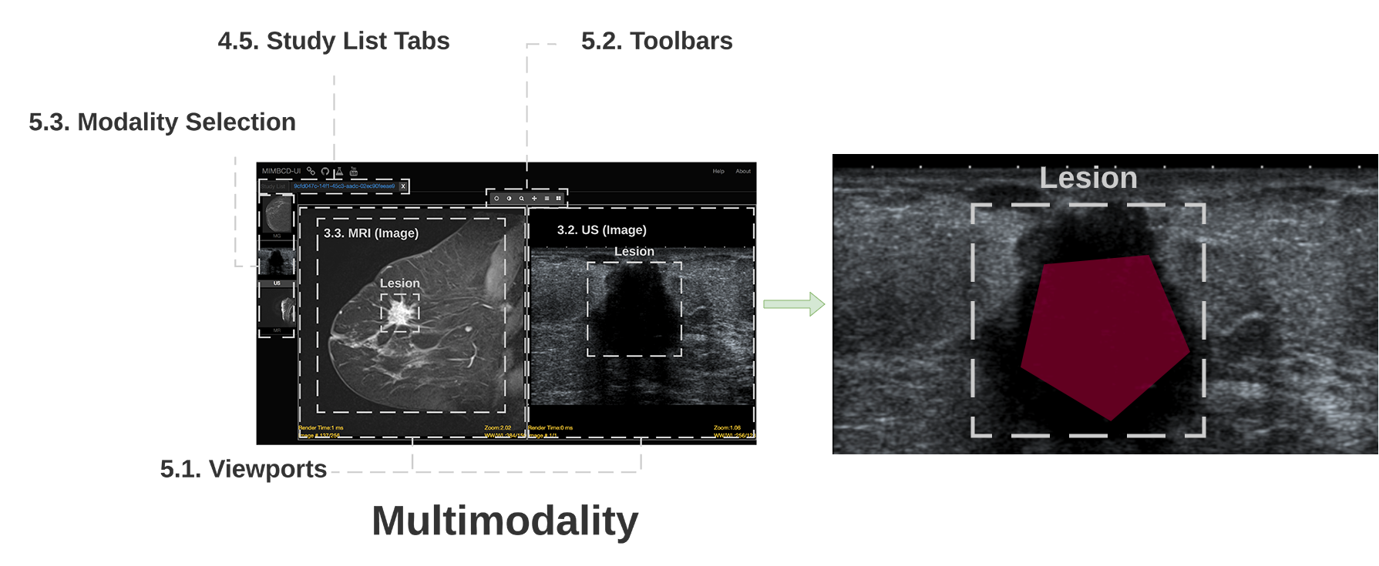
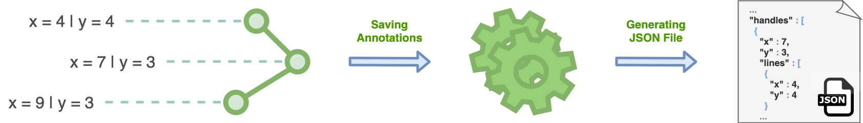
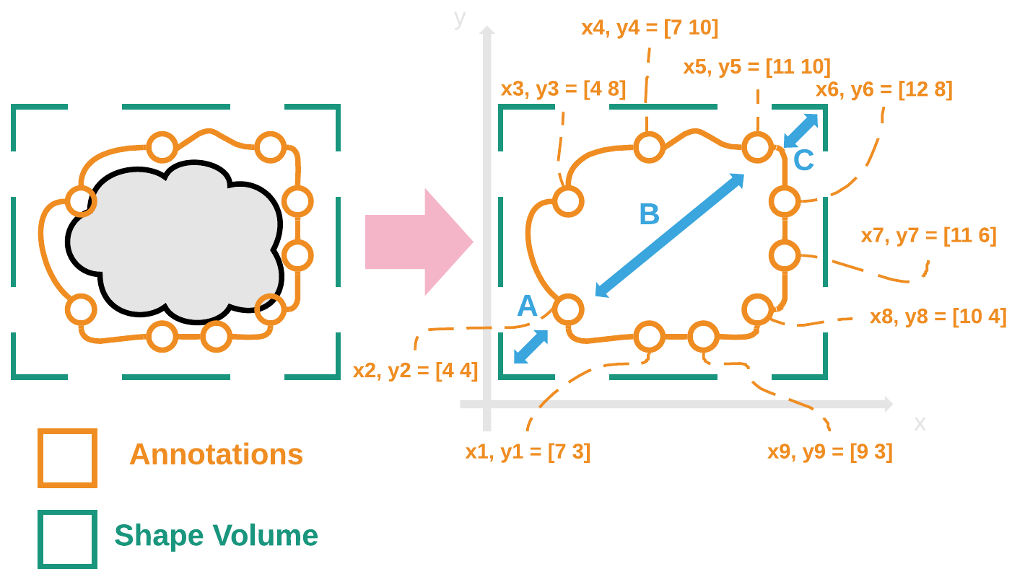
Medical Imaging Multimodality Annotating Framework
PhD in Computer Science and Engineering
Francisco Maria Calisto (francisco.calisto@tecnico.ulisboa.pt)
^{Motivation}
Deep Learning (DL) algorithms have increased the quality of automatic medical diagnosis at the cost of building datasets to train and test such supervised Machine Learning (ML) methods. In the radiology room [1, 2], medical imaging annotations are one of the main activities of radiologists and the quality of annotation depends on the clinician experience, as well as on the number of studied cases. Manual annotations [3] are very useful to extract features (Figure 1) like contours, intersections, margins, and shapes that can be used in the processes of lesion segmentation (i.e., masses and calcifications) and classification (i.e., BI-RADS) made by automatic (AI-Assisted) agents.
^{Annotated Data}
Our solution, will enable ML communities to organize and promote medical imaging projects. As result of our generated dataset (Figure 3), the community can now have access to a tool, creating their own datasets of medical images and annotations, respectively. With our solution, the community has now a way for the data extraction of lesion annotations among the breast cancer disease. This data is saved to a set of JSON files, one per each patient, where each file has JSON objects organized into a standard structure. Now, the extraction of the latter data, i.e., JSON objects, requires specialized knowledge and understanding of the data structure. As follows, we will explain our annotations data structure for the JSON files generation from user interactions.
Figure 3: [DOI: 10.13140/RG.2.2.33967.28323] Schematic diagram for the annotations flow and JSON file generation.
^{Conclusions}
In this poster, we propose a new framework supported by an interactive UI of a system platform. More precisely, the purpose of this UI is to generate a standardized dataset of medical imaging annotations. Across the domain of breast cancer, we adopt a multimodality visualization strategy (i.e., MG, US and MRI) in order to provide clinicians a tool for the production of those qualified datasets. In the end, we foster clinicians' sharing and collaborative evaluation by developing a distributed, as well as remote accessible system. The outputs of our framework will reduce healthcare costs, enabling medical-error mitigation, while improving the patient's healthcare. We achieve that due to the various embodiment items of this framework. The properties and environment characteristics, also underline the framework description and how it will be addressed to work on the radiology room.
Figure 1: Multimodality view. The UI components are as follows: 4. List of Patient Views; and 4.5. Study List Tabs; as well as 5. Medical Imaging Diagnosis Views; 5.1. Viewports; 5.2. Toolbars; and 5.3. Modality Selection. In our definition, medical image segmentation is the process of manually draw for boundaries within our various modalities of images. The goal of the clinician is to annotate the lesion between the red polygon and the dashed gray square.
^{Lesion Delineation}
For a proper classification made by automatic agents, manual annotations can be used in the process of lesion delineation and segmentation [4]. In this poster, we explain how our framework operates for the delineation and annotation of medical images. We refer to lesion delineation as the ROI area (Figure 2) of the lesion which is delineated by a radiologist. We visually show the relation between the lesion and the delineation.
^{References}
[1] Francisco M. Calisto, Alfredo Ferreira, Jacinto C. Nascimento, and Daniel Gonçalves. 2017. Towards Touch-Based Medical Image Diagnosis Annotation. In Proceedings of the 2017 ACM International Conference on Interactive Surfaces and Spaces (ISS '17). Association for Computing Machinery, New York, NY, USA, 390–395.
DOI: https://doi.org/10.1145/3132272.3134111
[2] Francisco M. Calisto, 2017. Medical Imaging Multimodality Breast Cancer Diagnosis User Interface, Master’s thesis, Instituto Superior Técnico, Avenida Rovisco Pais 1, 1049-001 Lisboa - Portugal (EU).
DOI: https://doi.org/10.13140/RG.2.2.15187.02084
[3] Francisco M. Calisto, Nuno Nunes, and Jacinto C. Nascimento. 2020. BreastScreening: On the Use of Multi-Modality in Medical Imaging Diagnosis. In Proceedings of the International Conference on Advanced Visual Interfaces (AVI '20). Association for Computing Machinery, New York, NY, USA, Article 49, 1–5.
DOI: https://doi.org/10.1145/3399715.3399744
[4] Francisco M. Calisto, 2020. Breast Cancer Medical Imaging Multimodality Lesion Contours Annotating Method. Instituto Superior Técnico. (2020).
DOI: https://doi.org/10.13140/RG.2.2.14792.55049
^{Acknowledgements}
I would like to convey a special thanks to Professor Jacinto C. Nascimento and Professor Nuno Nunes for advising me during my research work. Also, my MSc Students were of chief importance for the roots of this poster, due to that I would like to thank to Hugo Lancastre and Nádia Mourão.
Figure 2: Labels of the lesions. The grey area is the lesion, the yellow represents the annotations taken by the radiologist, the green represents the shape volume.
Jacinto Nascimento and Nuno Nunes
PhD in Computer Science and Engineering

