Slide 1

Vel Tech Rangarajan Dr. Sagunthala R&D Institute of Science and Technology
School of Computing
Department of Computer Science and Engineering
10211CS224 / FULL STACK APPLICATION DEVELOPMENT (JAVA)
PROJECT REVIEW : MILESTONE PROJECT – 1
Date: 25-03-2026
End-to-End Event Lifecycle & Ticketing Platform
SDG: SDG No – SDG Title(Example: SDG 4 – Quality Education)
Presented By:
M.Sudeepthi– VTU25846 – 23UECS0362
Courses Handling Faculty:
Dr.Sumithra M.(TTS3744)

Slide 2
INTRODUCTION
1
Background:
Current event management relies on fragmented tools, causing high fees, ticket fraud, and data silos for organizers.
Importance:
This project centralizes the entire lifecycle from creation to check-in ensuring a secure, transparent, and seamless user journey.
Real-world Relevance:
As the global live events industry scales, there is a critical demand for robust systems that prevent scalping and handle high-volume traffic.
System Overview:
An integrated web ecosystem featuring automated ticketing, secure QR validation, real-time sales analytics, and organizer dashboards.
2
3
4
5
6
7
8
9

Slide 3
PROBLEM STATEMENT
1
Current event management and ticketing processes often rely on fragmented, manual systems that lead to significant inefficiencies.
Organizers struggle with high service fees, lack of real-time sales data, and the constant threat of ticket fraud or duplication.
Furthermore, attendees frequently face complex booking journeys and unreliable check-in procedures.
Organizers frequently cannot access comprehensive attendee behavior data, making it difficult to plan targeted marketing for future events.
A lack of diverse and secure payment gateway integrations.
There is a critical need for a fully automated, end-to-end platform that provides a secure, transparent, and high-performance solution to streamline the entire event lifecycle for all stakeholders.
2
3
4
5
6
7
8
9

Slide 4
OBJECTIVE(S)
To design and develop a centralized, end-to-end web platform that automates the entire event lifecycle, from initial organizer setup to final attendee check-in.
To implement a secure, QR-based digital ticketing system that eliminates ticket duplication and prevents unauthorized secondary market reselling.
To improve the user booking experience by providing an intuitive, mobile-responsive interface for seamless event discovery and instant seat selection.
To evaluate the performance of the system under high-concurrency traffic to ensure stability during peak ticket release windows.
To automate the post-event reporting process, providing organizers with instant, data-driven insights to improve future event planning.
For a business-focused presentation Use the "analytics dashboard" and "user booking experience" points.
To implement a secure, QR-based digital ticketing system and real-time analytics dashboard to eliminate fraud and improve data-driven decision-making for organizers.
1
2
3
4
5
6
7
8
9

Slide 5
PROPOSED SYSTEM
1
Integrated Ecosystem: A unified web-based solution that manages the complete event lifecycle, from initial planning and digital ticketing to real-time entry validation.
Automated Workflow: Replaces manual coordination with automated event setup tools, tiered pricing configurations, and instant digital ticket generation.
Secure QR Validation: Implements unique, encrypted QR codes for every ticket, ensuring high-speed and fraud-proof entry at the venue via a dedicated scanning module.
Data-Driven Dashboards: Provides organizers with real-time sales tracking and attendee analytics, solving the issue of fragmented or delayed data reporting.
Scalable Architecture: Designed with a robust backend capable of handling high-concurrency booking traffic, eliminating the common issue of system crashes during peak sales.
Enhanced Security: Utilizes secure payment gateway integrations and role-based access control to protect sensitive user financial data and organizer assets.
User-Centric Discovery: Offers a seamless discovery and booking interface, reducing the complex "booking journey" found in traditional legacy systems.
Cost Efficiency: Minimizes overhead by eliminating the need for multiple third-party management tools, offering a more direct and affordable path for organizers.
2
3
4
5
6
7
8
9

Slide 6
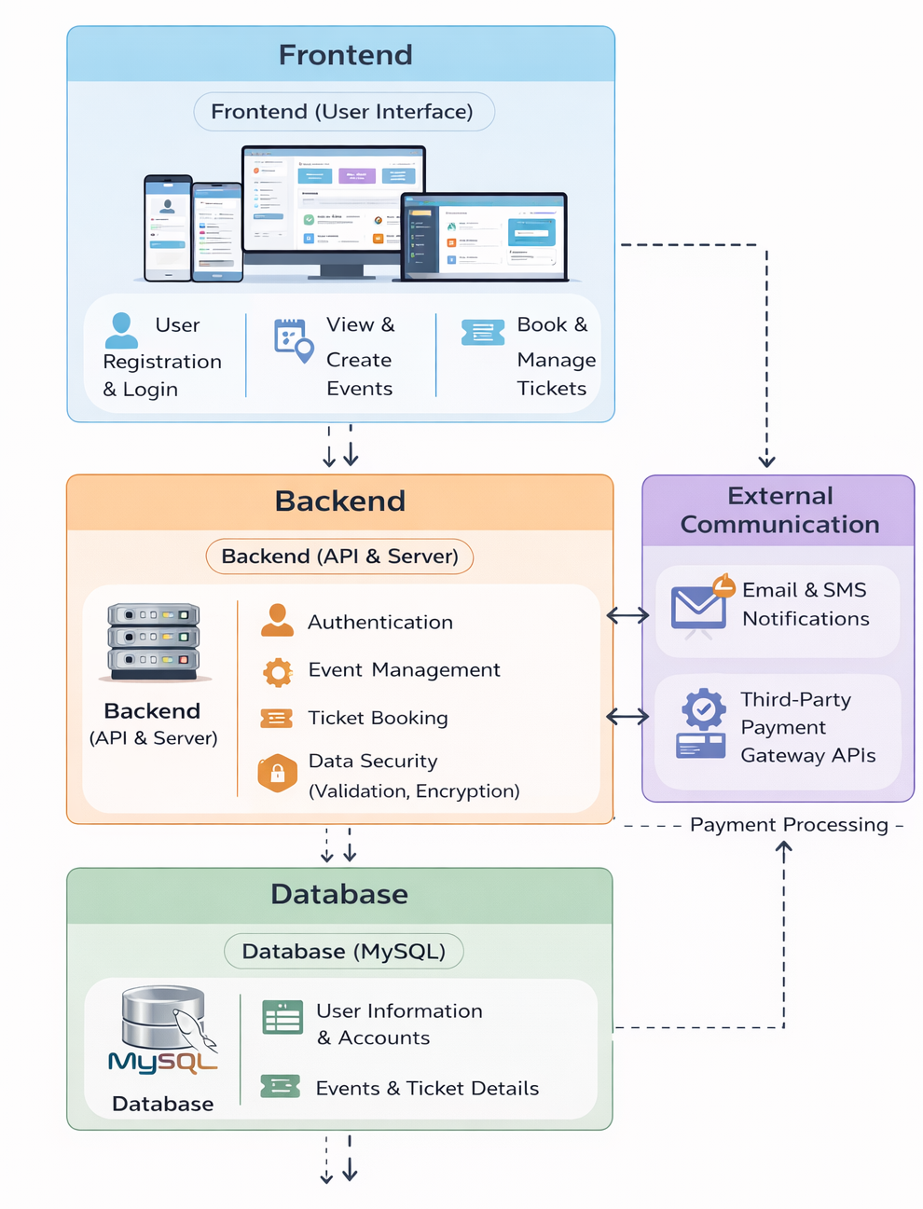
PROPOSED SYSTEM ARCHITECTURE
1
2
3
4
5
6
7
8
9

Slide 7
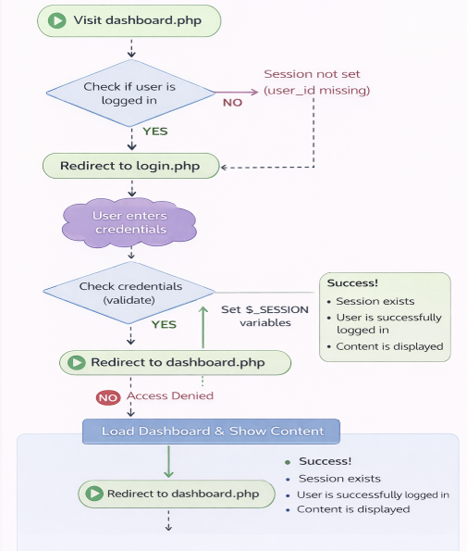
WORKFLOW
1
2
3
4
5
6
7
8
9

Slide 8
TECHNOLOGIES USED
1
Frontend: HTML5,CSS,JS
Backend: PhpMyAdmin
Database: MySQL
Tools:
XAMPP, phpMyAdmin , Visual Studio Code , Web Browser (Chrome/Edge)
Hardware Requirements :
Minimum 4 GB RAM, Intel i3 Processor, Storage: 10 GB
Software Requirements :
Operating System: Windows / Linux / macOS , XAMPP (Apache & MySQL server) ,Web Browser (Chrome, Edge, Firefox) ,Code Editor (VS Code )
2
3
4
5
6
7
8
9

Slide 9
MODULE DESCRIPTION
Module 1: User Management
Handles user registration, login, and authentication. Users can create accounts, securely log in, and access features based on their role (user or organizer). This module ensures proper session handling and access control.
Module 2: Event Management
Allows organizers to create, update, and manage events. Organizers can add event details such as title, description, date, time, location, and total tickets. This module ensures only authorized users (organizers) can create events.
Module 3: Ticket Booking System
Enables users to browse available events and book tickets. Users can select events, choose the number of tickets (with limits), and confirm bookings. The system checks ticket availability and updates the number of tickets sold dynamically.
Module 4: Database Management
Handles storage and retrieval of all application data. Manages tables like users,events and tickets ensuring data consistency, integrity, and efficient query execution using MySQL.
Module 5: User Dashboard / Ticket Tracking
Provides users with a personalized view of their bookings. Users can view their booked tickets, event details, and booking history, which acts as proof of registration.
1
2
3
4
5
6
7
8
9

Slide 10
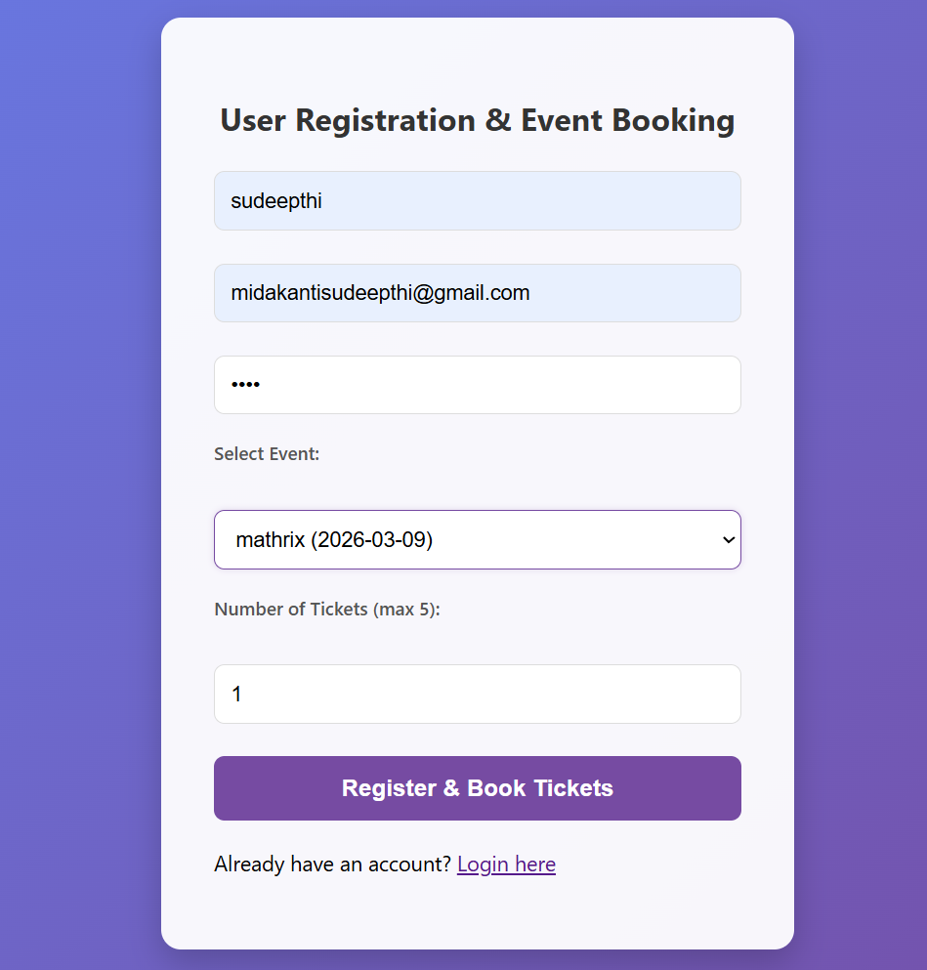
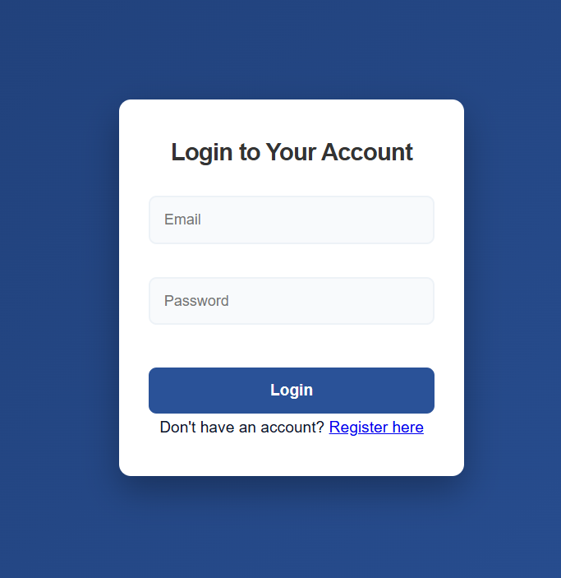
IMPLEMENTATION SCREENSHOTS
1
2
3
4
5
6
7
8
9

Slide 11
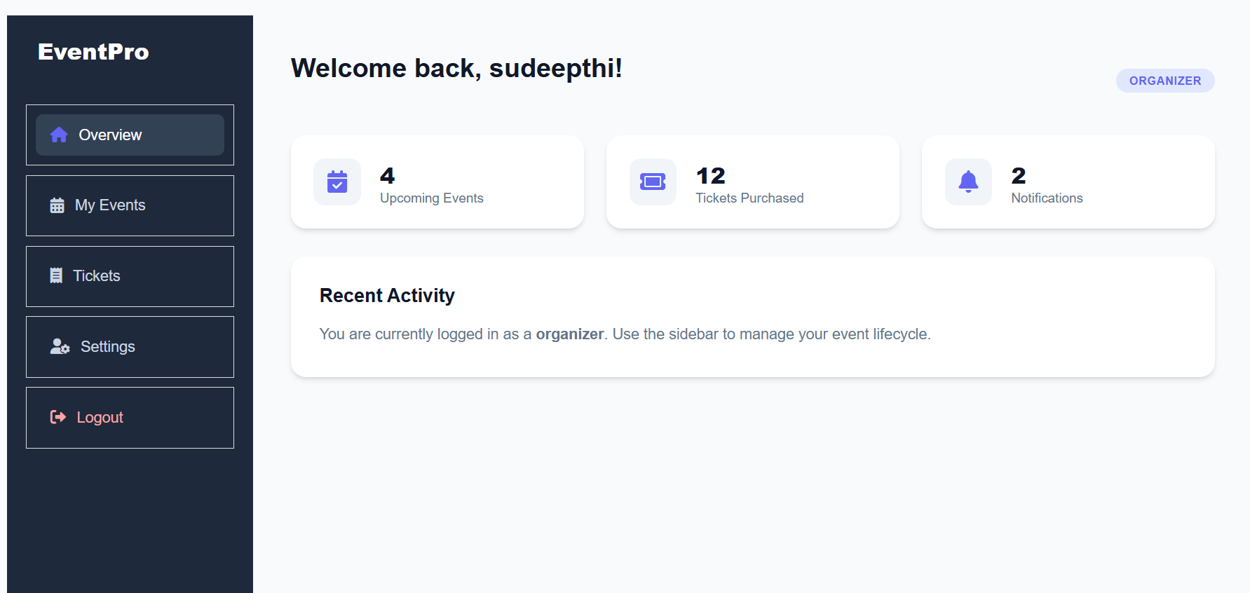
IMPLEMENTATION SCREENSHOTS
1
2
3
4
5
6
7
8(C)
9

Slide 12
ADVANTAGES & LIMITATIONS
1
Advantages
Provides a centralized platform to manage all event-related activities efficiently.
Enables users to book tickets easily with real-time availability updates.
Supports role-based access for secure and organized event management.
Integrates event creation, booking, and tracking in a single system.
Reduces manual work and improves overall efficiency.
Limitations
Depends on internet/server availability to access the platform.
Lacks advanced features like online payment and email confirmation.
Requires improved security and scalability for real-world usage.
Limited user interface design compared to modern web applications.
Manual role management is required without a dedicated admin panel.
2
3
4
5
6
7
8
9

Slide 13
Thank you

