Slide 1
Title page

Slide 2
Part A: Documentation
The fun stuff

Slide 3
Class diagram

Slide 4
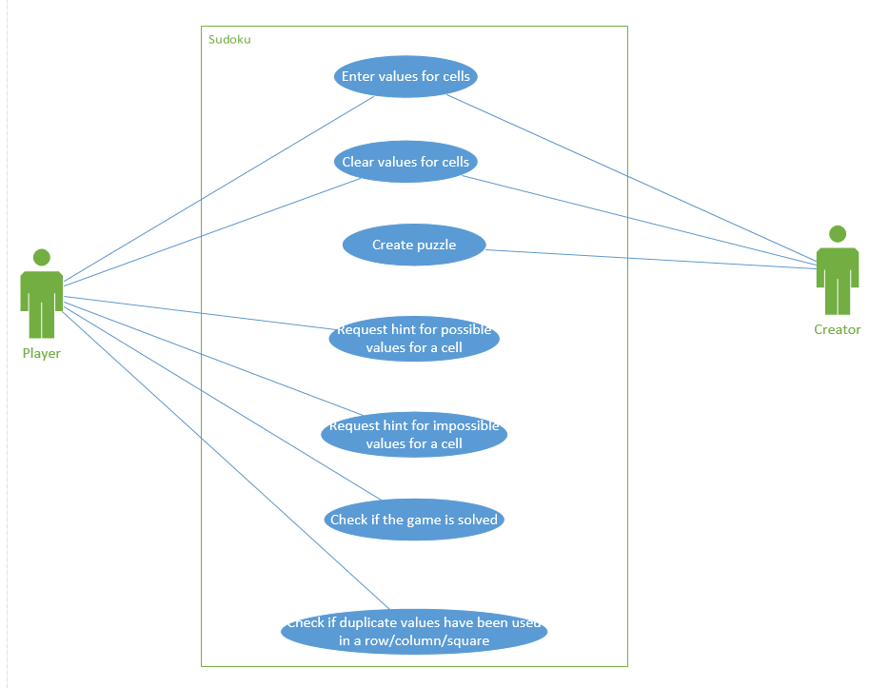
Use Case diagram

Slide 5
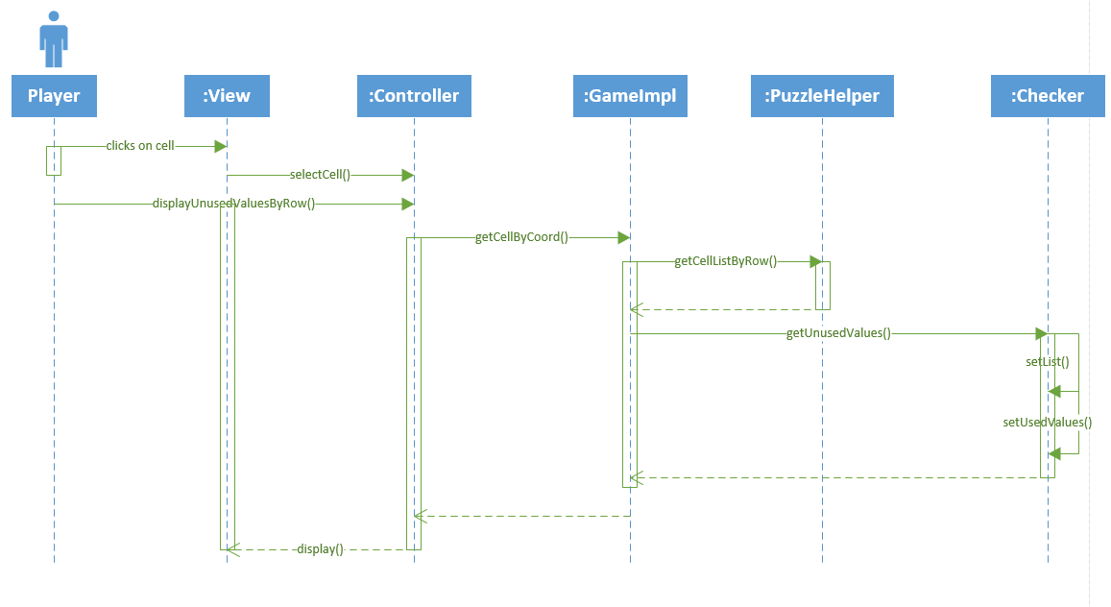
Sequence Diagram – get unused values by row

Slide 6
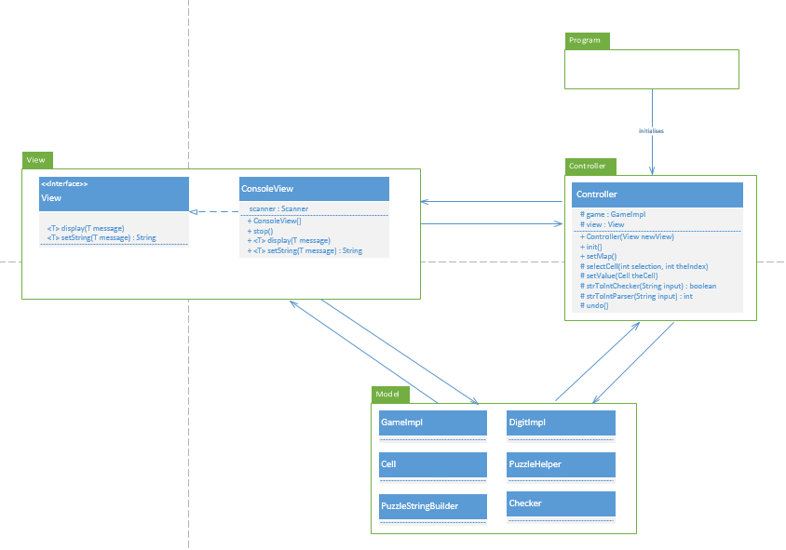
MVC structure diagram

Slide 7
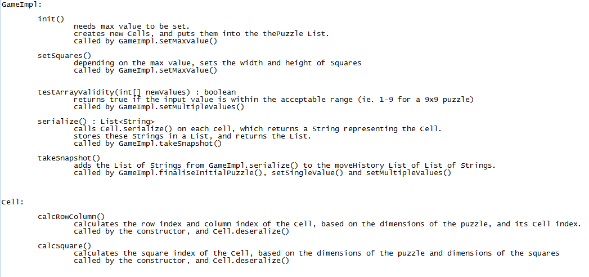
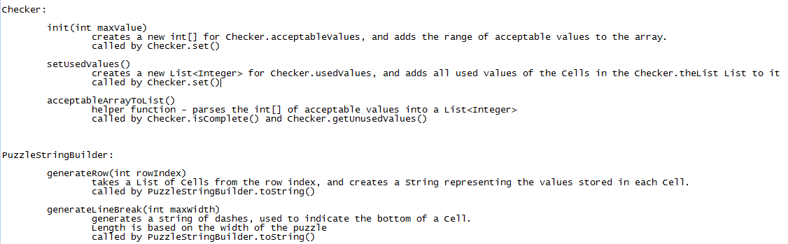
Protected function list

Slide 8
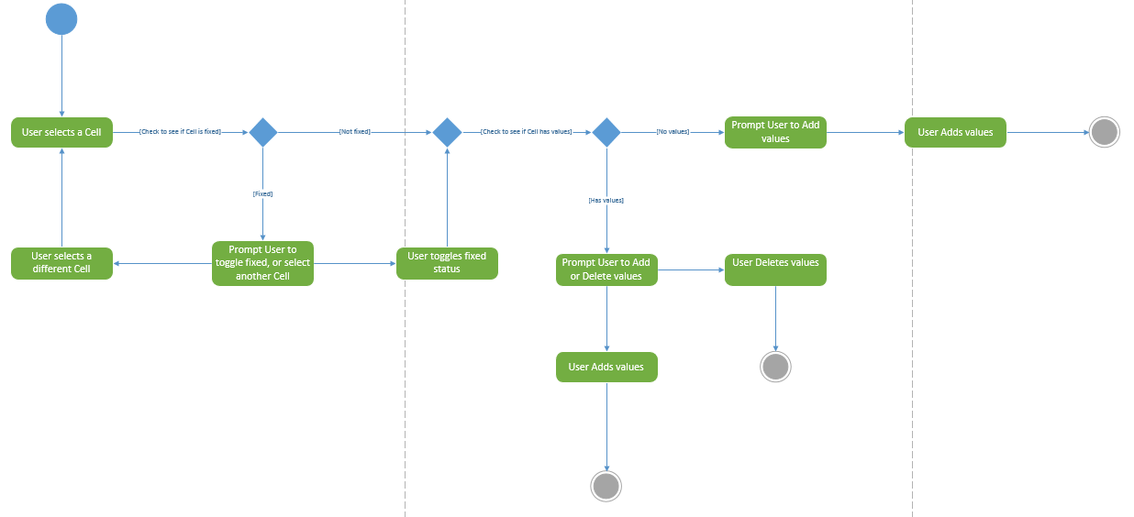
Activity diagram – adding/deleting a cell’s values

Slide 9
Part B: Model code & test cases
Where the magic happens

Slide 10
List of must have features:
Fix entered cells so they cannot be changed
Clear the game to start again
Unfix the cells so all can be changed
Enter a value for a cell
Keep track of # of moves
Keep a history of past moves
Undo a move (repeatedly)
Hint of possible values for a cell
Get by row
Get by column
Get by square
Check that there no duplicates in a row
Check that there no duplicates in a column
Check that there no duplicates in a square
Check that the game is solved
Hint of impossible values for a cell
Get all used values for a row
Get all used values for a column
Get all used values for a square
Check if row has one of each number
Check if column has one of each number
Check if square has one of each number

Slide 11
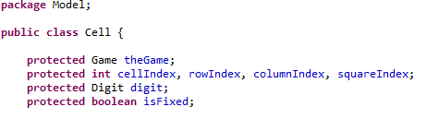
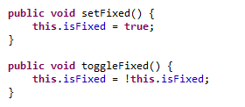
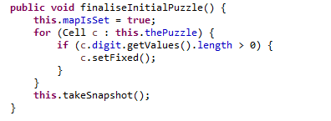
Fix a cell, so its value can’t be changed
Cell class has a bool attribute, if fixed then the Cell’s digit
cannot be changed.
GameImpl.finaliseInitialPuzzle() is called by the
creator of the puzzle, to make the intial values of
the puzzle concrete.

Slide 12
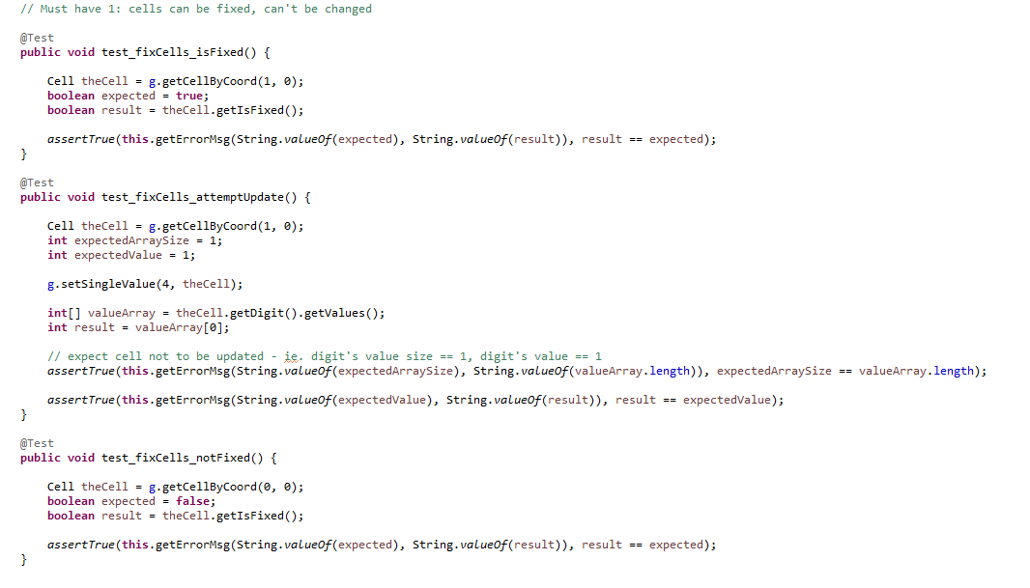
Fix a cell: test cases
Tests whether a Cell has successfully been fixed,
and that the Cell’s value cannot be changed if it is fixed.

Slide 13
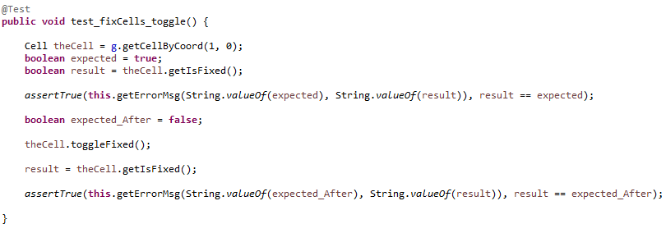
Unfix a cell
Cell.toggleFixed() is used to unfix a Cell.
Unfix a cell : test case

Slide 14
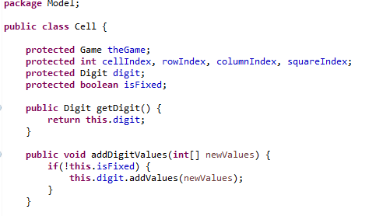
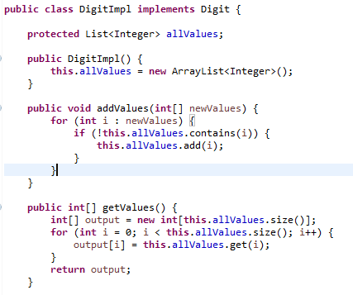
Add a value for a cell
Each Cell has a Digit.
The DigitImpl class handles storing, adding, and
retrieving the range of values stored in the Cell

Slide 15
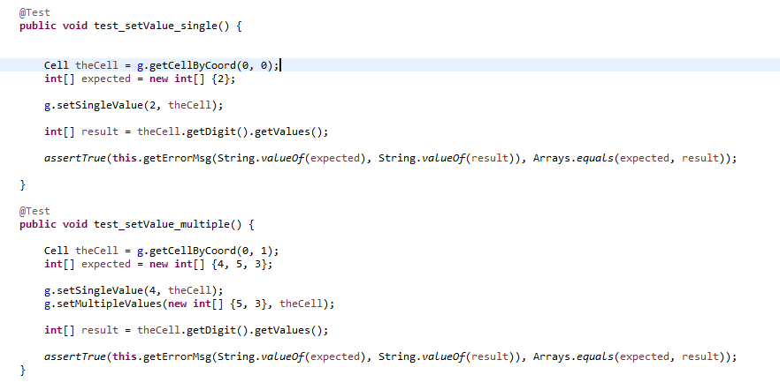
Add value(s) to a cell: test cases
Tests whether a Cell has successfully added a
single value, and multiple values, to its Digit

Slide 16
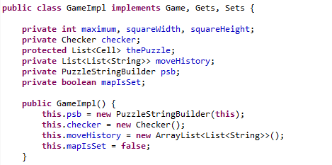
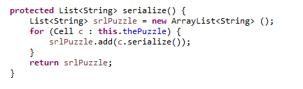
Keep a history of past moves
The GameImpl class has a 2d List of Strings to store the
move history, which is created in the constructor.
The GameImpl class has a 2d List of Strings to store the
move history, which is created in the constructor.

Slide 17
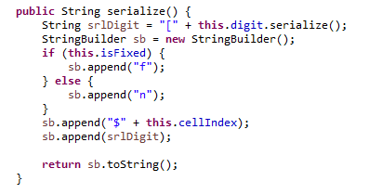
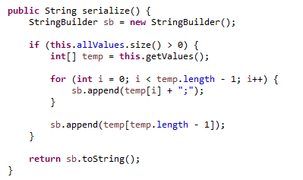
The GameImpl class has a 2d List of Strings to store the
move history, which is created in the constructor.
GameImpl.serialize() calls Cell.serialize(),
which calls Digit.serialize().
This results in a List of Strings.

Slide 18

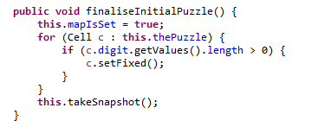
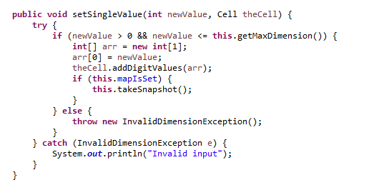
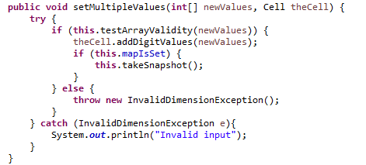
This List of Strings stored to GameImpl.moveHistory by
GameImpl.takeSnapshot() method, which is called by:
GameImpl.finaliseInitialPuzzle(), setSingleValue() and setMultipleValues()
ie. when the Creator of the puzzle finalises it, and whenever a Solver inputs value(s) into a Cell

Slide 19
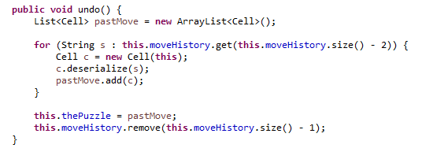
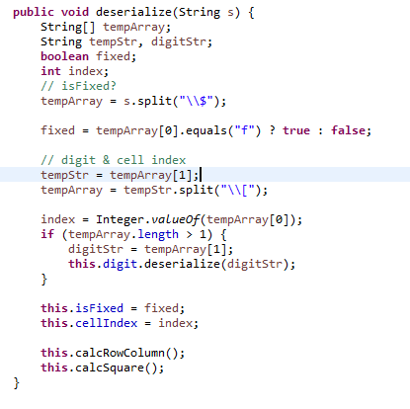
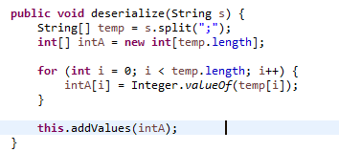
Undo a move - repeatedly
GameImpl.undo() takes the last stored List of
Strings in its moveHistory List, deserializes the
List, and sets this List of Cells as the current puzzle.
Cell.deserialize() splits the String, determining its
attributes, and row/column/square indexes.
This method also calls its respective DigitImpl’s
deserialization method.

Slide 20
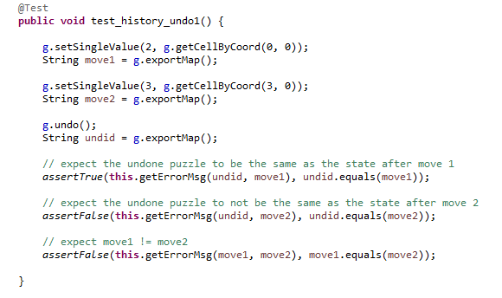
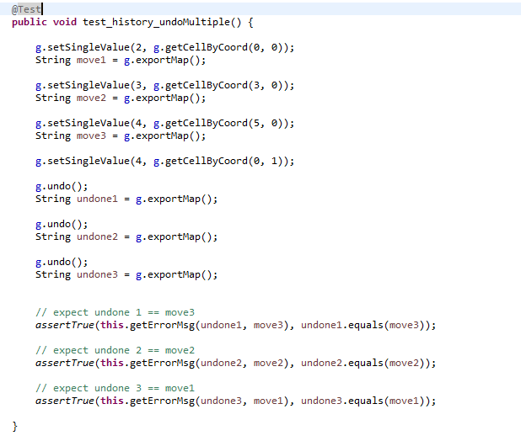
History & undo: test cases

Slide 21
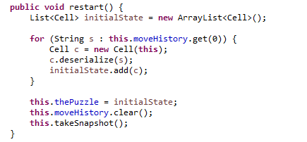
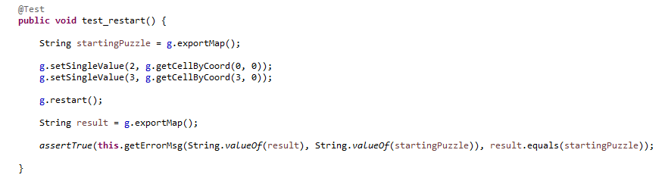
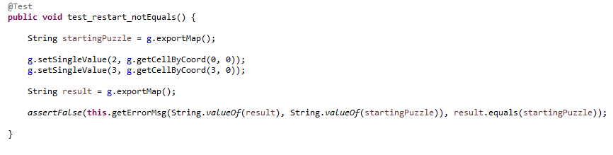
Restart the game
GameImpl.restart() takes the first List of Strings in its
moveHistory, deserializes it, and sets it as the current
puzzle.
Restart the game : test cases

Slide 22

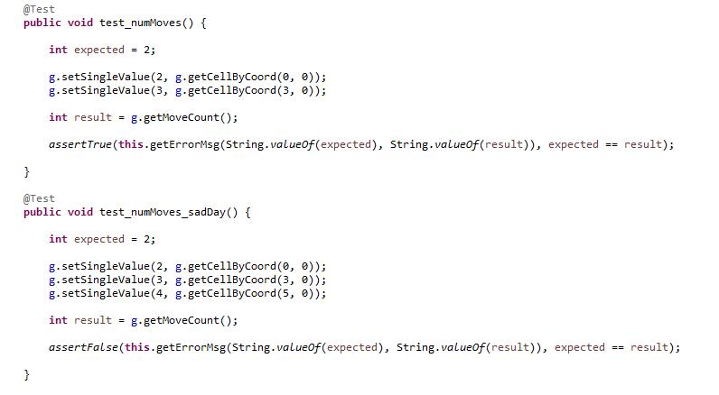
Get number of moves
Get number of moves : test cases

Slide 23
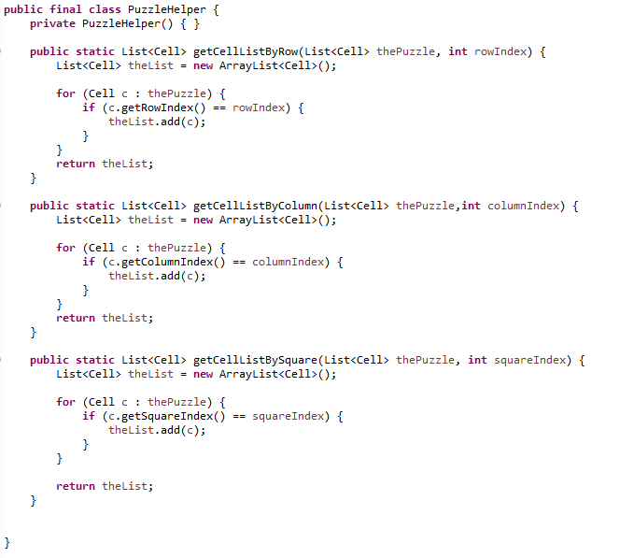
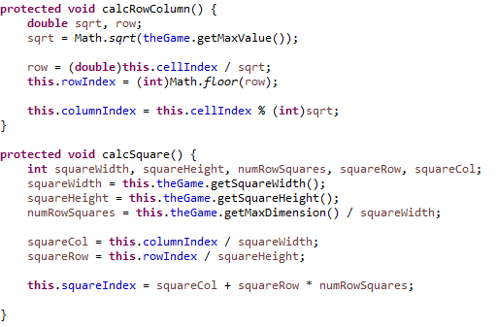
Get by row, column, square
The static class PuzzleHelper takes a list of Cells,
and a row, column, or square index, and returns the
respective sub-list.
The class definitely didn’t have to be static, but I
wanted to learn how to build a static class in Java.
Cell.calcRowColumn() and calcSquare() ascertain the
Cell’s different index values, based on the dimensions
of the puzzle, and the dimensions of the squares.

Slide 24
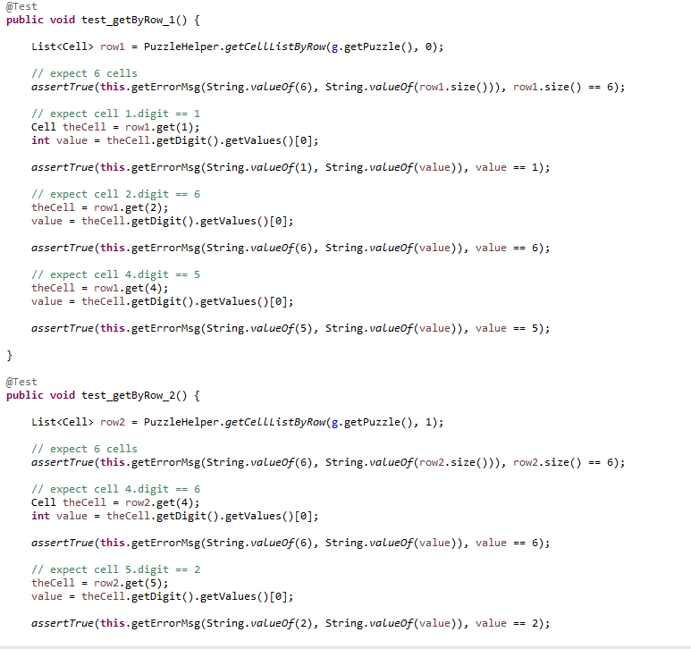
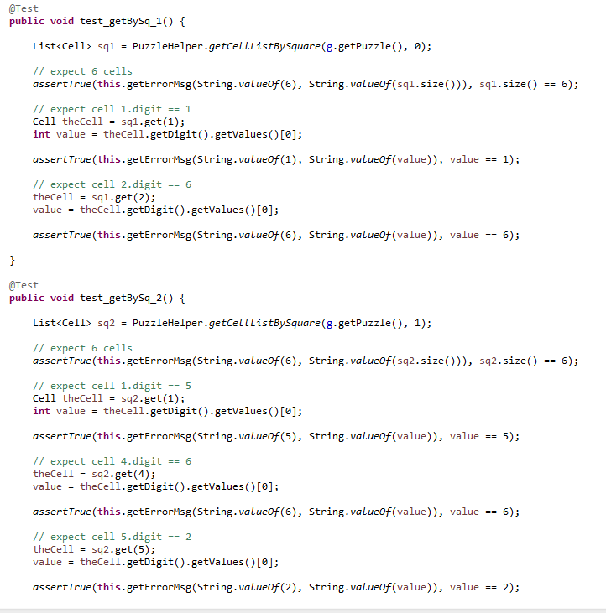
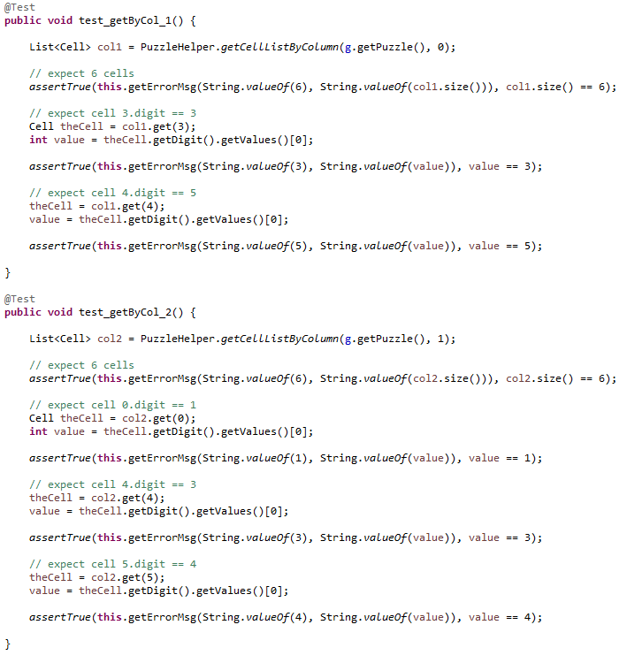
Get by row, column, square : test cases

Slide 25
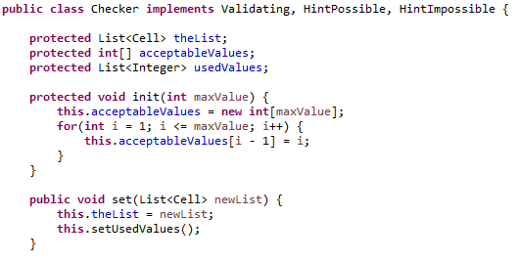
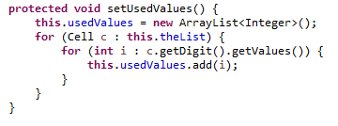

Get all used values for row, column, square
The Checker class takes a List of Cells, and creates an
array of acceptable values.
Checker.setUsedValues() iterates through this list
of Cells, and adds all the values to a List of Integers.
Checker.getUsedValues() returns this list.

Slide 26
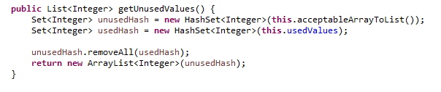
Get all unused values for row, column, square
Checker.getUnusedValues() creates a HashSet of
the possible values, and used values, compares them,
removes the used values, and returns the unused values
as a List.

Slide 27
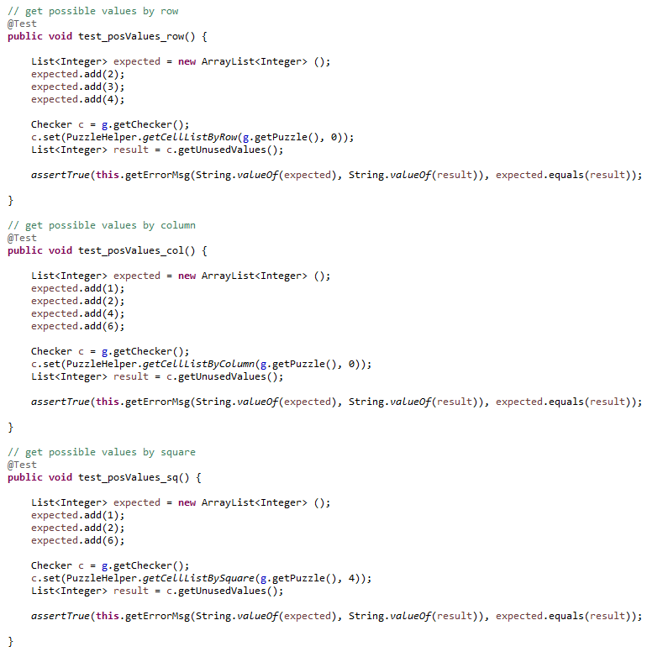
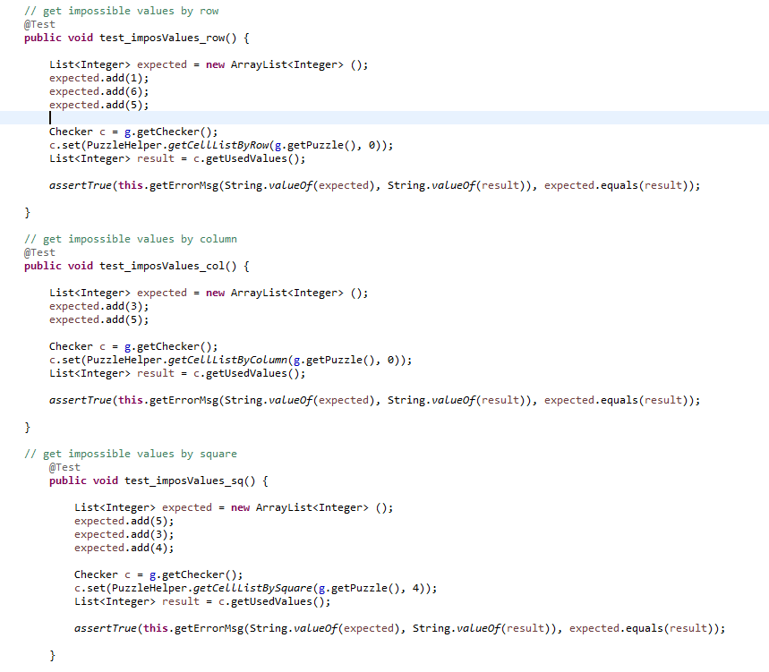
Get impossible/possible by row,col,sq : test cases

Slide 28
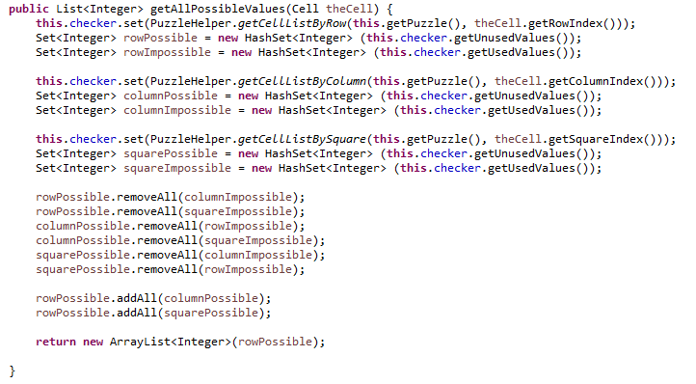
Get all possible values for a cell
GameImpl.getAllPossibleValues() creates a HashSet of all used and unused values for a cell’s
respective square, column and row.
The three possible collections remove all values that are in the impossible collections, then are merged
and returned as a List of Integers.

Slide 29
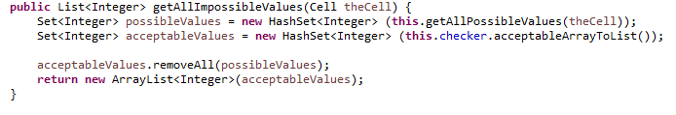
Get all impossible values for a cell
GameImpl.getAllImpossibleValues() creates a HashSet of the possible values, and the acceptable values
(ie. 1-9 for a 9x9 puzzle).
All possible values are removed from the acceptable collection, then are returned as a List of Integers.

Slide 30
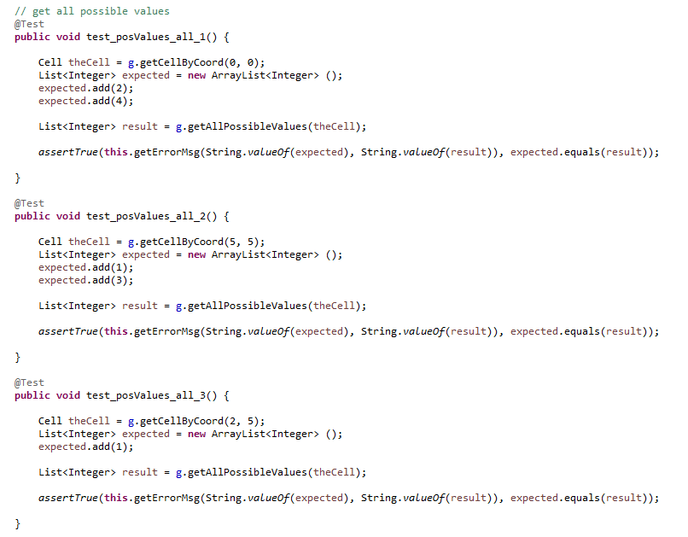
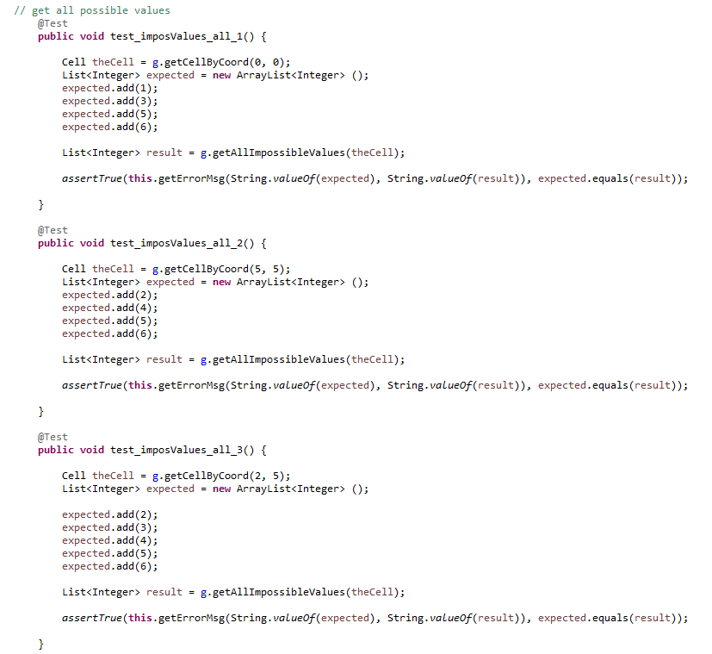
Get impossible/possible for a cell : test cases

Slide 31
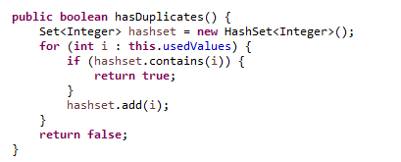
Check for no duplicates
Checker.hasDuplicates() iterates through a HashSet,
created from the list of Used values.
If a duplicate is found, it returns true.

Slide 32
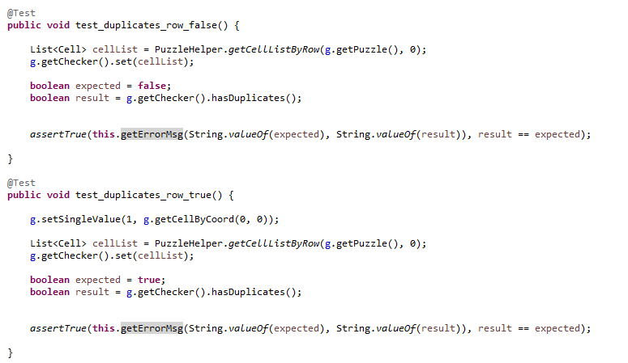
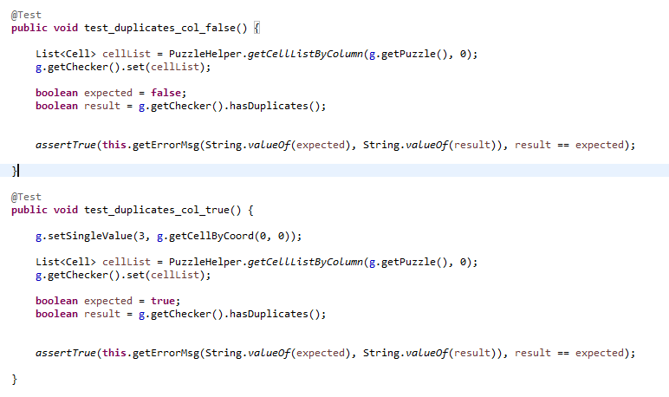
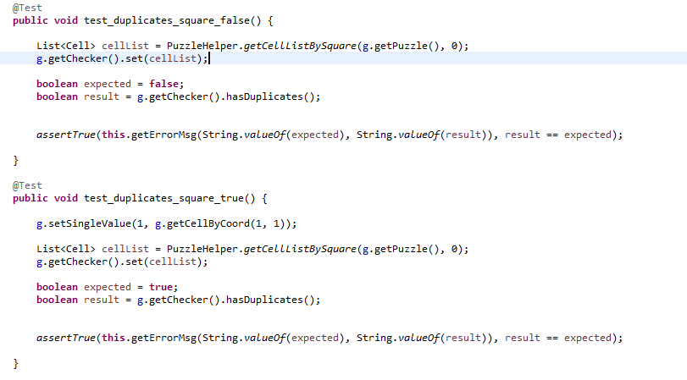
Check for no duplicates : test cases

Slide 33
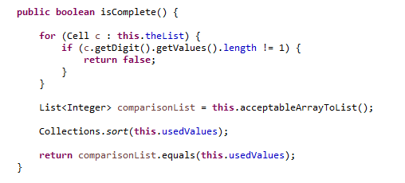
Check if row, column, square is complete
Checker.isComplete() compares the list of used values
with the list of acceptable values.
If a Cell has multiple values, it returns false.

Slide 34
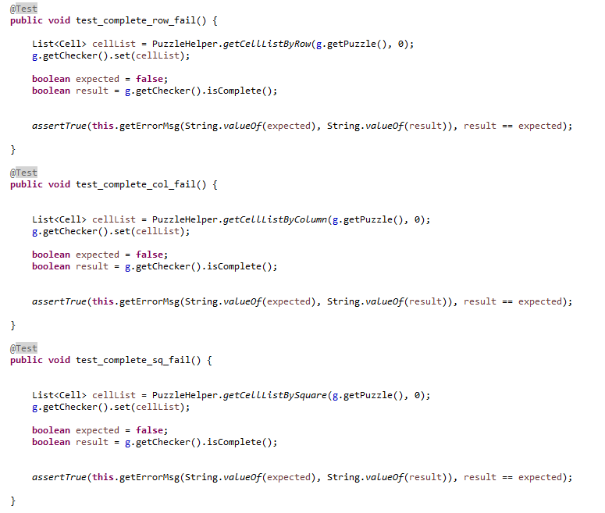

Check if row, column, square is complete : tests

Slide 35

Check if puzzle is solved
GameImpl.isSolved() iterates through each square, column and row, and returns
false if the list of cells being checked is not solved.

Slide 36


Check if puzzle is solved : test cases

