Slide 1
Helloworld
(shell script file)
libraries
File System
Create container
+Start container
Docker image
Helloworld:latest
Helloworld
(shell script file)
run
libraries
File System
libraries
Docker container
Helloworld:latest
File System
Docker image
Ubuntu : 16.04

Slide 2
Create container
+Start container
run
Docker
image
Docker
container
libraries
File System
libraries
Docker container
Helloworld:latest
File System
Docker image
Ubuntu : 16.04

Slide 3
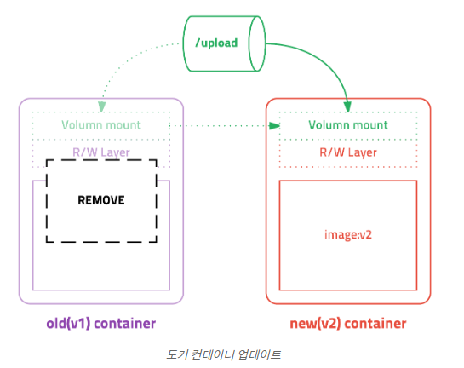
컨테이너 업데이트
새 버전의 이미지 다운 → pull
기존 컨테이너 삭제 → stop, rm
새 이미지를 이용하여 새 컨테이너 실행 → run

Slide 4
Template
= image
= 아직 사용 x
busybox
Docker build –t example./mysql-data:latest
Dockerfile
create
+ start
= run
Container
Docker run --name mysql-data example/mysql-data:latest
Docker run --name mysql mysql:5.7 –volumes-from mysql-data

