Slide 1
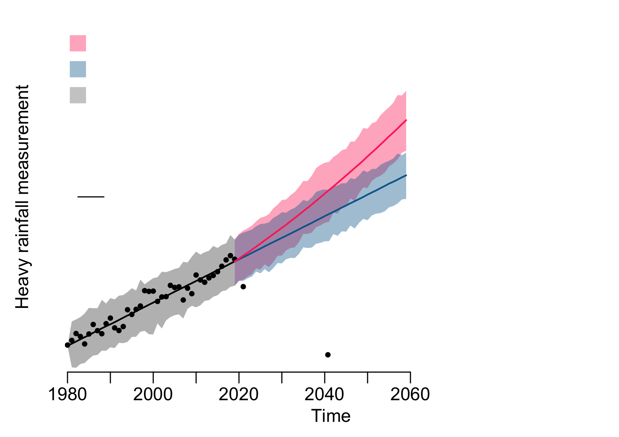
High emissions scenario: fossil fuel emissions continue to rise without any actions to reduce emissions
Low emissions scenario: society implements ways to reduce global fossil fuel emissions by 2050
Hindcast: model results for a historical period that are used for comparing model estimates with observations
Range: the difference between two values (for example, the difference between the minimum and maximum values of the model simulation)
Mean (average): a calculated 'central’ value of a list of numbers
Observation (historical measurement): a measurement made to gather information

Slide 2
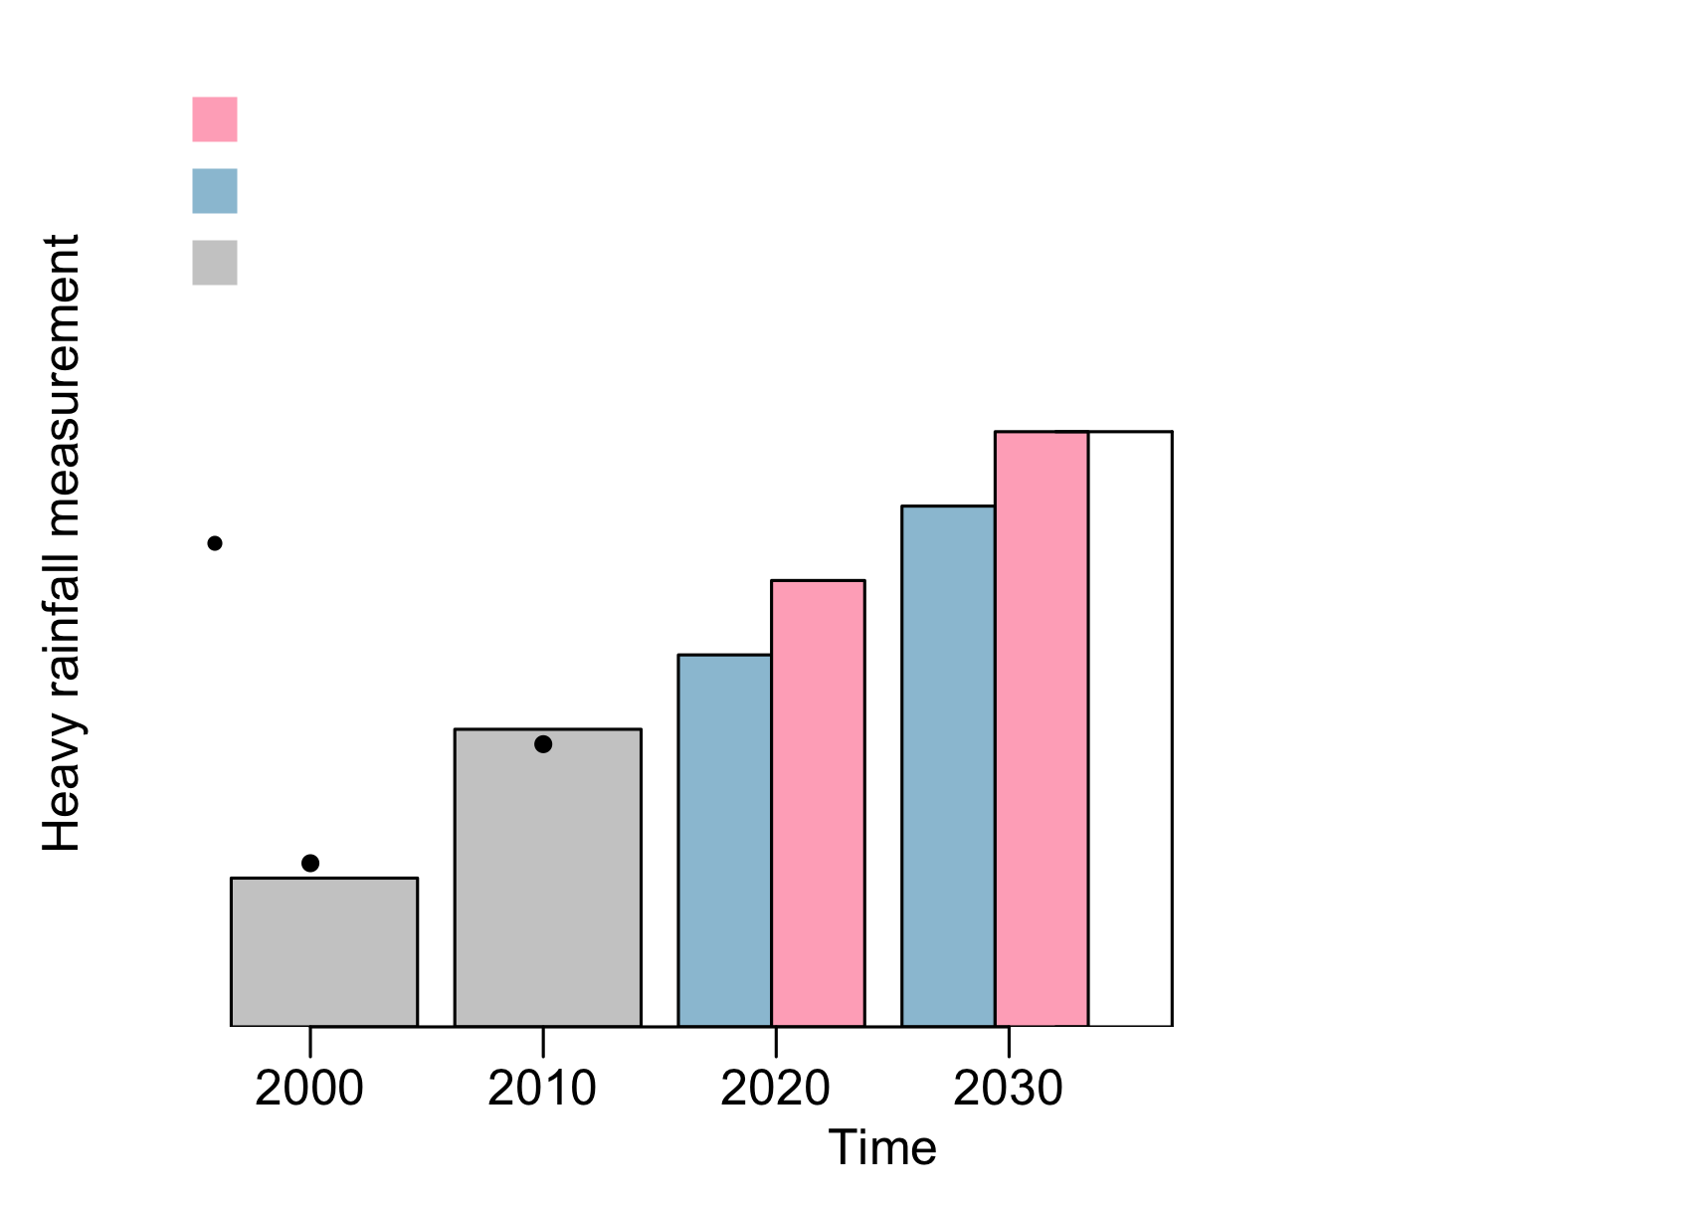
High emissions scenario: fossil fuel emissions continue to rise without any actions to reduce emissions
Low emissions scenario: society implements ways to reduce global fossil fuel emissions by 2050
Hindcast: model results for a historical period that are used for comparing model estimates with observations
Observation (historical measurement): a measurement made to gather information
Mean (average): a calculated 'central’ value of a list of numbers

Slide 3
High emissions scenario: fossil fuel emissions continue to rise without any actions to reduce emissions
Low emissions scenario: society implements ways to reduce global fossil fuel emissions by 2050
Hindcast: model results for a historical period that are used for comparing model estimates with observations
Observation (historical measurement): a measurement made to gather information
Largest value within 75th percentile + 1.5 x Range
Heavy rainfall measurement
Range: the difference between two values (for example, the difference between the 25th percentile and the 75th percentile of the model simulation)
Median: the middle value of a sorted list of numbers.
Smallest value within 25th percentile - 1.5 x Range
Time

Slide 4
High emissions scenario: fossil fuel emissions continue to rise without any actions to reduce emissions
Low emissions scenario: society implements ways to reduce global fossil fuel emissions by 2050
Hindcast: model results for a historical period that are used for comparing model estimates with observations
Observation (historical measurement): a measurement made to gather information
Range: the difference between two values (for example, the difference between the minimum and maximum values of the model simulation)
Heavy rainfall measurement
Mean (average): a calculated 'central’ value of a list of numbers
Time

